Slide 1

“Junker” Gas Calorimeter Device
B.M.A.A

Slide 2

An-Najah National University faculty of Engineering
Mechanical Engineering Department
Prepared by :
Amr Ahmad
Ahmad Rabah
Bader Abu Rayya
Mahmoud Nour
Supervised by:
Dr. Mohammed al-sayyed

Slide 3
Outline:
Introduction.
Our Design.
Obstacles & Challenges.
Process description.
Required data to be Measured.
Equations and formulas.
Results & Calculations.
Recommendations.
Conclusion.

Slide 4
Introduction:
What is Calorimeter:
Device used for measuring heating values of gaseous fuels in a sufficient way .
Main aims of building Calorimeter:
Chick combustible gases quality.
Identifying the type of an unknown gas.
Educational goals.

Slide 5
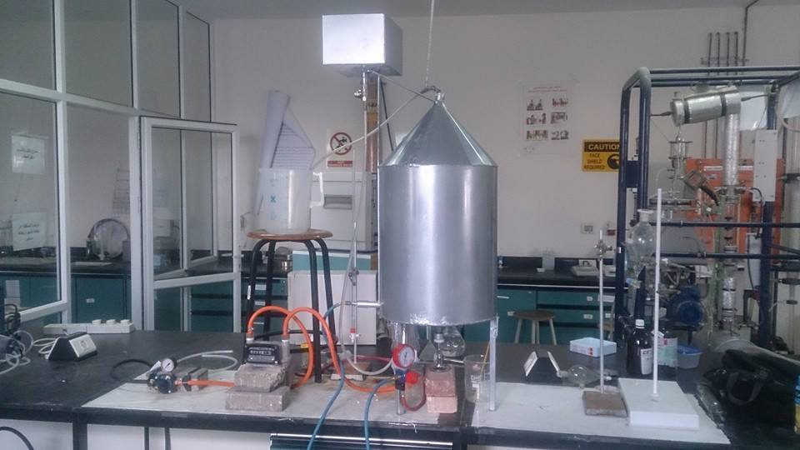
As Built Design:
1
Part | Description
1 | Water tank
2 | Gas line
3 | Pressure regulator
4 | Gas volume counter
5 | burner
6 | Vacuum pressure gage
3
5
2
4
6

Slide 6
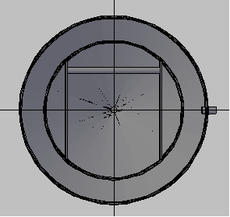
Bottom View
1
2
Part NO | Description
1 | Outer shell
2 | Inner shell
3 | copper plates
4 | Vacuum suction line
5 | Vacuum zone
3
4
5

Slide 7
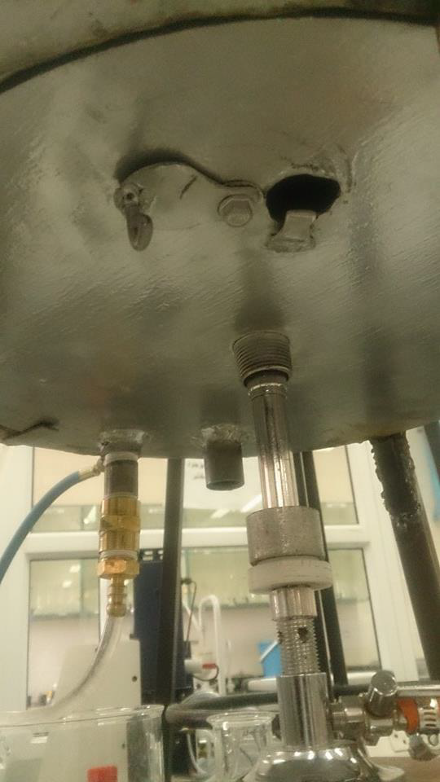
The Base
1
Part NO | DESCRIPTION
1 | Sight opening
2 | Threaded opening for burner
3 | Opening for exhaust gases and condensate
4 | Water inlet
2
3
4

Slide 8
Obstacles & Challenges:
Lake of good fabrication in the local market
Some of components is not available in the local market .
No enough time , and laboratories availability.
Controlling gaseous fluids.
NO donors , so the cost was personal.

Slide 9
Process:
1. Connect the Vacuum line
2.
connect the gas line .
6. Collect the
out going water .
3.
Ignite the burner, then wait 20-30 min.
5.
Let the water flow .
4.
Fill the water tank

Slide 10
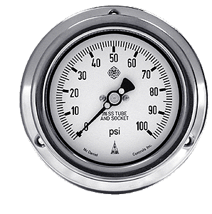
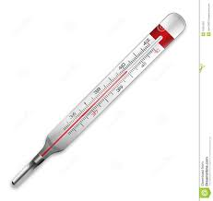
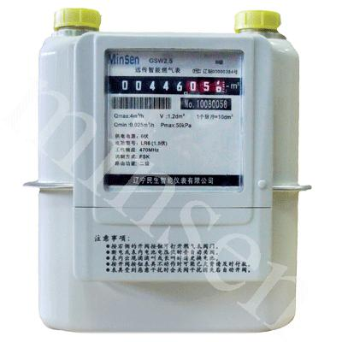
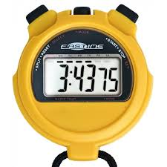
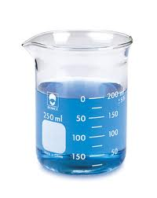
Parameters to be measured:
(PAtm.).
(Troom).
(Ti).
(To).
(Tinside).
(Vgas).
(Vwater).
(tprocess).

Slide 11
Equations and formulas:
To calculate the energy stored into the water, we need the previous measurements :
To calculate mass of burned gas. There is a need to find NO. of moles of gas .
1 mole at 273º k 22.4 L
1 mole at Troom k volume of 1 mole =??

Slide 12
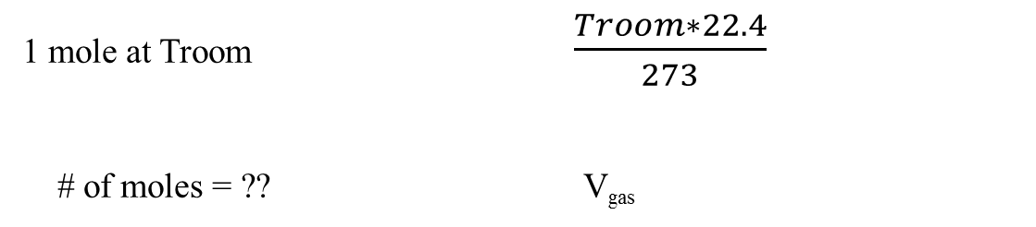
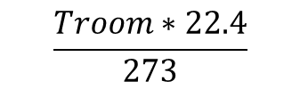
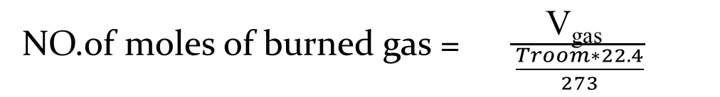
volume of (1) mole at Troom =
$$\frac{Troom∗22.4}{273}$$
1 mole at Troom $\frac{Troom∗22.4}{273}$
# of moles = ?? V_{gas}
NO.of moles of burned gas = $\frac{\text{V}\text{gas} }{\frac{Troom∗22.4}{273}}$

Slide 13
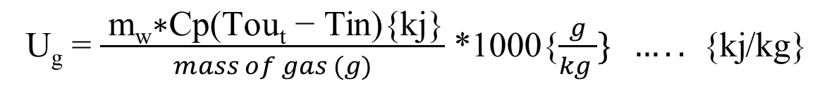
Mass of burned gas = NO.of moles *molar mass
Mass of water= Volume * density
U_{g} = $\frac{ \text{m}\text{w}\text{∗}\text{Cp}\text{(}\text{Tout}\text{ − }\text{Tin}\text{)\{}\text{kj}\text{\}}}{mass of gas (g)}$ *1000{$\frac{g}{kg }\} …..$ {kj/kg}
Error = Theoretical value − Actual value *100%
Theoretical value

Slide 14
Results:
Test (1):
*Gas used : propane (C3H8)
*Theoretical heating value for the gas = 46357 kj/kg
*Troom=21ºC , PAtm.= 1 atm
Error% | Ug (kj/kg ) | ΔT (⁰C) | T_{in} (⁰C) | T_{out} (⁰C) | M_{w} (kg) | V_{w} (L) | V_{g} (L) | M_{g} (kg)
19.7 % | 37060.2 | 17.2 | 18 | 35.2 | 11 | 11 | 11.7 | 21.34

Slide 15
Test (2):
*Gas used : propane (C3H8)
*Troom= 22ºC , Patm.= 1 atm
*Theoretical heating value for the gas = 46357 kj/kg
Error% | U_{g} (kj/kg ) | ΔT (⁰C) | T_{in} (⁰C) | T_{out} (⁰C) | M_{w} (kg) | V_{w} (L) | V_{g} (L) | M_{g} (g)
13.8 % | 39790.4 | 15 | 23 | 38 | 3.75 | 3.75 | 3.25 | 5.9

Slide 16
Test (3):
Gas used : propane (C3H8)
Troom= 22ºC , PAtm.= 1 Par
Theoretical heating value for the gas = 46357 kj/kg
Error% | U_{g} (kj/kg ) | ΔT (⁰C) | T_{out} (⁰C) | T_{in} (⁰C) | M_{w} (kg) | V_{w} (L) | V_{g} (L) | M_{g} (kg)
11.3% | 40942.5 | 13 | 35 | 22 | 2.75 | 2.75 | 2 | 3.65

Slide 17
Recommendations:
The device should be in a smaller scale to decrease heat losses into materials used.
Using digital measuring devices instead of those used to get more accurate values.
good welding to achieve good vacuum insulation , also use a good vacuum compressor.
Using a very well-known gas with high quality.
find out experimentally and theoretically heat dissipated into materials inside the device before and after reaching the steady state.

Slide 18
Conclusion:
this device helps to understand the concept of heat transfer and the calorific value.
Existing sources of error, such as reading gauges, welding, quality of gas, vacuum, all resulted in delays in the work.
Up the working efficiency of the device is about 90%, and this is an excellent thing for the work of a student manual manufacturing.
Our device does not exist in Palestine, where the cost of building it= 2000 NIS, where the Junker calorimeter price in the market = 8000 NIS.

Slide 19

Special Thanks
Dr. Abdulraheem Abu Safa
Eng. Yousef Ratrout
Eng. Maha fuqha

Slide 20
Thank You
☺

