Slide 1
Assessment of the Bidding Process in Construction Project
AN-NAJAH NATIONAL UNIVERSITY
FACULTY OF ENGINEERING AND INFORMATION TECHNOLOGY
CIVIL ENGINEERING DEPARTMENT
Abdullah H. Abu Zant.
Ayman K. Ilaiwi.
Mohammed Fadel.
Sodqi M. Alhnaini.

Slide 2
Outline
Methodology
Bid Evaluation in Japan and Comparison
Bid Evaluation in Palestine
Bid Evaluation in Jordan and Comparison
Bid Evaluation in UAE and Comparison
Conclusions and Recommendations

Slide 3
Methodology
The main objective of this research is to assess the bid process in Palestine.
In order to achieve this main objective, many activities will be proceeded, the following are activities to achieve the main objective:
  Study the process of bidding.
  Gathering data from Central Tenders Department.
  Gathering information about the bid process that is adopted in many countries.
  Analyze the gathered information.
  Comparison has been made between the Palestinian bid process and the process among the other countries.

Slide 4
BIDS EVALUATION AND SELECTION IN PALESTINE
Introduction
Opening of Tender Returns
Pre-qualification and post-qualification:

Slide 5
Pre-qualification:
Pre-qualification documents:
lowest price will be recommended to award the bid
Notes:
تقليص عدد المناقصين المحتملين لدخول مناقصة
نحتاجها في المشاريع الكبيرة ذات الطبيعة المتخصصة

Slide 6
Post-qualification:
There are two methods of post-qualification:
Method I: firstly technical offers ..
Method II: financial offers..
and if this technical offer does not meet the minimum requirements, the technical offer of the next bid will be considered.

Slide 7
Tenders Evaluation
Evaluation criteria depends on the project funds..
Internal Funded Projects:
in this case could be achieved in one of the following methods:
Method I: classifications
Method II: pre-qualification
Method III: post-qualification

Slide 8
European Union Funded Projects:
The evaluation accomplished in three stages:
Administrative: will be verified..
Technical Evaluation:
evaluated for the bidder who are qualified from the previous stage…
how meets the instructions and specifications…
will be eliminated…
Financial Evaluation (Arithmetic Check):

Slide 9
European Union Funded Projects:
Financial Evaluation (Arithmetic Check):
study the bill of quantities…
recommend the bid of the lowest price…
reported to the Ministry of Finance…
recommendation(s) are/are not accepted…

Slide 10
Bid Evaluation In Jordan
Opening of Tender Returns:
  The date for opening is set early.
  Bids are opened in the presence of the tenders committee.
  The bids envelopes are assure to be closed. Then The members of the tenders committee sign the copies of submitted bids that are being opened.
  Then the bid bond must be checked.
  In the case of one envelope is submitted, the technical and financial are both inside, the total price of the bid is announced.

Slide 11
Bid Evaluation In Jordan
Opening of Tender Returns:
  In the case of the submitted bids are two envelopes, which are financial and technical, the technical envelope will be opened and then evaluated, then the financial offers of the qualified bidders will be opened and evaluated.

Slide 12
Bid Evaluation In Jordan
Evaluation of bids:
  Local Projects:
    The contractors that have the required classification are allowed to enter the bid.
    The offer of the lowest price is recommended provide that all required documents are submitted, if not the next bid is considered.
    Pre-qualification of the bidders is carried out in the case of some projects that are complex for example and require advanced technical capabilities in order to assure that the financial and technical capabilities of bidders are sufficient for these projects. The qualified bidders are invited to enter the bid.

Slide 13
Bid Evaluation In Jordan
Evaluation of bids:
  International Projects: achieved in two stages:
    pre-qualification including the technical, administrative, financial status and the available equipment. This stage results in the exclusion of unqualified contractors. While the qualified contractors are invited to purchase and receive bidding documents to be able to involved in the competition.
    financial and technical offers are submitted by the qualified bidders.

Slide 14
Bid Procedures In UAE
There are three methods for tendering in UAE:
  Tendering without pre-qualification and technical and financial criteria.
  Tendering with pre-qualification.
  Tendering with technical and financial criteria.

Slide 15
Bid Procedures In UAE
Opening of bids:
  Tendering without pre-qualification and technical and financial criteria.
  Tenders Committee reject any bid that submitted after the specified date.
  The documents will be checked and signed by the committee.
  Chick for bid bond validity, and read the total price loudly.

Slide 16
Bid Procedures In UAE
Opening of bids:
  Tendering with pre-qualification.
  First stage: pre-qualification is required and bidders in this stage submit their technical offers.
  Second stage: the financial offers are submitted by the qualified bidders.

Slide 17
Bid Procedures In UAE
Opening of bids:
  Tendering with technical and financial criteria.
  Technical offers only are opened.
  Evaluate the technical offers, and select the qualified bidders (greater than 60%).
  Opening of the financial offers for the qualified bidders.

Slide 18
Bid Procedures In UAE
Methods of bidding:
  Tendering without pre-qualification and technical and financial criteria.
  It is done on one stage.
  Simple projects.

Slide 19
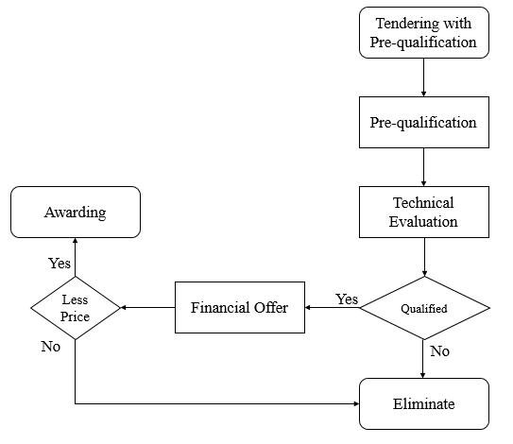
Bid Procedures In UAE
Methods of bidding :
  Tendering with pre-qualification.
  It is done on two stages.
  Large and complex projects.

Slide 20
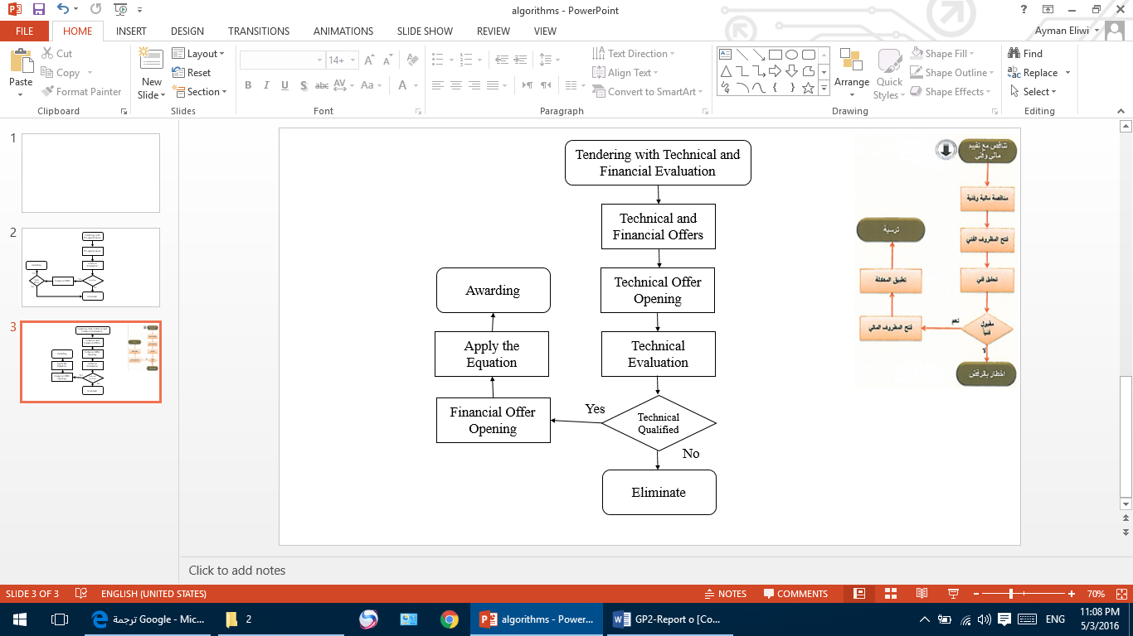
Bid Procedures In UAE
Methods of bidding :
  Tendering with technical and financial criteria.
  It is done on one stage in which the offers are submitted including both technical and financial offers.
  Evaluation done in two steps.

Slide 21
Bid Procedures In UAE
Methods of bidding :
  Tendering with technical and financial criteria.
Types of projects and their evaluation criteria:
Category | Type of Projects | Evaluation Criteria
 |  | Financial | Technical
1 | Straightforward projects | 80% | 20%
2 | Complex projects | 70% | 30%
3 | Innovative projects | 60% | 40%
4 | Design and construction projects (buildings) | 30% | 70%
5 | Design and construction projects (highways) | 50% | 50%

Slide 22
Tendering without pre-qualification and technical and financial criteria:
Evaluation
  The bid with the lowest price will be awarded.
  When to consider the next bid?

Slide 23
Tendering with pre-qualification
Tenders Evaluation: the evaluation process will be accomplished in two stages:
  Stage I: evaluate pre-qualification proposals according to the specified criteria, the qualified bidders will be announced to submit their financial offers.
  Stage II: evaluate the financial offers of the qualified bidders, the bid of the lowest price wil be awarded.

Slide 24
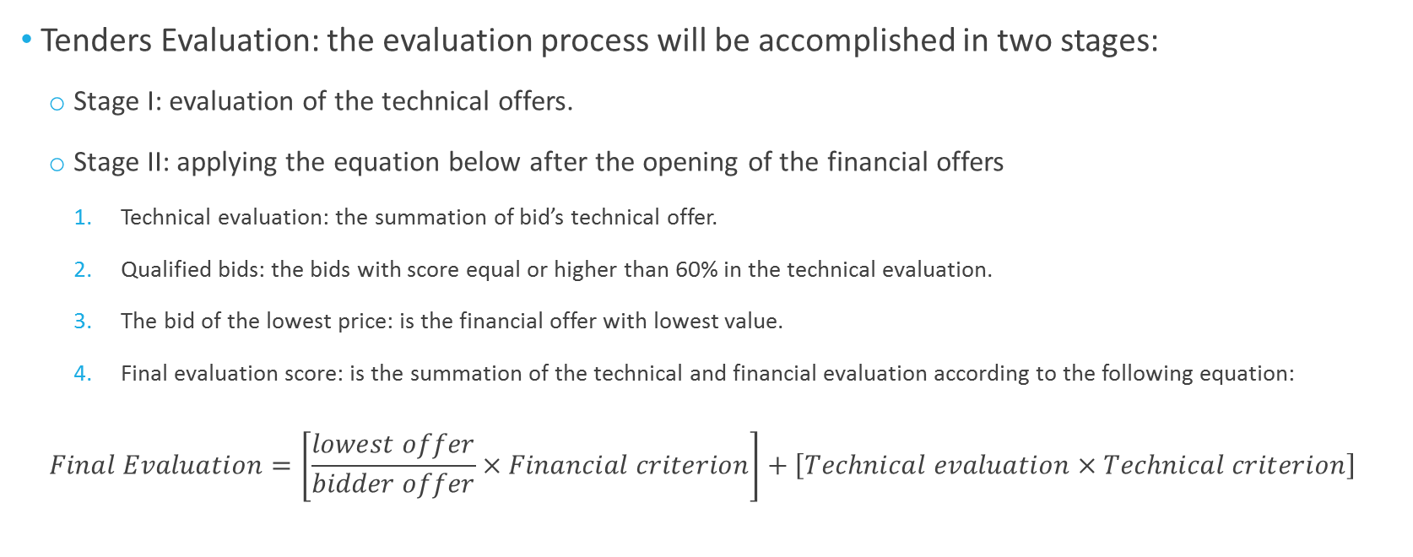
Tendering with Technical and Financial Criteria:
Tenders Evaluation: the evaluation process will be accomplished in two stages:
  Stage I: evaluation of the technical offers.
  Stage II: applying the equation below after the opening of the financial offers
    Technical evaluation: the summation of bid’s technical offer.
    Qualified bids: the bids with score equal or higher than 60% in the technical evaluation.
    The bid of the lowest price: is the financial offer with lowest value.
    Final evaluation score: is the summation of the technical and financial evaluation according to the following equation:
  $$Final Evaluation=\left[\frac{lowest offer}{bidder offer}×Financial criterion\right]+\left[Technical evaluation×Technical criterion\right]$$

Slide 25
Bid Procedures In Japan
Prequalification Evaluation.
Bidding Methods.
Bid opening.
Bid Evaluation

Slide 26
Prequalification Evaluation In Japan
Objective:
  To ensure that invitations to bid are extended only for technically and financially qualified bidders.
  To limit the number of bidders.
Criteria: set before.

Slide 27
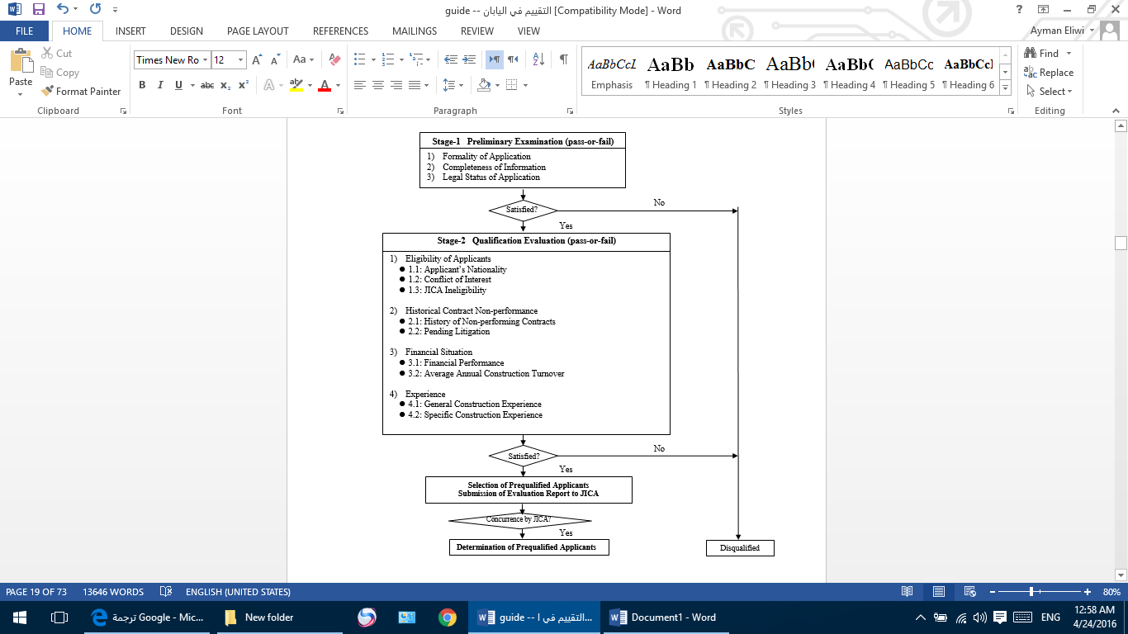
Prequalification Evaluation In Japan
Prequalification Evaluation Process:
  Preliminary Examination.
  Qualification Evaluation..

Slide 28
Bidding Methods in Japan:
Single-stage: One-envelope.
Single-stage: Two-envelope.
Two-stage.

Slide 29
Bid Opening in Japan
All bids received prior to the bid submission deadline shall be opened publicly at the time, date and place specified in the instructions to bidders. Bids received after the deadline for receipt of bids shall be returned unopened to the bidder.
The name of the bidder and total amount of each bid, shall be read aloud and recorded.

Slide 30
Bid Evaluation Procedures In Japan
The purpose of bid evaluation is to compare bids which conform to the technical specifications and are responsive to the bidding documents on the basis of their evaluated cost. The responsive qualified bid with the lowest evaluated cost, shall be selected for award.
Bid evaluation mainly passes through three stages;
  Preliminary Examination,
  Detailed Examination and
  Awarding of the bid.

Slide 31
Bid Evaluation Procedures In Japan
Preliminary Examination of Bids:
  The purpose is to confirm whether the bids received were complete.
  It shall be assured whether the bids are responsive to the bidding documents, whether the required securities have been provided and whether documents have been properly signed.
  If a bid is not substantially responsive to the bidding documents, it shall be rejected.

Slide 32
Bid Evaluation Procedures In Japan
Detailed Examination:
  Firstly, the technical evaluation is made and the qualified bids should be determined for; corrections for errors and provisional sums, modifications and discounts, currency conversions, analysis of bill of quantities, price deviations and adjustments.
  Secondly, the financial proposals will be evaluated.
Awarding the bid:
  The contract is awarded to the lowest price responsive bid.

Slide 33
Conclusion
We have got an out comes which contains both similarities and differences :
Similarities :
selecting of the most responsive and economic bidder is very important
transparency and equality.
bidding process have been reviewed generally
The process for Palestine, and the process for Jordan, United Arab Emirates and Japan
Pre-qualification procedure
Facing obstacles

Slide 34
Differences “comparison”
Several countries have been taken into consideration
Palestine VS Jordan
Palestine VS UAE
Palestine VS Jaban

Slide 35
Recommendations
Pre-qualification is important.
Uniform BOQ.
Workshops and courses.
The new Tendering and Procurement Law for the Governmental Works.

