Slide 1

Supply Chain and Inventory Management at
International Overseas Company
2
+
2
+
Presented by: Areej Sweidan Abdullah Abu Saa Hamzah Sawafta | Supervised by: Dr. Yahya Saleh

Slide 2
Outline:
Introduction
IOC Overview
Problem Statement
Objectives
Methodology
Results, Discussion and Analysis
Conclusion and Recommendations

Slide 3
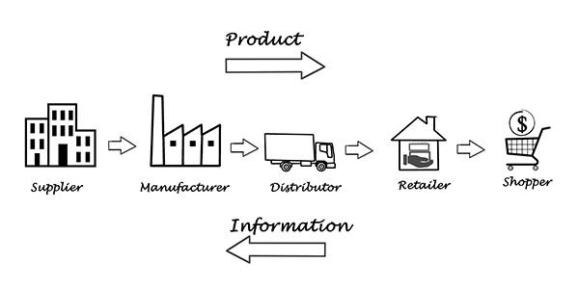
Introduction
What is Supply Chain?

Slide 4
Introduction
Inventory Management Definition
Wholesaling and Retailing
Inventory Management System benefits for retail industry:
  Provides fast real-time collection in all business locations
  Improves cash flow and profitability
  Higher customer satisfaction
An integrated system between supply chain management and inventory management should be taken into consideration

Slide 5
IOC overview
International Overseas Company (IOC) is located in Nablus and established in 1994.
A modest trading operation in the import and distribution of consumer goods.
IOC sat its core competencies around the Fast-Moving Consumer Goods (FMCG) business.

Slide 6
Ioc overview
Vision
To be one of the leading importing and distribution companies in the region.
Mission
To partner with leading multinational suppliers to best serve customers’ needs in Palestine. IOC is devoted to providing customers and consumers with the highest quality products and services that satisfy their needs and make their lives more enjoyable.

Slide 7
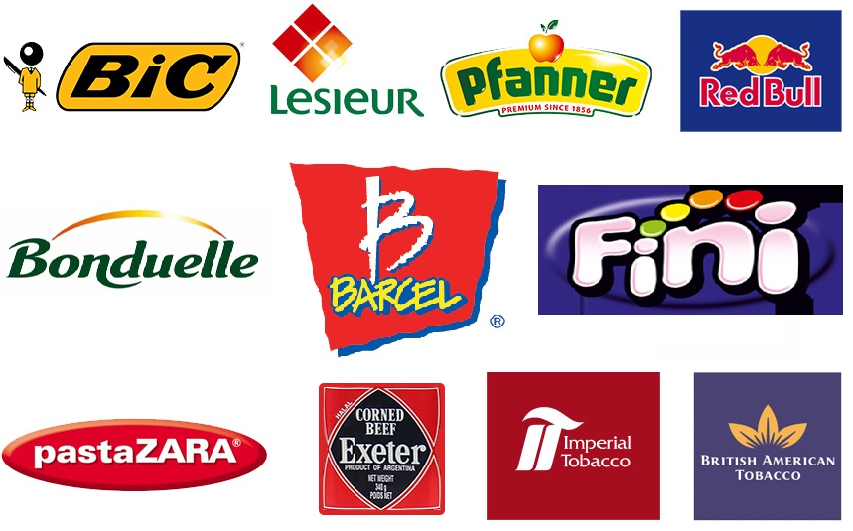
Ioc overview
IOC Brands

Slide 8
Problem Statement
IOC has been encountering problems in managing their inventories of some of their products due to the different types of supply and demand uncertainties, specifically, as most of their products are imported from external suppliers.
The aim of this project is to apply different inventory management and supply chain management tools to enhance the effectiveness of the existing supply chain and inventory systems at the IOC.

Slide 9
objectives
Determining a suitable forecasting method for each product, depending on their demand patterns.
Designing a suitable forecasting sales system for the International Overseas Company that suits their demand.
Developing inventory control policies for each type of product.
Establishing capable safety stock levels for each product that protects the company against demand uncertainty and delineate a clear re-ordering point.

Slide 10


Methodology
Two Products where taken:
  RedBull
  Lesieur Oil
    Corn oil
    Sunflower oil
All historical data were gathered for a time span for five years.

Slide 11
Methodology
Forecasting
  Determining the best forecasting method for the data acquired for each product item, by using Minitab.
  Using the developed forecasting method, future demand forecasts will be generated accordingly for the five items.
Inventory Management
Economic Order Quantity (EOQ) Safety Stock | Reorder Point (ROP) Total cost

Slide 12
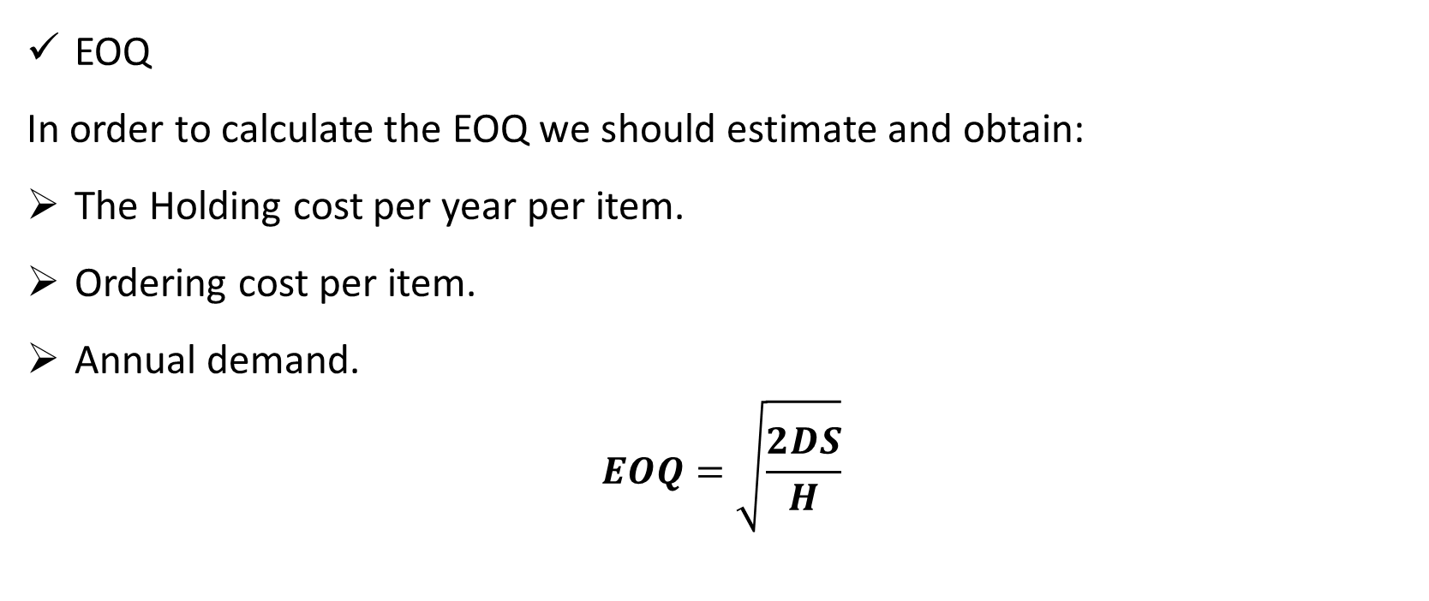
Methodology
EOQ
In order to calculate the EOQ we should estimate and obtain:
The Holding cost per year per item.
Ordering cost per item.
Annual demand.
$$EOQ=\sqrt{\frac{2DS}{H}}$$

Slide 13
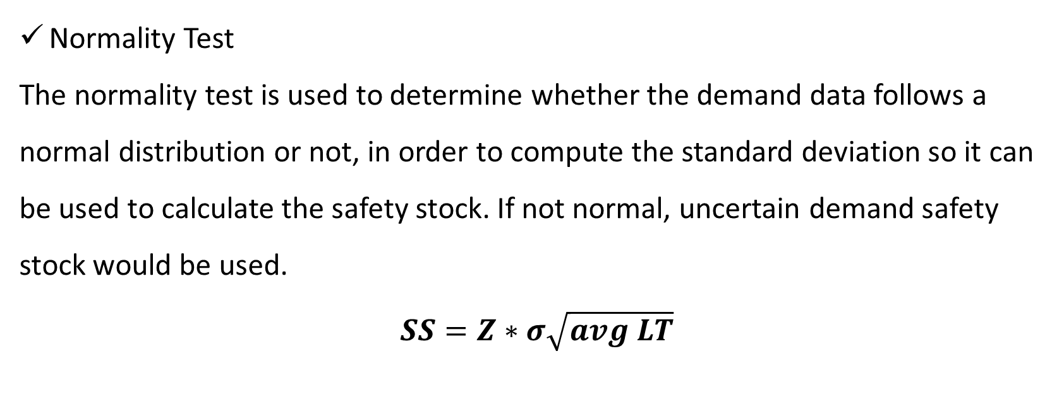
methodology
Normality Test
The normality test is used to determine whether the demand data follows a normal distribution or not, in order to compute the standard deviation so it can be used to calculate the safety stock. If not normal, uncertain demand safety stock would be used.
$$SS=Z∗σ\sqrt{avg LT}$$

Slide 14
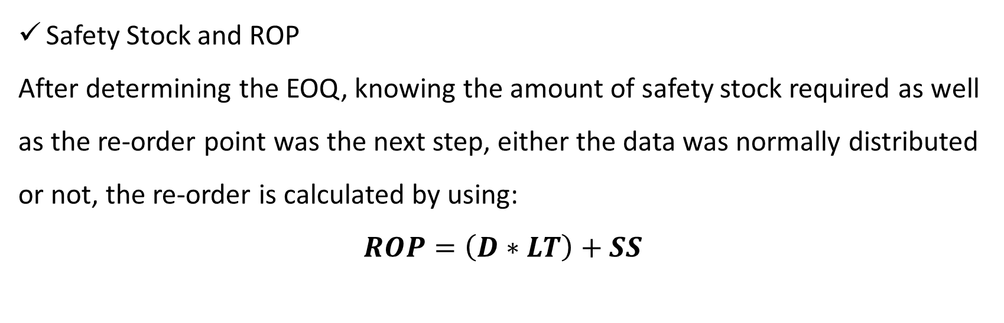
methodology
Safety Stock and ROP
After determining the EOQ, knowing the amount of safety stock required as well as the re-order point was the next step, either the data was normally distributed or not, the re-order is calculated by using:
$$ROP=\left(D∗LT\right)+SS$$

Slide 15
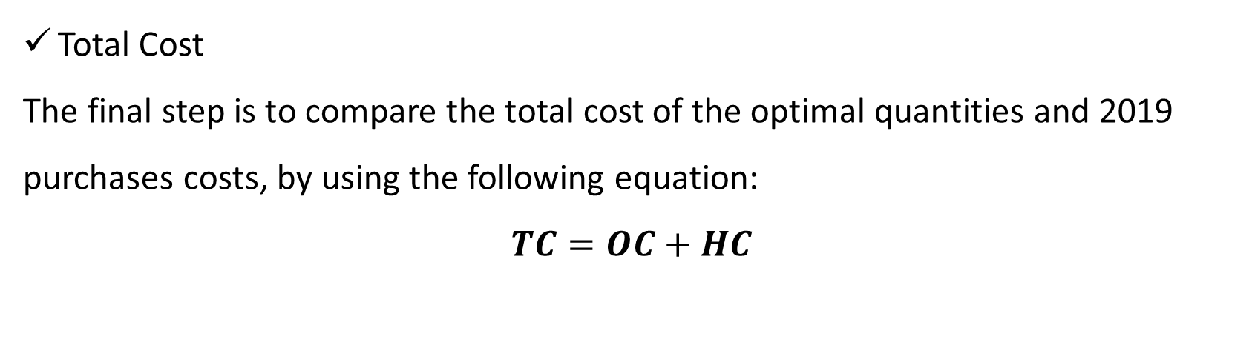
methodology
Total Cost
The final step is to compare the total cost of the optimal quantities and 2019 purchases costs, by using the following equation:
$$TC=OC+HC$$

Slide 16
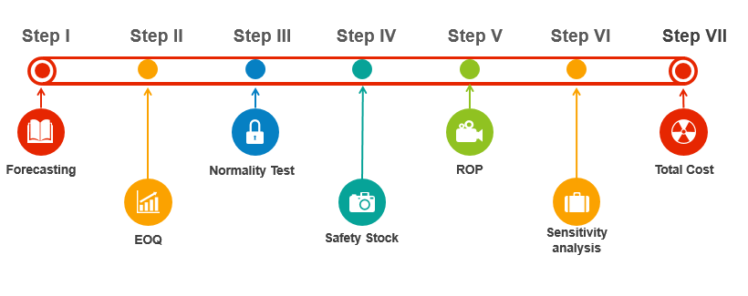
Methodology

Slide 17
Results, discussion and analysis
Demand Forecasting
Normality Test
Comparing two forecasting errors MAD and MSD, by testing multiple forecasting methods on Minitab
Product Name | Forecasting Method
Redbull | Single Exponential, Optimal ARIMA
Corn Oil 5L | Winters’ method
Corn Oil 3L | Moving Average
Sunflower Oil 5L | Single Exponential, Optimal ARIMA
Sunflower Oil 3L | Moving Average

Slide 18
Results, discussion and analysis
Demand Forecasting

Slide 19
Results, discussion and analysis
Demand Forecasting

Slide 20
Results, discussion and analysis
Demand Forecasting

Slide 21
Results, discussion and analysis
Demand Forecasting

Slide 22
Results, discussion and analysis
Demand Forecasting

Slide 23
Results, discussion and analysis
Economic Order Quantity – EOQ
  Holding Cost
    Cost associated in determining the annual holding cost:
    Annual Holding cost per box per year and product fraction (h)
Rent | Quartermaster
Electricity consumptions | Workers
Product | Redbull | Lesieur
Product fraction (h) | 15% | 25%
HC / box / year | 1.67 $ | 2.27 $

Slide 24
Results, discussion and analysis
Economic Order Quantity – EOQ
  Ordering Cost: it depends mainly on the container used to ship the product
Product | Redbull | Lesieur
Container | 20 ft. | 40 ft.
OC / order | 6014.29 $ | 8085.72 $

Slide 25
Results, discussion and analysis
Economic Order Quantity – EOQ
  EOQ Calculation
Product | EOQ | Capacity of container | Number of Containers | Approx. | New EOQ
Redbull | 11854 | 2240 | 5.29 | 5 | 11200
Corn Oil 5L | 9030 | 1202 | 7.51 | 7 | 8414
Corn Oil 3L | 6053 | 914 | 6.62 | 6 | 5484
Sunflower 5L | 6188 | 1202 | 5.14 | 5 | 6010
Sunflower 3L | 3904 | 914 | 4.27 | 4 | 3656

Slide 26
Results, discussion and analysis
Economic Order Quantity – EOQ
  Time Between Orders – TBO
Item | TBO (month)
Redbull | 6.8
Corn Oil 5L | 8.8
Corn Oil 3L | 12.8
Sunflower 5L | 13.4
Sunflower 3L | 20.5

Slide 27
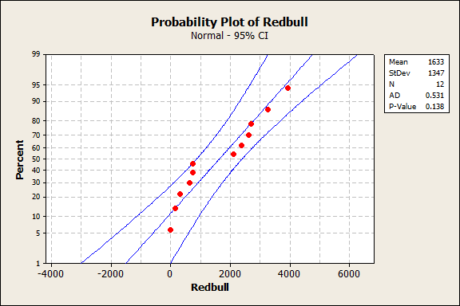
Results, discussion and analysis
Normality Test

Slide 28
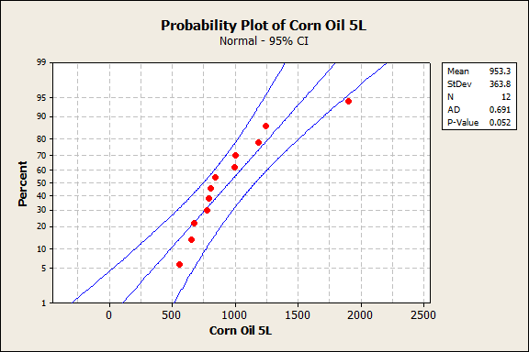
Results, discussion and analysis
Normality Test

Slide 29
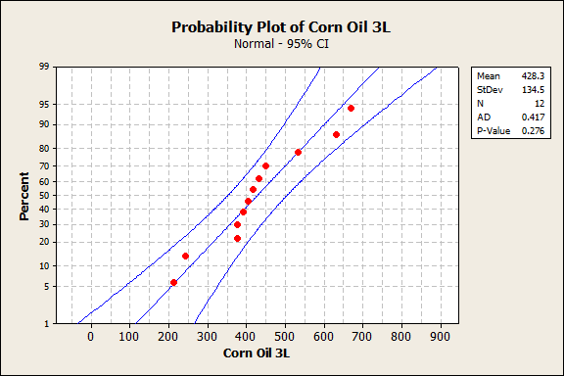
Results, discussion and analysis
Normality Test

Slide 30
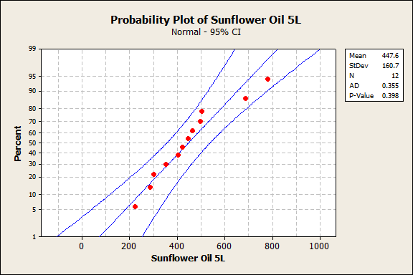
Results, discussion and analysis
Normality Test

Slide 31
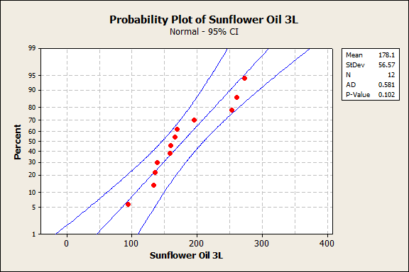
Results, discussion and analysis
Normality Test

Slide 32
Results, discussion and analysis
Safety Stock and Reorder Point
Product | Avg. Demand | STD of the demand | LT (month) | Z (CSL=95%) | Safety Stock | ROP
Redbull | 1633 | 1347 | 3 | 1.65 | 3850 | 8749
Corn Oil 5L | 953.3 | 363.8 | 1.5 | 1.65 | 736 | 2166
Corn Oil 3L | 428.3 | 134.5 | 1.5 | 1.65 | 272 | 914.5
Sunflower 5L | 447.6 | 160.7 | 1.5 | 1.65 | 325 | 996.4
Sunflower 3L | 178.1 | 56.57 | 1.5 | 1.65 | 115 | 382

Slide 33
Results, discussion and analysis
Total Cost
  Sensitivity Analysis
Product | EOQ | New EOQ | Sensitivity analysis
Redbull | 11854 | 11200 | 1.001611
Corn Oil 5L | 9030 | 8414 | 1.002497
Corn Oil 3L | 6053 | 5484 | 1.004877
Sunflower Oil 5L | 6188 | 6010 | 1.000426
Sunflower Oil 3L | 3904 | 3656 | 1.002155

Slide 34
Results, discussion and analysis
Total Cost
  Sensitivity Analysis
Product | New EOQ | Purchases | Sensitivity analysis
Redbull | 11200 | 19347 | 1.153156
Corn Oil 5L | 8414 | 8410 | 1
Corn Oil 3L | 5484 | 2742 | 1.25
Sunflower Oil 5L | 6010 | 3204 | 1.204446
Sunflower Oil 3L | 3656 | 1828 | 1.25

Slide 35
Results, discussion and analysis
Total Cost

Slide 36
Results, discussion and analysis
Savings
Product | Savings
Redbull | 2387
Corn Oil 5L | 1
Corn Oil 3L | 4466
Sunflower Oil 5L | 3145
Sunflower Oil 3L | 2655
Total | 12654 $

Slide 37
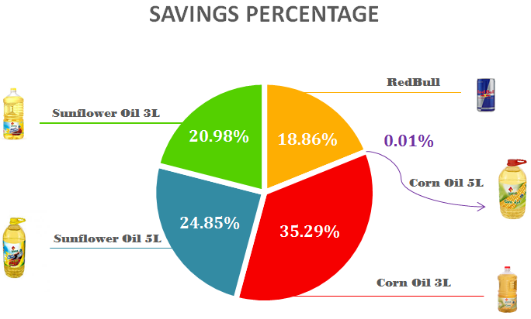
Results, discussion and analysis

Slide 38
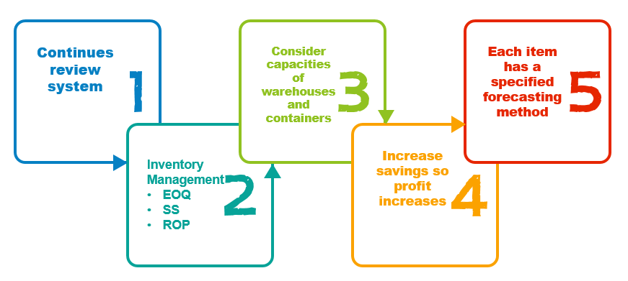
Conclusion

Slide 39
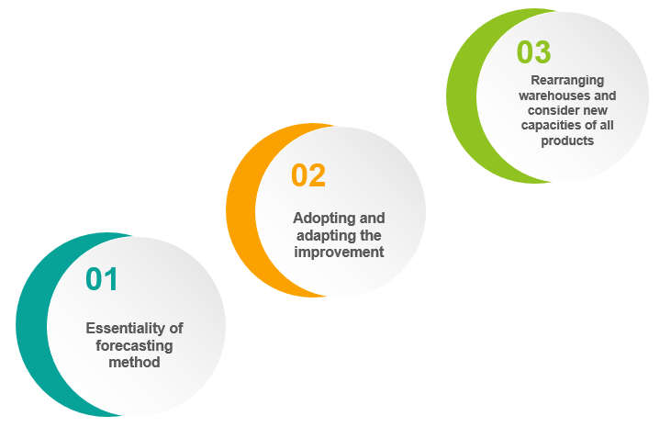
Recommendations

Slide 40
THANK YOU
2
+
2
+

