Slide 1
Public Transportation in the North West Bank
(Nablus, Jinen, Tulkarem, Tubas, and Qalqelia)
Current Assessment and Future Prospects
Student : Mahmoud Qassrawi
Mo’taz Abboshi
Raja Rabaya
Dr: Khalid Al-Sahli
Mon 20/05/2013

Slide 2
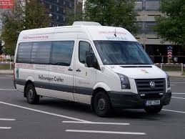
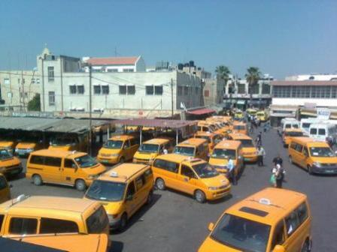
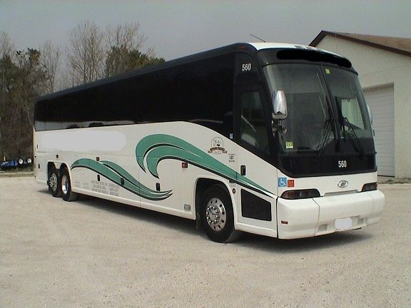
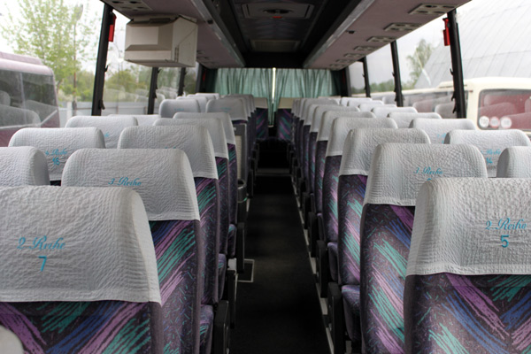

Slide 3
Current situation
Public transportation system in west bank face many problems as :
The absence of laws
Delay
Pollution
Age of buses, provided service is not satisfactory

Slide 4
The general objective of this research is to analyze and evaluate the current public transportation system, to find an optimal system of work of the public transport network, and mechanism of action between the companies concerned.
solutions will, improve the public transport system, and to provide better service for users.

Slide 5
The evaluating and assessing the public transportation in Palestine, which requires accurate techniques of data collection.
The date was collected from field work and meetings with some drivers and official workers in public transportation sector; the collected information was for each parking complex.

Slide 6
First type of data is the average headway for buses and shared taxis enter and leave the complexes in Nablus, Jenin, Tulkarem, Tubas, and Qalqelia ,and have been summarized in tables for each complex.

Slide 7
Average headway in one direction=
(Number of work hours *60 minute) divided by (number of vehicles *average number of trips in that direction per day).
Number of work hours= 10 hour or 12 hour ,
Depending on the size of the village and their need for the city

Slide 8
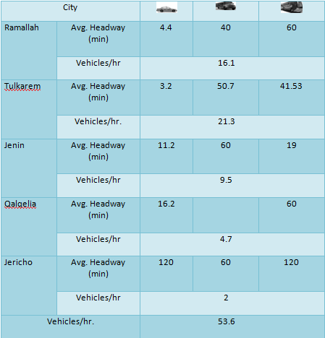
Average headway and number of vehicles entering the Western Public Transport Complex during the day(cities complex)

Slide 9
The average headway numbers give an indication that the demand is high on the shared taxis but not for the mini busses or the public busses, that’s because the service provided by the shared taxis and, and the low headway, make the passengers use shared taxis as travelling method from the communities to the center of the other governorate.

Slide 10
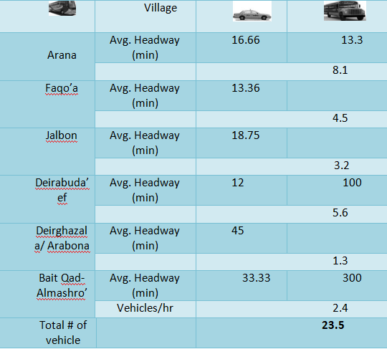
Average headway and number of vehicles exiting the An-Nasra Public Transport Complex( in jenin) during the day

Slide 11
The average headway gives an indication that the demand and number of passengers is high between jenin city and this sample of villages , but it shows also that customers prefer in general the shared taxis to use more than mini busses and public busses.

Slide 12
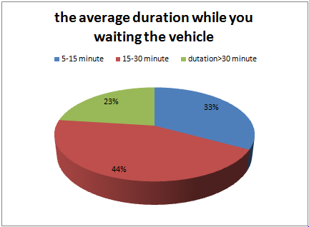
The average duration while people waiting for a vehicle.

Slide 13
Cost analysis for Busses and Shared Taxis
Cost analysis require Other type of data collected as, the distance in Km between cities ,and date relevant to vehicle as fuel unit cost , fee, Insurance cost, registration cost, taxes, maintenance cost, and indirect cost, In addition to headway data.

Slide 14
Income per trip = # of passenger * Fee
Income per vehicle per day = Income per trip* Total trips per vehicle
Income per vehicle per month= Income per vehicle per day*25 days/month
Fuel cost per trip= Fuel cost(NIS/km)* Distance(Km)
Fuel cost per vehicle per month= Fuel cost per vehicle per day*25days/month
Depreciation cost/month=(Initial price-salvage value)/# of year
12 months

Slide 15
Total cost per month=
Average maintenance cost per month+ Insurance &registration cost per month+ Depreciation cost/month+ Permit cost per month+ Fuel cost per vehicle per month
Net Income per month=
Income per vehicle per month- Total cost per month

Slide 16
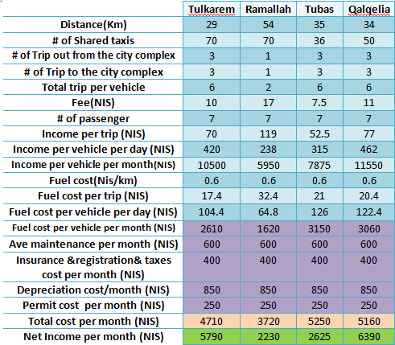
Sample calculations of cost for some shared taxis routes between Nablus and some major cities.

Slide 17
The previous table represents the major routes between Nablus and the other cities, and shows the net income per month, which varies between 2000 NIS to more than 6000 NIS.
These numbers are affected by the demand and the purpose of the journey; for example there is a very low demand between Jenin and Qalqelia so the passengers have an alternative route which is Nablus city.

Slide 18
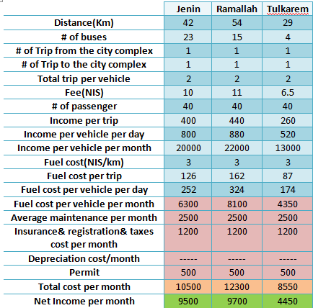
Sample calculations of cost for some public busses(50 passengers)routes from Nablus governorate to other major cities.

Slide 19
The previous table show the cost analysis, for the routes between the major cities in the north of the West Bank, the demand is high due to the large population in this cities, which leads to high net income per month to the drivers and buses company.
Study show that the most of these busses are old, but benefit show the ability to Renewal.

Slide 20
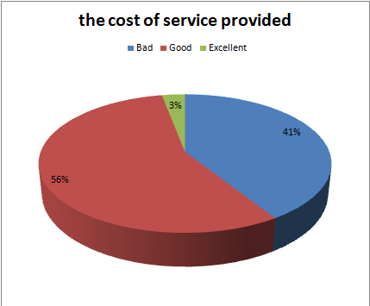
people opinion about the cost of service provided

Slide 21
Proper Solutions
Based on the study, the problems have several possible solutions, but there are no one solution for the all cases of the Public Transportation in the West Bank, so possible solutions were collected and made in a way to resolve the issues.

Slide 22
Possible solution
renewal of public transport buses.
renewal of public transport taxis.
merge lines.
and matters related to government.

Slide 23
Renewal of public transport buses
Most of current busses are old buses (1986-1994), it a 20 years of service, so it consumes a high amount of diesel, and they are in unsatisfactory situation; no air condition, may break down at any time of travelling, also the passengers are not comfortable.
The following table shows the cost analysis for old busses. Take busses of( Jinen-Nablus) as example

Slide 24
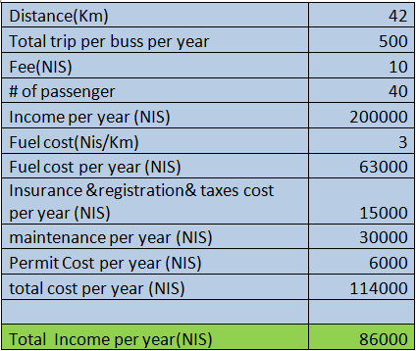
operation cost analysis for old busses (1986-1994)

Slide 25
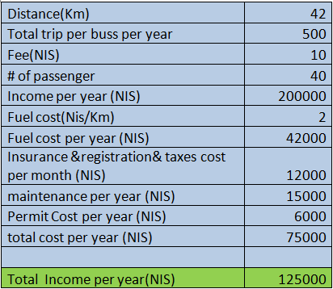
operation cost analysis for bus (2000-2001)

Slide 26
From the previous table we note that there is a large difference in profit; the newer buses get 39000 NIS more than the older one per year. Moreover, it provides a high quality of service.
we have know that the buses (model 2000-2001) price is 110000 (NIS), and the buses (1986-1994) are evaluated in the range of (20000-30000) NIS.

Slide 27
If the companies decided to renew the busses
110000-25000= 85000 (NIS) company pays for replacing one bus.
On the other hand, the profit increases by 39000 NIS/ year.
Assume the newer one will work for 8 years, (from the difference between models for older & newer ones)
Depreciation (110000-25000)/8= 10600 (NIS)/year
The profit become 39000-10600 = 28400 NIS/year
The returned year = 85000/28400 = 3 year
Economically, this is a good process, also this will attract more passengers to use public busses.

Slide 28
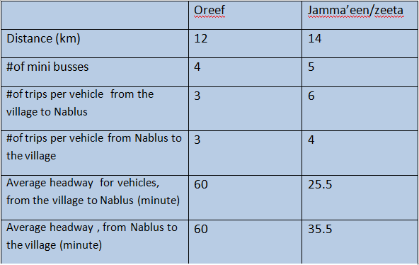
Merge lines
Oreef and Jamma’een/Zeeta headway data for busses.

Slide 29
Total number of trips from Oreef and Jamma’een to eastern complex in Nablus =
4buss * 3 trips (Oreef) + 5 busses *6 trips (Jamma’een/Zeeta)=42 trip
Total number of trips from eastern complex in Nablus to Oreef and Jamma’een=
4buss * 3 trips (Oreef) + 5 busses *4 trips (Jamma’een.Zeeta)= 32 trip

Slide 30
The average headway of vehicles entering the eastern complex, from Oreef and Jamma’een, after merging the two lines :
12 (hour) * 60 (minute) / 42 trip = 17.15 minutes
The average headway of vehicles leaving the eastern complex, from Oreef and Jamma’een, after merging the two lines:
12 (hour) * 60 (minute) / 32 trip = 22.5 minutes

Slide 31
Issues Related to Government
Fuel cost: the fuel cost is very high and this reduces the possibility of the public transportation companies’ to competition and providing a good service.
Road network: the inappropriate road network is the main reason for not renewal the public transportation vehicles, a good road network not only helps in reducing the maintenances cost but it reduces the operating cost as well.

Slide 32
Taxes: reduce the taxes and other expenses to open the way to the public transportation companies to reduce the ticket price and improve the services, thus attracting more ridership.
Apply the low : as the allotted age of vehicle and Redistribution of franchise lines

Slide 33
Recommendations
Study the capacity of current complexes to carry the volume of movement, and the possibility of establishing new complexes because we noticed during our study that some complex are crowed and serve more than 20 lines.
Study the fuel consumption and air pollution increase resulted from distraction of people from using public transportation, and using their carsinstead.
Revaluate the lines and design of routes that connect between communities.

Slide 34
Improve the road safety systems.
Feasibility studies related to the renewal the current buses.
Explore the option of establishing a Railway system between major governorates.
Study the working principles of Transportation Companies, and how to improve the industry for the companies and the people.

