Slide 1
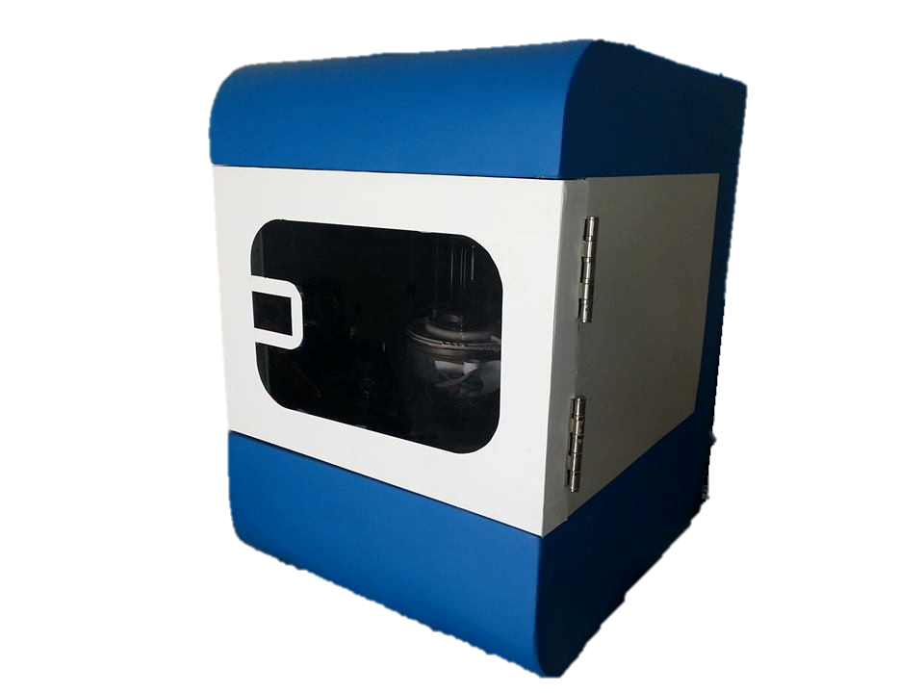
Climate Chamber
Produced by:
Mosab Ordoniya
Hamze Johri
Hisham Khanfa
Superviser:
Dr.Kamel Subhe

Slide 2
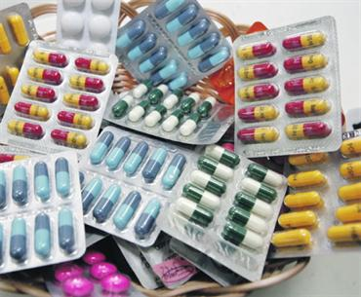


Slide 3
ABSTRACT
Climate chamber, as the name indicates, a cabinet or a chamber that modulates many cases of storing, working and calibrating ..
conditions for many products such as measurement systems, electronic equipment and drags.

Slide 4

What is Climate Chamber ?
is an enclosure used to test the effects of specified
environmental conditions on biological items, industrial products, materials, and
electronic devices and
components

Slide 5
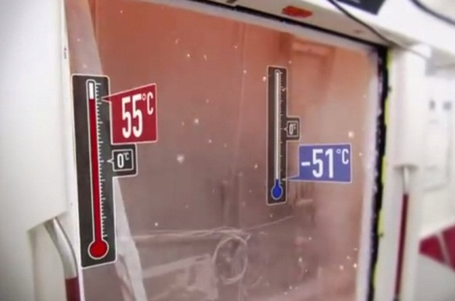
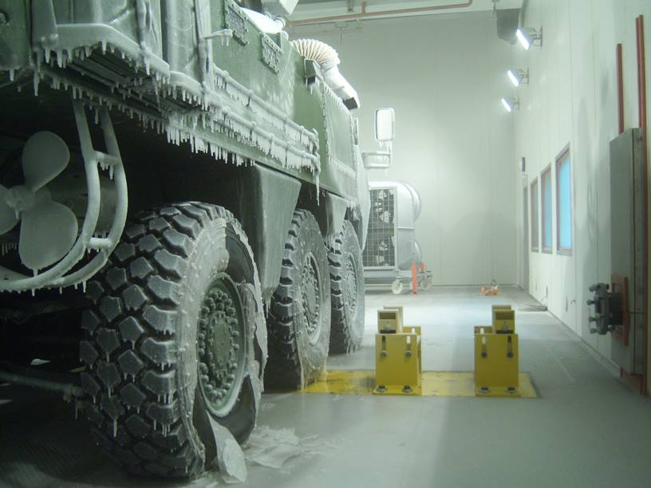
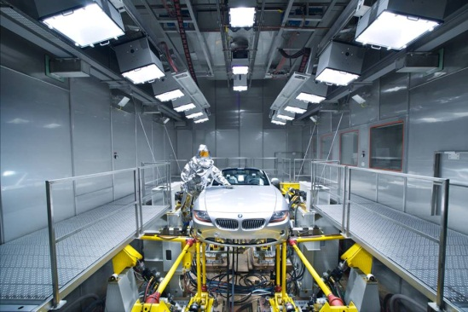
Conditions maybe included
Extreme temperatures
Sudden and extreme temperature variations
Moisture or relative humidity
Electrodynamics vibrations
Electromagnetic radiation
Salt spray
Rain
Weathering
Exposure to sun, causing UV degradation.
Vacuum

Slide 6
Field of applications on climate chamber
Aerospace
Automotive
Biotechnology
Defense
Electronics
Energy
Pharmaceuticals and Cosmetics
Clean Rooms

Slide 7
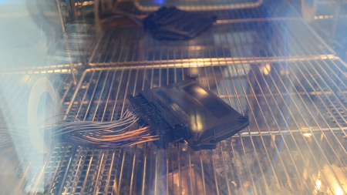
Applications on climate chamber
Electronics

Slide 8
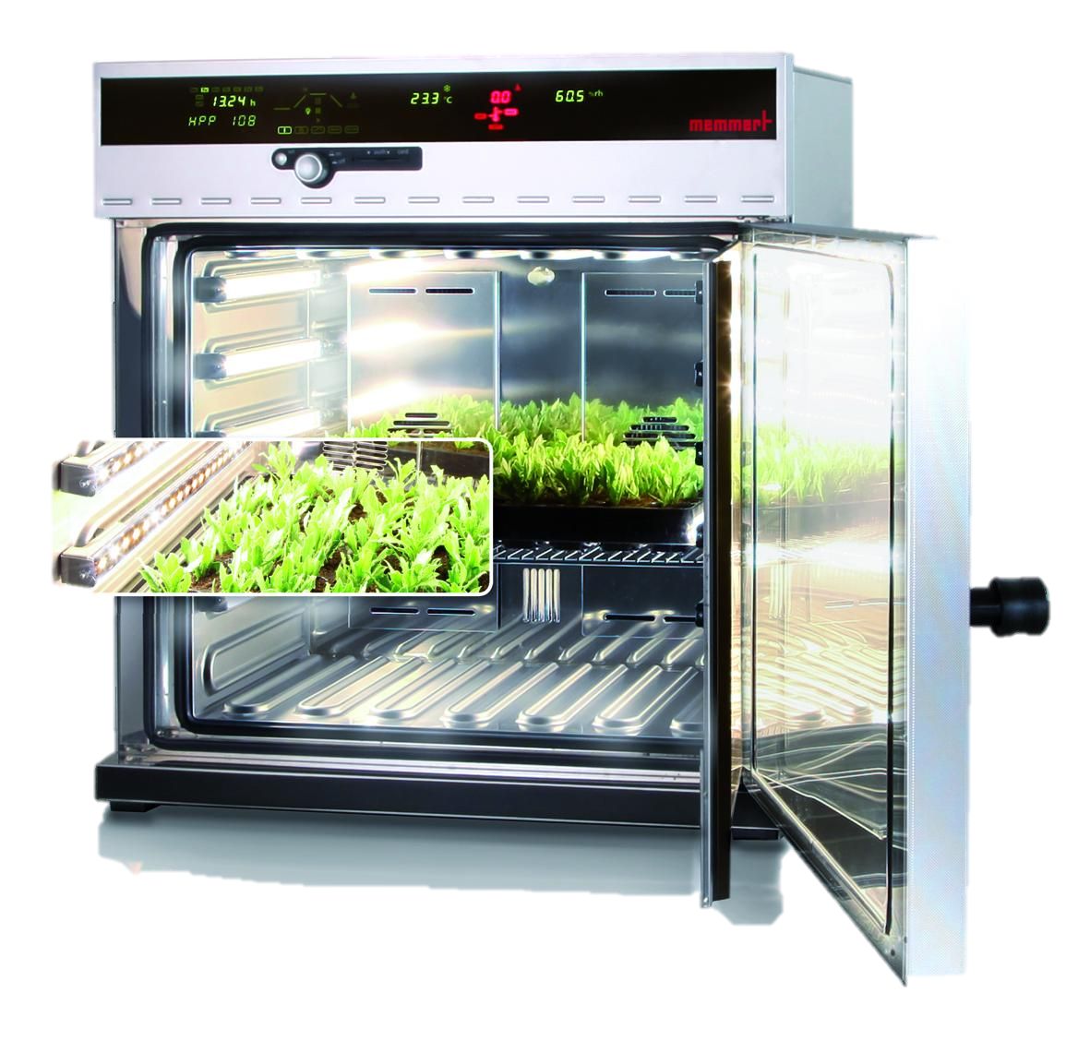
Applications on climate chamber
Biotechnology

Slide 9
Control
About the controlling in details; the humidity will be lowered by passing the
enclosed air through cold surfaces, so that the vapor condensed, it will be increased
by evaporating water. Moreover, the temperature will be lowered using
refrigeration cooling unit, increased using heater.

Slide 10
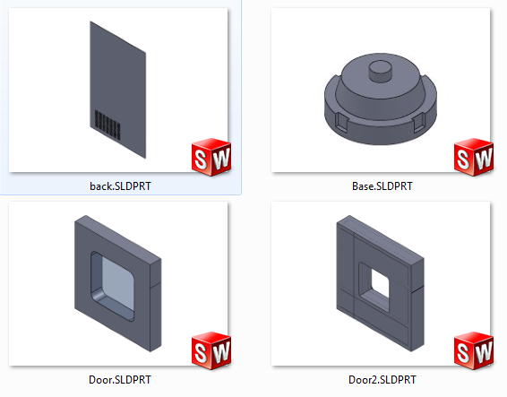
Parts design [with alternatives]

Slide 11
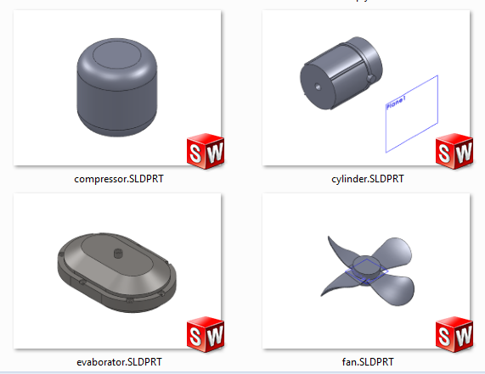
Parts design [with alternatives]

Slide 12
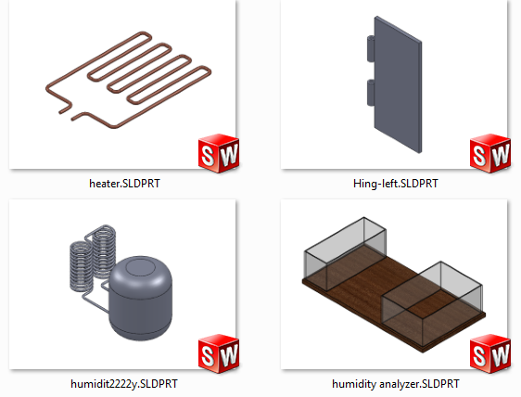
Parts design [with alternatives]

Slide 13
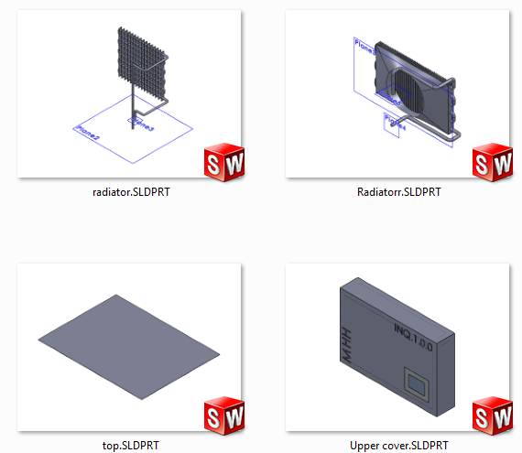
Parts design [with alternatives]

Slide 14
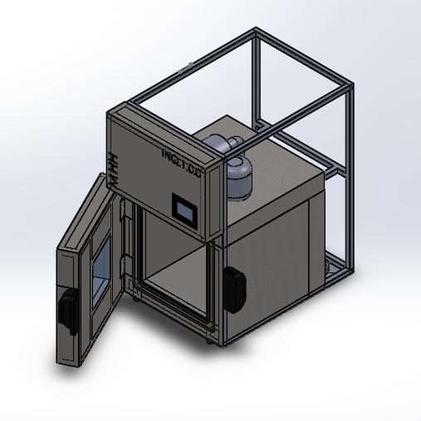
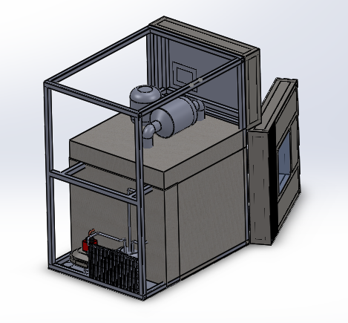
Complete assembly

Slide 15
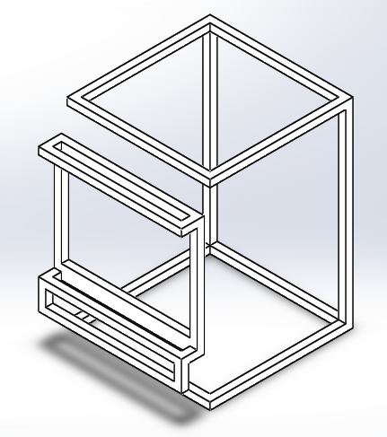
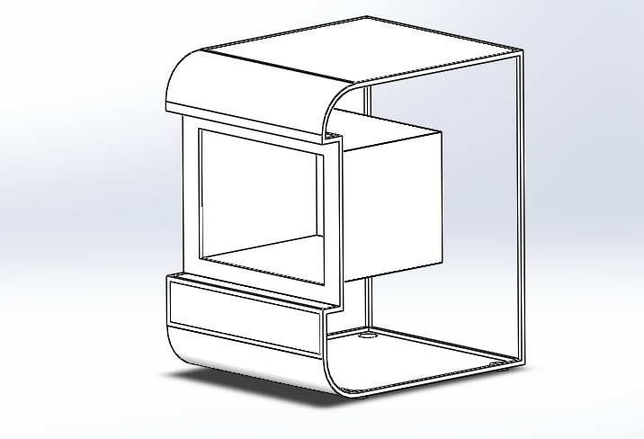
Frame design

Slide 16
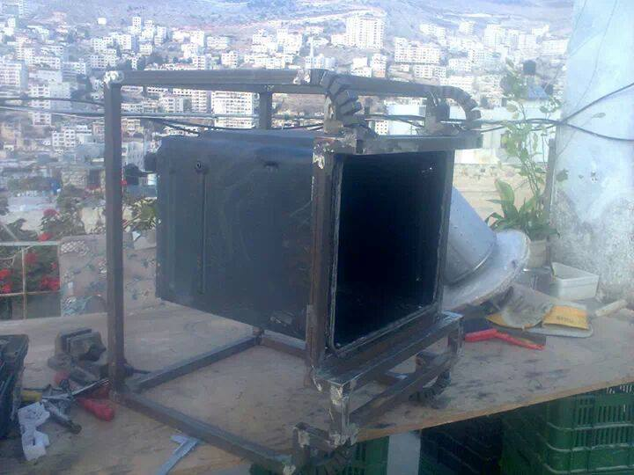
building the main frame

Slide 17
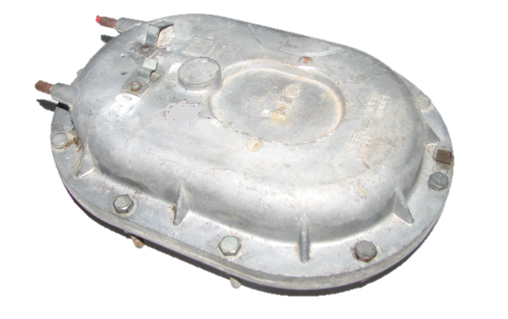
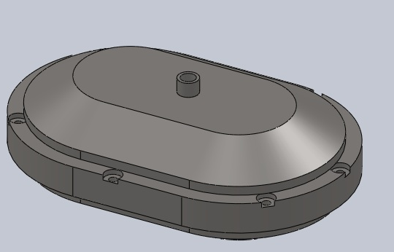
Evabrator

Slide 18
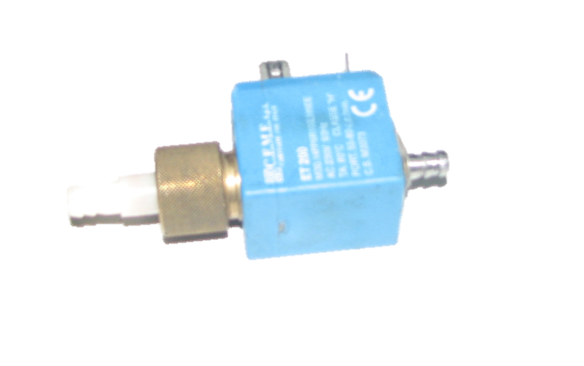
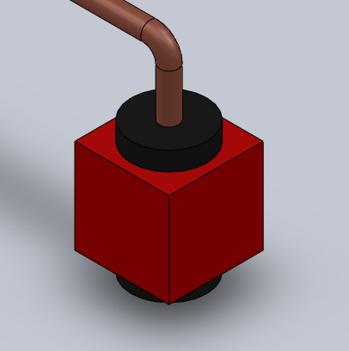
Steam Gas

Slide 19
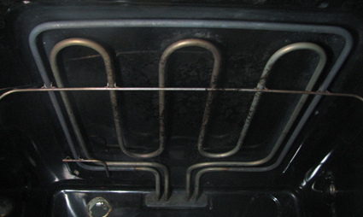
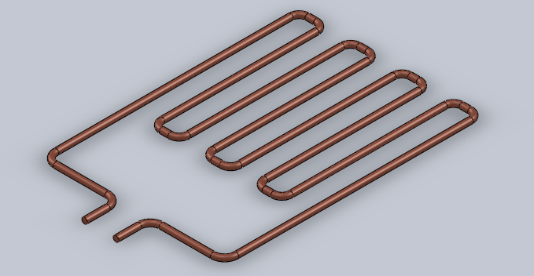
Heater

Slide 20
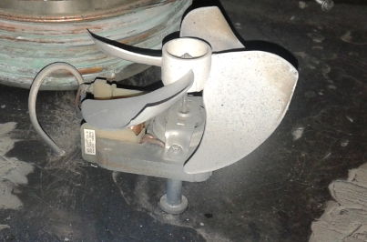
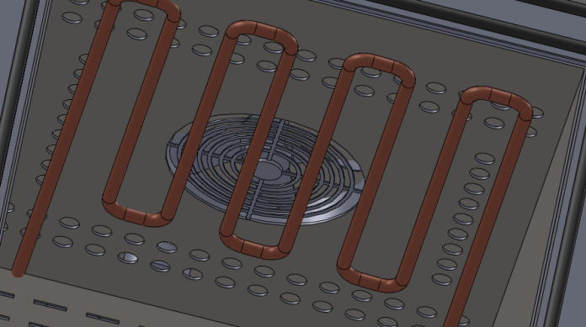
Fans

Slide 21
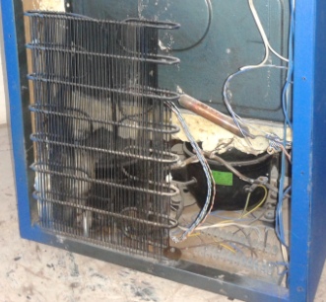
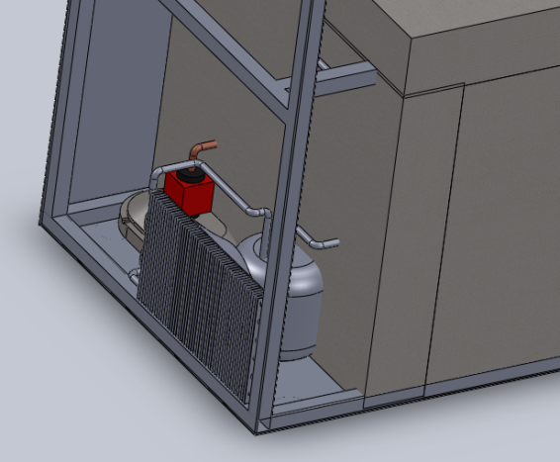
Condenser

Slide 22
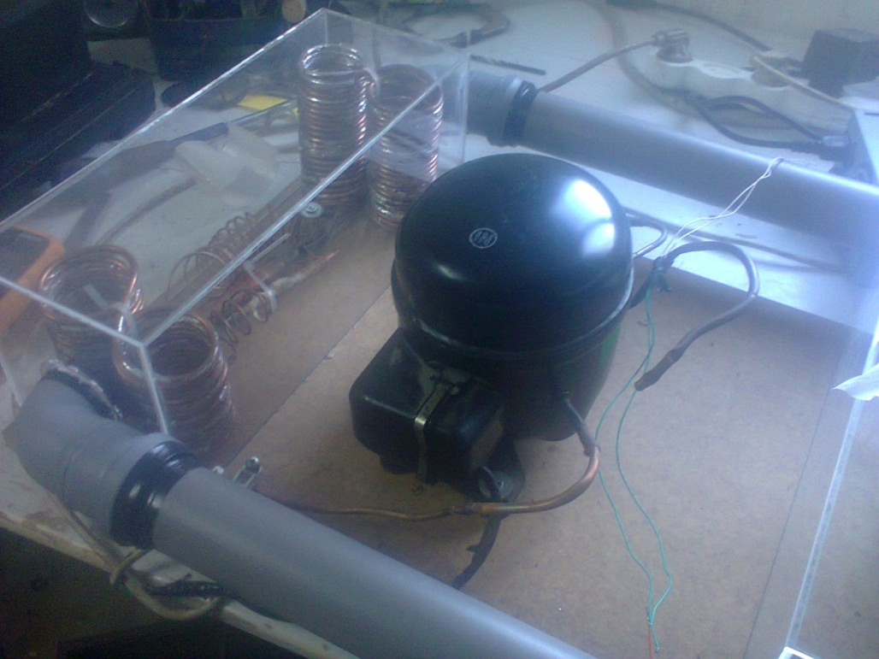
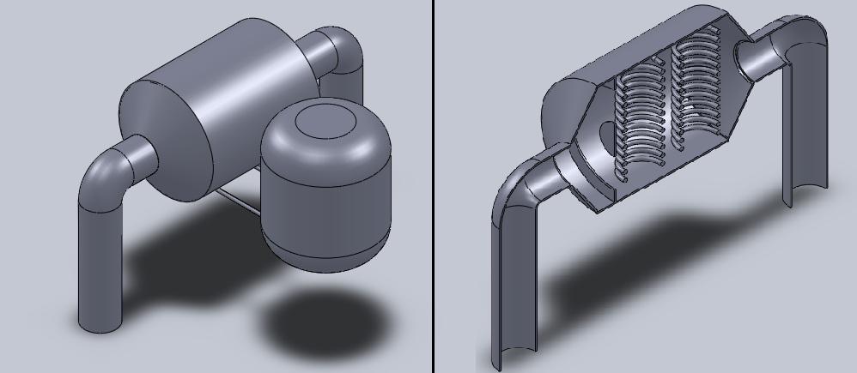

Slide 23
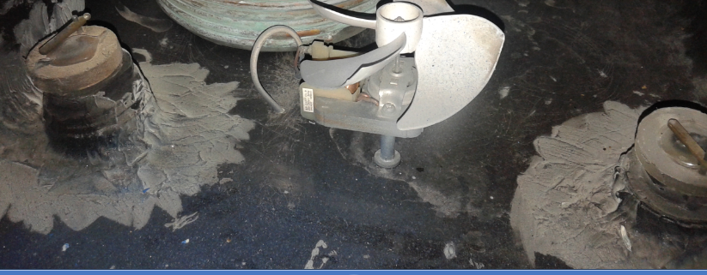

Slide 24
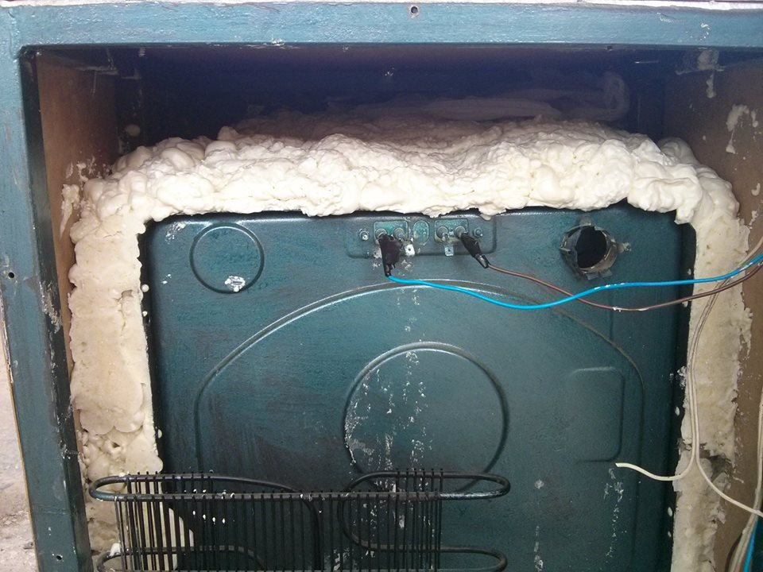

Slide 25
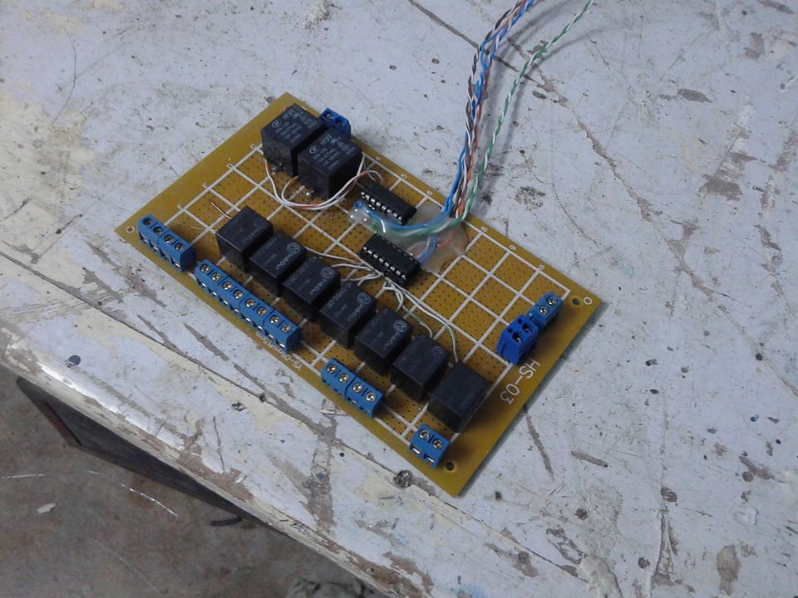

Slide 26
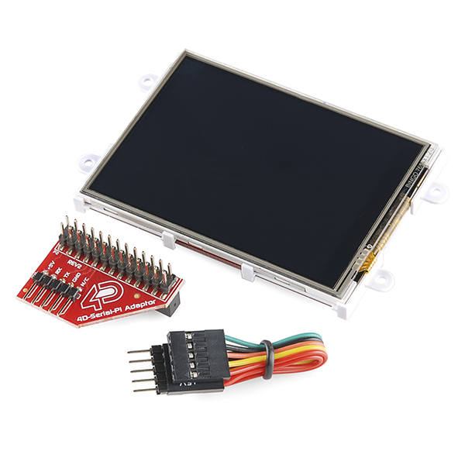
Control system

Slide 27
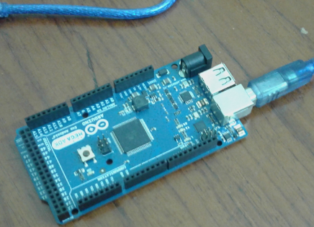
Control system

Slide 28
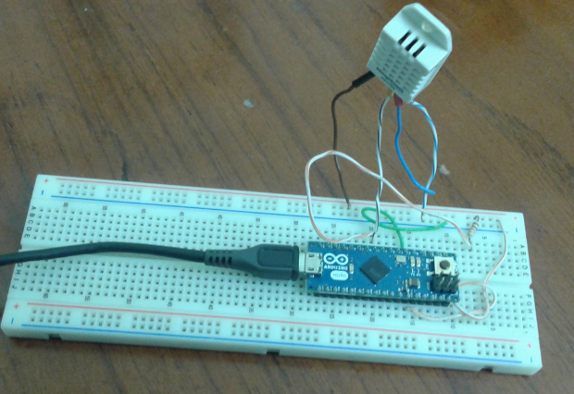
Control system

Slide 29
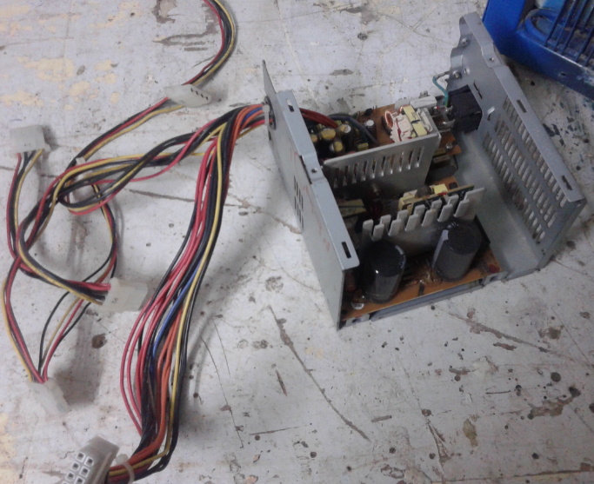
Control system

Slide 30
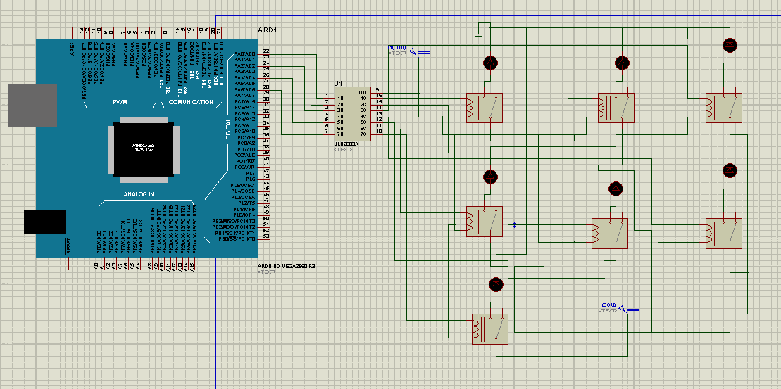

Slide 31

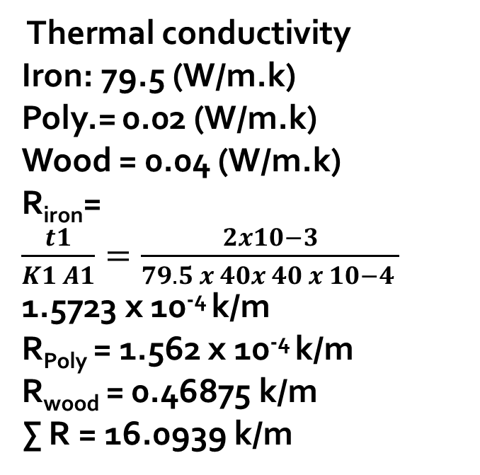
Side View
Thermal conductivity
Iron: 79.5 (W/m.k)
Poly.= 0.02 (W/m.k)
Wood = 0.04 (W/m.k)
R_{iron}= $\frac{t1}{K1 A1}=\frac{2x10−3}{79.5 x 40x 40 x 10−4 }$ 1.5723 x 10⁻⁴ k/m
R_{Poly} = 1.562 x 10⁻⁴ k/m
R_{wood} = 0.46875 k/m
∑ R = 16.0939 k/m

Slide 32
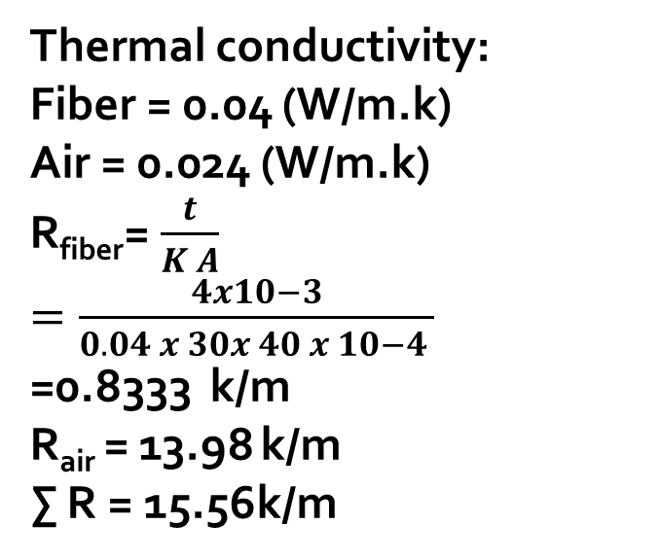
Front View
Thermal conductivity:
Fiber = 0.04 (W/m.k)
Air = 0.024 (W/m.k)
R_{fiber}= $\frac{t}{K A}$
$=\frac{4x10−3}{0.04 x 30x 40 x 10−4 }$
=0.8333 k/m
R_{air} = 13.98 k/m
∑ R = 15.56k/m

Slide 33
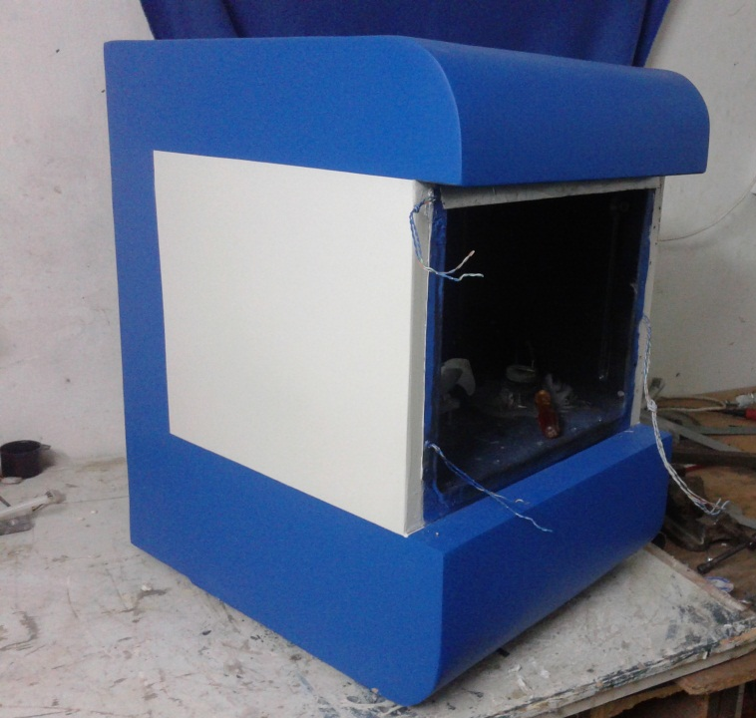

Slide 34
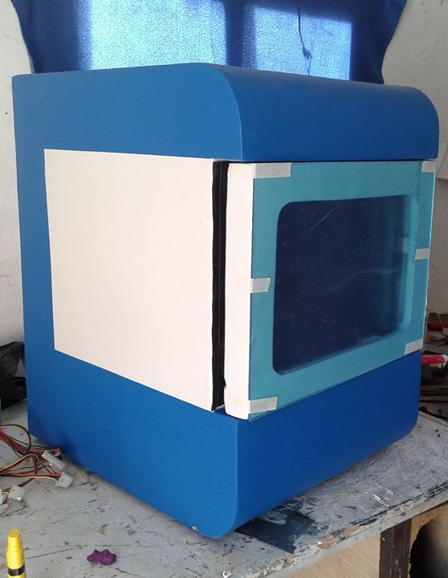
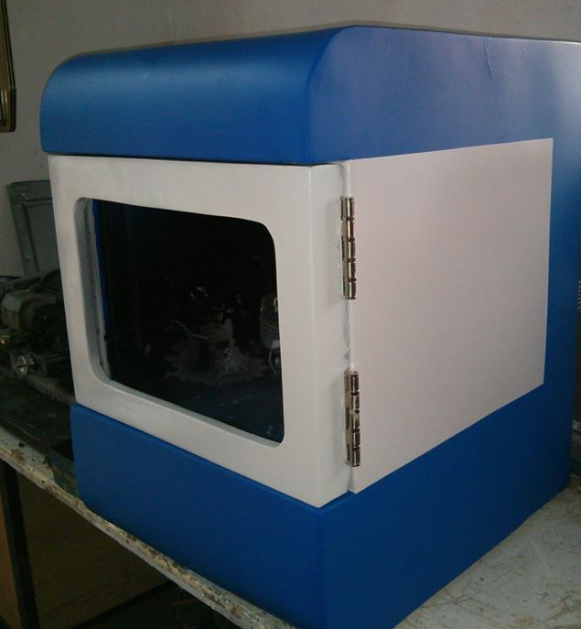

Slide 35
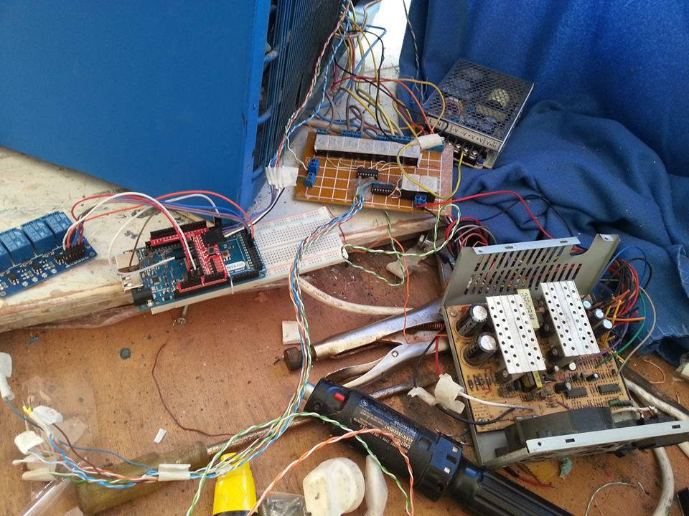

Slide 36
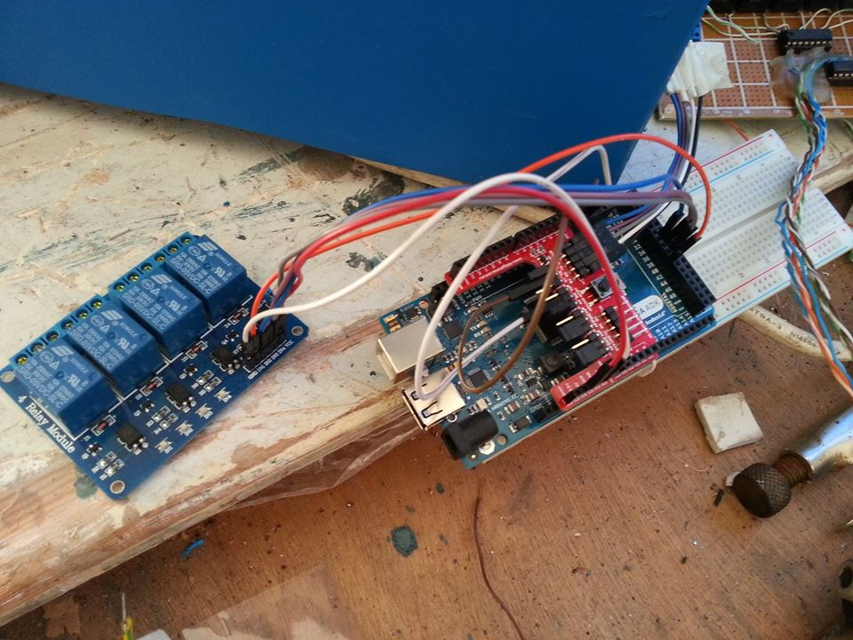

Slide 37
