Slide 1

MEDICS
by :mohamad jondi,
ahmad amira

Slide 2
2
OVERVIEW
  Introduction
  Problem
  Solution
  Implementation
  Thank You

Slide 3
4
PROBLEM
First Problem
Managing patient information in healthcare settings poses significant challenges. The process is often cumbersome and error-prone, leading to inefficiencies and potential risks.
the need to reenter medical history every time you entar a hospital or a clink
najah University | 2024
Second Problem
Doctors bad handwritings kills.

Slide 4
5
SOLOTION
1
Implementing a centralized Electronic Health Record (EHR) system. This system stores patients information and make it accesable from anywhere
Najah University | 2024
2
Digitalizing doctors' notes and prescriptions. By using a digital input method, such as typing

Slide 5




TECHNOLOGIES
Najah University | 2024

Slide 6
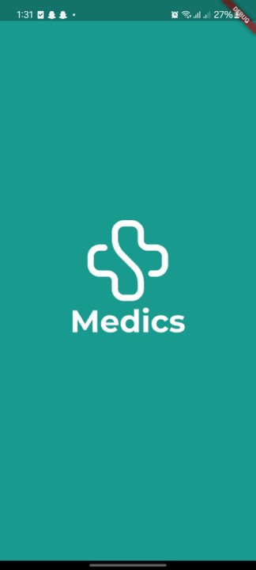
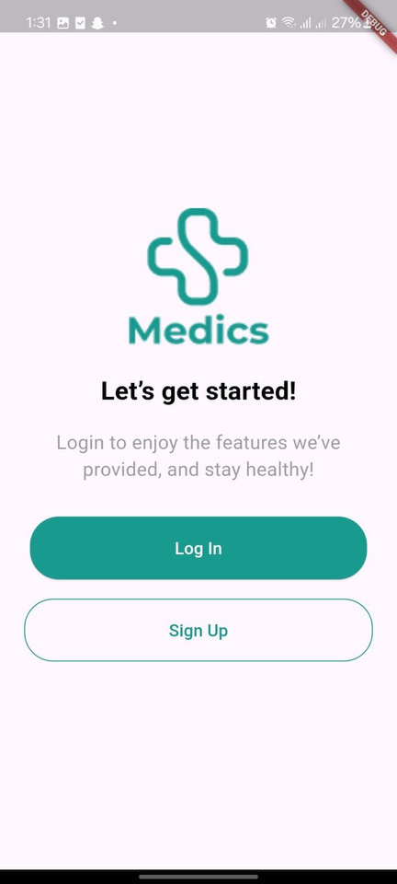
3
INTRODUCTION
Larana University | 2024

Slide 7
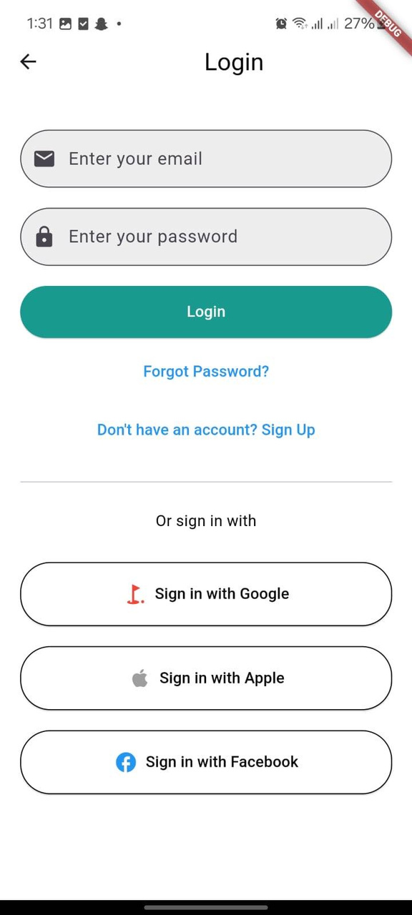

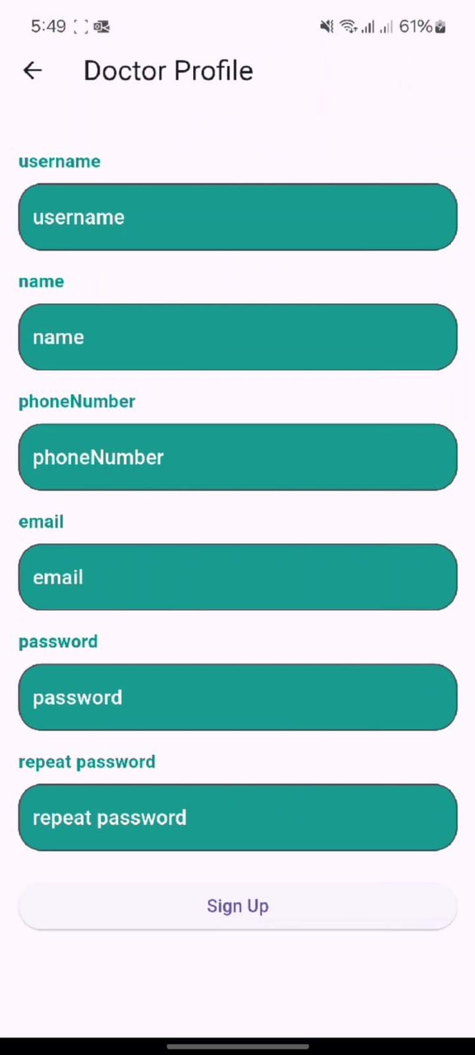
6
Najah University | 2024

Slide 8
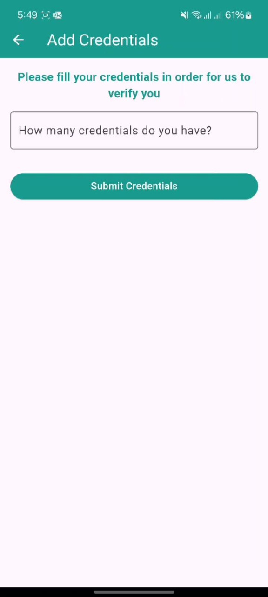
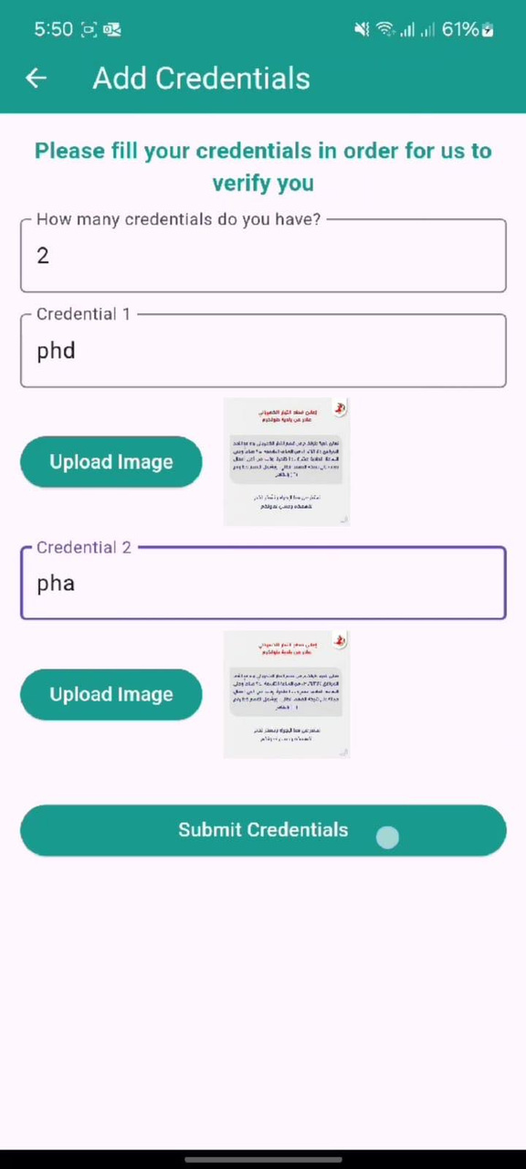
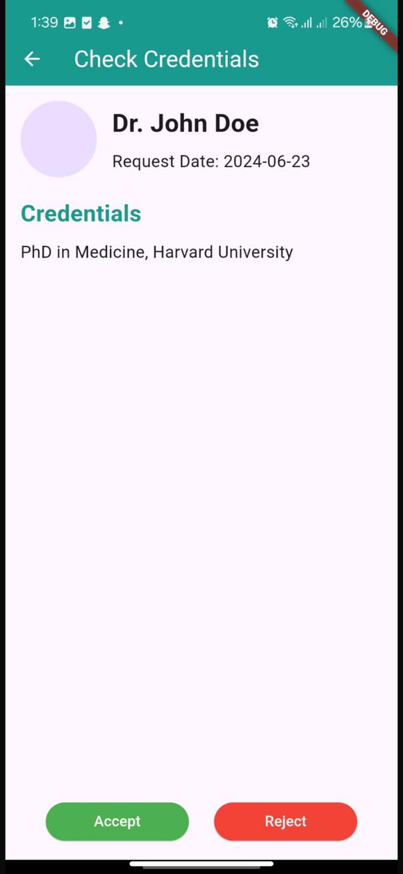
Najah University | 2024

Slide 9
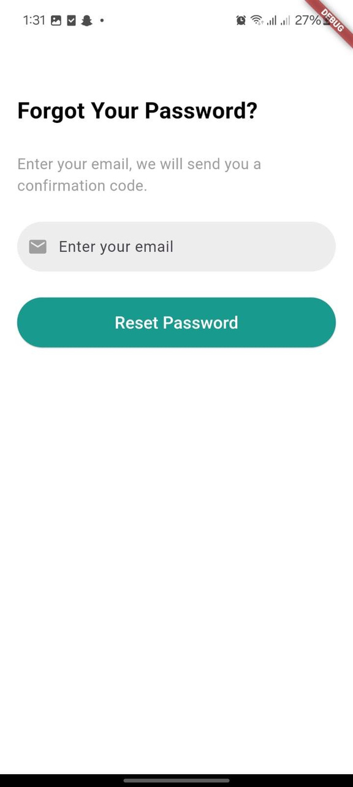
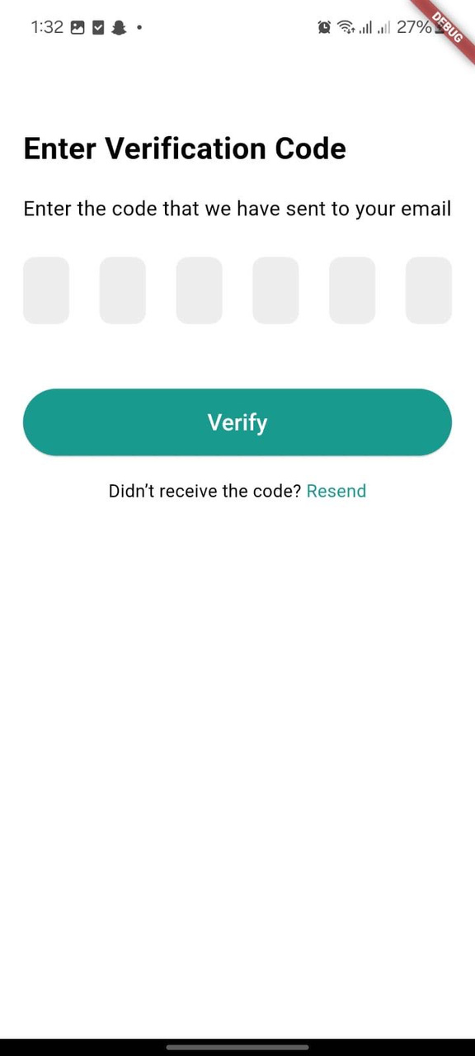
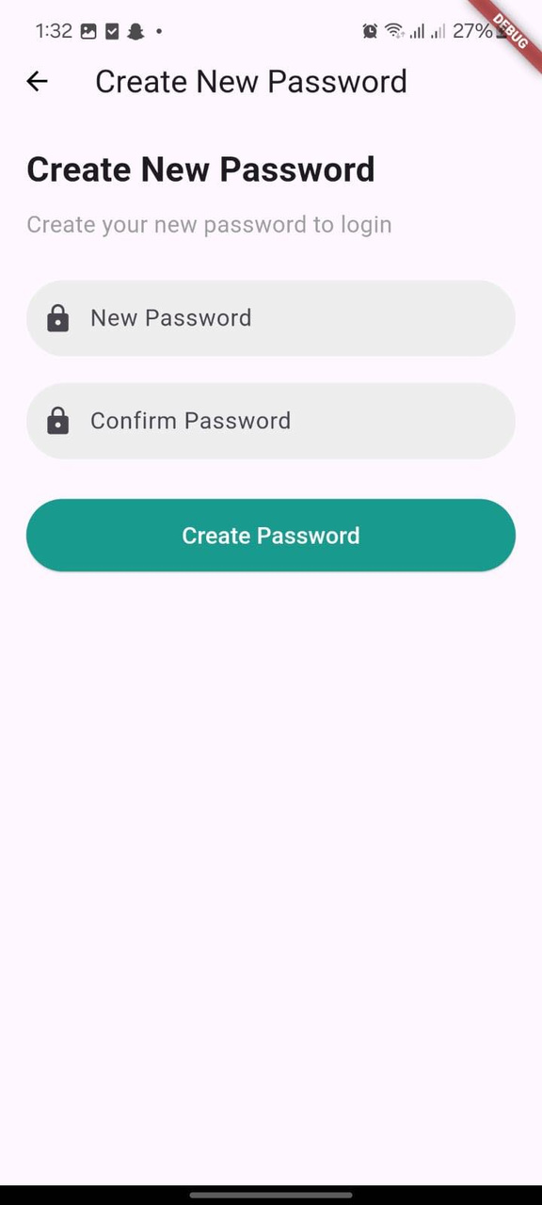
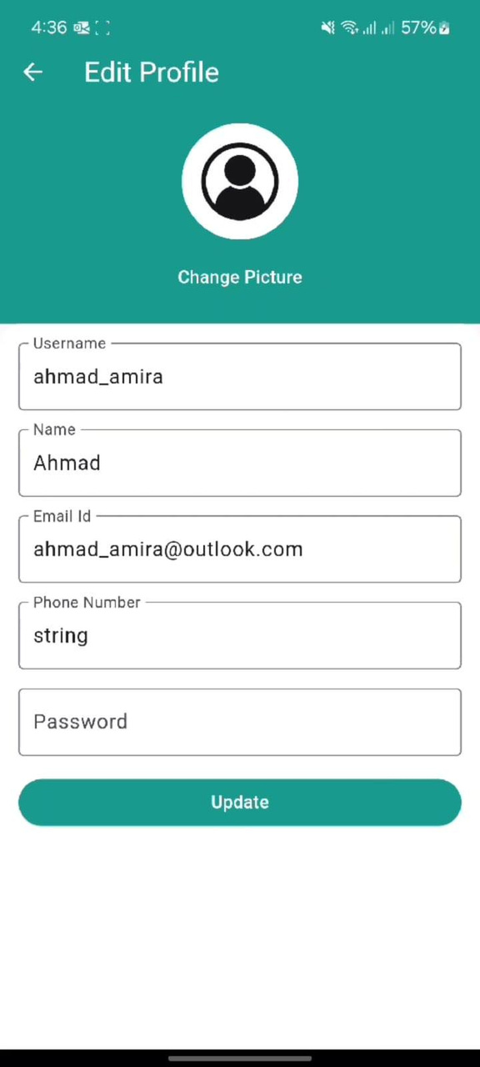
6
Najah University | 2024

Slide 10
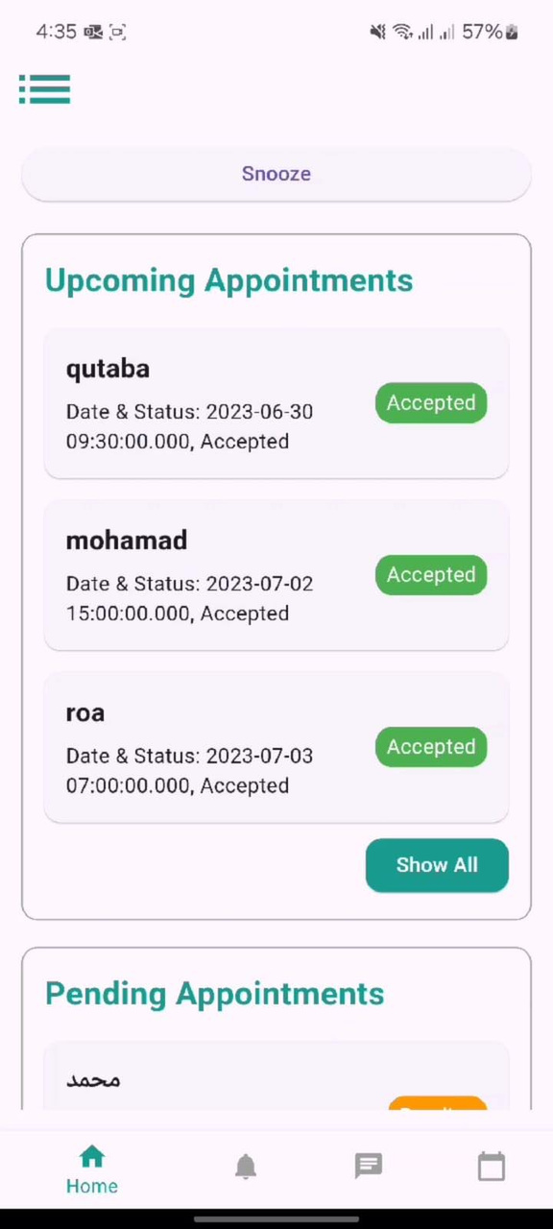
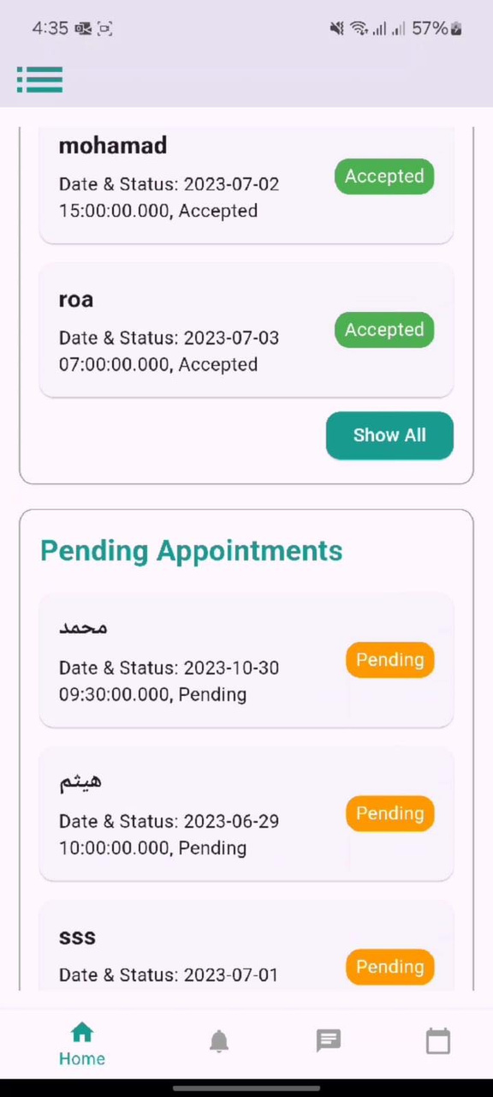
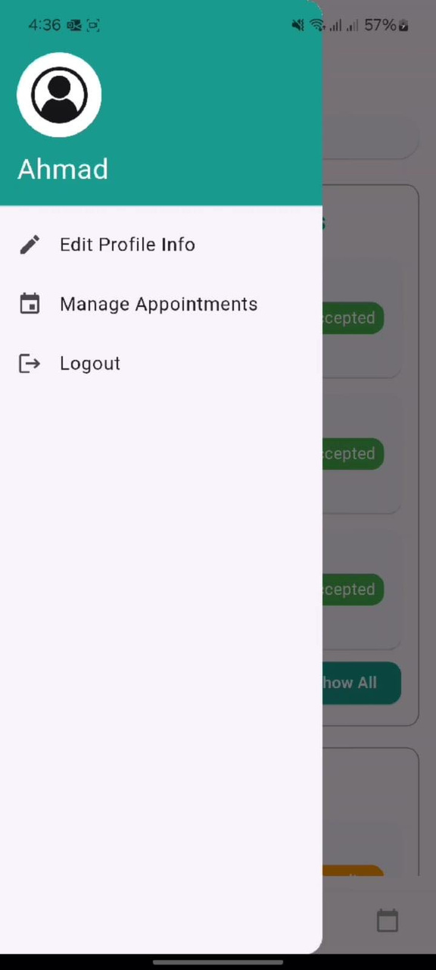
Najah University | 2024

Slide 11
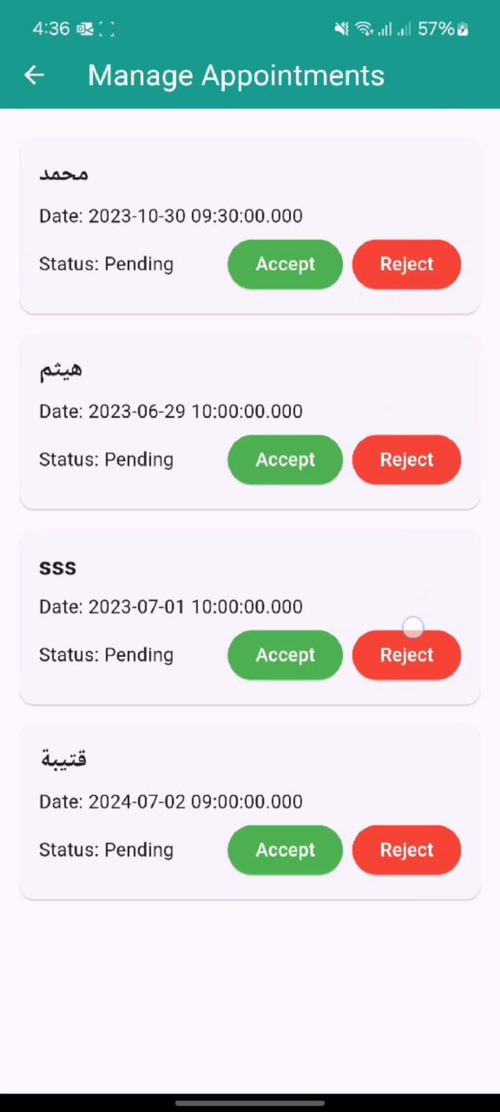
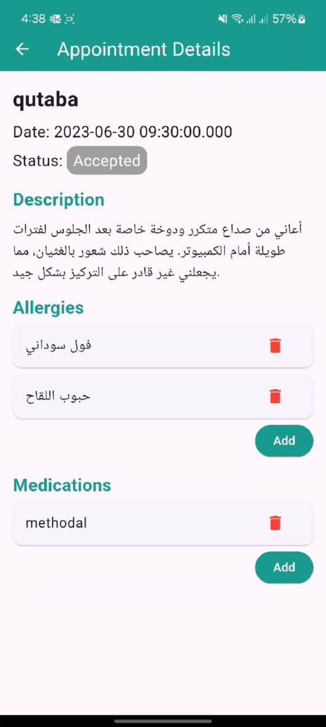
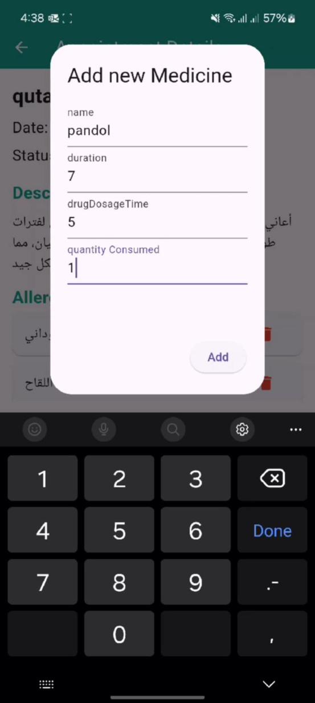
Najah University | 2024

Slide 12
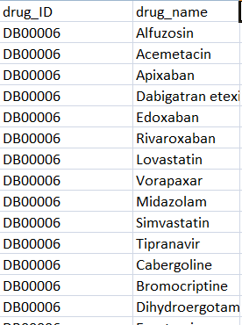
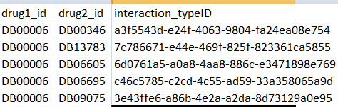
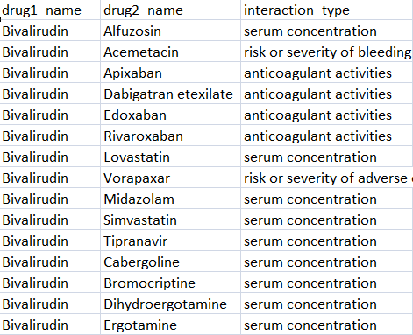
Najah University | 2024

Slide 13
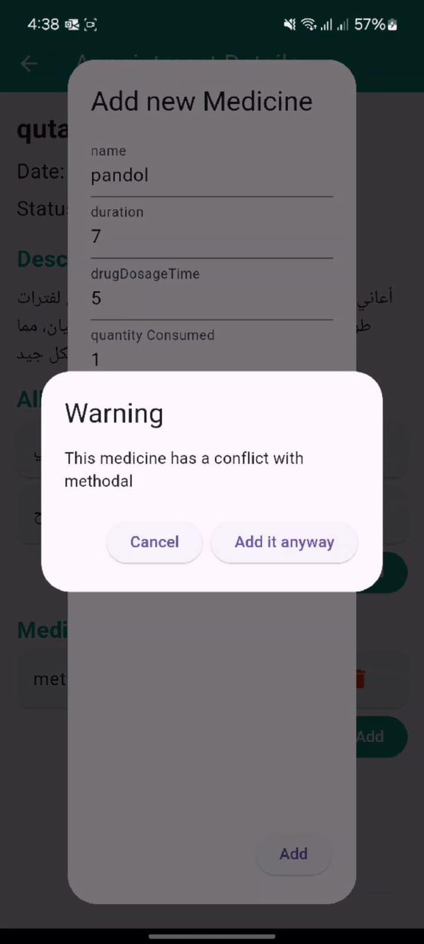
Najah University | 2024

Slide 14
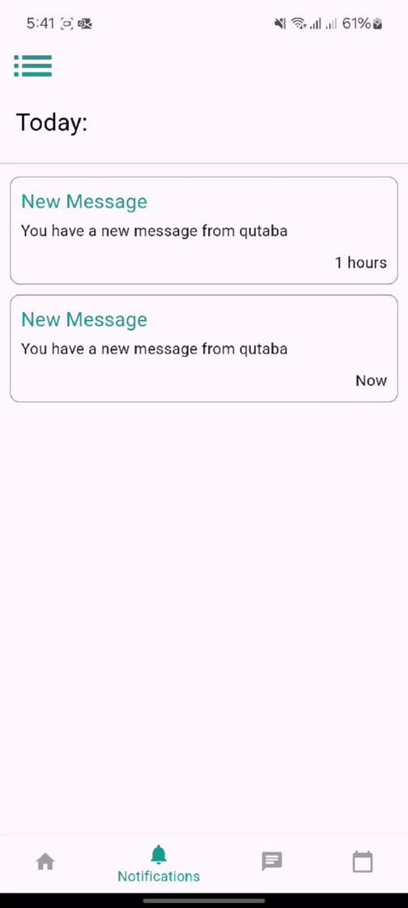
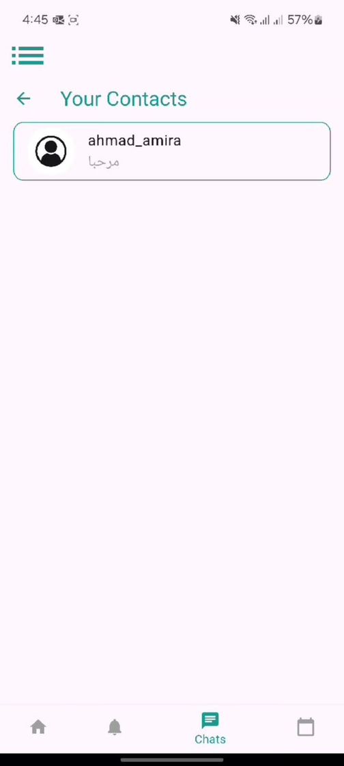
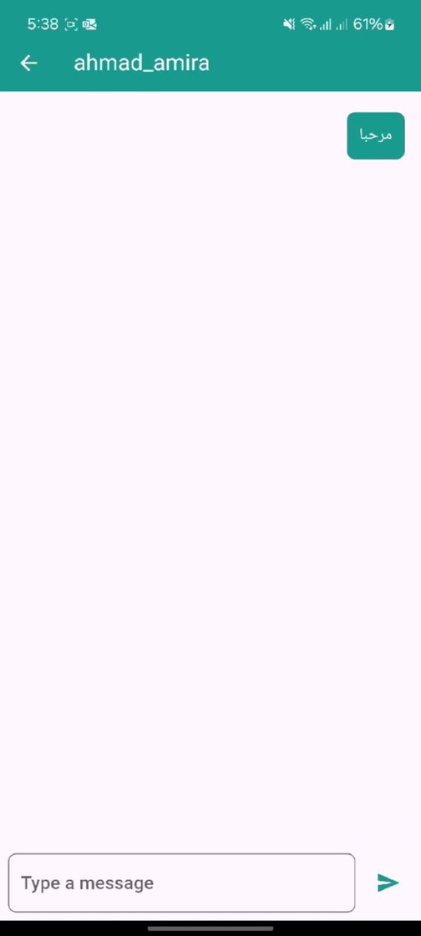
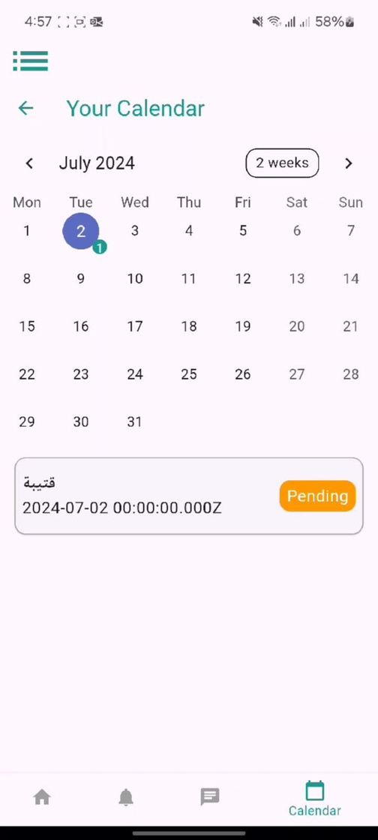
Najah University | 2024

Slide 15
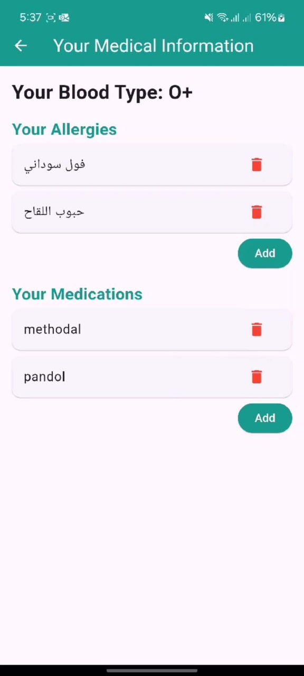
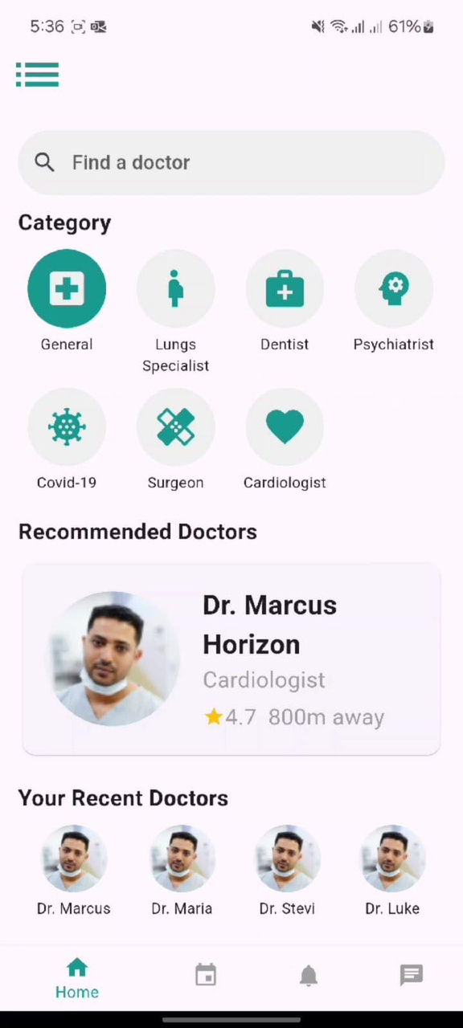
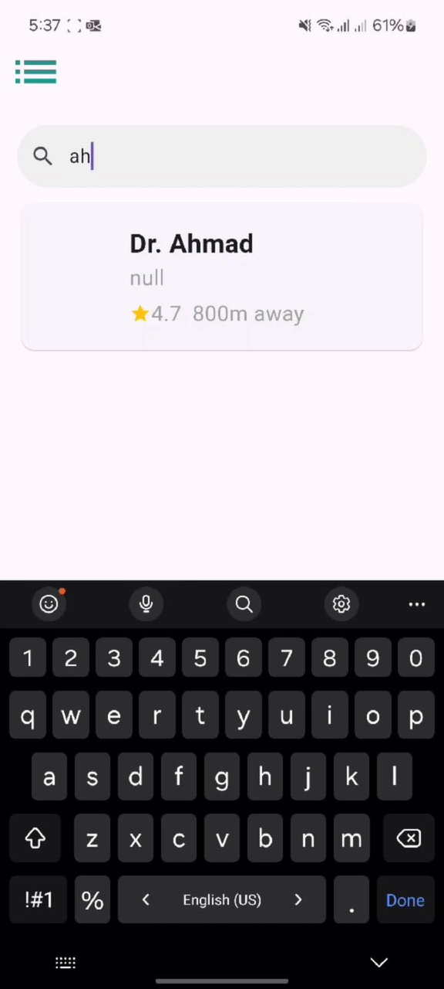

Slide 16
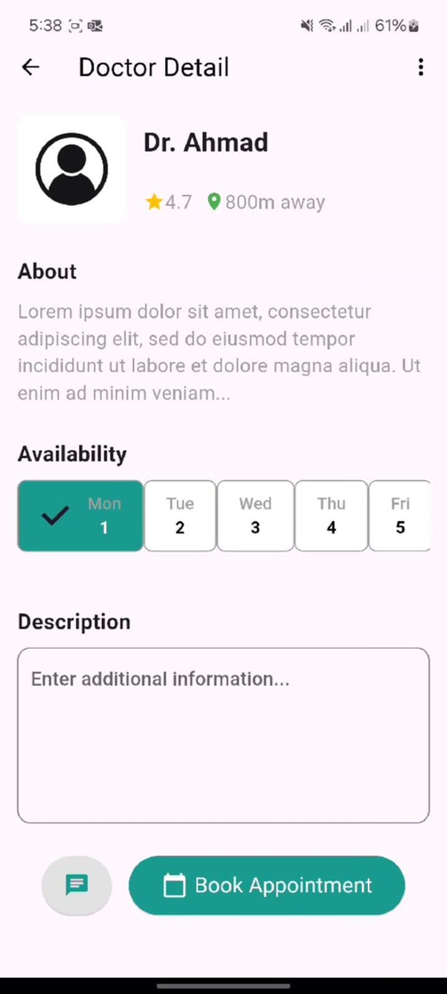
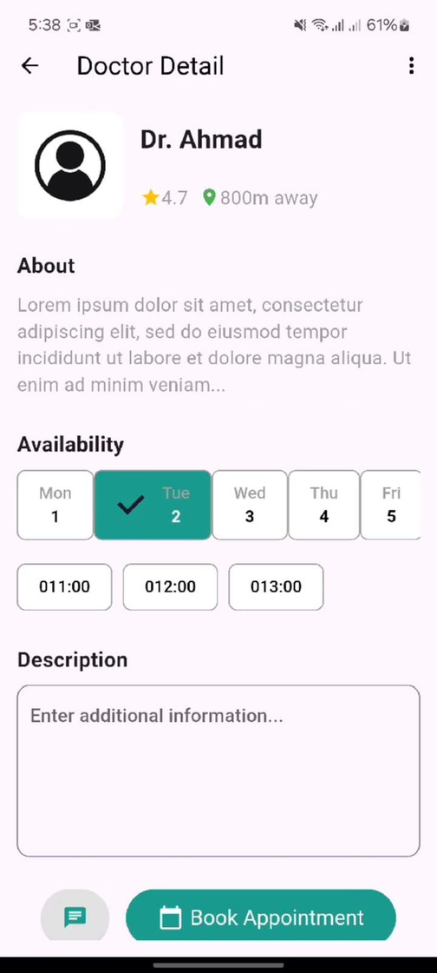
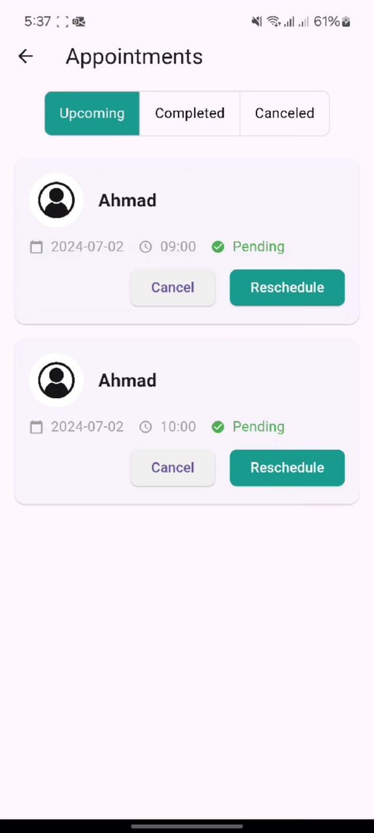

Slide 17
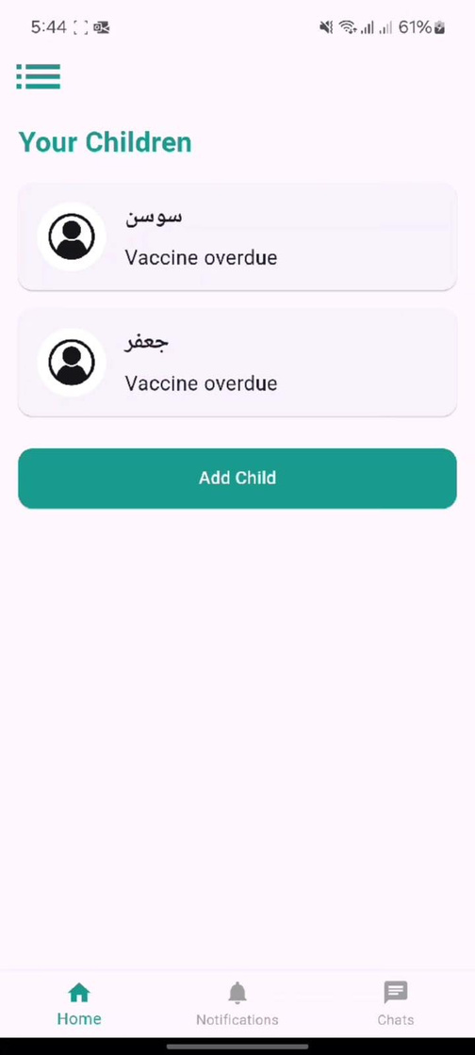
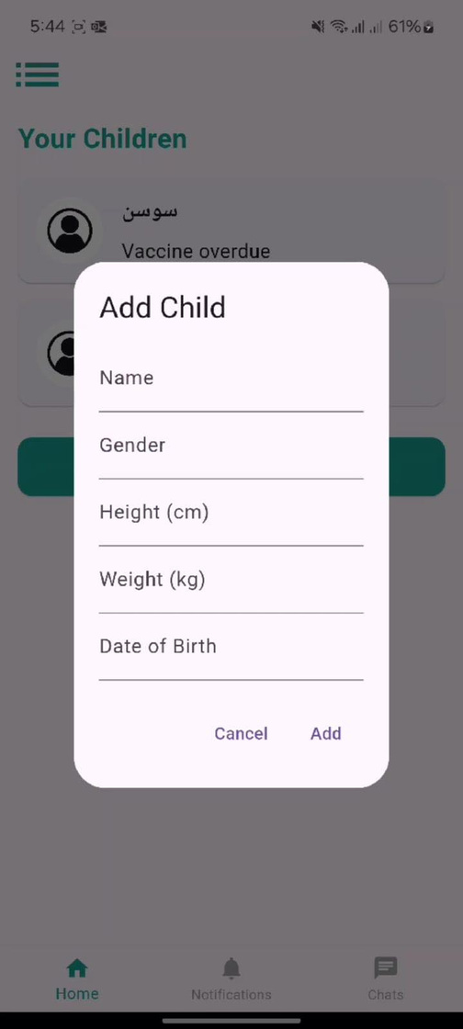
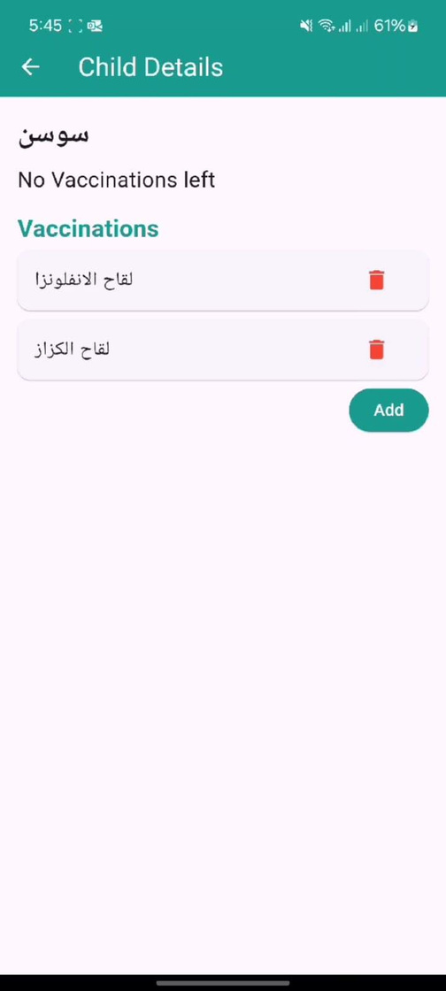
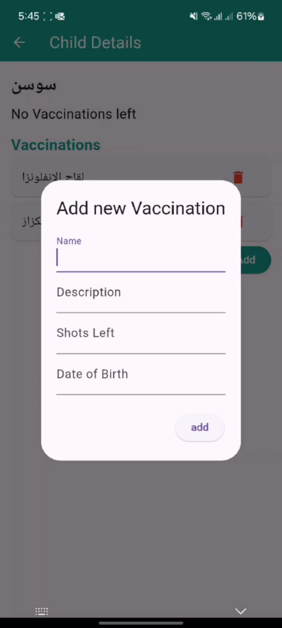

Slide 18
FUTURE WORK
1
integrating it with other systems like pos of pharmacies
Najah University | 2024
2
introducing internt of things to the system and implementing a feature like apple watches monitor system

Slide 19
najah University | 2024
THANK YOU
Presented By : mohamad jondi ,
Ahmad Amira

