Slide 1
Graduation Project
Analysis and design of water and sewer networks for the village of Saffarin
Prepared by : - Adeeb Hasan
- Mohammad Jallad
- Ahmad Ataya
Under the supervision of Dr. Anan jayyousi

Slide 2
Objectives
• Analysis the existing Water network
• Design a new Water network
• Design a Sewer network
• Cost Estimate for Sewer network

Slide 3
Site Location
Saffarin Village is located south-east of the Tulkarem Governorate on coordinates of 32°15′43″N, 35°06′39″E,and 12 km away from it.
Saffarin village is bordered by the Beit Lid village from the east, the Shufa village from the west and Kafr Al Labad village from the north
The village elevations ranges from 285m to 345m

Slide 4

Population and Growth Rate
Growth Rate = 1.7 %

Slide 5
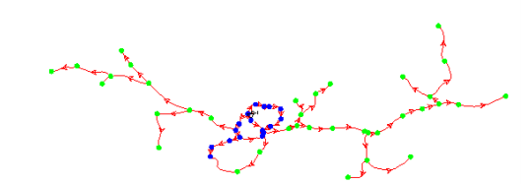
Analysis of existing water network

Slide 6
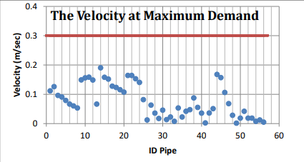
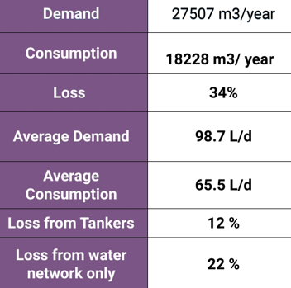
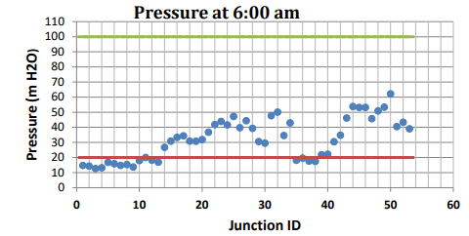
Analysis of existing water network

Slide 7
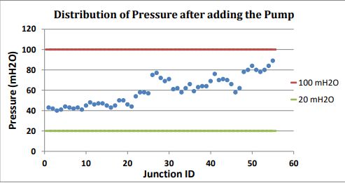
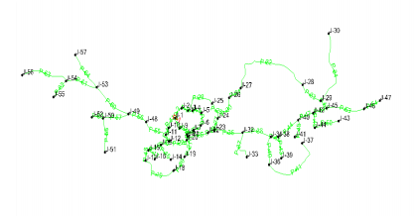
Designing of new water distribution network

Slide 8
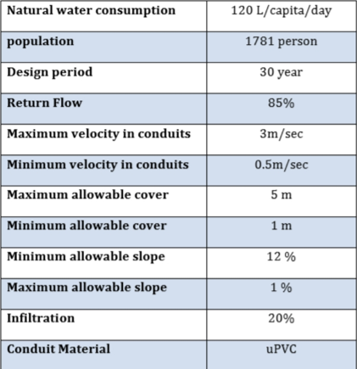
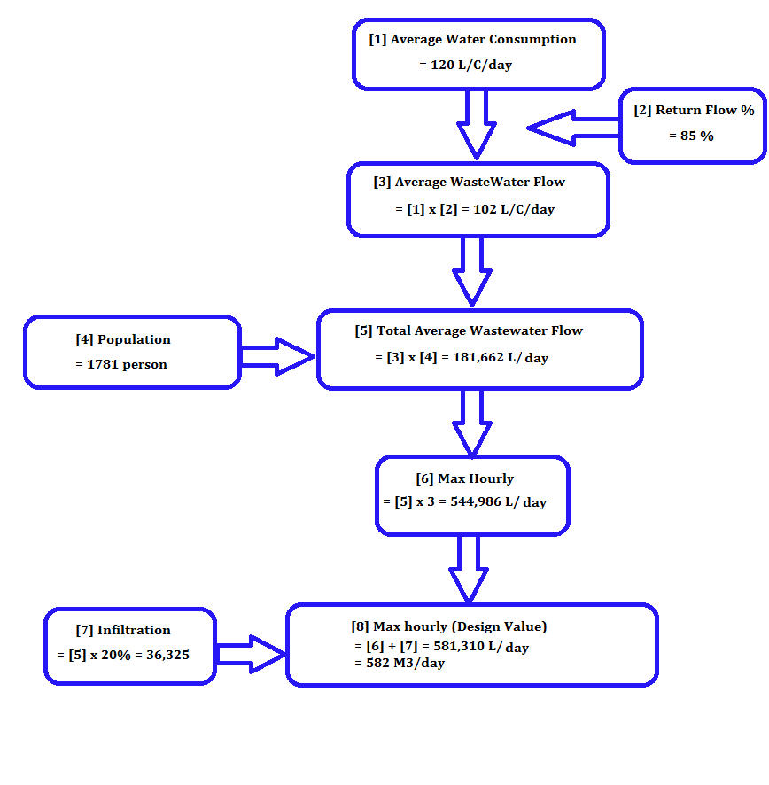
Designing of New Sewer Network

Slide 9
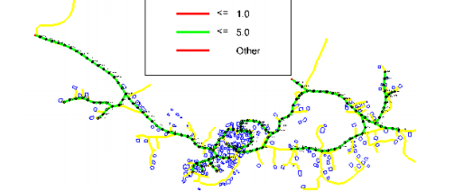
Designing of New Sewer Network
- Waste water = 582 m3/day
-Number of manholes = 157

Slide 10
Graduation Project 2
PROJECT WORK PLAN AND COST ESTIMATE FOR WASTE WATER NETWORK

Slide 11
Introduction
Project planning is one of the most important steps to be taken care of ,as a methodology that makes the work progressing well, and as a line that facilitates the achievement later, and makes the idea easy to implement, and the project plan has enough details for the tasks and work to be performed, which is useful where workers don’t get lost in the chaos of tasks and accurate details and current views.

Slide 12
Identify the main stages of the project plan
• Budget (Cost).
• Time Schedule
•completion requirements(Resources (

Slide 13
Objective
The main objectives of the project can be summarized in the following:
➢ Calculate the costs and quantities, and prepare BOQ.
➢ Prepare project schedules.
➢ Determine project duration.
➢ Identify and control all resources needed by the project

Slide 14
Steps of project implementation
The waste water network project is implemented through of the following activities in the order below:
1. Surveying works 5. Bedding, Pipe laying and embeddin
2. Demolition of asphalt pavement 6. Backfilling to bas course layer
3. Excavation 7. Basecourse layer
4. Installation of manholes 8. Asphalt works
9. Testing at completion

Slide 15
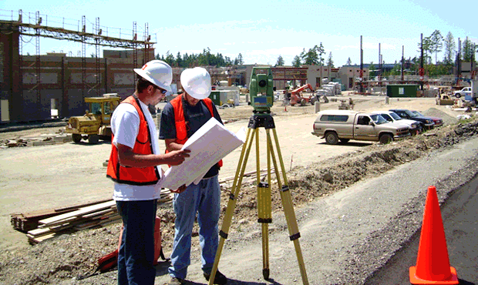
Survey works in sewage networks

Slide 16
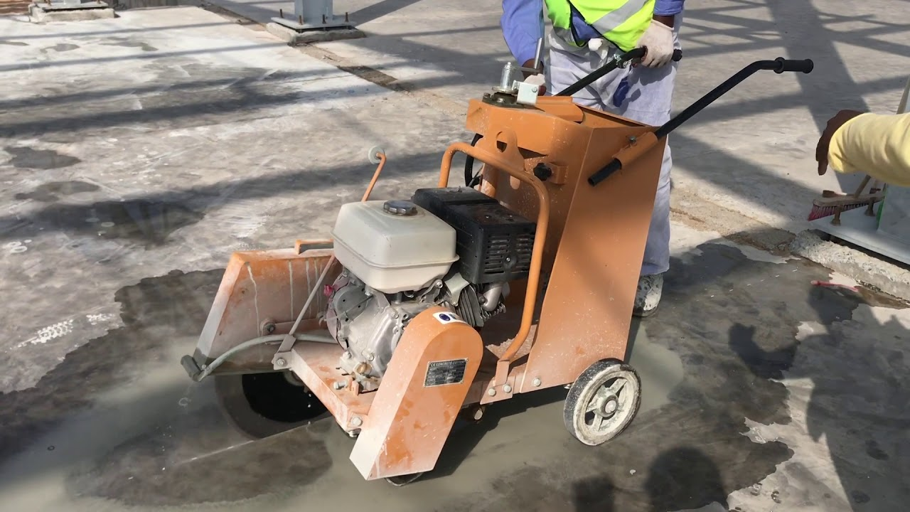
2. Demolition of asphalt pavement

Slide 17
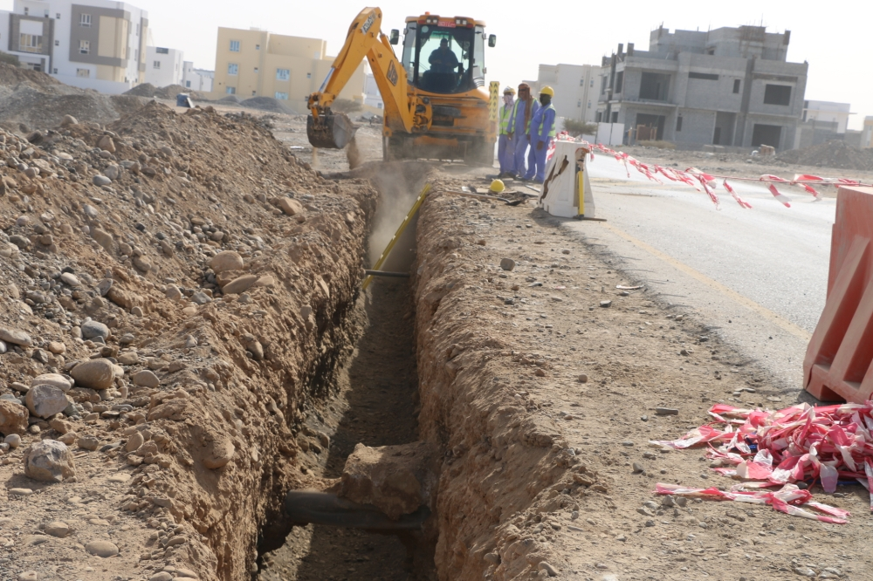
3. Excavation

Slide 18
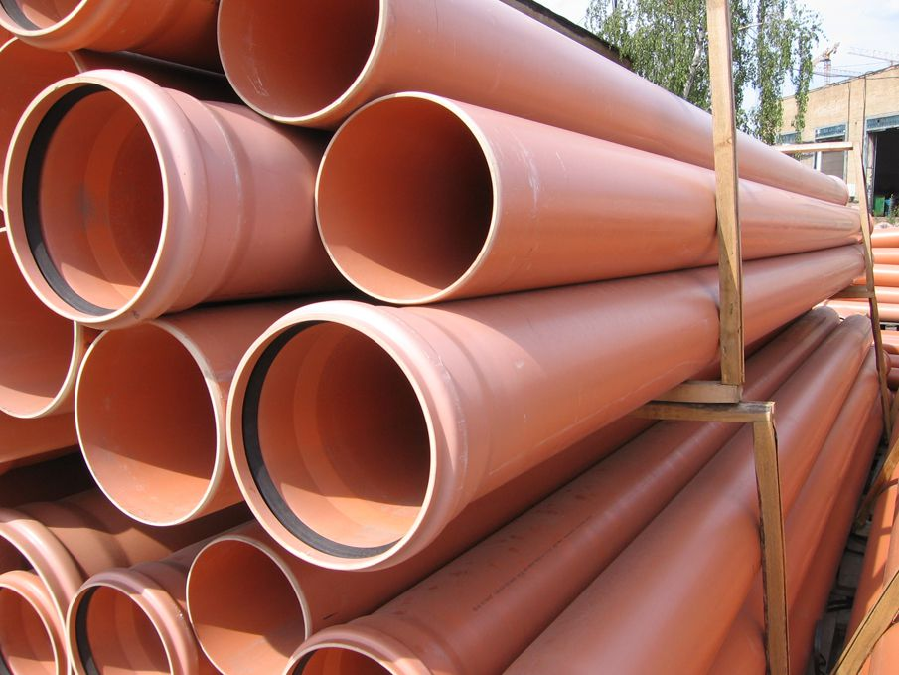
4. Transport and storage of construction materials

Slide 19
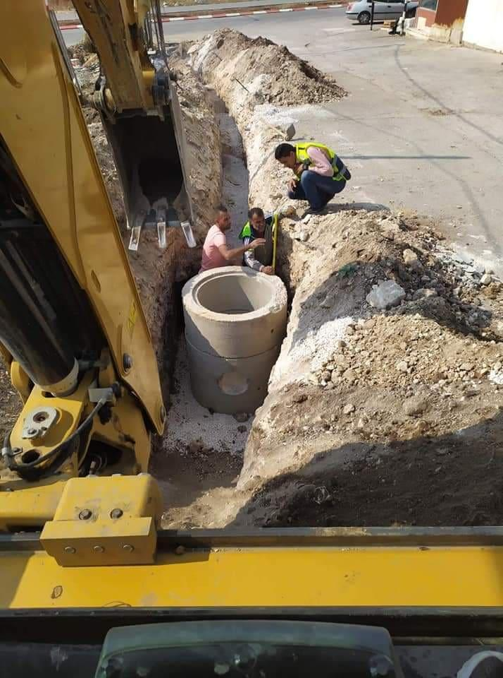
5. Installation of Manholes

Slide 20
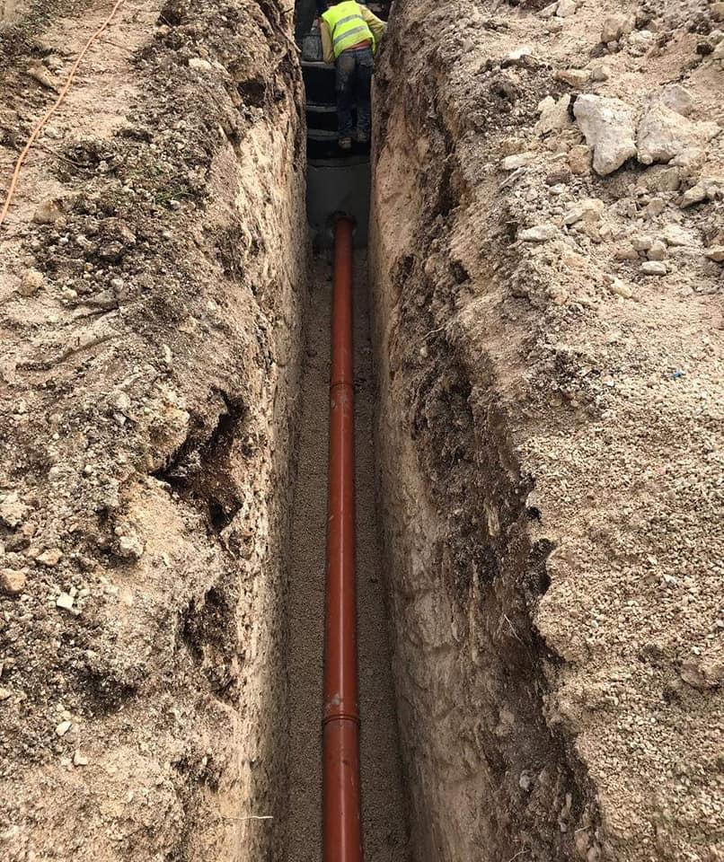
6. Pipeline installation

Slide 21
7. Testing the lines
It is necessary to try the lines before filling them and consider the following:
• Ensure the pipes are impermeable.
• Ensure the quality and impermeable of connections.
• Ensure the quality of the implementation of the network in general.

Slide 22
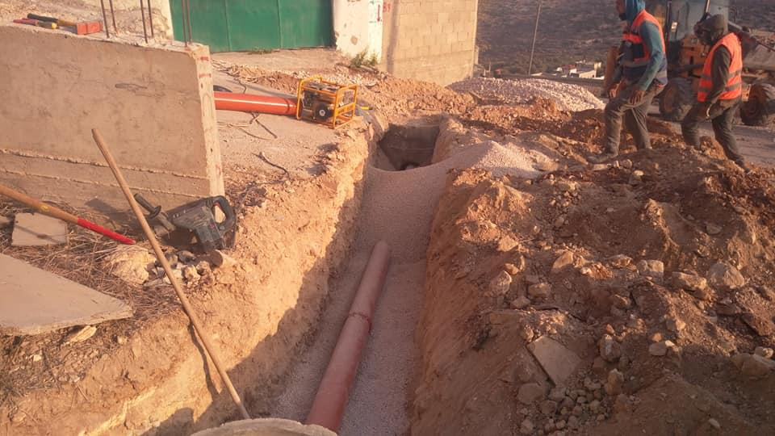
8. Backfilling

Slide 23
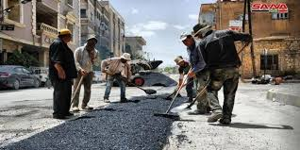
9. Paving

Slide 24
Quantity surveying
Quantity surveying is one of the most important works done by the engineer and it is considered to be the basis of the estimating of the construction cost. it is divided into two main sections:
1. Preparation of engineering drawings to make measurements and
calculations for the construction works.
2. Preparation of BOQ including the quantities and the estimated cost.

Slide 25
Data Required for the Preparation of a Quantity Survey is:
❖ Drawings
Complete and fully dimensioned drawings (i.e. plans, elevations, sections and other details) of all network element. The drawings are drawn by AutoCAD with all the details shown on page
❖ Specifications
Detailed specifications, giving the nature, quality and class of work, materials to be used, quality of the material, their properties, and method of preparation are required

Slide 26
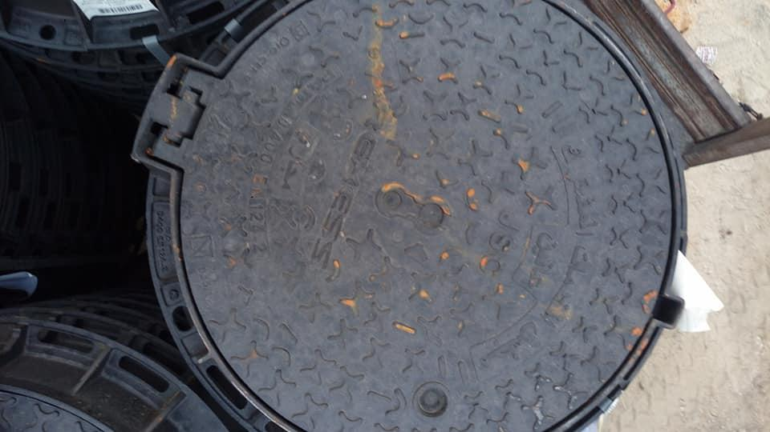
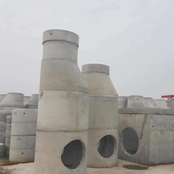
Specification and Quantities of manholes
• Number of manholes is : 157
• Number of drop manholes : 28
• Material : precast concrete sections with type B 150
• Concrete Base slab (type B300) with a thickness of 20 cm
• Blinding concrete with thickness of 10 cm
• Material of Manhole cover : iron steel
• Shape of manhole : Circular

Slide 27
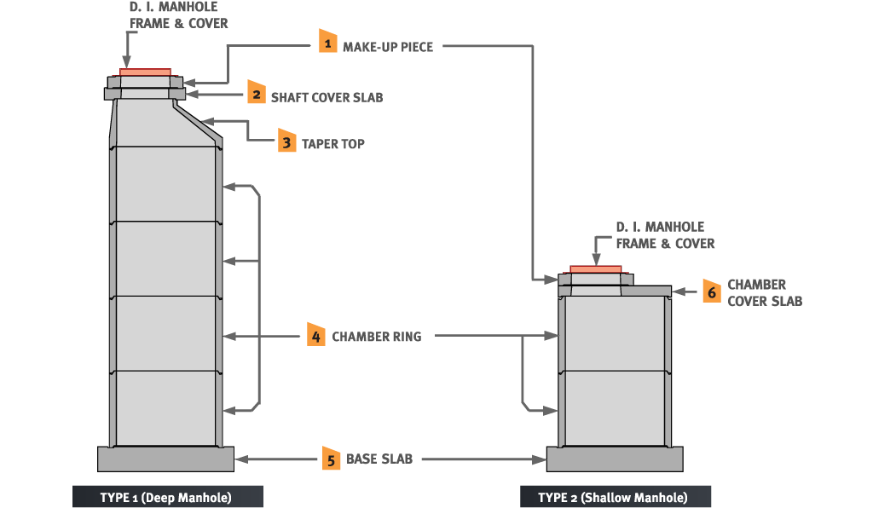
Specification and Quantities of manholes
Parts of manhole

Slide 28
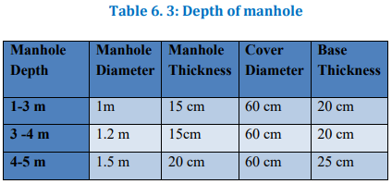
Specification and Quantities of manholes
• The details of the manhole depend on its depth as shown in the table 6.3

Slide 29
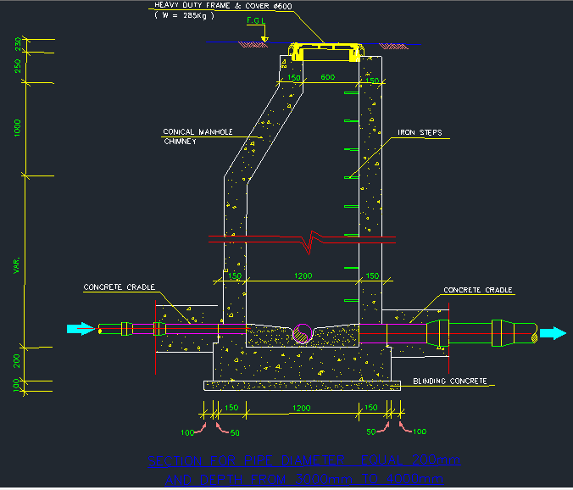
• All manhole details are drawn by AutoCAD

Slide 30
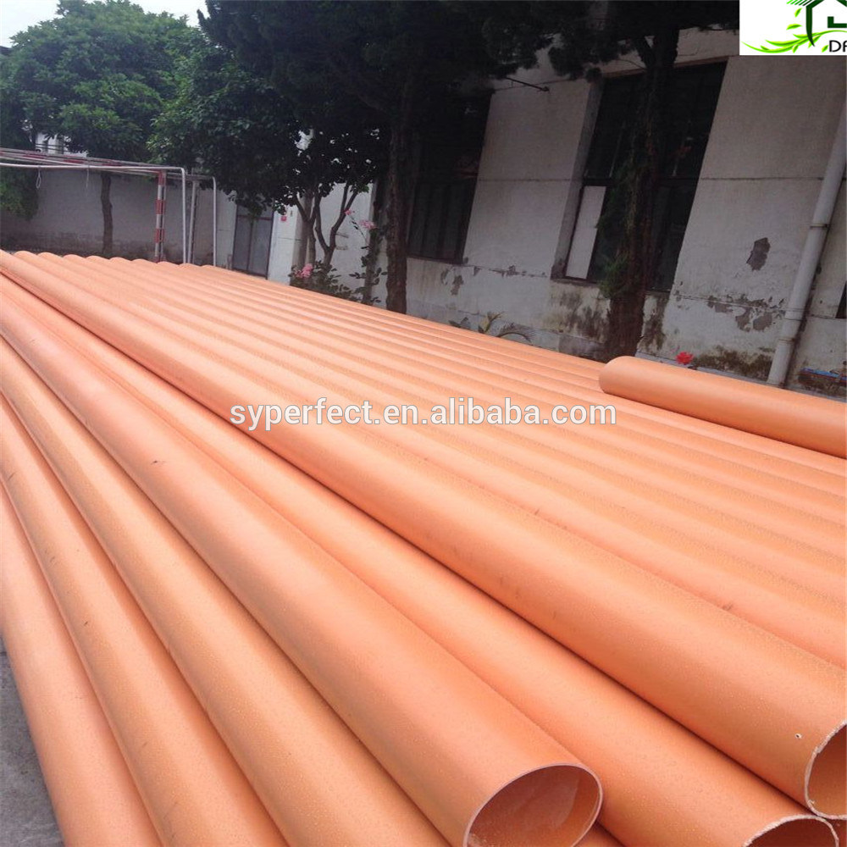
Specification of pipes
• Material : UPVC
• Diameter : 8 Inches
• Length : 3m

Slide 31
Quantities and Prices
1- Excavation
- Total Excavation volume = 7000𝒎𝟑
- Unit price =15$ /𝒎𝟑
- Total Price = 7000 x 15 = 105000 $

Slide 32
Quantities and Prices
2- Demolition of asphalt pavement
-Total length of sewerage network= 3980 m
- Unit Price = 3 $/ m
- Total Price = 3980 x 3 = 11940$

Slide 33
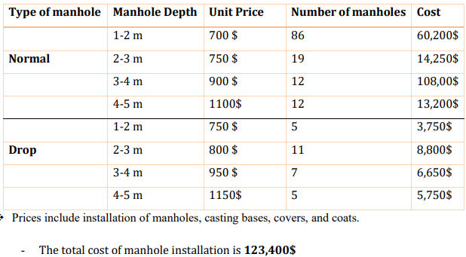
Quantities and Prices
3- Installation of manhole

Slide 34
Quantities and Prices
4- Pipeline Installation
-Total length of sewerage network= 3,980 m
- Unit Price =50 $/m
- Total Price = 3,980 x 50 = 199,000$

Slide 35
Quantities and Prices
5- Backfilling
Backfilling volume = excavation volume = 7,000 𝒎𝟑
- Unit Price = 15 $/𝒎𝟑
- Total Price =7000 x 15= 105,000 $

Slide 36
Quantities and Prices
6- Base Course layer
- Base Course quantity = length of trench x width of trench
- Quantity ( 𝑚2 )=3,980 x 0.80
- Total quantity of Base Course = 3,184 𝒎𝟐
- Unit Price = 9 $/𝒎𝟐
- Total Price =3,184 x 9 = 28,656 $

Slide 37
Quantities and Prices
7- Asphalt Pavement layer
- Asphalt layer quantity = length of trench x width of trench
- Quantity ( 𝑚2 )=3,980 x 0.80
- Total quantity of asphalt = 3,184 𝒎𝟐
- Unit Price =20 $/𝒎𝟐
- Total Price =3,184 x 20=63,680$

Slide 38
Quantities and Prices
8- Testing at completion of Network
- Total length of line =3,980 m
- Unit Price =7 $/ m
- Total Price =3980 x 7 =27,860$

Slide 39
Quantities and Prices
- Total price = 664,536$

Slide 40
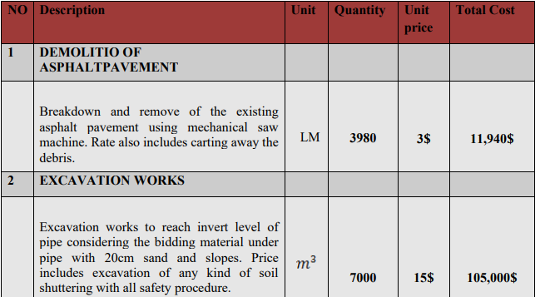
Bill of Quantities (BOQ)
After calculating the quantities and prices for all activities, the bill of quantities shown in the table 6.5 was prepared.

Slide 41
Resources
Resources are required to carry out the project tasks. They can be people, equipment, facilities, funding, or anything else capable required for the completion of a project activities.
The lack of a resource will therefore be a constraint on the completion of the project activity.

Slide 42
Resources Estimating
The goal of activity resources estimating is to assign resources to each activity in the activity list. There are many of techniques for estimating activity resources. The technique that use in project is expert judgment.
Expert judgment means bringing in experts who have done this sort of work before and getting their opinions on what resources are needed.

Slide 43
Resources are required to carry out the project.
Labor
Material
Equipment

Slide 44
Labor Resources includes:
project manager
Quality control engineer
Site engineer
Safety officer
Forman
Surveyor
Skilled Labor
Semi-skilled labor
Un-skilled labor
Operator

Slide 45
Labor Resources
The number of skilled labors is used in project two-person, number of semi-skilled labor is 3 person and number of un-skilled labor is 5 persons.

Slide 46
material Resources includes:
Manholes
Pipe line
Bedding and Embedding material
Back Filling Material
Base Course Material
Asphalt Material

Slide 47
Equipment Resources includes:
Saw machine to cut asphalt layer.
JCB excavator to digging the trench.
BOBCAT for cleaning and backfilling purposes.
Dump Truck
Level device
Plate compacter

Slide 48
Primavera Program
Primavera P6 One of the most useful and effective project Management software available on the market. it was launched in 1983 by Primavera Systems Inc.
Primavera Systems Inc. provides project and program management software for the Architecture, Engineering and Construction industry. Focused on project portfolio management, or PPM, Primavera's solutions let users measure progress, assure governance, improve team collaboration and prioritize project investments and resources.

Slide 49
The main advantages of using Primavera P6 software program include:
Preparing time schedule for project.
calculate and control costs as well as monitoring the growth of the project, either progress or delay, it also calculates the duration of the project and the resources to be used and determine the optimal use of these resources.
Diminished risk along with cost connected with schedule overrun.
It optimizes management of resources.
It offers clear field of vision of what’s taking in the project.

Slide 50
Calculate Duration of activity
From expert judgment the productivity rate of team we will get productivity rate
Duration for activity = Total Quantity / Productivity rate.
Total Quantity (UNITS)
Productivity rate (UNITS/DAY)
Duration result in (DAY)

Slide 51
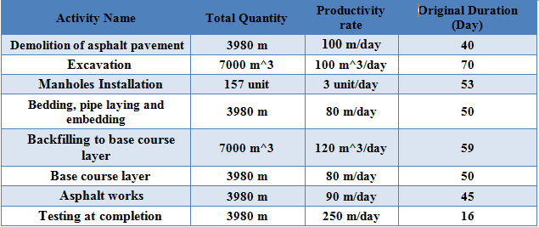
Duration of activities

Slide 52
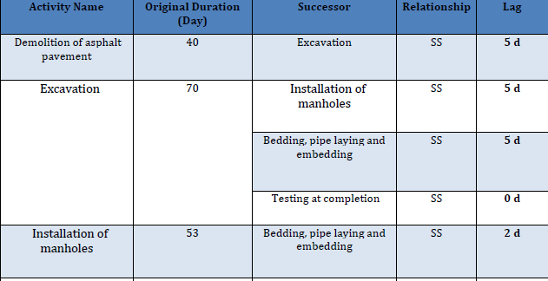
Relationship between activity:

Slide 53
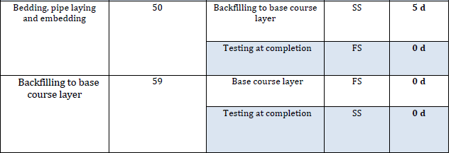
Relationship between activity:

Slide 54
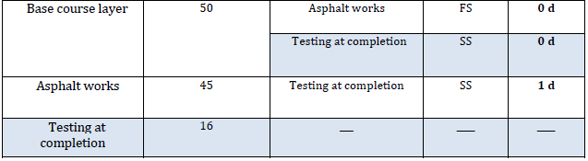
Relationship between activity:

Slide 55
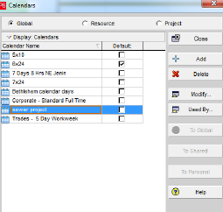
Steps used in the Primavera program includes:
Creating Calendar is called sewer project

Slide 56
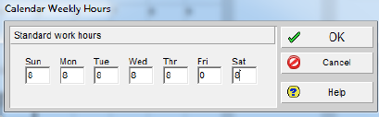
Steps used in the Primavera program includes:
Modify Calendar weekly hourly

Slide 57
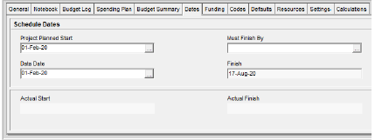
Steps used in the Primavera program includes:
Add project is called Saffarin Sewer Network
Select the Calendar for project
Select the start date of project

Slide 58
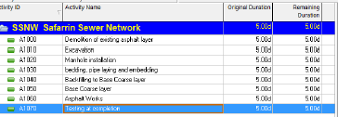
Steps used in the Primavera program includes:
Add activity to the project

Slide 59
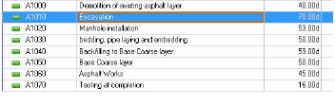
Steps used in the Primavera program includes:
Define duration for all activity

Slide 60
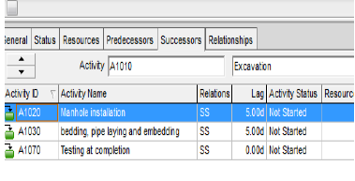
Steps used in the Primavera program includes:
Assign a successor to all activity

Slide 61
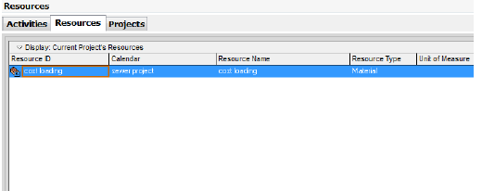
Steps used in the Primavera program includes:
Define Resources
Assign the calendar to resource
Define resources as cost loading and type of resource is material as shown in Figure

Slide 62
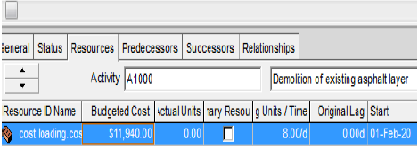
Steps used in the Primavera program includes:
Assign Budget Cost to all activity

Slide 63
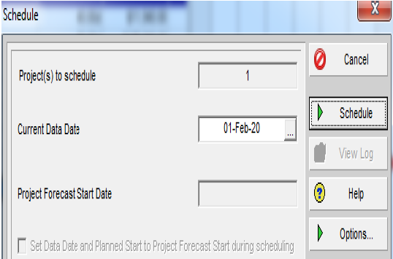
Steps used in the Primavera program includes:
Schedule
Schedule form start date of project

Slide 64
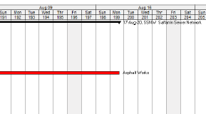
Steps used in the Primavera program includes:
Results
Calendar Day

Slide 65
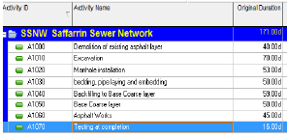
Steps used in the Primavera program includes:
Results
Working Day

Slide 66
Steps used in the Primavera program includes:
Results:-
Working Days = 171 Days
Calendar day for activity =199 Days, add 20 Days for mobilization that includes installation offices, sign board and Prepare & Submit Shop Drawings Submittals.
The Total calendar day = 219 Days.
Total Bid Price = 664,536$. This price includes all expenses and profit.

Slide 67
THANK YOU

