Slide 1
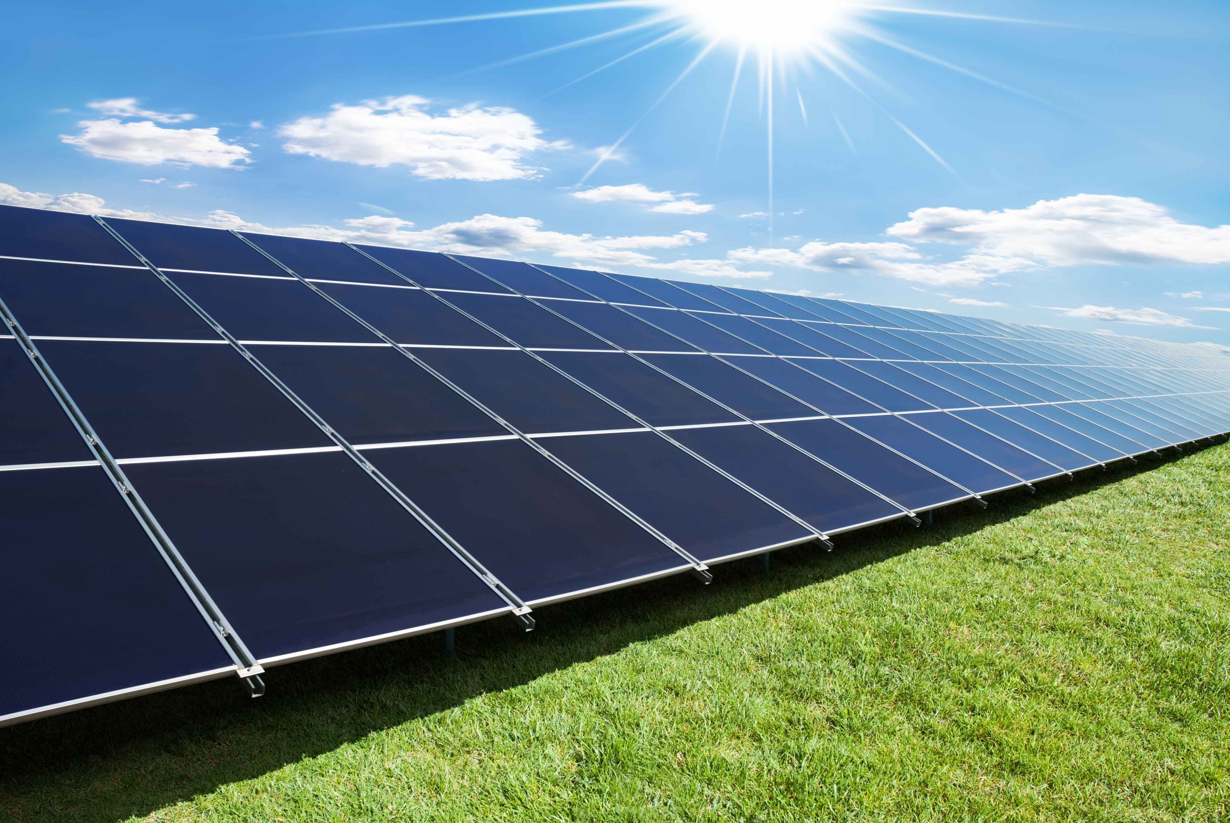
PV solar street light for Nablus city
Prepared by : Nasouh Abdul Majid

Slide 2
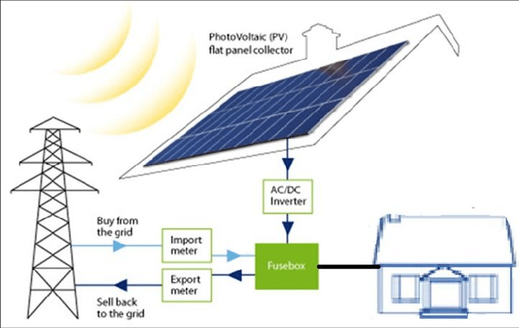
PV System
What is PV system?
A photovoltaic system, also PV system or solar power system, is a power system designed to supply usable solar power by means of photovoltaics. It consists of an arrangement of several components, including solar panels to absorb and convert sunlight into electricity, a solar inverter to convert the output from direct to alternating current.

Slide 3
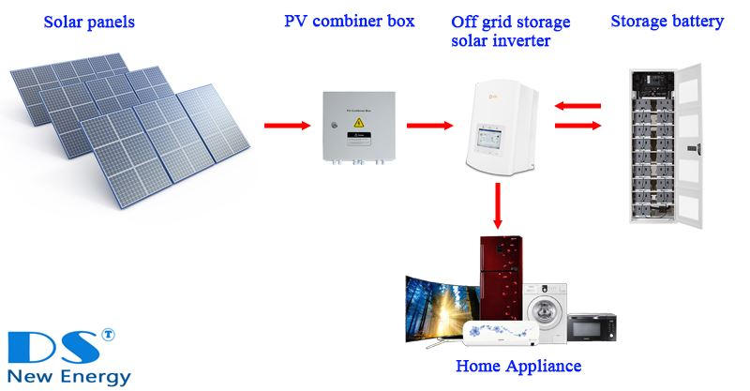
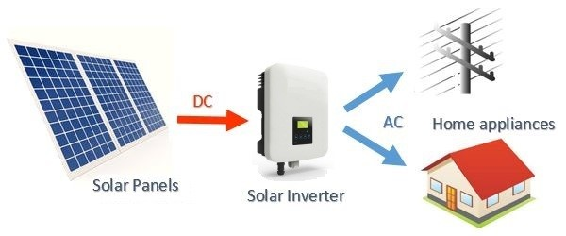
PV System Types
ON-Grid
OFF –Grid

Slide 4
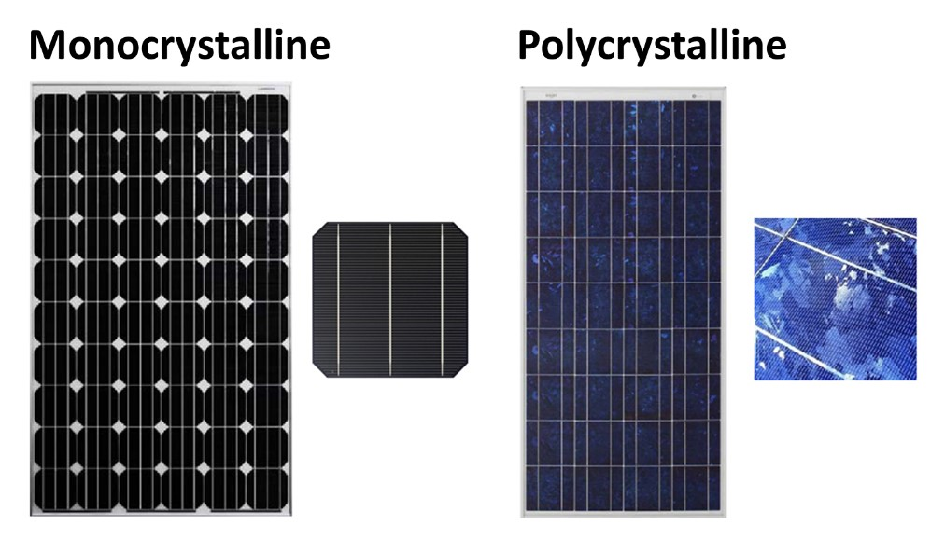
PV Panel Types
1- Monocrystalline
2- Polycrystalline

Slide 5
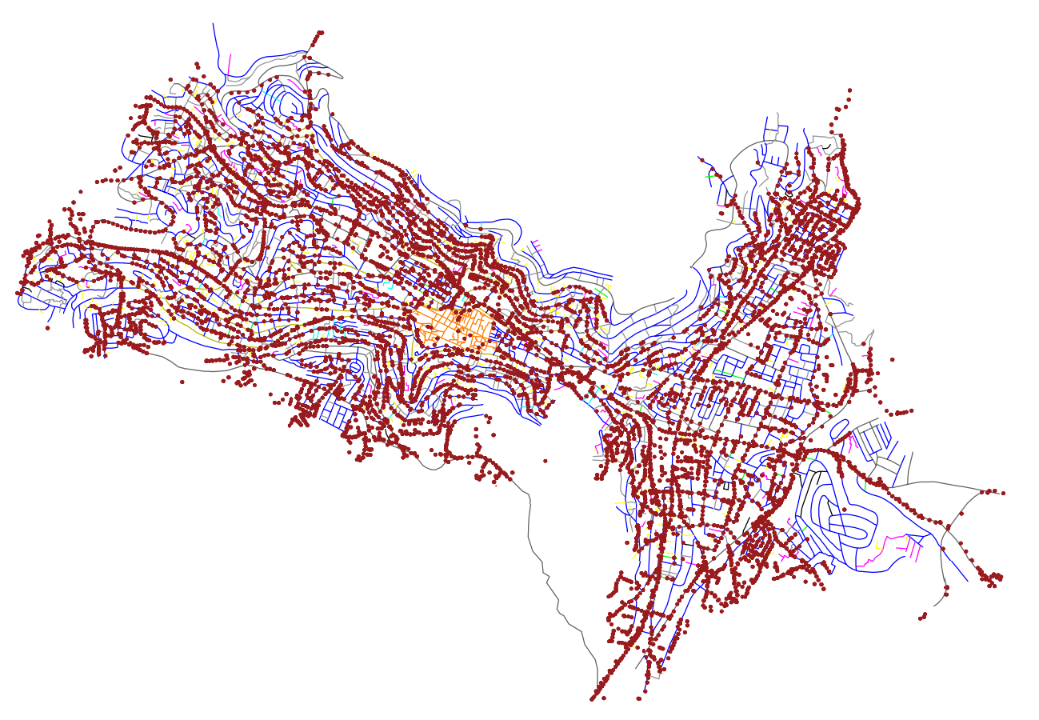
Nablus City Lighting
According to Nablus Municipality and Northern Electricity distribution company (NEDECO) , Nablus city contains approximately 6800 lighting poles.
The photo is for AutoCAD plan for Nablus street light poles distribution from the municipality where the location of every pole.

Slide 6
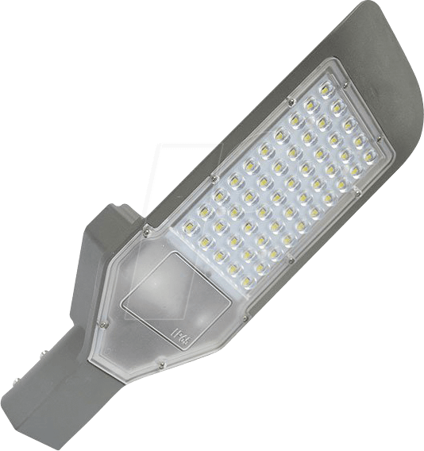
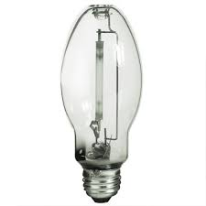
Street Lamps
They use two types of lamps for lighting :
1- HPS lamps which is the mostly used in Nablus poles, where they use different types (250W,70W,50W) of it according to the area.
2- LED lamps they started to use it recently in the main streets and they use different types (120W,90W,50W) .
LED Lamp
HPS Lamp

Slide 7
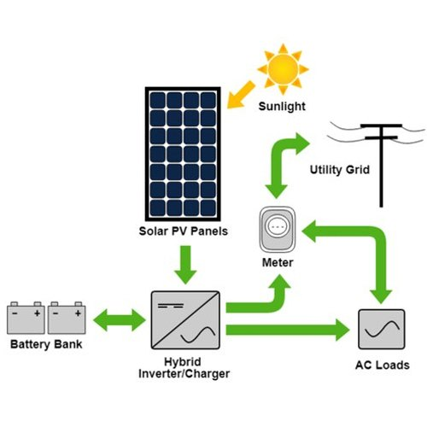
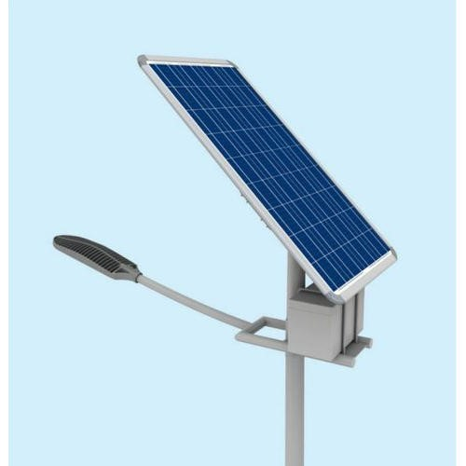
PV Street Light Components
1- PV Panel
2- Rechargeable Battery
3- Controllers
4- Motion and light sensors
5- 100 W LED Lamp
and pole
6- Inverter
7- ATS

Slide 8
System Calculations
Since the LED consume 100w the Lamp will work for 100% at least 7 hours daily from the sunset because of the city movement so the needed power at least 700W.
As well the motion sensor and the controller will limit the light consumption 30% where the light will work as average for 5 hours so the power needed (30w*5) 150W daily
The total power required = 700+150= 850w daily at least
I choose the panel type By considering any Circumstances and a 0.24-0.26 safety factor to be in the safe side , the needed PV panel should produce 230-250w and I will use 24v 100 amp battery with 500w inverter .

Slide 9
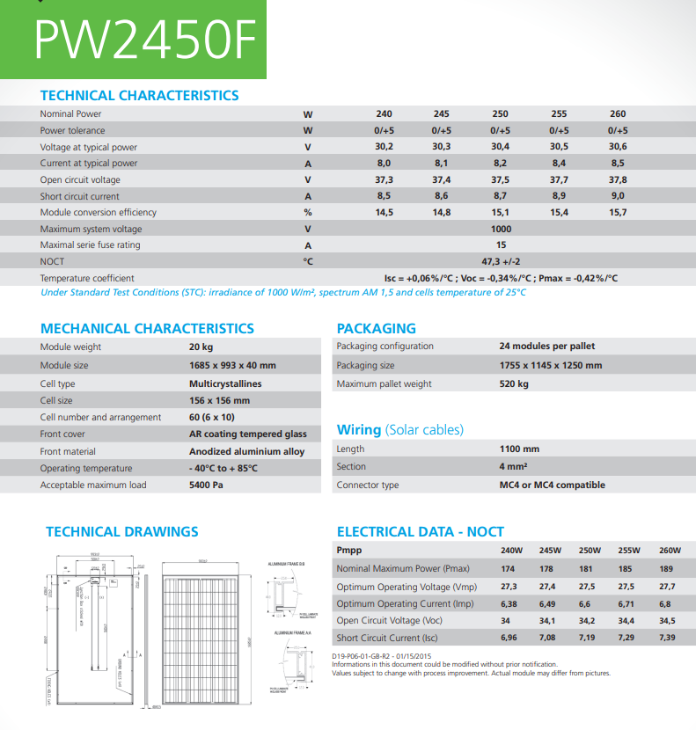

Slide 10
Conclusion
The aim of this project is to save consumed power on the system since we had a growth of population in Nablus and that causes pressure on electrical network , and also will save the taxes we pay for lighting .
The feasibility study of the project and the simulation will be at graduation project 2 in the next semester

