Slide 1

An-Najah National University Faculty of Engineering.
Industrial Engineering Department.
Graduation Project (2)
Matching Job Market Qualifications Demand with Educational Market Qualifications Supply in the West Bank.

Slide 2
Prepared by:
Esra’ Sawalha
Rania Jawabreh
Maram Hussein
Mays Jaber
Supervised by:
Dr. Ahmad Al-Ramahi.

Slide 3
OUTLINE:
Introduction
Problem statement
Objective
Literature review
Methodology
Survey analysis and result
Conclusion an Recommendations

Slide 4
INTRODUCTION
Education in Palestine is an important aspect of Palestinian life .
Palestinian higher education has been able to play an important and effective role in providing the Palestinian people with opportunities and incentives to pursue scientific and technical study .
To some extent Palestinian university education suffers from unemployed university graduates .

Slide 5
PROBLEM STATMENT
Palestine suffers from high unemployment rates; especially among university graduates.
The absence of real planning by higher education for the needs and guidance of the local and regional market, has resulted in the emergence of unprecedented levels of unemployment for its graduates .
Matching job market qualifications demand and educational market qualifications remains the biggest concern that worries countries and peoples .

Slide 6
OBJECTIVES
The project aims to develop a tool/model to align the outputs of higher education with the needs of local market for engineers in West Bank .
So we expect in this approach to reduce the problem of high unemployment for engineers in Palestine , harmonize higher education outputs and labor market requirements by curriculum development and providing training courses for graduates , and finally provide recommendations to universities employers .

Slide 7
Literature review
A Dynamic Model for Matching Job Market Qualifications Demand and Educational Market Qualifications Supply.
In this paper a semantic web framework was proposed, that can be used to improve the effectiveness and efficiency of the information flow between student, educational institution and employer.

Slide 8
Shaping the Engineering Qualifications for Improving Living Standards and Resources Efficiency.
This paper aims to determine the qualifications need of local industry in Palestine.
It comes as an output of the first work package named “Identify stakeholders, their needs and education and training contents in Palestine” of the Tempus project .

Slide 9
METHODOLGY
We adopted in this study an analytical and descriptive approach, where you do a questionnaire that includes a set of educational qualifications for each discipline that we targeted in our study, where we collected these qualifications from job postings on the Jobs site and other sites.

Slide 10
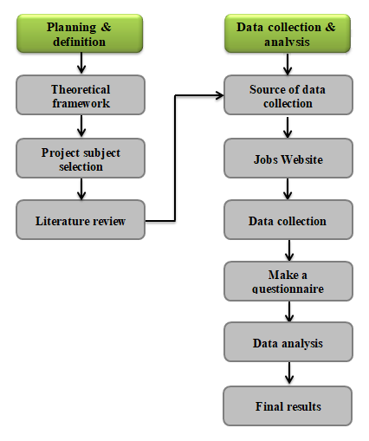
Frame Work
The graph below shows the framework of the project methodology
.

Slide 11
Steps to prepare the study tool:
Initially, we made a preliminary draft of the questionnaire in order to evaluate it by presenting it to a number of experienced arbitrators, including doctors and specialists.
Then it was distributed to employers in companies and factories and their mobilization.

Slide 12
Data and information sources:_
We collected a large amount of job advertisements on the sites, especially (Jobs website), in addition to reviewing books and special or related publications

Slide 13
Mechanism for filling out the questionnaire:
In the questionnaire, we used a five-point scale to correct the questionnaire (Strongly agree =1 , agree=2 , Neutral=3, Disagree=4, Strongly Disagree=5 ).

Slide 14
Survey analysis and result:-
In this section, we will present the questionnaire data analysis and results of the data that have been collected .
We had 45 Responses , Divided into six sections :-
First part : Basic Data for each company
Company / Institution Name
Nature of work (production sector)
The nature of work (service sector)
Type of Organization
Governorate
Number of workers / employees
Number of engineers
The age of the company / organization
Job title of the respondent to the questionnaire
Years of Experience
Company / Institution website

Slide 15
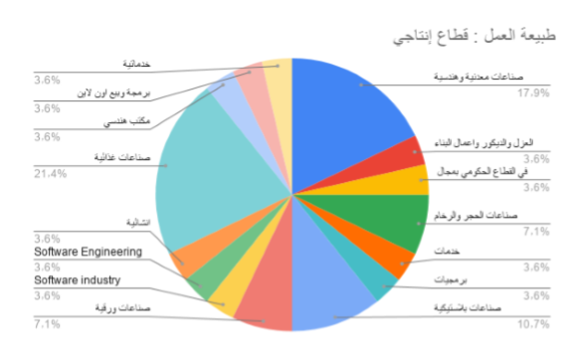
Nature of work (production sector):

Slide 16
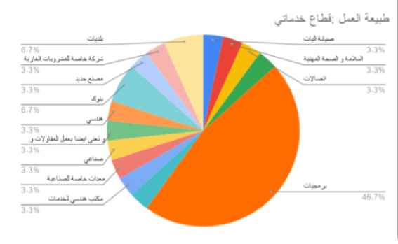
The nature of work (service sector):-

Slide 17
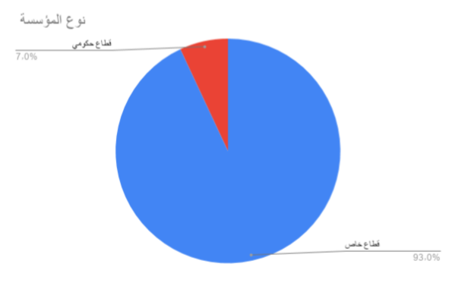
Type of Organization:-

Slide 18
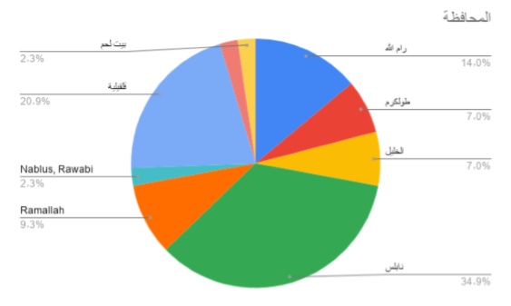
Governorate: -

Slide 19
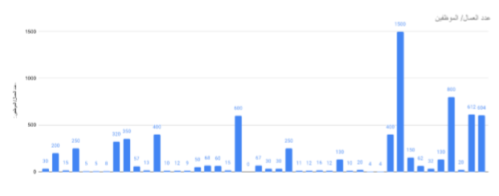
Number of workers / employees:-

Slide 20
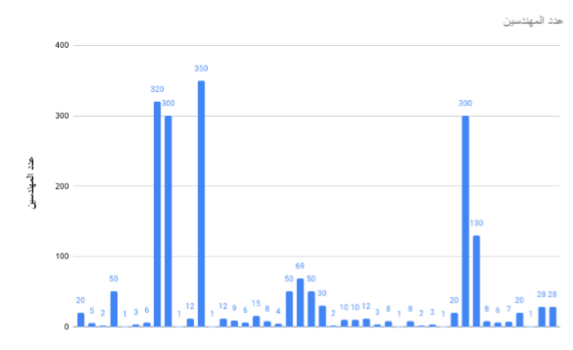
Number of engineers:-

Slide 21
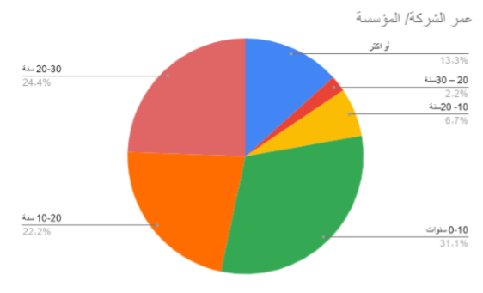
The age of the company / organization:-

Slide 22
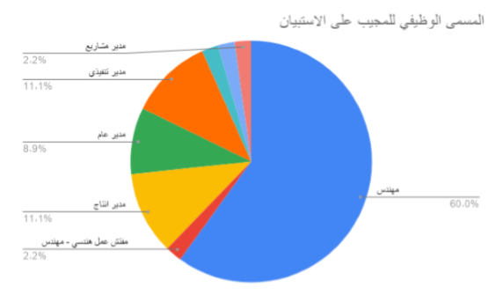
Job title of the respondent to the questionnaire

Slide 23
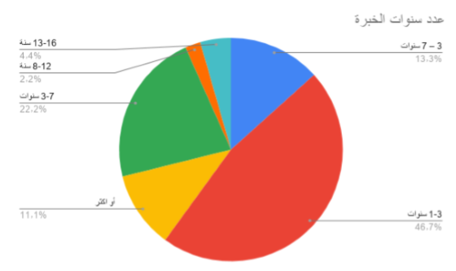
Years of Experience

Slide 24
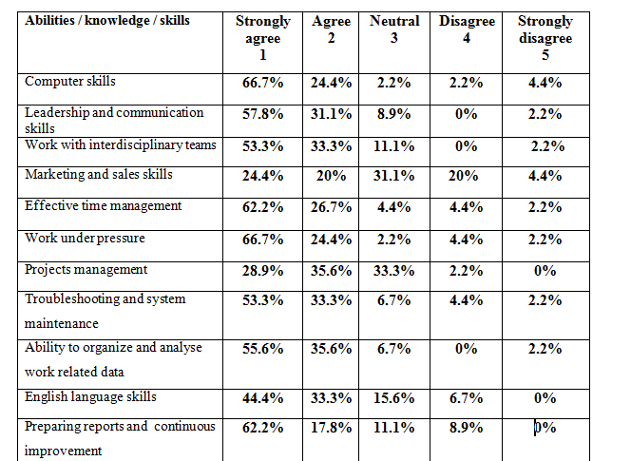
Second Part :- Analysis of the questionnaire on the general specifications of engineering graduates from all disciplines.

Slide 25
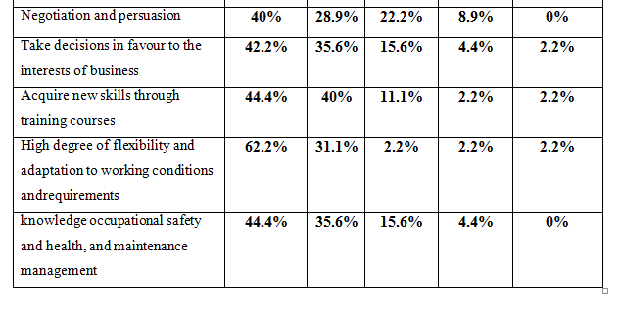
Survey analysis and result CONT:-

Slide 26
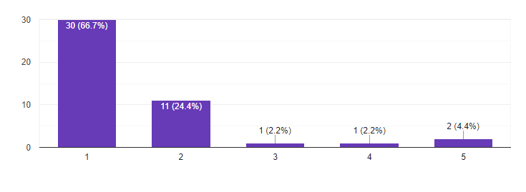
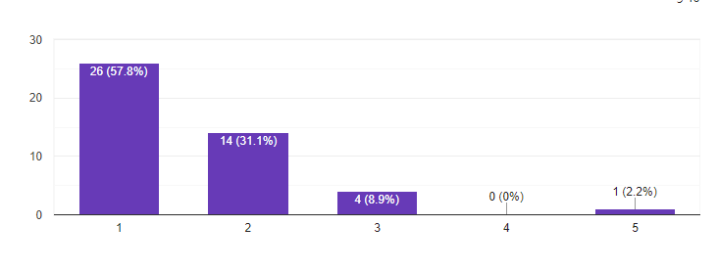
Computer skills:-
Leadership and communication skills:-

Slide 27
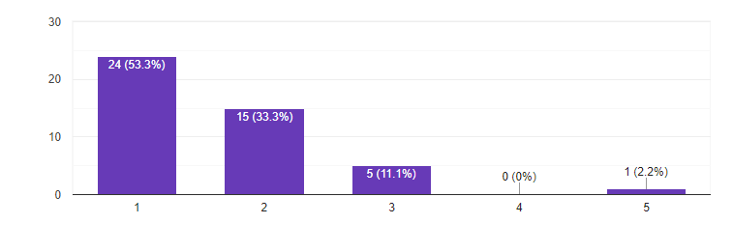
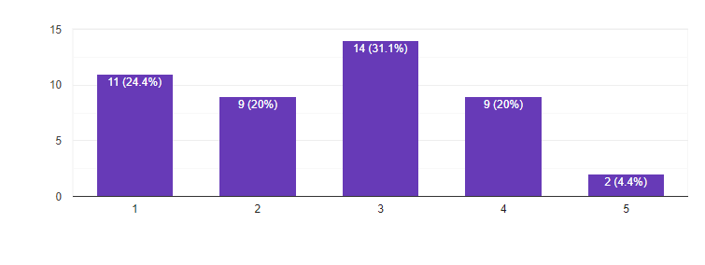
Work with interdisciplinary teams:-
Marketing and sales skills:-

Slide 28
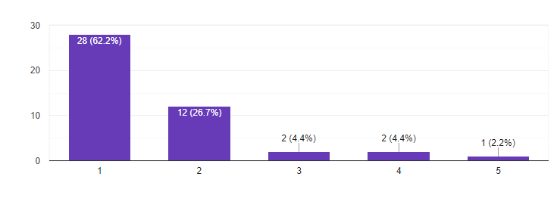
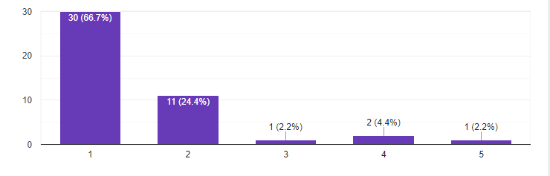
Effective time management:-
Work under pressure:-

Slide 29
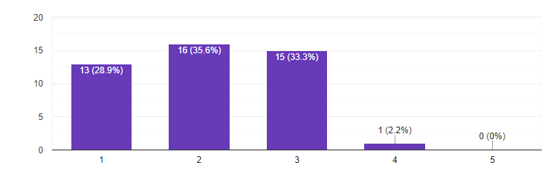
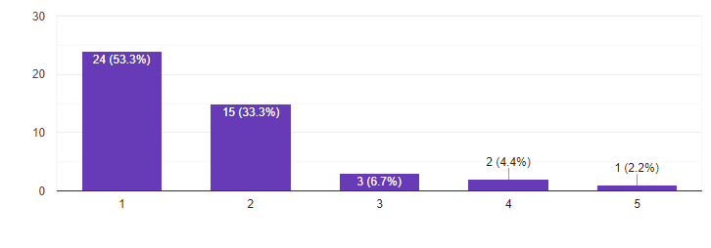
Projects management:-
Troubleshooting and system maintenance:-

Slide 30
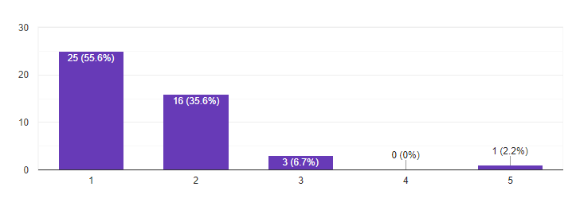
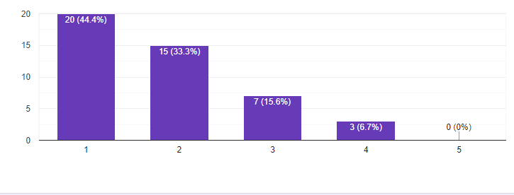
Ability to organize and analyse work related data:-
English language skills:-

Slide 31
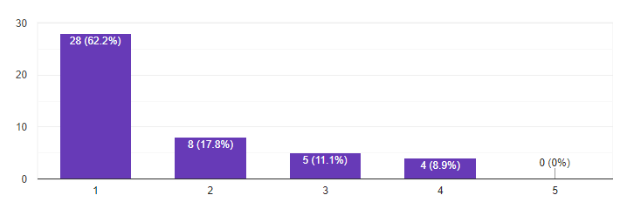
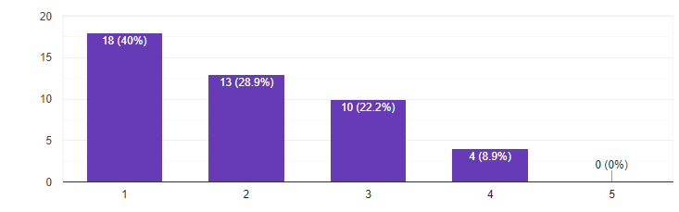
Preparing reports and continuous improvement:-
Negotiation and persuasion:-

Slide 32
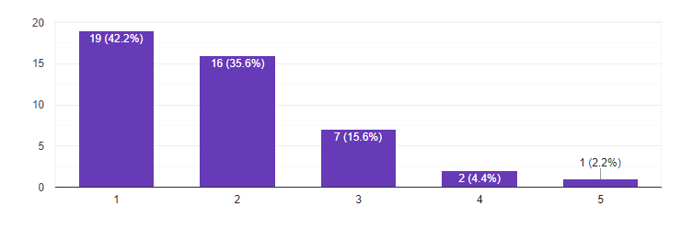
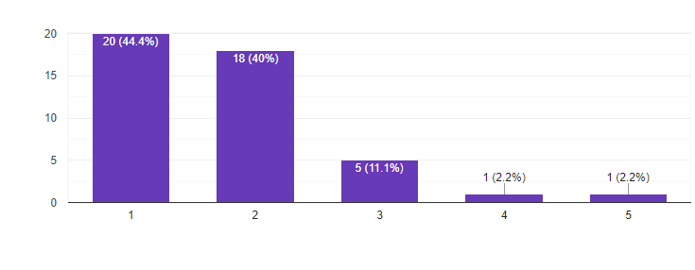
Take decisions in favour to the interests of business :-
Acquire new skills through training courses :-

Slide 33
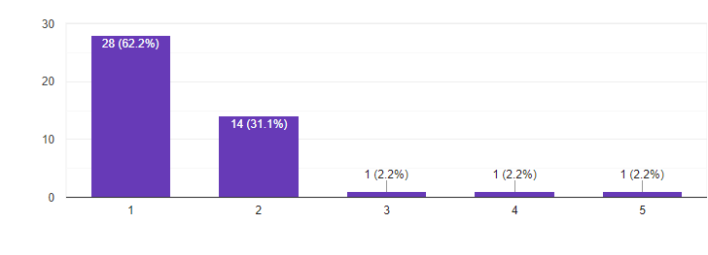
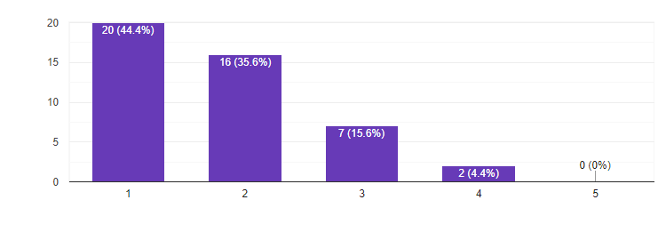
High degree of flexibility and adaptation to working conditions and requirements:-
Sufficient knowledge of the principles of occupational safety and health, and maintenance management :-

Slide 34
Results:-
The most important qualifications that should be on the engineer in general
computer leadership skills
leadership and communication skills
working with interdisciplinary teams,
effective time management
project management skill
occupational safety and health
These results indicate the need for universities to develop their programs and curricula.

Slide 35
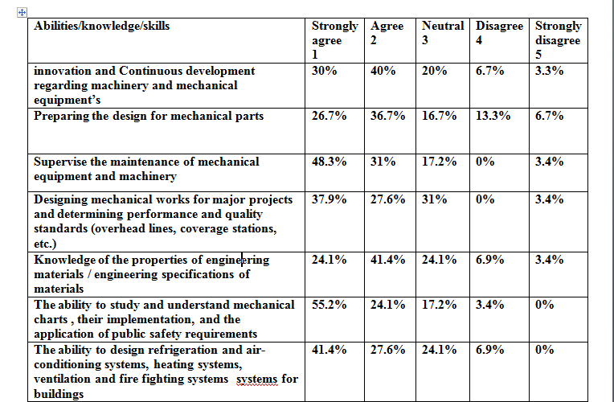
Third Part :- Analysis of the questionnaire on the specifications of graduates of Mechanical engineering

Slide 36
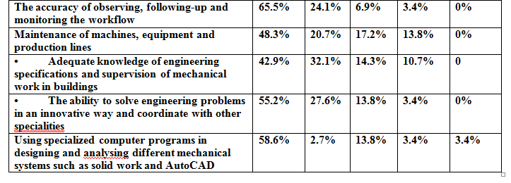
Survey analysis and result CONT:-

Slide 37
Results:-
The results also show the need for preparing continuous workshops to share experiences and skills in practice, with the aim of integrating students into the practical market and identifying the most important skills to be possessed and working to develop them.
And finally , focusing on computerized skills and work to develop them continuously to keep pace with future developments and increase focus on them instead of theoretical skills.

Slide 38
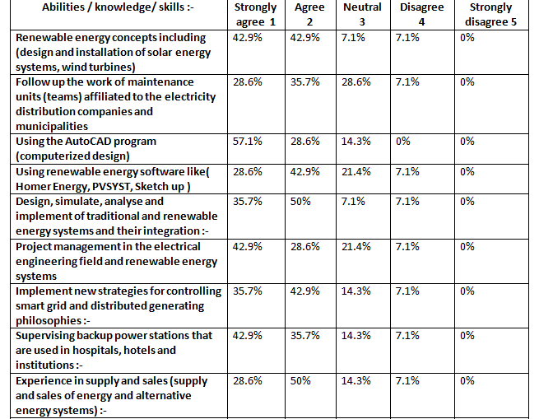
Third Part :- Analysis of the questionnaire on the specifications of graduates of Energy And Environment engineering

Slide 39
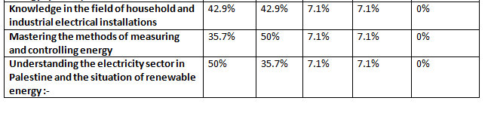
Survey analysis and result CONT:-

Slide 40
Results:-
The results show the need for energy and environmental engineers to have the specifications of computer skills and dealing with advanced technological means; AutoCAD program and Using renewable energy software like( Homer Energy, PVSYST, Sketch up ).

Slide 41
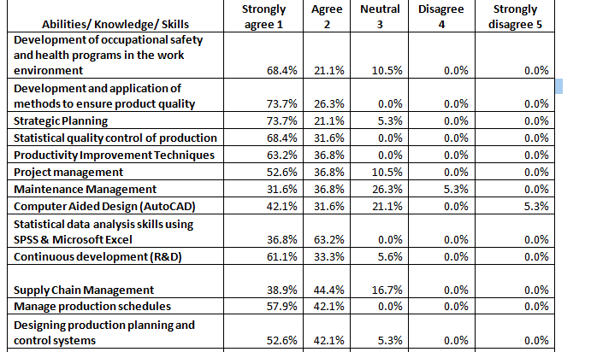
Forth Part :- Analysis of the questionnaire on the specifications of graduates of Industrial engineering

Slide 42
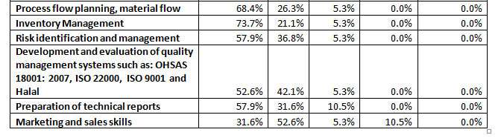
Survey analysis and result CONT:-

Slide 43
Results:-
The results also show the need for industrial engineers to have the specifications of computer skills and dealing with advanced technological means.
The need of highly qualified industrial engineers to analyze available data and information, problem solving and decision making.
The industrial engineering graduate should be capable of identifying, modeling, analyzing, and solving problems in various industrial areas.

Slide 44
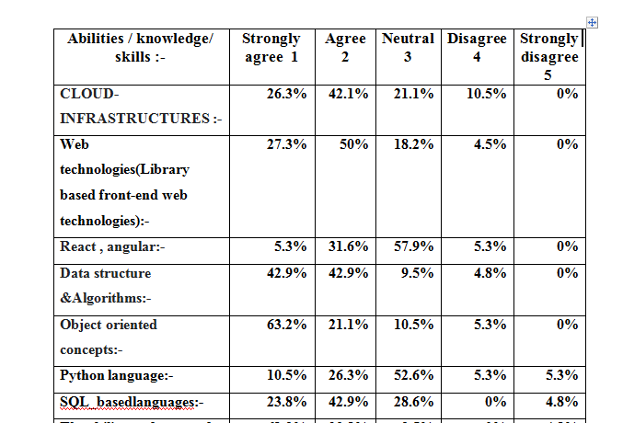
Fifth Part :- Analysis of the questionnaire on the specifications of graduates of Computer engineering

Slide 45
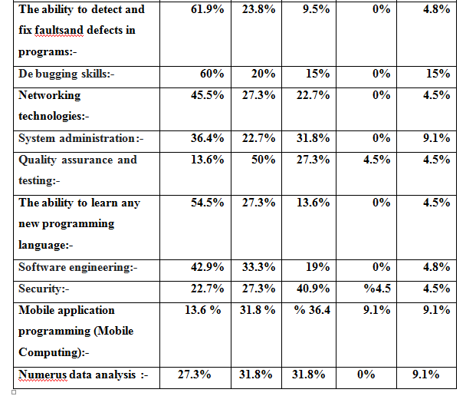
Survey analysis and result CONT:-

Slide 46
Results:-
The results also show the need for computer engineers to have the specifications of the Python and SQL language, security field, mobile computer programming, and big data analysis.
These results indicate that a computer engineering graduate should know more and work hard in the hardware field, and work hard to improve the appropriate language that reduces time and effort to solve problems.

Slide 47
Conclusion:-
It turned out that there is a gap between job Market Qualifications Demand with Educational Market Qualifications Supply . Also, we found that labor market institutions are not involved in the development of educational and scientific plans.
This study recommends that the importance of coordination between the public and private sectors and the university in the educational process to constantly develop its curricula to suit the local and international labor market in order to maintain its position and quality.
Furthermore, after graduation by helping them to obtain jobs by providing opportunities for the distinguished among them at least, to reduce unemployment and motivate them to be the best representative for their educational institution.

Slide 48
Recommendations:-
This study recommends the need to coordinate with the official authorities between the public and private sectors and the university in the educational process to constantly develop its curricula.
Reconsidering the suitability of engineering specialties to the needs of the labor market.
Prepare excellent engineering professionals through a responsive curriculum to current and future needs.

Slide 49
Recommendations:-
Enhance students’ ability to acquire skills for lifelong learning and continual professional growth.
It is recommended to implement training programs for new graduates that are able to bridge the gap between the data of engineering education and the need of the labor market.
The university must take into account the interest in training during the study.

Slide 50
Thank You
Any Questions …

