Slide 1

Factors Affecting Bid/No Bid Decision Making IN The West Bank
Prepared By:
Sameh Halaweh
Mohannad Hanbali
Odai Abu Al-Rub
Supervisor:
Eng. Reema Nassar
Notes:
An-Najah National University
Faculty Of Engineering
Civil Engineering Department
Sameh Halaweh 10823818
Odai Abu Al-Rub
Mohannad Hanbali

Slide 2
Outline
Introduction
Methodology
Data Collection & Analysis
Conclusion & Recommendations

Slide 3

Problem Of The Study
To bid or Not to bid?
Effects of bidding decision?
How this dilemma can be solved?
Factors remain the same?

Slide 4

Objectives
Explore & rank the factors.
Elaborate the critical factors.
Recommend some decision techniques.
Recommend some improvements.

Slide 5

Previous Studies
Bagies (2009), Saudi Arabia.
Ma (2011), Auckland.
Enshassi (2011), Gaza Strip.
Jarkas (2012), Qatar.
Various models were conducted around the world.

Slide 6
Methodology
Interviews & Search
Identify Factors
Questionnaire
Conclusion
& Recommendation
Data Collection
& Analysis

Slide 7
Factors Classification
Contractor Factors
Client Factors
Contract & Project Factors
External Factors

Slide 8
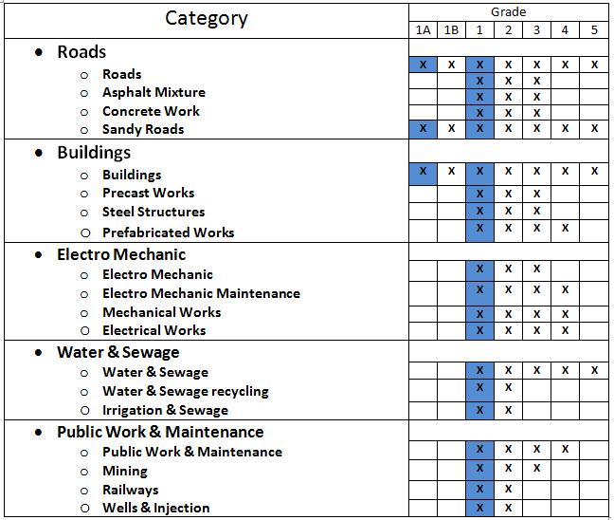
Contractors Classification

Slide 9

Sample size
Population = 61.
Sample = 38.

Slide 10
Questionnaire
The questionnaire consisting of two parts:
Part 1
Part 2
includes the factors with four evaluation levels depending on its importance to the contractor.
includes general questions, which is related to the company
To Questionnaire

Slide 11


Slide 12

Data Collection
After a final questionnaire is formed, the questionnaires were distributed over representative sample of contracting companies of that belongs to the desired classification categories around the West Bank from 1st of February to 1st of April 2013.

Slide 13

Data Collection
Questionnaires were distributed by three means:
Personal Delivery
Emails
Fax
Personal delivery of questionnaire to the contracting companies was the main mean ,to ensure that the contractor would response for the questionnaire .
The following tables represent the data collected from 38 contracting companies:

Slide 14
Number | Factors related to the contractor | 1 Not Important | 2 Little Important | 3 Important | 4 Very Important
1. | Need for Work. | 1 | 5 | 17 | 15
2. | Current Workload. | 0 | 2 | 25 | 11
3. | Previous Experience in Similar Projects. | 3 | 9 | 18 | 8
4. | Strategy of the Company. | 1 | 3 | 26 | 8
5. | Classification Criteria for the Contractors. | 1 | 5 | 18 | 14
6. | Expected Risk. | 1 | 15 | 12 | 10
7. | Expected Profitability. | 0 | 6 | 15 | 17
8. | Expected Total Cost. | 1 | 5 | 24 | 8
9. | Pre-qualification Requirement. | 1 | 12 | 19 | 6
10. | Previous Profit in Similar Projects. | 5 | 12 | 15 | 6
11. | Availability of Other Projects. | 3 | 8 | 21 | 6
12. | Availability of Required Resources (raw materials, labors, equipments). | 1 | 12 | 14 | 11
13. | Availability of Required Cash | 2 | 8 | 13 | 15
14. | Financial facilities with Banks | 6 | 13 | 12 | 7

Slide 15
Number | Factors related to the general environment | 1 Not Important | 2 Little Important | 3 Important | 4 Very Important
1 | Weather Condition | 6 | 21 | 10 | 1
2 | Laws and Government Regulations in Construction | 6 | 17 | 12 | 3
3 | Taxes | 5 | 16 | 11 | 6
4 | Inflation Rate | 4 | 10 | 16 | 8
5 | Political Situation | 1 | 9 | 15 | 13
6 | Economic Environment | 0 | 5 | 15 | 18
7 | Probable Number and Identity of Competitors | 2 | 4 | 23 | 9
8 | Situation of the Construction Industry | 2 | 9 | 22 | 5

Slide 16
Number | Factors related to the contract and project characteristics | 1 Not Important | 2 Little Important | 3 Important | 4 Very Important
1 | Size of Project | 0 | 5 | 16 | 17
2 | Location of Project and Accessibility | 0 | 5 | 18 | 15
3 | Contract Duration | 2 | 8 | 21 | 7
4 | Size and Validity of Bonds and Insurance Required | 6 | 16 | 13 | 3
5 | Contract Conditions | 3 | 10 | 19 | 6
6 | Type of Project | 3 | 10 | 20 | 5
7 | Complexity of the Project | 4 | 8 | 17 | 9
8 | Value of Liquidated Damages | 2 | 18 | 14 | 4
9 | Adequacy of Tender Information | 2 | 6 | 14 | 16
10 | Proportion to Be Subcontracted | 6 | 15 | 13 | 4
11 | Time Available for Tendering Preparation | 3 | 11 | 14 | 10
12 | Tendering Duration | 5 | 7 | 24 | 2
13 | Identity of Consultant & Designer | 5 | 4 | 13 | 16
14 | Degree of Hazard of Works | 3 | 14 | 13 | 8
15 | Type of Contract. | 2 | 15 | 18 | 3

Slide 17
Number | Factors related to client/employer characteristics | 1 Not Important | 2 Little Important | 3 Important | 4 Very Important
1 | Financial Stability of Employer | 0 | 0 | 7 | 31
2 | Identity and Reputation of Employer in the Industry | 0 | 0 | 10 | 28
3 | Previous Experience of Contractor with Employer | 4 | 9 | 10 | 15
4 | Promptness of Employer in Payments Process | 0 | 4 | 14 | 20
5 | Clients policy to Adopt the Advanced Payment | 8 | 12 | 9 | 9
6 | Client's policy in Resolving the Disputes and Litigations | 9 | 12 | 11 | 6
7 | Mean of Advertisement | 6 | 19 | 11 | 2
8 | Client’s Requirements | 4 | 9 | 20 | 5
9 | Type of Client | 3 | 9 | 14 | 12
10 | Project Source of Funding | 1 | 4 | 12 | 21
11 | The Client’s Level of Supervision, Restriction, Monitoring, and Controlling over the Contractors | 8 | 8 | 10 | 12
12 | Client’s Safety Requirements | 6 | 12 | 9 | 11
13 | Quality Level that the Clients Ask for | 8 | 7 | 10 | 13

Slide 18


Slide 19
These are the results of analyzing the data of the first part of the questionnaire:
The job role of the respondents is: 87% General Managers.
The decision making in contracting companies depends on: 95% Experience and Intuition.
The responsible to follow-up of the announcements of tenders is:
79% General managers.
4. The decision makers for bids in companies is: 92% General managers.
5. The common ways in companies to know about tenders are:
1.100% Newspaper.
2. 92% Invitations.
6.Number of years that the contracting companies have in construction sector are: 66% 10-20 years.

Slide 20

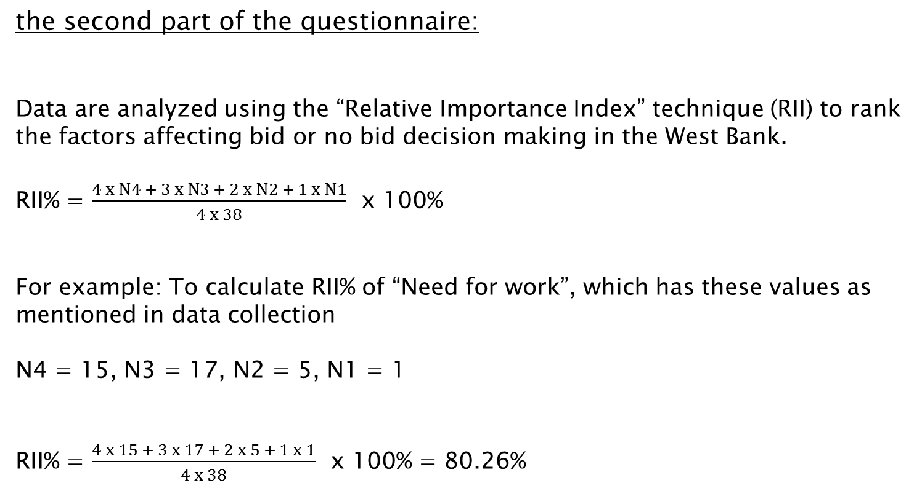
the second part of the questionnaire:
Data are analyzed using the “Relative Importance Index” technique (RII) to rank the factors affecting bid or no bid decision making in the West Bank.
RII% = $\frac{4 x N4 + 3 x N3 + 2 x N2 + 1 x N1}{4 x 38}$ x 100%
For example: To calculate RII% of “Need for work”, which has these values as mentioned in data collection
N4 = 15, N3 = 17, N2 = 5, N1 = 1
RII% = $\frac{4 x 15 + 3 x 17 + 2 x 5 + 1 x 1}{4 x 38}$ x 100% = 80.26%

Slide 21
Number | Factors related to the general environment group | RII% | Ranks relative to the group | Ranks relative to all factors
1 | Weather Condition | 53.95 | 8 | 50
2 | Laws and Government Regulations in Construction | 57.89 | 7 | 48
3 | Taxes | 61.84 | 6 | 44
4 | Inflation Rate | 68.42 | 5 | 30
5 | Political Situation | 76.32 | 2 | 15
6 | Economic Environment | 83.55 | 1 | 5
7 | Probable Number and Identity of Competitors | 75.66 | 3 | 17
8 | Situation of the Construction Industry | 69.74 | 4 | 27

Slide 22
Number | Factors related to the contractor characteristics | RII% | Ranks relative to the group | Ranks relative to all factors
1. | Need for Work. | 80.26 | 3 | 10
2. | Current Workload. | 80.92 | 2 | 9
3. | Previous Experience in Similar Projects. | 70.39 | 9 | 23
4. | Strategy of the Company. | 76.97 | 5 | 13
5. | Classification Criteria for the Contractors. | 79.61 | 4 | 11
6. | Expected Risk. | 70.39 | 9 | 23
7. | Expected Profitability. | 82.24 | 1 | 7
8. | Expected Total Cost. | 75.66 | 7 | 17
9. | Pre-qualification Requirement. | 69.74 | 12 | 27
10. | Previous Profit in Similar Projects. | 64.47 | 11 | 39
11. | Availability of Other Projects. | 69.74 | 12 | 27
12. | Availability of Required Resources (raw materials, labors, equipments). | 73.03 | 8 | 20
13. | Availability of Required Cash. | 76.97 | 5 | 13
14. | Financial Facilities with Banks | 63.16 | 14 | 41

Slide 23
Number | Factors related to the contract and project characteristics | RII % | Ranks relative to the group | Ranks relative to all factors
1 | Size of Project | 82.89 | 1 | 6
2 | Location of Project and Accessibility | 81.58 | 2 | 8
3 | Contract Duration | 71.71 | 5 | 22
4 | Size and Validity of Bonds and Insurance Required | 58.55 | 15 | 47
5 | Contract Conditions | 68.42 | 8 | 30
6 | Type of Project | 67.76 | 9 | 33
7 | Complexity of the Project | 70.39 | 6 | 23
8 | Value of Liquidated Damages | 63.16 | 13 | 41
9 | Adequacy of Tender Information | 78.95 | 3 | 12
10 | Proportion to Be Subcontracted | 59.87 | 14 | 45
11 | Time Available for Tendering Preparation | 70.39 | 6 | 23
12 | Tendering Duration | 65.13 | 11 | 38
13 | Identity of Consultant & Designer | 76.32 | 4 | 15
14 | Degree of Hazard of Works | 67.11 | 10 | 34
15 | Type of Contract. | 64.47 | 12 | 39

Slide 24
Number | Factors related to client/employer characteristics | RII% | Ranks relative to the group | Ranks relative to all factors
1 | Financial Stability of Employer | 95.39 | 1 | 1
2 | Identity and Reputation of Employer in the Industry | 93.42 | 2 | 2
3 | Previous Experience of Contractor with Employer | 73.68 | 5 | 19
4 | Promptness of Employer in Payments Process | 85.53 | 3 | 3
5 | Clients Policy to Adopt the Advanced Payment | 62.50 | 11 | 43
6 | Client's policy in Resolving the Disputes and Litigations | 59.21 | 12 | 46
7 | Mean of Advertisement | 55.92 | 13 | 49
8 | Client’s Requirements | 67.11 | 8 | 34
9 | Type of Client | 73.03 | 6 | 20
10 | Project Source of Funding | 84.87 | 4 | 4
11 | The Client’s Level of Supervision, Restriction, Monitoring, and Controlling over the Contractors | 67.11 | 8 | 34
12 | Client’s Safety Requirements | 66.45 | 10 | 37
13 | Quality Level that the Clients Ask for | 68.42 | 7 | 30

Slide 25


Slide 26
Top ten factors affecting bid/no bid decision making in the West Bank
Rank | Top Ten Factors Affecting Bid/No Bid Decision Making in the West Bank | RII%
1. | Financial Stability of Employer | 95.39
2. | Identity and Reputation of Employer in the Industry | 93.42
3. | Promptness of Employer in Payments Process | 85.53
4. | Project Source of Funding | 84.87
5. | Economic Environment | 83.55
6. | Size of Project | 82.89
7. | Expected Profitability | 82.24
8. | Location of Project and Accessibility | 81.58
9. | Current Workload | 80.92
10. | Need for Work | 80.26

Slide 27

Recommendations
Decision techniques.
Improvements for contractors.
Improvements for clients.

Slide 28
Decision Techniques
Mind Map
Logic Flow Chart
Pros & Cons
Multiple Attributes Analysis
Weighted Scoring Model

Slide 29
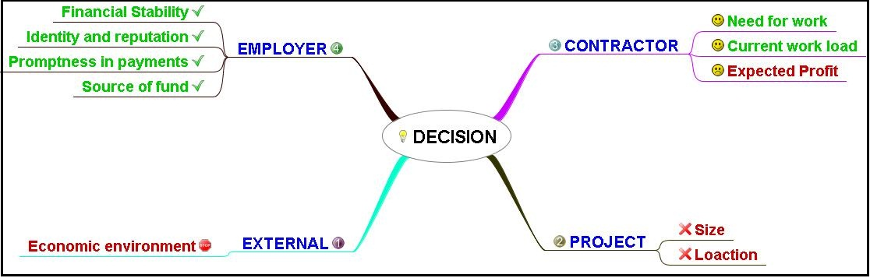
Mind Map

Slide 30
Logic Flow Chart
Start
Do I have enough resources
No
Yes
Is the employer good
No
Not To Bid
Yes
Is the project in Nablus
No
Yes
Bid
End

Slide 31
Pros & Cons
Pros | Score | Cons | Score
Good financial stability of the employer | 8 | Unsuitable location | 6
The company needs to work | 8 | The expected profit isn't high | 7
Size of the project is suitable | 7 | Weak economic environment | 6
Total | 23 | Total | 19

Slide 32
Multiple Attributes Analysis
Attributes | Score | Weight
Size of the project | 10 | 10%
Location of the project | 20 | 20%
Financial stability of the employer | 40 | 40%
Expected profit | 30 | 30%
Attributes | Project A (Score) | Project B (Score)
Size of the project | 70 | 80
Location of the project | 80 | 70
Financial stability of the employer | 90 | 60
Expected profit | 90 | 40

Slide 33
Multiple Attributes Analysis
Attributes | Project A | Project B
Size of the project | 0 | 1
Location of the project | 1 | 0
Financial stability of the employer | 1 | 0
Expected profit | 1 | 0
Attributes | Project A (Score) | Project B (Score)
Size of the project | 0 | 0.1
Location of the project | 0.2 | 0
Financial stability of the employer | 0.4 | 0
Expected profit | 0.3 | 0
Total | 0.9 | 0.1

Slide 34
Weighted Scoring Model
Attributes | Weight (W) | Scores of Proj. A (S) | W x S | Scores of Proj. B (S) | W x S
Financial stability of the employer | 30% | 80 | 24 | 70 | 21
Size of the project | 15% | 75 | 11.25 | 60 | 9
Location of the project | 10% | 60 | 6 | 40 | 4
Expected profit | 25% | 75 | 18.75 | 50 | 12.5
Need for work | 20% | 80 | 16 | 80 | 16
Total | 100% | 370 | 76% | 300 | 62.5%

Slide 35

Recommended Improvements Of Bidding Strategies: Contractors
1
2
3
4
5
Taking the critical factors into account.
Use some techniques.
Avoid unethical behavior.
Deal with each project uniquely.
Hire a professional engineer.

Slide 36

Recommended Improvements Of Bidding Strategies: Clients
1
2
3
4
5
Provide an advance payment.
Determine the percentage of subcontractors.
Use classification categories or prequalification
Don′t select the lowest price only.
Use unit price contracts mainly.

Slide 37

Thank You

