Slide 1
بسم الله الرحمن الرحيم
Design and analysis of an electric power system, with the design of a load flow program using MATLAB

Slide 2
The objective of the project:
1- Achieve the balance of real and reactive power.
2- Choose the scheme of the network.
3- Choose the technical and economical network.
4- Load flow study of the chosen network.
5- MATLAB Code.

Slide 3
1**The balance of real and reactive power :
--For real power :
P_{G}=P _{load}+ P _{loss}
P_{G}=0.9 P_{L}+ (0.05-0.075) P_{L}
P_{G}'=1.2 P_{G}
-- For reactive power:
Our power factor is 0.8 and we improve it to 0.933
Q_{A} + Q_{T.L} + Q_{c}= Q_{L} +∆ Q_{T.L}+∆Q_{T.R}
Q_{T.L}=∆ Q_{T.L}
∆Q_{T.R}=10%*S*M*# of T.R
P.F _{economical} =

Slide 4
2**The network load distribution points :
1
4
A
3
2
5
6

Slide 5
The suggested network distribution which is 9 network:
1-
2-
3-
1
4
1
4
1
4
3
3
3
A
A
A
5
2
6
5
2
6
5
6
2

Slide 6
4-
5-
6-
1
4
1
4
1
4
A
3
A
3
3
A
6
2
5
6
2
5
2
5
6

Slide 7
9-
A
7-
8-
2
1
4
4
1
1
A
A
3
3
5
6
5
6
3
2
2
5
4
6

Slide 8

To get the optimum design we use this laws :
To calculate the voltage
V=
Where P: the total power that flow in the T.L
in MW
L:the length of the T.L in KM
For the ring networks we use this law to calculate the power in it
For example:
P₁₋₃=
3
1’
2
1

Slide 9
The final table with the total calculation :
# of network | Length (KM) | Distance (KM) | P (MW) | Q (MVAR) | # of T.R
1 | 480 | 240 | 179.86 | 59.468 | 4
2 | 510 | 255 | 245.7 | 55.354 | 4
3 | 540 | 270 | 166.36 | 53.354 | 4
4 | 410 | 205 | 210.12 | 70.748 | 4
5 | 510 | 225 | 210.12 | 49.952 | 4
6 | 470 | 235 | 266.84 | 87.336 | 3
7 | 600 | 355 | 266.84 | 51.739 | 5
8 | 455 | 256 | 266.84 | 57.406 | 5
9 | 356 | 220 | 241.66 | 79.95 | 5

Slide 10
3**A- Technical study of the networks:
1- selection of the transformers :
The selection of the transformers depend on the apparent power flow in it, so we will take in consideration that 70% of the power flows in one transformer . so
S_{nom(transformer)}= 0.7 of S_{nom(lead)} ➔ S_{nom(transformer)}= S_{nom(lead)}\ 1.4.
Depending in the previous equation we make the following tables.
Table (1) for Network #1
Transformer | S_{load} (MVA) | S _{nom} (MVA) | Standard S (MVA) | Type of transformer | V_{H}\V_{L} (KV) | R_{T}(Ω) | X_{T}(Ω) | P_{O.C} (MW) | Q_{O.C} (MVAR)
A | 28.69 | 20.64 | 63 | 3-winding | V_{H}=230 | R_{TH}=1.4 | X_{TH}=104 | 0.045 | 0.315
 |  |  |  |  | V_{M}=121 | R_{TM}=1.4 | X_{TM}=0
 |  |  |  |  | V_{L}=O.C | R_{TL}=2.8 | X_{TL}=195.6
1 | 25.6 | 18.29 | 40 | 2-winding | 230\6.6 | 5.6 | 158.7 | 0.005 | 0.36
2 | 28.69 | 20.642 | 25 | 2-winding | 115\6.5 | 2.54 | 55.9 | 0.027 | 0.175
3 | 48.619 | 34.727 | 63 | 3-winding | V_{H}=230 | R_{TH}=1.4 | X_{TH}=104 | 0.045 | 0.315
 |  |  |  |  | V_{M}=121 | R_{TM}=1.4 | X_{TM}=0
 |  |  |  |  | V_{L}=6.6 | R_{TL}=2.8 | X_{TL}=195.6
4 | 10.73 | 7.664 | 10 | 2-winding | 115\6.6 | 7.95 | 139 | 0.014 | 0.07
5 | 13.95 | 9.964 | 10 | 2-winding | 115\6.6 | 7.95 | 139 | 0.014 | 0.07
6 | 6.58 | 4.664 | 6.3 | 2-winding | 115\6.6 | 14.7 | 220.4 | 0.0115 | 0.0504

Slide 11
Table (2) for network # 4
Transformer | S_{load} (MVA) | S _{nom} (MVA) | Standard S (MVA) | Type of transformer | V_{H}\V_{L} (KV) | R_{T}(Ω) | X_{T}(Ω) | P_{O.C} (MW) | Q_{O.C} (MVAR)
1 | 53.72 | 38.37 | 63 | 3-winding | V_{H}=230 | R_{TH}=1.4 | X_{TH}=104 | 0.005 | 0.36
 |  |  |  |  | V_{M}=121 | R_{TM}=1.4 | X_{TM}=0
 |  |  |  |  | V_{L}=6.6 | R_{TL}=2.8 | X_{TL}=195.6
2 | 115.19 | 82.28 | 125 | 3-winding | V_{H}=230 | R_{TH}=0.5 | X_{TH}=48.6 | 0.085 | 0.625
 |  |  |  |  | V_{M}=121 | R_{TM}=0,5 | X_{TM}=0
 |  |  |  |  | V_{L}=6.6 | R_{TL}=1.0 | X_{TL}=82.8
3 | 17.38 | 12.41 | 16 | 2-winding | 115\6.6 | 4.38 | 86.7 | 0.019 | 0.112
4 | 10.73 | 7.664 | 10 | 2-winding | 115\6.6 | 7.95 | 139 | 0.014 | 0.07
5 | 13.95 | 9.964 | 10 | 2-winding | 115\6.6 | 7.95 | 139 | 0.014 | 0.07
6 | 6.58 | 4.664 | 6.3 | 2-winding | 115\6.6 | 14.7 | 220.4 | 0.0115 | 0.0504

Slide 12
Table (3) for network #8
Transformer | S_{load} (MVA) | S _{nom} (MVA) | Standard S (MVA) | Type of transformer | V_{H}\V_{L} (KV) | R_{T}(Ω) | X_{T}(Ω) | P_{O.C} (MW) | Q_{O.C} (MVAR)
1 | 58.6 | 41.85 | 63 | 3-winding | V_{H}=230 | R_{TH}=1.4 | X_{TH}=104 | 0.005 | 0.36
 |  |  |  |  | V_{M}=121 | R_{TM}=1.4 | X_{TM}=0
 |  |  |  |  | V_{L}=6.6 | R_{TL}=2.8 | X_{TL}=195.6
2 | 49.13 | 35.098 | 63 | 3-winding | V_{H}=230 | R_{TH}=0.5 | X_{TH}=48.6 | 0.085 | 0.625
 |  |  |  |  | V_{M}=121 | R_{TM}=0,5 | X_{TM}=0
 |  |  |  |  | V_{L}=6.6 | R_{TL}=1.0 | X_{TL}=82.8
3 | 17.38 | 24.82 | 25 | 2-winding | 115\6.5 | 2.54 | 55.9 | 0.027 | 0.175
4 | 10.73 | 15.328 | 16 | 2-winding | 115\6.5 | 4.38 | 86.7 | 0.019 | 0.112
5 | 13.95 | 9.964 | 10 | 2-winding | 115\6.6 | 7.95 | 139 | 0.014 | 0.07
6 | 6.58 | 4.664 | 6.3 | 2-winding | 115\6.6 | 14.7 | 220.4 | 0.0115 | 0.0504

Slide 13
Table (4) for network #9
Transformer | S_{load} (MVA) | S _{nom} (MVA) | Standard S (MVA) | Type of transformer | V_{H}\V_{L} (KV) | R_{T}(Ω) | X_{T}(Ω) | P_{O.C} (MW) | Q_{O.C} (MVAR)
1 | 25.6 | 36.57 | 40 | 2-winding | 115\6.3 | 1.4 | 34.7 | 0.036 | 0.26
2 | 118.83 | 84.88 | 125 | 3-winding | V_{H}=230 | R_{TH}=0.5 | X_{TH}=48.6 | 0.085 | 0.625
 |  |  |  |  | V_{M}=121 | R_{TM}=0.5 | X_{TM}=0
 |  |  |  |  | V_{L}=6.6 | R_{TL}=1.0 | X_{TL}=82.8
3 | 63.2 | 45.08 | 63 | 3-winding | V_{H}=230 | R_{TH}=1.4 | X_{TH}=195.6 | 0.045 | 0.315
 |  |  |  |  | V_{M}=121 | R_{TM}=1.4 | X_{TM}=0
 |  |  |  |  | V_{L}=6.6 | R_{TL}=2.8 | X_{TL}=104
4 | 10.73 | 15.328 | 16 | 2-winding | 115\6.6 | 4.38 | 86.7 | 0.019 | 0.112
5 | 13.95 | 9.964 | 10 | 2-winding | 115\6.6 | 7.95 | 139 | 0.014 | 0.07
6 | 6.58 | 4.664 | 6.3 | 2-winding | 115\6.6 | 14.7 | 220.4 | 0.0115 | 0.0504

Slide 14

2- selection of the T.L :
Selection of transmission lines depends on the current flows in it, and we select the cross sectional area of the T.L. and we will use tables to determine the T.L, and we will find the current flow using this equation:
I_{nom}=
But we should take in consideration the current that flows after the fault. Because when the fault occurs one of the lines will be off so the current will flow in the other line so
I_{max T.L}= I_{nom}
I _{worst case}= I_{max T.L}= I_{nom} * 2
And the tables below show the selection of T.L for the networks.

Slide 15
Table (5) for network #1
Branch | Distance(KM) | V_{nom} (kV) | I_{nom}(A) | I _{worst case} (A) | Cross section (mm²)
A-1 | 75 | 220 | 195.2 | 390.5 | 240
A-2 | 65 | 110 | 150.58 | 301 | 95
1-3 | 20 | 220 | 127.59 | 255.1 | 240
3-4 | 30 | 110 | 56.3 | 112.6 | 70
3-5 | 30 | 110 | 107.69 | 215 | 70
5-6 | 20 | 110 | 34.5 | 69.07 | 70
Table (6) for network #4
Branch | Distance(KM) | V_{nom} (kV) | I_{nom}(A) | I _{worst case} (A) | Cross section (mm²)
A-1 | 75 | 220 | 244.1 | 288.32 | 240
A-2 | 65 | 220 | 199.97 | 400 | 240
1-4 | 25 | 110 | I_{max fault}=113.85 | 113.85 | 70
1-3 | 20
3-4 | 30
2-5 | 30 | 110 | 145.2 | 284 | 95
5-6 | 20 | 110 | 34.5 | 69.07 | 70

Slide 16
Table (7) for network #8
Branch | Distance(KM) | V_{nom} (kV) | I_{nom}(A) | I _{worst case} (A) | Cross section (mm²)
A-1 | 75 | 220 | 244.1 | 288.32 | 240
A-2 | 65 | 220 | 199.97 | 400 | 240
1-4 | 25 | 110 | I_{max fault}=113.85 | 113.85 | 70
1-3 | 20
3-4 | 30
2-5 | 30 | 110 | 145.2 | 284 | 95
5-6 | 20 | 110 | 34.5 | 69.07 | 70
Table (8) for network #9
Branch | Distance(KM) | V_{nom} (kV) | I_{nom}(A) | I _{worst case} (A) | Cross section (mm²)
A-2 | 65 | 220 | 311.85 | 623.7 | 300
2-3 | 30 | 220 | 63.122 | 165.65 | 240
4-1 | 25 | 110 | I_{max fault}=171.17 | 171.17 | 70
3-1 | 20
3-4 | 30
2-5 | 30 | 110 | 145.2 | 284 | 95
5-6 | 20 | 110 | 34.5 | 69.07 | 70

Slide 17
3- selection of switch gear:
Choosing the switch gear depend on several factors such as operating voltage, number of lines that can be connected through the S.G and the possibility to link other lines in the future, and in the location of the S.G in the network.
And in the next tables shows the selection for the S.G.
For network # 1
The bus | Operating voltage | # of S.G
1 | 220 | 11
2 | 110 | 4
3 | H.T 220 M.T 110 | 5
 |  | 11
4 | 110 | 4
5 | 110 | 11
6 | 110 | 4

Slide 18
For network # 4
The bus | Operating voltage | # of S.G
1 | H.T 220 | 5
 | M.T 110 | 5
2 | H.T 220 | 11
 | M.T 110 | 5
3 | 110 | 11
4 | 110 | 4
5 | 110 | 11
6 | 110 | 4
For network # 8
The bus | Operating voltage | # of S.G
1 | H.T 220 | 5
 | M.T 110 | 5
2 | H.T 220 | 5
 | M.T 110 | 5
3 | 110 | 5
4 | 110 | 5
5 | 110 | 11
6 | 110 | 4

Slide 19
For network # 9
The bus | Operating voltage | # of S.G
1 | 110 | 5
2 | H.T 220 | 11
 | M.T 110 | 5
3 | H.T 220 | 5
 | M.T 110 | 5
4 | 110 | 5
5 | 110 | 11
6 | 110 | 4

Slide 20
B- economical study of the networks
To calculate the capital and running cost we will use this equation:
Z= E_{N}*K + I
B-1 : capital cost
**Cost of the T.L:
depends on the cross sectional area , operating voltage and the length of the T.L
In the next table we will show the calculation of network # 1
Branch | Length (KM) | Voltage (KV) | Cross-sectional area (mm²) | Cost \KM (10³*Ruble) | Total cost (10³*Ruble)
A-1 | 150 | 220 | 240 | 27.8 | 4170
A-2 | 130 | 110 | 95 | 16.9 | 2197
1-3 | 40 | 220 | 240 | 27.8 | 1112
3-4 | 60 | 110 | 70 | 15.8 | 948
3-5 | 60 | 110 | 70 | 15.8 | 948
5-6 | 40 | 110 | 70 | 15.8 | 632
TOTAL |  |  |  |  | 10,007

Slide 21
**Cost of the transformers:
It depend on the rated power of the transformer and the operating voltage.
In the next table shows the calculation of network #1
Load Bus | Number of T.Rs | S _{nom} (MVA) | voltage | Cost \T.R (10³*Ruble) | Total cost (10³*Ruble)
1 | 2 | 40 | 220 | 169 | 338
2 | 2 | 25 | 110 | 66 | 132
3 | 2 | 63 | 220 | 159 | 318
4 | 2 | 10 | 110 | 54 | 108
5 | 2 | 10 | 110 | 54 | 108
6 | 2 | 6.3 | 110 | 49 | 98
A | 2 | 63 | 220 | 159 | 318
Total |  |  |  |  | 1420

Slide 22
**The cost of the switch gear and the auxiliary requirements:
The depend on the operating voltage and on the kind of the S.G that is used.
In the next table the calculation of network # 1
Bus # | Switchgear # | Voltage (KV) | Cost of S.G(10³*Ruble) | K constant
1 | #11 | 220 | 595 | -
2 | #4 | 110 | 36.3 | 130
3 | #5 at H.T | 220 | 180 | 520
 | # 11 at M.T | 110 | 294 | 290
4 | #4 | 110 | 36.3 | 130
5 | #11 | 110 | 294 | 290
6 | #4 | 110 | 36.3 | 130
Total |  |  | 1471.9 | 1490
The capital cost will be:
K = K_{SUB} + K_{T.L}
K=4381.9 +10007 =14388.9 * 10³ Ruble.

Slide 23
B-2 : Running cost:
the cost will be calculated as in the following equation:
I = I_{T.L} + I _{SUB} + I _{∆w} .
which is equal to this equation:
I = (n* K_{T.L}) + (m*K _{sub­})+ Z _{losses}.
Where Z _{losses}= z _{L} * (∆W₁ +∆W₂)
∆W₂= T *_{O.C}
∆W₁= Ʈ ( _{T.L} + _{T.R})
Where Ʈ=(0.124 + T_{max}*10⁻⁴) *8760 ,taking T_{max} = 4000 hours
➔ Ʈ = 2405 hours
In the next tables we will show the power losses in the transformers and in the T.L .

Slide 24
Power loss in the T.L
Branches | Voltage (KV) | P+jQ (MVA) | R (Ω) | ∆P_{T.L}(MW)
A-1 | 220 | 70.54+j23.66 | 6.05 | 0.6916
A-2 | 110 | 26.6+j10.75 | 15.3 | 0.898
1-3 | 220 | 46.54+j14.066 | 6.05 | 0.297
3-4 | 110 | 10.2+j3.32 | 21.4 | 0.203
3-5 | 110 | 19.74+j5.596 | 21.4 | 0.7445
5-6 | 110 | 6.24+j2.076 | 21.4 | 0.076
Total |  |  |  | 2.9101

Slide 25
Power loss in the Transformer
Transformer # | Voltage (KV) | P+jQ (MVA) | R(Ω) | ∆P_{T.R} (MW) | P _{O.C} (MW)
A | 220 | 26.6+j10,75 | 2.54 | 0.0431 | 0.027
1 | 220 | 70.54+j23.66 | 5.6 | 0.64 | 0.05
2 | 110 | 26.6+j10.75 | 2.54 | 0.172 | 0.027
3 | 220 | 46.54+j14.066 | 1.4 | 0.068 | 0.045
 | 220 | 29.94+j2.916 | 1.4 | 0.026 | -
 | 220 | 16.6+j5.15 | 2.8 | 0.175 | -
4 | 110 | 10.2+j3.32 | 7.95 | 0.0755 | 0.014
5 | 110 | 19.74+j5.596 | 7.95 | 0.276 | 0.014
6 | 110 | 6.24+j2.076 | 14.7 | 0.052 | 0.0115
Total |  |  |  | 1.5276 | 0.1885

Slide 26
∆W₁ = 10,668.23 MW
∆W₂ = 1651.26 MW
Z _{losses}= 160 *(10,668.23 + 1651.26) = 1,971.12 * 10³ Ruble
I = (n* K_{T.L}) + (m*K _{sub­}) + Z _{losses}.
I = (2.8% * 10007) + (7.8% *2269) + (8.8% * 2112.9) + 1971 = 2614.2 * 10³ Ruble.
After founding the running cost now we will find the total cost which is equal to:
Z= E_{N}*K + I
Z= (0.2 *14388.9) + 2614.2 = 5492*10³ Ruble

Slide 27
And for the other network is the same as the calculation in this network we will present the final cost for each network and it’s :
1- for network # 4
Z= E_{N}*K + I
Z= (0.2 * 14647.3) + 2739.7 = 5669.2 *10³ Ruble
2- for network # 8
Z= E_{N}*K + I
Z= (0.2 *14646.8) + 2362.4 = 5291.6 *10³ Ruble.
3- for network #9
Z= E_{N}*K + I
Z= (0.2 *13079.8) +3400.7 = 6016.66 *10³ Ruble.
From the previous calculation we obtain than network # 8 is the most economical network. So it will be selected to analysis it for load flow study.

Slide 28
8-
1
4
A
3
2
5
6
This is network # 8 that we chose for load flow study

Slide 29
4 – load flow study
In the load flow study we will study three cases:
A- Maximum load
B- Minimum load
C- After fault case
We will use the (E-tap power station) program to analysis the network in the previous cases.

Slide 30
4-A – maximum case:
The network figure and table of data after first run
CKT / Branch | From-To Bus Flow |  | To-From Bus Flow |  | Losses |  | % Bus Voltage |  | Vd % Drop in Vmag
ID | MW | Mvar | MW | Mvar | kW | Kvar | From | To
Line 1-3 | -12.720 | -6.080 | 13.770 | 6.935 | 1049.1 | 854.4 | 89.5 | 98.0 | 8.53
Line1-4 | -1.702 | -0.794 | 1.720 | 0.760 | 18.4 | -34.1 | 89.5 | 90.6 | 1.12
T5 | 14.422 | 6.874 | -14.372 | -5.680 | 50.4 | 1194.0 | 89.5 | 86.6 | 2.93
Line15 | -46.495 | -20.325 | 46.826 | 21.269 | 331.3 | 943.2 | 98.5 | 100.0 | 1.53
Line A-1 | -49.689 | -22.350 | 50.073 | 23.706 | 383.7 | 1355.7 | 98.3 | 100.0 | 1.67
Line 3-4 | -11.236 | -5.373 | 12.034 | 6.009 | 798.4 | 636.5 | 90.6 | 98.1 | 7.44
T6 | 9.516 | 4.613 | -9.469 | -3.742 | 46.8 | 870.9 | 90.6 | 83.5 | 3.37
Line2-5 | -18.930 | -8.901 | 19.685 | 9.737 | 754.4 | 835.4 | 93.7 | 98.4 | 4.78
Line5-6 | 6.124 | 2.794 | -6.014 | -2.752 | 109.8 | 42.0 | 93.7 | 91.7 | 1.94
T7 | 6.403 | 3.054 | -6.368 | -2.517 | 34.6 | 536.9 | 93.7 | 90.4 | 3.25
T8 | 6.403 | 3.054 | -6.368 | -2.517 | 34.6 | 536.9 | 93.7 | 90.4 | 3.25
T9 | 3.007 | 1.376 | -2.993 | -1.183 | 14.2 | 193.0 | 91.7 | 89.3 | 2.46
T10 | 3.007 | 1.376 | -2.993 | -1.183 | 14.2 | 193.0 | 91.7 | 89.3 | 2.46
T1 | 23.248 | 10.163 | -9.842 | -4.868 | 8.5 | 0.5 | 98.5 | 98.4 | 0.02
 |  |  | -13.397 | -5.295 |  |  | 98.5 | 98.4 | 0.04
T2 | 23.248 | 10.163 | -9.842 | -4.868 | 8.5 | 0.5 | 98.5 | 98.4 | 0.02
 |  |  | -13.397 | -5.295 |  |  | 98.5 | 98.4 | 0.04
T25 | 24.217 | 11.277 | -12.034 | -6.009 | 88.7 | 11.4 | 98.3 | 98.1 | 0.25
 |  |  | -12.094 | -5.256 |  |  | 98.3 | 97.9 | 0.39
T26 | 25.473 | 11.073 | -13.770 | -6.935 | 86.1 | 23.4 | 98.3 | 98.0 | 0.28
 |  |  | -11.617 | -4.115 |  |  | 98.3 | 97.9 | 0.39
Total |  |  |  |  | 3831.8 | 8193.6

Slide 31
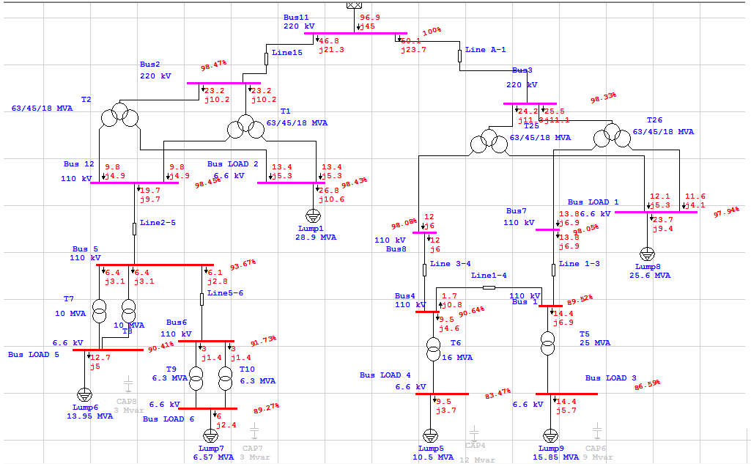

Slide 32
From the table and the figure we saw that there is a drop voltage in many buses because of that we added capacitors in the buses that have the max drop and we get this table and figure. And we get a drop in the losses equal to 925.1 KW.
CKT / Branch | From-To Bus Flow |  | To-From Bus Flow |  | Losses |  | % Bus Voltage |  | Vd % Drop in Vmag
ID | MW | Mvar | MW | Mvar | kW | Kvar | From | To
Line 1-3 | -13.230 | 5.375 | 14.003 | -4.778 | 772.4 | 597.6 | 105.9 | 109.5 | 3.63
Line1-4 | -1.758 | -1.770 | 1.782 | 1.720 | 23.1 | -50.0 | 105.9 | 107.2 | 1.31
T5 | 14.989 | -3.605 | -14.955 | 4.401 | 33.5 | 795.1 | 105.9 | 107.0 | 1.19
Line15 | -47.304 | -13.421 | 47.558 | 14.035 | 254.4 | 613.3 | 108.9 | 110.0 | 1.11
Line A-1 | -50.838 | 1.830 | 51.108 | -0.889 | 269.9 | 941.2 | 109.5 | 110.0 | 0.52
Line 3-4 | -11.751 | 7.220 | 12.455 | -6.683 | 703.6 | 537.1 | 107.2 | 109.5 | 2.38
T6 | 9.970 | -8.939 | -9.916 | 9.938 | 53.7 | 999.1 | 107.2 | 107.5 | 5.19
Line2-5 | -19.401 | -2.065 | 19.916 | 2.603 | 515.5 | 538.1 | 105.7 | 108.9 | 3.16
Line5-6 | 6.264 | -0.595 | -6.189 | 0.591 | 75.0 | -3.3 | 105.7 | 104.6 | 1.15
T7 | 6.568 | 1.330 | -6.544 | -0.954 | 24.3 | 376.1 | 105.7 | 104.3 | 1.39
T8 | 6.568 | 1.330 | -6.544 | -0.954 | 24.3 | 376.1 | 105.7 | 104.3 | 1.39
T9 | 3.094 | -0.296 | -3.085 | 0.427 | 9.7 | 131.2 | 104.6 | 104.8 | 0.19
T10 | 3.094 | -0.296 | -3.085 | 0.427 | 9.7 | 131.2 | 104.6 | 104.8 | 0.19
T1 | 23.652 | 6.711 | -9.958 | -1.302 | 6.8 | 0.5 | 108.9 | 108.9 | 0.01
 |  |  | -13.687 | -5.409 |  |  | 108.9 | 108.9 | 0.04
T2 | 23.652 | 6.711 | -9.958 | -1.302 | 6.8 | 0.5 | 108.9 | 108.9 | 0.01
 |  |  | -13.687 | -5.409 |  |  | 108.9 | 108.9 | 0.04
T25 | 24.648 | -1.097 | -12.455 | 6.683 | 59.8 | 22.7 | 109.5 | 109.5 | 0.06
 |  |  | -12.133 | -5.563 |  |  | 109.5 | 109.0 | 0.46
T26 | 26.190 | -0.733 | -14.003 | 4.778 | 64.1 | 20.8 | 109.5 | 109.5 | 0.00
 |  |  | -12.123 | -4.024 |  |  | 109.5 | 109.0 | 0.46
Total |  |  |  |  | 2906.7 | 6027.5

Slide 33
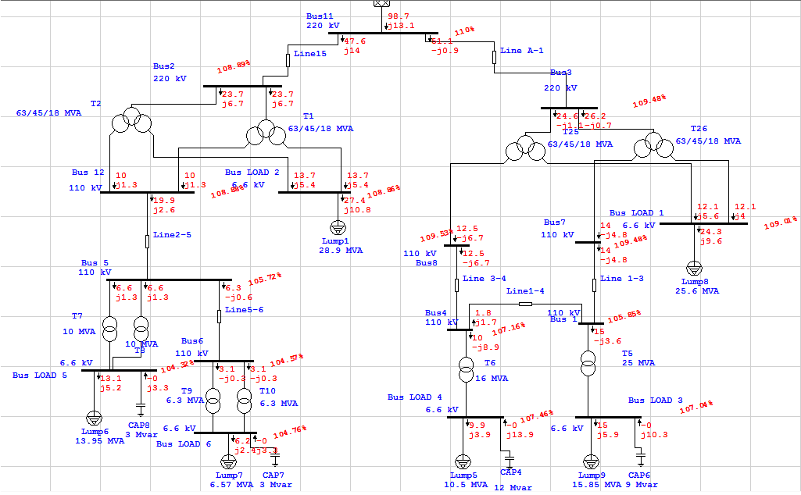

Slide 34
B– Minimum case:
we reduce the loads to 40% from the original case.
The network figure and table of data after first run
CKT / Branch | From-To Bus Flow |  | To-From Bus Flow |  | Losses |  | % Bus Voltage |  | Vd % Drop in Vmag
ID | MW | Mvar | MW | Mvar | kW | Kvar | From | To
Line 1-3 | -7.130 | -3.155 | 7.416 | 3.344 | 285.5 | 189.2 | 94.8 | 99.2 | 4.40
Line1-4 | 1.298 | 0.686 | -1.288 | -0.732 | 10.3 | -46.1 | 94.8 | 94.0 | 0.86
T5 | 5.832 | 2.469 | -5.825 | -2.302 | 7.1 | 167.2 | 94.8 | 93.8 | 1.05
Line15 | -18.526 | -7.502 | 18.576 | 7.432 | 50.3 | -69.5 | 99.4 | 100.0 | 0.57
Line A-1 | -20.006 | -9.053 | 20.068 | 9.249 | 61.1 | 195.5 | 99.3 | 100.0 | 0.66
Line 3-4 | -8.280 | -3.847 | 8.679 | 4.135 | 398.8 | 287.9 | 94.0 | 99.2 | 5.24
T6 | 9.568 | 4.579 | -9.524 | -3.764 | 43.8 | 815.1 | 94.0 | 86.8 | 3.25
Line2-5 | -7.675 | -3.189 | 7.785 | 3.258 | 109.4 | 68.5 | 97.6 | 99.4 | 1.77
Line5-6 | 2.512 | 0.998 | -2.496 | -1.042 | 16.4 | -44.2 | 97.6 | 96.9 | 0.74
T7 | 2.582 | 1.096 | -2.577 | -1.018 | 5.0 | 77.2 | 97.6 | 96.5 | 1.18
T8 | 2.582 | 1.096 | -2.577 | -1.018 | 5.0 | 77.2 | 97.6 | 96.5 | 1.18
T9 | 1.248 | 0.521 | -1.246 | -0.492 | 2.1 | 28.9 | 96.9 | 96.0 | 0.92
T10 | 1.248 | 0.521 | -1.246 | -0.492 | 2.1 | 28.9 | 96.9 | 96.0 | 0.92
T1 | 9.263 | 3.751 | -3.892 | -1.629 | 1.3 | 0.1 | 99.4 | 99.4 | 0.01
 |  |  | -5.369 | -2.122 |  |  | 99.4 | 99.4 | 0.01
T2 | 9.263 | 3.751 | -3.892 | -1.629 | 1.3 | 0.1 | 99.4 | 99.4 | 0.01
 |  |  | -5.369 | -2.122 |  |  | 99.4 | 99.4 | 0.01
T25 | 10.482 | 4.482 | -8.679 | -4.135 | 5.2 | 19.5 | 99.3 | 99.2 | 0.12
 |  |  | -1.798 | -0.327 |  |  | 99.3 | 99.2 | 0.11
T26 | 9.524 | 4.571 | -7.416 | -3.344 | 6.4 | 12.5 | 99.3 | 99.2 | 0.10
 |  |  | -2.102 | -1.214 |  |  | 99.3 | 99.2 | 0.11
Total |  |  |  |  | 1011.2 | 1808.0

Slide 35
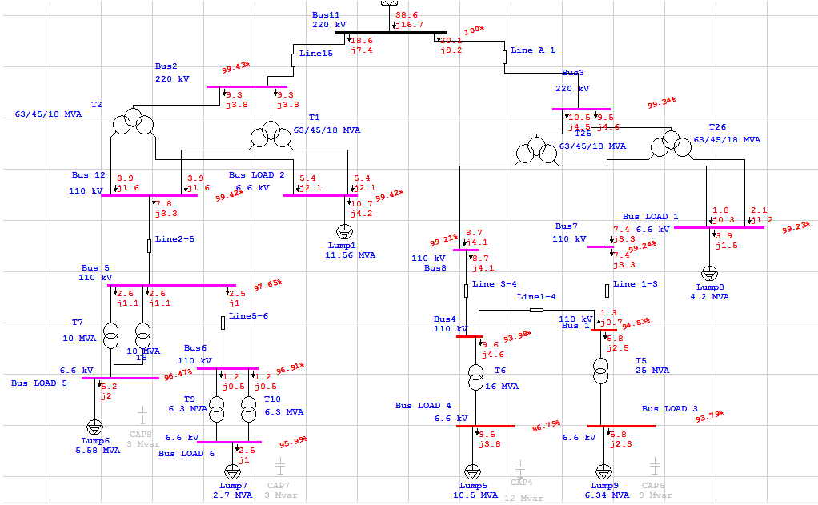

Slide 36
From the table and the figure we saw that there is a drop voltage in many buses because of that we added capacitors in the buses that have the max drop and we get this table and figure. And we get a drop in the losses equal to 15.8 KW.
CKT / Branch | From-To Bus Flow |  | To-From Bus Flow |  | Losses |  | % Bus Voltage |  | Vd % Drop in Vmag
ID | MW | Mvar | MW | Mvar | kW | Kvar | From | To
Line 1-3 | -7.266 | 3.191 | 7.517 | -3.041 | 251.5 | 150.9 | 103.2 | 105.1 | 1.91
Line1-4 | 1.324 | -2.458 | -1.293 | 2.419 | 30.4 | -39.6 | 103.2 | 103.5 | 0.33
T5 | 5.942 | -0.733 | -5.937 | 0.859 | 5.3 | 126.2 | 103.2 | 103.4 | 0.20
Line15 | -18.703 | -7.535 | 18.749 | 7.425 | 46.3 | -109.4 | 104.5 | 105.0 | 0.54
Line A-1 | -20.484 | 6.760 | 20.536 | -6.597 | 52.7 | 162.9 | 105.0 | 105.0 | 0.04
Line 3-4 | -8.595 | 5.608 | 9.013 | -5.313 | 417.9 | 294.9 | 103.5 | 105.2 | 1.65
T6 | 9.889 | -8.026 | -9.837 | 8.995 | 52.1 | 968.8 | 103.5 | 103.6 | 4.82
Line2-5 | -7.751 | -3.196 | 7.852 | 3.247 | 100.5 | 51.5 | 102.8 | 104.4 | 1.70
Line5-6 | 2.536 | 0.996 | -2.521 | -1.048 | 15.0 | -51.7 | 102.8 | 102.0 | 0.71
T7 | 2.608 | 1.100 | -2.603 | -1.029 | 4.6 | 71.0 | 102.8 | 101.6 | 1.13
T8 | 2.608 | 1.100 | -2.603 | -1.029 | 4.6 | 71.0 | 102.8 | 101.6 | 1.13
T9 | 1.260 | 0.524 | -1.258 | -0.497 | 2.0 | 26.6 | 102.0 | 101.2 | 0.88
T10 | 1.260 | 0.524 | -1.258 | -0.497 | 2.0 | 26.6 | 102.0 | 101.2 | 0.88
T1 | 9.351 | 3.767 | -3.926 | -1.624 | 1.2 | 0.1 | 104.5 | 104.4 | 0.01
 |  |  | -5.424 | -2.144 |  |  | 104.5 | 104.4 | 0.01
T2 | 9.351 | 3.767 | -3.926 | -1.624 | 1.2 | 0.1 | 104.5 | 104.4 | 0.01
 |  |  | -5.424 | -2.144 |  |  | 104.5 | 104.4 | 0.01
T25 | 10.179 | -4.250 | -9.013 | 5.313 | 1.9 | 23.1 | 105.0 | 105.2 | 0.12
 |  |  | -1.163 | -1.040 |  |  | 105.0 | 104.9 | 0.18
T26 | 10.305 | -2.510 | -7.517 | 3.041 | 6.2 | 11.1 | 105.0 | 105.1 | 0.04
 |  |  | -2.782 | -0.520 |  |  | 105.0 | 104.9 | 0.18
Total |  |  |  |  | 995.4 | 1784.1

Slide 37
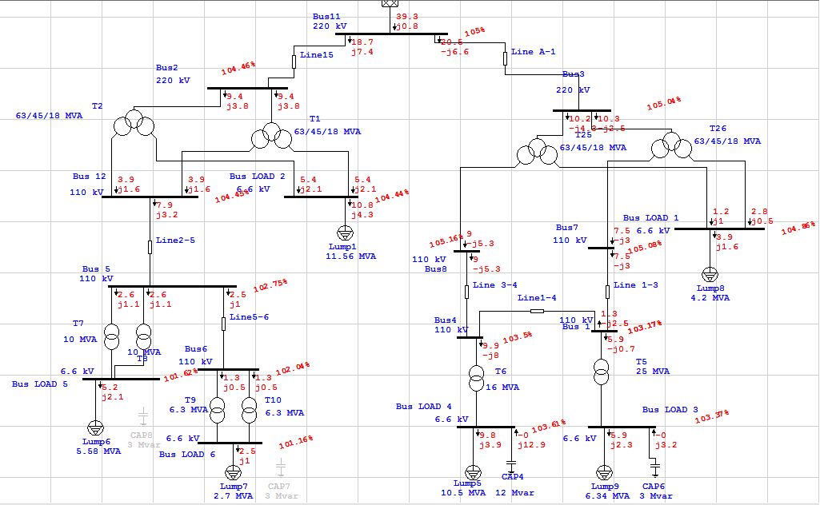

Slide 38
C– Fault case:
in this case we assume that a fault occurs in the most important line in the network, The network figure and table of data after first run.
CKT / Branch | From-To Bus Flow |  | To-From Bus Flow |  | Losses |  | % Bus Voltage |  | Vd % Drop in Vmag
ID | MW | Mvar | MW | Mvar | kW | Kvar | From | To
Line 1-3 | -13.921 | -6.545 | 14.959 | 7.380 | 1038.7 | 835.0 | 98.1 | 106.6 | 8.47
Line1-4 | -2.143 | -1.010 | 2.167 | 0.971 | 24.4 | -39.1 | 98.1 | 99.4 | 1.29
T5 | 16.064 | 7.554 | -16.012 | -6.328 | 51.7 | 1226.1 | 98.1 | 95.2 | 2.95
Line15 | -47.103 | -20.188 | 47.380 | 20.886 | 277.6 | 697.4 | 108.6 | 110.0 | 1.38
Line A-1 | -52.036 | -23.167 | 52.739 | 24.192 | 703.0 | 1025.7 | 106.9 | 110.0 | 3.11
Line 3-4 | -12.036 | -5.625 | 12.791 | 6.214 | 754.7 | 588.2 | 99.4 | 106.7 | 7.21
T6 | 9.869 | 4.655 | -9.828 | -3.884 | 41.4 | 770.4 | 99.4 | 92.1 | 3.14
Line2-5 | -19.304 | -8.786 | 19.929 | 9.455 | 625.7 | 669.7 | 104.3 | 108.6 | 4.33
Line5-6 | 6.238 | 2.753 | -6.147 | -2.740 | 90.9 | 12.8 | 104.3 | 102.5 | 1.76
T7 | 6.533 | 3.016 | -6.504 | -2.571 | 28.8 | 445.8 | 104.3 | 101.3 | 2.93
T8 | 6.533 | 3.016 | -6.504 | -2.571 | 28.8 | 445.8 | 104.3 | 101.3 | 2.93
T9 | 3.073 | 1.370 | -3.061 | -1.210 | 11.8 | 160.0 | 102.5 | 100.3 | 2.22
T10 | 3.073 | 1.370 | -3.061 | -1.210 | 11.8 | 160.0 | 102.5 | 100.3 | 2.22
T1 | 23.551 | 10.094 | -9.965 | -4.728 | 7.1 | 0.4 | 108.6 | 108.6 | 0.02
 |  |  | -13.580 | -5.367 |  |  | 108.6 | 108.6 | 0.03
T2 | 23.551 | 10.094 | -9.965 | -4.728 | 7.1 | 0.4 | 108.6 | 108.6 | 0.02
 |  |  | -13.580 | -5.367 |  |  | 108.6 | 108.6 | 0.03
T25 | 25.232 | 11.708 | -12.791 | -6.214 | 80.1 | 11.7 | 106.9 | 106.7 | 0.24
 |  |  | -12.361 | -5.483 |  |  | 106.9 | 106.5 | 0.37
T26 | 26.804 | 11.459 | -14.959 | -7.380 | 77.3 | 25.6 | 106.9 | 106.6 | 0.27
 |  |  | -11.768 | -4.053 |  |  | 106.9 | 106.5 | 0.37
Total |  |  |  |  | 3861.0 | 7035.8

Slide 39
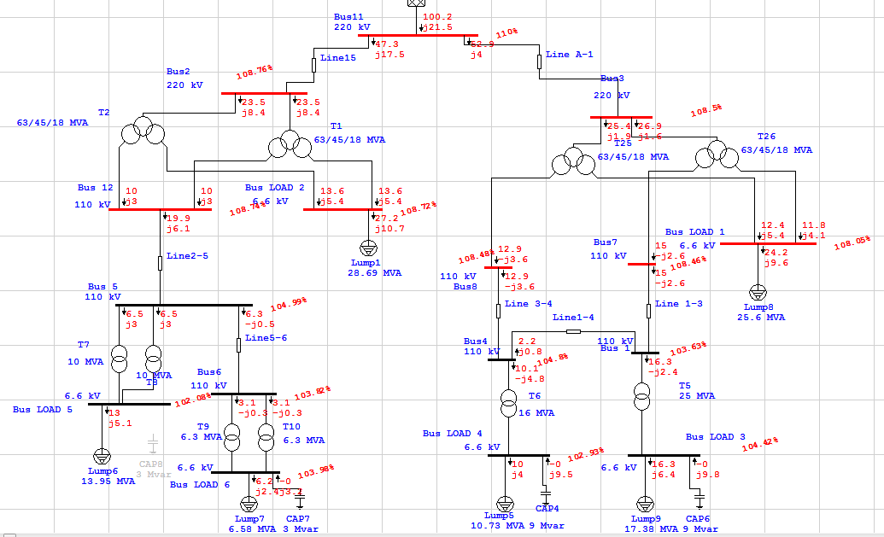
This the figure is after improving the after fault :

Slide 40
This the data is after improving the after fault :
CKT / Branch | From-To Bus Flow |  | To-From Bus Flow |  | Losses |  | % Bus Voltage |  | Vd % Drop in Vmag
ID | MW | Mvar | MW | Mvar | kW | Kvar | From | To
Line 1-3 | -14.176 | 3.231 | 15.011 | -2.577 | 834.7 | 653.6 | 103.6 | 108.5 | 4.83
Line1-4 | -2.174 | -0.816 | 2.195 | 0.767 | 21.1 | -48.8 | 103.6 | 104.8 | 1.17
T5 | 16.350 | -2.415 | -16.310 | 3.368 | 40.2 | 953.4 | 103.6 | 104.4 | 0.79
Line15 | -47.086 | -16.811 | 47.350 | 17.458 | 263.6 | 646.7 | 108.8 | 110.0 | 1.24
Line A-1 | -52.270 | -3.443 | 52.852 | 4.026 | 581.8 | 582.4 | 108.5 | 110.0 | 1.50
Line 3-4 | -12.272 | 4.072 | 12.918 | -3.583 | 645.9 | 489.3 | 104.8 | 108.5 | 3.69
T6 | 10.077 | -4.839 | -10.038 | 5.567 | 39.1 | 728.0 | 104.8 | 102.9 | 2.81
Line2-5 | -19.349 | -5.490 | 19.905 | 6.075 | 555.2 | 585.7 | 105.0 | 108.7 | 3.75
Line5-6 | 6.265 | -0.541 | -6.189 | 0.539 | 75.9 | -1.5 | 105.0 | 103.8 | 1.17
T7 | 6.542 | 3.015 | -6.514 | -2.575 | 28.4 | 440.7 | 105.0 | 102.1 | 2.91
T8 | 6.542 | 3.015 | -6.514 | -2.575 | 28.4 | 440.7 | 105.0 | 102.1 | 2.91
T9 | 3.094 | -0.270 | -3.085 | 0.403 | 9.8 | 132.9 | 103.8 | 104.0 | 0.15
T10 | 3.094 | -0.270 | -3.085 | 0.403 | 9.8 | 132.9 | 103.8 | 104.0 | 0.15
T1 | 23.543 | 8.406 | -9.952 | -3.038 | 6.9 | 0.5 | 108.8 | 108.7 | 0.02
 |  |  | -13.584 | -5.369 |  |  | 108.8 | 108.7 | 0.04
T2 | 23.543 | 8.406 | -9.952 | -3.038 | 6.9 | 0.5 | 108.8 | 108.7 | 0.02
 |  |  | -13.584 | -5.369 |  |  | 108.8 | 108.7 | 0.04
T25 | 25.400 | 1.874 | -12.918 | 3.583 | 67.5 | 14.7 | 108.5 | 108.5 | 0.01
 |  |  | -12.415 | -5.442 |  |  | 108.5 | 108.0 | 0.45
T26 | 26.870 | 1.569 | -15.011 | 2.577 | 67.1 | 21.4 | 108.5 | 108.5 | 0.04
 |  |  | -11.792 | -4.125 |  |  | 108.5 | 108.0 | 0.45
Total |  |  |  |  | 3282.5 | 5773.2

Slide 41
5- The economical benefit of using the capacitors:
From previous we see that adding capacitors to the network decreases the power losses.
So will calculate the cost of the power losses after adding the capacitors and see if it’s
worth spending money on capacitors or not ?
So the losses equal to 925.1 KW. And from previous we know that every 1 MWH charged for 160 Ruble, if we calculated the losses per one year equals to
∆P _{loss} * Ʈ = 0.9251 MW * 2405 H= 2224.865 MWH the cost will equal to 2224.865 * 160 =355978.5 Ruble
And for the cost of the capacitors which costs for every 3 MVAR is 18*10³ Ruble the total # of the capacitors is 27 MVAR which costs 9*18*10³ = 162000 Ruble
The saving is about 355978.5 –162000=193978.5 =194*10³ Ruble

Slide 42
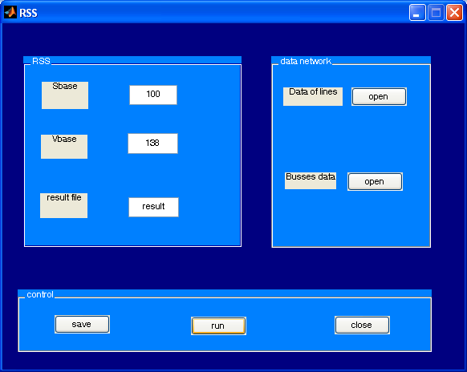
6- the MATLAB code: we used the MATLAB program to make
A load flow program and after a huge effort we get this program
1
2
3
5
4

Slide 43
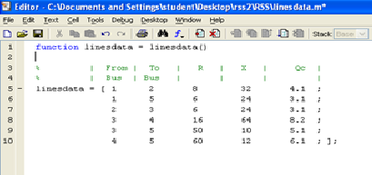
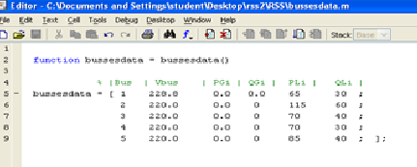
This the data we used in the program and after that the result:

Slide 44
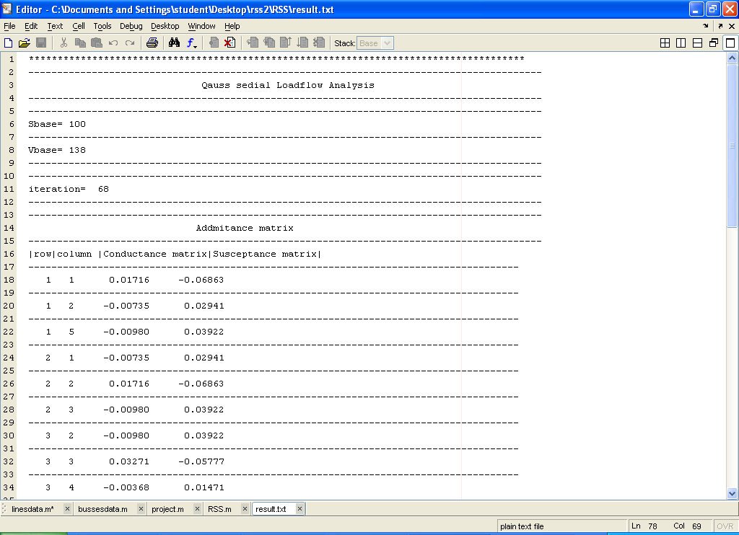
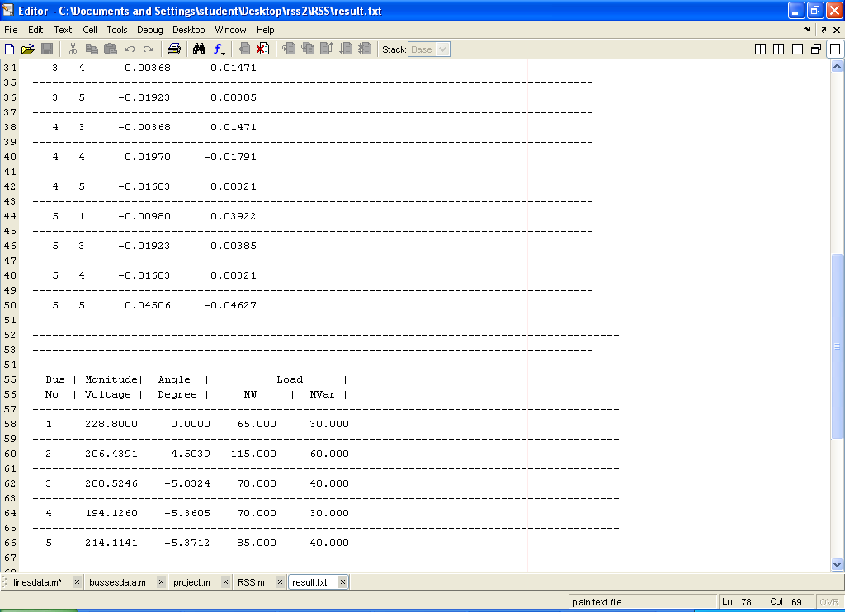
This is the result the we get :

Slide 45
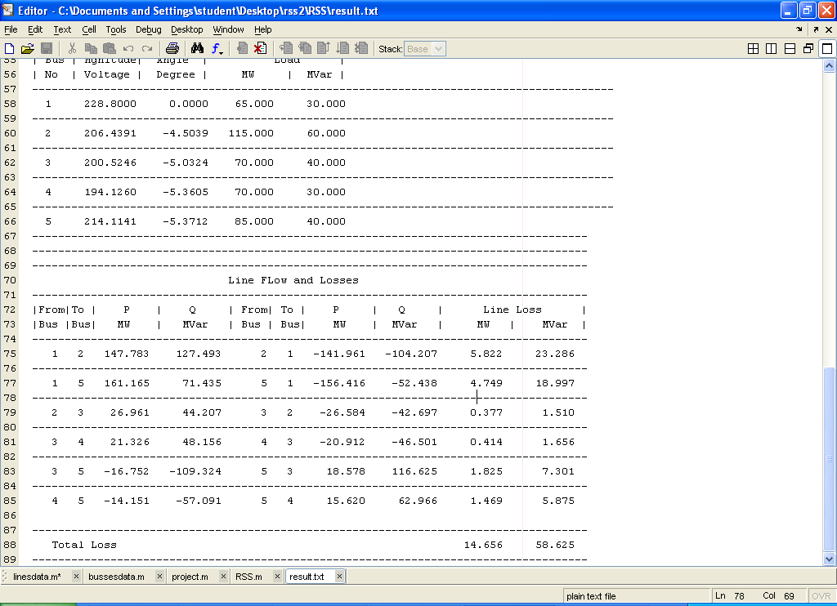

Slide 46
Conclusion :
The design of any network should cover two important sides the technical and the economical side to reach the optimum design and this side we take in our design, but after design we should but the network under condition to see if it can stand these condition is:
1- Maximum condition
2- Minimum condition
3- After Fault condition
After we do these studied the network we came out of result indicate that the network is ready to be installed .

Slide 47
?

