Slide 1
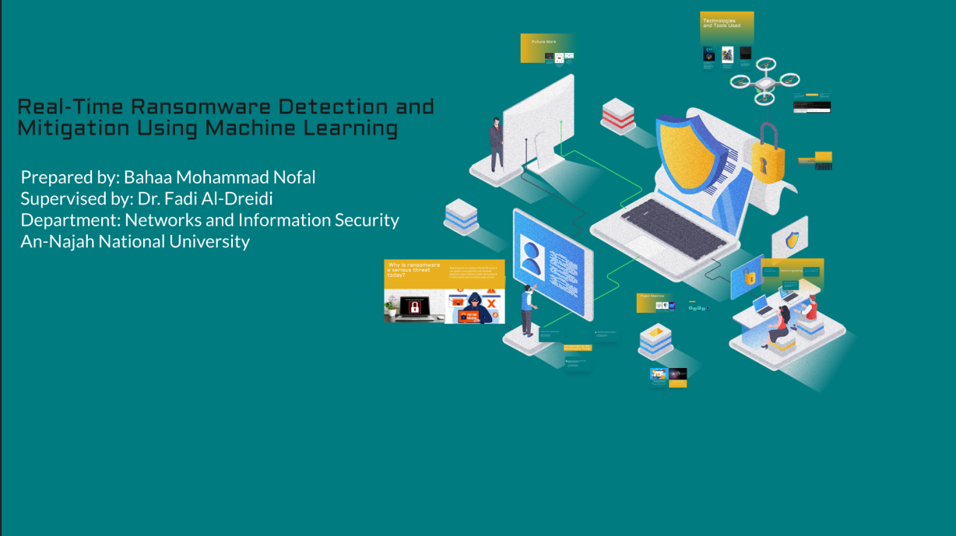
Prepared bye Bahaa Mohammad Nofal Supervised by: Dr. Fadi Al-Dreidi Department: Networks and Information Secu An-N jah National University

Slide 2
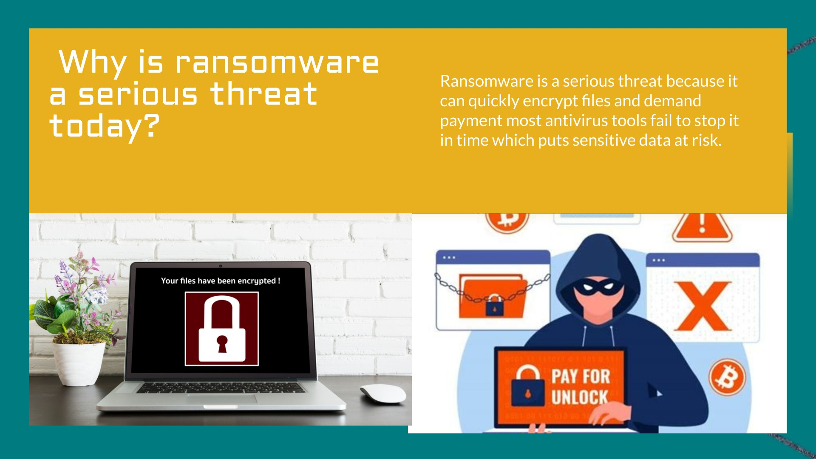

Slide 3


Slide 4
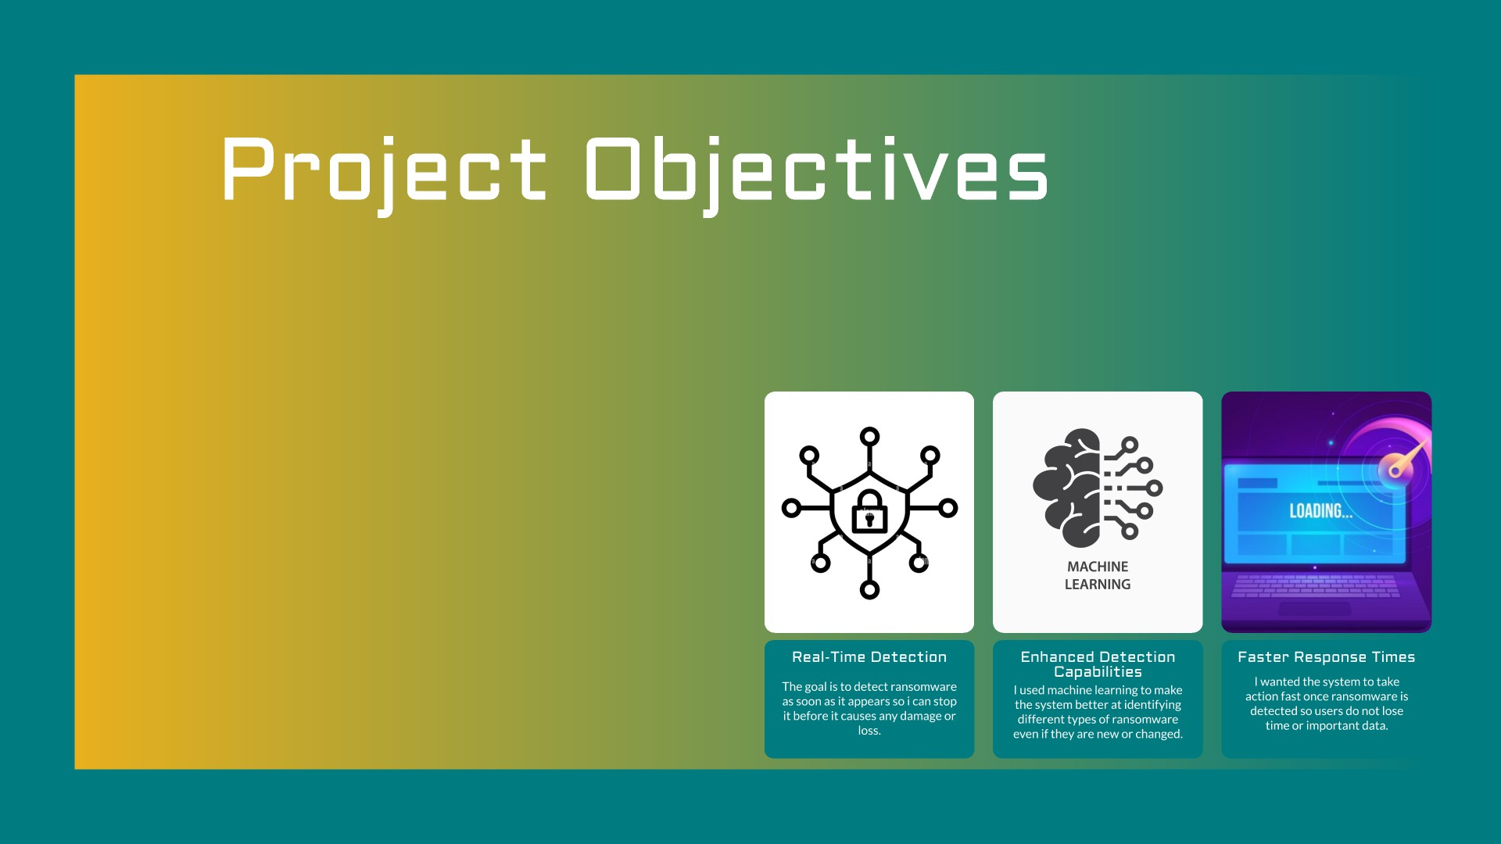

Slide 5


Slide 6
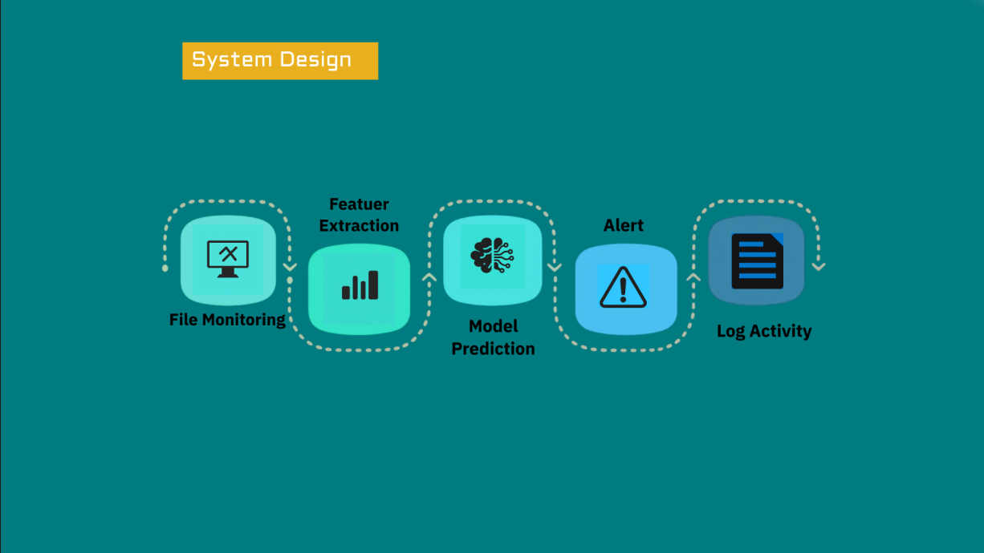

Slide 7


Slide 8
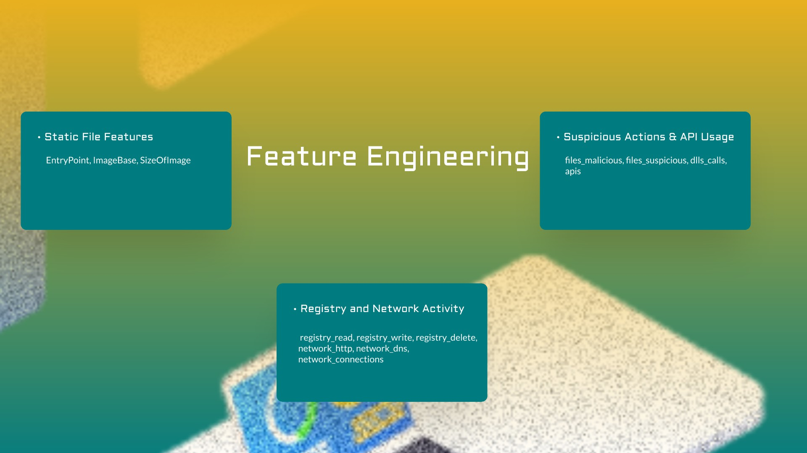

Slide 9
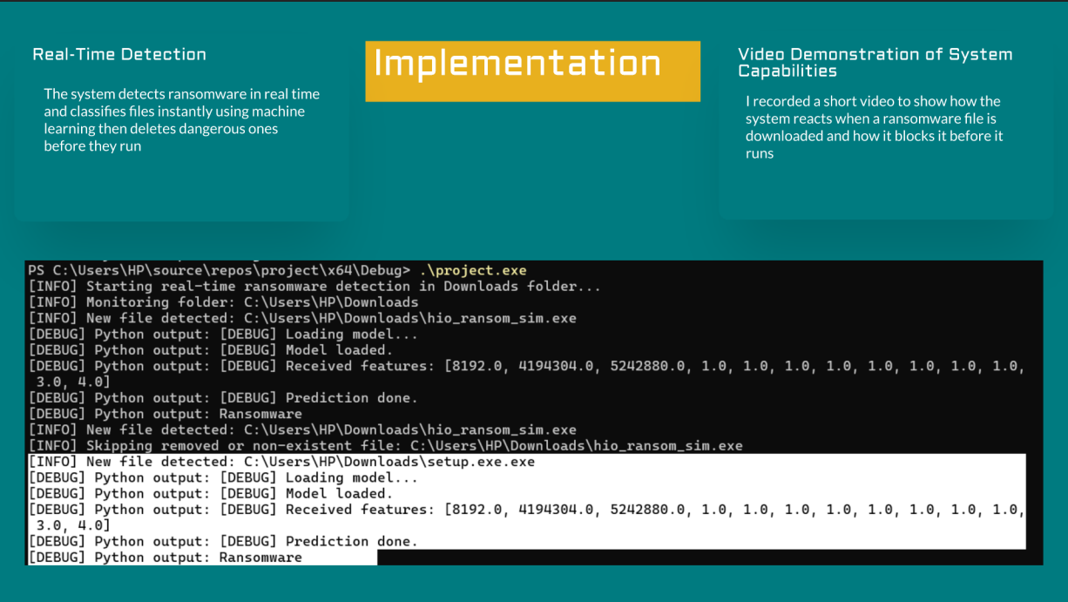

Slide 10
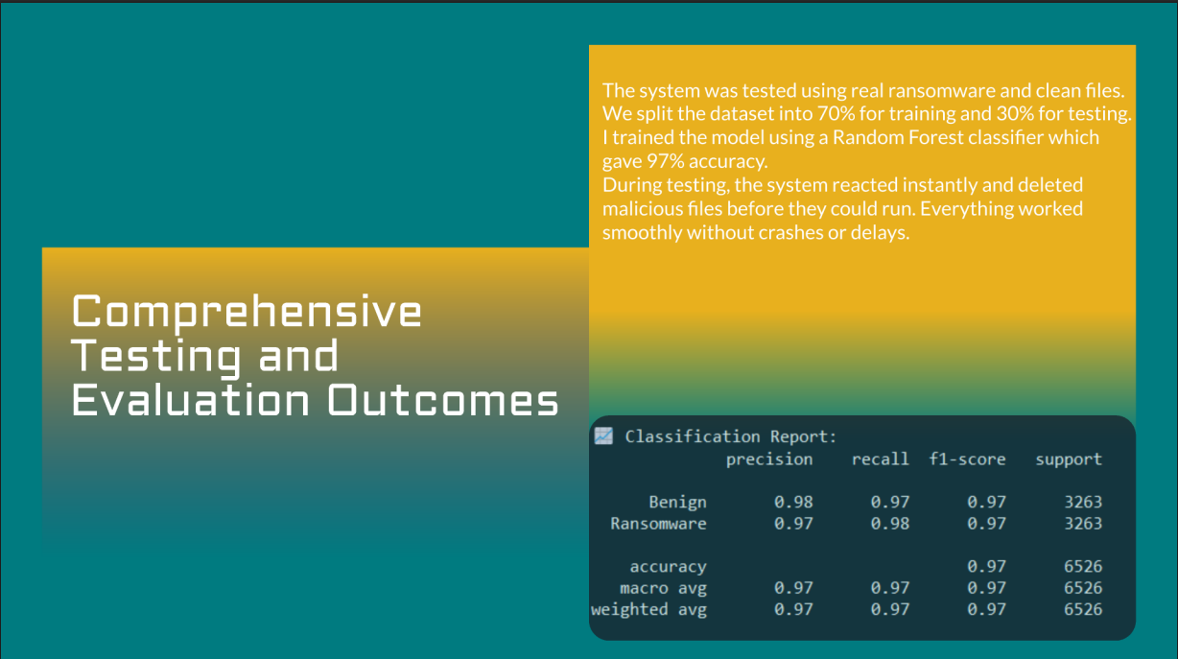

Slide 11
