Slide 1


Analytic Hierarchical Process - Based Supplier Selection in Dental Healthcare
Graduation Project
By: Balsam Khalil Maya Abu Arayes Raghad Shehadeh
Supervisor: Dr. Yahya Saleh

Slide 2



Outline
Introduction
1
4
Methodology
Constraints &
Earlier Courses
2
5
Results & Analysis
Literature Review &
Previous Studies
3
6
Conclusion &
Recommendations

Slide 3

01
Introduction

Slide 4

1.1 General Background
  A person's quality of life is significantly impacted by dental issues
  For dentists, creating a loyal patient base is essential
  Key: Service Quality
  Low-quality supplies lead to shoddy work, patient dissatisfaction & legal action
  Quick changes in the dental healthcare environment

Slide 5



1.2 Dental Healthcare in Palestine
  Critical sector that faces many challenges
  According to FDI, Palestine has serious problem in this sector
  Availability of supplies is a main concerns & selection of reliable supplier plays a core role

Slide 6

1.3 Problem Statement
  Supplier selection have effects on customer satisfaction
  Right materials from right suppliers with right qualities & quantities & right time
  It depends on many factors, so it’s MCDM
  Using AHP
  No study has been conducted in Palestine

Slide 7



1.4 Research Objectives
Study the ways in which dentists make these decisions
Increase dentists' ability for selecting the best supplier
Develop a clear methodology & assessment tool to use

Slide 8

02
Constraints & Earlier courses

Slide 9


2.1 Constraints & Limitations
Reactivity
Lack of Knowledge
Randomness
not all dentists were eager to assist
about the AHP, had to explain the purpose
most dentists switch suppliers & pick randomly

Slide 10
2.2 Earlier Courses
Methods of Quantitative Analysis II
Supply Chain Management
Decision Analysis
Computer Applications Lab
Total Quality Management

Slide 11

03
Literature Review & Previous Studies

Slide 12

Literature Review
1
4
Decision Analysis
Supplier Selection and Evaluation
2
5
Multi – Criteria Decision Analysis
Dental Health Care
3
6
Supply Chain
Analytic Hierarchy Process (AHP)

Slide 13
Supplier selection using AHP
Hsu & Pan (2009)
Kumcu & Ozyoruk (2020)
  Used AHP & Monte Carlo
  Developed a model to measure service quality
  Used AHP & 0-1 programming
  Quality the most important criteria
Erdebilli et al., (2021)
Ali & Kassam (2022)
  Used TOPSIS & Linear Programming
  To identify best orthodontic brackets supplier
  Used integrated fuzzy AHP-TOPSIS
  Quality the most crucial factor

Slide 14

04
Methodology

Slide 15

Methodology
1. Study Approach
3. Tools & Data Collection
5.Quality Standards
Qualitative & Quantitative
  Questionnare &interviews
  Consistensy
2. Sample & Population
4. Data Analysis
  Non-probability Convenient sampling
  AHP& Software

Slide 16


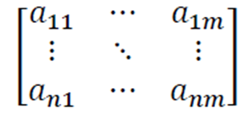
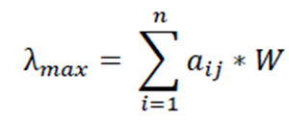
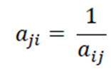
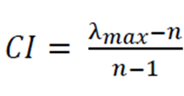
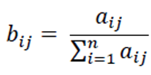
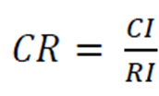
AHP Steps
2
Identify
the
Goal
1
Compare
the
significance
If the CR <10%, it is consistent
Otherwise go back to step 2
3
Calculate the
weights
5
Calculate the consistency
ratio (CR)
4

Slide 17

05
Results & Analysis

Slide 18
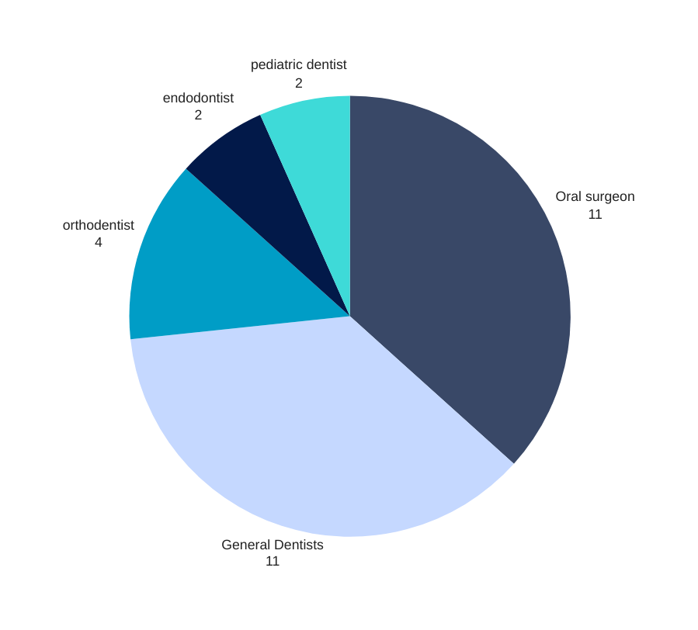
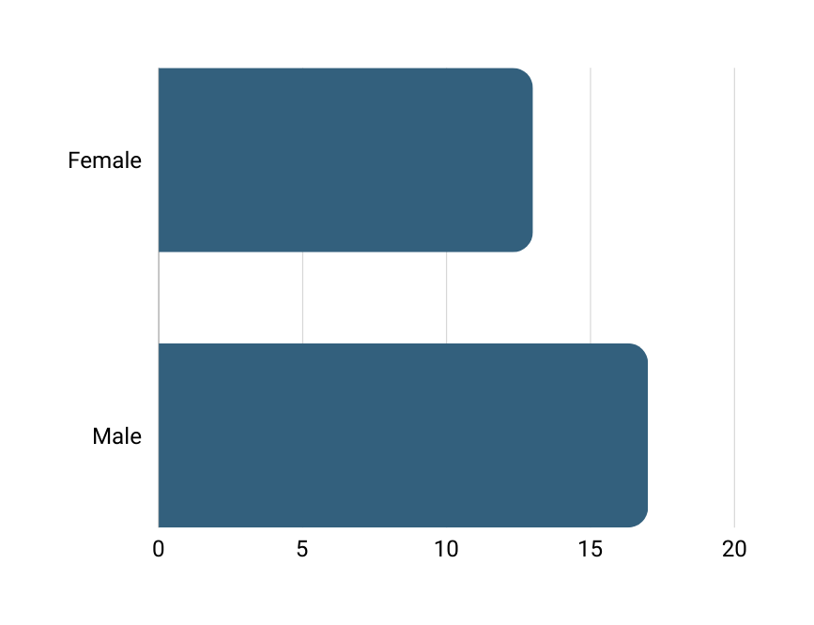

5.1 The Results of the
First Questionnaire
SPECIFIC SPECIALIZATION
43.7%
GENDER

Slide 19


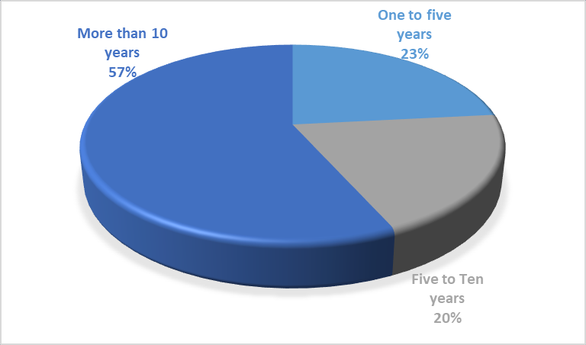


5.1 The Results of the
First Questionnaire
International suppliers
6.7%
Regional Suppliers
16.7%
100%
Local suppliers
YEARS OF EXPERIANCE
SOURSE OF SUPPLIERS

Slide 20



5.1 The Results of the First ﻿Questionnaire
Number of suppliers dentists Deal with
60%
30%
10%
Dealing with 1 - 4 suppliers
Dealing with 5 - 8 suppliers
Dealing with more than 8 suppliers

Slide 21
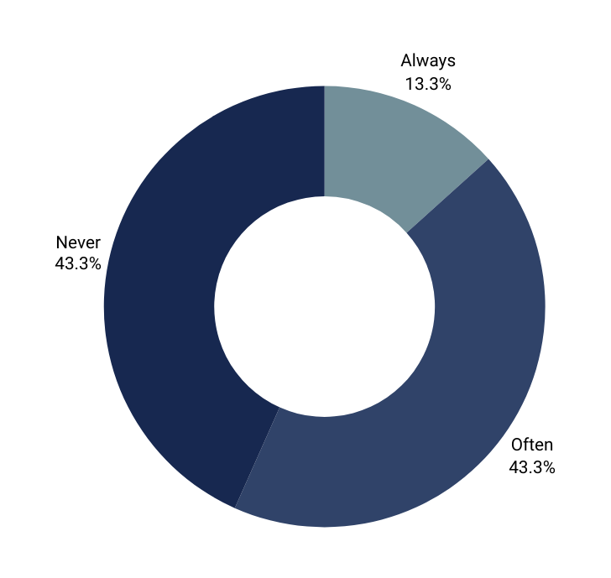

5.1 The Results of the First ﻿Questionnaire
20%
80%
Facing Difficulties
The Need for a Guide

Slide 22
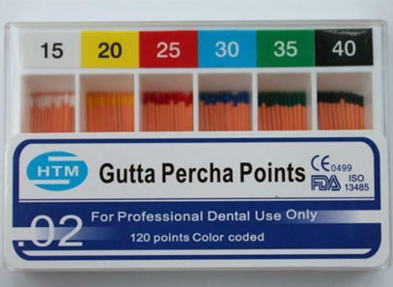
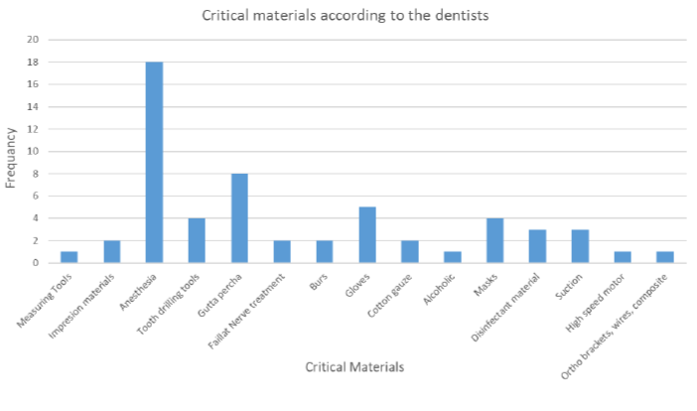
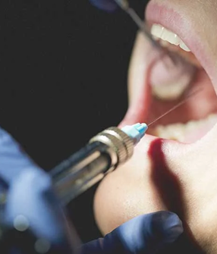

Filling material
Critical Materials
Anesthesia
Gloves

Slide 23
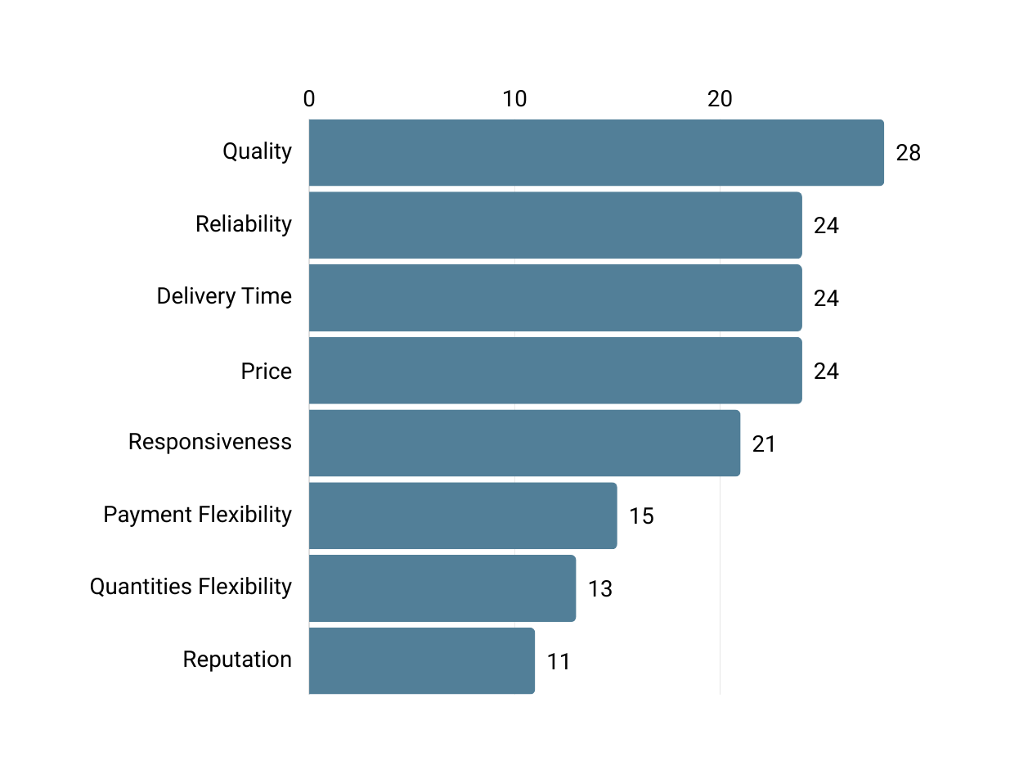
5.1 The Results of the First ﻿Questionnaire
Evaluating Factors

Slide 24




Factors
Quality
Reliability
Delivery Time
Price
Responsiveness
Providing the desired quality standards and product specifications
The ability to perform the promised service dependably and accurately
The amount of time that it takes for goods that have been bought to arrive
Cost refers to purchasing each product
The willingness to help customers and to provide prompt service

Slide 25


5.2 The Results of the Second ﻿Questionnaire﻿
  Based on the top five factors, 41 dentists were asked to complete the second questionnaire.
  In order to determine the consistency ratio (CR) and the relative weights of the various criteria.
The following hierarchy was established for our analytic tool, AHP Online, using a demo version of the software.
Goal: selecting the best supplier
Level 0
Level 1
Quality
Delivery time
Responsiveness
Price
Reliability

Slide 26

Mean Matrix
Using the software, the Mean matrix was as follows:
 | Quality | Reliability | Delivery time | Price | Responsiveness
Quality | 1 | 3.283673 | 4.049022085 | 4.336751 | 1.547867446
Reliability | 0.304537 | 1 | 1.398685095 | 1.875596 | 1.116790699
Delivery time | 0.246973 | 0.714957 | 1 | 1.932844 | 0.877529927
Price | 0.230587 | 0.533164 | 0.517372428 | 1 | 0.523066113
Responsiveness | 0.64605 | 0.895423 | 1.139562276 | 1.911804 | 1

Slide 27
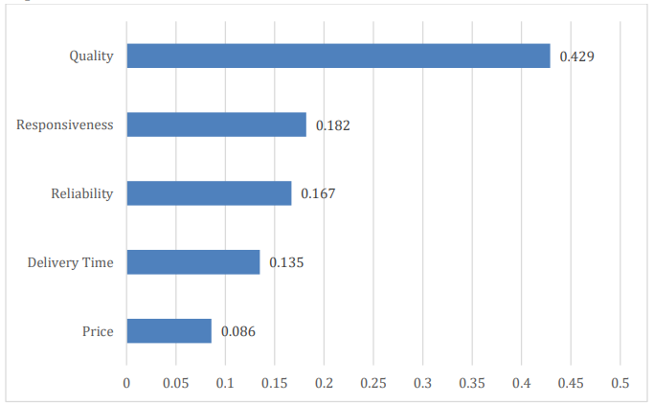

Priority Vector
The priorities were calculated and obtained as shown:
Priority Vector
42.9%
18.2%
16.7%
13.5%
8.6%

Slide 28




Via conducting the previous AHP equations:
λ𝑚𝑎𝑥 = 5.1147
Consistency Index (CI) = 0.02898
Random Consistency Index (RI)= 1.12
Consistency Ratio (CR) =0.025609
n = 5
Since CR < 10%, which is (2.561%) then the inconsistency is acceptable and compatible with AHP

Slide 29
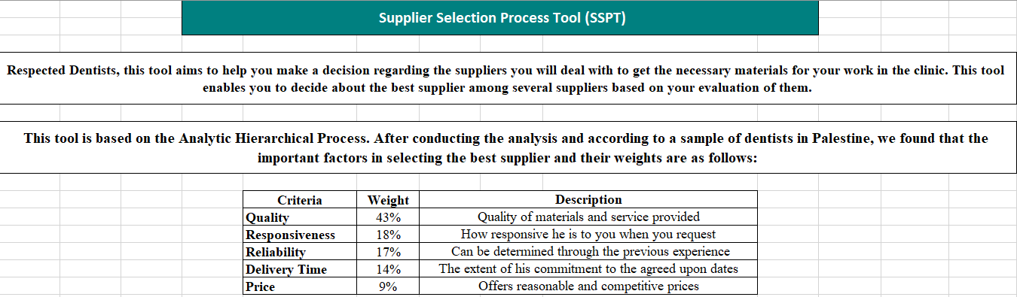
5.3 Supplier Selection Process Tool (SSPT)

Slide 30

06
Conclusions & Recommendations

Slide 31

6.1 Conclusion
  Supplier selection in dental healthcare is a crucial consideration.
  Choosing a dental clinic supplier should be based on specific criteria with related weights for the best decision.
  AHP is a valuable tool for dentists in supplier selection that enhances objectivity and effectiveness.
  The main criterion that most dentists care about is Quality, followed by Responsiveness, Reliability, Delivery time and price.

Slide 32

6.2 Recommendations
1
Commitment to use this designed tool
Provide the suppliers with feedback after the results of AHP comparison
3
2
Encourage dentists to adopt AHP as an approved decision-making tool
4
Establish workshops for dentists to explain the importance of decision making

Slide 33


Thank You!

