Slide 1

Graduation Project II
Integrated Redesign of School of Fine Art
Prepared By:
Leena Dwaikat
Dina Abu Hamed
Asma’ Maslamani
Supervised By: Eng. Hasan Mathar

Slide 2
Outlines:
Introduction
Site analysis
Architectural design
Structural design
Environmental design
Electrical design
Mechanical design
Safety
Quantity Survey

Slide 3
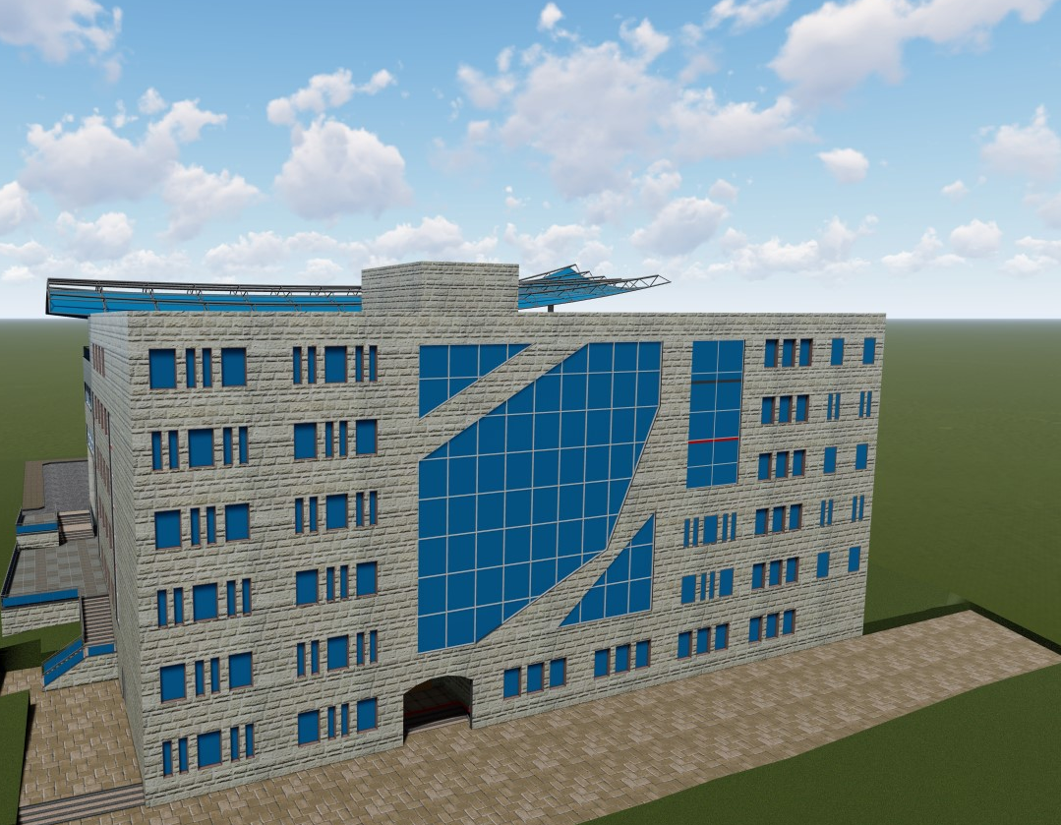
Introduction:

Slide 4
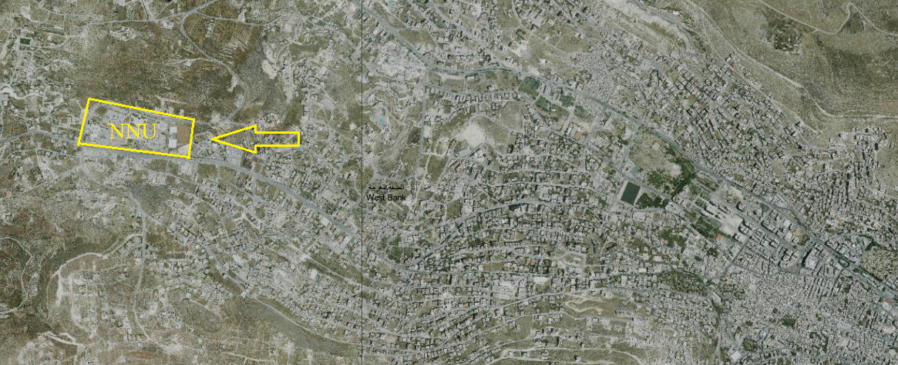
Site Analysis:

Slide 5
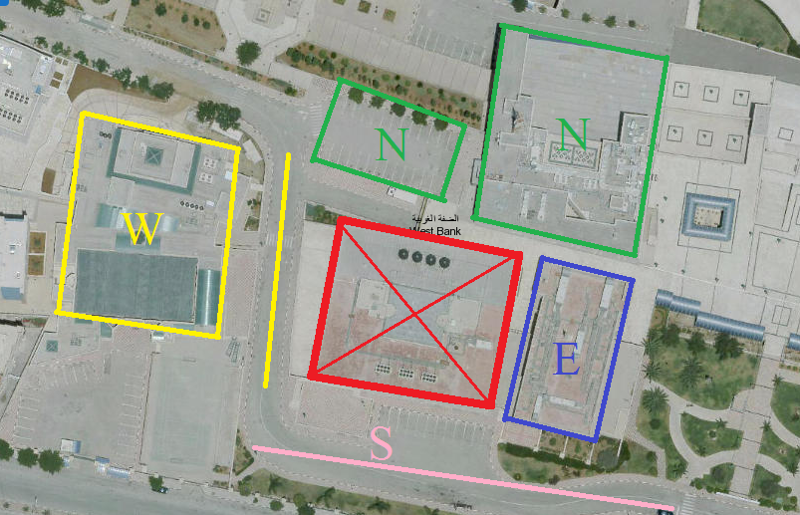
Site Analysis:

Slide 6
Architectural Design

Slide 7
Main Problems:
Insufficient area of some spaces, such as: classrooms, studios and computer labs.
Insufficient number of W.C’s.
Insufficient number of lifts (the existed are 2, the needed are 3).
Insufficient movements area.
Lack in the music department spaces.

Slide 8
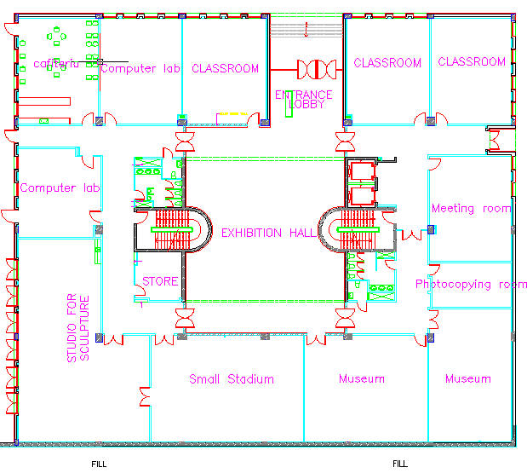
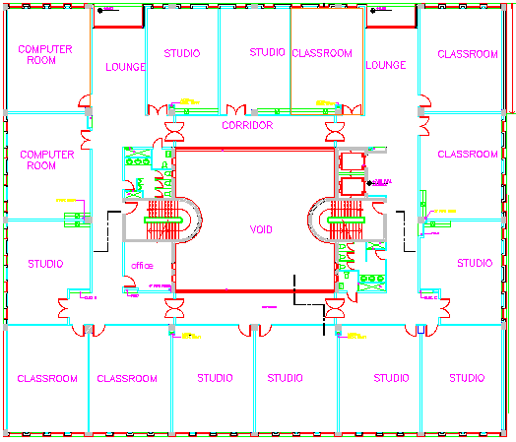
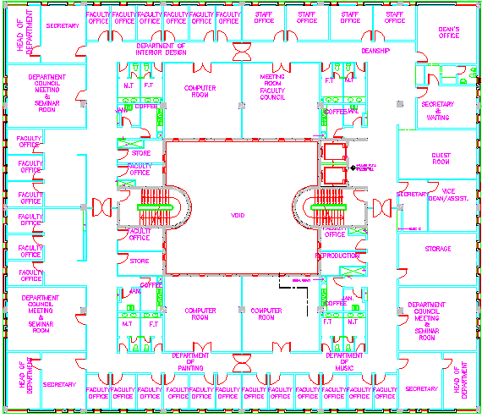
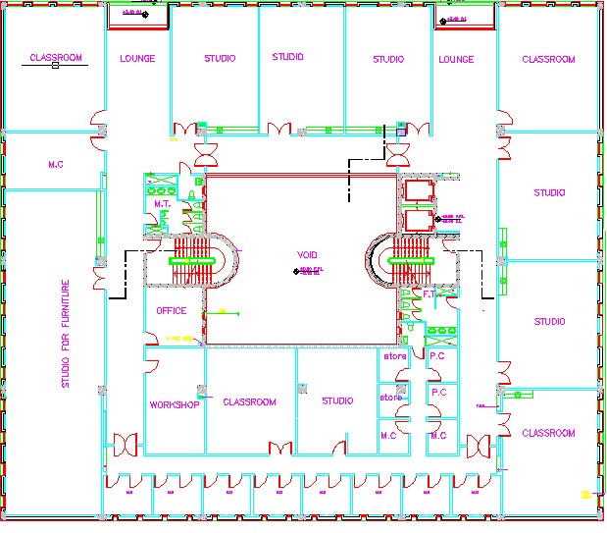

Slide 9
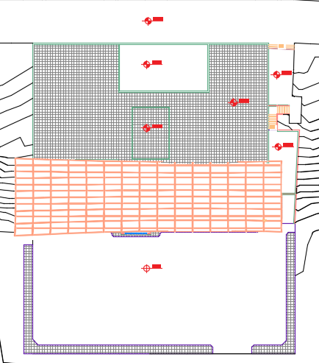
Architectural Design:
7 Floors – 13500 m²

Slide 10
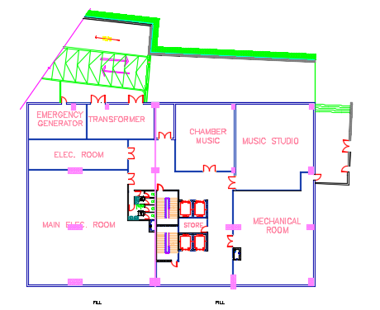
Basement Floor 2:
Service Floor – Area = 1440 m²

Slide 11
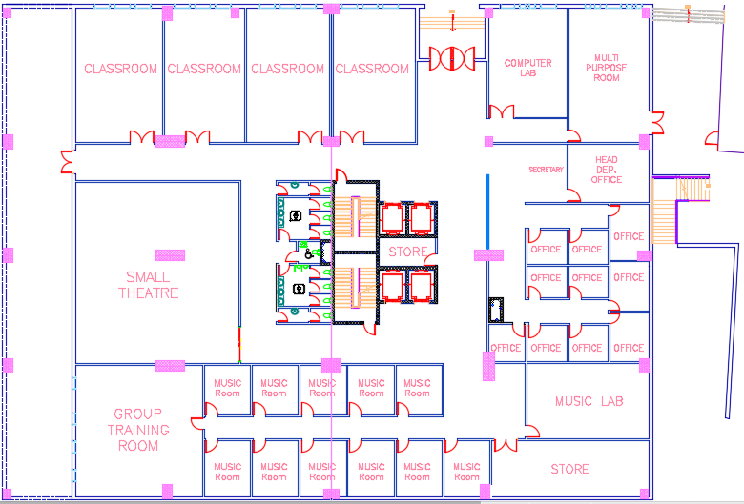
Basement Floor 1:
Music Department Floor – Area = 1977 m²

Slide 12
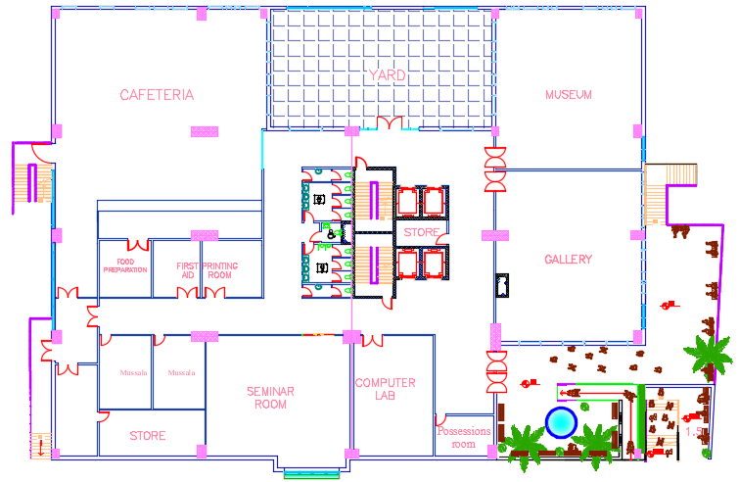
Ground Floor:
Ground Floor – Area = 2055m²

Slide 13
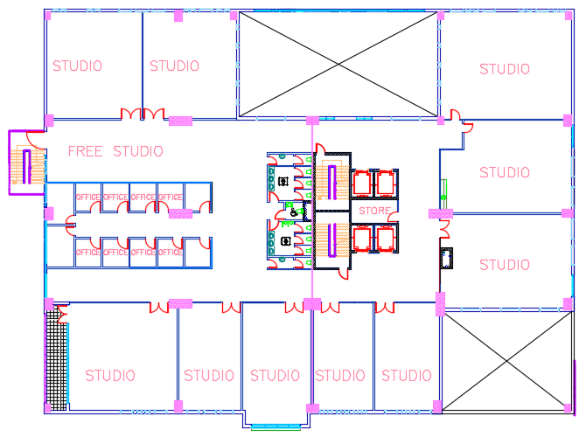
First Floor:
Graphic & Interior Design Department– Area = 2055m²

Slide 14
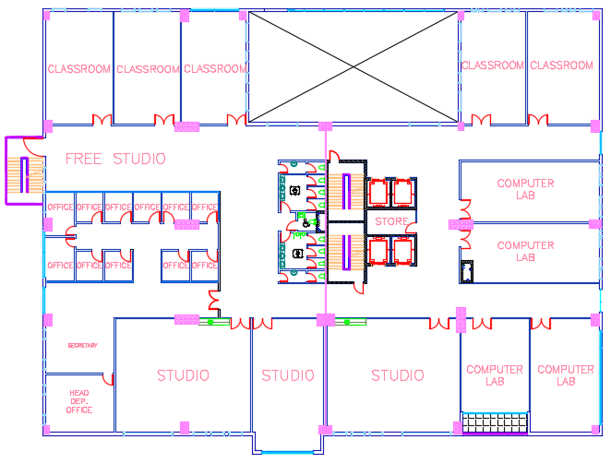
Second Floor:
Graphic & Interior Design Department– Area = 2200m²

Slide 15
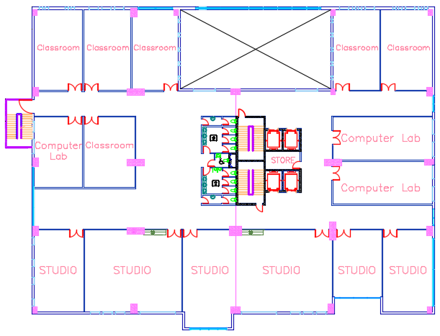
Third Floor:
Applied Art Department– Area = 2200m²

Slide 16
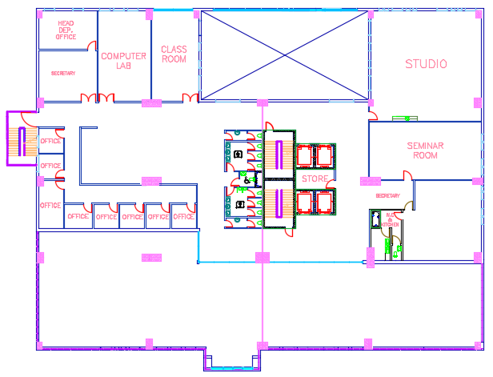
Fourth Floor:
Applied Art Department– Area = 1545 m²

Slide 17
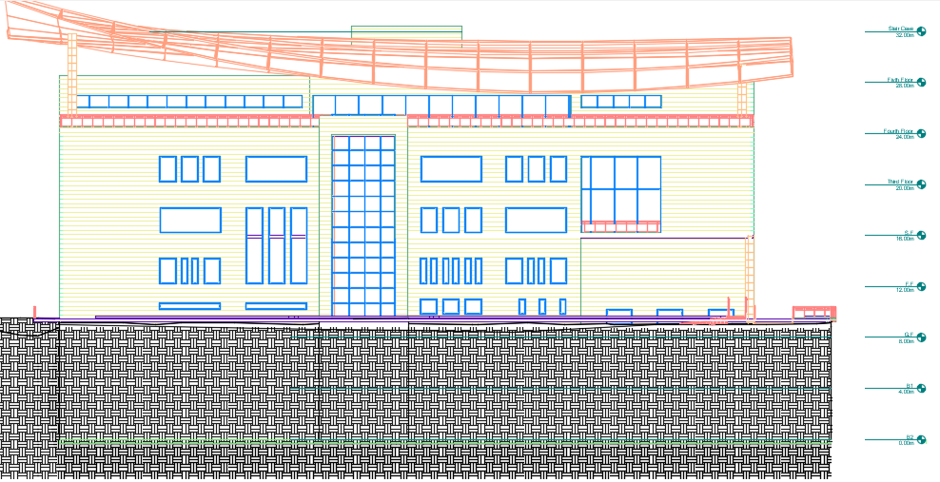
South Elevation:

Slide 18
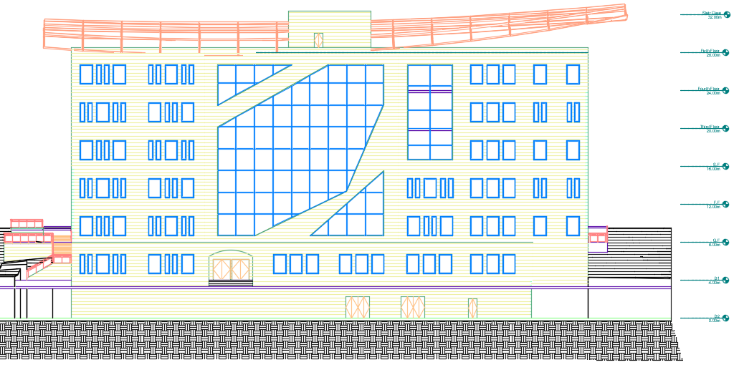
North Elevation:

Slide 19
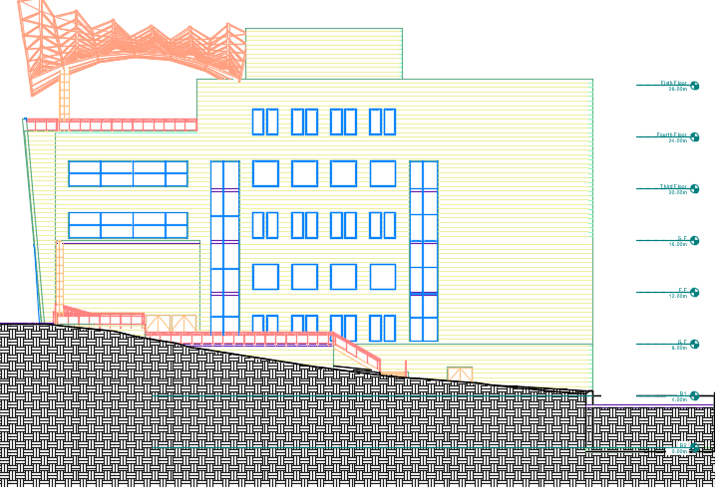
East Elevation:

Slide 20
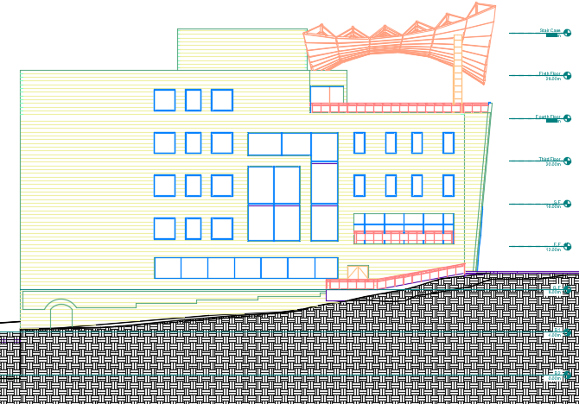
West Elevation:

Slide 21
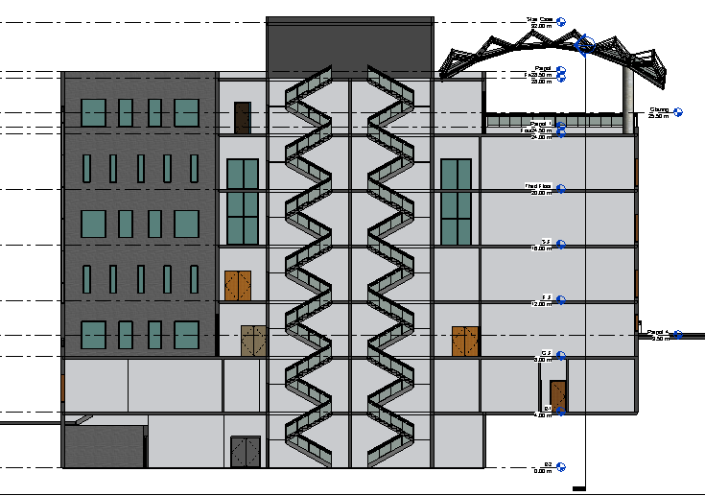
Section 1:

Slide 22
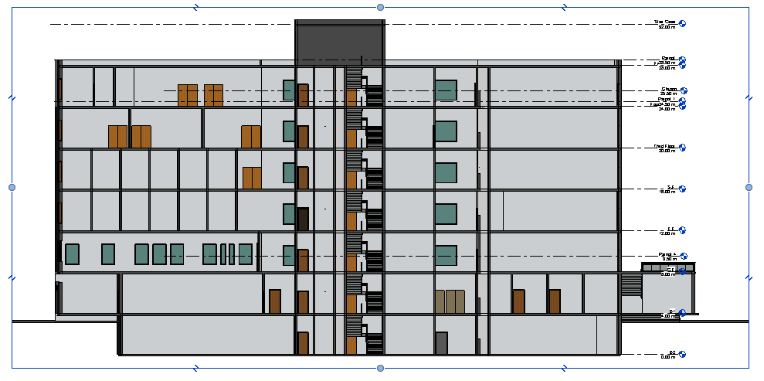
Section 2:

Slide 23
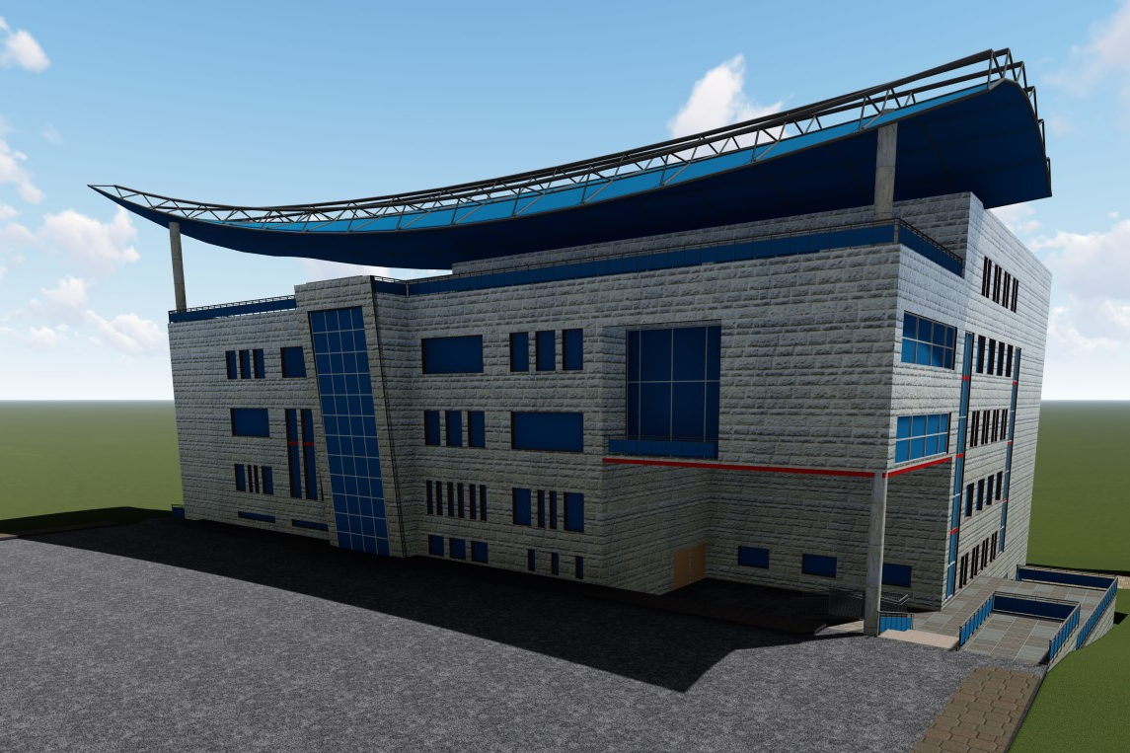
3D Model:

Slide 24
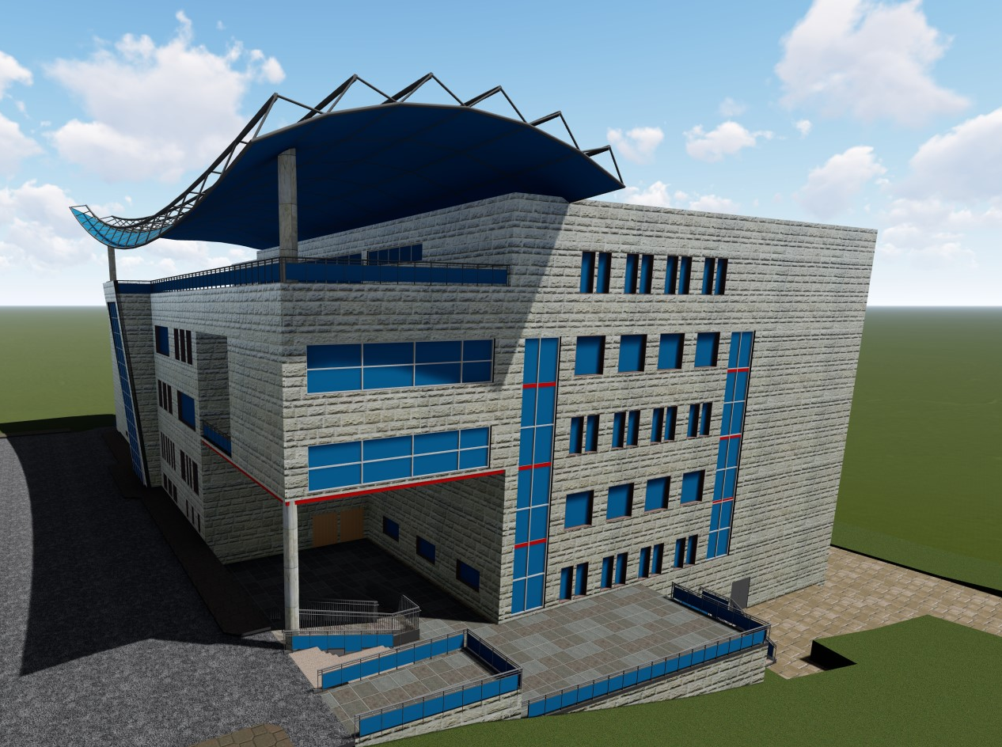
3D Model:

Slide 26
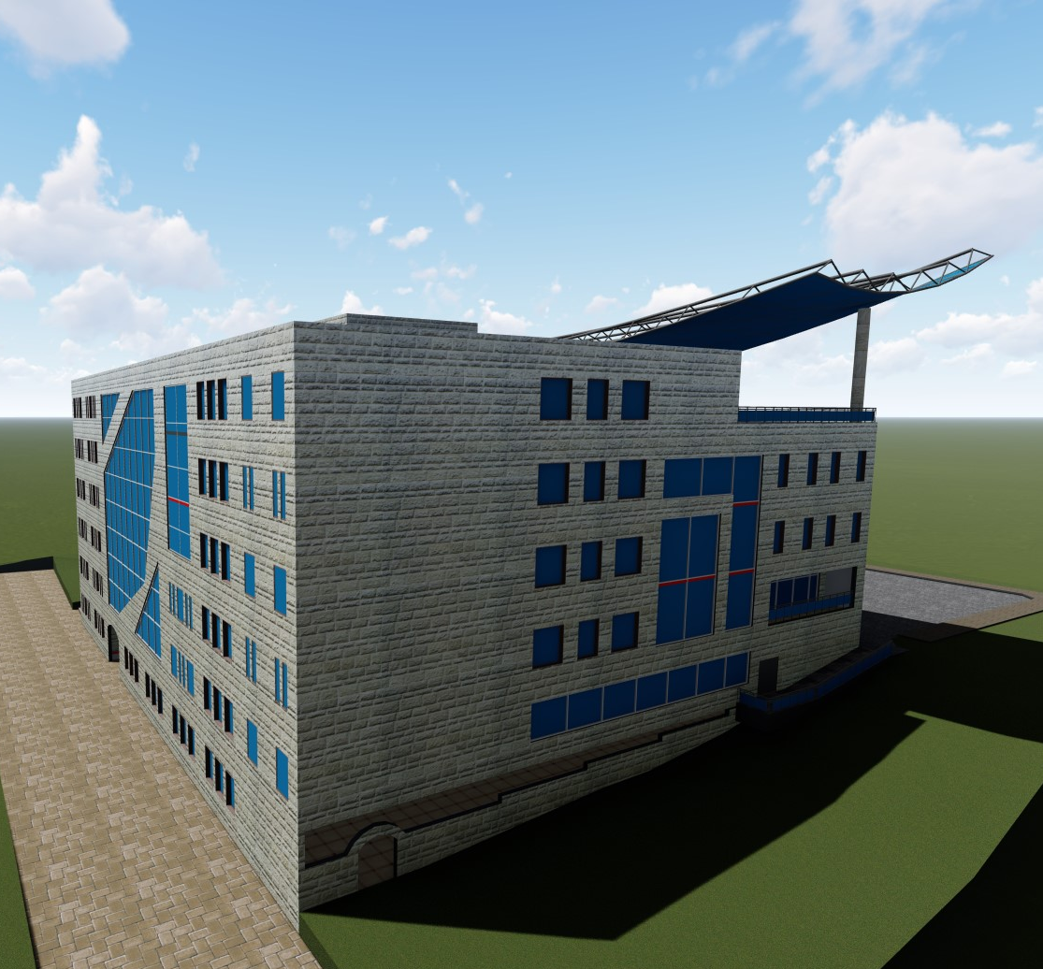
3D Model:

Slide 27
Structural Design

Slide 28
Codes and Standards:
ACI -318-14 for reinforced concrete structural design.
UBC -97 for earthquake design.
ASCE for load combinations
For the design of the structure and its elements ETABS , SAP, SAFE and hand calculations were used

Slide 29
Design data:
Concrete strength, f’_{c}=24 MPa for slabs.
Concrete strength, f’_{c}=28 MPa for other elements.
Steel yield strength f_{y}=420 MPa.
Bearing capacity for soil = 400 kN/m²

Slide 30

Seismic Design data:
The city of structure is Nablus.
The seismic zone factor. Z=0.2.
The soil profile is type Sc.
The acceleration seismic coefficient Ca=0.24
The velocity seismic coefficient Cv=0.32
The Seismic importance factor is 1
The structural design type is intermediate, R=5.5

Slide 31
Sections Dimensions:
Structural Element | Dimensions
U-boot Slab | 50 cm
Columns | (60X80) , ( 80X120 ) , ( 90X240)
Beams | ( 50 X50) , (50 X 80 )

Slide 32
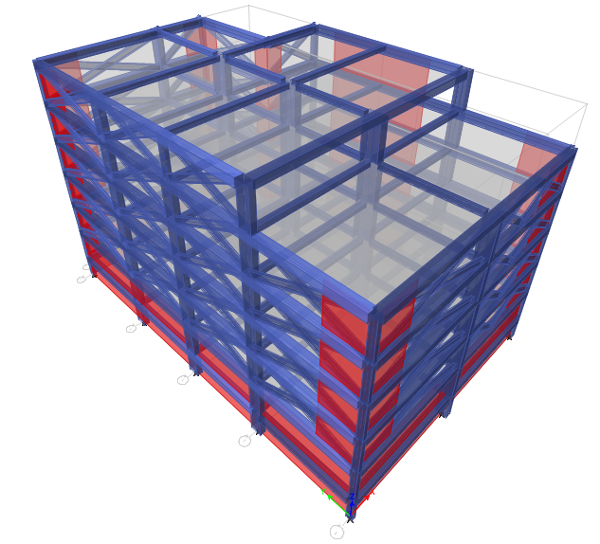
Modeling:

Slide 33
Verification of the model:
Compatibility check
Equilibrium check
Internal force check

Slide 34
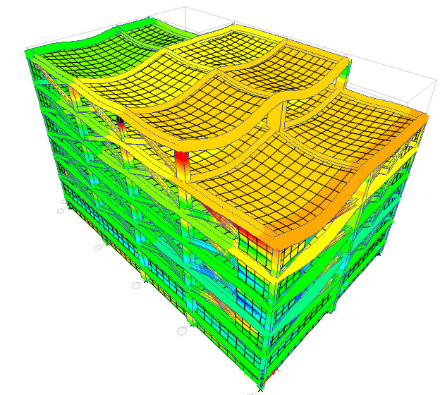
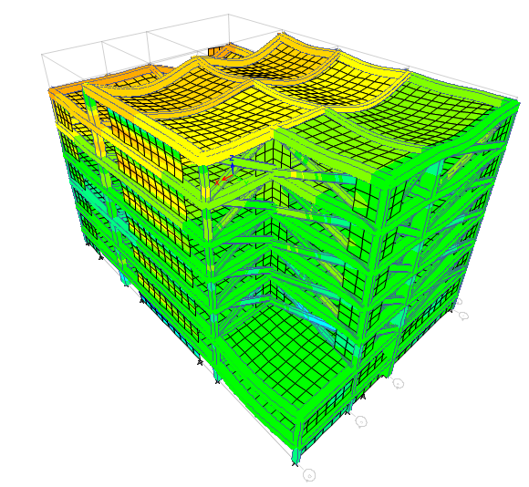
Compatibility check :

Slide 35
Equilibrium Check
Load Case | ETABS | Manual | Error % | Status
 | KN
Dead | 110178 | 109746 | 0.4 | ok
Live | 21004 | 20781 | 1.06 | ok
SID | 35006 | 34635 | 1.06 | ok

Slide 36
Internal Forces Check:
Elements | ETABS | Manual | Error % | Status
 | KN
B1 | 725 | 695 | 4.1 | ok
S2 | 375 | 341 | 9 | ok
Columns | 22048 | 21252 | 3.6 | ok

Slide 37
Seismic Design checks
Time Period Check
0.695 < (1.4×.578 = .804)
Drift Story Check
44.66 mm < 100 mm
Deflection check
54.4 mm < 56 mm
Modal participating mass ratio check
0.9659 > 0.90
Base shear check
21680 kN > 21653.5 kN
22892 kN > 21653.5 kN

Slide 38
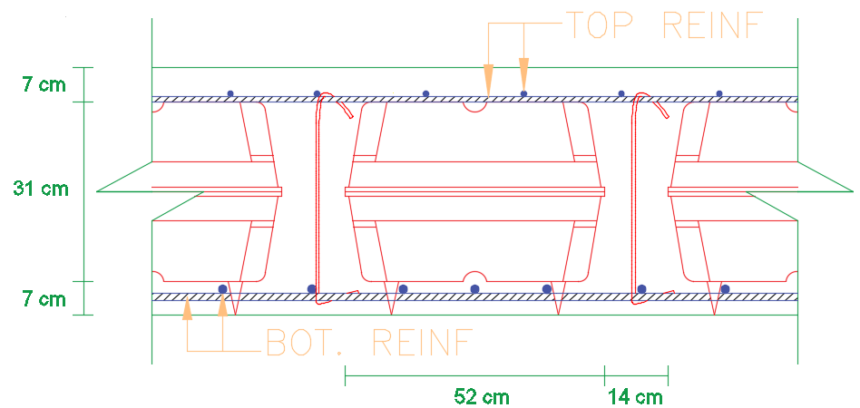
Slab Reinforcement:

Slide 39
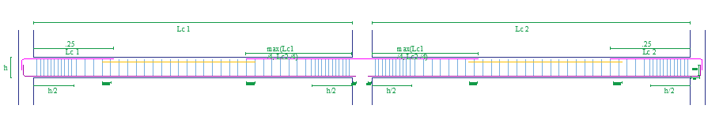
Beams Reinforcement:

Slide 40
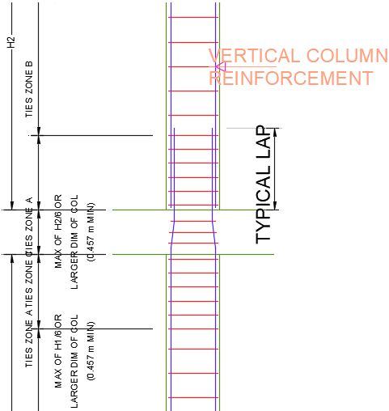
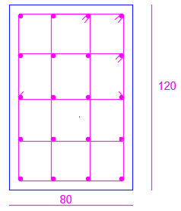
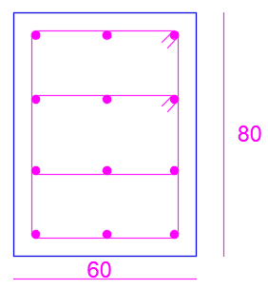
Columns Reinforcement:

Slide 41
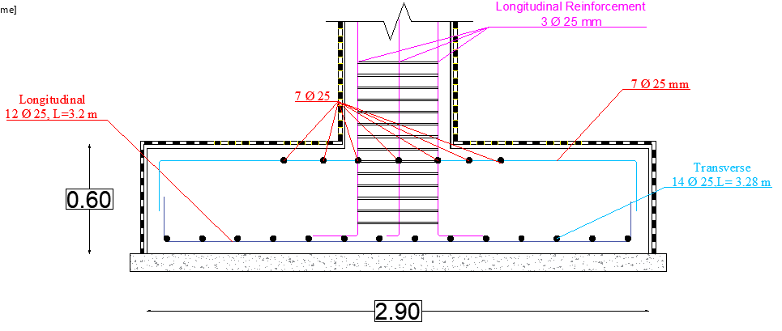
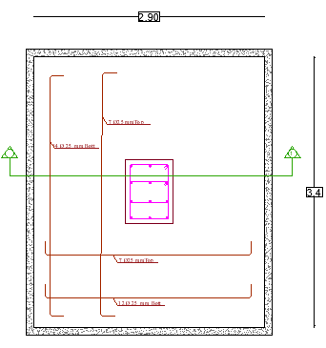
Footing Reinforcement

Slide 42
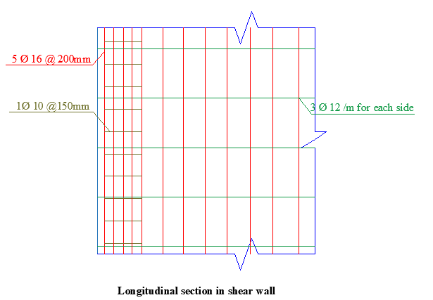
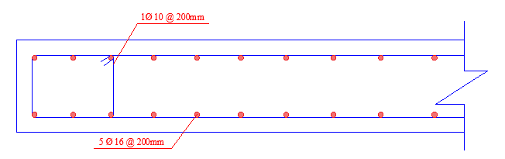
Shear wall Reinforcement

Slide 43
Environmental Design

Slide 44
Environmental Design:
Material used.
Thermal design.
Artificial lighting.
Acoustical design.

Slide 45
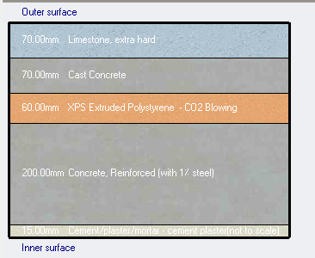
Material used and properties:
External walls layers:
(7) cm limestone
(7) cm cast concrete
(6) cm insulation
(20) cm shear wall
(1.5) cm plaster
U value (W/m2-K)= O.468

Slide 46
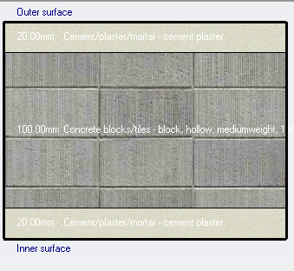
Material used and properties:
Internal walls layers:
(2) cm plaster
(10) cm block
(2) cm plaster
U value (W/m2-K)= 2.097

Slide 47
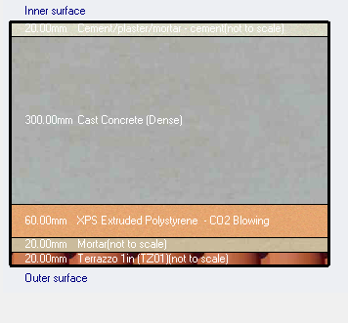
Material used and properties:
Internal floor layers:
(2) cm Terrazzo
(2) cm mortar
(6) cm insulation
(30) cm cast concrete
(2) cm plaster
U value (W/m2-K)=0.433

Slide 48
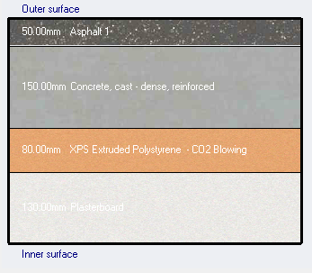
Material used and properties:
Flat Roof layers
(5)cm Asphalt
(15) cm cast concrete
(8)cm insulation
(30) Cm cast concrete
(13)Cm plaster
U value (W/m2-K)=0.316

Slide 49
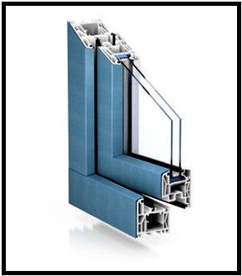
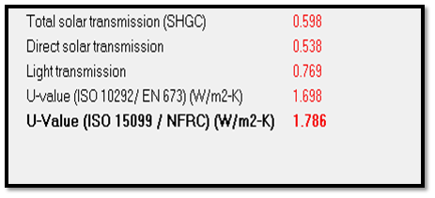
Glass Properties:
Double LoE (e2=0.1) clear glass with 6mm/13 mm Argon gas.

Slide 50
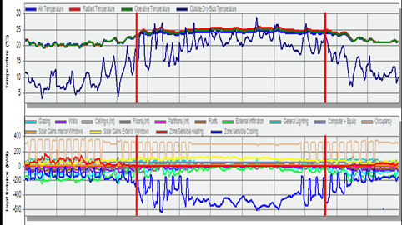
Heating and cooling load analysis:
205.78 kW | Heating design capacity.
435.05 kW | Cooling design capacity.

Slide 51
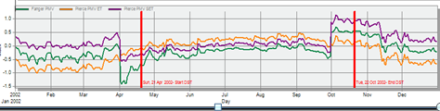
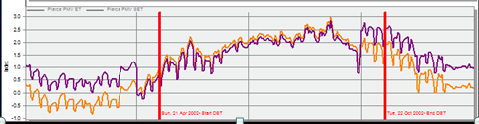
Thermal Comfort:
Thermal Comfort with cooling
Thermal Comfort without cooling

Slide 52
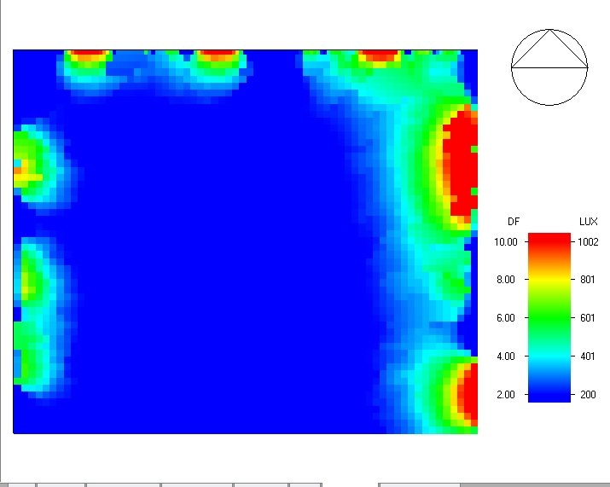
Natural daylight analysis:
DF | Room
2.7 | Classroom
2.6 | Cafeteria
2.2 | Studio
2.3 | offices
2.7 | Theater

Slide 53
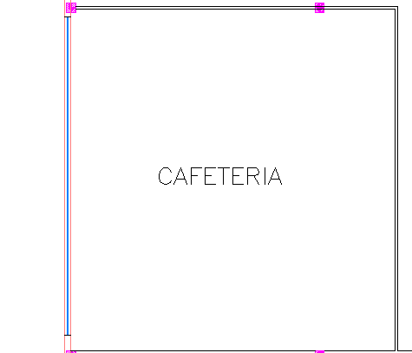
Acoustical Design:
Reverberation Time:
Cafeteria:
The required reverberation time RT60 for the cafeteria is between (0.6 – 1.0)

Slide 54
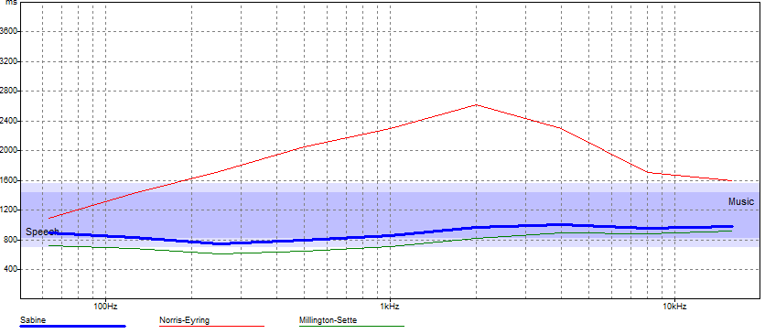
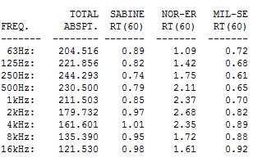
Results from ECOTECT

Slide 55
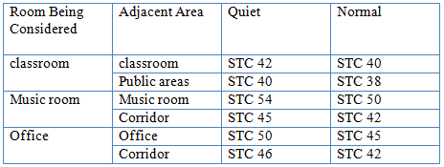
Sound Transmission Class:

Slide 56


STC - Classroom:
STC for external wall
STC for internal wall

Slide 57


Impact Insulation Class
Results from INSUL

Slide 58
Electrical Design

Slide 59


Artificial lighting Design :
Classroom:

Slide 60

Results from DIAlux:
E(lux) recommended | E(lux) from DIAlux
300 | 407

Slide 61

First floor lighting plan

Slide 62

Sockets arrangement for ground floor :
Quantity of sockets | Function
4 | Classroom
5 | Studio
6 | Museum
10 | Cafeteria
3 | W.C

Slide 63

Circuit Breaker Branches:

Slide 64


Sockets Arrangement for Computer Lab:
quantity of sockets | Function
40 | Computer lab

Slide 65
Mechanical Design

Slide 66

Water supply system:

Slide 67

Water distribution system:

Slide 68

Drainage system:
Rain water drainage:

Slide 69

Drainage Layout For Fourth Floor

Slide 70
HVAC design:
Systems used are VRF
Main components of centralized system are
Outdoor unit (chiller)
Inside unit (fan coil)
Collectors
Ducts.
Diffusers

Slide 71


Outdoor Unit:
Model of APSc 60-2S with cooling capacity 238KW

Slide 72


Fan Coil Unit:

Slide 73


Diffusers:

Slide 74



HVAC Design for Computer Lab:

Slide 75

Final duct sizing and distribution of diffusers:

Slide 76

VRF system in third floor :

Slide 77
Safety design

Slide 78



Fire Alarm system:

Slide 79

Fire Alarm Layout For Ground Floor

Slide 80

Fire Alarm Layout For First Floor

Slide 81

Emergency Egress system:

Slide 82
Cost Survey

Slide 83
Work | Total Cost (NIS) | Unit Cost (NIS/m²)
Structural work | 3,621,357 | 278.57
Finishes Work | 1,764,000 | 135.69
Mechanical Work | 1,767,122 | 135.93
Electrical Work | 106,166 | 8.17
Total | 7,258,644.06 | 558

Slide 84
Thank You ☺

Slide 85
Work | Total Cost (NIS) | Unit Cost (NIS/m²)
Structural work | 7,242,713 | 557.13
Finishes Work | 1,764,000 | 135.69
Mechanical Work | 1,767,122 | 135.93
Electrical Work | 106,166 | 8.17
Total | 10,880,000.62 | 837

