Slide 1

Design of water and wastewater networks for the $6^{th}$ neighborhood of Rawabi city
Prepared by:
Shatha Zaid Rahaf Bsharat
Ashraf Taha Noor Surakji
Submitted to:
Dr.Abdel-Haleem Khader

Slide 2

Outline
Introduction
Objectives
Study area
Methodology
Modeling , Analyzing & Design
Result & Conclusion

Slide 3
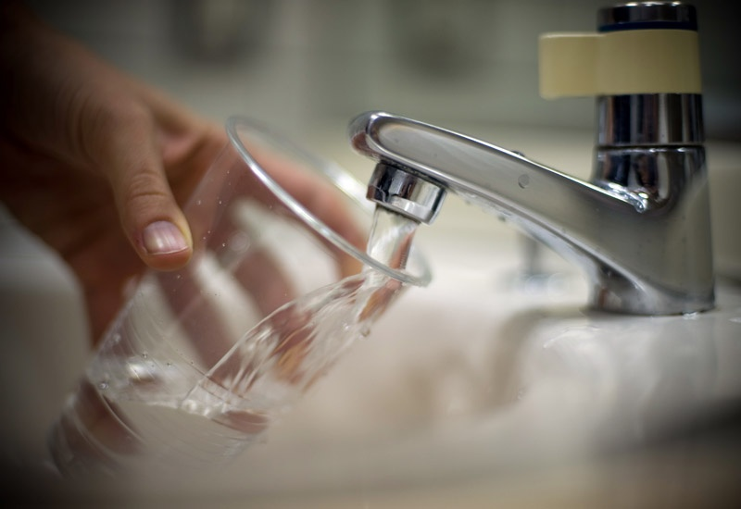
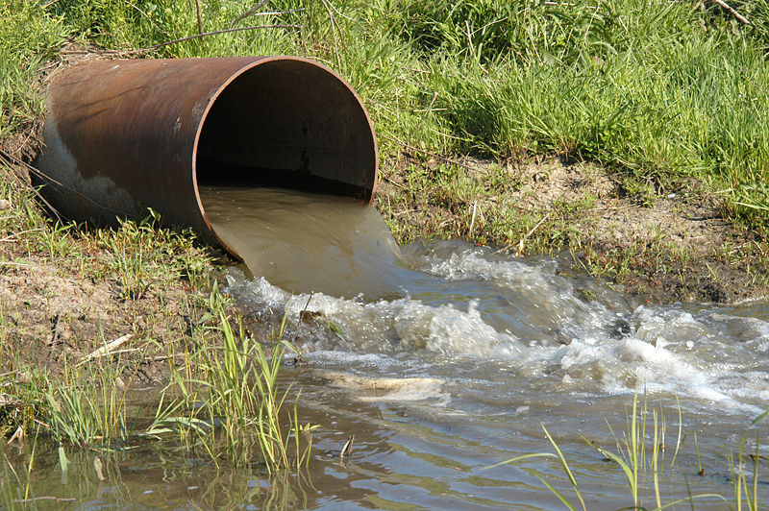
Introduction
Water take a great importance to humans in everyday life most of the activities we do need water. So that demand is continuously increasing, this means increasing the wastewater production, where wastewater constitutes about (80%-90%) of water demand

Slide 4
Objectives
Design of Wastewater collection network that have life period of 30 years.
Design of Water distribution network that have life period of 30 years.

Slide 5
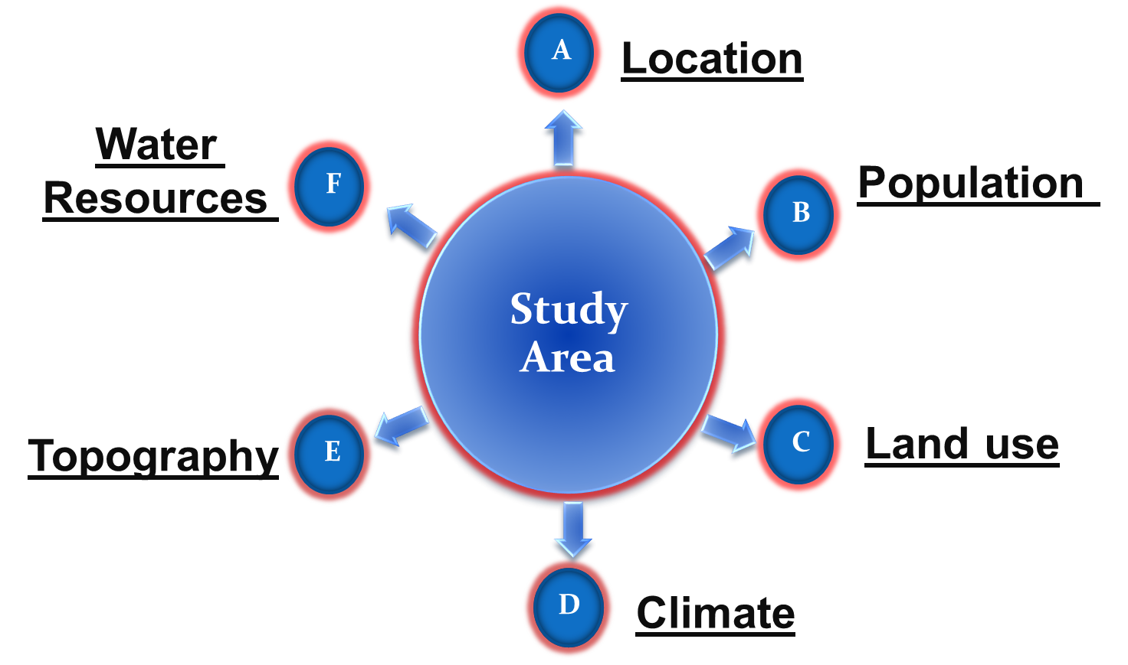
Study Area

Slide 6
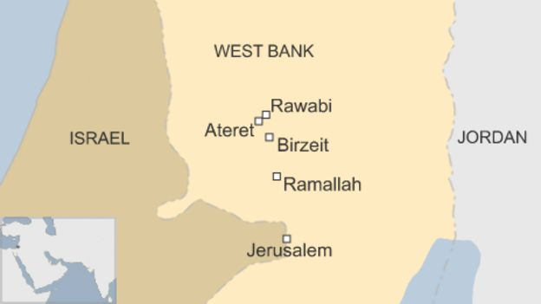
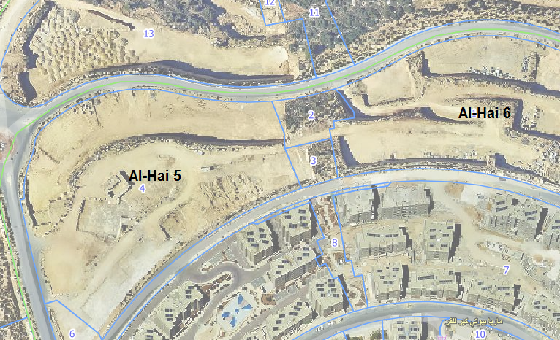
Location

Slide 7
Population
According to master plan from Municipality the neighborhood consists of 10 buildings, with 379 apartments, which are planned for 5 persons for each.
Total population = No. of apartment * No. of capita per apartment
= 379 * 5
= 1895 capita

Slide 8
Land Use
The land use patterns in this neighborhood is residential
Climate
The city is characterized by its Mediterranean climate, In summer, the average temperature is about 22 degree, with a humidity percentage of 55%. On the other hand, the average temperature drops to 8.5 degree in winter
Rawabi has an average annual precipitation of 600 mm

Slide 9
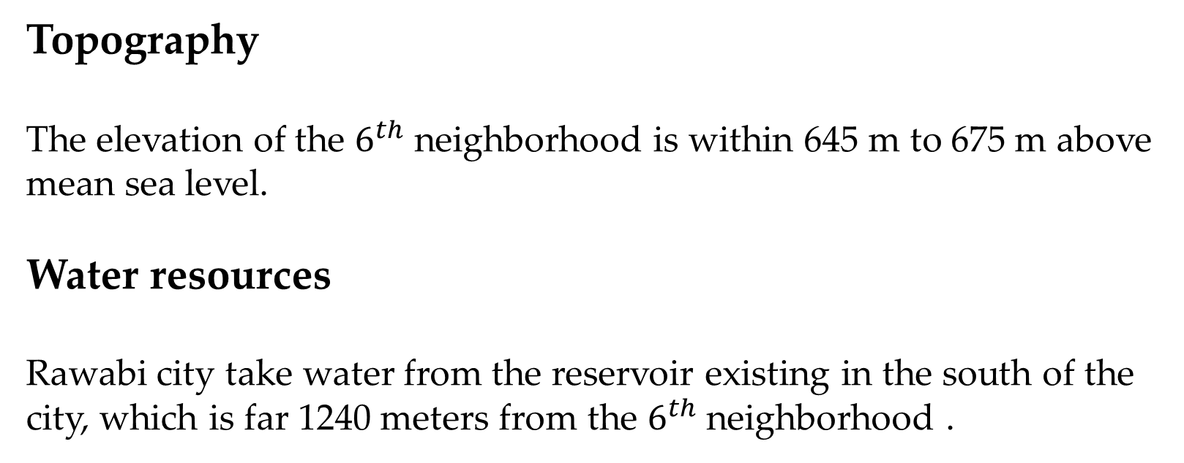
Topography
The elevation of the $6^{th}$ neighborhood is within 645 m to 675 m above mean sea level.
Water resources
Rawabi city take water from the reservoir existing in the south of the city, which is far 1240 meters from the $6^{th}$ neighborhood .

Slide 10
MODELING , ANALYSIS AND DESIGN

Slide 11
Thirdly, we drew the nodes, manholes and pipes of the networks on the map.
Fourthly, we inserted the elevation of nodes and manholes manually in the programs.
Finally, we calculated the demand for each node and manhole, and then we inserted these values in programs
The procedure steps of design water & wastewater network
first of all we start the WaterCad & SewerCad program and import all the files necessary for design
for the analysis of watercad network we used the pressure found in the entrance of the neighborhood and we designed based on it instead of the reservoir.

Slide 12
Water demand represents the necessary minimum amount of water sufficient to meet the basic needs for drinking and residential water losses

Slide 13
From master plan and some assumption;
• The neighborhood has 10 buildings with number of floors & apartments.
• Total number of apartments = 379
• Each apartment has population equal 5 capita.
• Total population = No. of apartment * No. of capita per apartment
= 379 * 5
= 1895 capita
• The consumption per capita equal 120 L/capita.day including all losses in the network
• Maximum hour factor in WaterCad = 1.8

Slide 14
Total demand for WDN = Total population * 120 L/c. d * maximum hour factor
= 1895 * 120 * 1.8 * 10^(-3)
= 409.32 m^3/day
Peak factor in SewerCad (PK) = (3-4)
(PK) =5/P^(1/6) P: population in thousands
= 4.49 > 4 so we take PK = 4

Slide 15
Return fraction of wastewater (RF) = (0.8-0.85), we take 0.85
Infiltration rate (IR) = 20%
Total demand for WWCN = (Total population *120 L/c. d * RF* PF +Total population*120 L/c. d * RF * IR) * 10^(-3)
= 1895 * 120 * 0.85 * 4 + 1895 * 120 * 0.85 * 0.2
= 811.818 m^3/day

Slide 16
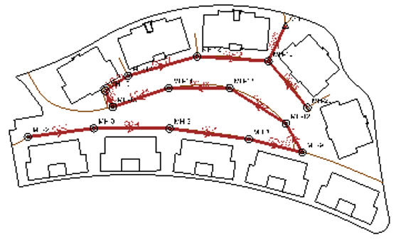
Wastewater collection network

Slide 17
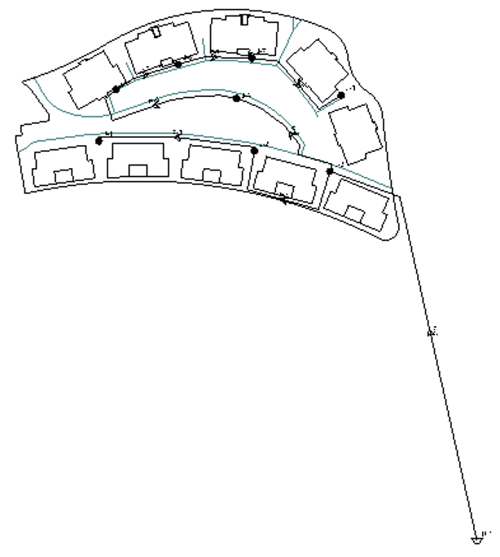
Water distribution network

Slide 18
Water distribution network

Slide 19
Results and Conclusions
Water Distribution Network:
- Pressure:
Allowable Range:
(20-100) m H2O

Slide 20
Results and Conclusions
Water Distribution Network:
- Velocity:
Allowable Range:
(0.3-3) m/s

Slide 21
Results and Conclusions
Wastewater Network:
- Velocity:
Allowable Range:
(0.6-3) m/s

Slide 22
Results and Conclusions
Wastewater Network:
- Slope:
Allowable Range:
(1-15) %

Slide 23
Results and Conclusions
Wastewater Network:
- Cover depth:
Allowable Range:
(0.5-5) m

Slide 24
Results and Conclusions
Changing the diameters Adjusting the pressure, velocity, slope and cover depth.
Our design is applicable and serviceable for the selected design period: around 30 years.
We recommended going ahead with this project.

