Slide 1

Graduation Project
QUICKMART
Majd Waked | Abdullah Shawareb
Supervised by Dr. Hanal AbuZant

Slide 2
01
WHY QUICKMART?
LIST OF CONTENTS
02
TARGET GROUP
03
T E C H N O L O G I E S
04
FEATURES
05
FUTURE WORK

Slide 3

WHY QUICKMART?
CHALLENGES FOR BUYERS
  DECISION OVERLOAD
  QUALITY OF PRODUCTS
  PRICE COMPARISON
  Complex user
  SECURITY CONCERNS.

Slide 4

WHY QUICKMART?
Challenges for sellers
  High competition
  Customer Support
  Order management
  Customer expectations
  MARKETING COSTS

Slide 5

TARGET
GROUP ?
  BUSY PROFESSIONALS
  SMALL TO
MEDIUM-SIZED
TRADERS
  DEAL SEEKERS
  YOUNG ADULTS

Slide 6




TECHNOLOGIES?
FRONT END
FRONT END

Slide 7


TECHNOLOGIES?
BACK END
FOR DATABASE

Slide 8

FEATURES

Slide 9
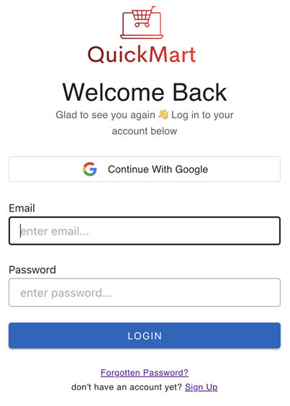
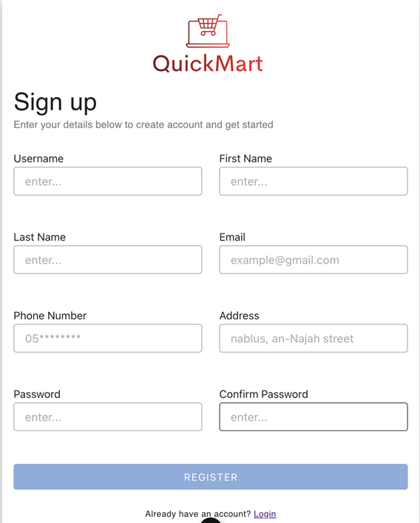
WEB PAGE
Web User Interface
Login Form
Registration Form

Slide 10
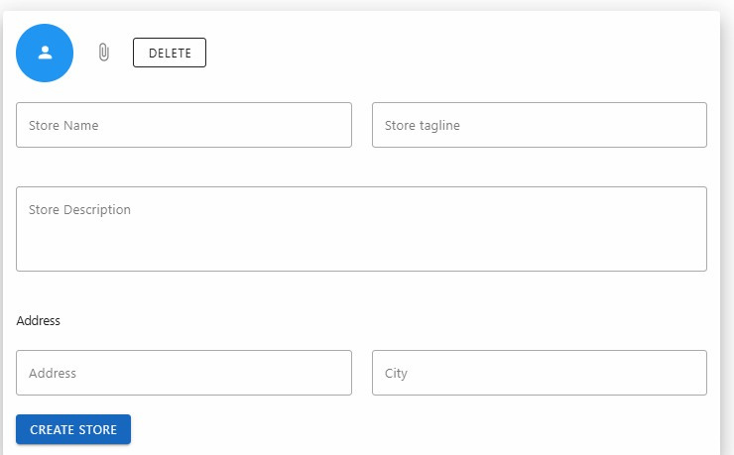
Web User Interface
WEB PAGE
Sign Up As Store

Slide 11
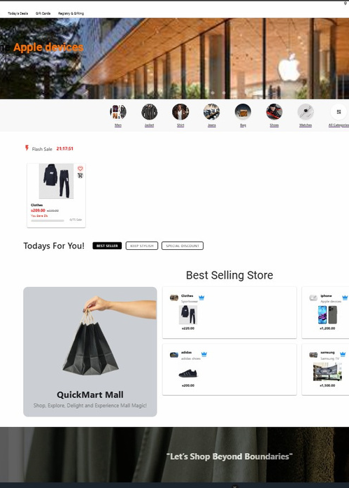
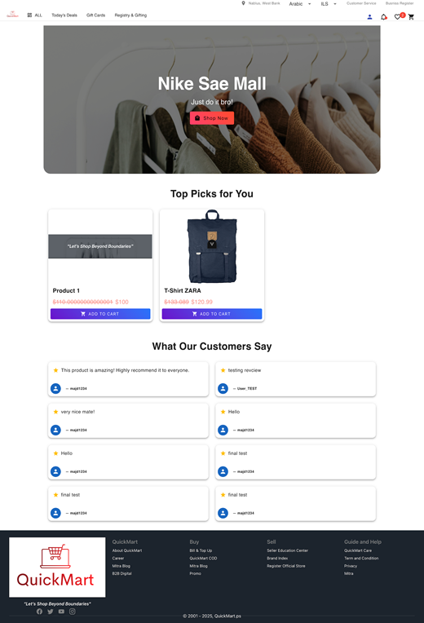
WEB PAGE
Web User Interface
Landing Page
Store Profile Page

Slide 12
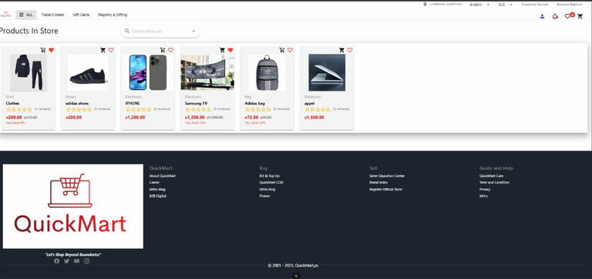

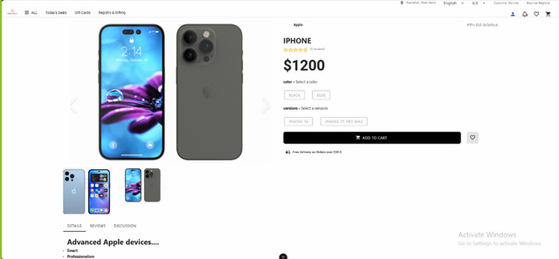
WEB PAGE
Web User Interface
Products Page
Product Details Page

Slide 13
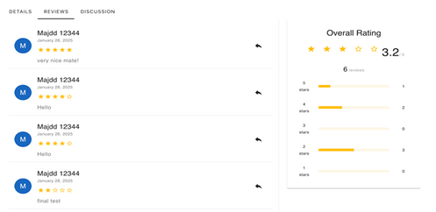
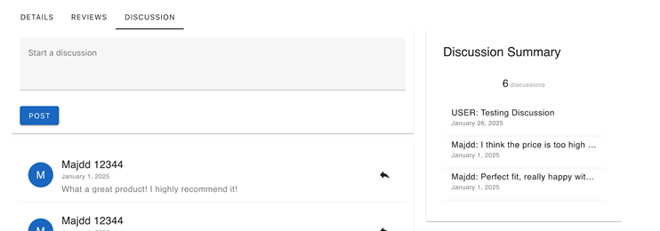
WEB PAGE
Web User Interface
Product Review Section
Product Discussion Section

Slide 14
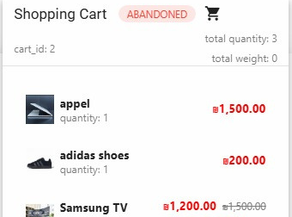
Web User Interface
WEB PAGE
Cart Summery Menu

Slide 15
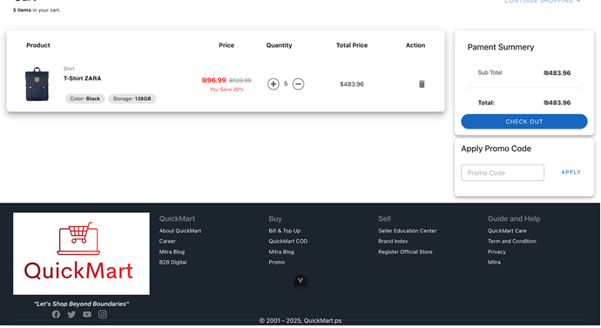
Web User Interface
WEB PAGE
Cart Page

Slide 16
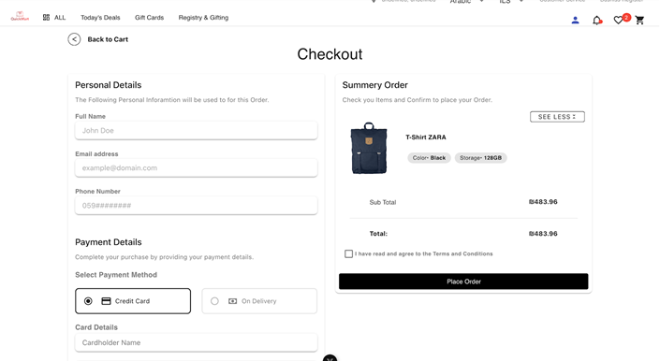
Web User Interface
WEB PAGE
Checkout Page

Slide 17
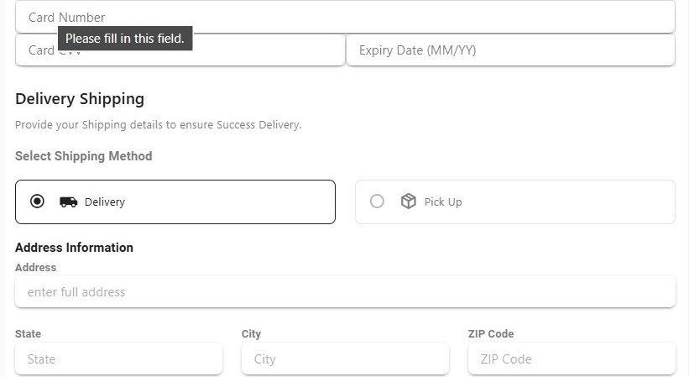
Web User Interface
WEB PAGE
Checkout Page

Slide 18
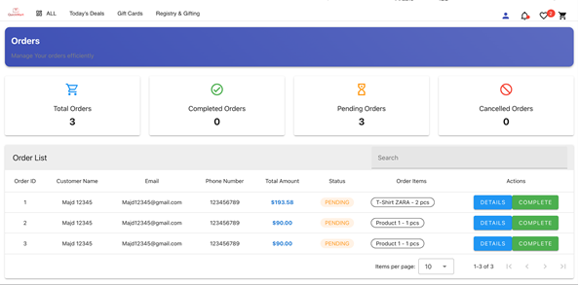
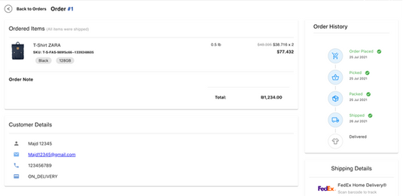
WEB PAGE
Web User Interface
Customer Orders Page
Customer Orders Details Page

Slide 19
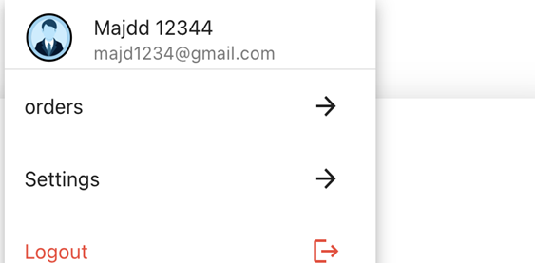
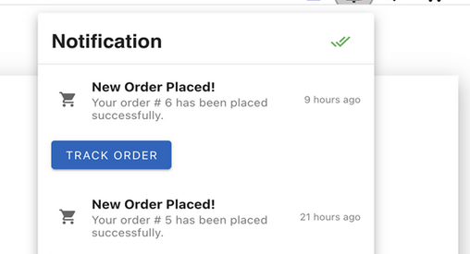
WEB PAGE
Web User Interface
User Menu
Notification Menu

Slide 20
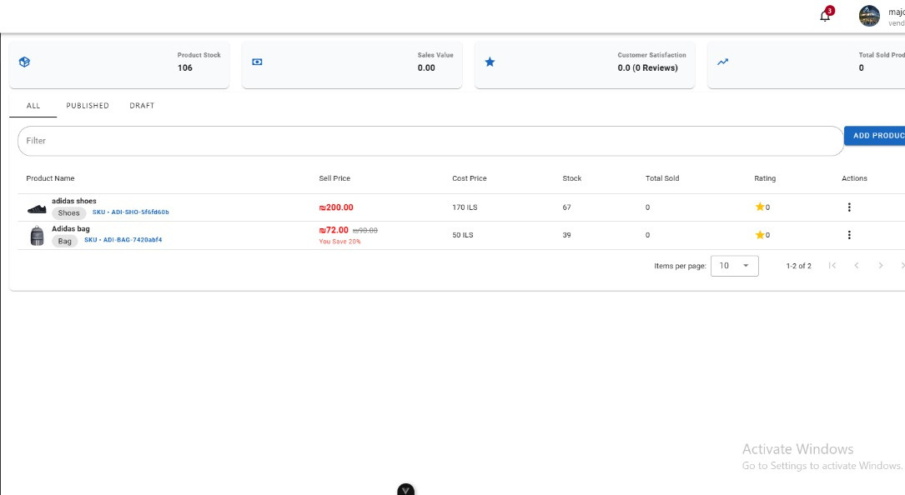
Web User Interface
WEB PAGE
Product Management Page

Slide 21
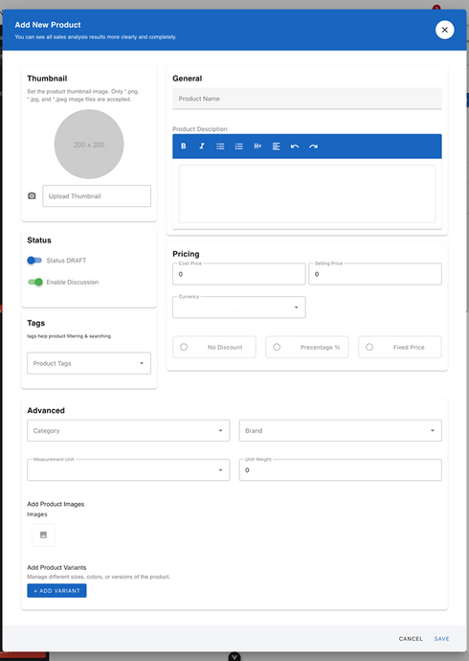
WEB PAGE
Web User Interface
Add Product Form

Slide 22
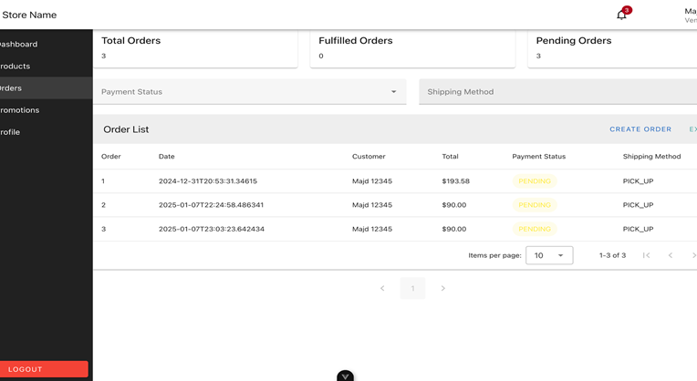
Web User Interface
WEB PAGE
Vendor Order Management Page

Slide 23
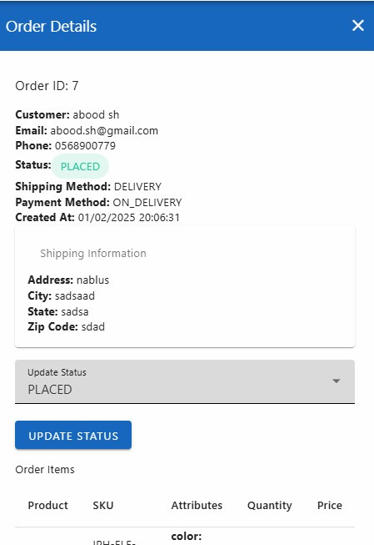
Web User Interface
WEB PAGE
Vendor Order Management Page

Slide 24
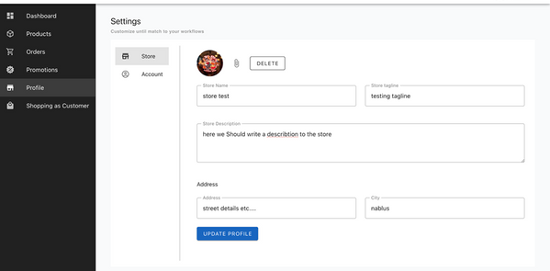
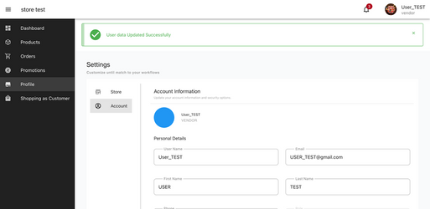
WEB PAGE
Web User Interface
Store Profile Setting Page
Vendor Profile Setting Page

Slide 25
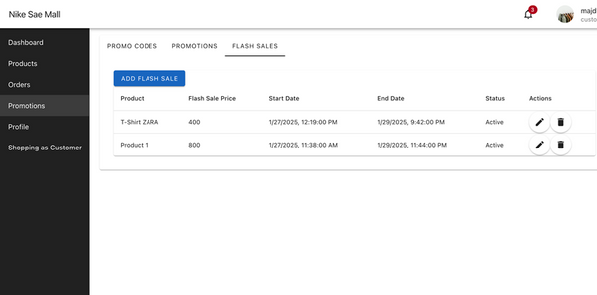
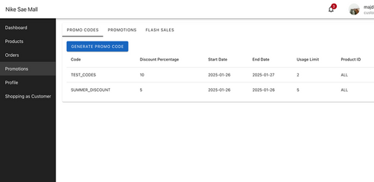
WEB PAGE
Web User Interface
Vendor Flash Sale
Management Page
Vendor Promo Code Management Page

Slide 26
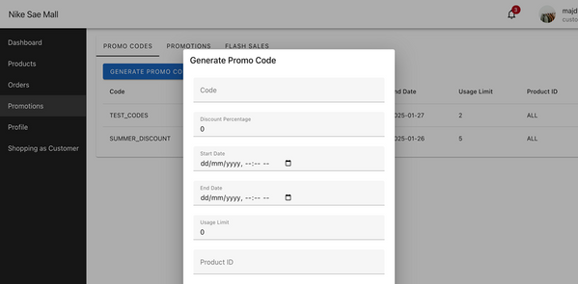
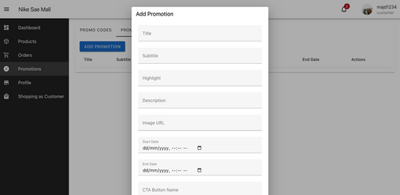
WEB PAGE
Web User Interface
Vendor Promo Code Form
Vendor Add Promotion Form

Slide 27
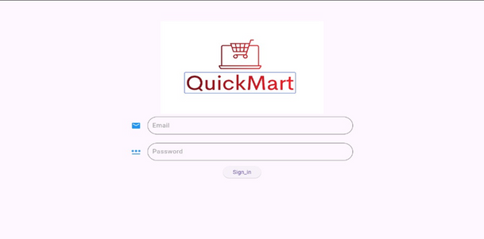
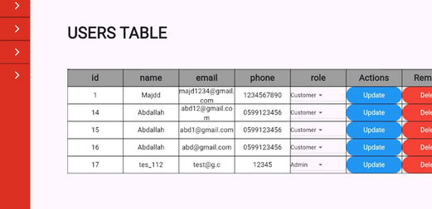
WEB PAGE
Admin Dashboard Pages
Admin Login Page
Admin User Management Page

Slide 28
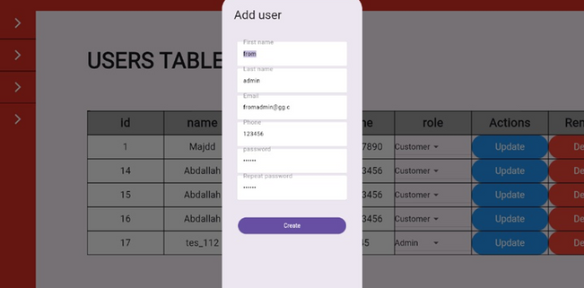
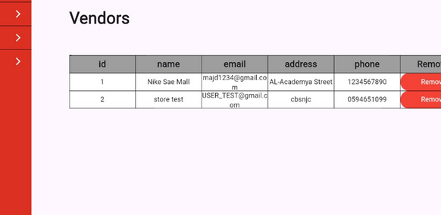
WEB PAGE
Admin Dashboard Pages
Admin Add User Form
Admin Vendor Management Page

Slide 29
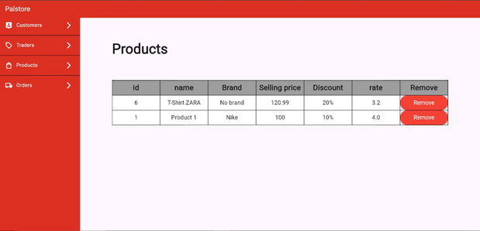
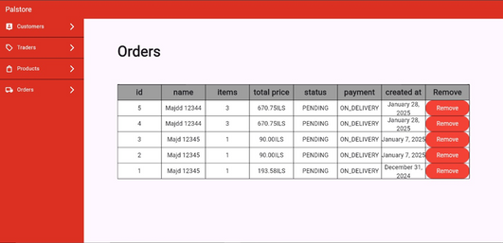
WEB PAGE
Admin Dashboard Pages
Admin Product Management Page
Admin Orders Management Page

Slide 30
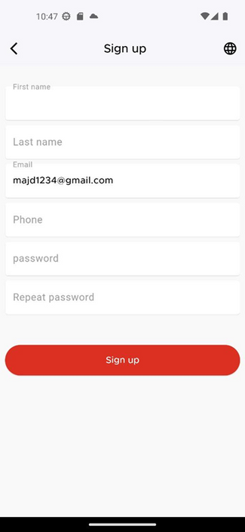
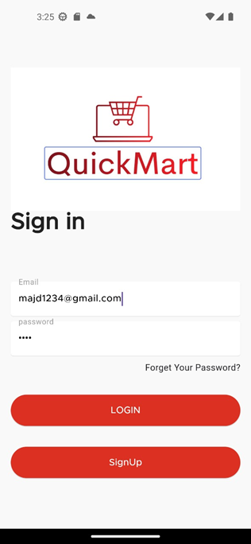
USER APP
  SIGN IN PAGE
  SIGN UP PAGE

Slide 31
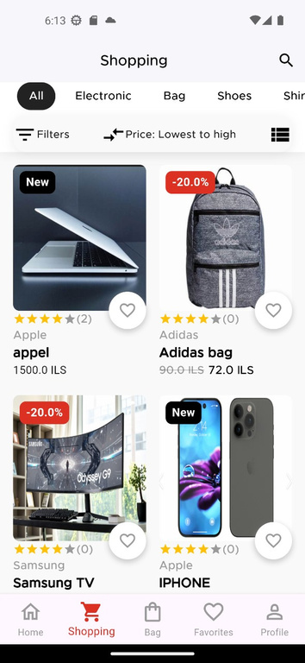
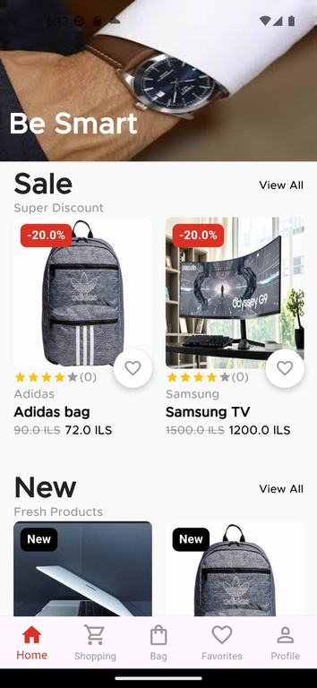
USER APP
Home Page
  Shopping Page

Slide 32
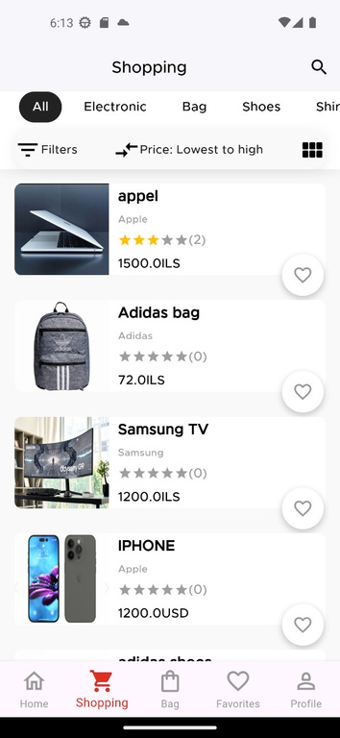
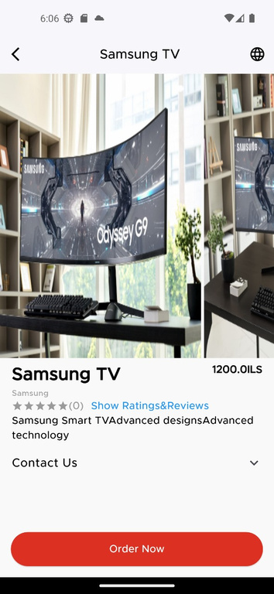
USER APP
  Details Page

Slide 33
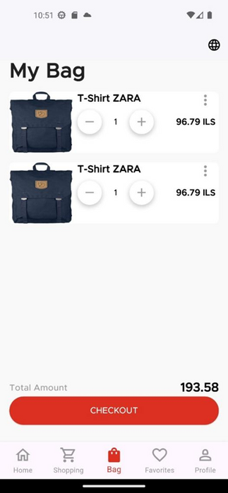
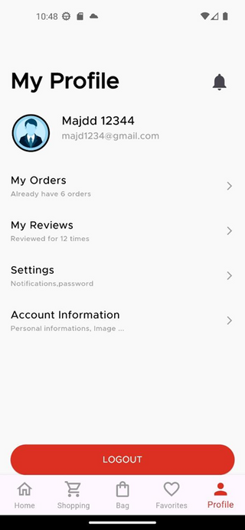
USER APP
Home Page
  My Bag Page
  My Profile Page

Slide 34
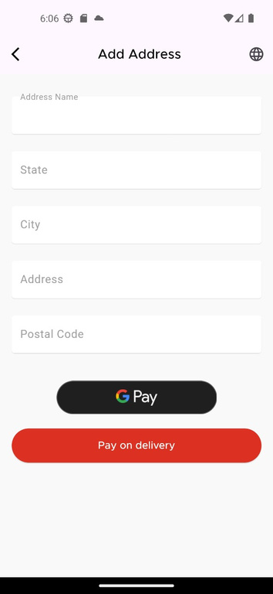
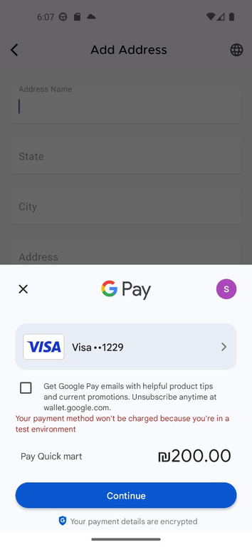
USER APP
Home Page
  Check Out Page

Slide 35
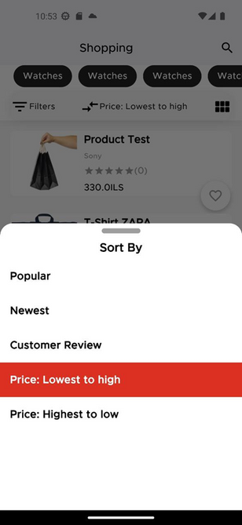
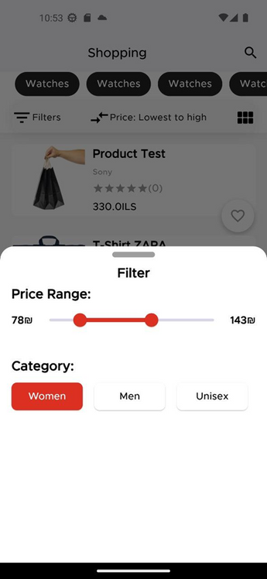
USER APP
  Sort BY Page
  Filter Page “Price Range”

Slide 36
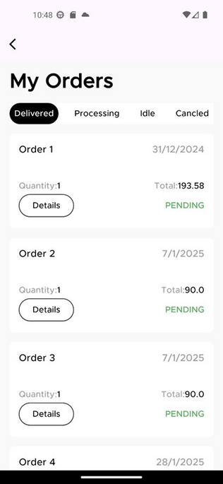
USER APP
My Orders Page

Slide 37
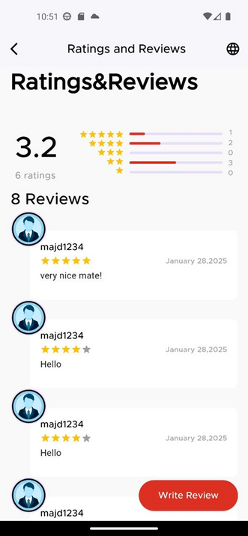
USER APP
Rating & Reviews Page

Slide 38
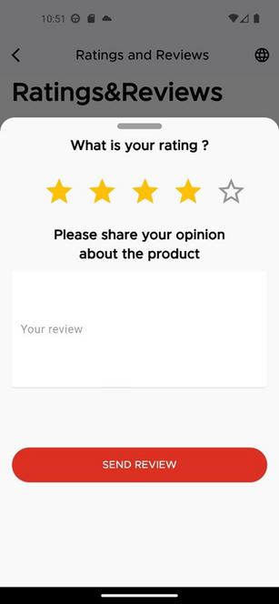
USER APP
Add Rate & Review Page

Slide 39
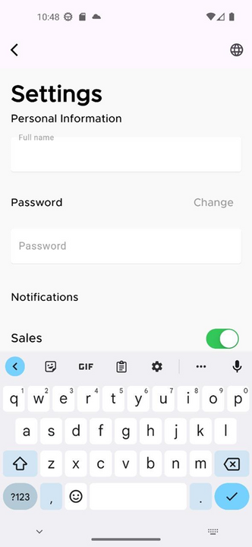
USER APP
Settings Page

Slide 40

Sustainability Initiatives
  Google Map
FUTURE WORK
Loyalty Programs:
  Dilivery Dashboard
  Social Media Sharing

Slide 41

THANKS
FOR WATCHING
Any Questions?

