Slide 1
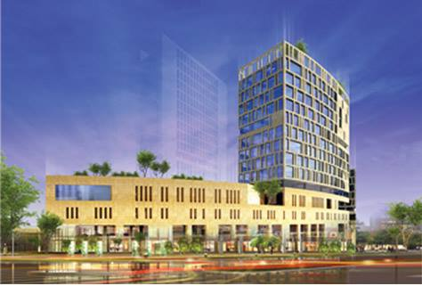
PRESTRESSED CONCRETE DESING
AL – ERSAL TOWER _ RAMALLAH
Supervisor: Eng. Ibrahim Arman
Prepared By: Areej Younis
  Hana Hamdan
Lubna Abu-Hashyeh
Shefa Salahat

Slide 2
Layout
Introduction
Preliminary Design
Final design
Visibility Studies

Slide 3

INTRODUCTION
Project Description
Structural Plans
Materials
Codes and Standards
Gravity and Lateral Loads
Soil Description

Slide 4
Project Description
  Al-Ersal Tower is a commercial and residential building of 3 basements, a ground floor, and 13 stories
  Location : at al-Ersal .St in Ramallah
  Total area = 26311.66 (m²)
  Structural design systems :
  - flat plate post tension concrete - flat plate reinforced concrete

Slide 5
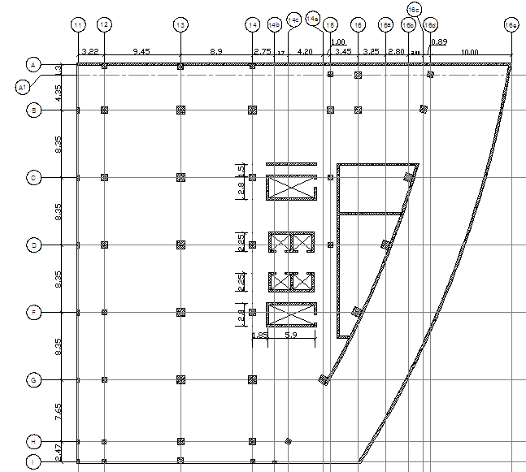
Structural Plans
Structural plan for
basement 3

Slide 6
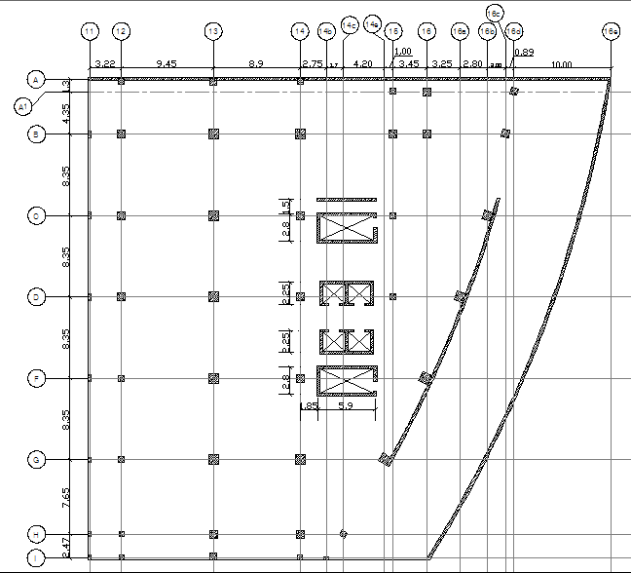
Structural Plans
Structural plan for
basement 2

Slide 7
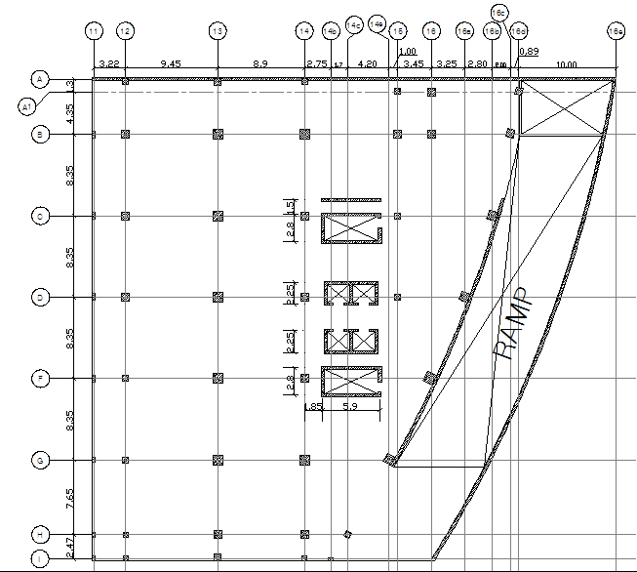
Structural Plans
Structural plan for
basement 1

Slide 8
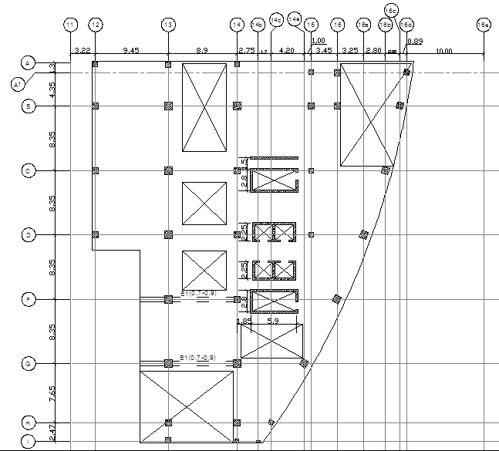
Structural Plans
Structural plan for
ground and 1st floors

Slide 9
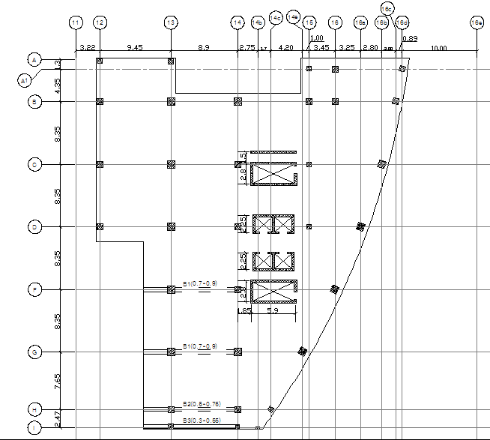
Structural Plans
Structural plan for
2nd – 13th floors

Slide 10
Materials
Structural materials
Prestressed concrete
f’c= 45 MPa, Ec=31*10³ MPa
Prestressed reinforcing steel
Grade 270 low relaxation strands (Ø12.7mm, Aps=99 mm²)
Reinforced Concrete
f’c= 40 MPa, Ec=29.7*10³ MPa for slabs, beams, stairs and walls
Reinforcing steel for concrete
grade 60
fyp =1676 MPa, Eps = 200GPa, fu= 1862 MPa ,
breaking strength of strand = 184 Mpa
fy =420 MPa
Es=200 GPa
f’c= 45 MPa, Ec=31*10³ MPa for other elements
f’ci=32MPa, Ec=26.58*10³ MPa

Slide 11
Materials
Non-structural materials
Tiles
ɣ= 26 KN/m³
Plastering
ɣ= 23 KN/m³
Concrete mortar
ɣ= 23 KN/m³
Aggregates (fine &course)
Masonry stone
ɣ= 26 KN/m³
Block
ɣ= 12 KN/m³
False ceiling
ɣ= 18 KN/m³
ɣ= 0.15 KN/m²

Slide 12
Codes and Standards
ACI 318-08 (American Concrete Institute)
IBC -09 (International Building Code)
ASCE-2005 (American Society of Civil Engineers)
UBC-97 (Uniform Building Code)
PTI (Post-Tension Institute )

Slide 13
Gravity Loads
Live loads
LL = 3.5 KN/ m^{2 →} For basement 3 and basement 2
Dead loads
DL = 6.25KN/m^{2→} For Prestressed concrete
Supper Imposed load
SD = 2.5 KN/m^{2 →} For basement 3 and basement 2
LL = 5 KN/ m² → For other floor
DL = 6.75KN/m^{2→} For Reinforcement concrete
SD = 4 KN/m^{2 →} For other floor

Slide 14
Load Combinations
U = 1.4D
U = 1.2D + 1.6L + 0.5L
U = 1.2D + 1.6L+ (1.0L or 0.5W)
U = 1.2D + 1.0W + 1.0L + 0.5L
U = 1.2D + 1.0E + 1.0L + 0.2S
U = 0.9D + 1.0W
U = 0.9D + 1.0E
U = 1.2D + 1.6 L + 1.0 S → For gravity load design

Slide 15
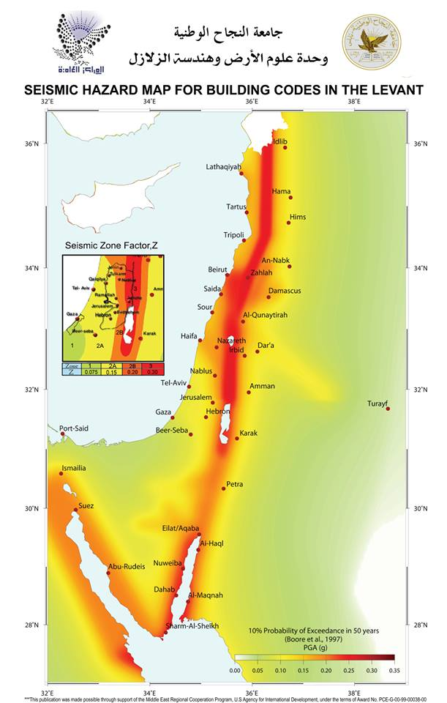
Lateral Loads
Seismic Loads
The seismic load factors are as follows:
Seismic zone factor : Z = 0.2
Soil profile: S_{B} (rock) according to IBC-2009
Importance factor: I=1.25
Site class :
The mapped spectral acceleration for a 1-second period: S1 = 0.25
Ss: The mapped spectral acceleration for short periods: S2 = 0.5
Response modification factor : R=4

Slide 16
Lateral Loads
Wind load
The wind load factors are as follow:
Site is Exposure B category
Gust – effect factor: G = 0.85
External pressure coefficient : Cp: wind ward = 0.8, lee ward = ± 0.5, side wall = - 0.7
Velocity pressure evaluated at height Z above the ground (N/m²): q z
Velocity pressure exposure coefficient evaluated at height Z: Kz from table 27.3-1 at ASCE-05 Code. Which is function of height
Importance factor depends on the structure use: I=1
Topographic factor : Kzt = 1
Wind directionally factor : Kd = 0.85
Basic wind speed (m/s) : V = 120 Km/hr

Slide 17
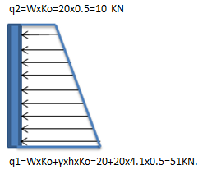
Soil Description
The soil type is: S_{B} (rock) according to IBC-2009
Soil internal friction angle, Ø = 30°
Soil allowable bearing capacity = 270 KN/m²
Live load (surcharge) = 15 KN/m²
Back filling material is selected by soil (base coarse Ø ≥ 30º
Ko = 0.5
q 1 = 7.5 KN/m²
q ₂ = 137 KN/ m²

Slide 18

Preliminary design
Slab Design
→Flat Plate post-tensioned Slab
Check punching
Check stresses
Losses
Ultimate design method
→Reinforced concrete flat plate
Check punching

Slide 19
Slab Design
Prestressed concrete Flat plate
Slab thickness checks
Check punching
Check stresses
→slab thickness= L/45
= 8.35/45
= 0.186 mm
So, take 250 mm as thickness of slab

Slide 20
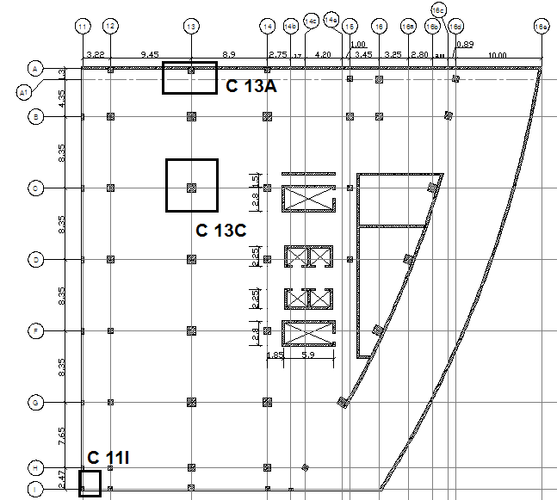
Check punching

Slide 21
Check Punching
Check punching
Interior column 13 C
Use 2Ø12/100 mm
Edge column 13 A
Use 2Ø12/100 mm
Edge column 11 I
No need for shear reinforcement steel

Slide 22
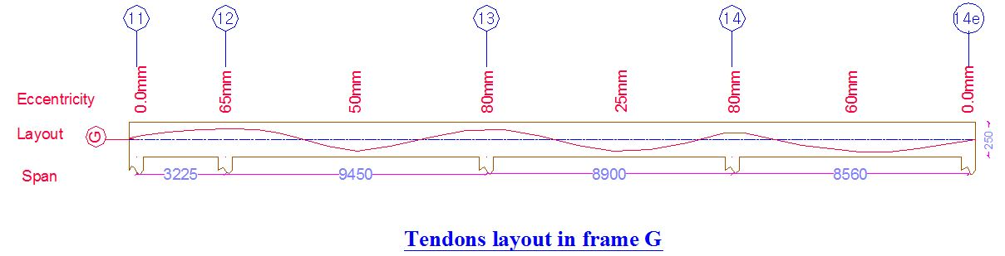
Tendons Layout in Frame G

Slide 23
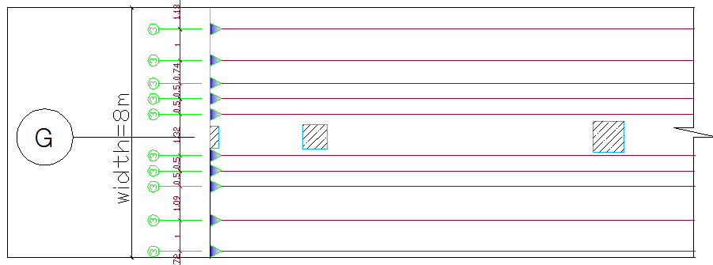
Tendons Layout in Frame G

Slide 24
Check Stress
Initial stage :
f(top/bottom)= -(Pi /AC) ± (Munb/St )
Where :
Pi : perstressed force before losses , KN
Ac : Area of concrete , m²
Munb : Moment due to Wunb at initial stage , KN/m
St : Top section modulus , st = I_{g} /C_{t} , m³
I_{g} : Moment of inertia , m⁴
C_{t} : distance from the center of concrete section to the top of section ,
Allowable stress at initial stage ( End support , Mid span) :
fti = 0.25 fci`^½
= 1.414 MPa
fci = 0.6fci`
= 19.2 MPa

Slide 25
Check Stress
Final stage:
f(top/bottom) = -(Pe/AC) ± ( Munb/St)
Where :
Munb : Moment due to Wunb at final stage , KN.m
Pe: perstressed force after losses , KN
Allowable stresses at final stage ( End support , mid span ) :
ft =0.5 fc`^½
= 0.5 =3.354 MPa
fc = 0.45 fc`^½
=-20.25 MPa
All stresses are acceptable and within the allowable stresses.

Slide 26
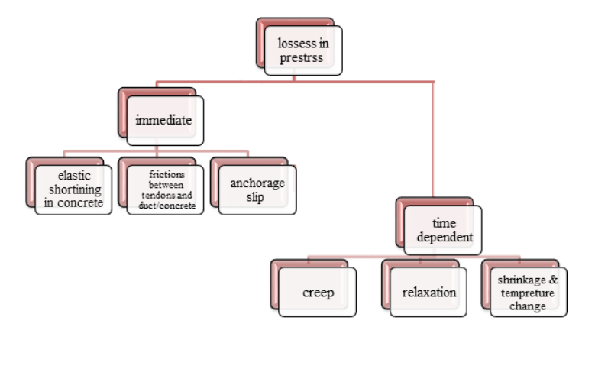
Δf_{pes} = 11 MPa

Slide 27
% of Losses in each frame
Name of frame
Y(13)
Y(12)
Y(11)
Y(14)
Y(15)
Y (17)
X(A)
X(B)
X(C)
X(D)
X(F)
X(G)
X(H)
X(I)
%[1- (Pe/Pi) ]
26
26
26
26
26
15
24
24
19
18
16
16
18
18

Slide 28
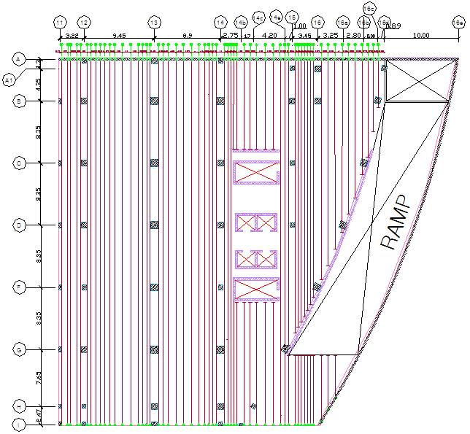
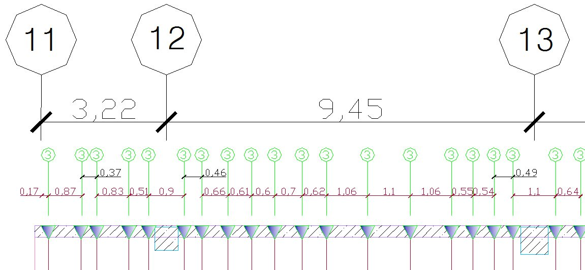
Tendons layout in X-direction

Slide 29
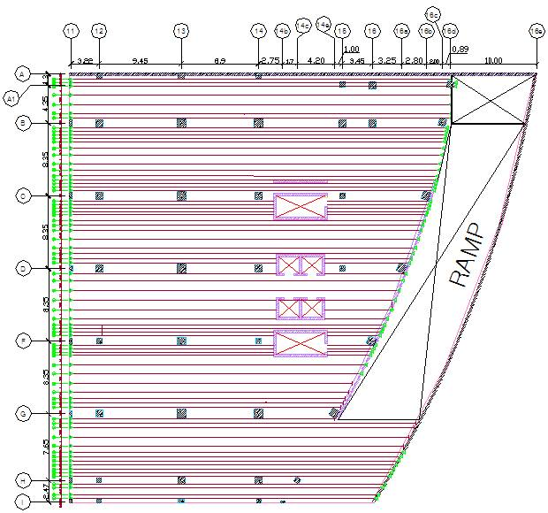
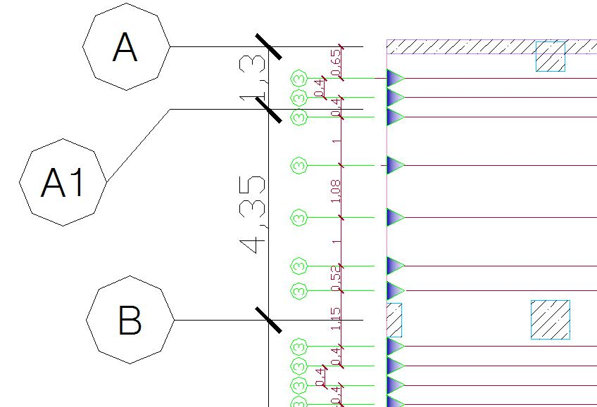
Tendons layout in Y-direction

Slide 30
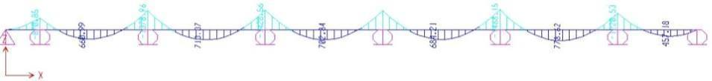
Ultimate Design Method
Ultimate moment – frame 13 (1.2 D + 1.6 L + 1.0 HS)
  use minimum steel for ultimate in case of cable cut off
  Check the adequacy of using minimum steel

Slide 31
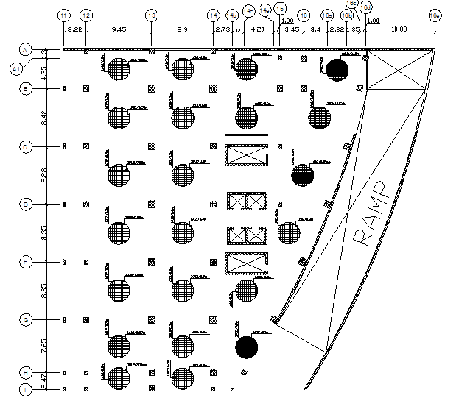
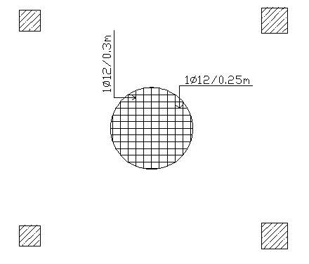
Bottom reinforcement steel

Slide 32
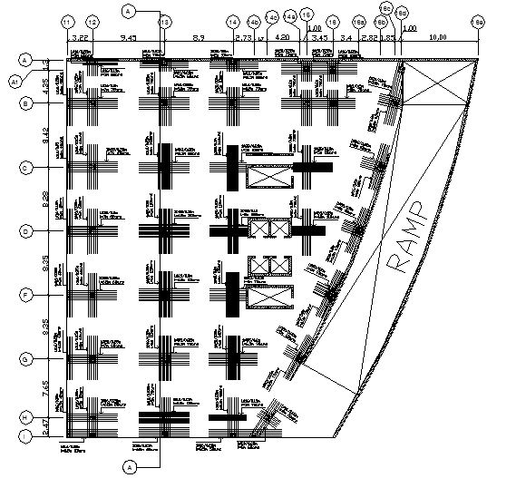
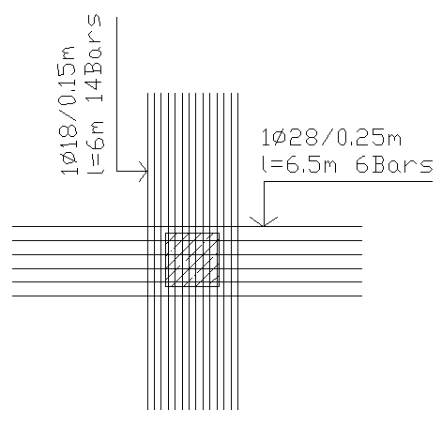
Top reinforcement steel

Slide 33
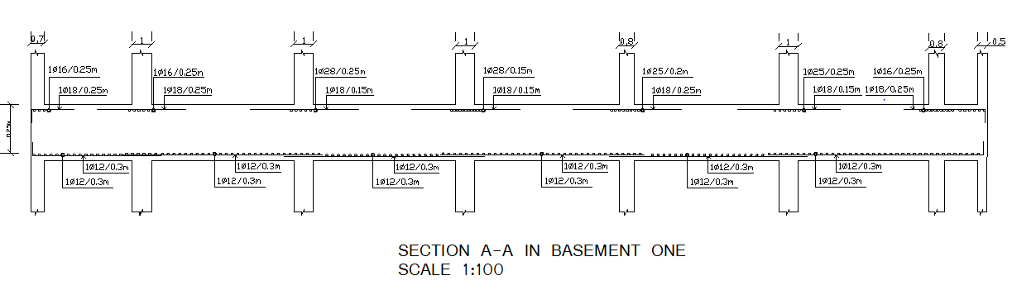
Section A-A

Slide 34
Slab Design
Reinforced concrete flat plate
Slab thickness = 0.27 m
d = 0.23 m
Slab thickness checks
Check punching

Slide 35
Check Punching
Interior column 13 C
Vu=1601 kN
ØVc=1643 kN
Use 2Ø12/100 mm
Edge column 13 A
Vu=555.94 kN
ØVc=821.87 kN
Use 2Ø12/100 mm
Edge column 11 I
Vu=52.25 kN
ØVc=387.3 kN
No need for shear reinforcement steel

Slide 36
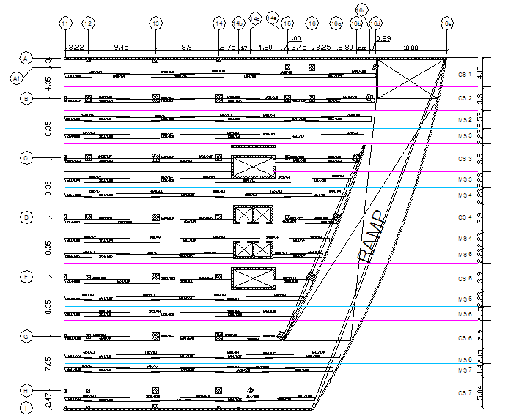
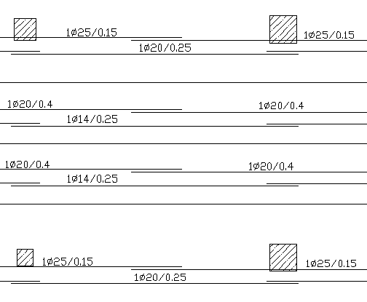
X
Flat Plate reinforcement steel in X-Direction

Slide 37
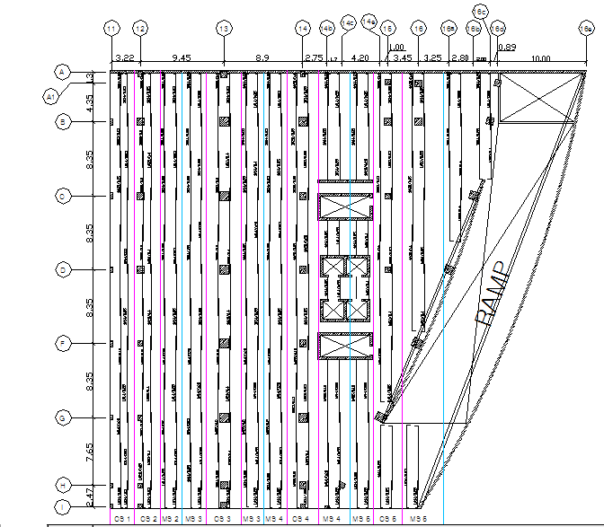
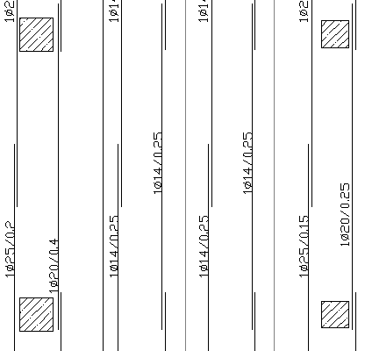
Flat Plate reinforcement steel in Y-Direction

Slide 38

FINAL DESIGN
Structural Model on SAP
Verifications of Structural Analysis
Columns Design
Beams Design
Stairs Design
Walls Design
Mat Foundation Design
SAP Modeling of Tendons

Slide 39
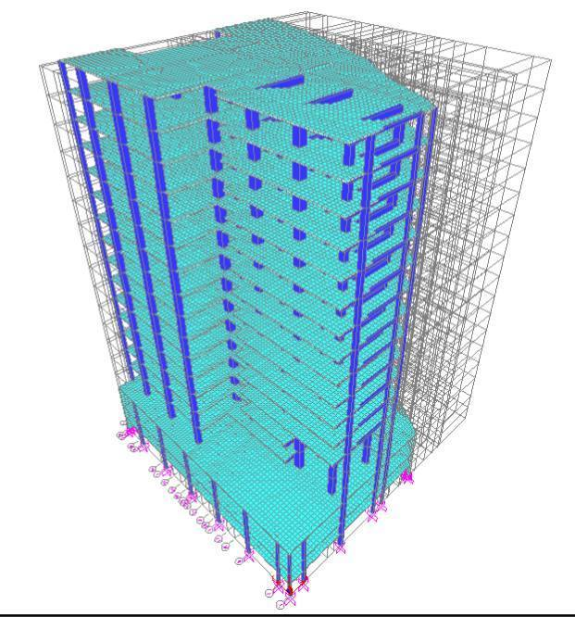
Structural Model on SAP
Define:
material :concrete f’c =45 MPa , f’c= 40 MPa
Section :Frame (column and beam ) , Area (slab, walls and mat foundation)
Load : dead, live, super dead, seismic and wind

Slide 40
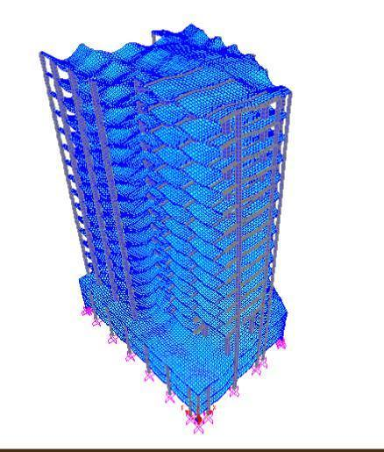
Verification of Structure Analyses
Check Compatibility

Slide 41
Equilibrium Check
% of Difference | Hand calculation (KN) sum of load in Z-direction | SAP (KN) sum of load in Z-direction | Load
2.19% | 256420.93 | 250800.21 | Dead
2.4% | 112490 | 115177.8 | Live
1.85 % | 92530 | 90818 | Super dead

Slide 42
Lateral Load Checks
 |  | Shear resulted from wind pressure
Difference % | Shear from SAP (KN) | Shear calculated manually (KN) | wind pressure
8% | 1796.116 | 1969.248217 | wind x
11% | 2397.277 | 2159.015259 | wind y
 |  | Shear resulted from seismic load
Difference % | Base shear from SAP (KN) | Base shear calculated manually (KN) | seismic load
0.9% | 10589.79 | 10693 | X1
0.9% | 10589.79 | 10693 | X2
0.9% | 10589.79 | 10693 | Y1
0.9% | 10589.79 | 10693 | Y2

Slide 43
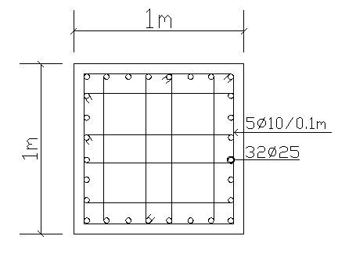

Column Design
check slenderness
9 ≤ 34 – 12 (-.704/ 5.66) → OK
Reinforcement of column 13
Group no.1

Slide 44
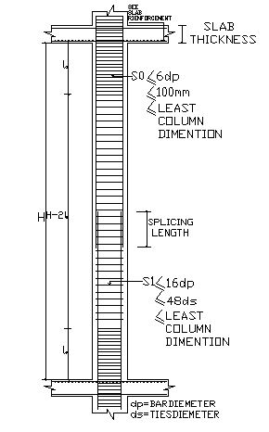
General longitudinal
section in column

Slide 45
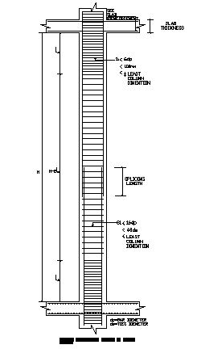
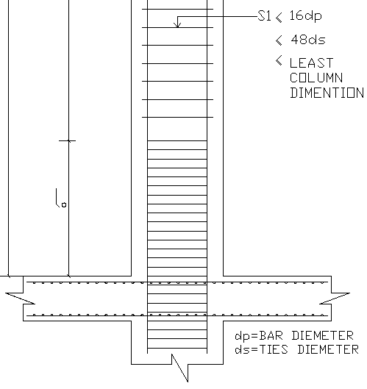
General longitudinal section in column

Slide 46
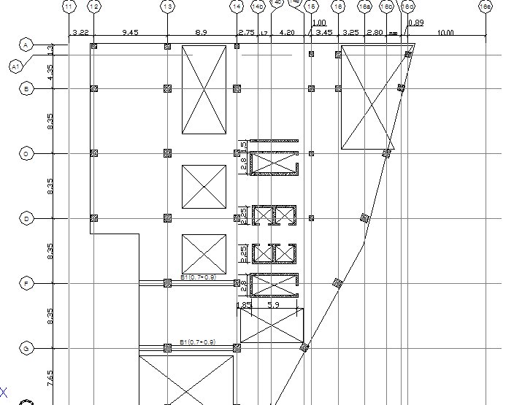
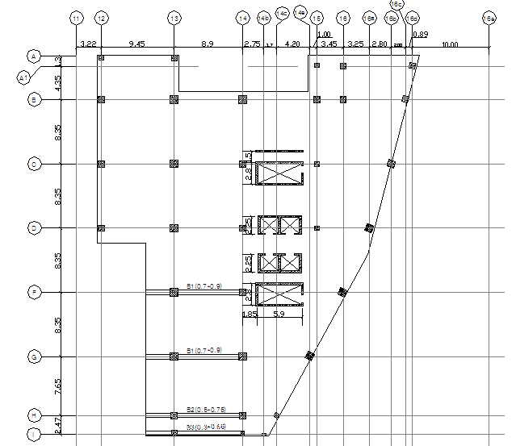
Beams Design
Beam locations at ground and 1st floors
Beam locations at 2nd – 13th floors

Slide 47
Beams Design
Item | Moment | h(mm) | b(mm) | d(mm) | As(mm²) | Bar Ø (mm) | # of bars | As for shear
B1 | M+ | 900 | 600 | 830 | 12150 | 32 | 16 | 2Ø12/100
 | M- | 900 | 600 | 830 | 12150 | 32 | 16 | 2Ø12/100
B2 | M+ | 750 | 500 | 680 | 8760 | 32 | 10 | 2Ø12/200
 | M- | 750 | 500 | 680 | 8760 | 32 | 10 | 2Ø12/200
B3 | M+ | 550 | 300 | 490 | 2670 | 25 | 6 | 1Ø12/200
 | M- | 550 | 300 | 490 | 2670 | 25 | 6 | 1Ø12/200

Slide 48
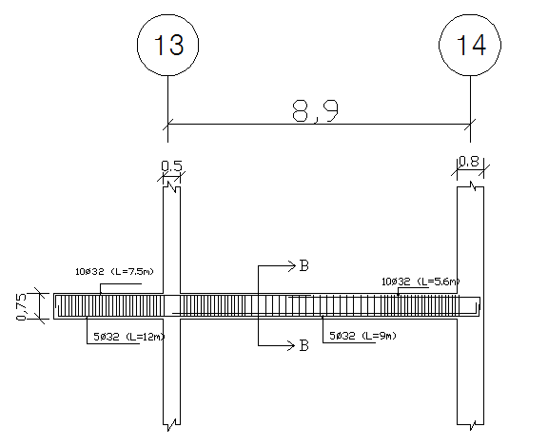
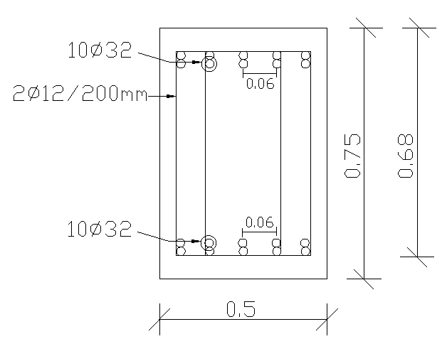
Cross section in beam 2
Longitudinal section in beam 2

Slide 49
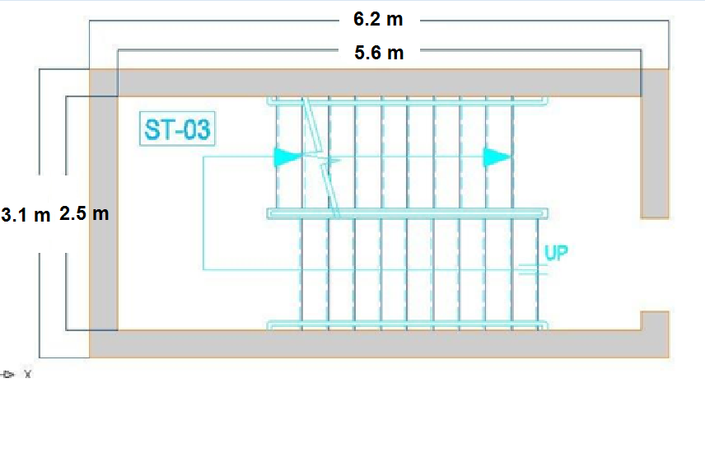
Stairs Design
Flight :
According to ACI 318-08 code h =0.15 m
WD =3.75 KN/m², WL = 5 KN/m² and
WSD = 4 KN/m²
Landings:
1st : (b=1.61, h=0.15 and L= 2.5) m
2nd: (b=1m, h=0.15 and 2.5) m
Stair -03 plan

Slide 50
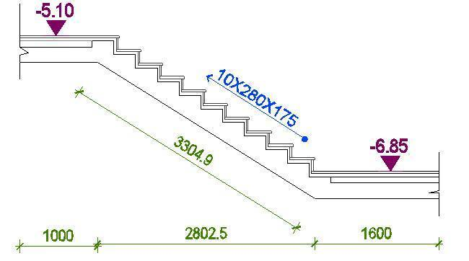
Cross section in stairs

Slide 51
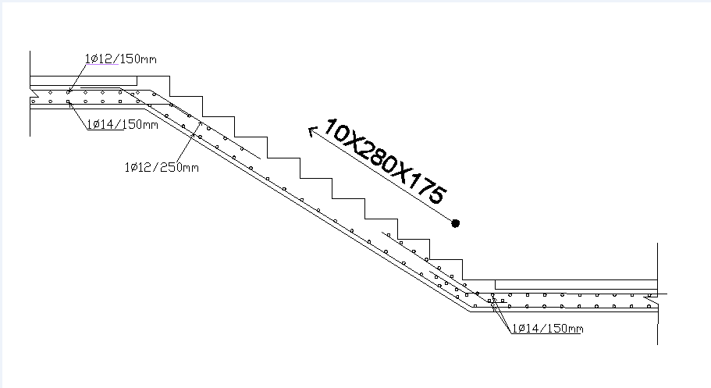
Stairs reinforcement details

Slide 52
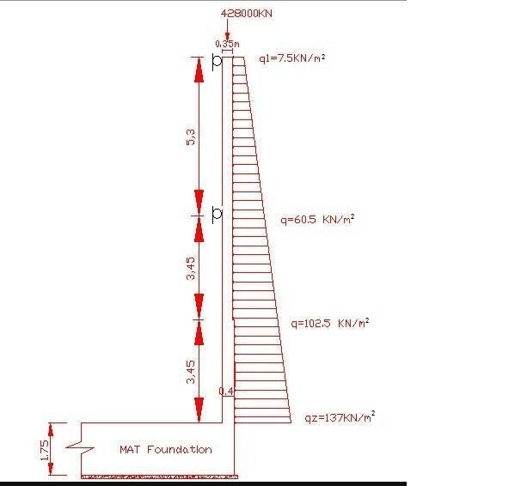
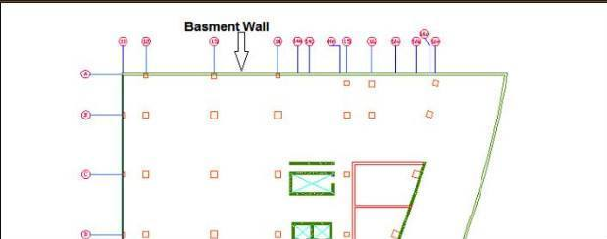
Basement Wall Design
h = 0.35 m
h = 0.35 m
Basement wall at plan
h = 0.40 m

Slide 53
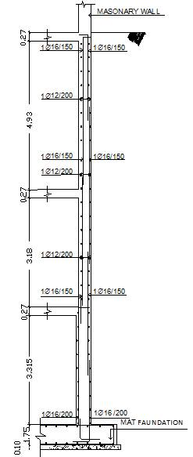
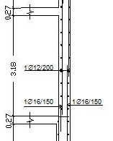
Basement wall reinforcement details

Slide 54
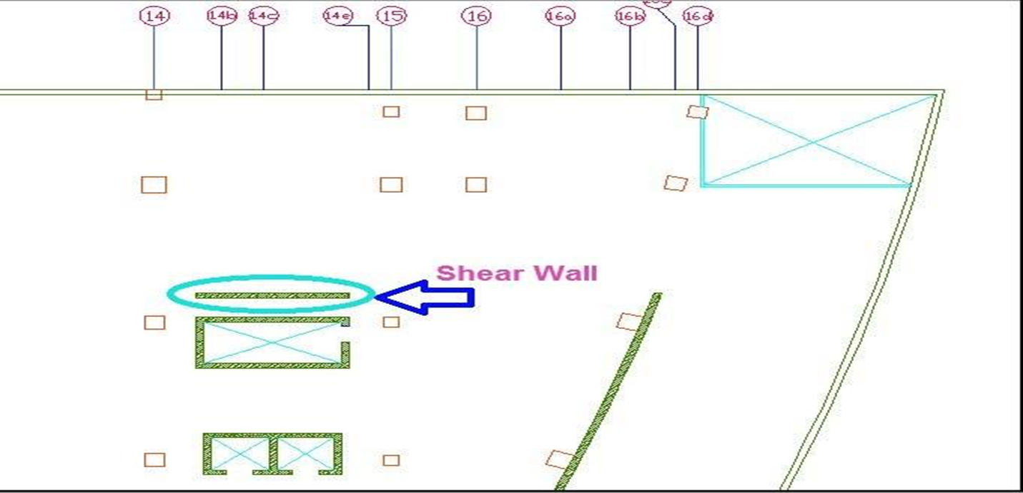

Shear wall Design

Slide 55
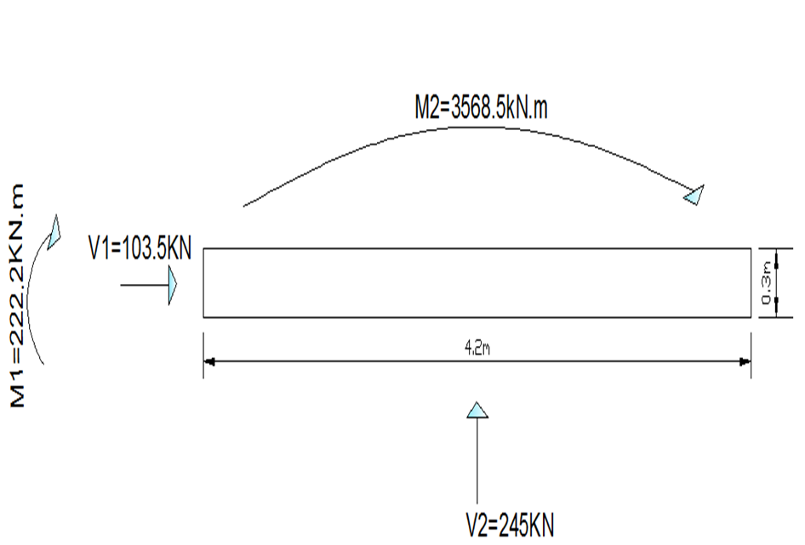
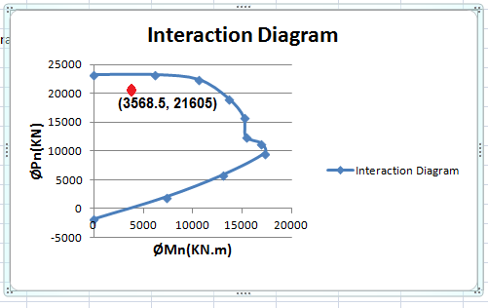
Shear Wall Design
Shear wall loads

Slide 56
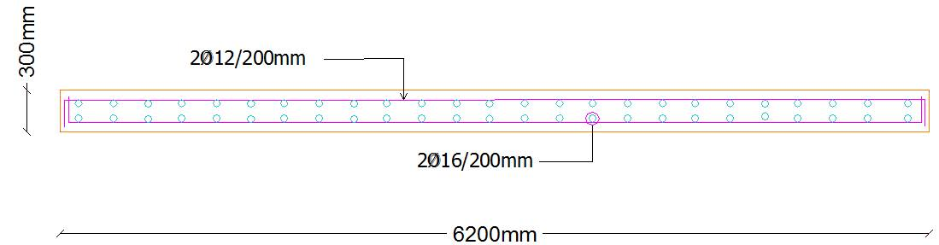
Shear Wall Design
Shear wall reinforcement details

Slide 57
Mat Foundation Design
→Mat thickness = 1.75 m
d = 1.65 m
Mat thickness check
Check punching

Slide 58
Check Punching
Interior column 13 C
Vu=29777 kN
ØVc =29331.6 kN
Edge column 13 A
Vu=523.118 kN
ØVc =12728.8 kN
Corner column 11 I
Vu=52.2 kN
ØVc =6780 kN

Slide 59
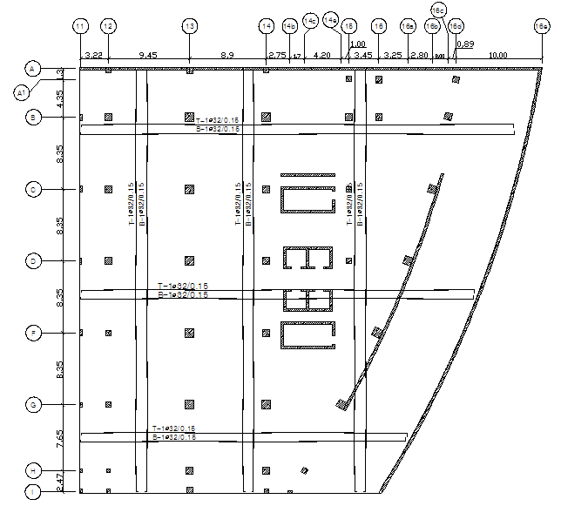
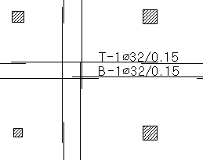
Mat foundation reinforcement steel

Slide 60
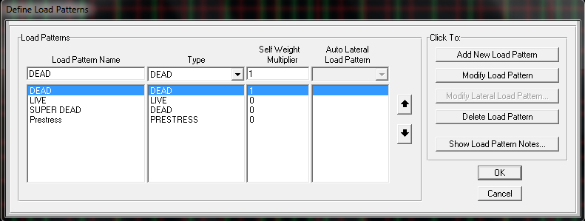
SAP Modeling of Tendons
Prestress loads definition

Slide 61

Hyper static definition

Slide 62

Tendon section definition

Slide 63

Tendon profile

Slide 64

Tendon load

Slide 65

Tendon eccentricity
ord 2(m) | Coord 1(m) | Point ID
0 | 0 | 1
- 0.015 | 1.235 | 2
0.05 | 2.47 | 3
- 0.035 | 6.295 | 4
0.075 | 10.12 | 5
- 0.04 | 14.295 | 6
0.08 | 18.47 | 7
- 0.04 | 22.645 | 8
0.08 | 26.82 | 9
- 0.065 | 30.995 | 10
0.08 | 35.17 | 11
- 0.04 | 39.345 | 12
0.065 | 43.52 | 13
- 0.02 | 46.345 | 14
0 | 49.17 | 15

Slide 66

Prestressing moment check
% of Difference | 13Frame (KN/m) | 3D SAP (KN/m)
7.42 | 110.53 | 119.4
2.38 | 257.22 | 263.5
10.04 | 155.49 | 141.3
1.07 | 381.85 | 377.8
8.75 | 226.65 | 208.4
0.35 | 379.94 | 381.3
10.94 | 151.4 | 170
2.57 | 325.78 | 334.4
5.36 | 173.19 | 183
4.72 | 313.06 | 328.6
6.84 | 137.18 | 128.4
5.51 | 231.96 | 245.5
9.9 | 68.47 | 62.3
Prestressing moment

Slide 67
Visibility Study
Price NIS | Quantity | Item
237469 | 521.9 (m³) | Concrete | Reinforced concrete flat plate
205200 | 72 (ton) | Steel
164305 | 483.25 (m³) | Concrete | Flat plate post-tensioned slab
62700 | 22 (ton) | Steel
130477.5 |  | tendon

Slide 68


