Slide 1
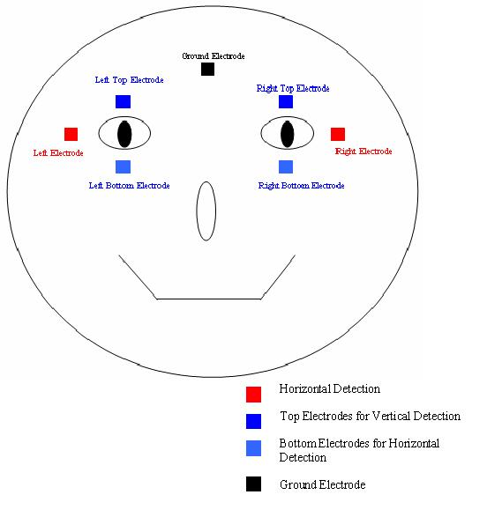
Eye mouse

Slide 2
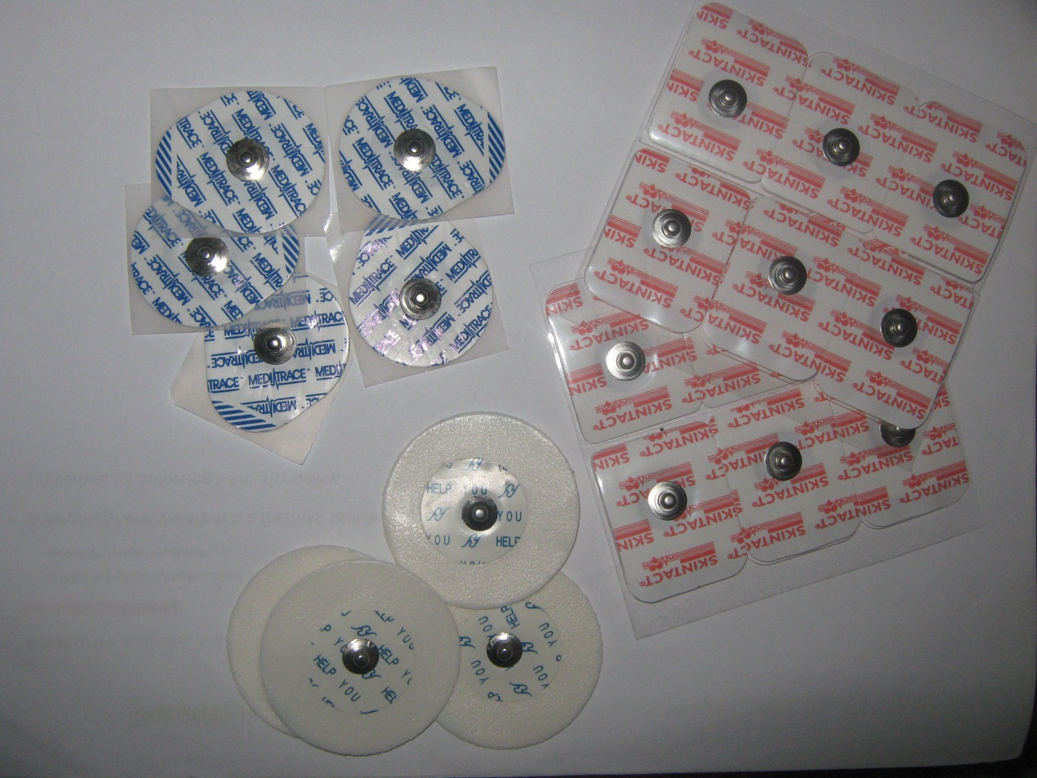
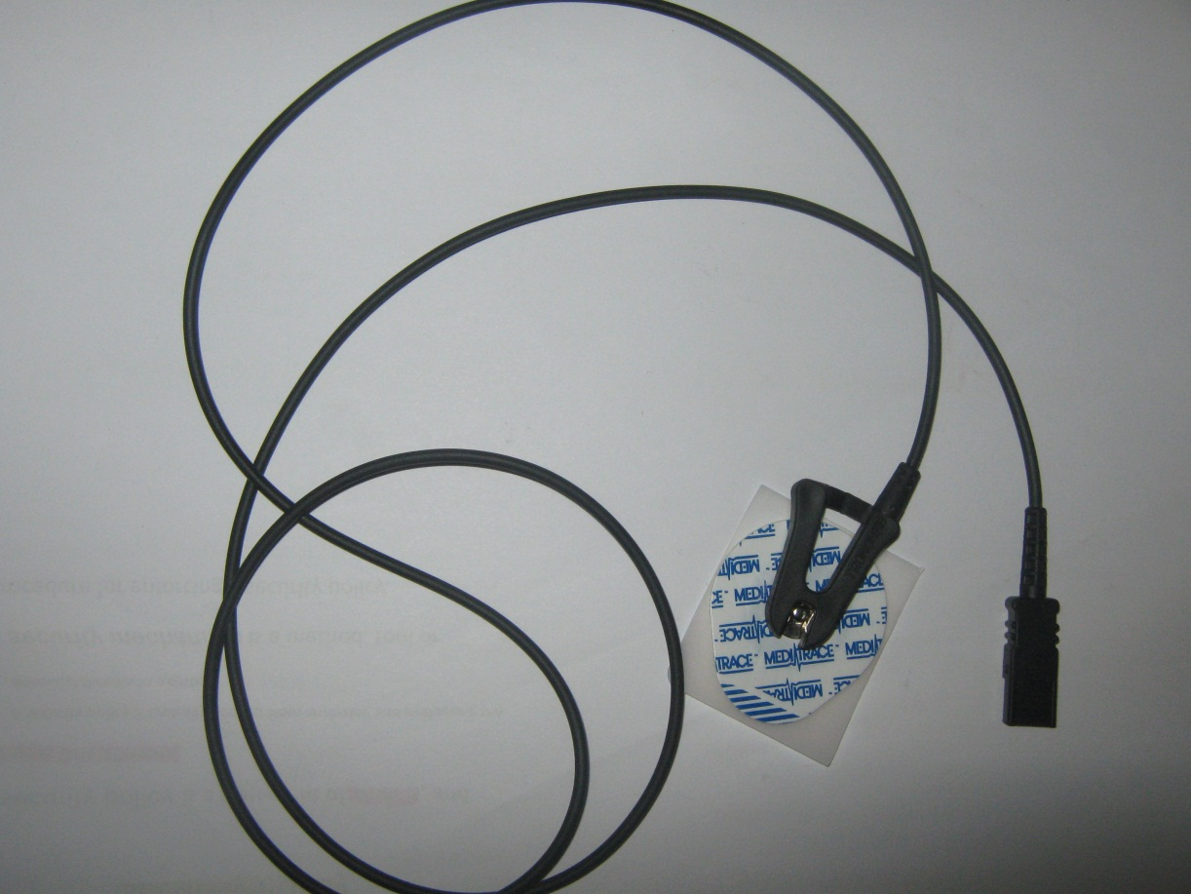

Slide 3
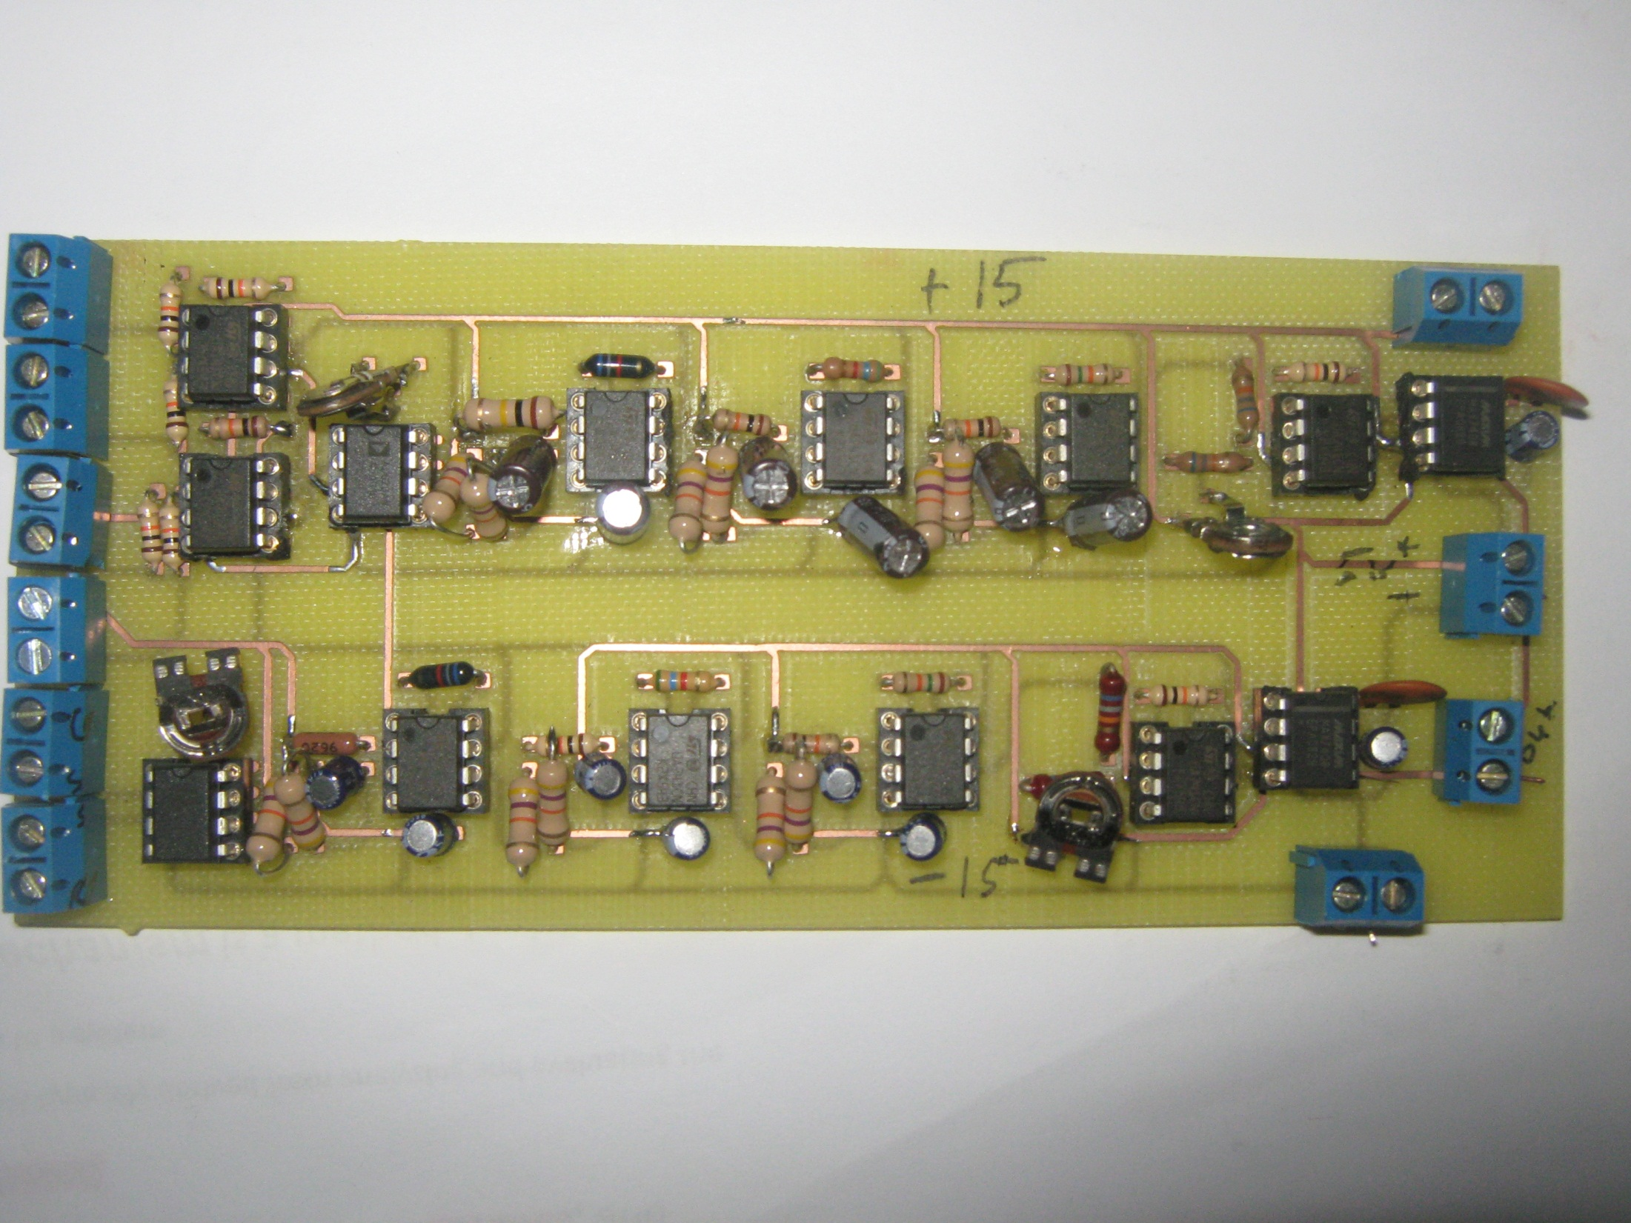

Slide 4

Ruba
&
Ola

Slide 5
Agenda
What is PHA ?
Components
Circuit description
Results

Slide 6
PHA
PHA :Phone-Home Automation
Controlled automatically.
Controlled remotely.
provided a telephone line.

Slide 7
Basic components
CMD 8870
ISD 25120
Microcontroller

Slide 8
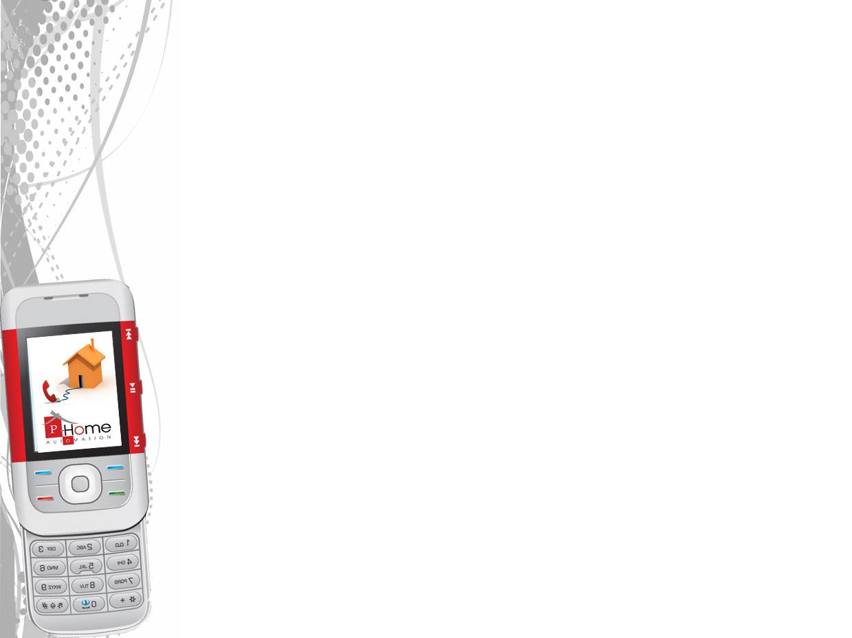
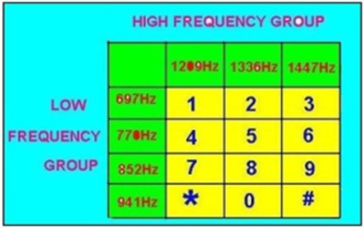
CMD 8870
DTMF (Double Tune Multi Frequency).

Slide 9
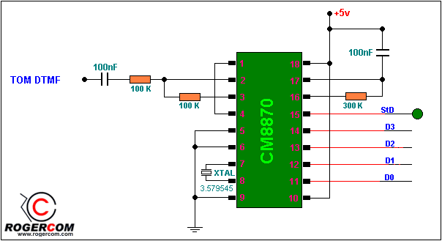

Slide 10
ISD 25120
single chip, multiple message voice recorder/playback device.
on-chip oscillator.
microphone preamplifier.
automatic gain control.
antialiasing filter.
smoothing filter.
speaker amplifier.
non-volatile memory cells.

Slide 11

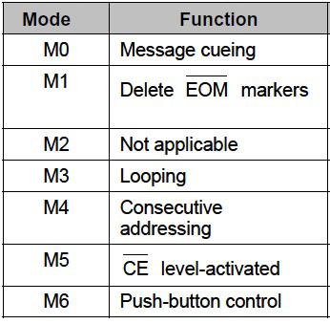
ISD(modes)
Operational Mode:
The ISD2500 series is designed with several build-in operational Mode that provide maximum functionality with external component.
Address Mode:

Slide 12
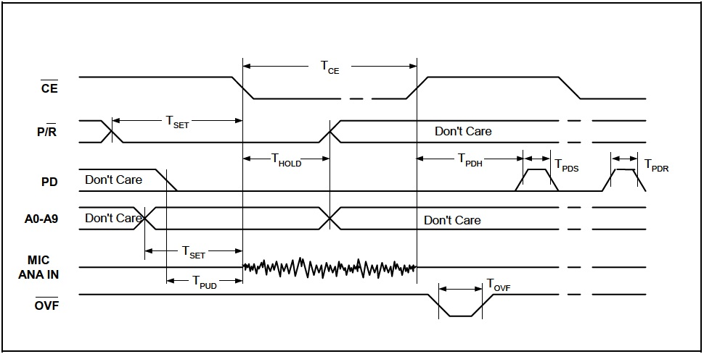
ISD(timing diagrams)
Record

Slide 13
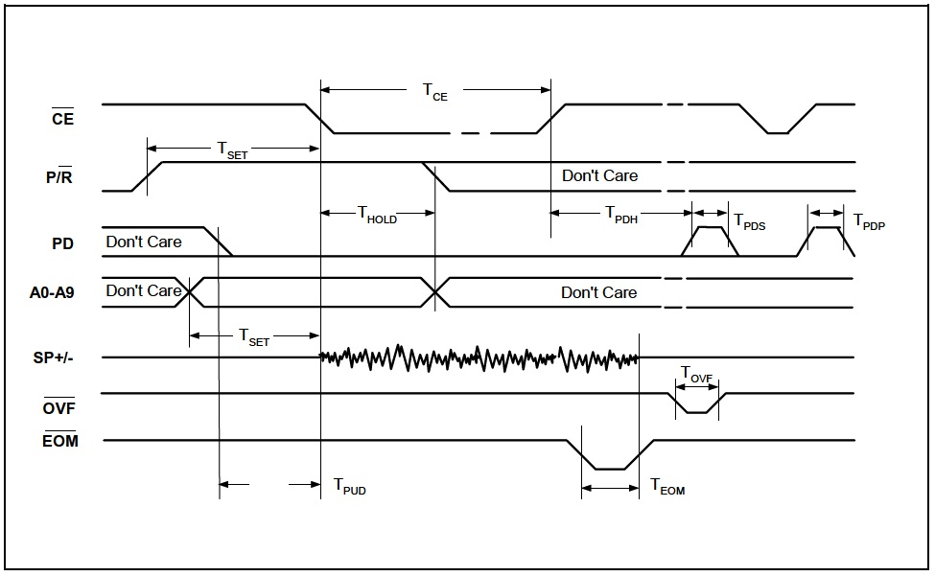
ISD(timing diagrams)
Play

Slide 14
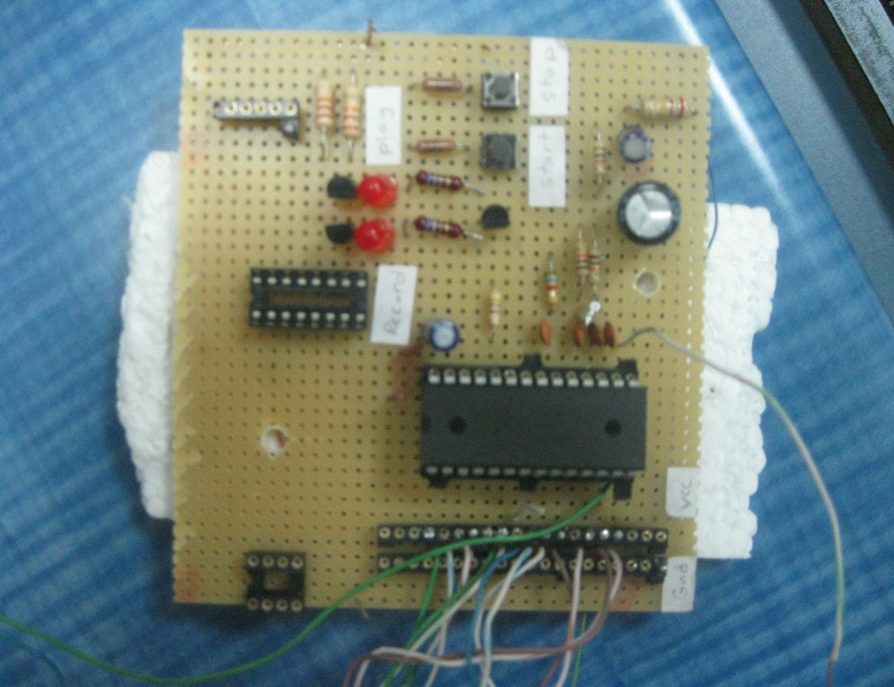
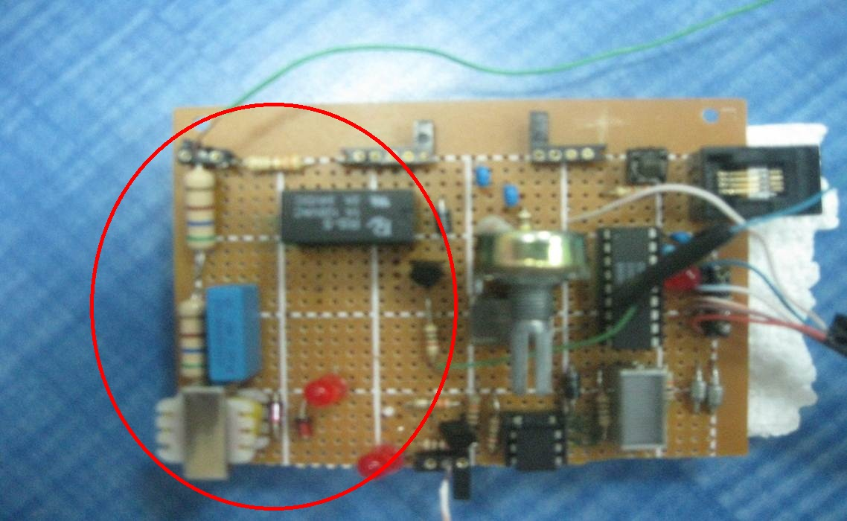
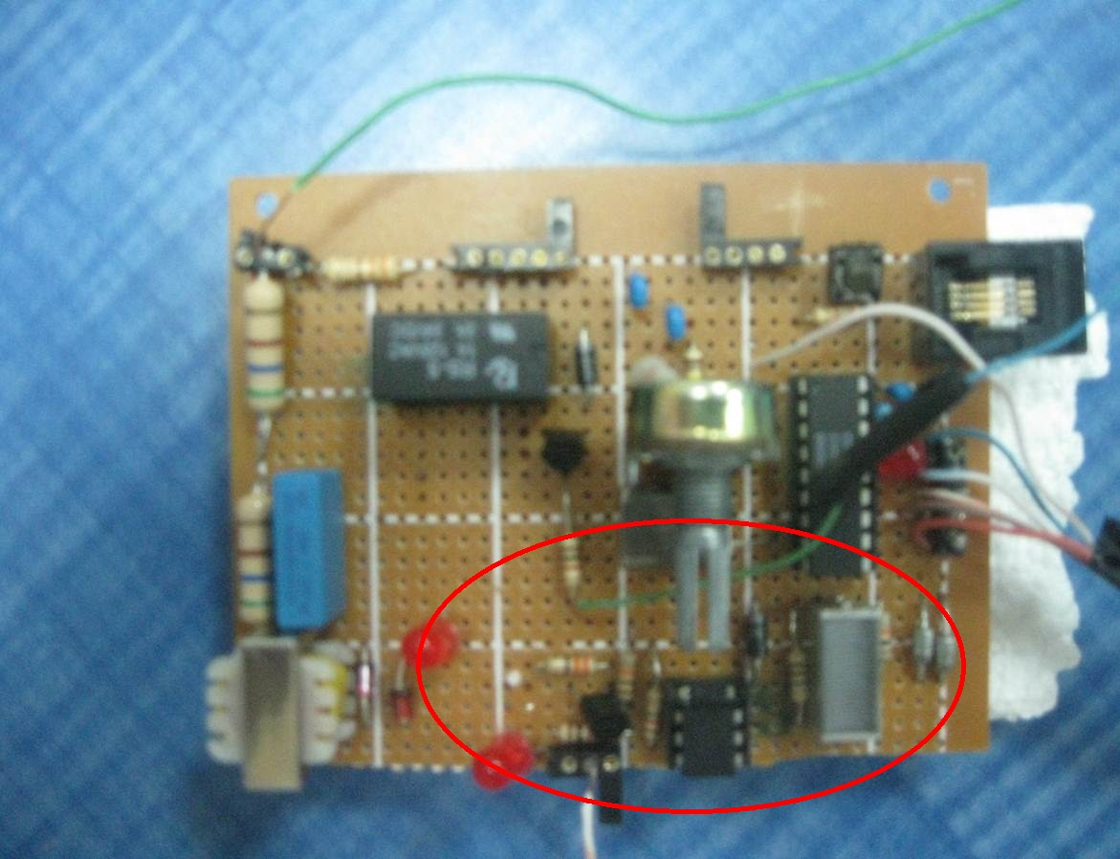
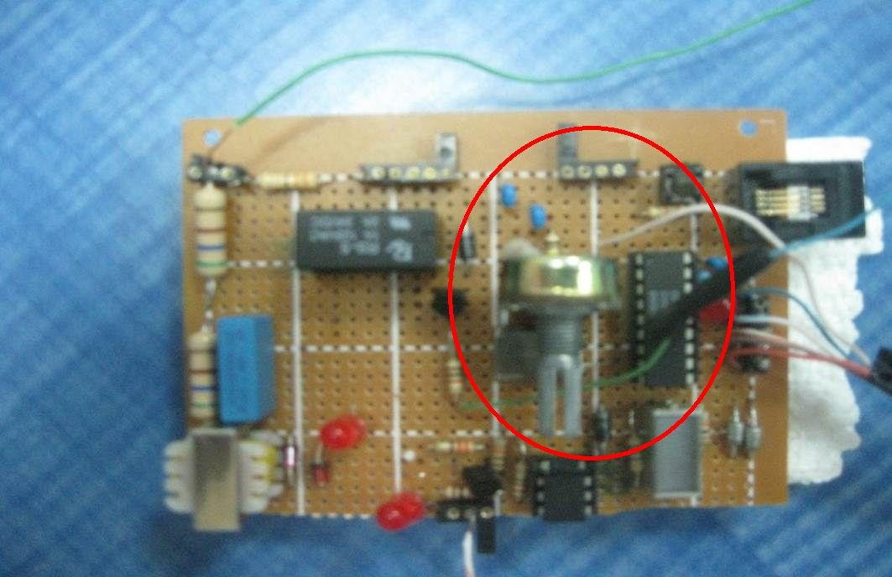
Input
Ring Detection
Open line
Block diagram
voice section
Decoding section
Interface
Output

Slide 15
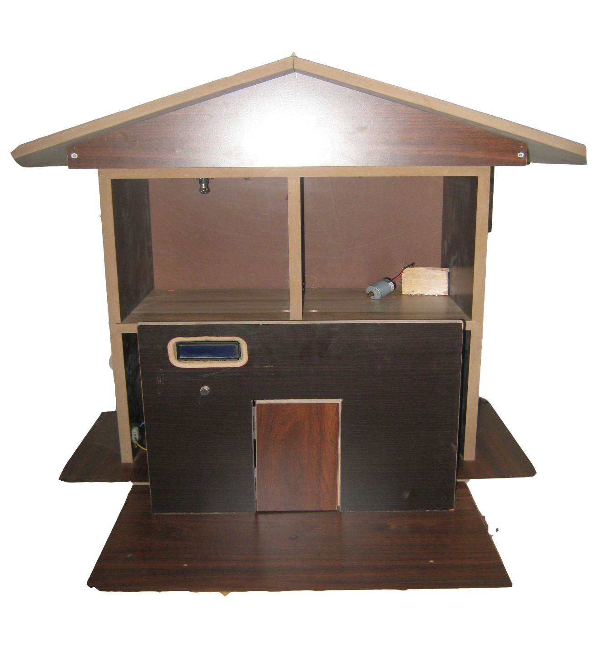
Output

Slide 16



Call the home phone number
The line is opened
First message :
12345*
Check the password:
Correct password
Wrong password
(After 3 trying the line is closed)
1
If the password is correct:
Choose the device

Slide 17

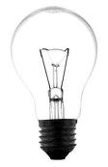
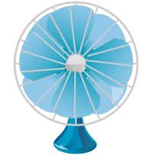
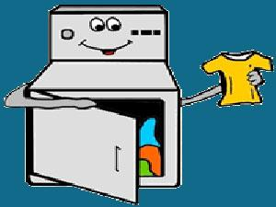
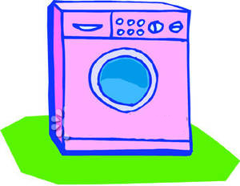
If the device number is correct :
The device will turn on or turn off

Slide 18
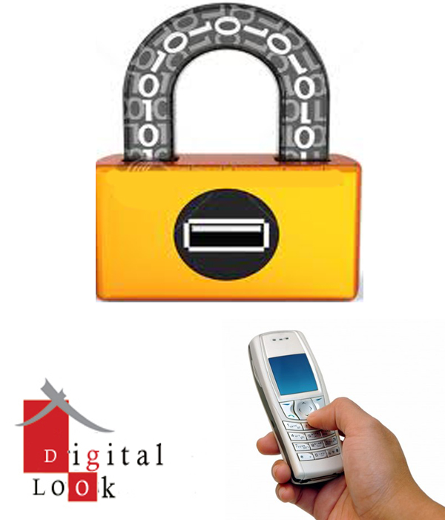

Slide 19

What is the digital lock??
Keyless door
Open the door using phone
DTMF principle

Slide 20
Block Diagram
amplification
Decoding
output

Slide 21
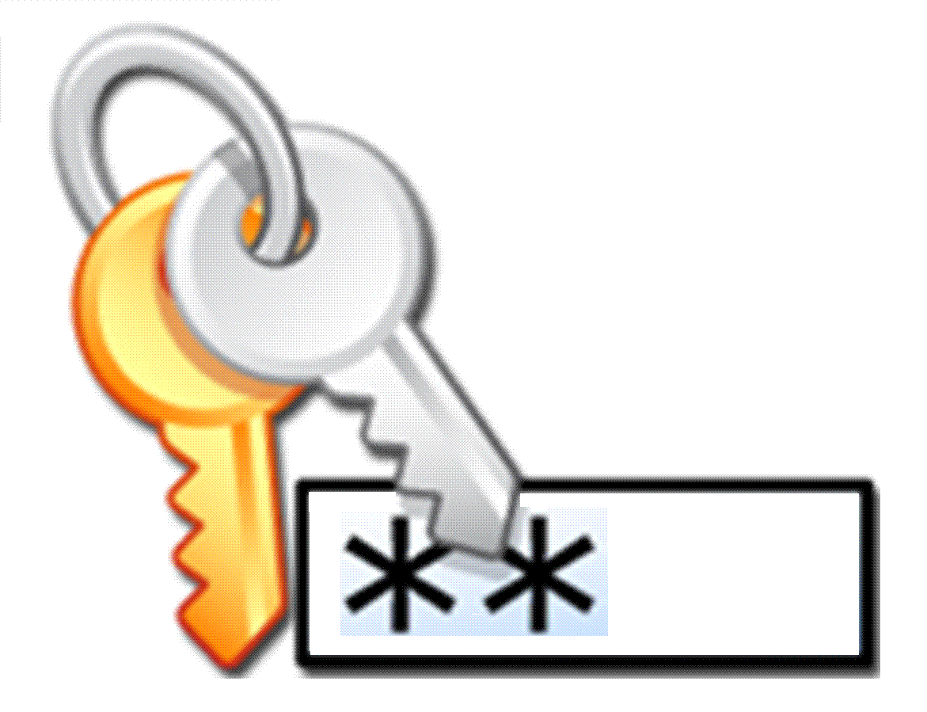




2
3
correct

Slide 22
Digital lock (components)
CMD8870
Microphone
LCD
Solenoid
microcontroller

Slide 23
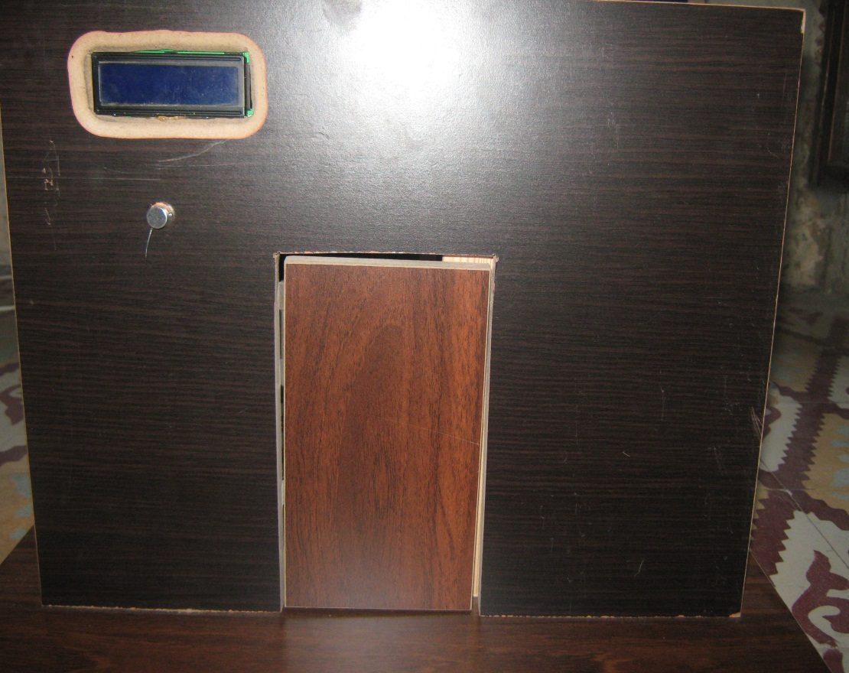
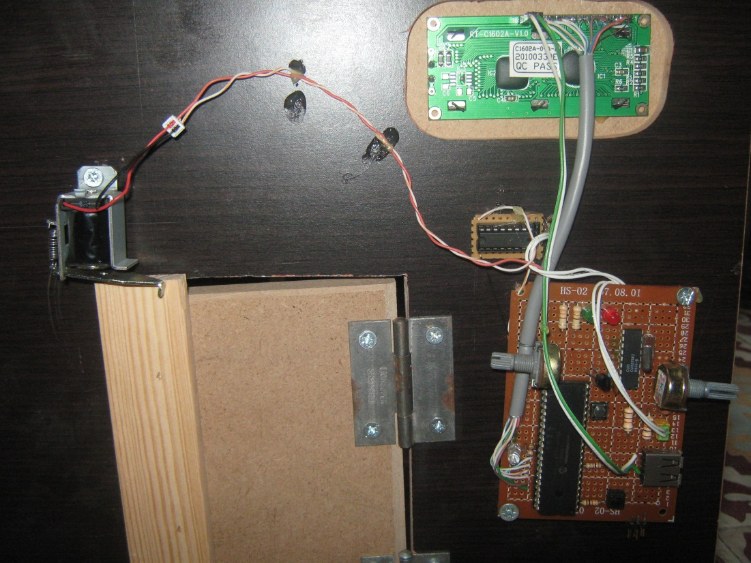
Output

