Slide 1






Optimizing Pneumonia Detection from Chest X-ray
By Yousef Taha, Yazeed Rashed
Supervised by Dr. Adnan Salman

Slide 2


Introduction
Pneumonia is an infection that inflames the air sacs in one or both lungs. It can be caused by bacteria, viruses, or fungi. Symptoms include cough, fever, and difficulty breathing. Early detection and treatment are vital to prevent severe health consequences, particularly in vulnerable populations like young children.
The use of chest X-rays is a common method for diagnosing pneumonia. With the advent of artificial intelligence, deep learning techniques have shown great promise in medical imaging. These advancements help in improving the accuracy and efficiency of diagnostics, reducing the burden on healthcare professionals.

Slide 3

Methodology
  Dataset
  The dataset consists of chest X-ray images sourced from Guangzhou Women and Children's Medical Center , comprising 5,863 images. Each image is labeled either 'Pneumonia' or 'Normal’.
  - Data Collection: Chest X-ray imaging was conducted as part of the standard clinical care at the medical center. Patients provided informed consent, and the data collection adhered to ethical guidelines.
  - Data Organization: The data is divided into training, validation, and testing sets to enable effective training and evaluation of the machine learning models. Each set contains separate folders for images labeled 'Pneumonia' and 'Normal'.

Slide 4
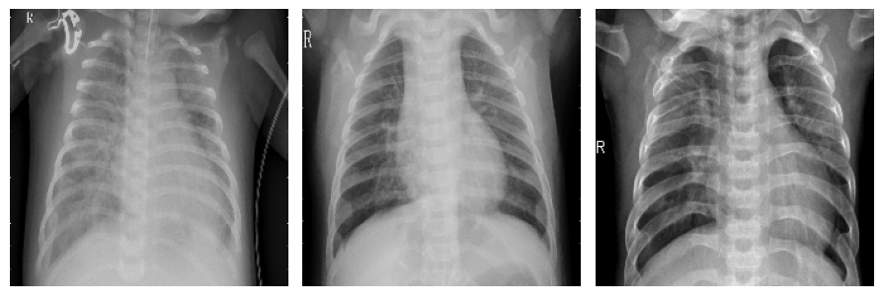
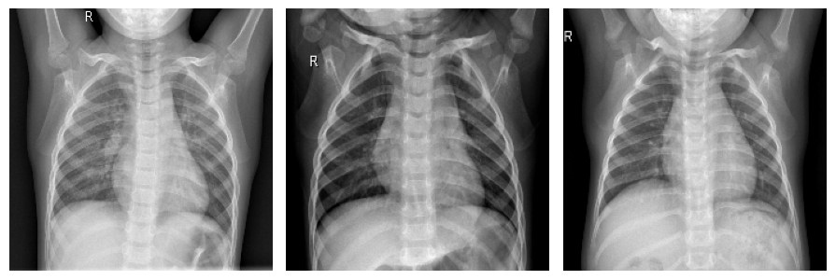
Methodology
  Pneumonia
  Normal

Slide 5

Methodology
  Pre-Modeling:
  - Data Splitting: The dataset was split into training and testing sets using the holdout method. Stratified sampling ensured proportional representation of both Pneumonia and Normal classes.
  - Training Set: 5,216 images (Pneumonia: 3,875, Normal: 1,341)
  - Testing Set: 624 images (Pneumonia: 390, Normal: 234)
  Data Preprocessing:
  - Image Resizing: All images were resized to a uniform size of 224x224 pixels to ensure consistency and meet the input requirements for the deep learning models.
  - Data Augmentation: Various augmentation techniques such as horizontal flipping, rotation, and zooming were applied to artificially increase the dataset size, introduce variability, and prevent overfitting

Slide 6

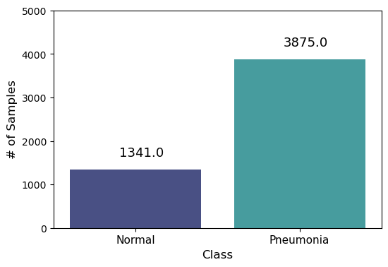
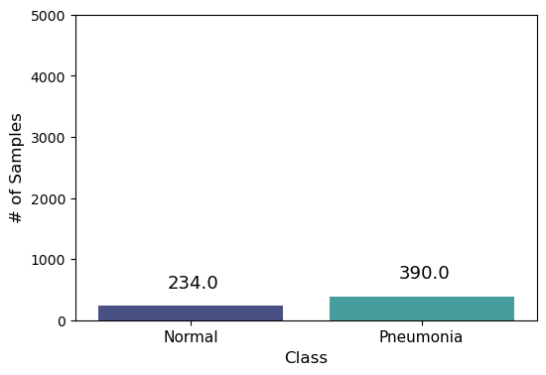

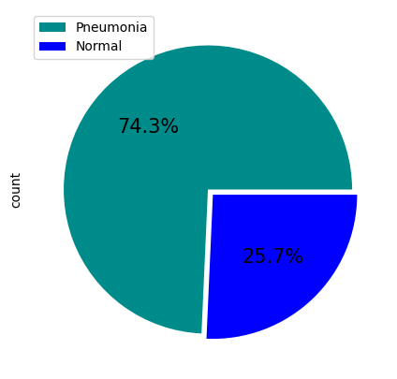
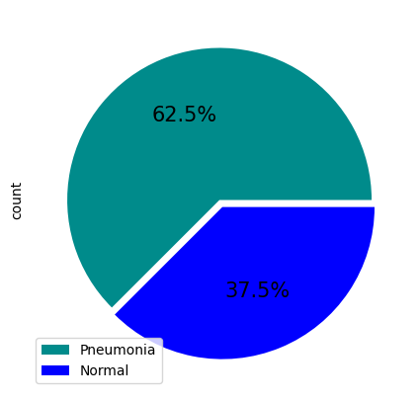

Training set
Testing set

Slide 7
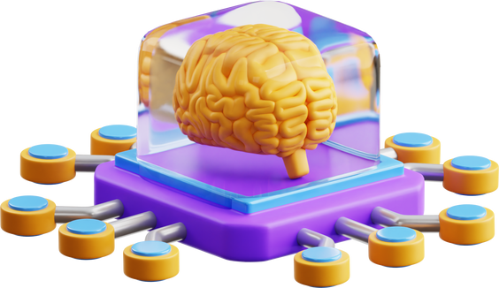
Methodology
  Learning Algorithms:
  MobileNet, NasNetMobile, EfficientNetB0, DenseNet121, and ResNet are CNN models used for image classification, each with distinct strengths. MobileNet, NasNetMobile, and EfficientNetB0 are optimized for efficiency and are suitable for mobile devices or low-resource environments. DenseNet121 excels in accuracy and performance on complex datasets. The choice of model depends on the specific needs for speed, accuracy, and resource constraints in a computer vision task.
  The objective of this study is to compare the performance of these models on a chest pneumonia classification task. Additionally, we investigated the performance of an ensemble with soft voting, where the ensemble consisted of lightweight models, and then compared the performance of each model with the performance of the ensemble and the more complex networks: ResNet and DenseNet.

Slide 8

Methodology
  Ensemble Model:
  - Soft Voting Ensemble: A soft voting ensemble method was used to combine the predictive outputs of MobileNet, NasNetMobile, and EfficientNetB0. This approach leverages the strengths of each individual model to enhance overall classification performance.
  - Final Classification: The ensemble model provided the final classification results, demonstrating superior accuracy and reliability compared to individual models.

Slide 9
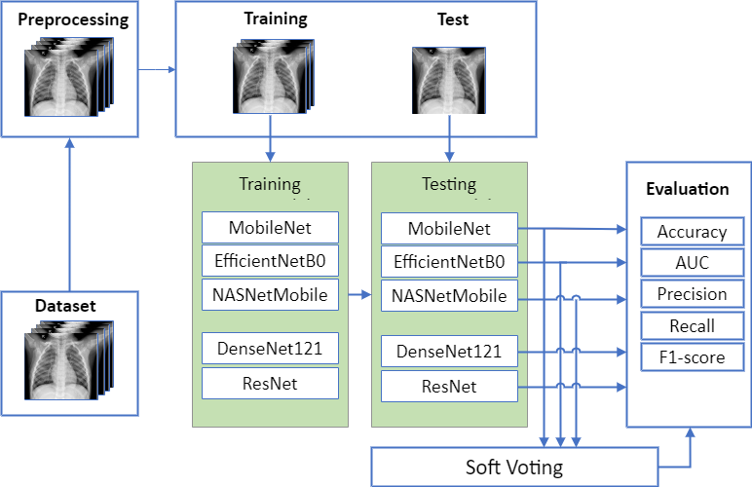

Slide 10
Methodology
  Training and Validation:
  -K-Fold Cross-Validation: This technique was utilized to provide a robust estimate of the model's performance. In k-fold cross-validation, the dataset is divided into k subsets (folds). The model is trained k times, each time using a different fold as the validation set and the remaining k-1 folds as the training set. This approach ensures that each data point is used for both training and validation, leading to a more accurate and generalizable model performance assessment. For this study, we used 10-fold cross-validation.
  -Early Stopping and Learning Rate Reduction: Early stopping was used to halt training when the validation performance ceased to improve, preventing overfitting. Additionally, the ReduceLROnPlateau callback was used to reduce the learning rate when the validation loss plateaued, allowing the model to make finer adjustments during training.

Slide 11
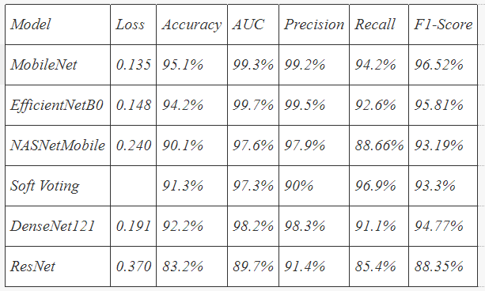

Discussion and Results
  Comparative Analysis
  The performance of each model was evaluated based on several metrics: accuracy, recall, precision, AUC, and F1-score. The following table summarizes the performance of each model:

Slide 12
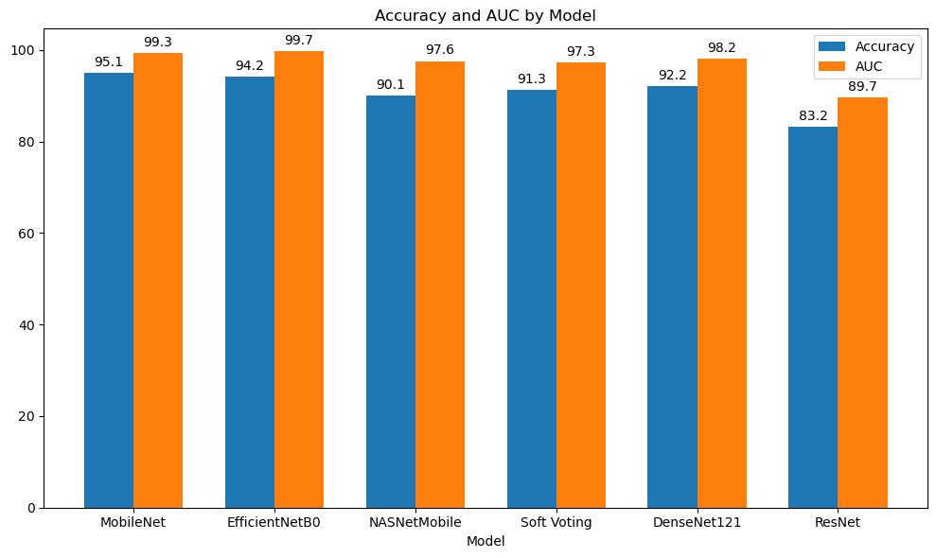

Slide 13
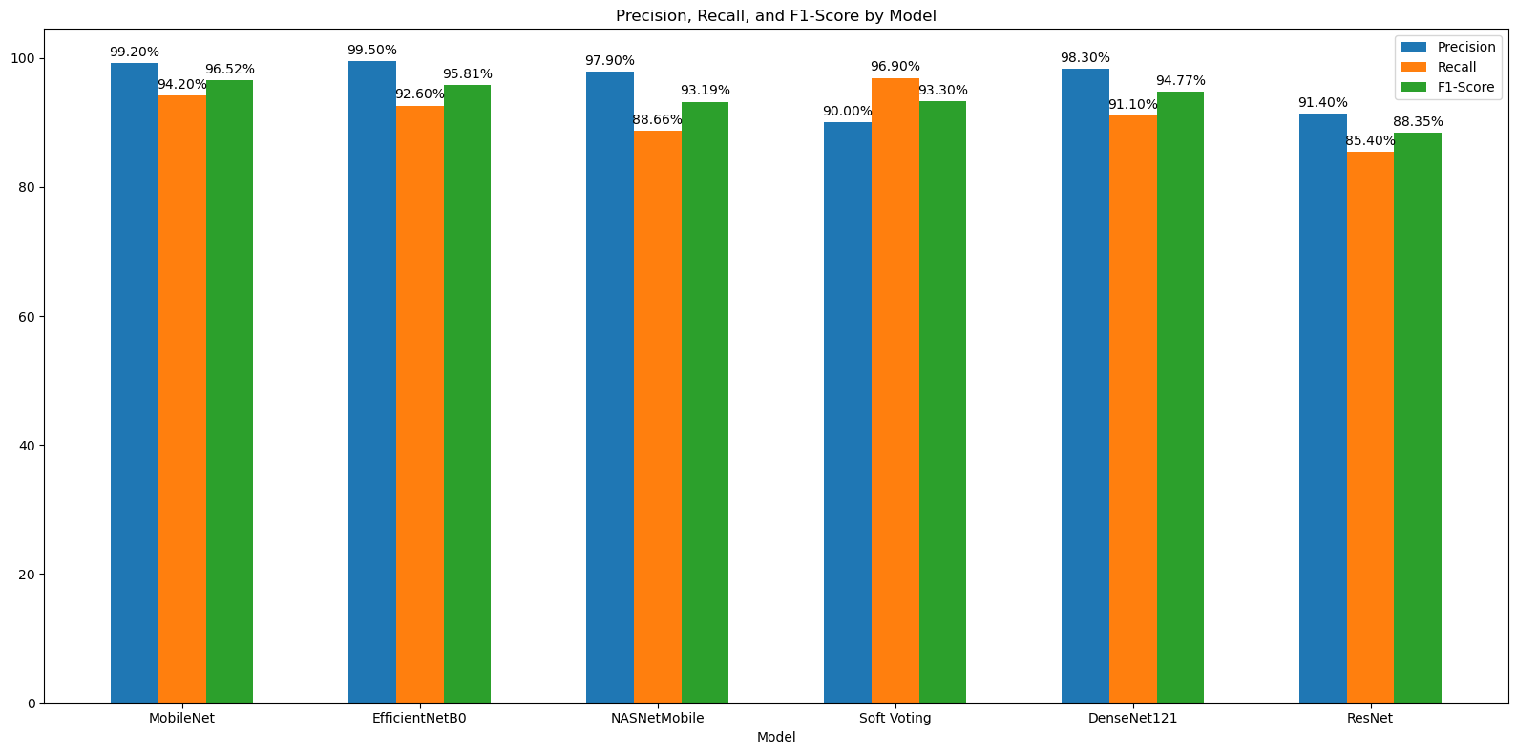

Slide 14

Discussion and Results
  Model Architectures:
  MobileNet: Designed for mobile efficiency with depthwise separable convolutions, MobileNet is lightweight and fast, achieving the highest accuracy (95.1%) and F1-score (96.52%), making it ideal for high-performance applications.
  EfficientNetB0: Utilizes compound scaling to balance depth, width, and resolution, achieving high accuracy (94.2%) and the highest AUC (99.7%). It excels in precision and recall, showcasing strong overall performance.
  NASNetMobile: Optimized through neural architecture search, NASNetMobile performed well with 90.1% accuracy and a 93.19% F1-score but was outperformed by MobileNet and EfficientNetB0.

Slide 15
Discussion and Results
  DenseNet121: Features dense connections for improved gradient flow and feature reuse, achieving 92.2% accuracy and a 94.77% F1-score, but slightly behind MobileNet and EfficientNetB0.
  ResNet: Known for its deep residual connections, ResNet showed the lowest performance in this study with 83.2% accuracy and an 88.35% F1-score, likely due to overfitting.
  Impact of Data Augmentation:
  Data augmentation significantly improved model generalizability, leading to high recall and precision values across all models. This technique prevented overfitting by introducing variations in the training data.

Slide 16
Discussion and Results
  Soft Voting Ensemble:
  The Soft Voting ensemble method combined model strengths to achieve high accuracy, AUC, precision, recall, and F1-score, though it did not surpass the individual performance of MobileNet and EfficientNetB0. This highlights the robustness and reliability of the ensemble approach, while also underscoring the standalone effectiveness of the top-performing models.

Slide 17

Conclusion
This research assessed several pre-trained convolutional neural networks (CNNs) for pneumonia detection from chest X-ray images, including MobileNet, EfficientNetB0, NASNetMobile, DenseNet121, and ResNet, along with a Soft Voting ensemble method to combine their strengths. The findings reveal that MobileNet and EfficientNetB0 were the most effective models. MobileNet achieved the highest accuracy of 95.1\%, offering an optimal balance between computational efficiency and performance. EfficientNetB0 excelled with the highest AUC of 99.7\%, showcasing its exceptional ability to distinguish between normal and pneumonia cases.

Slide 18

Conclusion
This study underscores the significant potential of deep learning models, particularly MobileNet and EfficientNetB0, in providing accurate and efficient tools for pneumonia detection from chest X-ray images. To further enhance diagnostic accuracy and reliability, future research could aim at expanding datasets, exploring advanced data augmentation techniques, and developing hybrid models. These findings offer valuable insights for healthcare professionals, enabling timely and accurate diagnoses and ultimately improving patient outcomes.

Slide 19


Thank You!

Slide 20












Resource page

