Slide 1


An Najah - National University Faculty of Engineering
Mechatronics Engineering Department
integrating Arduino Technology for Efficient Geothermal Heat Pump Management.
Graduation Project 2
Prepared By:
Hani Balati Ahmed assaf
Supervisor: Dr. Salameh Abdel-Fattah
FEB 6th -2025

Slide 2

Contents
01
02
03
04
05
06
07
08
Objectives
Introduction
Goethermal Heat exchanger
Proposed system
System Design
Methodology
Result and Analysis
Conclusion

Slide 3

Objectives
.
Objective01
Design an Integrated Sustainable System
Objective02
Implement Arduino- Based Smart Control
Objective03
Enhance Energy Efficiency
Objective04
Demonstrate Environmental Benefits
Objective05
Prototype Development and Testing

Slide 4



" With the increasing global demand for sustainable energy solutions, traditional heating and cooling systems are no longer efficient or eco- friendly. This project introduces an innovative approach by integrating geothermal heat pumps with solar energy, controlled via Arduino technology. As the f irst geothermal project in Palestine, it aims to demonstrate the feasibility and benefits of renewable energy, reducing costs and environmental impact while paving the way for future sustainable infrastructure in the region."

Slide 5


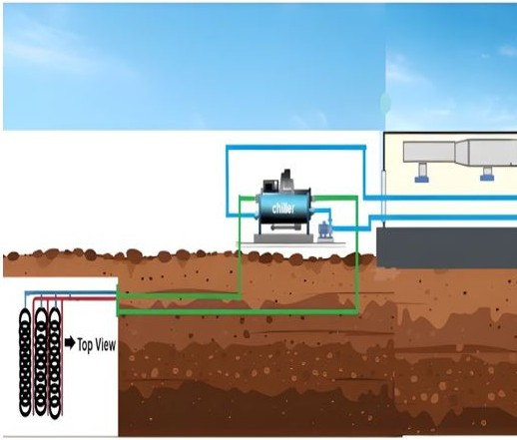
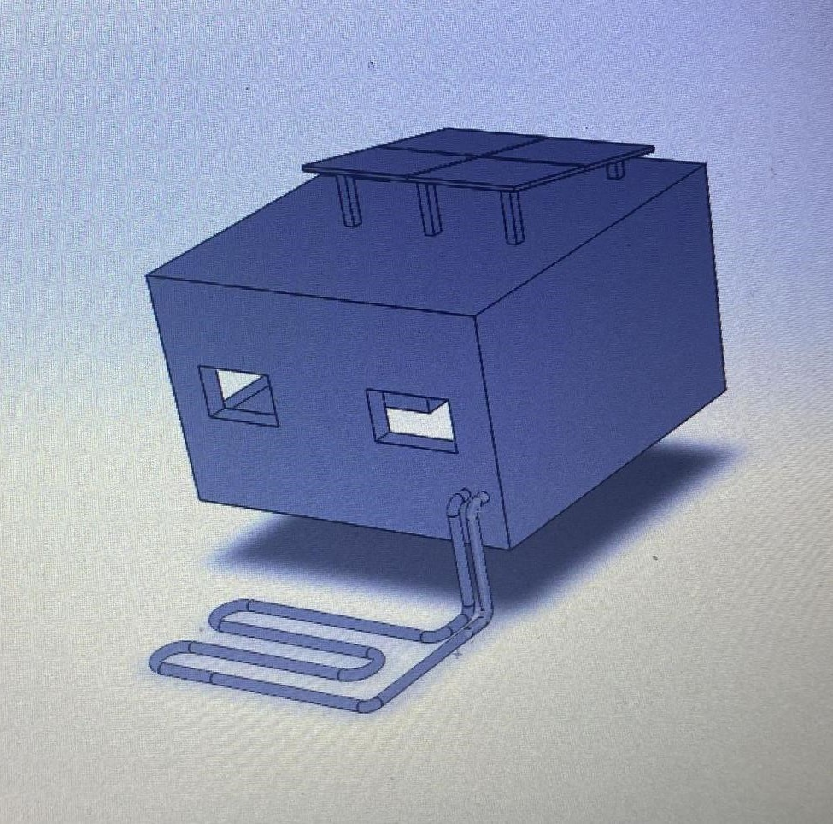
Proposed system
pump

Slide 6


System Design
Overview of the Integrated System Components:
🔹 Solar Panels – Capture solar energy and power the system.
🔹 Geothermal Heat Pump – Utilizes underground temperature for heating and cooling.
🔹 Arduino Automation – Controls the solar tracker, pump, and monitors system performance.
🔹 MOSFET Control for the Pump – Ensures efficient power regulation and flow control.
✅ Efficient | Automated | Renewable Energy Integration

Slide 7
Methodology:
Step 1: Prototype Testing in Palestine Conducted real-world testing in Arrabeh, Palestine.
use 6m copper pipes at 1.8m depth.
Step 3: Smart Control via Arduino Programming Developed code for:
Solar Tracking – Adjusts solar panel position for max efficiency.
Pump Regulation – Controls water flow based on temperature sensors.
Energy Optimization – Monitors voltage, current, and system performance.
Step 4: System Monitoring & Performance Analysis Collected real-time data on energy efficiency and thermal regulation.
Adjusted control algorithms to optimize system performance.
Assessed environmental impact and economic feasibility.
Step 2: Designing the Integrated System Combining three key components:
Solar Energy – Captured by solar panels, optimized with a tracking system.
Geothermal Heat Pump – Used to stabilize indoor temperatures.
Arduino & MOSFET – For automated control of pump operation.

Slide 8

Prototype
Test Results:
Environmental & Economic Benefits
Key Takeaways
Temperature Change
Sustainability
Energy- Efficient & Cost- Effective
Solar Tracking System
Carbon Footprint
Arduino- Controlled Automation
Cost Efficiency
Automated System
Scalability
Feasibility in Palestine
Electricity Consumption

Slide 9
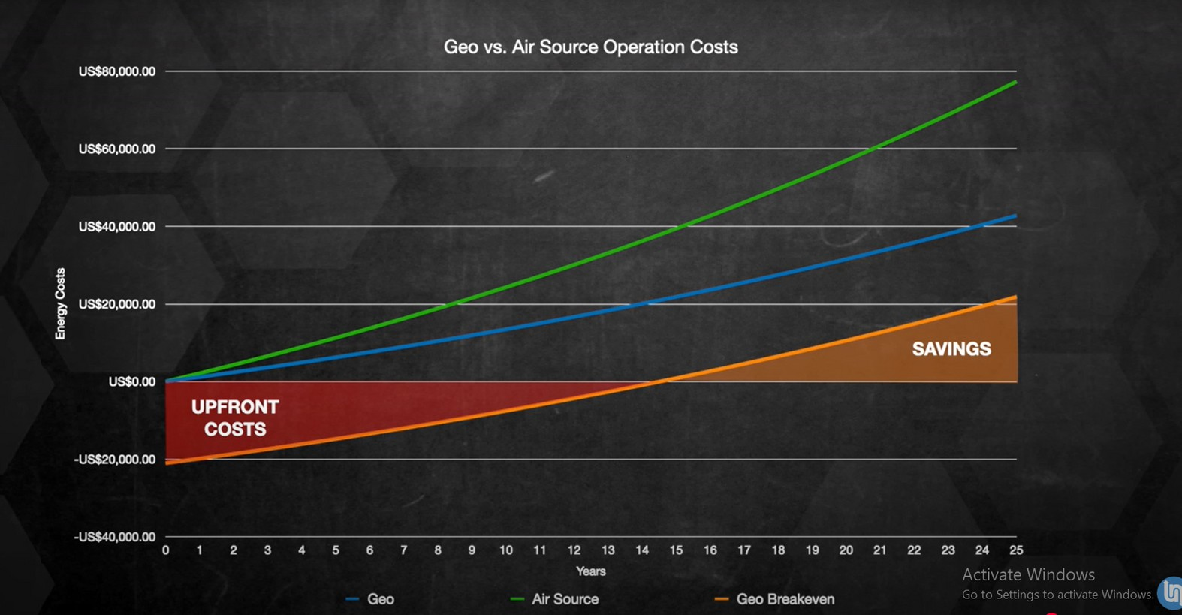
Economic Benefits
2
4
6

Slide 10
Conclusion:
The integration of renewable energy sources with Arduino automation has proven to be both feasible and efficient. By combining solar energy and geothermal heating, the
system successfully reduces energy consumption while maintaining stable indoor temperatures between 22 °C and 24 °C. The prototype testing demonstrated that
geothermal heat exchange is effective, with a 0 . 87 °C temperature change after water circulation, validating the system’ s ability to utilize underground thermal stability. The
Arduino- controlled automation significantly enhances system performance by regulating the solar tracker and water pump, ensuring optimal energy efficiency. Additionally, this
project marks an important step in introducing geothermal technology to Palestine, where no such systems currently exist. The results indicate that this system has the potential to serve as a cost- effective and sustainable alternative for heating and cooling, reducing
dependence on fossil fuels and conventional HVAC systems while promoting environmental sustainability.

Slide 11
THANK YOU

