Slide 1
Feasibility Study for Multiple Function Mall
Prepared By:
Hussein Zakarna
Husam Jaradat Husam Domaidy
Mohammed Romel Ayham Joma’a
Supervisor:
Dr. Ahmad Al- Ramahi

Slide 2
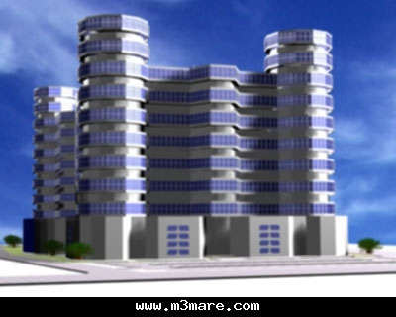
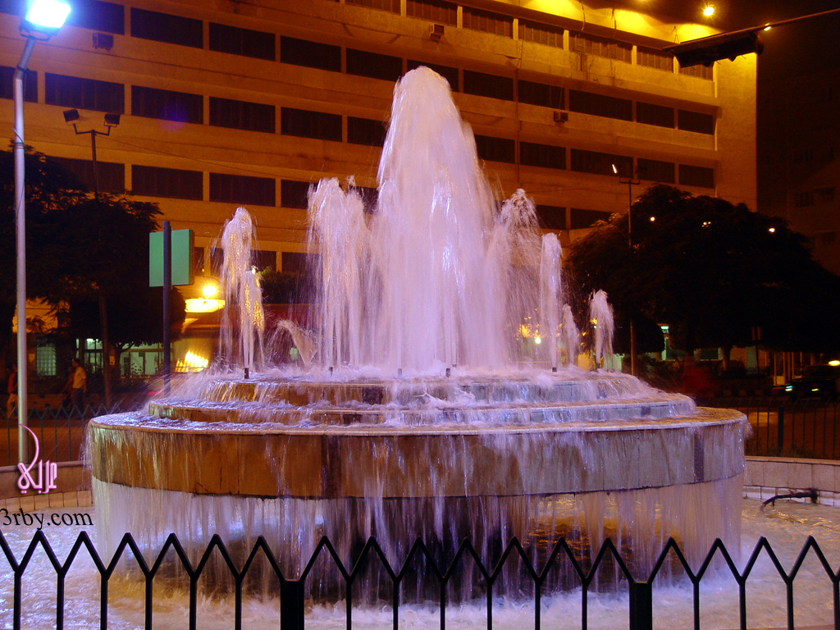
General Description:
Our project is about Multiple Function Mall.
Mall name is Global Mall Company.
The location in front of new campus of An-Najah National University.
Area of land where the mall to be established is 4108 m² .
Area of building of mall is 920 m² for the floor level and then it become 1200 m² for the other level.
The land is surrounded by four street (Rafidia street, Makhfeya street, Etesalat street, Creatable street).
Look to the following shape:

Slide 3
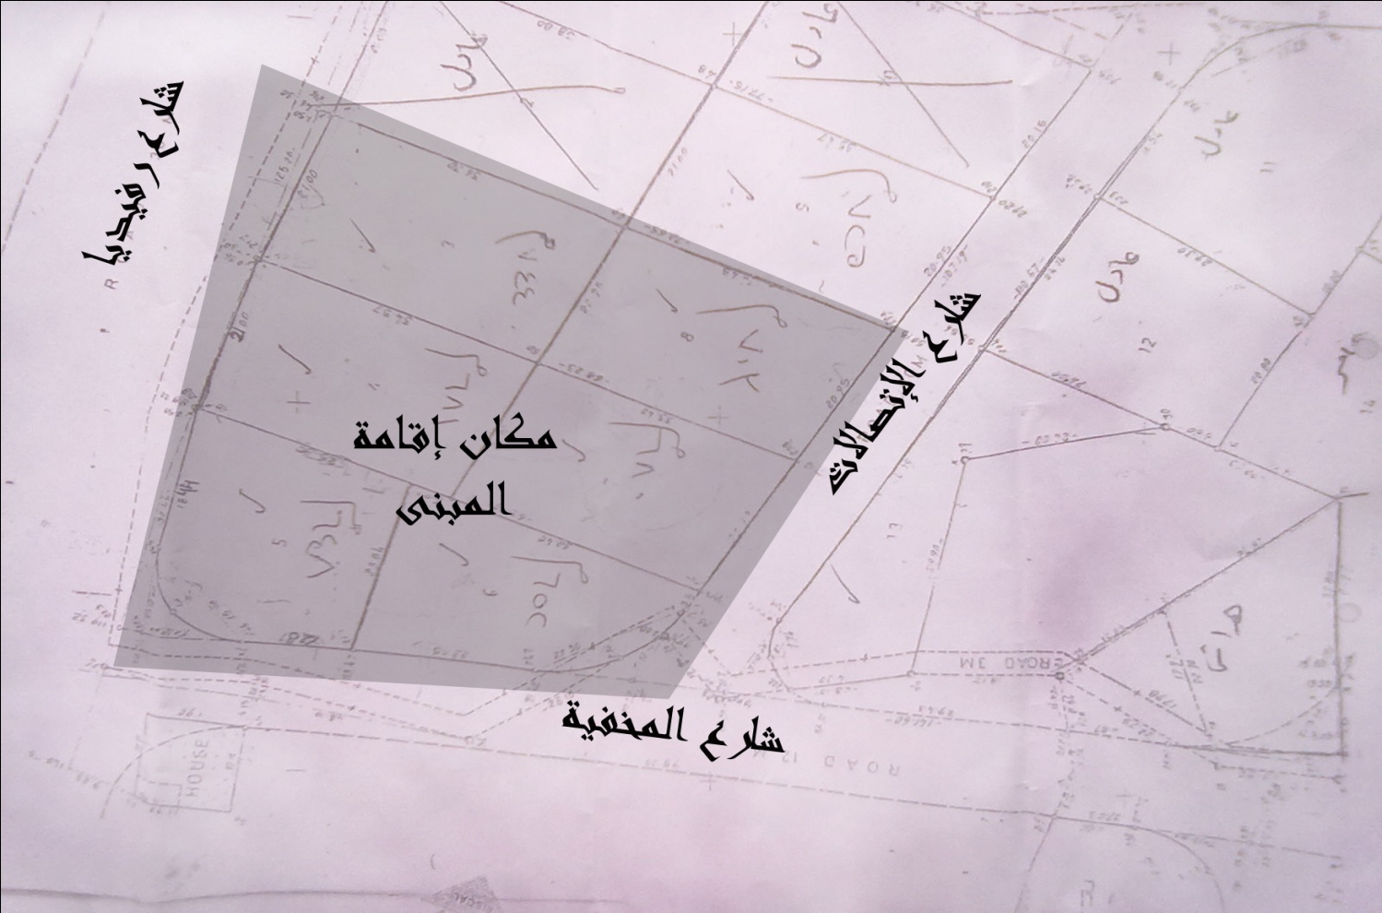
Explain the sketch of the land where mall is created.
This
Shape

Slide 4
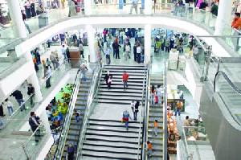
Mall’s Services:
Mall market is students of An-Najah university
(20,000 students).
The services which mall submit are:
  Stores (All area is 5720 m² ).
  Library, Students Service and Net Café (It’s area is 1200 m² ).
  Restaurant (It’s area is 1200 m² ).
  Gym (It’s area 1200 m² ).
  Students House ( It’s area 13200 m² ).
  Café Shop (It’s area 1000 m² ).

Slide 5
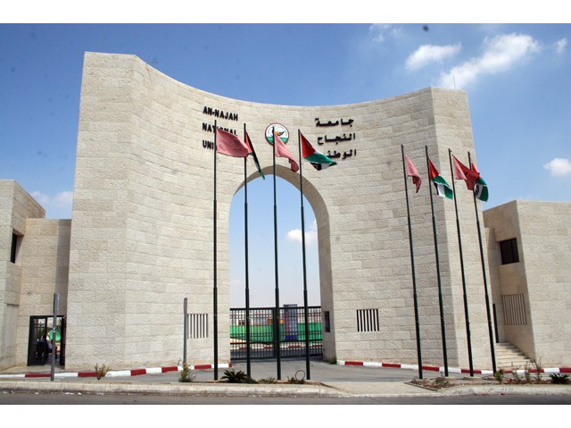
Market Study:
In this chapter, capacity of mall, the size of current demand in the market, the competitors in the market and their unit price were determined.
The market which was studied is students of An-Najah National University.

Slide 6
Market Study:
The methodology of market study,
  survey was designed.
  survey was distributed to 200 students in two campus of An-Najah University.
  Survey was analyzed by SPSS program.
  The results from SPSS were analyzed.
  The following shape explain the survey was distributed.

Slide 7
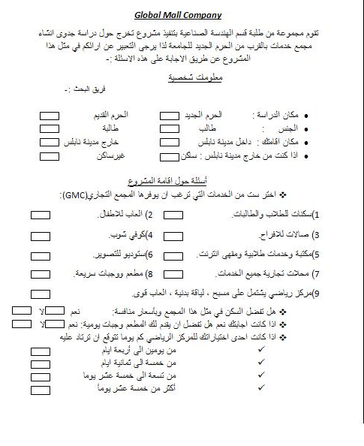
Market Study:

Slide 8
Market Study:
  Three scenarios were taken to determine size of current demand and size of market share.
  The first scenario was the survey represent all students in university (20,000 students) (Optimistic).
  The second scenario was the survey represent houses students according results of survey (9779 students) (Most Likely).
  The third scenario was according information from Student Union Council for number of students are living in Nablus (3000 students) where we assume that this number is Mall’s market (Pessimistic).
Capacity & Demand
Market Share

Slide 9
Market Study:
Capacity of mall was 3046 customers.
The size of current demand in the market was 48,966 Frequenting students (this number was estimated by summing of size of current demand for each service).
After competitors study, size of Mall’s market share was 12,675 students (this number was estimated by summing of size of market share for each service).
Current unit price in the market was according type of service.

Slide 10

Organizational structure and job descriptions:
In this chapter, the Organizational structure and job descriptions was determined.
The following shape explain this structure.

Slide 12

Cost of Establishment :
In this chapter the cost of establishment was determined.
Types of cost of establishment:
  Fees and licenses: Contains fees of design (11 NIS/m² ) and fees for lawyer to authorize the company (0.17 NIS/m² ), the total cost of this type is 264,952 NIS.
  Cost of land where the Mall is created was 1333.71 NIS/m² and the total cost of this type was 5,478,875 NIS.

Slide 13
Cost of Establishment:
  Building: contain cost of super deluxe for 1 m² was 2000 NIS/m² and total cost of this type was 47,440,000 NIS.
  Machine and Equipment: contain cost of machine required for each services until it work, total cost of this type was 875,000 NIS.
  Furniture: contain cost of furniture for each service and for workers and heads of departments, total cost of furniture is 1,322,100 NIS.

Slide 14
Cost of Establishment:
  Initial publicity: contain cost of placards for each service (200 m² ) and cost of inauguration was 20,000 NIS, and the total cost of this type was 44,000.
  Miscellaneous costs: contain cost of transport, modification, emergency and other, total cost of this type was 100,000 NIS.
  The total cost of establishment was 55,524,927 NIS.
Cost of establishment

Slide 15

Running Cost:
In this chapter, running cost was determine.
Running cost contain the following costs.
Variable cost: contain cost of raw material, this cost depend on number of customers and so we will explain this in financial study.
Fixed cost: contain cost of workers, taxes as waste tax , placards tax and property tax and cost of water and electricity, this cost distribute according to service.

Slide 16
Running Cost:
Emergency and maintenance: contain cost of emergency and cost of maintenance for each service, the total cost was 96,000 NIS/yr for firm which do this work and 2% from net profit without income tax cost of equipment and material required to make the maintenance.
Cleaning and Services: contain cost of firm which clean the Mall and cost of workers who work in service department, total cost for this type was 20,000 NIS/month.

Slide 17
Running Cost:
Depreciation cost: contain depreciation cost of building, depreciation cost of machine and equipment and depreciation cost of furniture, this cost distribute according to each service.
Advertisement cost: contain cost of advertisement for each service , this cost was 500 NIS/Service.
Total running cost was 174,593.5 NIS/month and 2% from net profit and 14% from net profit after removing 2%.
Running Cost

Slide 18
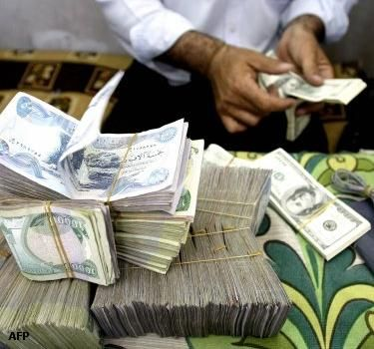
Financial study:
In this chapter, net profit, breakeven point for each service and payback period for Mall, according three scenarios.
Net profit for mall was 1,085,651 NIS/month according to optimistic scenario, 926,914 NIS/month according to most likely scenario and 583,412 NIS/month according pessimistic.
Breakeven point was 19,367 customer/month.
pay back period was 3.13 years according to optimistic scenario, 3.67 years according most likely scenario , 5.82 years according pessimistic scenario and 8.47 years according to 75% from net profit of pessimistic scenario.
Financial Study

Slide 19
Stores:
The following table explain feasibility study for stores.
Topic | Number
Capacity | 86 stores
Demand | 15200 students
Unit price (Annual rent) | 650 NIS/m²
Unit price (Vacancy) | 4400 NIS/m²
Running cost (per month) | 27,934 NIS/Month
Breakeven Point (per month) | 469 m² /Month
Net Profit at least (per month) | 154,011 NIS/Month
Net profit from Vacancy | 14,779,600 NIS/all stores

Slide 20
Library, Students Service and Net Café:
The following table explain feasibility study for Library, Students Service and Net Café.
Topic | Number
Capacity | 204 customers
Demand at least | 18080 students
Market Share at least | 6040 students
Unit price | 0.1-100 NIS/good (as goods)
Running cost (per month) | 50,915 NIS/Month
Breakeven Point (per month) | 6,182 Customer/Month
Net Profit (per month) | 143,005 NIS/Month

Slide 21
Restaurant:
The following table explain feasibility study for Restaurant.
Topic | Number
Capacity | 1120 customers
Demand (Midday) | 8291 students
Demand (Evening) | 1245 students
Market Share at least (Midday) | 1660 students
Market Share at least (Evening) | 870 students
Unit price | 7-15 NIS/Meal
Running cost (per month) | 61,858 NIS/Month
Breakeven Point (per month) | 3,904 Customer/Month
Net Profit (per month) | 208,542 NIS/Month

Slide 22
Gym:
The following table explain feasibility study for Gym.
Topic | Number
Capacity | 310 customers
Demand | 1140 students
Market Share at least | 612 students
Unit price | 5 NIS/training
Running cost (per month) | 20,913 NIS/Month
Breakeven Point (per month) | 5,333 Customer/Month
Net Profit (per month) at least | -3,777 NIS/Month

Slide 23
Student’s House:
The following table explain feasibility study for Student’s House.
Topic | Number
Capacity | 638 customers
Demand | 3000 students
Market Share at least | 2000 students
Unit price | 250 NIS/student
Running cost (per month) | 58,064 NIS/Month
Breakeven Point (per month) | 289 Customer/Month
Net Profit (per month) at least | 69,536 NIS/Month

Slide 24
Café Shop:
The following table explain feasibility study for Café Shop.
Topic | Number
Capacity | 688 customers
Demand | 2010 students
Market share at least | 1407 students
Unit price | 2-15 NIS/service
Running cost (per month) | 27,300 NIS/Month
Breakeven Point (per month) | 3,650 Customer/Month
Net Profit (per month) at least | 12,095 NIS/Month

Slide 25
All Services (Mall):
The following table explain feasibility study for Mall.
Topic | Number
Capacity | 3046 customers
Demand | 48,966 Frequenting students
Market share at least | 12,675 Frequenting students
Establishment cost | 55,524,927 NIS
Running cost (per month) | 246,984 NIS/Month
Breakeven Point (per month) | 19,367 Customer/Month
Net Profit (per month) at least | 583,412 NIS/Month
Net Profit (first year) | 583,412*12+14,779,600=21,780,544 NIS
Payback period | 5.82 years
Payback period at 75% Net profit | 8.47 years

Slide 26
Safety Plan:
In this chapter hazards, prevention of hazards and treatment of hazards were determined.
Hazards was as fires, explosion, electricity shocks, cutout of electric current and water and other hazards.
Prevention of hazards was according the type of hazard.
Treatment of hazards was according to type of hazards.
الخطر.docx
Safety Plan

