Slide 1
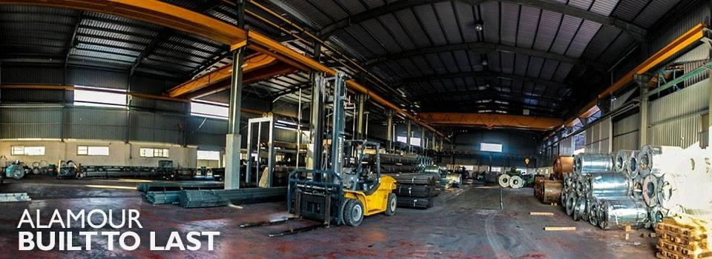
An-Najah National University
Faculty of Engineering & Information Technology
Industrial Engineering Department
Assessment of manufacturing processes of AL-Amour factory
Supervisor: Dr. Mohammad othaman
Dr. Ahmad Al-Rmahi

Slide 2



Our Team
Anas Mousa
Industrial & Systems Engineering student
Rashid Asbi
Industrial & Systems Engineering student
Zein Ishtaya
Ahmad Abu Hjleh
Industrial & Systems Engineering student
Industrial & Systems Engineering student

Slide 3
1
Introduction
2
Constraints , standards
3
Literature Review
Outline
4
Methodology & Preliminary Results
5
Conclusion
6
Recommendation

Slide 4

About The factory
Al –Amour Company For construction service sector
Located In Palestine Nablus
Started In 1999
More than 100 engineering and administrative staff

Slide 5
Cont.
A Palestinian private company that is founded in 1999 has more than 100 engineers and administrative staff in order to contribute to the construction sector service. This expansion in the work to pay the company to look at its plant space offers 7,000 , so they began expanding new area of 3000 in addition to the run pipe factory and the profiles in a given area 4000 .
The company has three main departments: -
Commercial Department
  Steel Division and peripherals
  Department of shingles and clips gypsum and peripherals
  Department of Wood and brick
Production Department
  Profiles and metal pipes manufacturing.
  Jacks manufacturing.
  Gypsum column.
  Gypsum base.
  Fencing Works And Barbed Wires.

Slide 6
.
Scope
increased capital equipment utilization
Reduce idle time
Less
inventory
Better utilization of labour

Slide 7
constrains
The first problem is which is the best tool to represent the value add time and non-value add time, secondly, which is the best tool to measure the effectiveness of equipment and how can improve that the company has traditional manufacturing (no lean or agile manufacturing), Thirdly, which is the best tool to reduce idle time and check if the rated capacity identical to the rated capacity. Fourthly, the misunderstanding of workers was a problem we faced.

Slide 8
Using the OEE and PCE calculations depend on the time by using the timer and fill these times in rout sheet and value stream mapping, it aware us that monitoring the worker beside him will affect his productivity, so we monitored the workers away from them. Also in this course, we knew how to build multiple activity chart and work center load report and its diagram.
Methods Engineering
(Quantitative method)

Slide 9

Literature Review
Lean manufacturing
. software development or financial services can benefit from adopting lean philosophy. As long as a company can identify a value stream, from when the customers order product to when they receive it, lean principles can be applied and waste removed
Lean manufacturing is defined as "A philosophy, based on the Toyota Production System, and other Japanese management practices that strives to shorten the time line between the customer order and the shipment of the final product, by consistent elimination of waste". All types of companies, manufacturing, process, distribution,
(Abhishek Kumar Singh, 1998)
(Hobbs, 2004) .

Slide 10
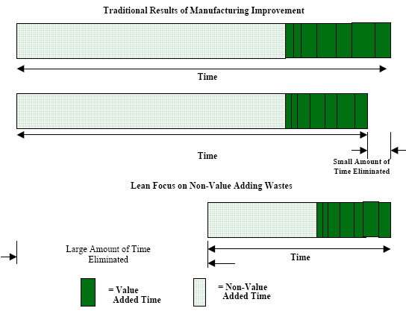
Figure 2. Traditional vs. Lean approaches

Slide 11
OEE Availability
OEE Availability is the ratio between the actual run time and the scheduled run time. The scheduled run time does not included breaks, lunches and other pre-arranged time a production line or process may be down.
OEE Performance
OEE Performance is the ratio between the actual number of units produced and the number of unit that theoretically can be produced and is based on the standard rate. The standard rate is rate the equipment is designed for.
OEE Quality
OEE Quality is the ratio between good units produced and the total units that were stated.
Overall Equipment Effectiveness

Slide 12
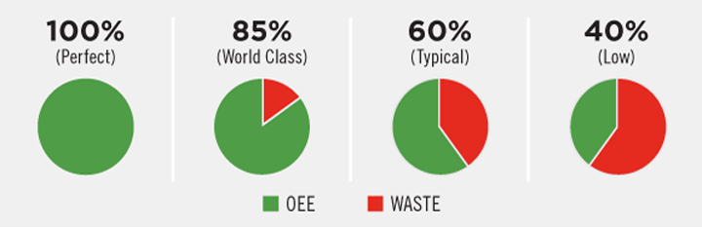
Overall Equipment Effectiveness
Figure 4. Standard OEE benchmarks

Slide 13
Value stream mapping (VSM) :
A value stream map takes into account not only the activity of the product, but the management and information systems that support the basic process. This is especially helpful when working to reduce cycle time, because you gain insight into the decision making flow in addition to the process flow.
Routing file :
A documents for the output of production and tracing the sequence of operations of a batch manufactured components.
A routing is the path that work follows from work center to work center as it is completed. Routing is specified on a route sheet or, in a computer-based system, in a route file (Smothers, 2009)
Work center load report:
This report shows released and planned load, total load, rated capacity and (over)/under capacity. The term overcapacity means that the work center is overloaded and the term undercapacity means the work center is under loaded (Lloyd, 2008).
Activity chart (MAC) :
Illustrate parallel activities and time relationships between two or more resources i.e. workers, plant/ equipment or materials. They are useful where the interaction between workers, equipment and materials repeat in periodic cycles so this chart can help identify the bottleneck and idling resources (Groover, 2007) .

Slide 14
Methodology
Visiting the factory as first step ; making interview with manager asking him about the problems they faced , what were the causes of these problems , production system in general , convincing them that the project will help them overcoming these problems . In The next step, we decided which are the best tools to improve manufacturing processes and check if the rated capacity identical to the total capacity or not.
We follow these procedures respectively:-
Depending on the data that collected by using stop watch and using it in route sheet and in value stream mapping we calculate the value added time and non value added time.
We need to see that the machines effective or not, based on OEE calculation after that we calculate processes cycle efficiency to approve that no lean or agile manufacturing (traditional manufacturing).
Depending on percentage of PCE and OEE we decide that the machines are:
1) Effective and efficient
2) Effective and not efficient
3) Not effective and efficient
4) Not efficient and no effective
After that we found that the work center load report and its diagram is applicable to check if the rated capacity identical to the total capacity and the multiple activity chart (MAC) is the best tool to find the ideal number of machines per operator and reducing idle time .

Slide 15
Preliminary results
5.1 Routing
By using stop watch we get setup time and operation time for each process of jacks product to calculate the cycle time of each process.
Task number | Symbols | Description of task | Setup time (sec) | Operation time/ unit(sec/unit)
1 | O | Shearing | 6 | 14
2 | O | Threading | 7 | 18
3 | O | Welding | 5 | 15
4 | O | Drilling | 5 | 10
5 | O | Painting | 4 | 20
6 | O | adding external part | 15 | 0
7 | O | Shearing | 6 | 14
8 | O | Drilling | 6 | 16
9 | O | Painting | 4 | 20
Total |  |  | 57 | 128

Slide 16
Description of tasks :
Shearing : this process is cutting of the pipe to appropriate length.
Threading : The pipes are threaded in a certain location to collect them with the other components.
Welding : in this process the welding two component are welded together .
Drilling: in this process two holes are drilled on the pipe .
Painting : in this process the pipe is painted .
Adding external part : this part is added manually
The following process 7,8 and 9 are processing to another pipe, the previous pipe and the second pipe both form a ( jack)
Shearing : this process is cutting of the second pipe to appropriate length.
Drilling : twelve holes on the second pipe are drilled .
Painting : the second part are painted .

Slide 17
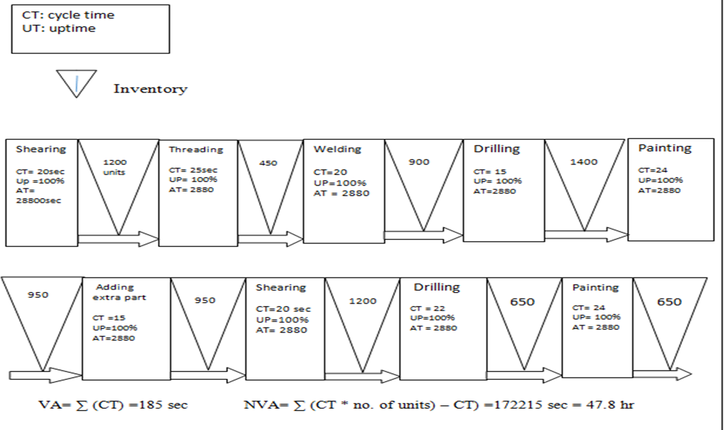

Slide 18
5.3 Calculation of OEE
Standard OEE benchmarks:-
Benchmark what is considered a good OEE score?
An OEE score of 100% is perfect production: manufacturing only good parts, as fast as possible, with no stop time .
An OEE score of 85 % is considered world class for discrete manufacturers, for many companies it is suitable long term goal .
An OEE score of 60 % fairly typical for discrete manufacturers but indicates there is substantial room for improvement
An OEE of 40% is not at all uncommon for manufacturing companies that are just starting to track and improve their manufacturing performance. It is low score and in most cases can be easily improved through straight forward measures (e.g by tracking stop time reasons and addressing the largest sources of down time -one at time ). We can summarize it as in figure

Slide 19
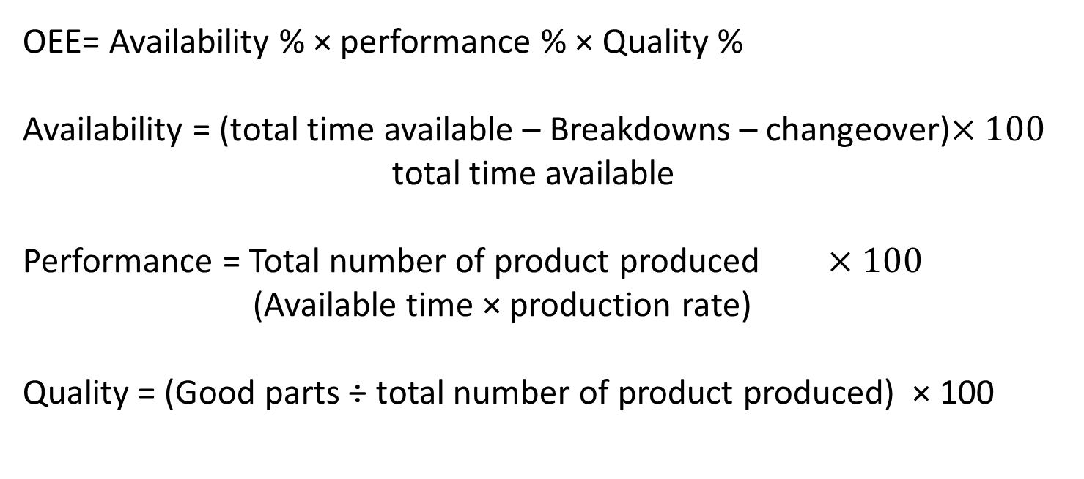
OEE= Availability % × performance % × Quality %
Availability = (total time available – Breakdowns – changeover)$×100$ total time available
Performance = Total number of product produced $×100$
(Available time × production rate)
Quality = (Good parts ÷ total number of product produced) × 100

Slide 20
Given :-
Production rate = = 0.937 pc/s
It works 8 hrs per day
Cycle time = 57.6 s
Total time available = 8 hr = 28800 sec
Breakdowns & change over time it need long time to occur so we estimate it 60 sec

Slide 21
calculations
Availability = (28800 – 60 – 60)/28800 = 99.5%
Performance = 400 /(8 hr * {450 pc/8 hr}) = 88.8 %
Quality = 350/ 400 =87.5%
OEE = 87.5 % ; this implies that its effective

Slide 22
5.4 Process cycle efficiency
(PCE)
PCE is the performance indicator of how efficiently the process is converting work-in-process into exits.
Note: PCE varies by application, but an average of 25% is world-class.
Process cycle efficiency (PCE) = value add time ÷ process cycle time
WIP = production rate * cycle time
average completion rate = production rate /available time

Slide 23
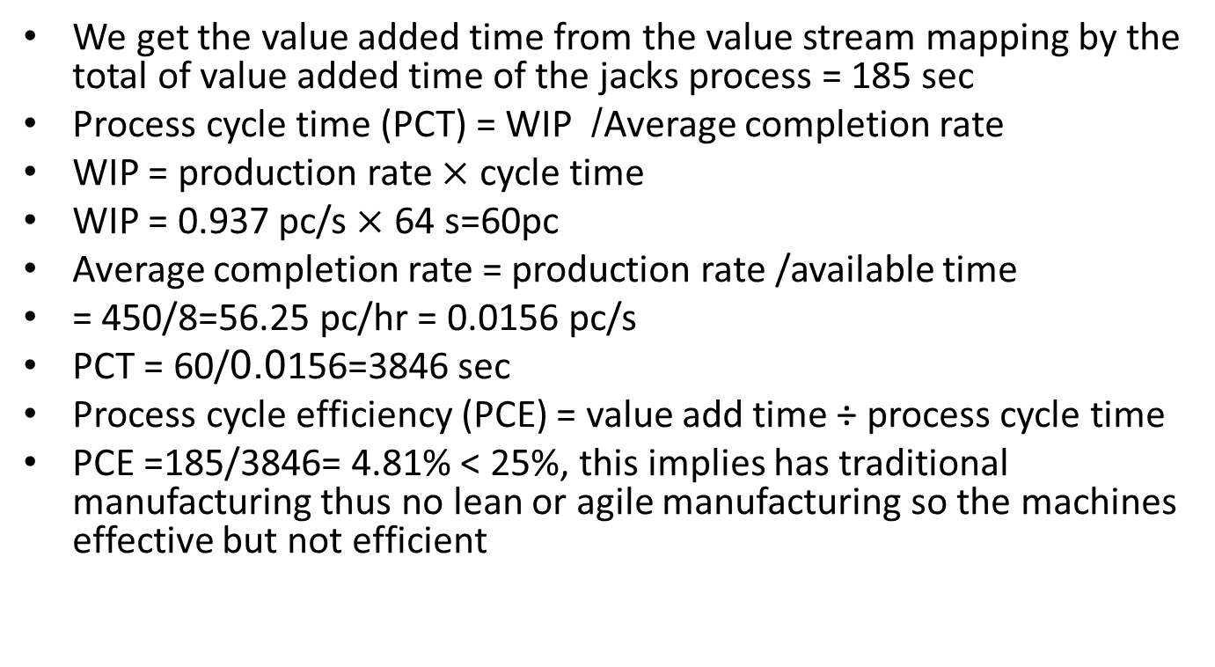
calculations

Slide 24
5.5 Routing file depending on a , t and b activities
We use documents for the following information: Operations to be performed, sequence of operation, work centers to be used, tooling needed at each operation and standard times (setup time and run time per piece.
* Before working on the routing files, we follow these tables to make easier calculations for Routing file, work center load report and multiple activity chart (MAC).
Hint:
a : concurrent activity (both machine and operator together) ex: load and unload machines
t : Independent machine activities (automating machining )
b : Independent operator activities (walking , inspection, packing )

Slide 25
Production line of pipes
Table 3: Sequence of pipes production line operation
A:loading the roll on the stand | B:Welding | C:Drawing | D:Bending, Rolling and Grinding | E:Welding | F:Controlling on the diameter | H:Shearing | I:unloading
a(A)=1.32 | a(B)= 0 | a(C) =0 | a(D) =0 | a(E)=0 | a(F)=0 | a(H)=0 | a(I)=16
t(A)=0 | t(B)=1.6 | t(C)=4 | t(D)=4 | t(E)=4 | t(F)=4 | t(H)=3.4 | t(I)=0
b(A)=8 | b(B)=1.4 | b(C)=1.4 | b(D)=6 | b(E)=6 | b(F)=2.8 | t(H)=2.8 | b(I)=16
Production line of Jacks
Table 4: Sequence of Jacks production line operation
A Shearing | B threading | C Welding | D Drilling | E painting | F Adding extra part | H shearing | I Drilling 2 | J painting
a = 2 | a = 2 | a = 2 | a = 1 | a = 1 | a = 6 | a =2 | a = 2 | a =1
t =14 | t =18 | t =15 | t =10 | t =20 | t =0 | t =14 | t =16 | t =20
b = 4 | b = 5 | b = 3 | b = 4 | b = 3 | b = 9 | b = 4 | b =4 | b =3

Slide 26
Gypsum columns
Table 5: Sequence of Gypsum column production line operation
D Unloading | C shearing | B Drawing, bending and rolling | A Loading the roll on the stand
a = 10 | a = 0 | a = 0 | a = 0.38
t =0 | t =2 | t =5.7 | t = 0
b = 2 | b =0 | b = 3 | b = 3
Gypsum base
Table 6: Sequence of Gypsum base production line operation
D Unloading | C Shearing | B Drawing, bending and rolling | A Loading the roll on the stand
a = 10 | a = 0 | a = 0 | a = 0.37
t = 0 | t = 2 | t = 3.5 | t = 0
b = 3 | b = 0 | b = 1.75 | b = 1.75

Slide 27
Production line name: pipes and profiles
Part #: part number from the associated Bill of Materials (BOM)
Drawing #: drawing may be from customer, internal system, or design definition.
Table 7: Routing file of pipes production line
Operation number | work center | Description of task | Setup time (Sec) | Run time (Sec)
1 | A | Load the roll on the stand | 9.32 | 0
2 | B | welding | 1.4 | 1.6
3 | C | Drawing | 1.4 | 4
4 | D | Gradual bending | 6 | 4
5 | E | welding | 6 | 4
6 | F | Controlling on the diameter | 2.8 | 4
7 | H | shearing | 2.8 | 3.4
8 | I | unload | 32 | 0
Total |  |  | 61.72 | 21

Slide 28
Production line name: Jacks
Table 8: Routing file of Jacks production line
operation number | work center | Description of task | Setup time (sec) | Operation time/ unit(sec/unit)
1 | A | Shearing | 6 | 14
2 | B | Threading | 7 | 18
3 | C | Welding | 5 | 15
4 | D | Drilling | 5 | 10
5 | E | Painting | 4 | 20
6 | F | adding external part | 15 | 0
7 | H | Shearing | 6 | 14
8 | I | Drilling | 6 | 16
9 | J | Painting | 4 | 20
Total |  |  | 58 | 127

Slide 29
Production line name: Gypsum columns
Part #: Drawing #:
Table 9: Routing file of Gypsum column of production line
Operation # | Work center | Description of task | Setup time (Sec) | Run time (Sec)
1 | A | Load the roll on the stand | 3.38 | 0
2 | B | Drawing , rolling and bending | 3 | 5.7
3 | C | Shearing | 0 | 2
4 | D | Load and unload | 12 | 0
total |  |  | 18.38 | 7.7

Slide 30
Production line name: Gypsum base
Part #: Drawing #:
Table 10 : Routing file of Gypsum base of production line
Operation No. | Work center | Operation name | Setup time (Sec) | Run time (Sec)
1 | A | Loading the roll on the stand | 2.12 | 0
2 | B | Drawing bending and rolling | 1.75 | 3.5
3 | C | shearing | 0 | 2
4 | D | Unloading | 13 | 0
total |  |  | 16.87 | 5.5

Slide 31
5.6 Work center load report
*This report shows released and planned load, total load, rated capacity and (over)/under capacity. The term overcapacity means that the work center is overloaded and the term under capacity means the work center is under loaded. This type of display gives information used to adjust available capacity or to adjust the load by changing the priority plan.
**Critical definitions: -
Released load = setup time + run time*order quantity
Planed load = setup time + run time*order quantity
Rated capacity = available time * utilization*efficiency
Available time= 8*6=48 hr, note: A work center has 6machines
Utilization = hours actually worked/available hours
Efficiency= actually rate of production / standard rate of production

Slide 32
Pipes production line
Table 11: Released and order quantity of pipes production line
Pipes production line | Order quantity (day 1) | Order quantity (day 2) | Order quantity (day 3) | Order quantity (day4) | Setup time (sec) | Run time (sec)
Released order | 3200 | 3500 | 3300 | 3150 | 61.72 | 21
Planed order | 2000 | 1700 | 1900 | 2050 | 61.72 | 21
Work center load report
Table 12: Work center load report of pipes production line
U%=75%
Day | 1 | 2 | 3 | 4
Released load | 18.86 (hr) | 21 | 19.81 | 18.39
Planed load | 11.68 (hr) | 9.93 | 11.1 | 11.97
Total load | 30.54 (hr) | 30.93 | 30.91 | 30.36
Rated capacity | 22.15 (hr) | 24.12 | 22.68 | 21.6
(over)/under capacity | 8.39(over) | 6.81(over) | 8.239(over) | 8.76(over)
Efficiency= | 61% | 67% | 64% | 60%

Slide 33
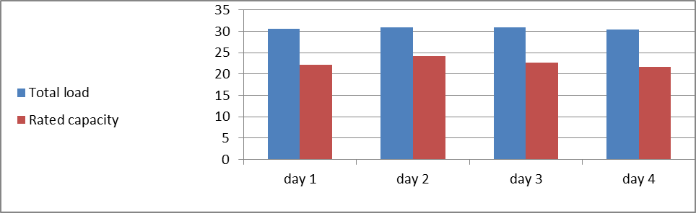
Figure 5: Work Center load of pipes production line
Depending on the figure above, we see that the pipes production line has negative risk that means they are late than schedule planned.
Jacks production line
Table 13: Released and order quantity of Jacks production line
Jacks production line | Order quantity in day 1 | Order quantity in day 2 | Order quantity in day 3 | Order quantity in day 4 | Setup time (sec) | Run time (sec)
Released order | 450 | 400 | 370 | 420 | 58 | 127
Planed order | 750-450=300 | 350 | 380 | 330 | 58 | 127

Slide 34
Work center load report
Available time= 8*8 =64 hr, note: A work center has 8 machines
Table 14: Work center load report of Jacks production line
Day | 1 | 2 | 3 | 4
Released load | 15.89 | 14.12 | 12.71 | 14.83
Planed load | 10.59 | 12.36 | 13.42 | 11.65
Total load | 26.48 | 26.48 | 26.13 | 26.48
Rated capacity | 28.8 | 25.6 | 23.68 | 26.88
(over)/under capacity | 2.32 Under | 0.88 Over | 2.45 Over | 0.4 under
Efficiency | 60% | 53% | 48% | 56%
U%= 75%

Slide 35
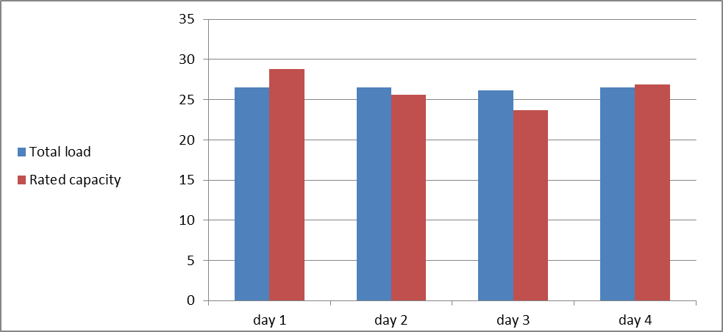
Figure 6: Work Center load of Jacks production line
According to the figure above, we see that the Jacks production is approximately identical to the schedule planned .
Gypsum columns
Table 15: Released and order quantity of Gypsum columns production line
Gypsum columns | Order quantity in day 1 | Order quantity in day 2 | Order quantity in day 3 | Order quantity in day 4 | Setup time (sec) | Run time (sec)
Released order | 2940 | 2850 | 3000 | 3100 | 18.38 | 7.7
Planed order | 900 | 990 | 840 | 740 | 18.38 | 7.7
Available time= 8*2 =16 hr, note: A work center has 2 machines

Slide 36
Work center load report
Table 16: Released and order quantity of Gypsum base production line
Day | 1 | 2 | 3 | 4
Released load | 6.29 | 6.1 | 6.42 | 6.63
Planed load | 1.93 | 2.12 | 1.03 | 1.58
Total load | 8.22 | 8.22 | 7.45 | 8.21
Rated capacity | 9.18 | 8.88 | 9.39 | 9.68
(over)/under capacity | 0.96 Under | 0.66 under | 1.94 under | 1.47 under
Efficiency | 76% | 74% | 86% | 80%
%U=75%

Slide 37
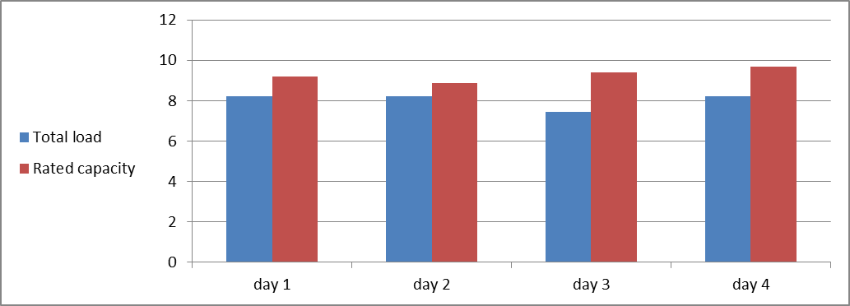
Figure 7: Work Center load of Gypsum columns production line
As the figure (7) shown the Gypsum column production line has positive risk which means they are faster than schedule planned .

Slide 38
Gypsum bases
Table 17: Released and order quantity of Gypsum base production line
Available time= 8*2 =16 hr, note: A work center has 2 machines
Gypsum columns | Order quantity (day 1) | Order quantity (day 2) | Order quantity (day 3) | Order quantity (day 4) | Setup time (sec) | Run time (sec)
Released order | 3840 | 3900 | 4000 | 3860 | 16.87 | 5.5
Planed order | 960 | 900 | 800 | 940 | 16.87 | 5.5

Slide 39
Work center load report
Table 18: . Work center load report of Gypsum base production line
Day | 1 | 2 | 3 | 4
Released load | 5.87 | 5.96 | 6.11 | 5.9
Planed load | 1.47 | 1.38 | 1.22 | 1.44
Total load | 7.34 | 7.34 | 7.33 | 7.34
Rated capacity | 9.6 | 9.75 | 10 | 9.65
(over)/under capacity E% | 2.26 Under 79% | 2.41 Under 81% | 2.67 Under 83% | 2.31 Under 80%

Slide 40
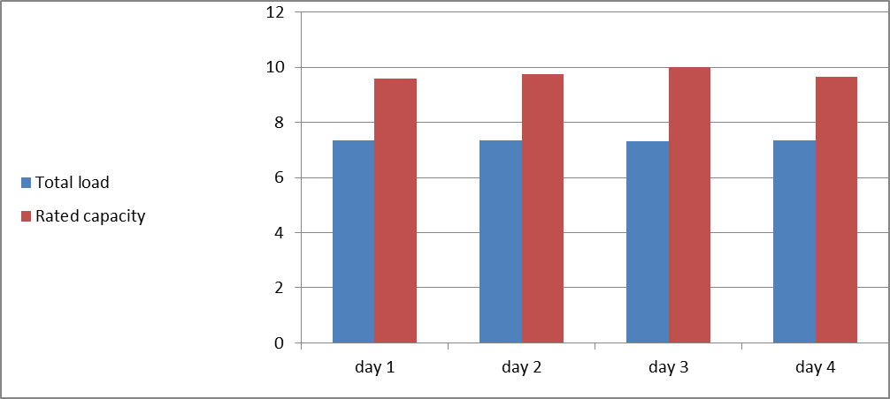
Figure 8: Work Center load of Gypsum bases production line
Depending on figure above we see that the Gypsum base production line has positive risk which means they are faster than schedule.

Slide 41
5.6 Multiple Activity chart
(MAC)
We use multiple activity chart that is used to show the interrelationships of individuals in teams of workers, or the relationships between workers and equipment, usually during the record stage of method study. The activities of each subject (whether worker or equipment) are recorded, normally as blocks in columnar form, against a common time scale. It is not usual, or necessary, to include a high level of detail, but it is necessary to distinguish between components of work where subjects are working in an independent way (such as a worker carrying out a manual task while a machine carries out an automatic process) or in an interconnected way (such as a worker setting up or operating a machine). The resulting chart clearly shows both interdependence and interference between subjects, and their effects in terms of creating delays and unoccupied time periods. They serve as useful devices to assist in the redistribution and balancing of workloads.

Slide 42
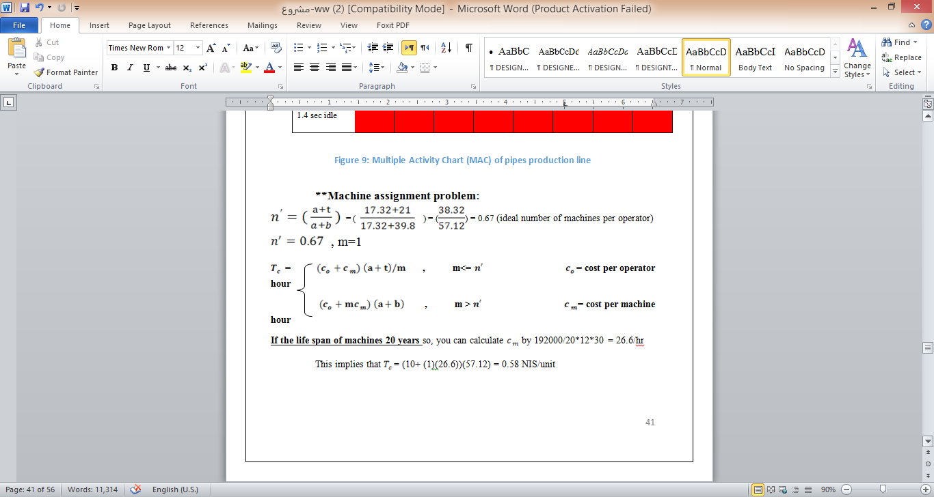

Slide 43
Excel

Slide 44
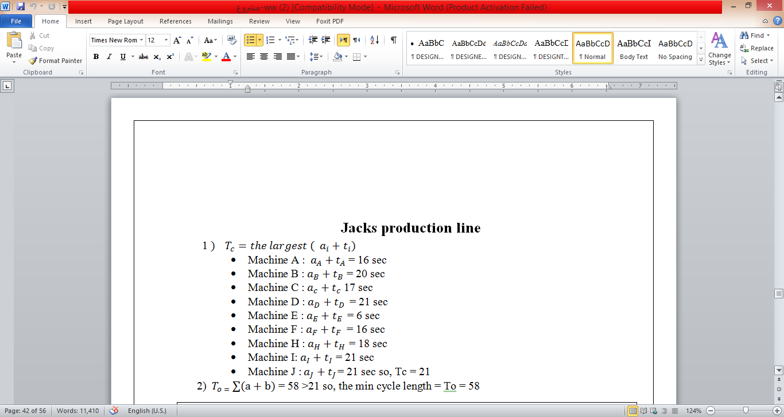
Jacks production line

Slide 45
Excel

Slide 46
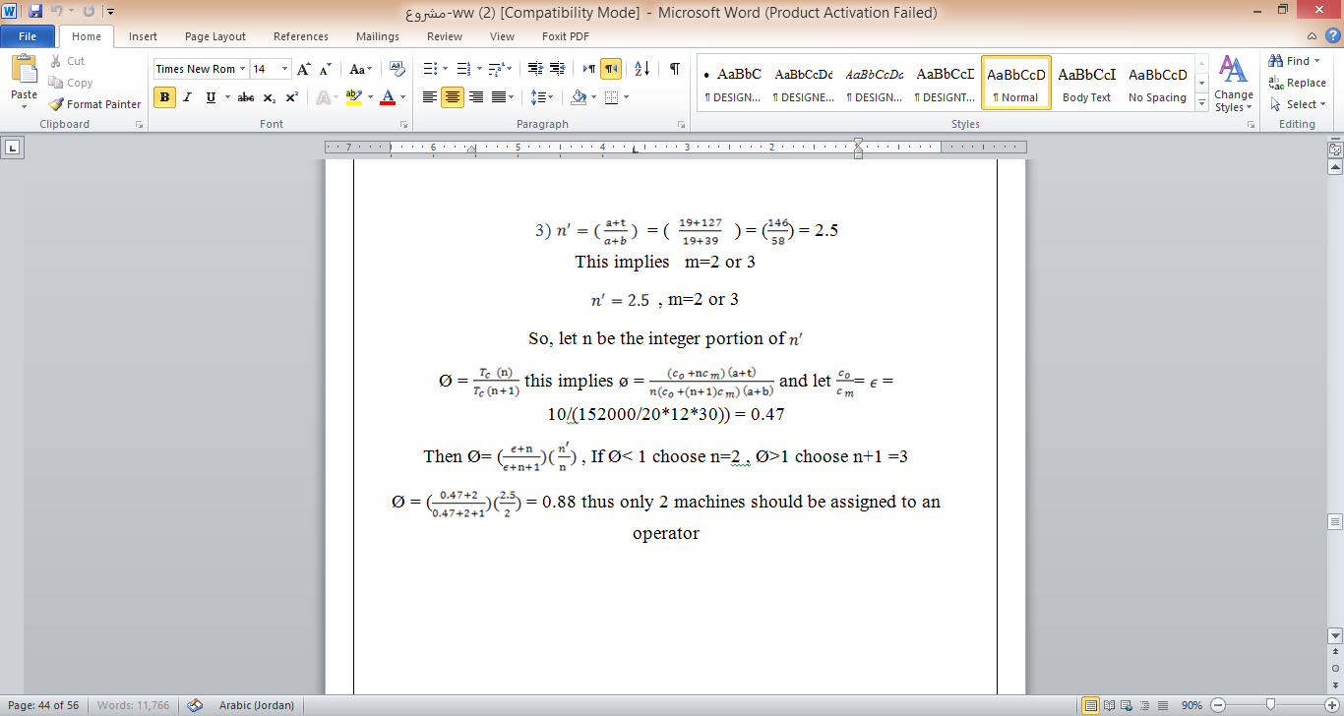

Slide 47
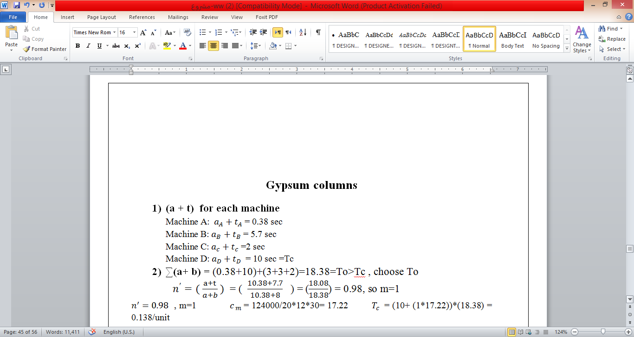
Gypsum columns

Slide 48
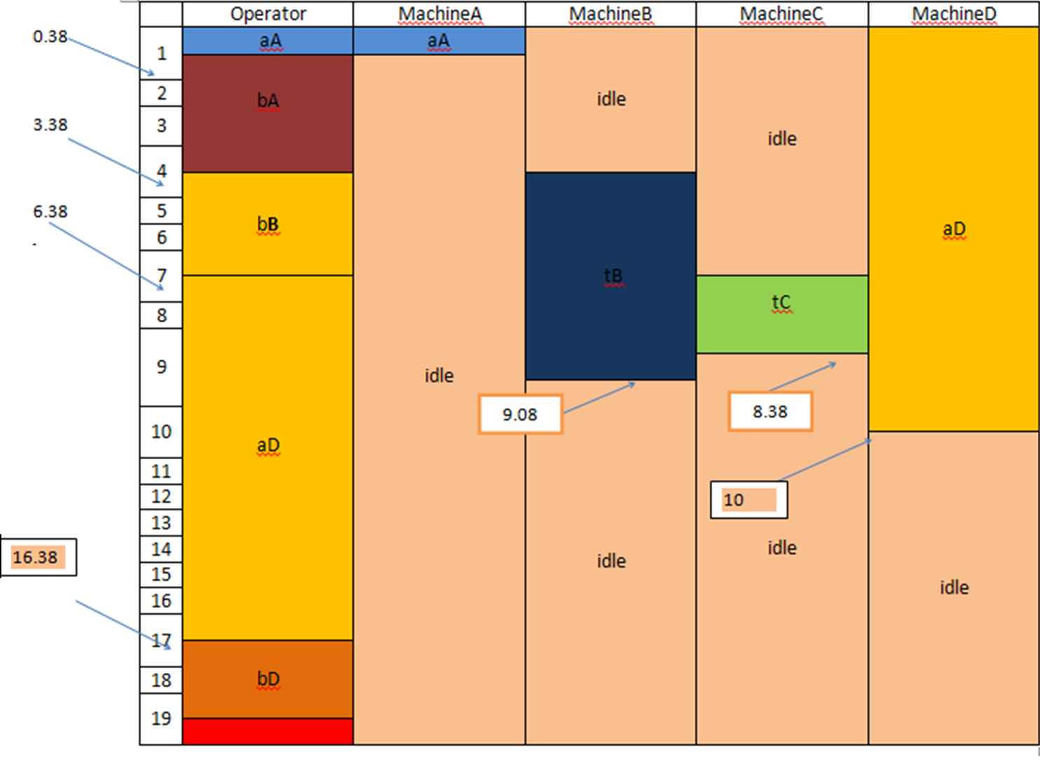

Slide 49
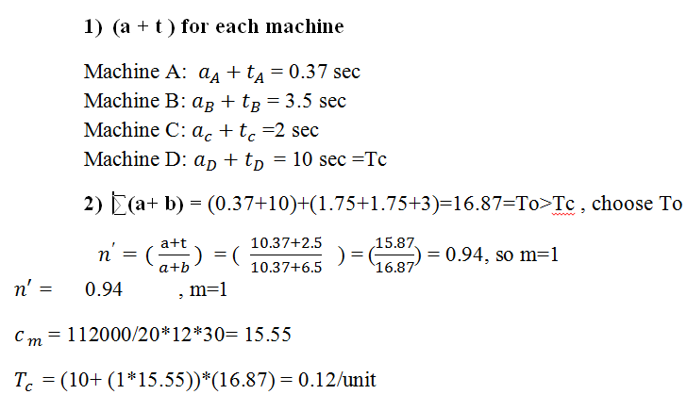
Gypsum base

Slide 50
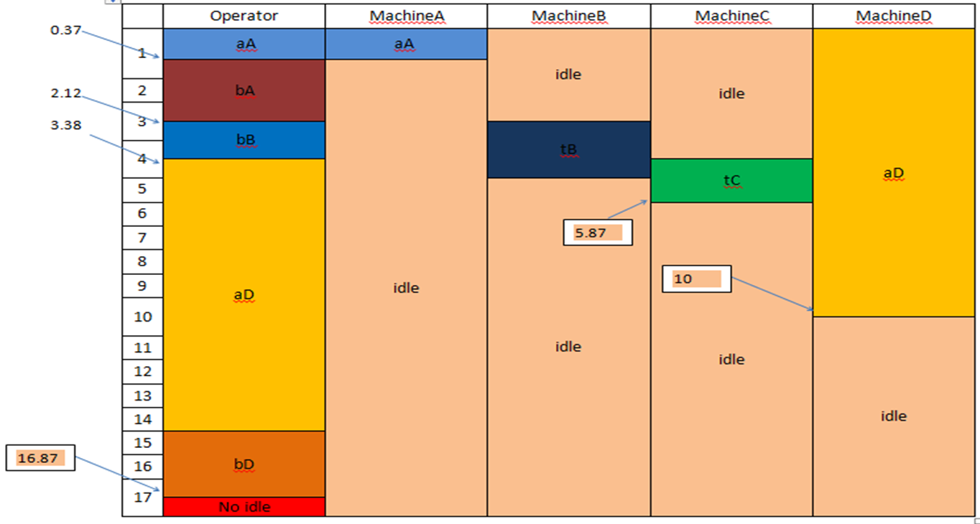

Slide 51
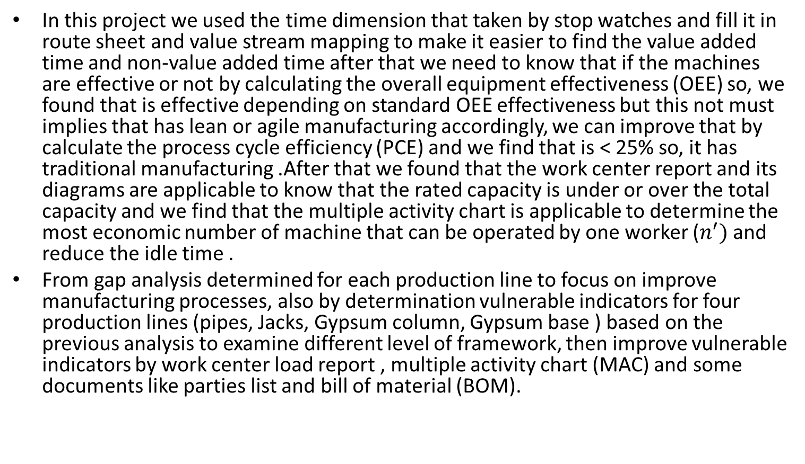
conclusion
In this project we used the time dimension that taken by stop watches and fill it in route sheet and value stream mapping to make it easier to find the value added time and non-value added time after that we need to know that if the machines are effective or not by calculating the overall equipment effectiveness (OEE) so, we found that is effective depending on standard OEE effectiveness but this not must implies that has lean or agile manufacturing accordingly, we can improve that by calculate the process cycle efficiency (PCE) and we find that is < 25% so, it has traditional manufacturing .After that we found that the work center report and its diagrams are applicable to know that the rated capacity is under or over the total capacity and we find that the multiple activity chart is applicable to determine the most economic number of machine that can be operated by one worker ($n^{′})$ and reduce the idle time .
From gap analysis determined for each production line to focus on improve manufacturing processes, also by determination vulnerable indicators for four production lines (pipes, Jacks, Gypsum column, Gypsum base ) based on the previous analysis to examine different level of framework, then improve vulnerable indicators by work center load report , multiple activity chart (MAC) and some documents like parties list and bill of material (BOM).

Slide 52
Recommendation
* Transferring the assignment from one worker to other to reduce idle time of worker because most manufacturing is automotive, this implies minimum number of worker that van operate one production line that means most economic number of machine that can operate by one worker .
* coupling machine if we can, to reduce idle time of the machine.
* Documentation with description should be provided for each process.
* 5S and other lean concepts should be spread in the company as a culture of work place and should be seeded inside the workers themselves as they can always help in improving the company .
*They must have a parts list that is a labeled list of the parts in the assembly along with their part numbers, part names, quantity, materials, and a make or buy decision like in Appendix I.
*They should use an effective Bill of Material (BOM) that is lists each stage of a products life from raw material to finally assembly like in Appendix I.
*They should have an effective report for daily work like in Appendix II.
*They must check from time to time about schedule and cost planed index and make leveling if there is possible.
.

Slide 53
Appendix I - :
1) PARTIS LIST :
PARTS LIST
Company: |  | Prepared by:
Product: |  | Date: / /
Part No. | Part Name | Quantity | Material | Make or Buy

Slide 54
2) BOM
Bill of Materials for Semi Automated Assembly
Company _ Prepared by_____________
Product ________________ Date _____________________
level | Part NO. | Part Name | Drawing No. | Make\Buy | comments

Slide 55
Appendix II:
شركة العامور للتجارة والصناعة
تقرير سير العمل اليومي
خطوط انتاج القواعد,الزوايا,الاعمدة
اسم مشرف خط الانتاج ...... التريخ.........
نوع خط الانتاج
خط انتاج الأعمدة | خط انتاج الزوايا | خط انتاج القواعد
 |  |  | عدد المشاتيح المنتجة
 |  |  | عدد القطع في المشتاح الواحد
 |  |  | عرض الشريحة الكاملة
 |  |  | سماكة الشريحة المستخدمة
 |  |  | كمية الامتار المنتجة (التالفة والصالحة)
 |  |  | كمية الامتار التالفة
 |  |  | نسبة المتار التالفة الى المنتجة
ملاحظات:..................................................... توصيات:........................................................

Slide 56
خط انتاج (الجكات)
اسم مشرف الخط :................ التاريخ :..............
جكات الطوبار
 | طول الجك المنتج
 | عدد الجكات المدهونة
 | عدد الجكات الغير المدهونة
 | العدد الكلي المنتج
الكمية المنتجة | العرض | الطول | زوايا الطوبار
الكمية المنتجة | العرض | الطول | تخت الطوبار

Slide 57
Thank you

