Slide 1

Students : Supervisor :
Aseel Zamel Dr.Manar Qamhia
Roba Darawsheh

Slide 2
Outline
Introduction
Existing problems
Tools and Technologies
Features
Demo
Future Work

Slide 3
Introduction
E-clinic is an application, which organizes the work of doctors
and helps them from suffering with manual reports and make the act of managing their clinics easy.
And helps patients by make the act of booking appointments easy and less time consuming.

Slide 4
Existing problems
1- Wasting time
2- Suffering with manual reports
3- Difficult managing the clinic

Slide 5
Tools and Technologies
Programming Languages :
1- We used JAVA and XML
2- PHP,HTML/HTML5, CSS, JQUERY, JAVA SCRIPT.
The programs used:
1-Android studio
2- Notepad++.
3-Xampp server.

Slide 6
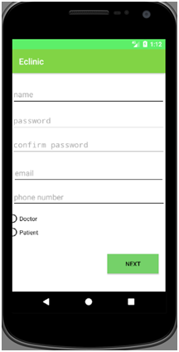
Features
Registration

Slide 7
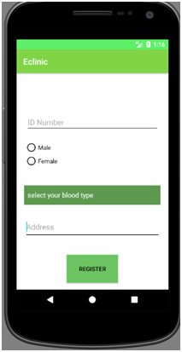
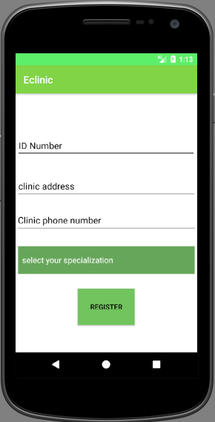

Slide 8
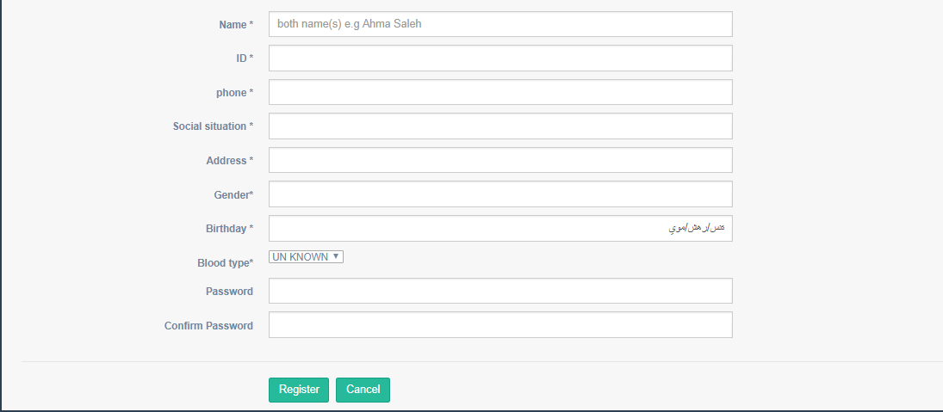
Patient registration

Slide 9
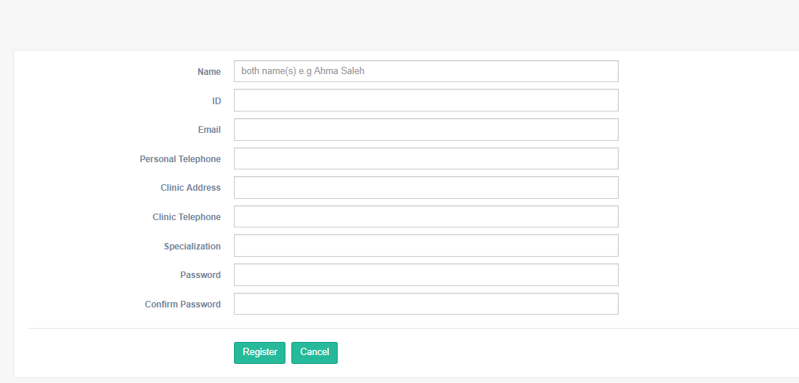
Doctor registration

Slide 10
Features cont.
Add Patient
Write reports and show history
Set schedule
See My schedule
Reserve appointments
See reserved appointments

Slide 11
Demo

Slide 12
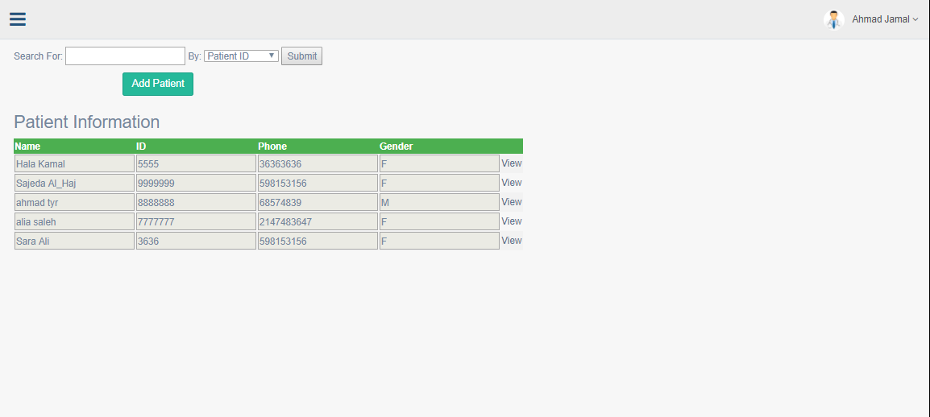

Slide 13
Future Work
Adding Map system to make it easy for patient to find clinic.
Chat system between doctor and patient.

Slide 14
Conclusion
we hope that e clinic solve the problem that patient faced when reserve the appointment and make it easy for doctor to Keep track of patients' reports easily

Slide 15
Thank You ^_^

