Slide 1

An-Najah National University
Building Engineering Department
Assessment & Redesign for Establishment of Manage & Development Orphans Funds in Ramallah City
Second semester 2022
Supervised by:
Dr. Mutasim Baba
Prepared by:
Aya Ziyad Rabay’a
Osama Ammar Tbaileh
Mohammad Bassam Saleh

Slide 2
Contents headlines:
Introduction
Site analyses
Architectural aspects
Environmental aspects
Electromechanical aspects
Structure aspects
Cost estimation aspects

Slide 3

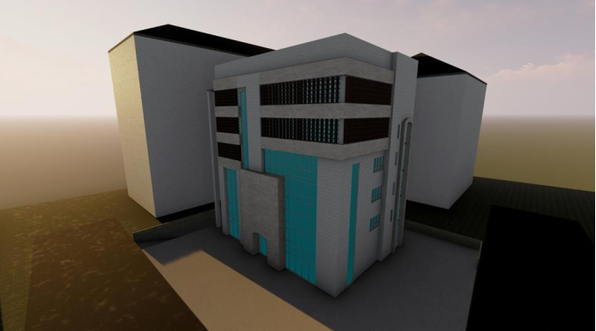
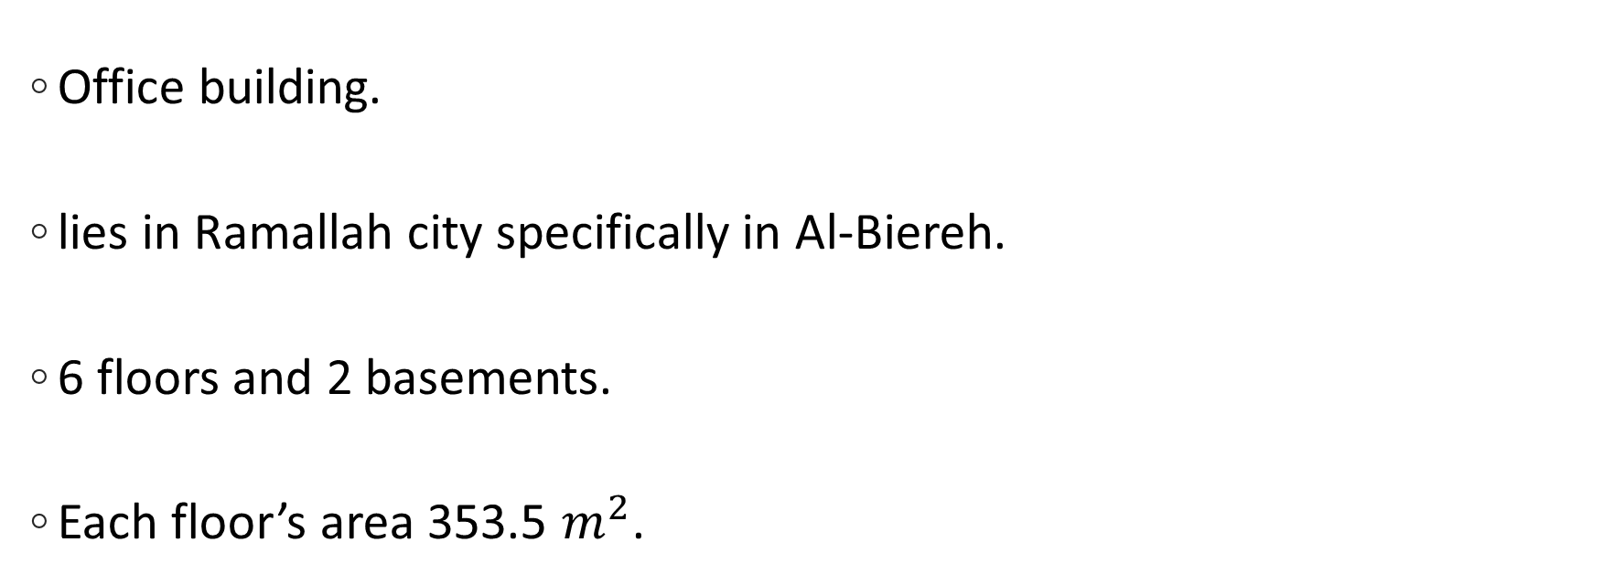
Introduction:
Office building.
lies in Ramallah city specifically in Al-Biereh.
6 floors and 2 basements.
Each floor’s area 353.5 $m^{2}$.

Slide 4
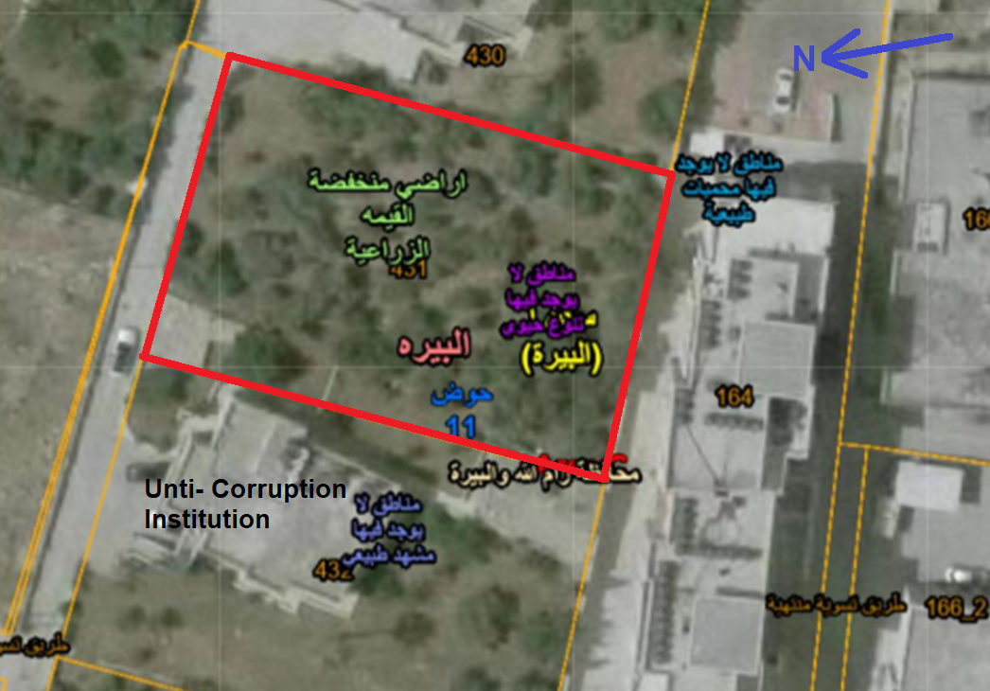
Site analyses:
The site is about 850 meters above sea level.
The site area is 1200 square meters.

Slide 5
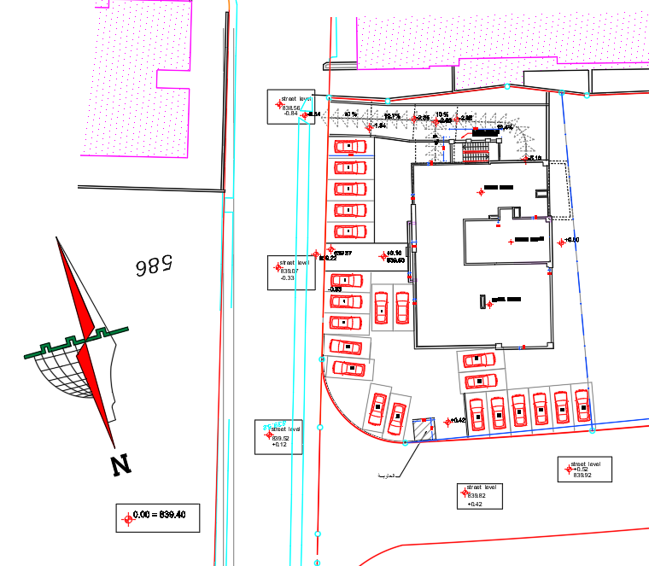
Site analyses:
Orientation of the building:

Slide 6
Architectural Aspects

Slide 7
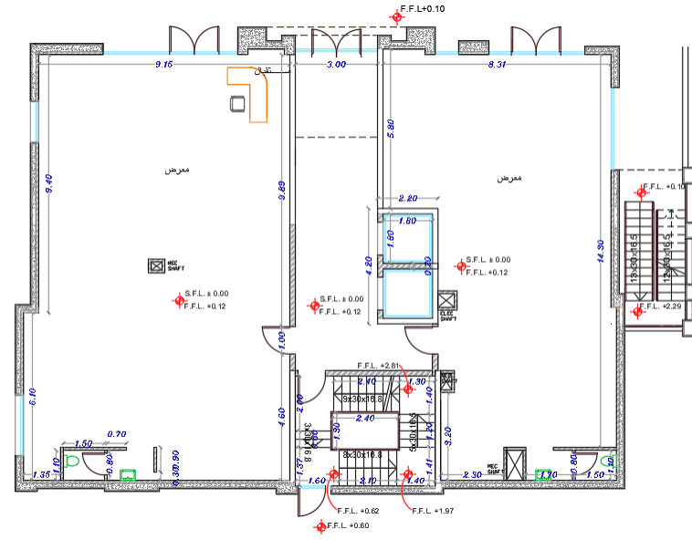
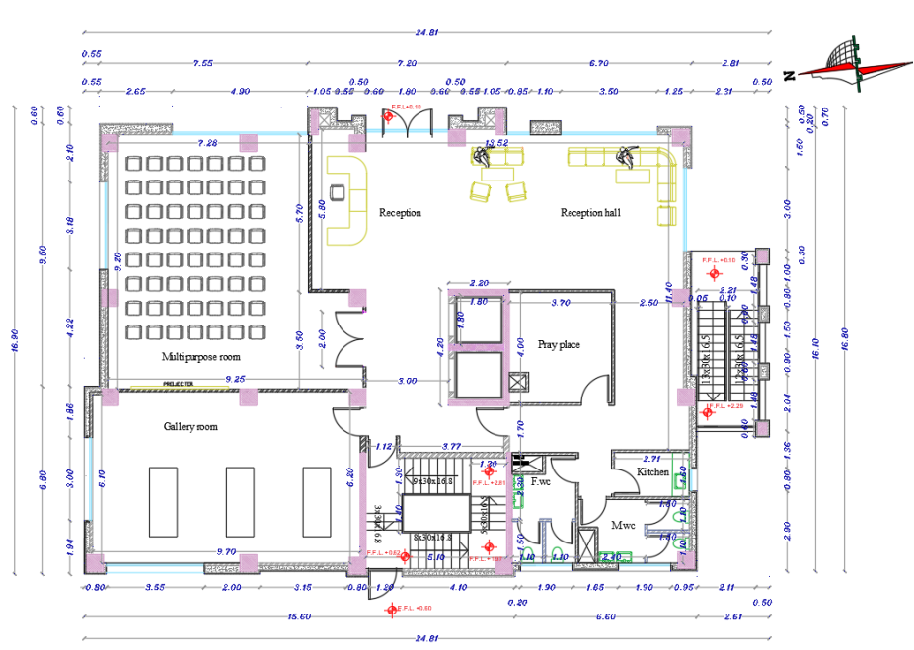
Architectural Aspects:
Ground Floor:
Before
After

Slide 8
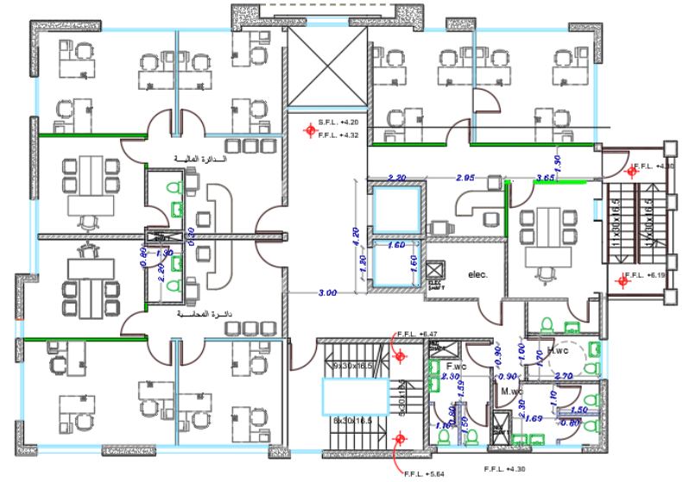
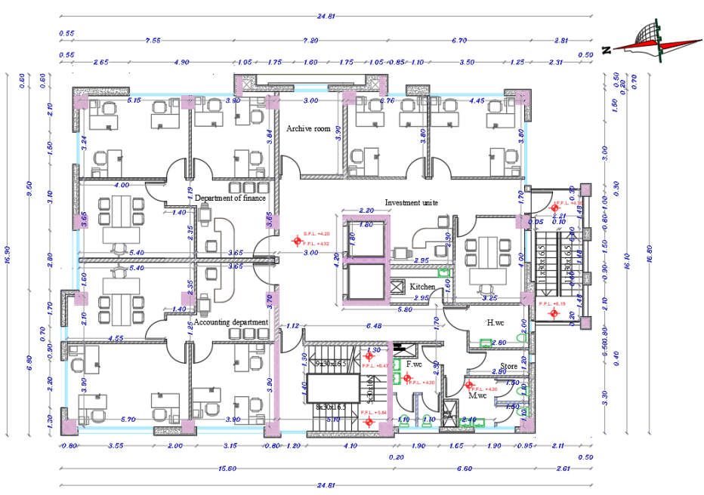
Architectural Aspects:
First Floor:
Before
After

Slide 9
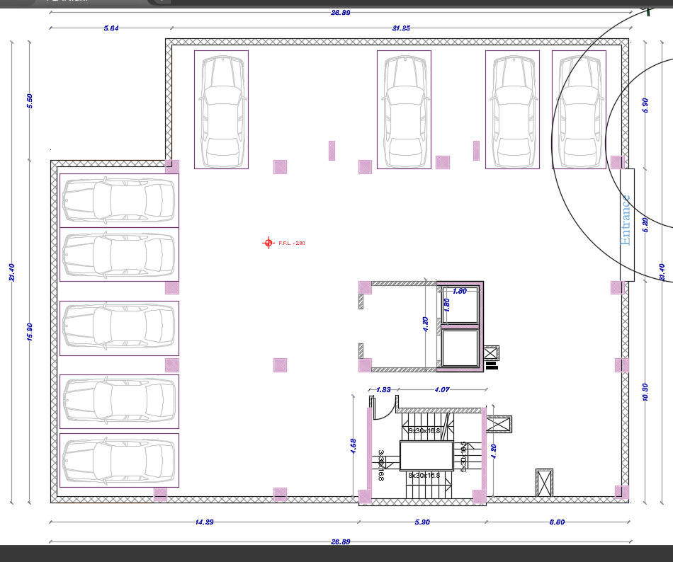
Architectural Aspects:
Car parking (B2):

Slide 10
Environmental Aspects

Slide 11
Environmental aspects:
Shading.
Daylight.
Solutions.

Slide 12
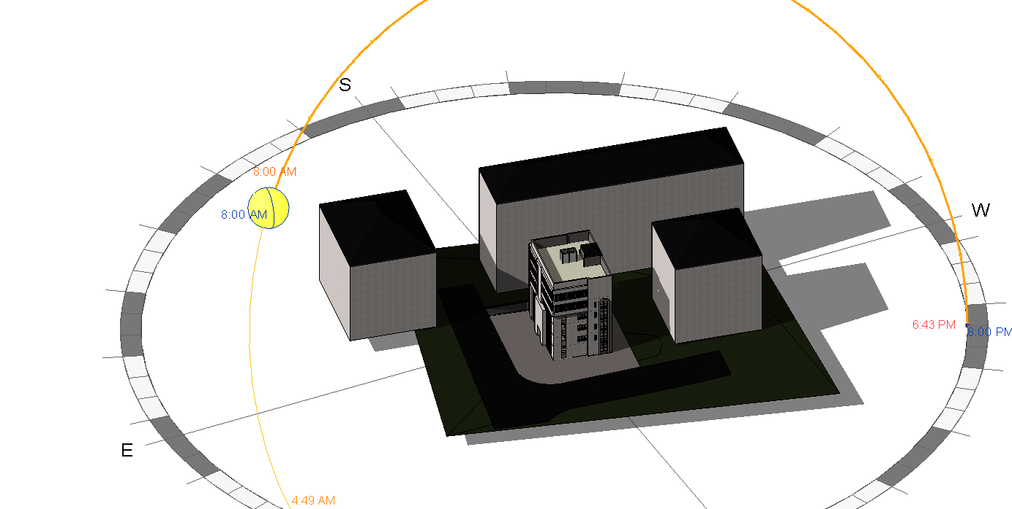
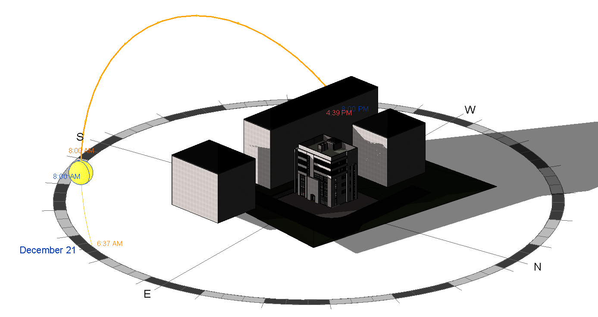
Environmental Aspects:
Shading:
21-July 8:00 AM
21-December 8:00 AM

Slide 13
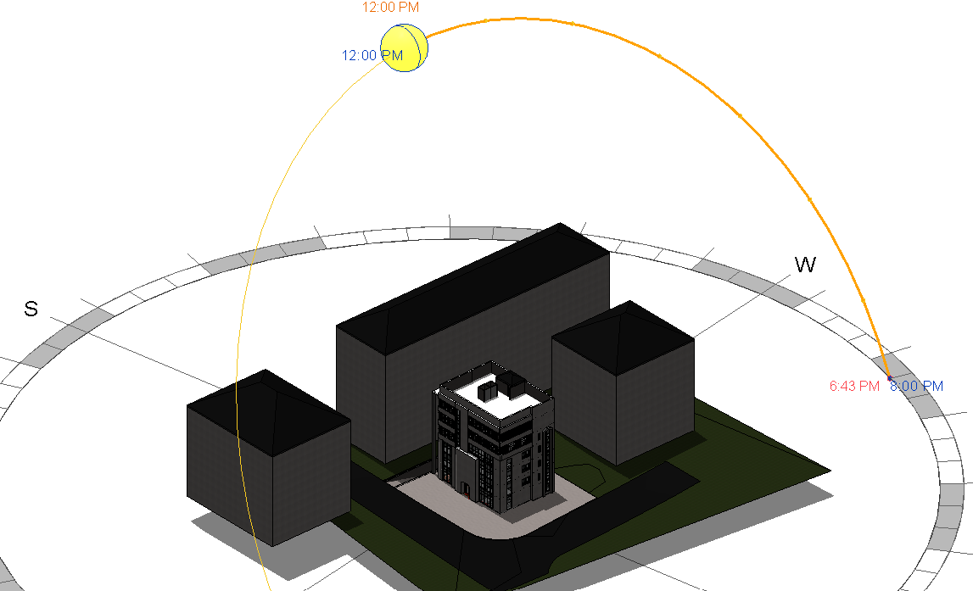
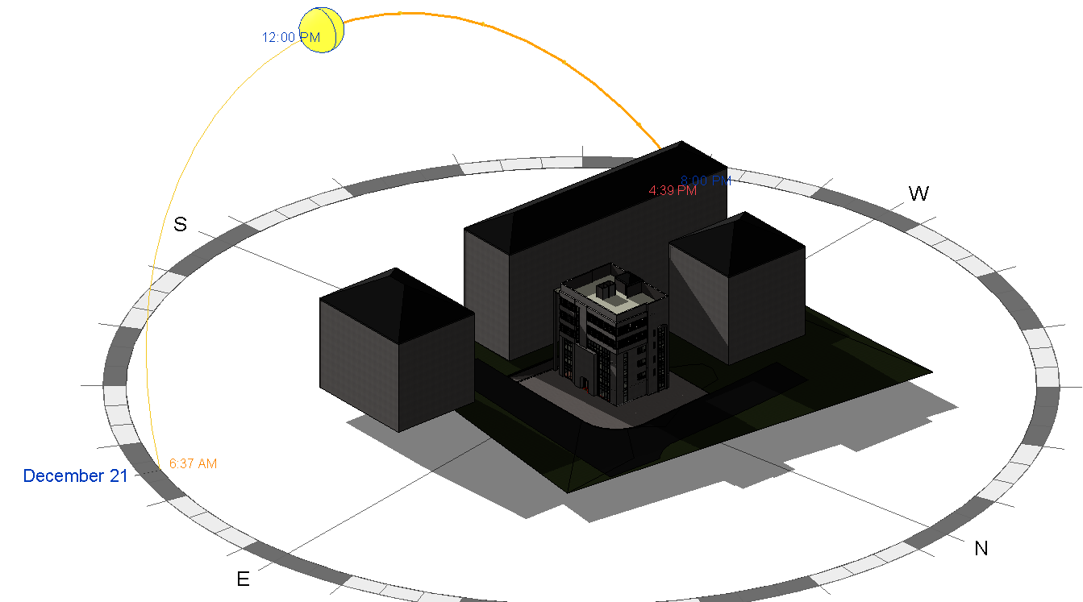
Environmental Aspects:
Shading:
21-July 12:00 PM
21-December 12:00 PM

Slide 14
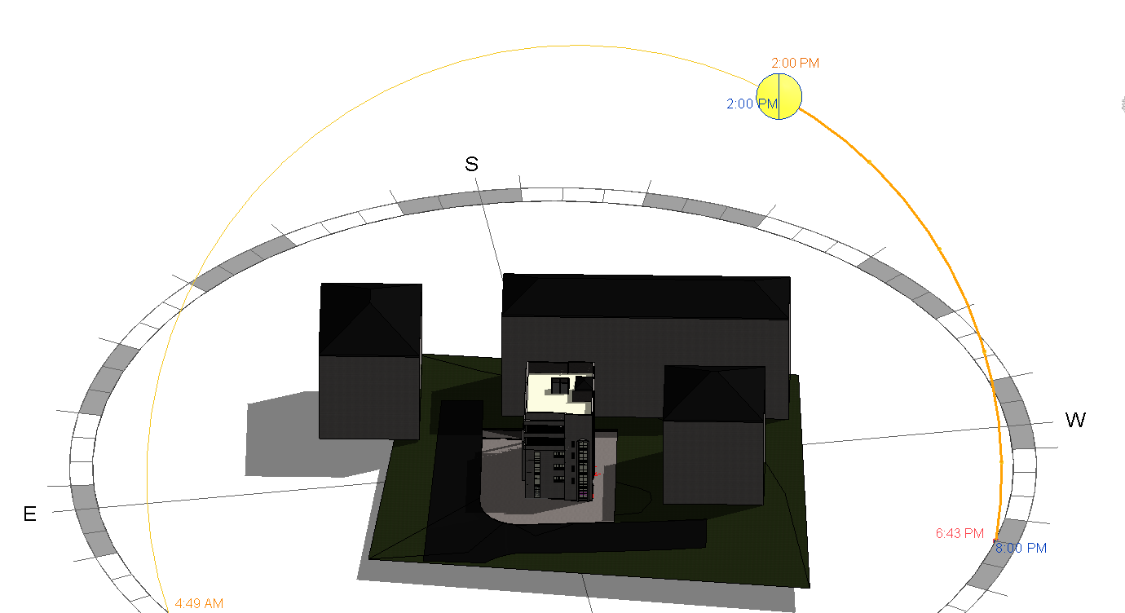
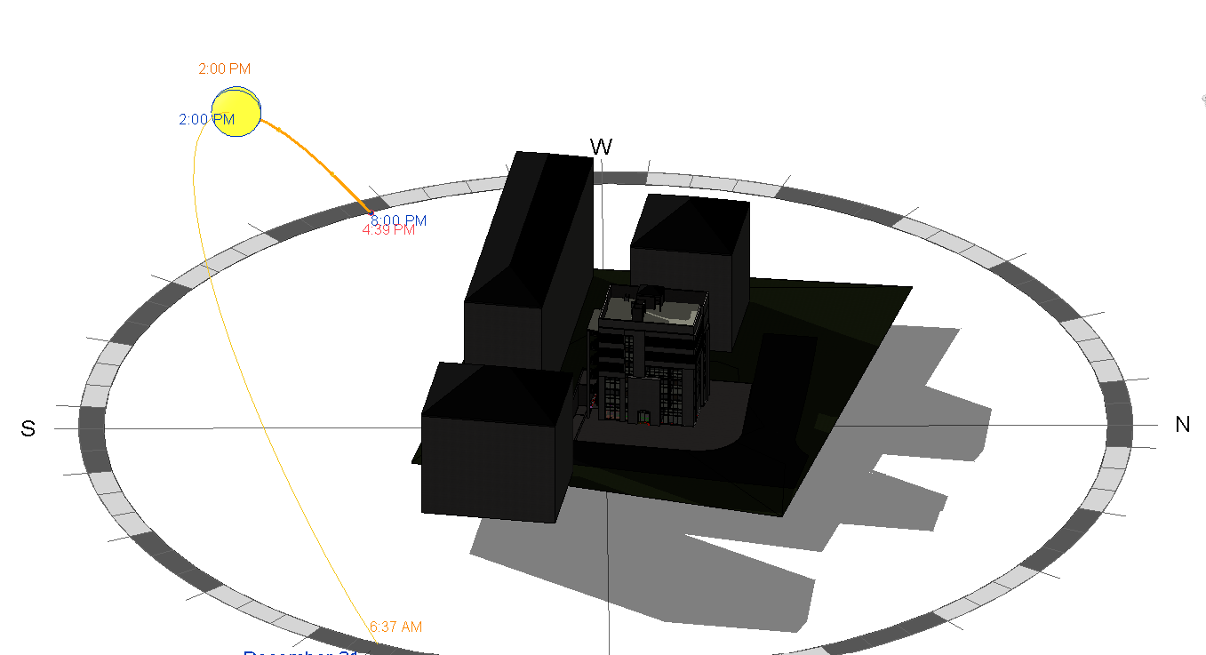
Environmental Aspects:
Shading:
21-July 2:00 PM
21-December 2:00 PM

Slide 15
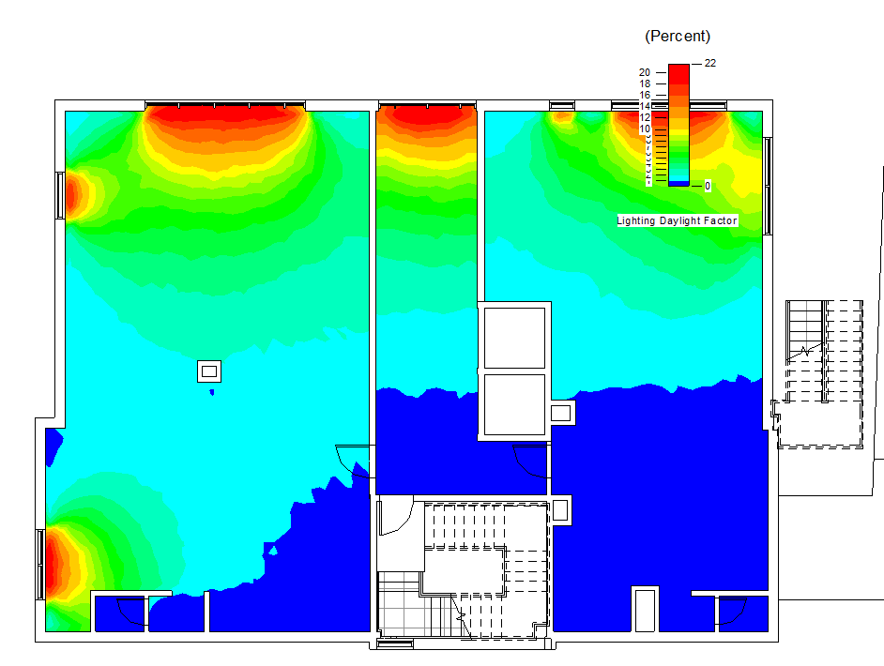
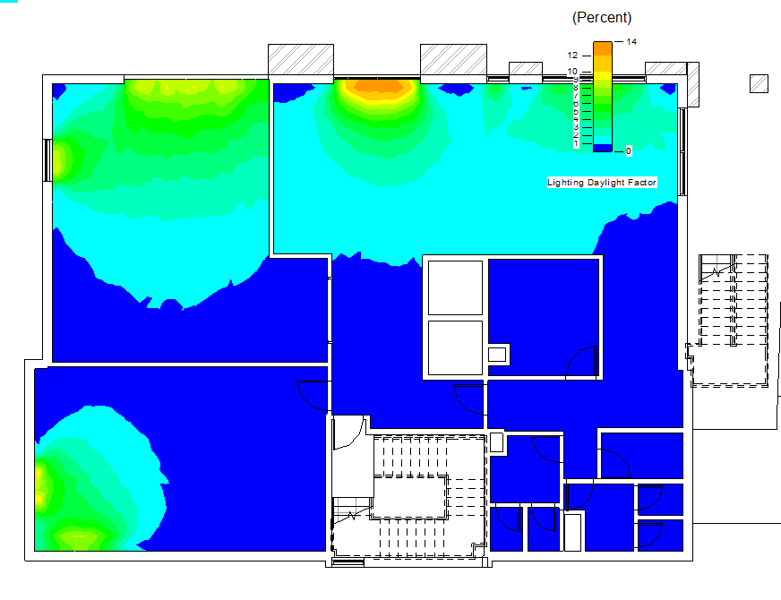
Environmental Aspects:
Daylight analysis:
Ground Floor:
Before
After

Slide 16
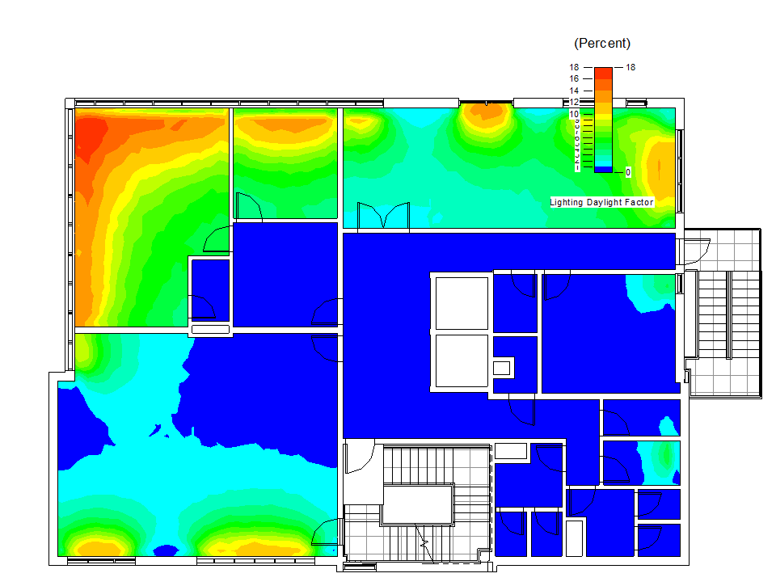
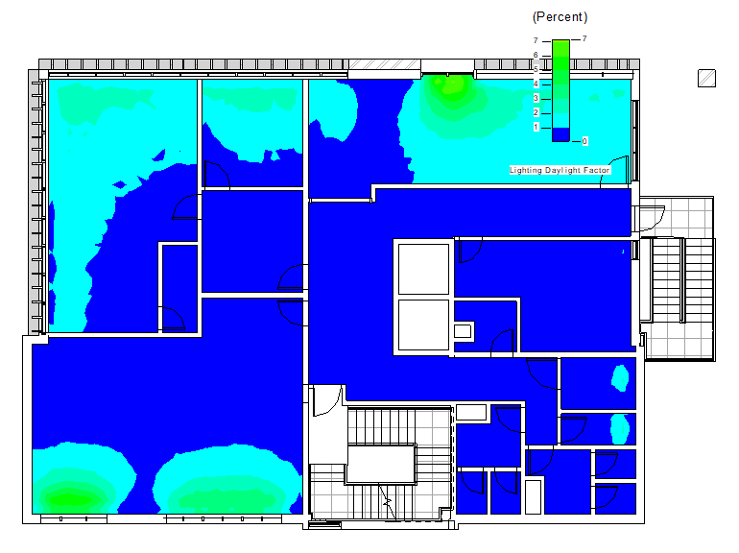
Environmental Aspects:
Daylight analysis:
Fifth Floor:
Before
After

Slide 17
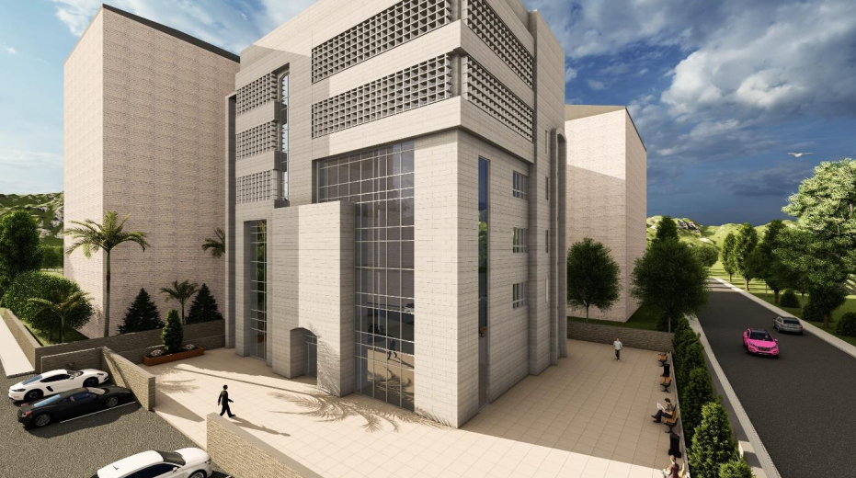
Environmental Aspects:
Solutions:

Slide 18
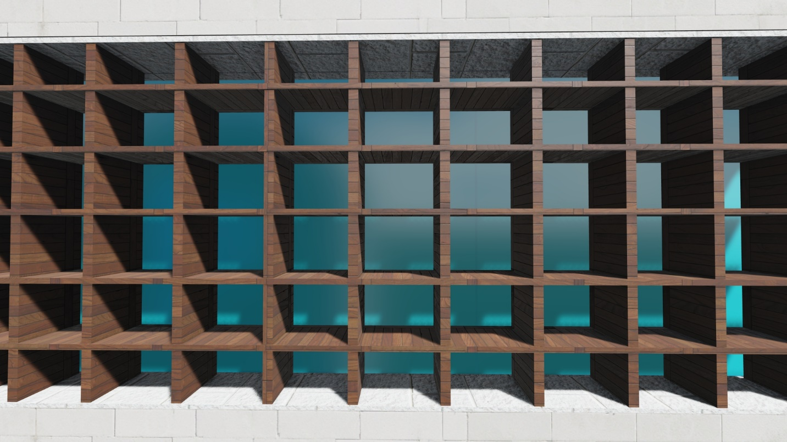
Environmental Aspects:
Solutions:

Slide 19

Environmental Aspects:
Solutions:

Slide 20
Electromechanical Aspects

Slide 21
Electromechanical aspects:
Artificial Lighting.
HVAC System.
Acoustical System.
Fire Fighting System.
Water Supply System.
Drainage System.

Slide 22
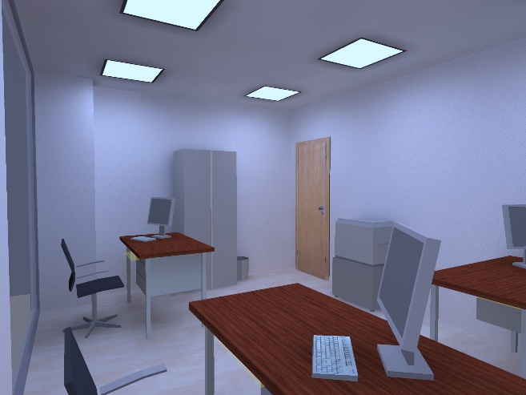
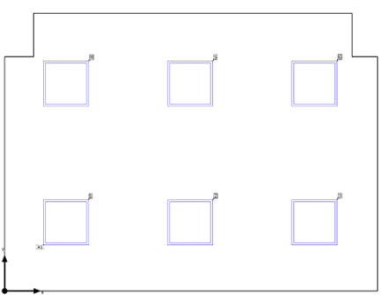
Electromechanical Aspects:
Artificial Lighting:
Employees Office Room

Slide 23
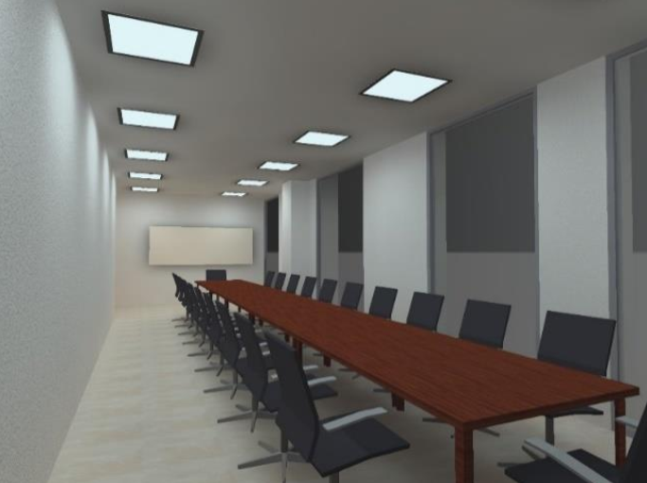
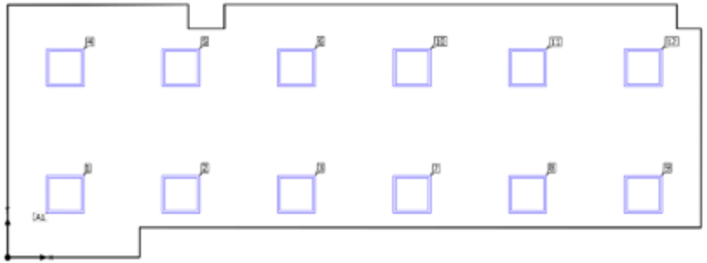
Electromechanical Aspects:
Artificial Lighting:
Meeting Room

Slide 24
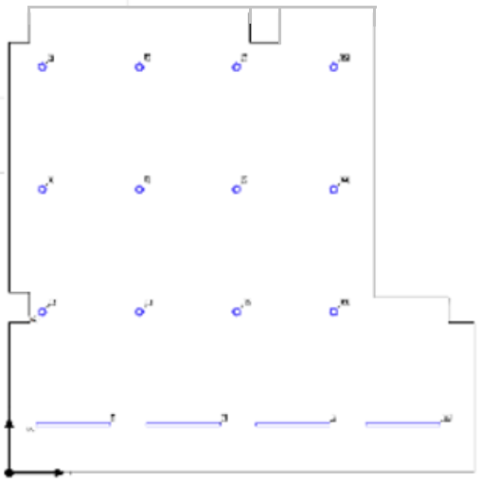
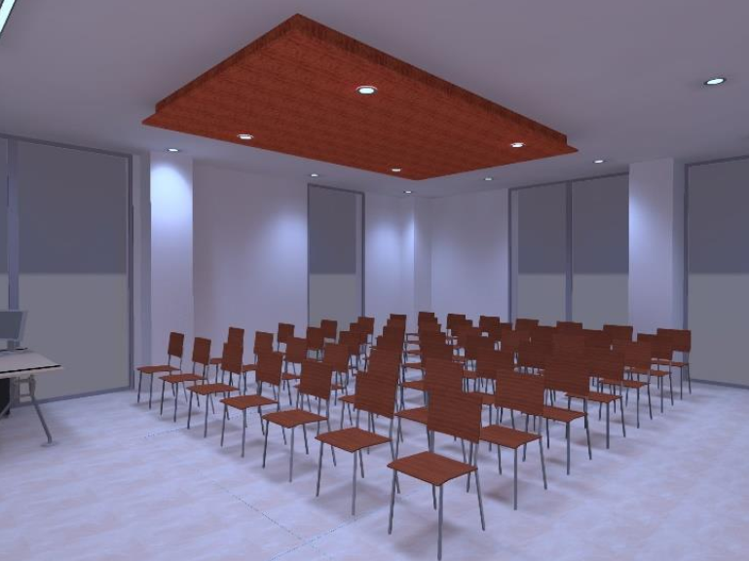
Electromechanical Aspects:
Artificial Lighting:
Multi-purpose Room

Slide 25
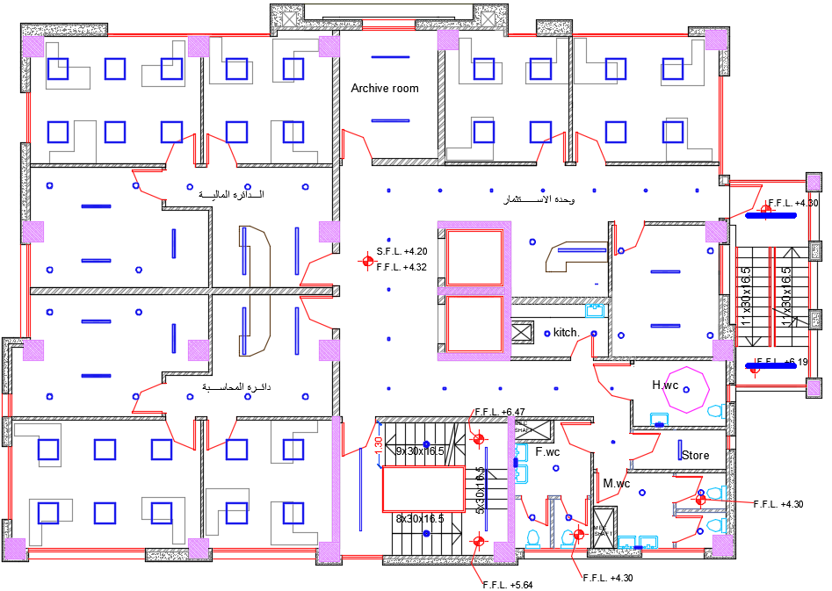
Electromechanical Aspects:
Artificial Lighting:
Artificial Lighting 1st Plan.

Slide 26
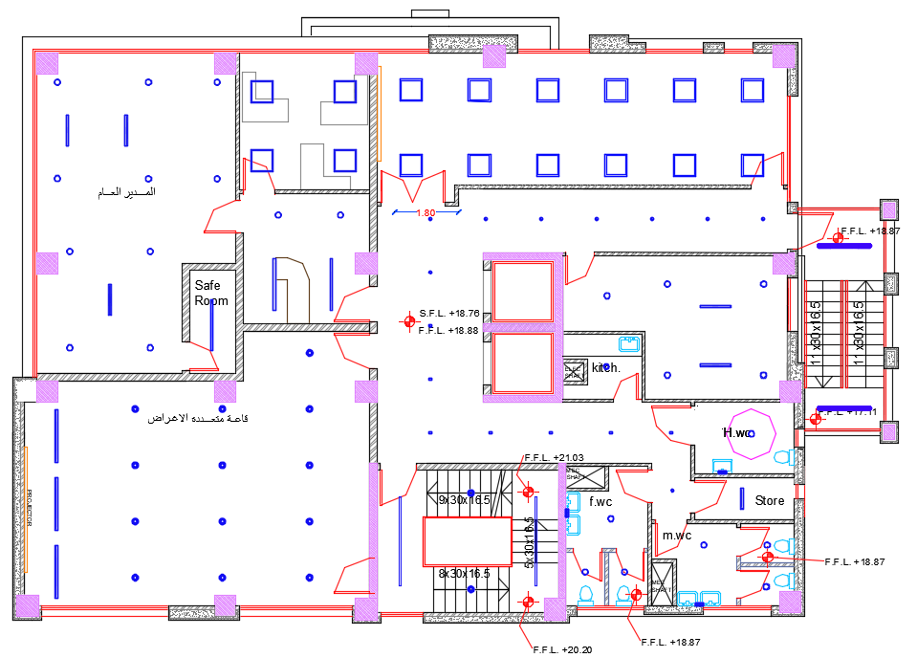
Electromechanical Aspects:
Artificial Lighting:
Artificial Lighting 5th Plan.

Slide 27
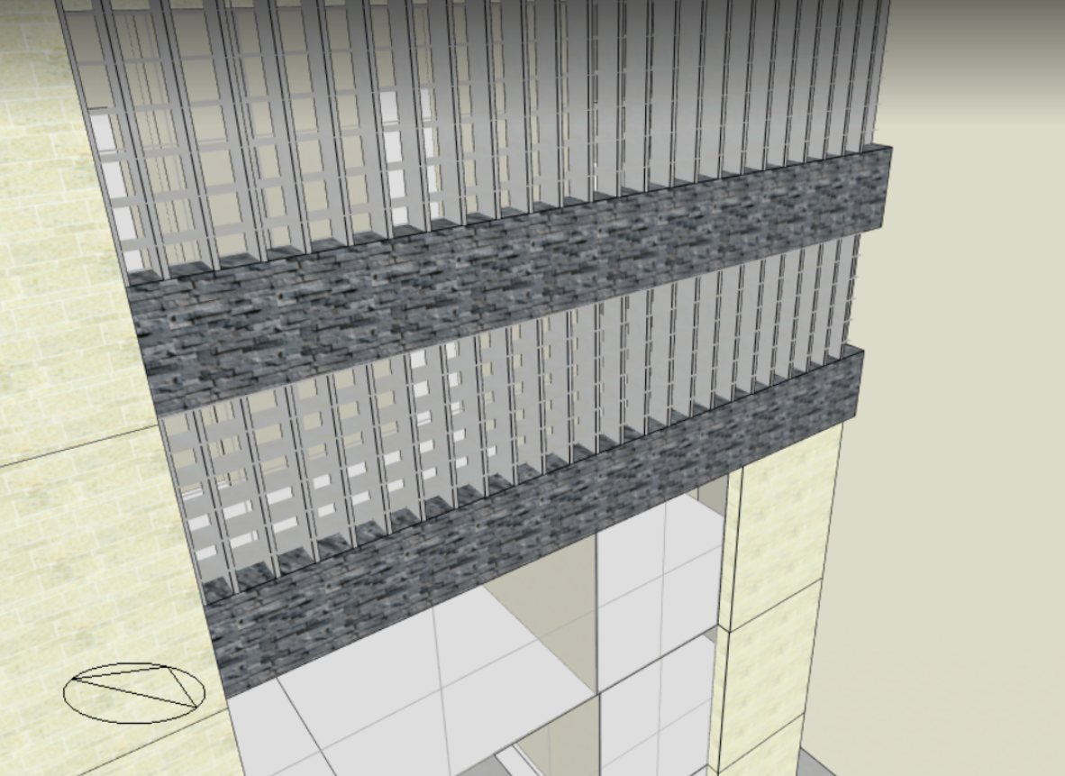
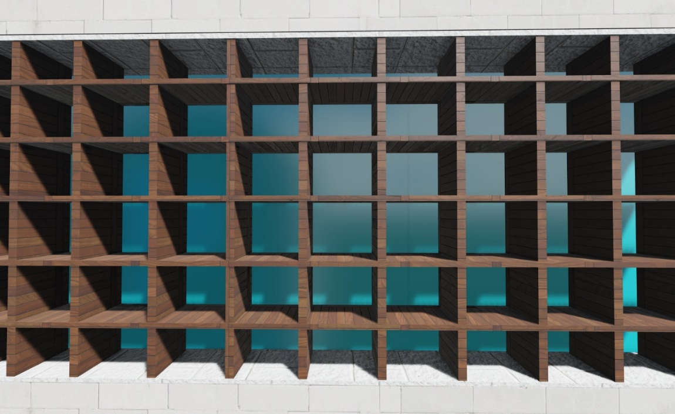
Design Builder software analysis
Electromechanical Aspects:
Improvement & treatment

Slide 28
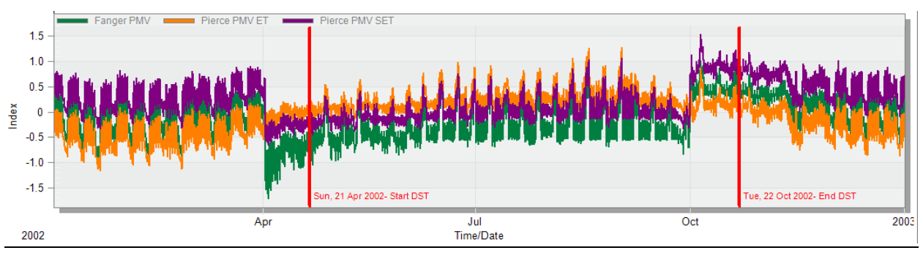
Design Builder software analysis
PMV

Slide 29
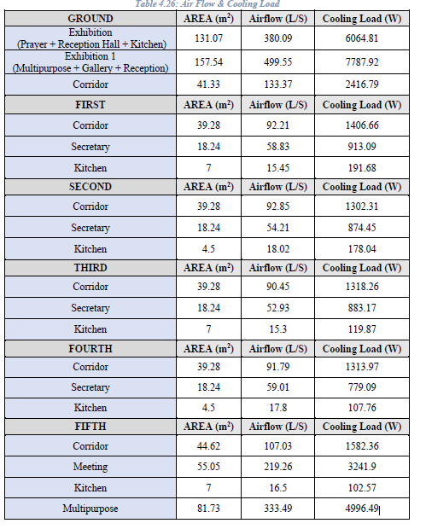
Electromechanical Aspects:
HVAC System:

Slide 30
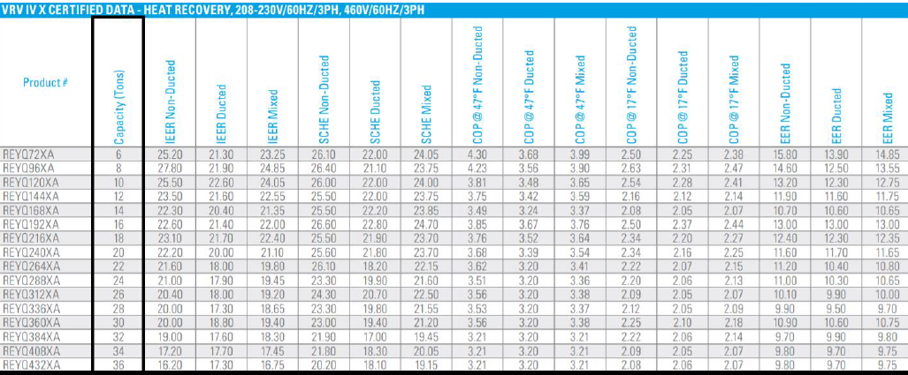
Electromechanical Aspects:
HVAC System:
VRV unit

Slide 31
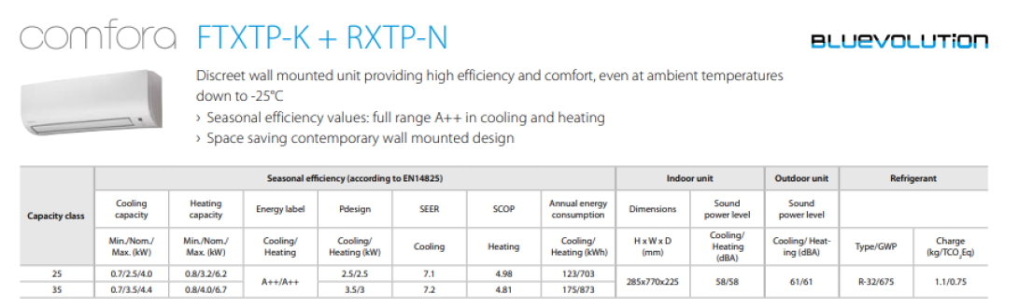
Electromechanical Aspects:
HVAC System:
Wall mounted unit

Slide 32
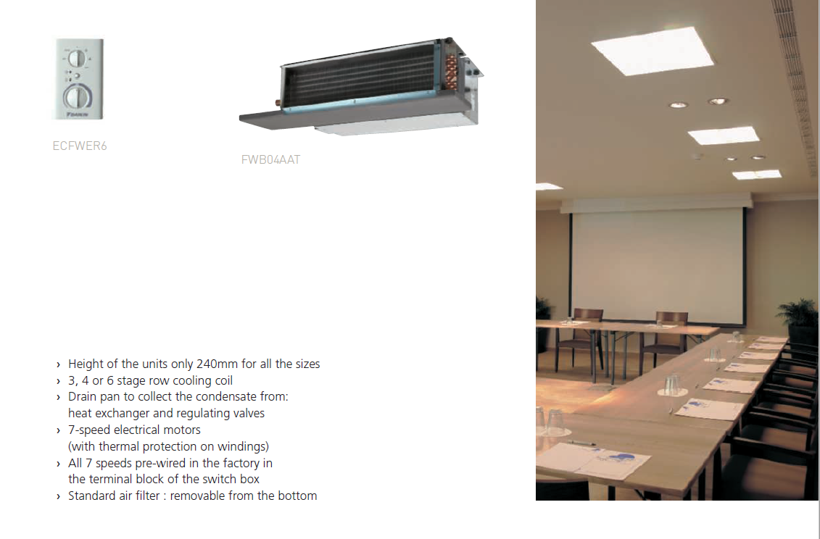
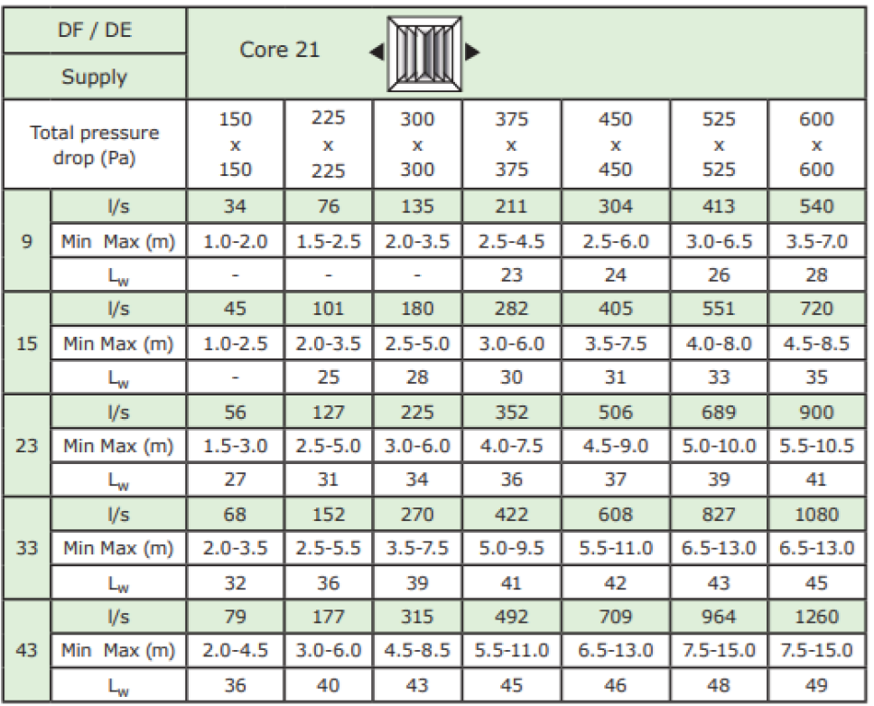
Electromechanical Aspects:
HVAC System:
Fan coil unit Diffusers

Slide 33
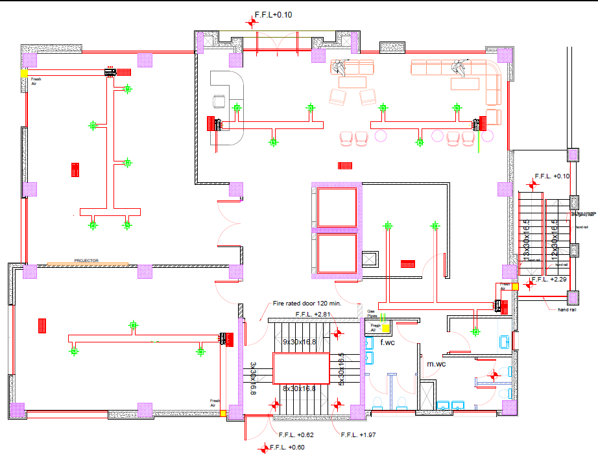
Electromechanical Aspects:
HVAC System:
HVAC units distribution in GF

Slide 34
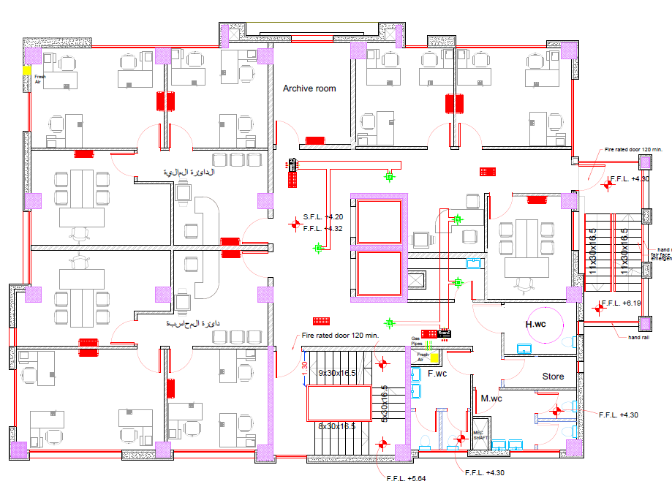
Electromechanical Aspects:
HVAC System:
HVAC unit distribution in 1st floor

Slide 35
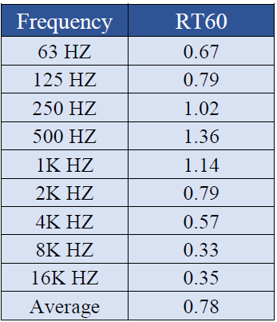
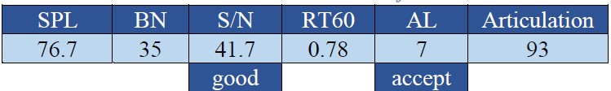
Electromechanical Aspects:
Acoustical system:
For Meeting Room:
AL< 10% accept
Standard reverberation time (0.6-1.4)

Slide 36

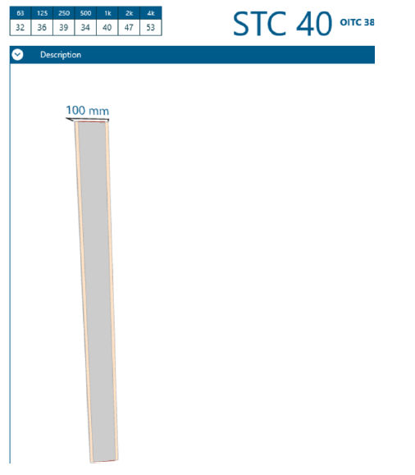
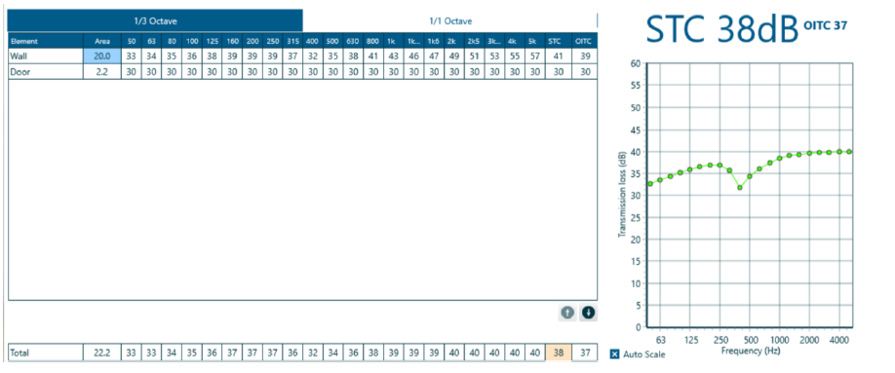
Electromechanical Aspects:
Acoustical system:
STC for barrier between office and adjacent office
Composite TL for barrier between office and corridor.
Standard STC 38
Standard STC 38

Slide 37
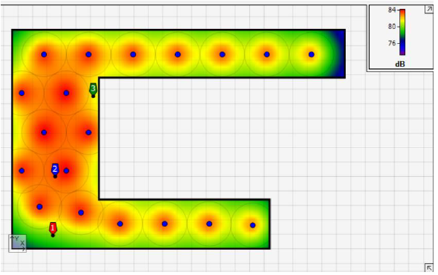

Electromechanical Aspects:
Acoustical system:
Acoustic design for corridor:
Recommendation 80 dB

Slide 38
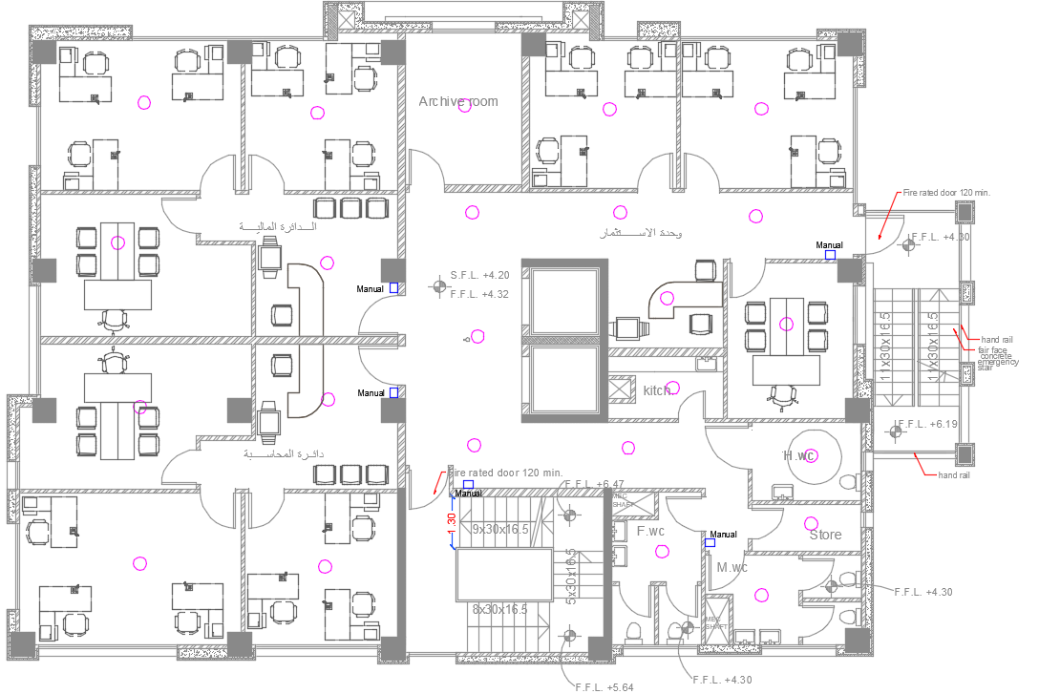
Electromechanical Aspects:
Fire Fighting System:
Fire Alarm System in 1st floor:

Slide 39
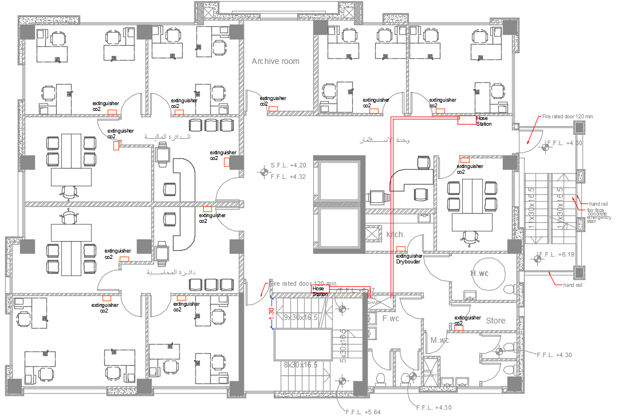
Electromechanical Aspects:
Fire Fighting System:
Fire Fighting System in 1st floor:

Slide 40
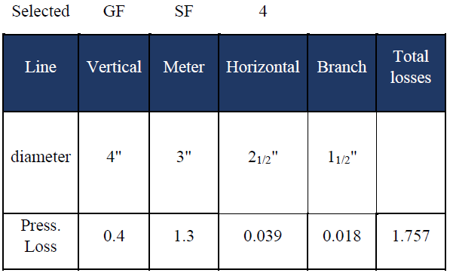
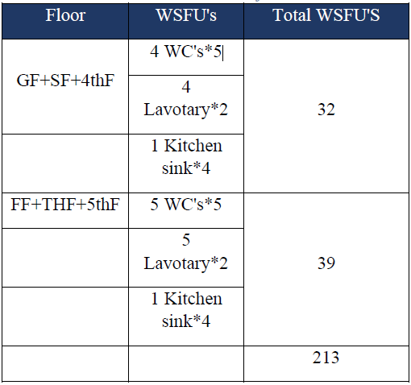
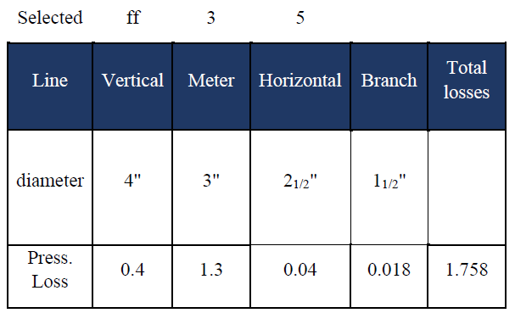
Electromechanical Aspects:
Water Supply System:
Size of pipes with total losses.
Total fixtures unit for water supply.

Slide 41
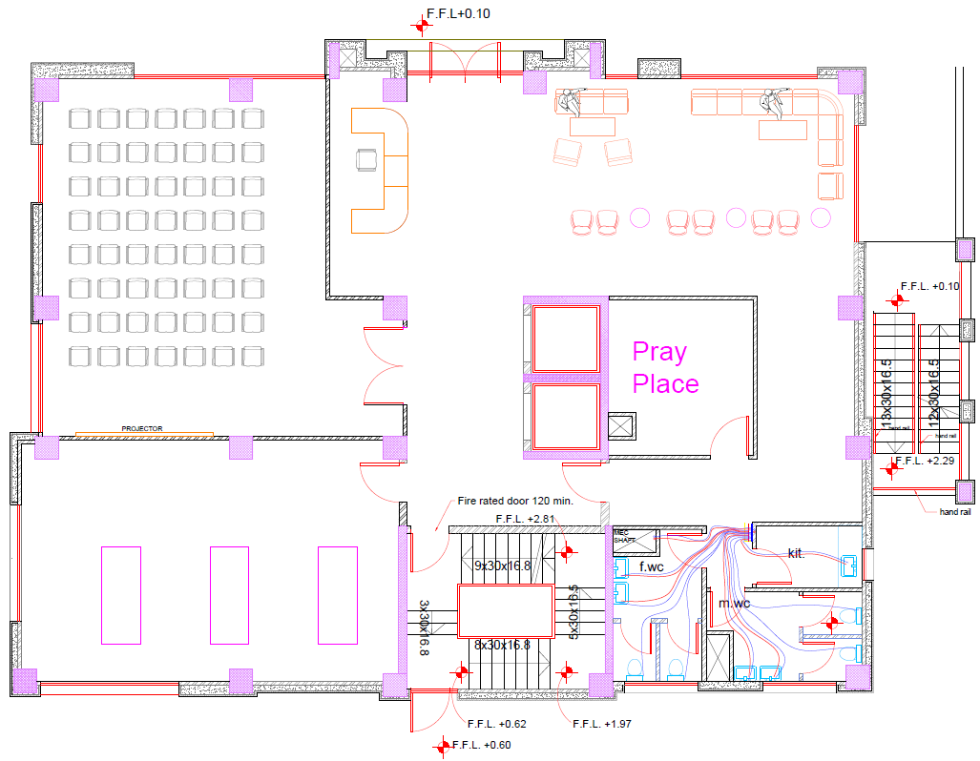
Electromechanical Aspects:
Water Supply System:
Water supply network in G.F:

Slide 42


Electromechanical Aspects:
Drainage System:
5. Drainage system
Drainage fixture unit in the building.
Diameter & slope for each type of fixture.

Slide 43
Structural Aspects

Slide 44

Structural Aspects:
Brief scope of limitations :
1- $f_{c}$=28 MPa. For columns and shear wall and 24MPa for slabs and beams .
2- $F_{y}$= 420MPa. For all structural element of project.
3- Number of floors are 6 with 2 basements.
4- Live load = 5 𝐾𝑁/𝑚^2 .
5- SI.Dead load = 4 𝐾𝑁/𝑚^2

Slide 45



Structural Aspects:

Slide 46

Structural Aspects:
Model checks:
Compatibility check:
OK

Slide 47
Structural Aspects:
Model checks:
Equilibrium check:
OK
Equilibrium Check
Load Case | Etab | Manually | Error %
Live | 12631.44 | 12631.2 | 0.002 | OK
SID | 30354.84 | 30381.19 | 0.087 | OK
Dead | 25226.83 | 25779.04 | 2.189 | OK
Error must be < 5%

Slide 48
Structural Aspects:
Model checks:
Stress-Strain check:
Columns Stress-Strain Check
Column # | Etab | Manually | Error %
C1 (corner) | 2837.87 | 2742.13 | 3.30 | OK
C2 (internal) | 4403.36 | 4502.98 | 2.26 | OK
C3 (edge) | 3553.23 | 3676.88 | 3.48 | OK
Beams Stress-Strain Check
Beam # | Etab | Manually | Error %
Beam 1 | 639.09 | 691.18 | 8.20 | OK
Beam 2 | 227.03 | 286.67 | 3.47 | OK
Beam 3 | 148.58 | 160.64 | 8.10 | OK
Slabs Stress-Strain Check
Slab # | Etab | Manually | Error %
Beam 1 | 64.72 | 66.98 | 3.49 | OK
Beam 2 | 73.94 | 74.78 | 1.13 | OK
Beam 3 | 30.11 | 29.2 | 3.00 | OK
OK
Error must be < 10%

Slide 49
Structural Aspects:
Model checks:
Deflection check:
OK
Deflection Check on 5th floor Ceiling
 | Etab | Max. Allowed
From Sevice | 26.74 | 37.29 | OK
From Live | 8.01 | 24.86 | OK

Slide 50


Structural Aspects:
Seismic design:
Seismic zone : 2A with (Z = 0.15)
Soil profile : SB.
Acceleration-dependent seismic coefficients Ca=0.15.
Velocity-dependent seismic coefficients Cv= 0.15.
Importance factor I=1.
Force reduction factor R=5.5
Q all. = 3.5 Kg/${cm}^{2}$

Slide 51

Structural Aspects:
Seismic design:
Period check:
T manual = 1.37seconds
$T_{Etab X}=1.92>1.37$
$T_{Etab Y}=1.41>1.37$
OK.

Slide 52

Structural Aspects:
Seismic design:
Drift check:
Drift limitation = 2 % times story height.
OK.

Slide 53


Structural Aspects:
Design for structural elements:
G.F ceiling:

Slide 54


Structural Aspects:
Design for structural elements:
Beams:

Slide 55


Structural Aspects:
Design for structural elements:
Columns:

Slide 56


Structural Aspects:
Design for structural elements:
Foundation:

Slide 57

Structural Aspects:
Design for structural elements:
Shear wall:

Slide 58

Structural Aspects:
Design for structural elements:
Stairs:

Slide 59
Cost Estimation Aspects

Slide 60

Cost Estimation Aspects:
General unit cost of the project:

Slide 61
Thank You

