Slide 1
Active Virtual Circuit
Tariq Issa
Husam Omar

Slide 2
Outline
Introduction
- SDN
- OpenFlow
- Floodlight, Mininet, REST APIs
Working principle.
Results.

Slide 3
Introduction

Slide 4
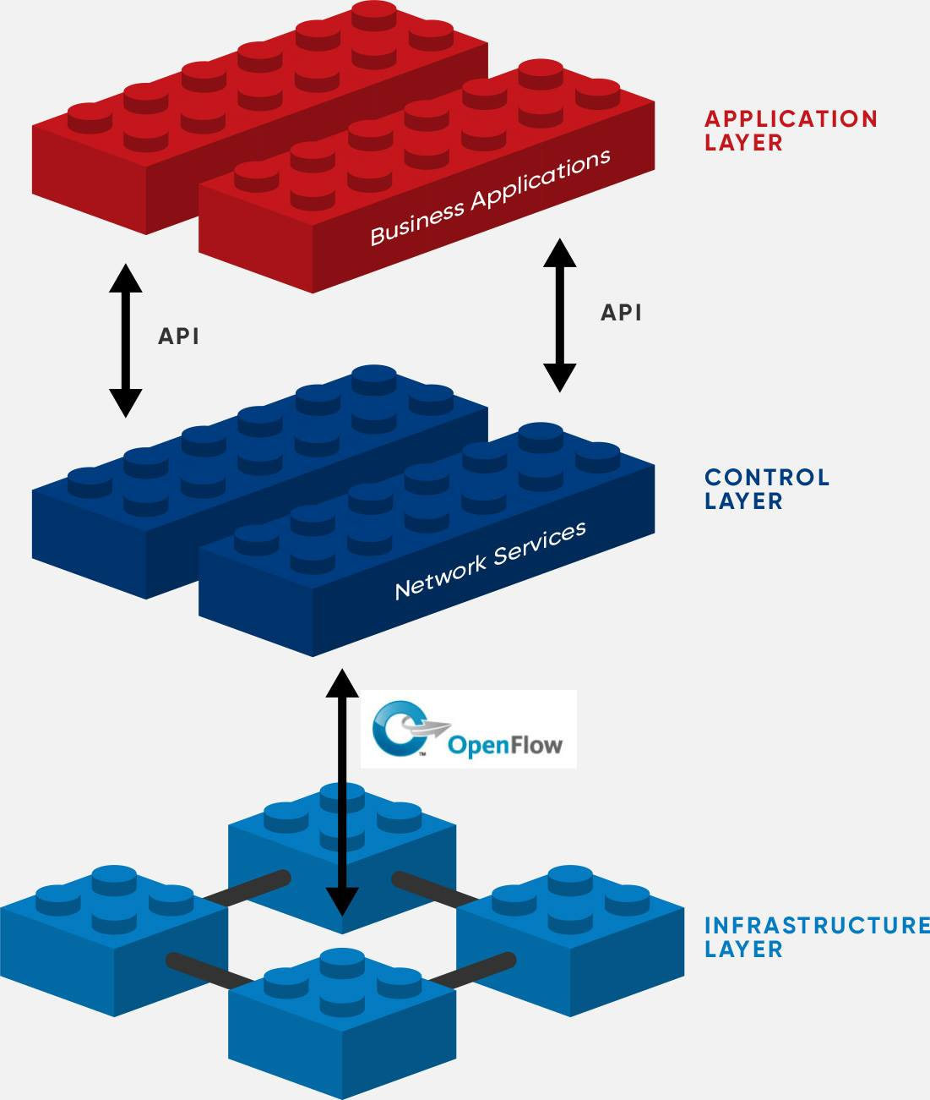
Software Defined Network (SDN)
Separation of traffic forwarding from control
Logically centralized control
Programmability of network services
SDN controller work as network an operating system

Slide 5
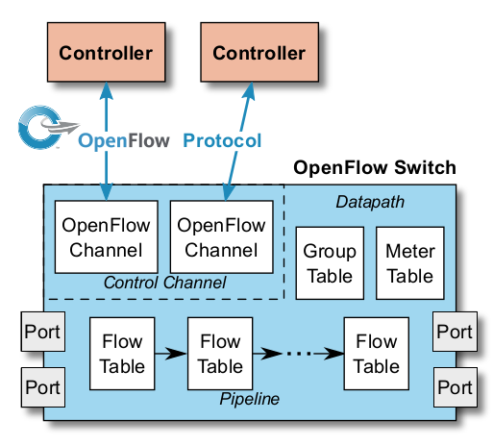

OpenFlow
Is a communication protocol.
Introduced OpenFlow Switch.

Slide 6
Floodlight, Mininet and
REST APIs
FloodLight controller
Is a software that acts as networks OS, it controls multiple OF switches.
Mininet
Is a network emulator that creates virtual network topology .
REST API
Is the northbound API of the controller .

Slide 7
Working principle

Slide 8
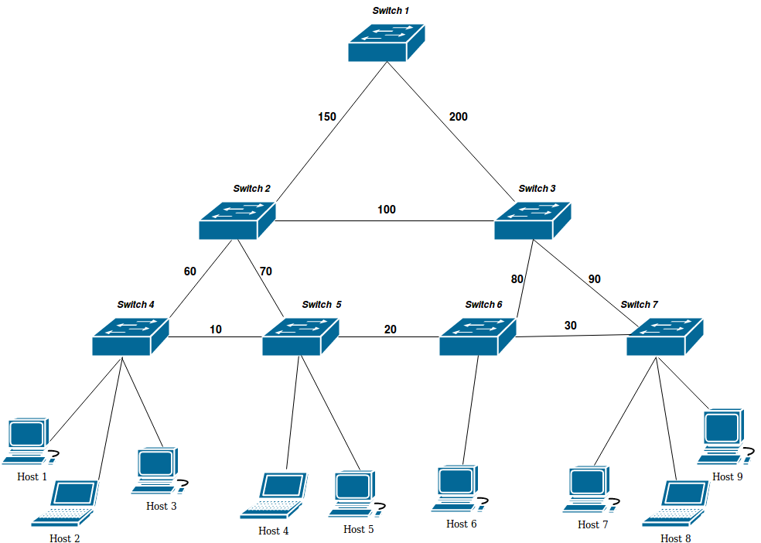
Network Topology

Slide 9
The alogrithm
Represent the topology as a graph.
Use Dijkstra shortest path algorithm where the chosen edges is equal or greater than the bandwidth desired.
Install flow entries on the switches got from Dijkstra algorithm .

Slide 10
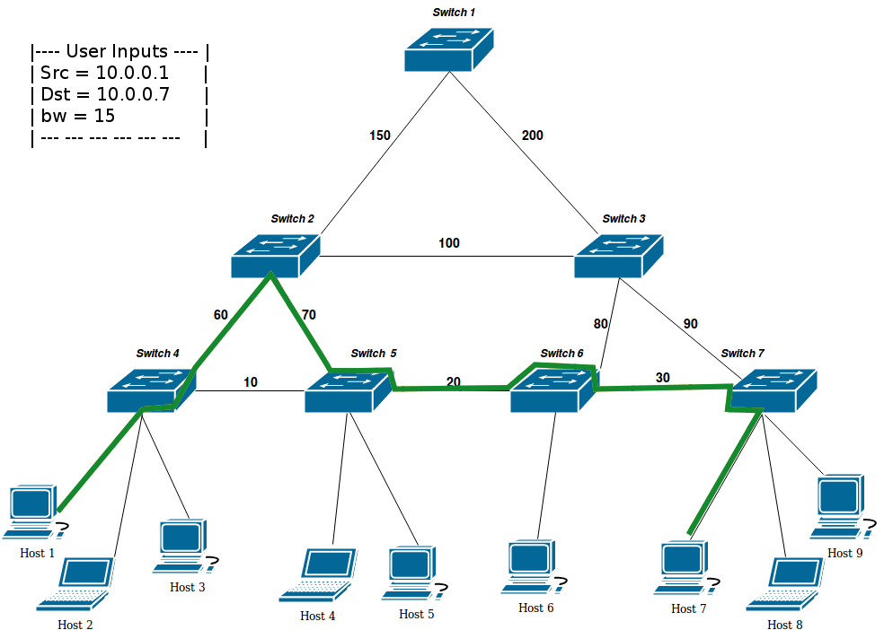
Flows Process Example :
-----------------------------------------

Slide 11
Results

Slide 12
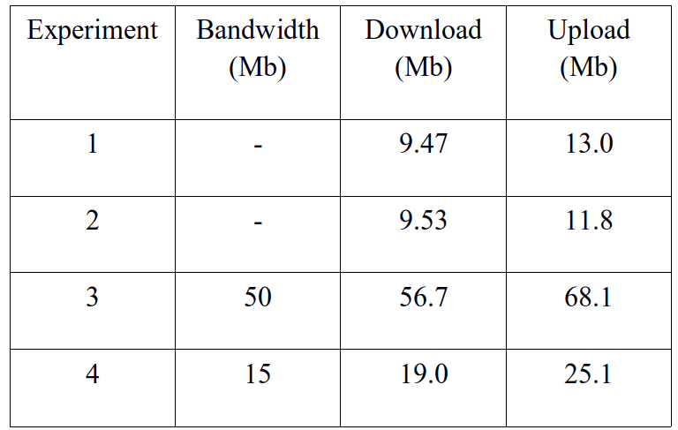
No traffic
No Flows
With Traffic No Flows
Traffic with Flows
Traffic with Flows

Slide 13
Thanks!
Any questions?

