Slide 1

Graduation Project 2
Smart irrigation system based iot

Slide 2


An-Najah National University
Telecommunication Engineering Department
Smart Irrigation System Based IoT

Slide 3

What to expect in coming slides ?
What is IOT ?
Application of IOT
Introduction
Hardware components
Software components
Flowchart
Block diagram
Advantages
Conclusion
.
Smart Irrigation System Based IoT

Slide 4


What is IOT ?
Term was proposed by Kevin Ashton in 1999
Connection of each and every thing to the internet
Relationship will be people –people , people-things &
things- things
Smart Irrigation System Based IoT

Slide 5
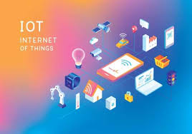
IOT has many applications in agriculture, smart cities, smart home, healthcare, business sectors, traffic monitoring, transport and logistics etc.
This is growing mega trend that will influence everything from businesses to our daily personal lives.
Here we are mainly focussing on agriculture as it plays a vital role in development of our country’s economy.
Smart Irrigation System Based IoT
Why IOT ?

Slide 6
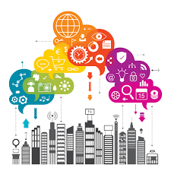
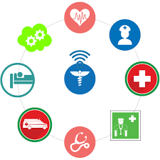
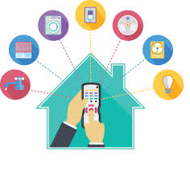

Application of IOT
.
healthcare
smart home
education

Slide 7
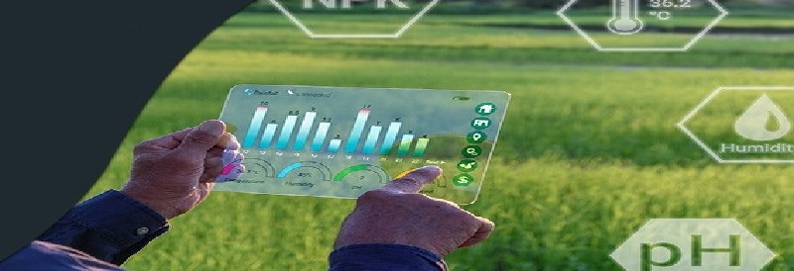
Smart Irrigation System Based IoT
IOT in Agriculture
.

Slide 8
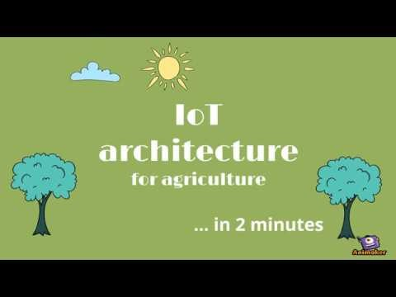
موك آب
احترافي
برنامج Spss

Slide 9

Smart Irrigation System Based IoT
supervisor
D. Saed Tarapiah
January 2008 - January 2011 “Politecnico di Torino” – Turin, Italy Ph.D. student, Department of Electronics Engineering.
September 2006 - September 2007 “Politecnico di Torino” – Turin, Italy M.Sc. degree in wireless systems and related technologies from the Electronics Department, College of Engineering.
September 2000 - May 2005 “An-Najah National University” – West bank, Palestine B.Sc. Degree from the Computer Department, College of Engineering .
Since September 2011 "An-Najah National University" - Nablus, Palestine Working with the Department of communication Engineering as an assistant professor.
.

Slide 10



Prepared by
Hiba Awwad
Sima Shanaa
Smart Irrigation System Based IoT

Slide 11

short break

Slide 12
Smart Irrigation System Based IoT
Introduction
Problem statement
One of the main problems facing farmers walk long distances to reach their farm, limited water and agricultural and increased competition from other sectors. Waste a large quantity of water. This position has destroyed some crops because of the lack of capable quantities of water, so too much watering leading to die out plants
01
Overview
02
The main technology used in this system is Global System for Mobile Communications (GSM), we used sensors to sense the status of the plants and arduino uno microcontroller, also some programming languages such as C++.
03
Objectives
our project aims to reduce the waste of water in irrigation. It will lead to saving money, which by the controller will work to switch the engine, so no need for employers

Slide 13
Smart Irrigation System Based IoT
Hardware component
Soil Moisture sensor
04
Arduino
03
02
DS18B20Temperature Sensor
01
GSM-GPRS SIM900A

Slide 14
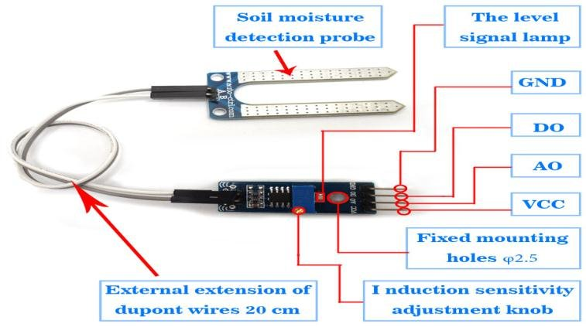
Smart Irrigation System Based IoT
Hardware component
1
Soil moisture sensor
The soil moisture sensor determines volumetric water content (VWC) by measuring the dielectric constant of the media using capacitance/frequency domain technology.
When there is water in the soil there will be less resistance and the soil will handle more power. But if the soil is dry it conducts power weekly and needs less power and more resistance.

Slide 15
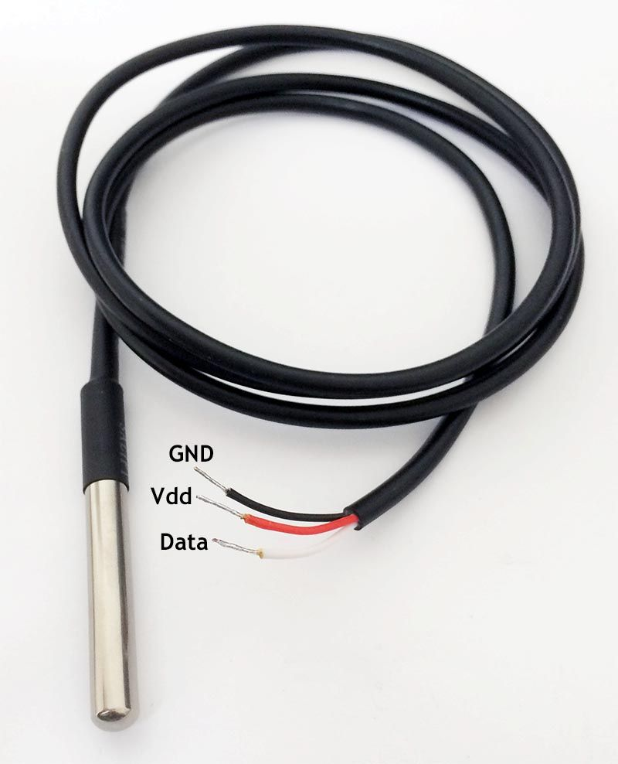
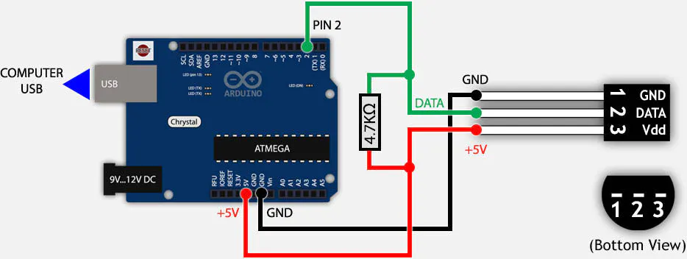
Smart Irrigation System Based IoT
Hardware component
2
DS18B20 Temperature Sensor
It can measure temperatures from -55°C to +125°C with ±0.5°C Accuracy .
VDD to the 5V out pin on Arduino and GND to ground. Next connect the remaining digital signal pin DQ to digital pin on Arduino, we need to add the 4.7k pull-up resistor between the signal and power pin to keep the data transfer stable.

Slide 16
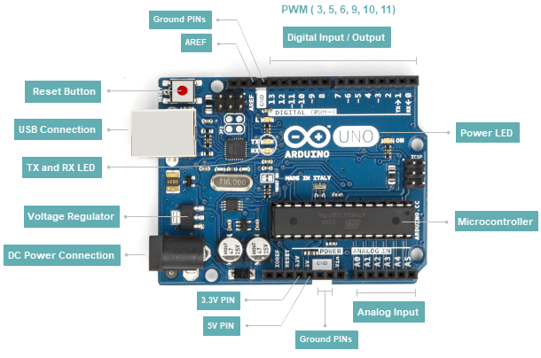
Smart Irrigation System Based IoT
Hardware component
3
Arduino is an open-source platform used for building electronics projects.
Arduino consists of both a physical programmable circuit board (often referred to as a microcontroller) and a piece of software, or IDE (Integrated Development Environment) that runs on your computer, used to write and upload computer code to the physical board.
is a microcontroller board based on the ATmega328P. It has 14 digital input/output pins (of which 6 can be used as PWM outputs), 6 analog inputs.
Arduino

Slide 17
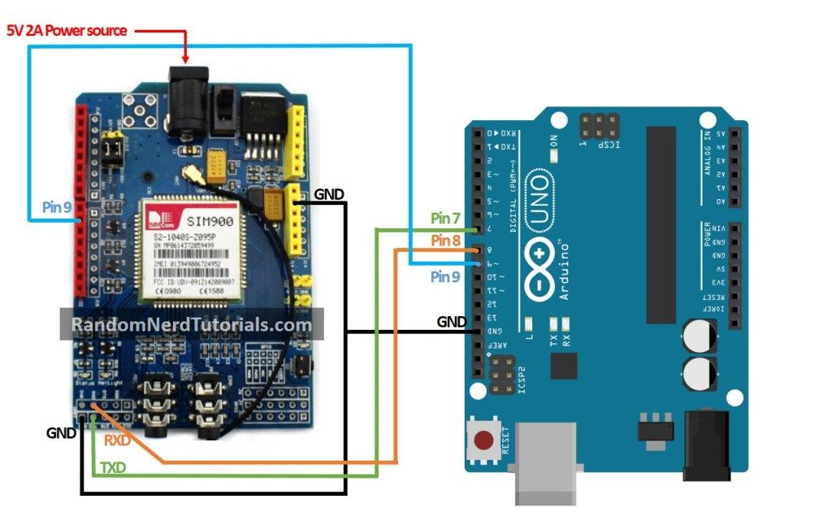
Smart Irrigation System Based IoT
Hardware component
4
GSM-GPRS SIM900a
The GSM modem is a highly flexible plug and play quad bandSIM900A GSM modem for direct and easy integration to RS232 applications. It Supports features like Voice, SMS, Data/Fax, GPRS and integrated TCP/IP stack. The tx and rx pins from arduino are connected to the rx and tx of GSM modem respectively.
It requires a SIM (Subscriber Identity Module) card just like mobile phones to activate communication with the network. Also, they have IMEI (International Mobile Equipment Identity) number similar to mobile phones for their identification.
We used AT command .

Slide 18
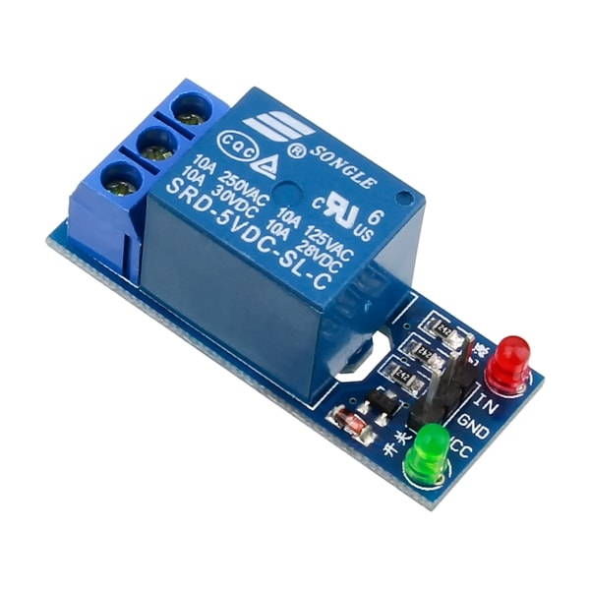
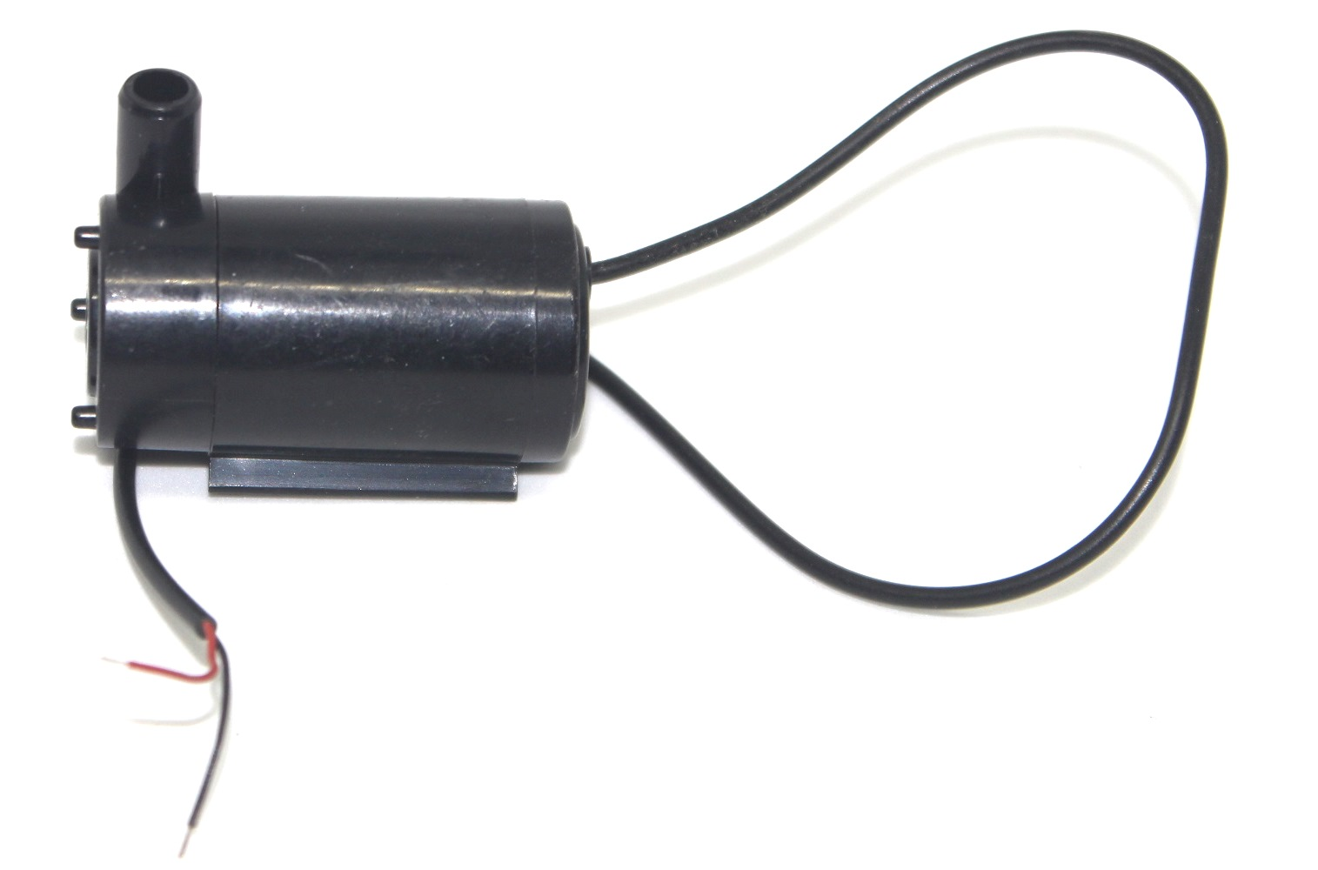
Hardware component
5
Relay
6
Water Pump
The relay couples the microcontroller and water motor. It controls the water supply to plant. Depends on the condition of plant relay can ON and OFF the water supply.

Slide 19
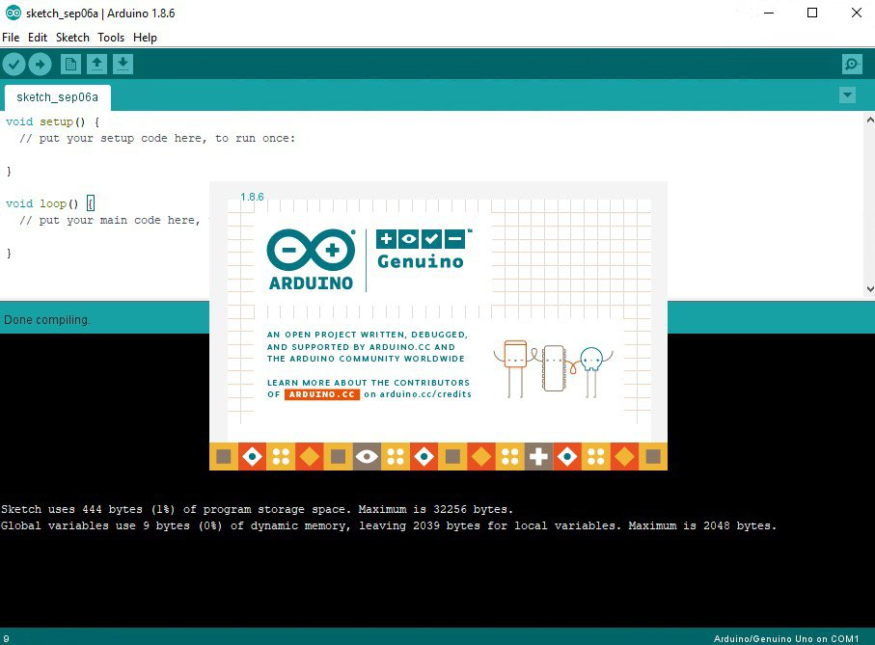
Software Component
We will used the arduino Integrated Development Environment (IDE) to interface hardware components with arduino uno.
Written in C and C++ languages.
We used AT Commands for SIM900A GSM/GPRS Module.
Smart Irrigation System Based IoT

Slide 20
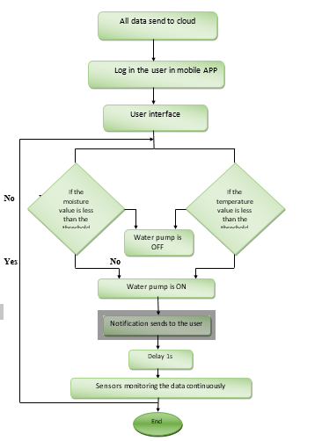
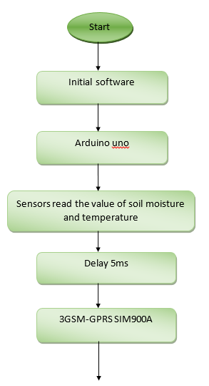
Flowchart

Slide 21

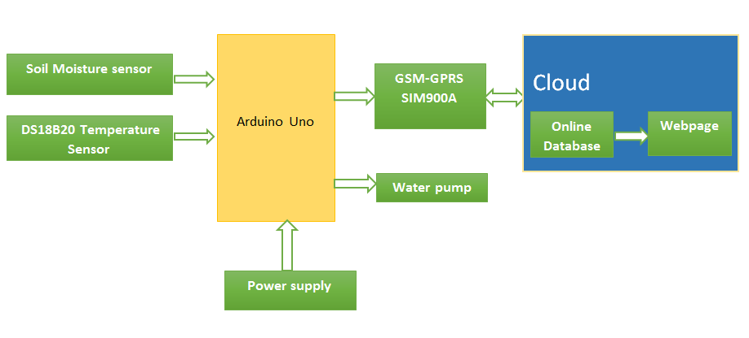
Block Diagram Of System
Smart Irrigation System Based IoT

Slide 22
Smart Irrigation System Based IoT
Advantages
reduce soil erosion and nutrient leaching
No manpower required
02
04
01
03
05
Reduced water consumption
Increase of productivity
Safe

Slide 23
Smart Irrigation System Based IoT
Conclusion
A reliable and efficient system for monitoring the environmental parameters.
Allows user to see accurate change in it .

Slide 24

Thank you

