Slide 1
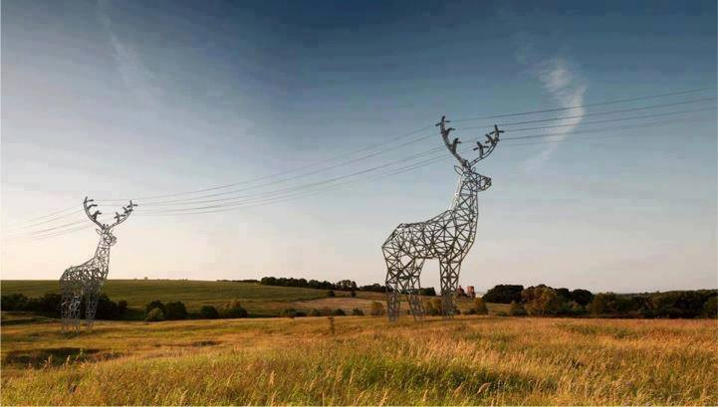

An-Najah National University
Faculty of Engineering
Electrical Engineering Department
Optimum Performances of Ramallah & Al-Birah Governorate Network
Prepared By:
Ahmad Joma’a
Osama Bani-Nimra
Supervisor:
Dr. Maher Khammash

Slide 2
Objective :
1- Collect all data about Ramallah network including all parameters (transformers, transmission lines , load ).
2- Design Unified Electrical Network for Ramallah district.
3- Improve the voltage level and decrease the losses in the network.
4- To get economical benefit when improving the performance of Ramallah network.
5- Analyze the network under maximum condition using load flow analyses.
6- Giving recommendations for the best system to be used in Ramallah and Improve the network to be unified.

Slide 3
Improvement the Electrical Distribution Network
Benefits and advantages of improving the electrical distribution networks
1. Reduction of power losses.
2. Increasing of voltage levels .
3. Correction of power factor.
4. Increasing the capability of the distribution transformer.
Methods of improvement of distribution electrical networks
1. Swing buses
2. Transformer taps
3. Capacitor Banks (compensation)

Slide 4
Description of Ramallah Network :
Feds by Jerusalem electrical CO. taken from Israel Electrical Company (IEC) .
There is 13 Connection points.
This connection point capacity is 130 MW (rated )
The rated voltage is 33KV.
Ramallah city contains 18 power distribution transformers
Ramallah district : 43villages surrounding the city of Ramallah .

Slide 5
Load Categories
Type of sector | Percentage
Residential sector | (60 – 65)%
Industrial sector | (15 – 18) %
Commercial sector | (10 – 12)%
Water pumping | 5%
Street lighting | (3 – 4)%

Slide 6
Network Elements
Transmission lines
33KV Transmission
Overhead transmission lines ACSR (3X120+1X50) mm
Underground Cable Copper XLBE single core 150mm
11KV Transmission
Overhead transmission lines ACSR (3X50+1X50) mm
Underground Cable Copper XLPE (3X95 +1X50) mm

Slide 7
Network Elements
 | Transformers
MVA | # of Transformers | Total capacity(MVA)
15 | 8 | 120
10 | 6 | 60
5 | 1 | 5
3(33KV/6.6KV) | 2 | 6
Total | 18 | 191

Slide 8
Network Elements
Substation name | Voltage changes | #of transformers | Transformers capacity
Silvana | 33/11 | 2 | 15 MVA
Al Tera | 33/11 | 1 | 10MVA
Ramallah north | 33/11 | 2 | (10&15)MVA
Betien west | 33/11 | 1 | 15MVA
Betien central | 33/6.6 | 1 | 3MVA
AL Tahona | 33/11 | 1 | 10MVA
Dar Al-Moalmeen | 33/11 | 2 | (10&15)MVA
Singel | 33/11 | 1 | 10MVa
Der Jreer | 33/11 | 1 | 5MVA
selwad | 33/11 | 1 | 3MVA
AL Rehan | 33/11 | 1 | 5MVA
Khrbatha | 33/11 | 1 | 15MVA
Nabi-saleh | 33/11 | 1 | 15MVA
Tri-fitness | 33/11 | 2 | (10&15)MVA

Slide 9
Network Construction
After we received the data from the company in excel and AutoCAD form we were abele to built the one line diagram
Note: there was no one line diagram for the network in the company so we built it according to the future structure from the company

Slide 10
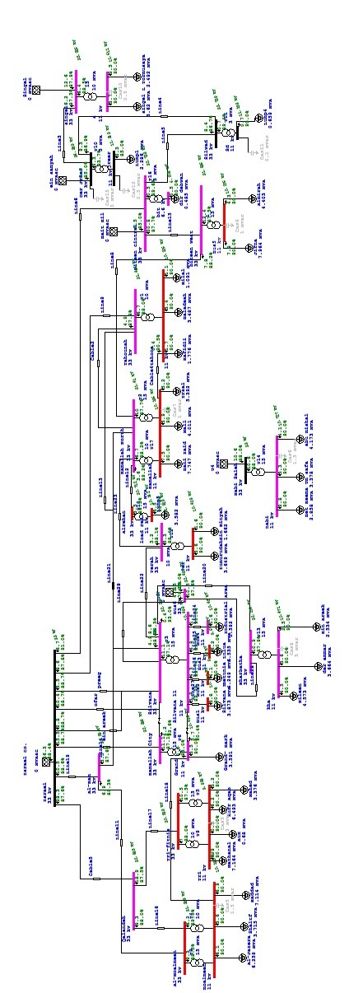
One-Line Diagram

Slide 11
Load factor
We have the average value of loads by using the load factor of each load which we got from the real data of network and real daily load curves from SCADA system
The average demand load factor in our network is 65% that means the average load to the maximum load ratio is 65% which considered as a very good operating load factor.

Slide 12
Analysis
Max
Before improved
After improved
Min
Before improved
After improved
Econ
Then we have done an economical study

Slide 13
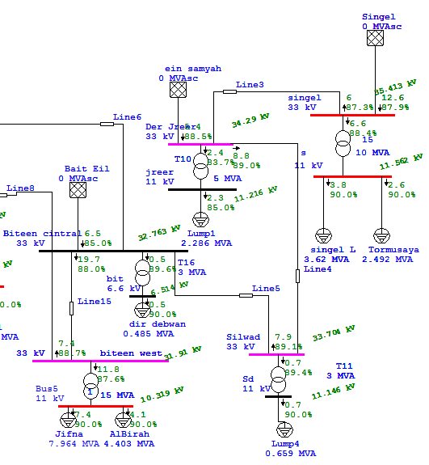
Max. Analysis
Parts of the Network before improved

Slide 14
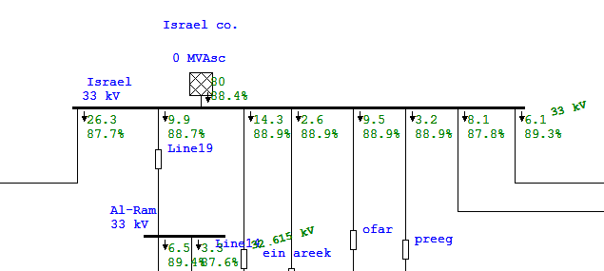
Cont…

Slide 15
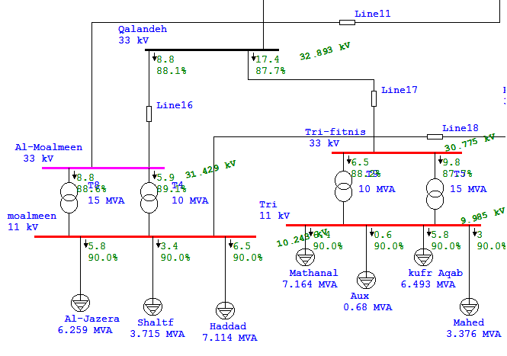
Cont…

Slide 16
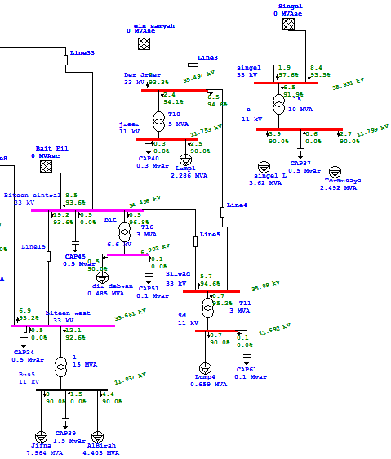
Max. Analysis
Parts of the Network after improved

Slide 17
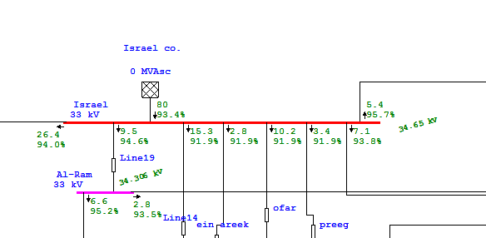
Cont…

Slide 18
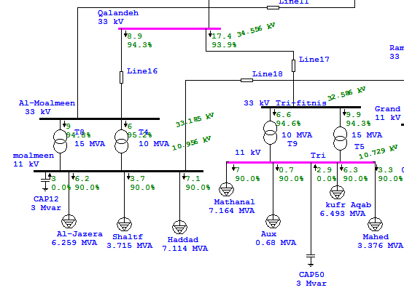
Cont…

Slide 19
Some Results Of Voltage
Bus name | Rated voltage KV | Before imp. KV | After Imp. KV
Al-Moalmeen | 33.00 | 31.42 | 33.18
Al-Ram | 33.00 | 32.61 | 34.22
Al-Terah | 33.00 | 31.99 | 33.64
Al-Tahounah | 33.00 | 31.55 | 33.46
Tri-fitniss | 33.00 | 30.77 | 32.59
Kharbatha load | 11.00 | 10.51 | 11.21
Silvana load | 11.00 | 10.53 | 11.19
Tri-fitniss load | 11.00 | 9.980 | 10.73
Tahounah load | 11.00 | 10.25 | 11.08
Rehan load | 11.00 | 10.25 | 10.89
Biteen | 6.60 | 6.51 | 6.90

Slide 20
Some Results Of Power Factor
Bus name | Before | After
Moalmeen | 83.4 | 94.7
Ramallah city | 89.4 | 93.0
Qalandia | 87.7 | 94.0
Al-ram | 88.7 | 94.5
Silvana | 88.9 | 91.9
Nabi-Saleh | 88.1 | 92.1
Jreer | 83.7 | 94.1
Tri-fitniss | 89.8 | 95.7
Terah | 88.5 | 92.3

Slide 21
Maximum Stage Results
 | Unit | Before | After
Total demand | MW | 113.9 | 121.91
Total demand | MVAr | 62.01 | 45.76
Total demand | MVA | 129.68 | 130.21
P.F | % | 87.8 | 93.6
Apparent losses | MW | 4.808 | 3.55

Slide 22
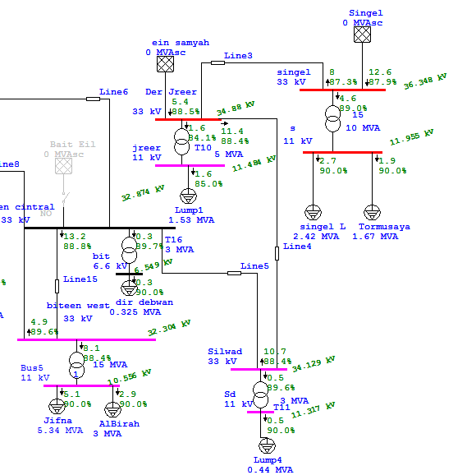
Min. Analysis
Parts of the Network before improved

Slide 23
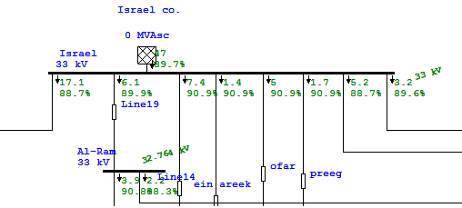
Cont…

Slide 24
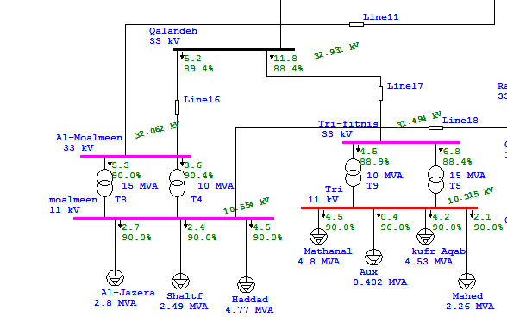
Cont…

Slide 25
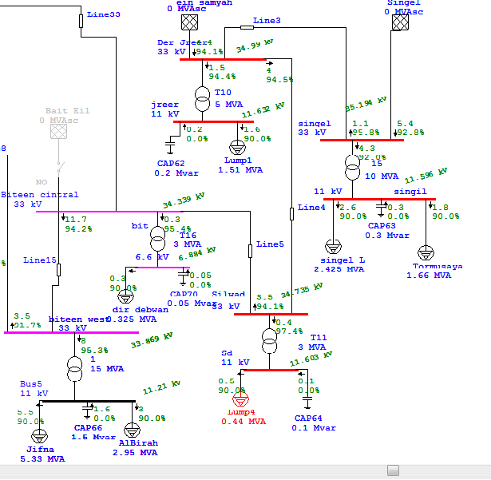
Min. Analysis
Parts of the Network After improved

Slide 26
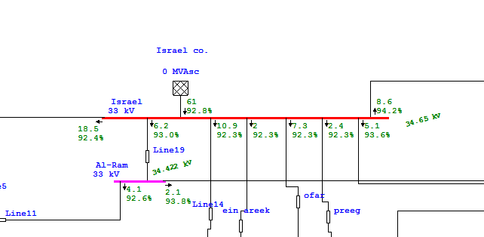
Cont…

Slide 27
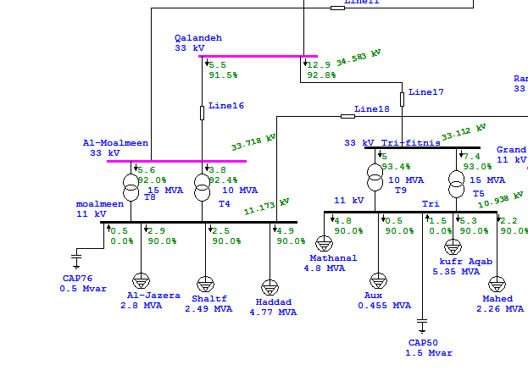
Cont…

Slide 28
Some Results of Voltages
Bus name | Rated KV | Before imp. KV | After imp. KV
Al-Moalmeen | 33.00 | 32.06 | 33.72
Al-Ram | 33.00 | 32.77 | 34.42
Al-Terah | 33.00 | 32.42 | 33.85
Al-Tahounah | 33.00 | 32.14 | 33.79
Tri-fitniss | 33.00 | 31.49 | 33.10
Kharbatha load | 11.00 | 10.73 | 11.32
Silvana load | 11.00 | 10.72 | 11.32
Tri-fitniss load | 11.00 | 10.31 | 10.93
Rehan load | 11.00 | 10.67 | 11.22
Tahounah load | 11.00 | 10.54 | 11.18
Biteen | 6.60 | 6.59 | 6.88

Slide 29
Some Results of Power Factor
Bus name | Before | After
Moalmeen | 74.3 | 91.5
Ramallah city | 89.1 | 93.4
Qalandia | 88.7 | 92.4
Al-Ram | 90.0 | 93.0
Silvana | 91.0 | 92.3
Nabi-Saleh | 88.7 | 94.1
Jreer | 84.1 | 94.4
Tri-fitniss | 89.8 | 94.1
Terah | 89.1 | 92.4

Slide 30
Minimum Stage Results
 | Unit | Before | After
Total demand | MW | 77.0 | 82.37
Total demand | MVAr | 40.5 | 31.78
Total demand | MVA | 86.98 | 88.28
P.F | % | 88.5 | 93.3
Apparent losses | MW | 2.652 | 1.72

Slide 31
Economical Study
P max=122 MW. P min=82 MW
Losses before imp.=4.8 MW Losses after imp.=3.5 MW
P.F before imp. =87.8 P.F after imp. =93.6
P avg=( P min+ P max)/2= 102 MW.
Total energy per year =P avg *8760= 893520 MWH.
Total cost per year=Total energy*cost(NIS/KWH)
= 893520*0.5 = 446.76 Million NIS/year.
Saving in penalties of P.F= 0.01*(.93-0.878)*Total cost of energy
= 232315 NIS/year.

Slide 32
Economical Study
Saving in losses:
losses before imp. – losses after imp. =
4.808 MW- 3.55MW= 1.258MW
The cost /KWH = 1258kw* 8760 * 0.5
= 5.51 Million NIS /year

Slide 33
Economical Study
Total fixed capacitor banks using in maximum case=10.45MVaR.
Cost per KVAR= 3JD=15NIS.
Total regulated capacitor banks using in maximum case=9MVAR.
Cost per KVAR= 15JD=75NIS.
Total cost of capacitor banks= (75*9000) + (10450*15) =831750 NIS.
Total saving=saving in losses +saving in penalties
= 5.745 Million NIS.
S.P.B.P=Investment /Saving
= 5.745 M /831750= 6.9 years. Less than 8 year which is acceptable .

Slide 34
Protection Analysis
Why protection system is needed
Personnel safety against electrical hazards .
Avoid equipment stress(thermal, electrical, mechanical damages) .
Make network stability .
Clear electrical faults and maintain service continuity.
_{Short cct calculation}
In our project we use Etap program to calculate the maximum currents, and we calculate the short cct current.

Slide 35
Protection Analysis
Selection of circuit breaker :
I C.B ≥ K safety*Imax load K safety=1.3
V C.B ≥ System
I breaking capacity ≥ 1.2 Is.c
Selection of instrument transformer :
Potential transformer : V p≥ V source
Current transformer : I p≥ 1.1Imaxload

Slide 36
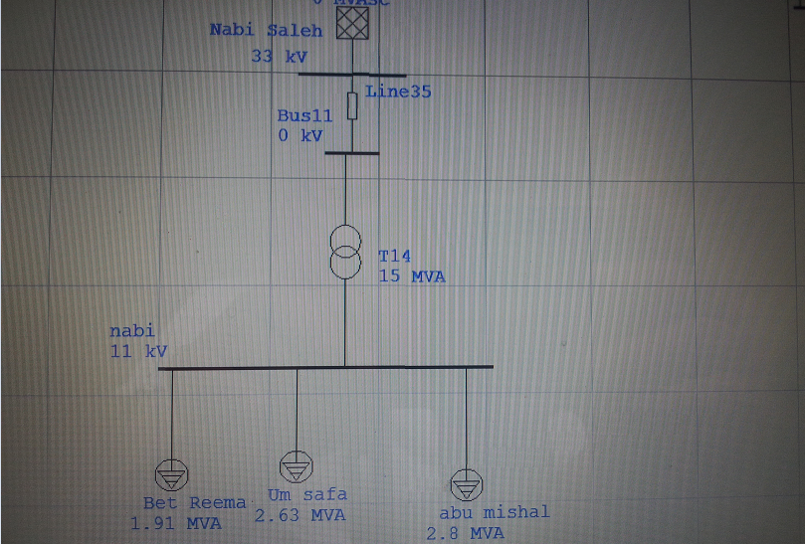
Power Transformers Protection:
The first transformer at al Nabi-Saleh connection point

Slide 37
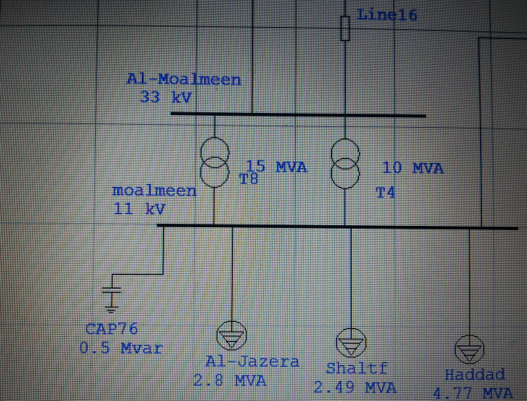
The second power transformer is at Al-Moalmeen

Slide 38
Protection Analysis
Place of fault | Rated KV | Imax A | Isc A | ICB Cal. A | ICB rated A | C.T ratio
Nabi-Saleh B.T | 33.00 | 123.0 | 1160 | 148 | 150 | 200/5
Nabi-Saleh A.T | 11.00 | 369 | 2662 | 443 | 500 | 400/5
Al-moalmeen B.T | 33.00 | 96 | 2156 | 115 | 125 | 100/5
Al-moalmeen A.T | 11.00 | 288 | 6288 | 346 | 400 | 300/5
Al-moalmeen B.T | 11.00 | 192 | 6176 | 230 | 200 | 200/5

Slide 39
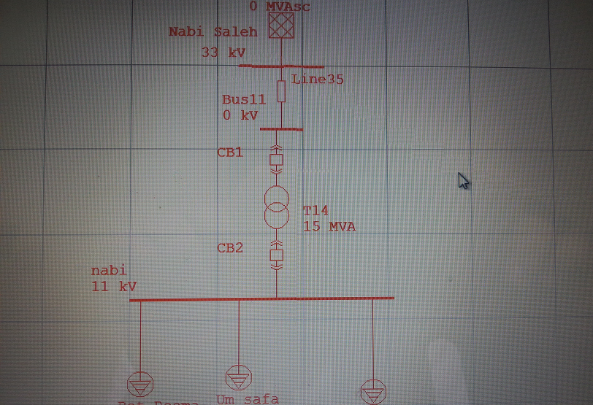
After adding the C.B

Slide 40
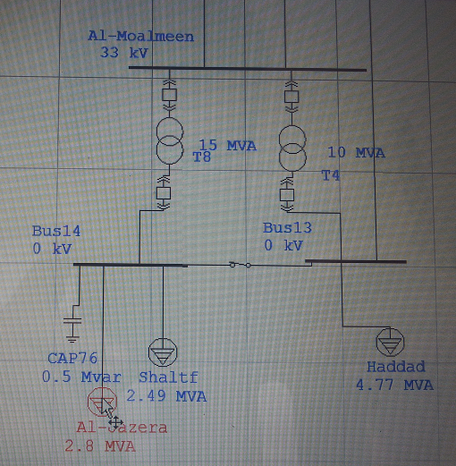
After adding the C.B

Slide 41
Conclusions
In maximum condition we improved the power factor more than 92%, in order of that the bills are reduced.
The voltages for all busses are increased above the nominal.
The power losses are reduced.
Tow stations are protected by using C.B.
When the power losses are reduced we saved about 5.5M NIS.
We added C.B fixed and regulated and the payback period is 6.9 years.

Slide 42
Recommendations
I noticed that the cables are replaced with transmission lines so we misses the chance to get a leading power factor.
Also we have to raise the power incoming from connection points to enhance the reliability.
At the end we hope the companies we deal with them gets less formally when sharing information with us, also takes our improved networks in serious, that can happen when we see our project applied on the ground.

