Slide 1

An- Najah National University
Faculty of Engineering & Information Technology
Industrial Engineering Department
" Preparation of Manual Procedures for Administrative and Operational Processes for Satco Company "
Osama Abu Jalboush
Zeyad Al Khatib
Supervisor: Dr. Nijim Hijleh

Slide 2
Outline
Background
Problem Statement
Scope of Work
Objective of Work
Importance of Work
Result and Analysis
Discussion
Conclusion & Recommendation

Slide 3
Background
SATCO is Trade and Contracting Company.
Established in 1991.
Main market is West Bank, Gaza Strip, Jerusalem.
Two manufacturing departments :
  Electricity Towers and Poles.
  Electricity Panels and Water Meters.
SATCO annual turnover is about 2 million ILS.
Facility of about 10000 m².
60 employees , 6 engineers.

Slide 4
Problem Statement
As a Palestinian company working on providing most of the local governorate with a major and expensive item, for building electrical networks. and after the first primary visits for the company location, to check the possibilities of implementing the 6-sigma on their production, we faced the fact that they are not performing the basics of production, quality, and inventory management.
Based on that we decided to change the project scope to implementing the basic operations management tools, the project will ultimately be able to build internal operational management tools to upgrade performance, and surely shall affect their profitability and strengthen their sustainability in the market, as sole manufacturer.

Slide 5
Scope of Work
As previously mentioned, SATCO company working in more than production line also on trade items, this study will emphasis analysis the manufacturing department (Towers, Poles and accessories) as profit loss center, and as separated business and working environment.

Slide 6
Objective of Work
A deep evaluation of the production management system and the best appropriate system to ensure maximum productivity for the company at the lowest cost.
Audit of the inventory control system and development of a well-structured procedure to ensure that core inventory objectives are met. Costs will be calculated based on inventory data. This will help management to improve pricing strategies.
All quality control measures are implemented and documented, to ensure that the company is on the safe side of a contractual point of supply, which will add a competitive advantage to the company.

Slide 7
Importance of Work
Application operation management tools are very important in the facility, such as the six-sigma and lean tool, which are used to improve the efficiency of production processes, and because the fundamentals of production, inventory and quality management are not present to start the application from the above theories, work has begun on the implementation of internal operational management tools.
The importance of the work is to build an appropriate management system for production, inventory and quality to improve performance, efficiency and reduce waste.

Slide 8
Tool:
Questionnaire forms
The areas of investigation are summarized in four types of questionnaire, the main objective of which is to facilitate the process of copying the status of the facility for all systems to be dealt with in this research.
The type of systems & questionnaires for it:
- Production management system
- Inventory management system
- Quality system
- Safety system
2. Gap Analysis
A GAP Analysis process allows organizations to determine how best achieve their business goals. It compares the current state with an ideal state or goals, which highlights shortcomings and opportunities for improvement.
- Was used to analyze the performance of each of the four systems by assessing the current state of the plant's pillar and tower manufacturing section

Slide 9
3. SWAT Analysis
STRENGTHS
Competitive Advantages
WEKNESS
Timescales & Deadlines
THREATS
Political & Economical Effects
OPPERTUNITY
Market Development
Experience
Assets, knowhow
Layout
Organization Structure
Management System
Innovation & Technology Development
Global Influences
Business/product Devlop.
Competitors
Market Demand
Poor Manag. System
Sole Manucturaer

Slide 10
GAB Analysis
Current State
Future State
1. No production management system
2. No inventory management system
3. No quality management system
4. Weakness safety system
Gap
1. To full adapted production management system
2. To full adapted inventory management system
3. To full adapted management system
4. To full adapted safety system
Remedies
1.1No production planning & control
1.2 No production order
1.3 No procedure
1.4 No documentation
1.5 No KPI
1.6 No MPS
1.7 No flow chart
1.8 No plant layout
1.9 No maintenance management
2.1 No MRP
2.2 No purchase order
2.3 No procedure
2.4 No documentation
2.5 No orders tracking
2.6 No arranging
3.1 No procedure for assure product quality
3.2 No documentation for product quality
3.3 No inspection for raw material & product
4.1 Lack of safety procedures
4.2 Lack of documentation of Injuries
4.3 Lack of safety in work-place
1.To build and implement production management system depending on tool: (Production Plan , MPS, excel, Visio)
2. To build and implement inventory management system depending on tool: (MRP, EOQ, Excel, Visio)
3. Documenting and continuously verifying the validity of systems and outputs, and working on a special document for process development.
4. A system for managing risks and educating workers, and designing a work environment that suits the manufacturing process.

Slide 11
Result and Analysis
We will present the findings from the work of the Panel on the writing of working procedures for both administrative and operational processes (Department of Electricity Towers and Poles) aimed at facilitating process documentation and increasing performance indicators, in this section, we will clarify procedures for each Production, Quality and Procurement Section, where will be present the scope of the work and responsibilities, objectives and processes for each procedure.

Slide 12
دليل الإنتاج
إجراءات عملية التصنيع
إجراءات استلام الطلبيات

Slide 13
1. إجراءات استلام الطلبيات
الهدف من الاجراء:
1. مراقبة العطاءات المطروحة من قبل الأقسام المسؤولة.
2. دراسة العطاءات المطروحة والطلبيات من قبل الأقسام المسؤولة لمعرفة قدرة الشركة في تلبيتها.
3. توزيع المهام على الأقسام لمعرفة دور وقدرة كل قسم.
مجال التطبيق:
يطبق هذا الاجراء على الطلبيات الواردة للمصنع سواء كانت عطاءات او طلبات فردية.

Slide 14
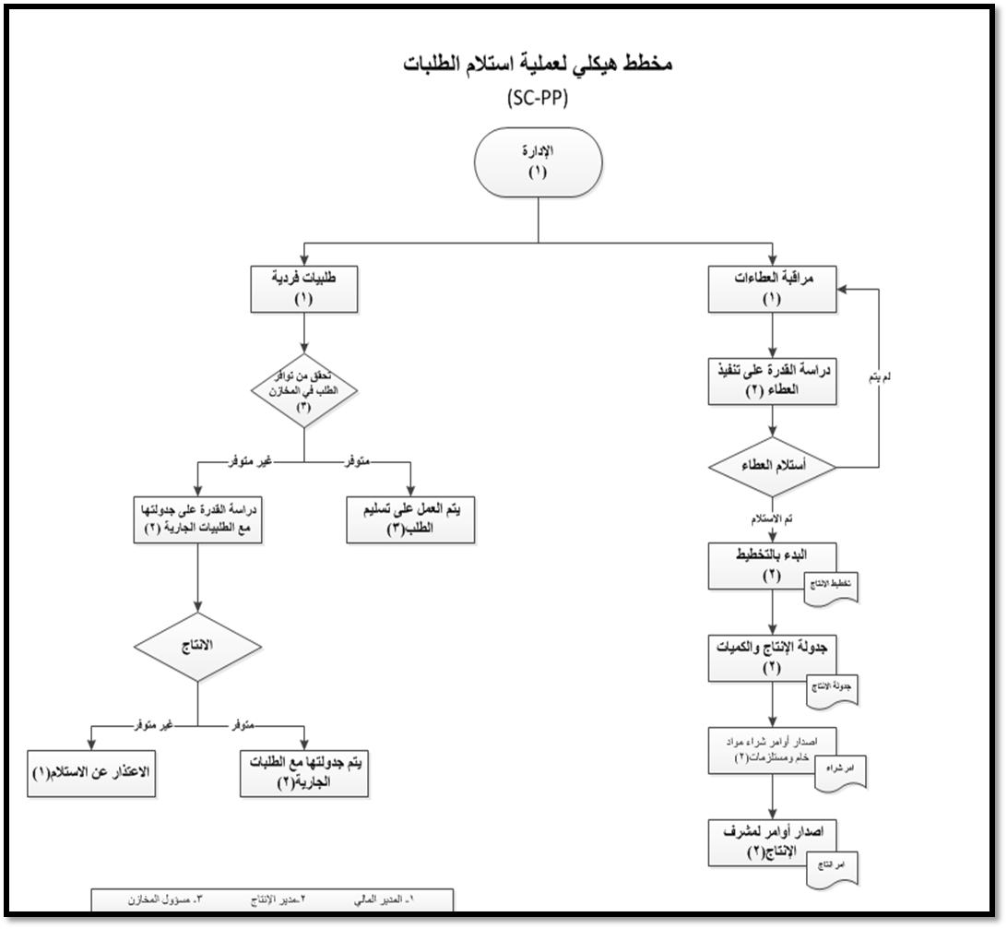

Slide 15
2. إجراءات عملية التصنيع
الهدف من الاجراء:
1. الأشراف على عمليات التصنيع والإنتاج.
2. العمل على تخطيط وجدولة للعطاءات المستلمة لتنظيم عملية الإنتاج.
3. ضمان سير العملية التصنيعية بشكل موثق وفعال وحسب الجدولة المخطط لها لتلبية الطلبيات والعطاءات المستلمة.
إدارة وتوفير القدرات الإنتاجية الازمة من عمال وماكينات ومواد خام.
مجال التطبيق:
يطبق هذا الاجراء على خط الإنتاج كما انه يشمل الإجراءات لمختلف المنتجات.

Slide 16
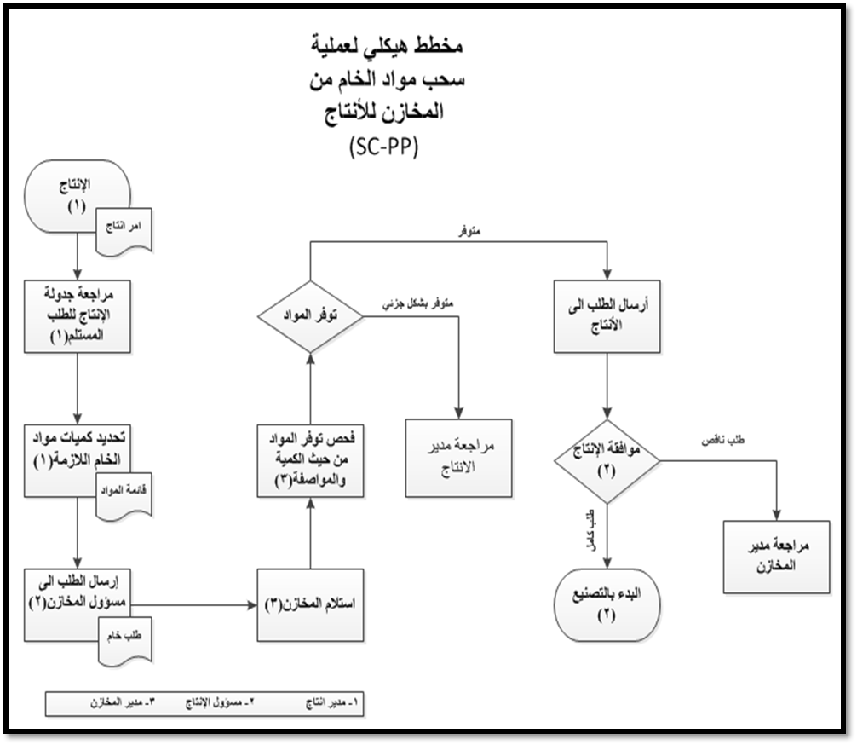

Slide 17
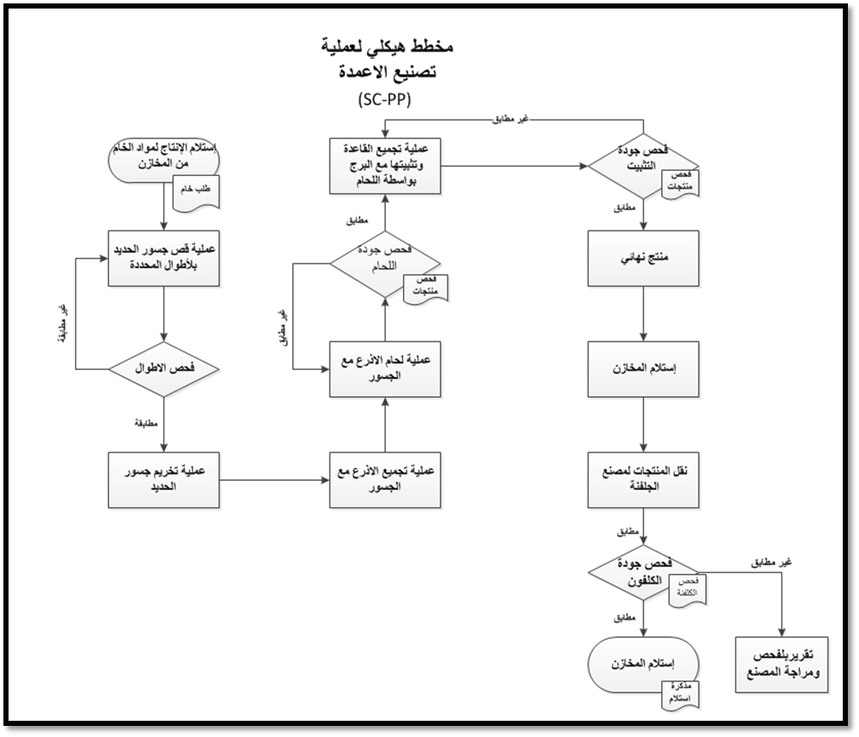

Slide 18
دليل الشراء
إجراءات عملية الشراء
إجراءات متعلقة بعمليات الشراء
إجراءات متعلقة بالموردين

Slide 19
إجراءات متعلقة بالموردين
الهدف من الإجراء:
لضمان تلبية جميع العطاءات والطلبيات المستلمة ومستلزمات الإنتاج.
مجال التطبيق:
يطبق هذا الاجراء على الموردين المسؤولين عن تلبية الطلبات بمواد الخام اللازمة.

Slide 20
2. إجراءات متعلقة بعمليات الشراء (سياسات الطلب والاتفاق)
الهدف من الإجراء:
لمعرفة طريقة الشراء التي تتناسب مع الكمية التي يتم طلبها من قبل دائرة الإنتاج.
مجال التطبيق:
يطبق هذا الاجراء على كميات المواد الخام التي يتم طلبها.

Slide 21
3. إجراءات عملية الشراء
الهدف من الإجراء:
لضمان حدوث تسلسل واضح لعملية شراء المواد الخام.
لضمان العمل على جدولة انتاج واضحة لتلبية جميع الطلبيات.
مجال التطبيق:
يطبق هذا الاجراء على المواد الخام التي يتم طلبها بهدف تلبية الطلبيات والعطاءات المستلمة.

Slide 22
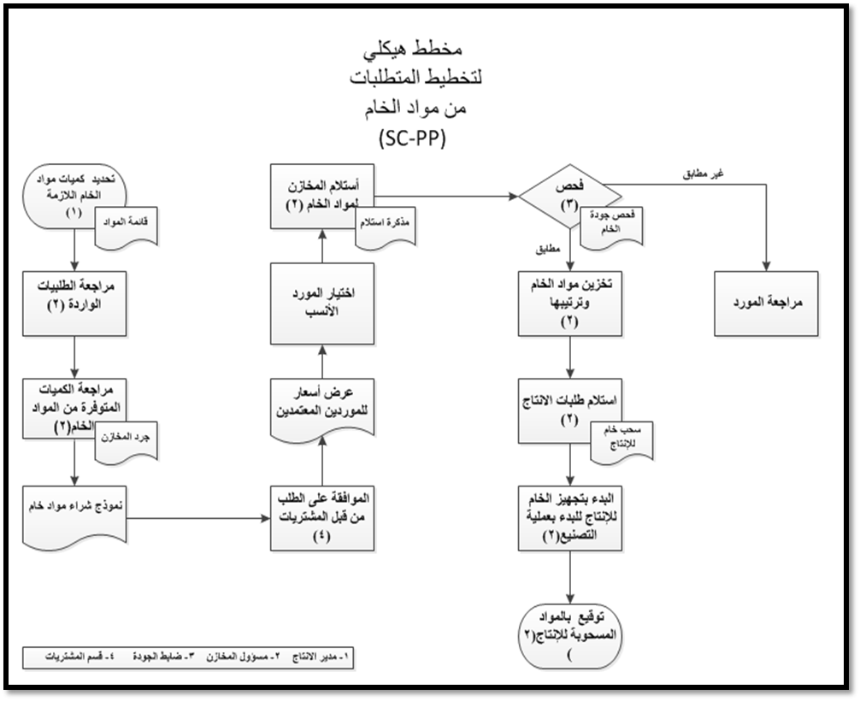

Slide 23
دليل ضبط الجودة
السلامة
مخازن
منتجات مجلفنة
منتجات
مواد خام

Slide 24
إجراءات ضبط الجودة:
الهدف من الإجراء:
1. عمل الفحوصات اللازمة لمراقبة جودة المواد الخام والمنتجات أثناء مراحل الإنتاج.
2. مراقبة جودة الإنتاج وظروف العمل داخل المصنع، ومراقبة عمل الفحوصات اللازمة للتأكد من جودة عملية التصنيع من لحام وتركيب وتجميع للأعمدة.
3. التأكد من مطابقة المنتجات الجاهزة للمواصفات المطلوبة والمطبقة في الشركة وفق آليات رقابة وضبط للجودة واضحة ومتفق عليها.
مجال التطبيق:
يطبق هذا الأجراء على كل من مواد الخام والمنتجات اثناء عملية التصنيع والمنتجات المجلفنة.

Slide 25
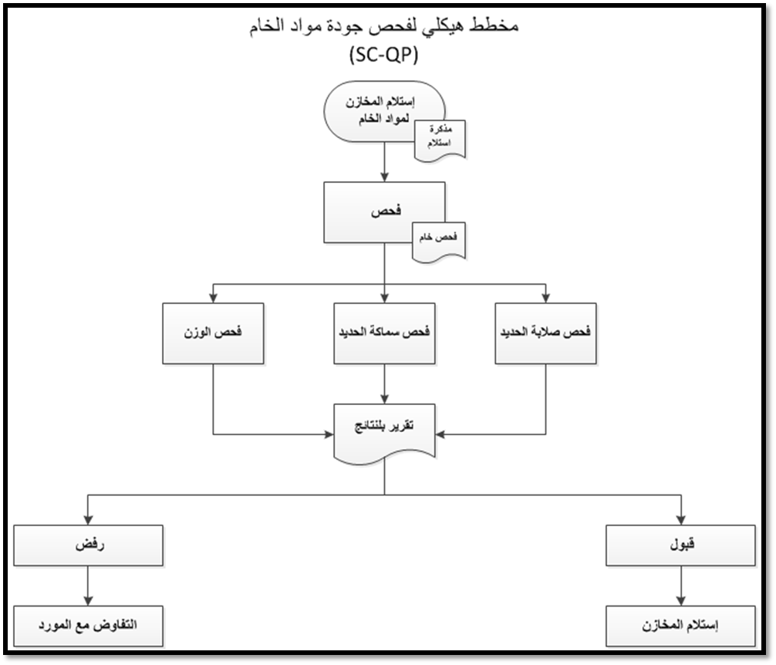

Slide 26
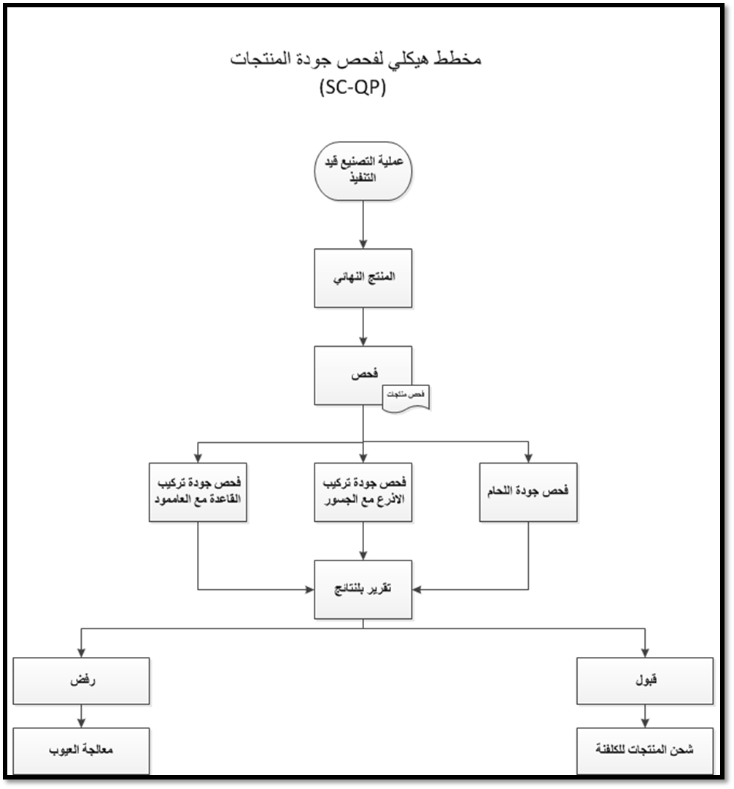

Slide 27
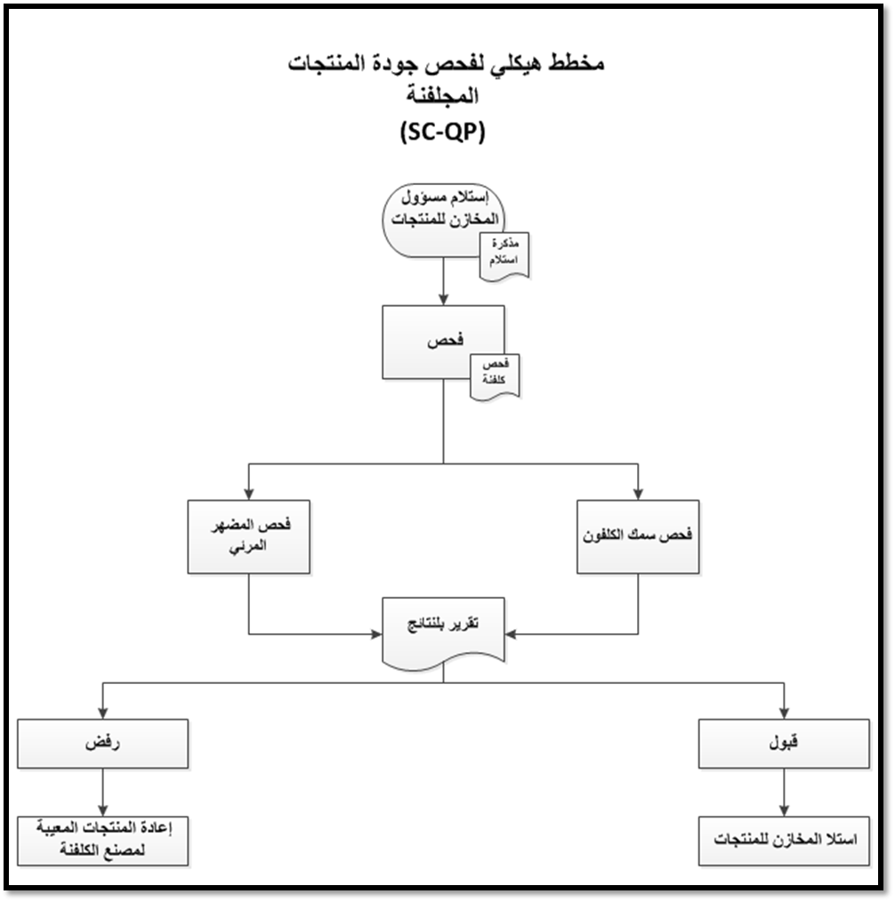

Slide 28
4. إجراءات ضبط المخازن
الهدف من الإجراء:
1. إدارة المخازن بشكل استراتيجي وفقا لسياسة الشركة ورؤيتها.
2. الإشراف على عمليات استلام مواد الخام والمنتجات المجلفنة والعمل على توثيقها.
3. الاستخدام الأمثل للمساحات التخزينية المتاحة.
4. تزويد قسم الإنتاج بكافة احتياجاته من المواد المطلوبة لتلبية العملية التصنيعية.
مجال التطبيق:
يطبق هذا الاجراء على المساحات التخزينية لدى شركة ساتكو.

Slide 29
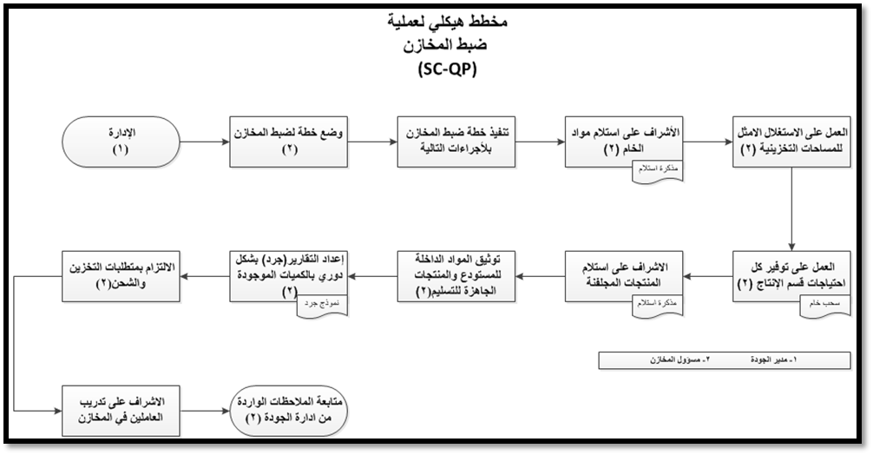

Slide 30
5. إجراءات ضبط السلامة
الهدف من الإجراء:
1. وضع أساسيات السلامة وفقا لمعايير السلامة الدولية وضمان تنفيذها في الوقت المناسب.
2. دراسة مخاطر المنشأة ووضع خطط وإرشادات لتفادي المخاطر المحتملة.
3. التعاون مع المشرفين لفهم نوع الأنشطة والعمليات التي ستتم بشكل يومي.
مجال التطبيق:
يطبق هذا الإجراء على المنشأة التصنيعية والمخازن لتجنب الإصابات.

Slide 31
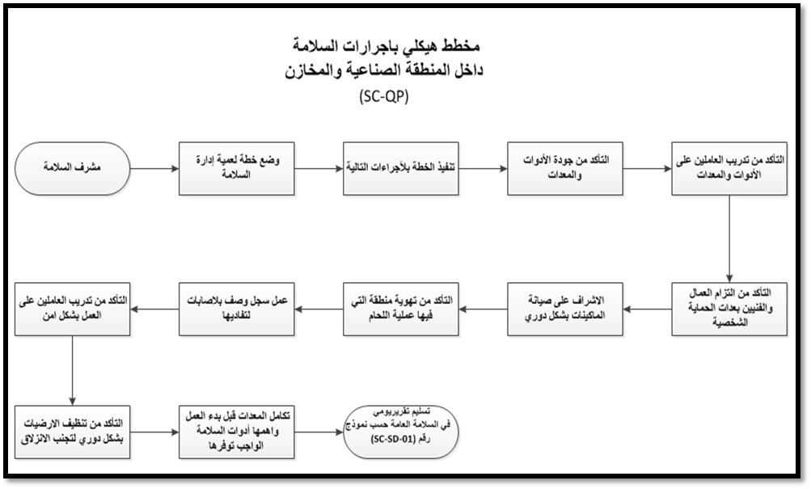

Slide 32
Discussion
Forms were reviewed by the work team for work procedures and plans for the flow of operations for different productive sectors to take background on how to write and document work procedures to be applied on the scope of the project, through company visits, monitoring and studying the implementation of administrative and operational processes and with the help of data obtained through gap analysis for sections Production, storage, quality control, analysis, and identification of weaknesses faced by the company in administrative and operational processes.
Therefore, work has been done on writing and documenting procedures for both administrative processes (procurement department, production, quality, orders receiving section) and operational processes (manufacturing and inventory section, quality and safety control), and the procedures were reflected in a flowchart to form a documented operation with the aim of uniformity in the performance of each of the operations and to ensure symmetry in the manufacturing output.
The importance of documentation lies in being the key to GMP compliance, and working with it ensures that all development, manufacturing, and testing can be traced. Documentation provides the way for auditors to assess the overall quality of operations within the company and the final product.

Slide 33
Conclusion
It has been proposed that the management of the plant work on the procedures manual in order to facilitate the documentation of inputs, processes, and outputs, which in turn will increase the efficiency of the work and ensure the quality of the processes and products. The objective of the ongoing improvement of the poles and Towers Section is to increase productivity, benefit from the use of machinery and personnel, and improve and increase the company's share in the Palestinian market.
The procedures define the operation of each procurement, manufacturing, and quality control section with a view to guiding officials to perform operations in an orderly manner.
The company's work on procedures and continuous scrutiny of the operations will provide access to the international quality system ISO, where the introduction of a manual of procedures and documentation of processes is an essential part of the quality assurance system (processes and products), and as such, must be linked to all aspects of manufacturing practices, with a view to defining the specifications for all materials, manufacturing method, control, purchase and receipt of orders, to ensure that each responsible person has the necessary information for operations and activities.
Quality control shows a strong positive correlation with all performance variables and must reflect a positive correlation with all performance measures.

Slide 34
Recommendation
Adoption of working procedures manual for all departments to facilitate documentation and knowledge of the responsibilities of staff and workers.
Work on measuring performance indicators for the operations to ensure that the required rates of productivity, quality, and others are achieved.
Work on continuous improvement of a manufacturing system to support process and output improvement activities.
Work on continuous improvement of management systems to improved financial performance.
Working to improve their competitive advantage by improving administrative and operating performance in terms of manufacturing, quality, and flexibility.

Slide 35
Thank

