Slide 1
Automated Car Washer
Suhaib Darawshi Khaled Jeetan

Slide 2
Agenda
Problem & Motivation Idea
Goals
Development Process Application
Future Work
PRESENTATION TITLE
2

Slide 3

Motivations
PRESENTATION TITLE
01
1- Traditional car washing methods are often time- consuming and manual.
02
2- Requiring the physical effort of the vehicle owner.
03
3- very costly and needs a lot of human attention and energy.
3

Slide 4
The idea
PRESENTATION TITLE
1- BUILDING AN AUTOMATED HARDWARE CAR WASHING SYSTEM
2- BUILDING A MONITORING SYSTEM WITH A MOBILE APPLICATION
4

Slide 5
Goals
PRESENTATION TITLE
1- have a cost-efficient system.
2-Convenience and Time-Saving: build a system allows users to initiate and monitor the cleaning process effortlessly.
3-Accessibility and Inclusivity: design a system to be accessible to a wide range of users
5

Slide 6
Goals ...
PRESENTATION TITLE
4-High-Quality Results:
5- Monitoring system for admin.
6

Slide 7
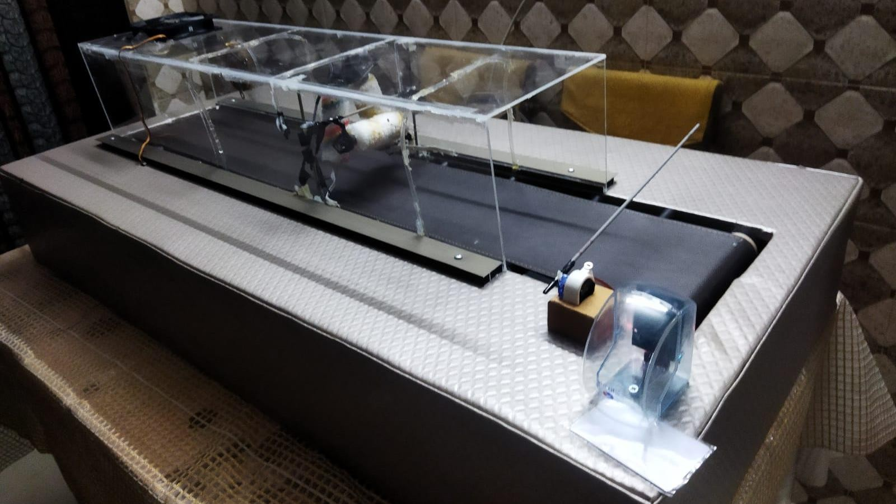
Development Process
PRESENTATION TITLE
7

Slide 8
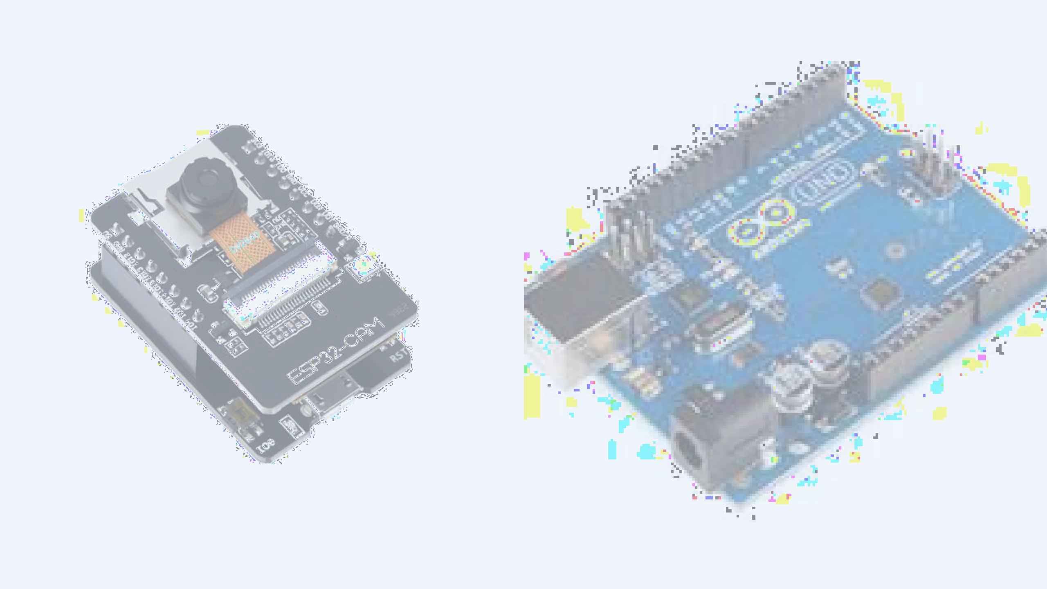
Development Process
8
PRESENTATION TITLE

Slide 9
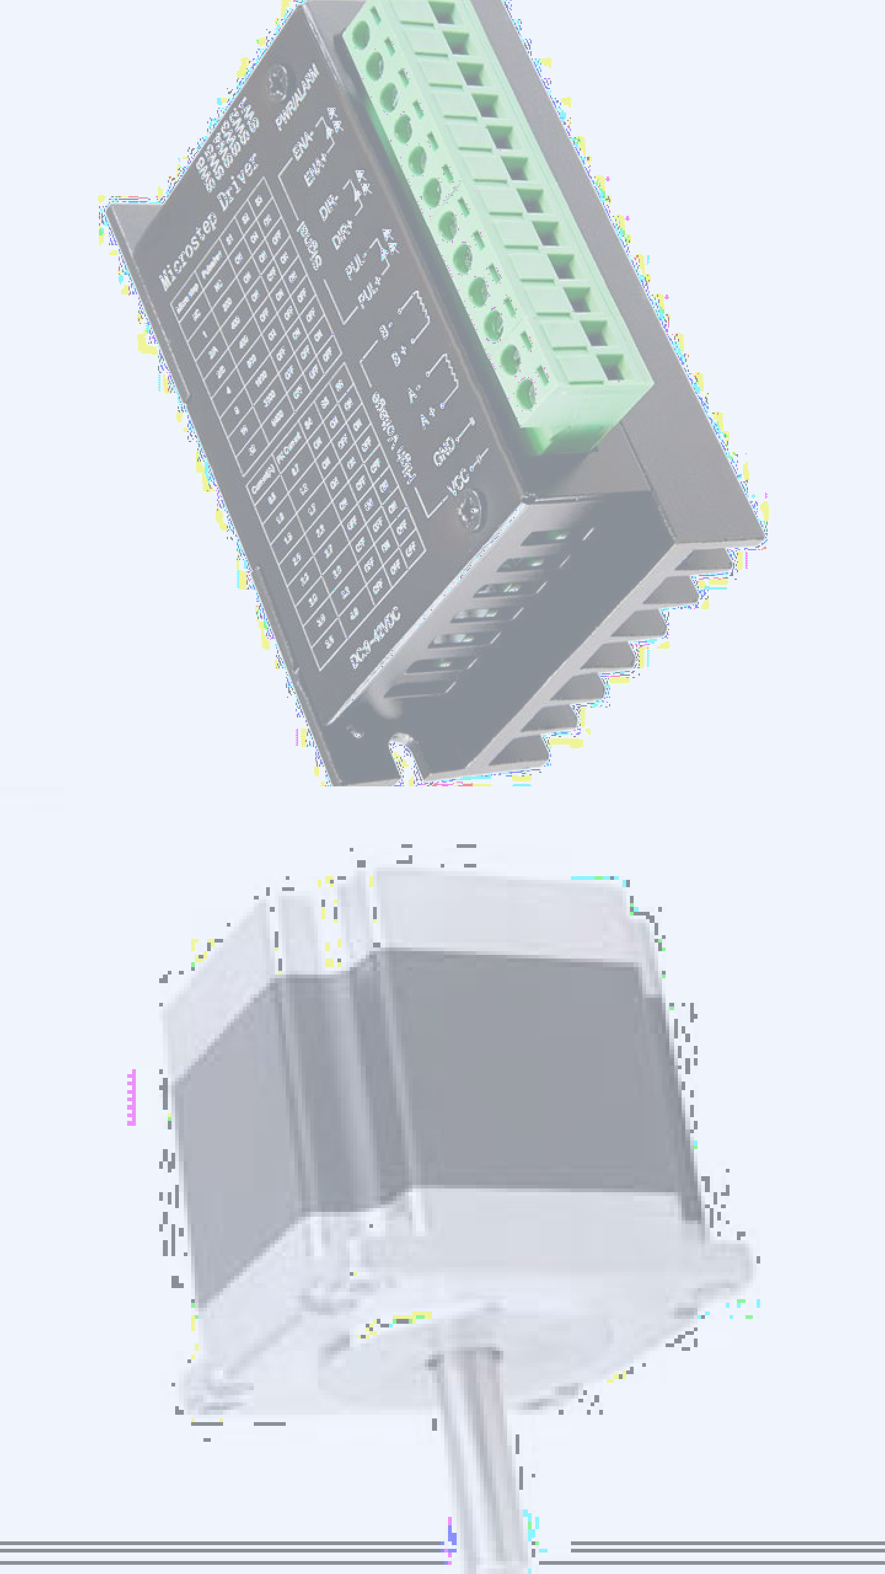
9
PRESENTATION TITLE
Components

Slide 10
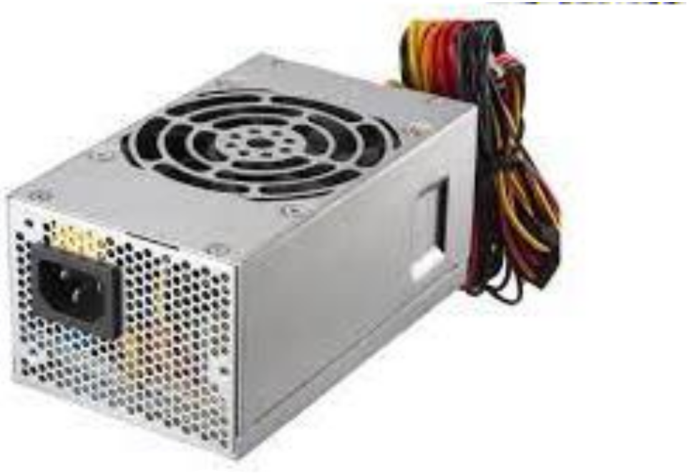
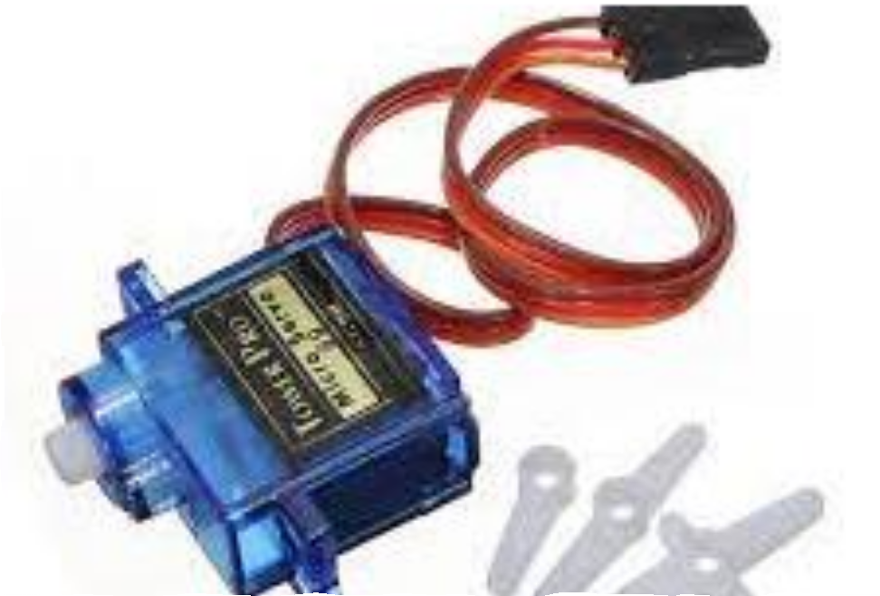
Components
PRESENTATION TITLE
10

Slide 11
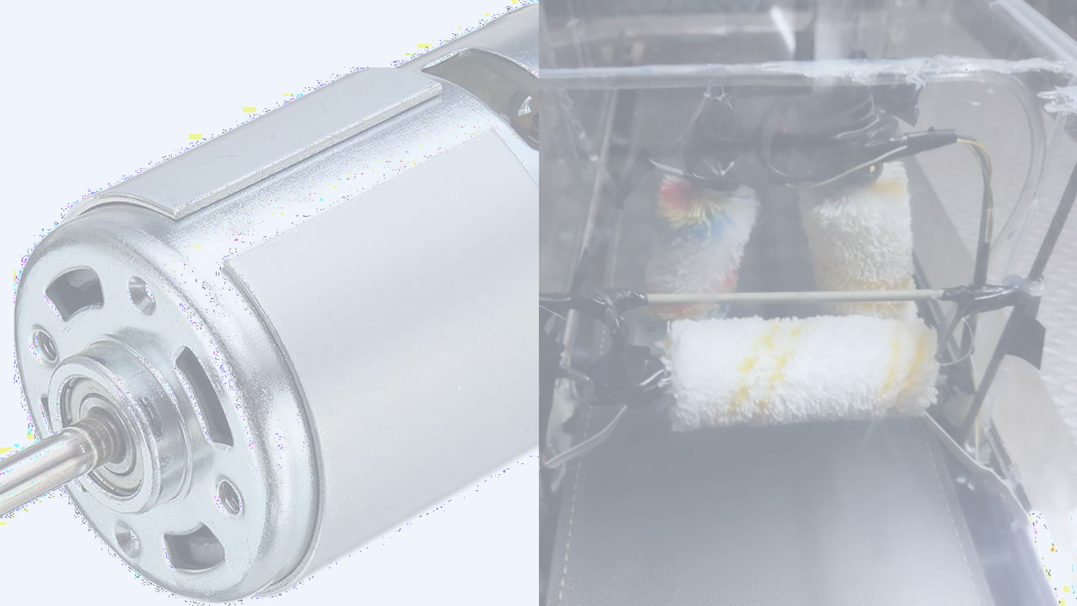
Components

Slide 12
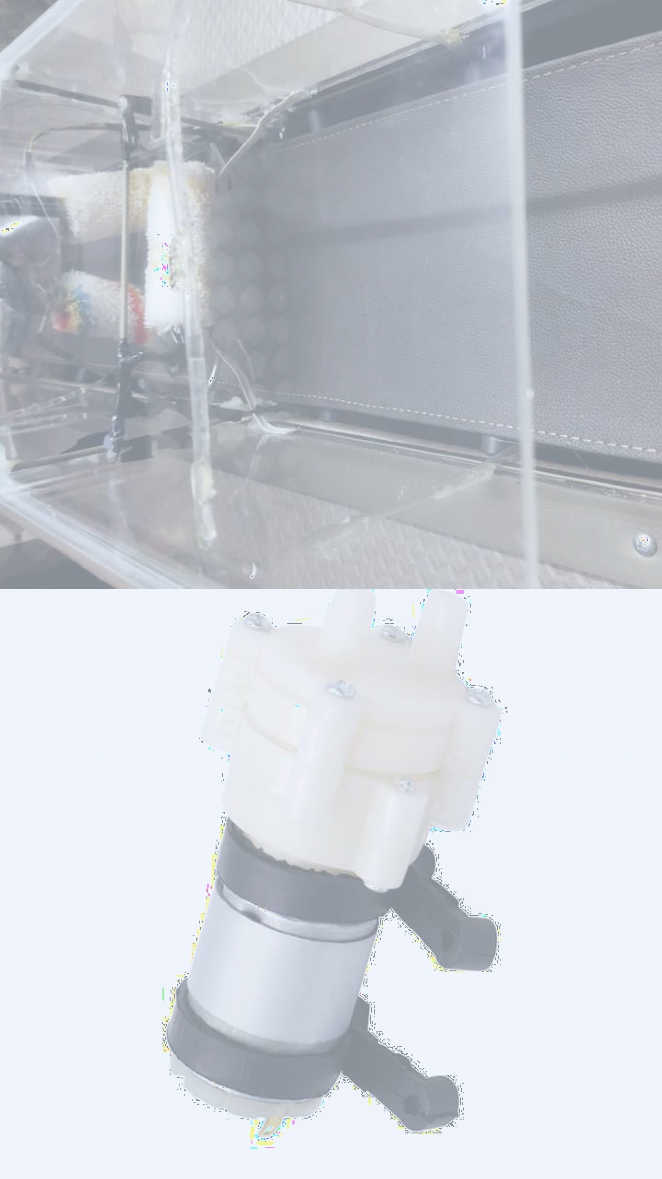
12
PRESENTATION TITLE
Components

Slide 13
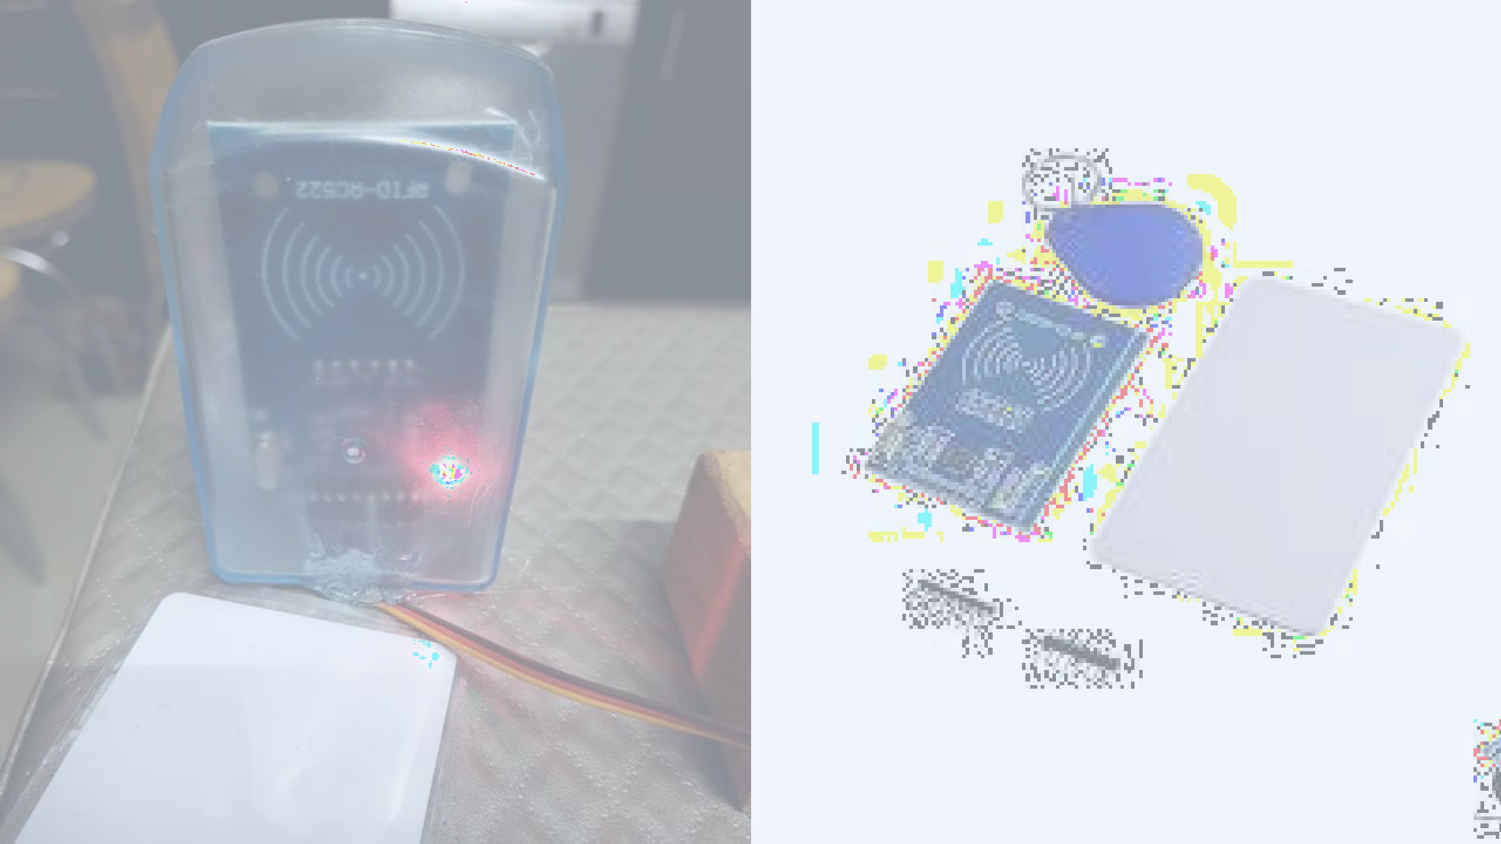
Components

Slide 14

14
PRESENTATION TITLE
Components

Slide 15
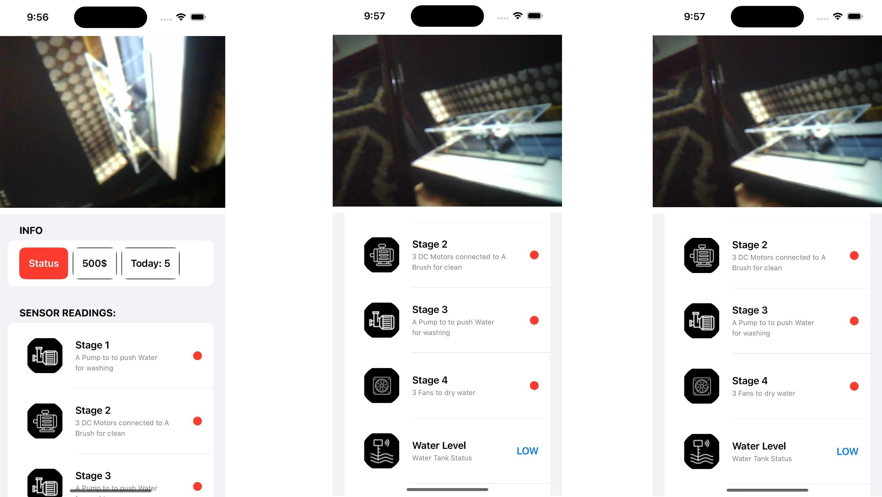
Admin Application

Slide 16
Future Work
PRESENTATION TITLE
1-MAKE A MOBILE
APPLICATION FOR THE USER.
2-ADD PAYMENT PROCESS
16

Slide 17
Thank you
Suhaib Darawshi Khaled Jeetan

