Slide 1


بسم الله الرحمن الرحيم
ANALYSIS OF THE WATER DITRUBUTION NETWORK AND DESING A STORM WATER COLLECTION NETWORK
Prepared by
Mohammed Saleh Zubide
Mohammed Khalid Jbara
Supervisor
Dr. Mohammad Al Masri

Slide 2
CONTENTS
Objectives
Methodology
Over view for the study area
Primary Evaluation for water sources
Analyses of the water network data
Scenarios and results
Design a storm water collection network
Results of the design

Slide 3
OBJECTIVES
Primary evaluation of the water sources for zeita town
Analyses of the water distribution network
Design a storm water collection network

Slide 4
METHODOLOGY
Visit the study area
Draw the network
Enter all data for the pipe
Determine the all data for the junction
Gather the information and data
Primary evaluation
Set up the monthly factor
Scenario for the demand
Results from(Steady state, EPS, in 25yr)
Design a Storm water network
Analyses of the Water Network
Prepare all data
Convert to raster
Draw catch basin,catchment,outfalls, conduits
Determine the intensity and runoff coefficient
Design

Slide 5
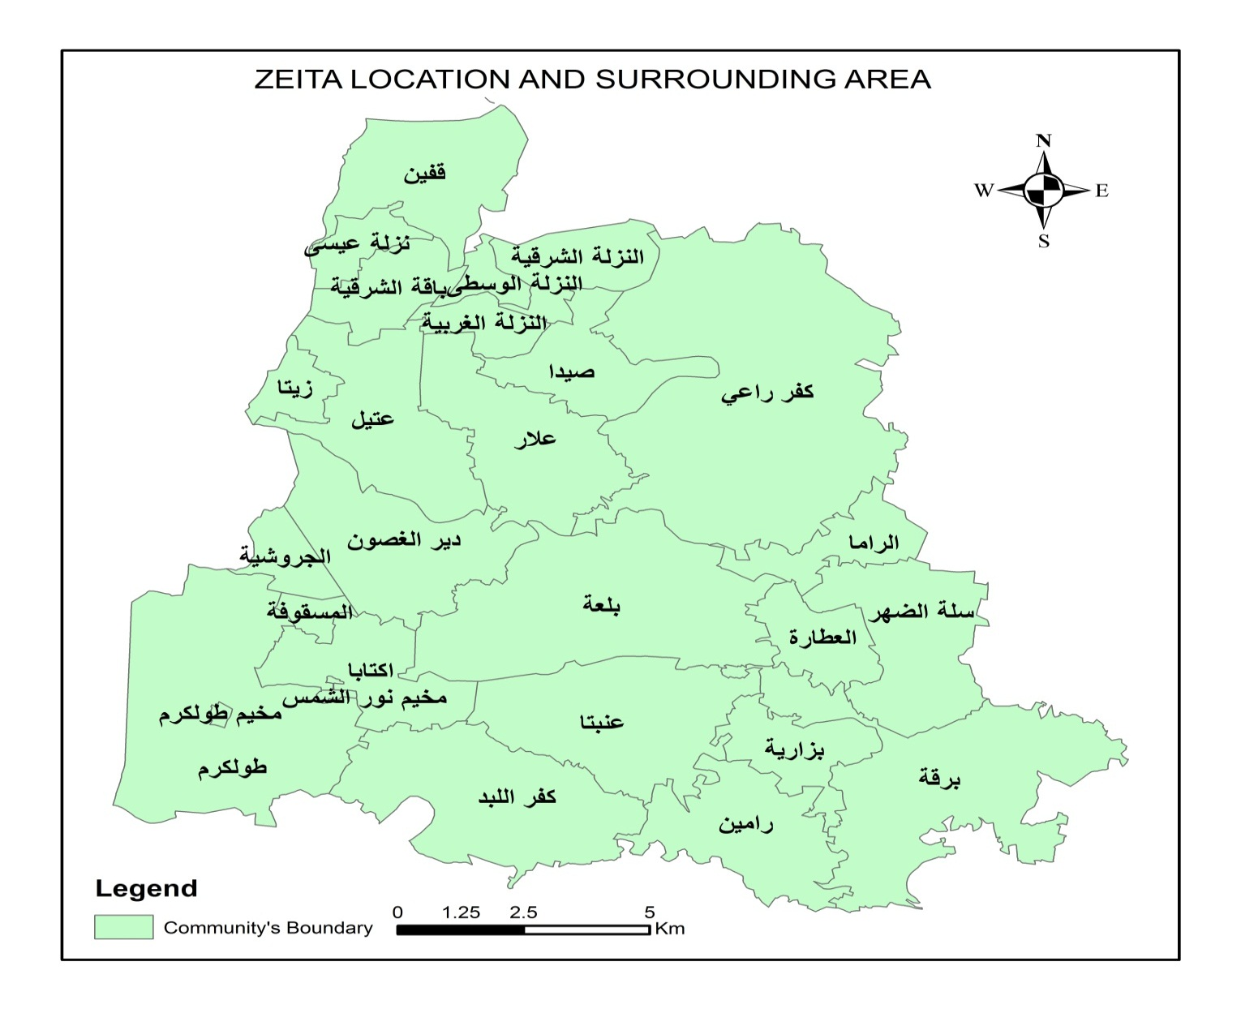
OVERVIEW FOR ZEITA VILLIGE
Location
خط الهدنة

Slide 6
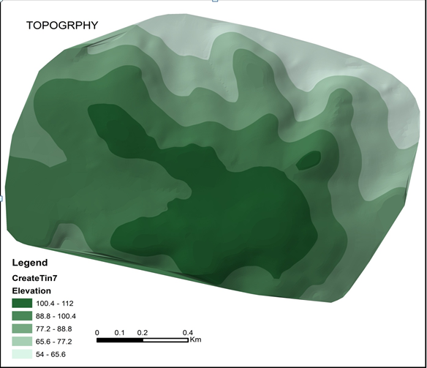

OVERVIEW FOR ZEITA VILLIGE
TOPOGRAPHY

Slide 7
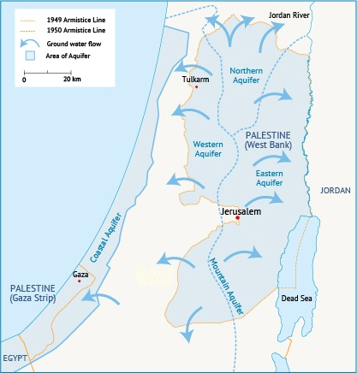
HYDROLOGICAL INFORMATION
Hydrological site:

Slide 8
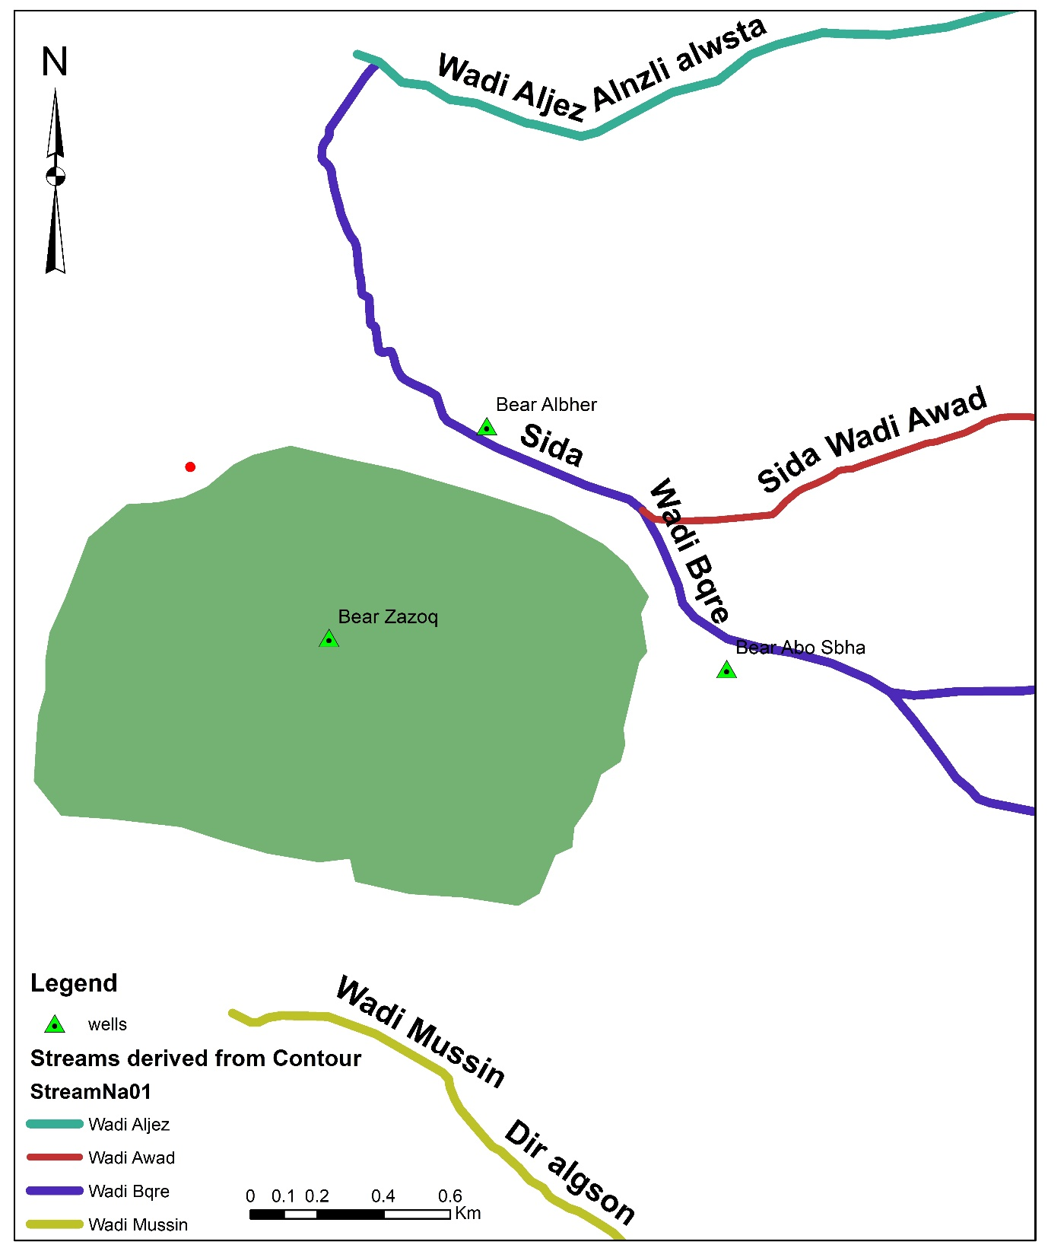
HYDROLOGICAL INFORMATION
Wadis:

Slide 9
HYDROLOGICAL INFORMATION
Annual rainfalls:
The annual average of the rainfall for the last 5 years is nearly 570mm.
Annual rainfall in Zeita town (mm)
2013 | 2014 | 2015 | 2016 | 2017
520 | 620 | 618 | 550 | 563

Slide 10
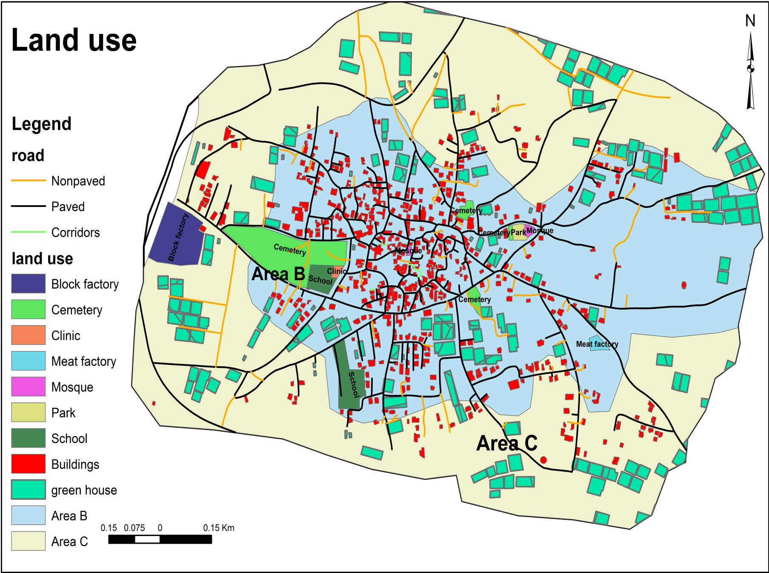
LAND USE

Slide 11
LAND USE
The table below show the approximated area for the land use field:
ID | Area( dunums ) | Percentage (%)
Total | 2000 | 100 %
Streets(Paved, Non Paved, Corridors). | 159 | 8%
Green house | 164 | 8.2%
Building | 90 | 4.5%
Cemetery | 33 | 1.65%
park | 1.5 | 0.075%
Block factory | 18 | 0.9%
Schools | 13 | 0.65%
The rest(olive trees or citrus fruits or farms.) | 1522 | 76.1%

Slide 12
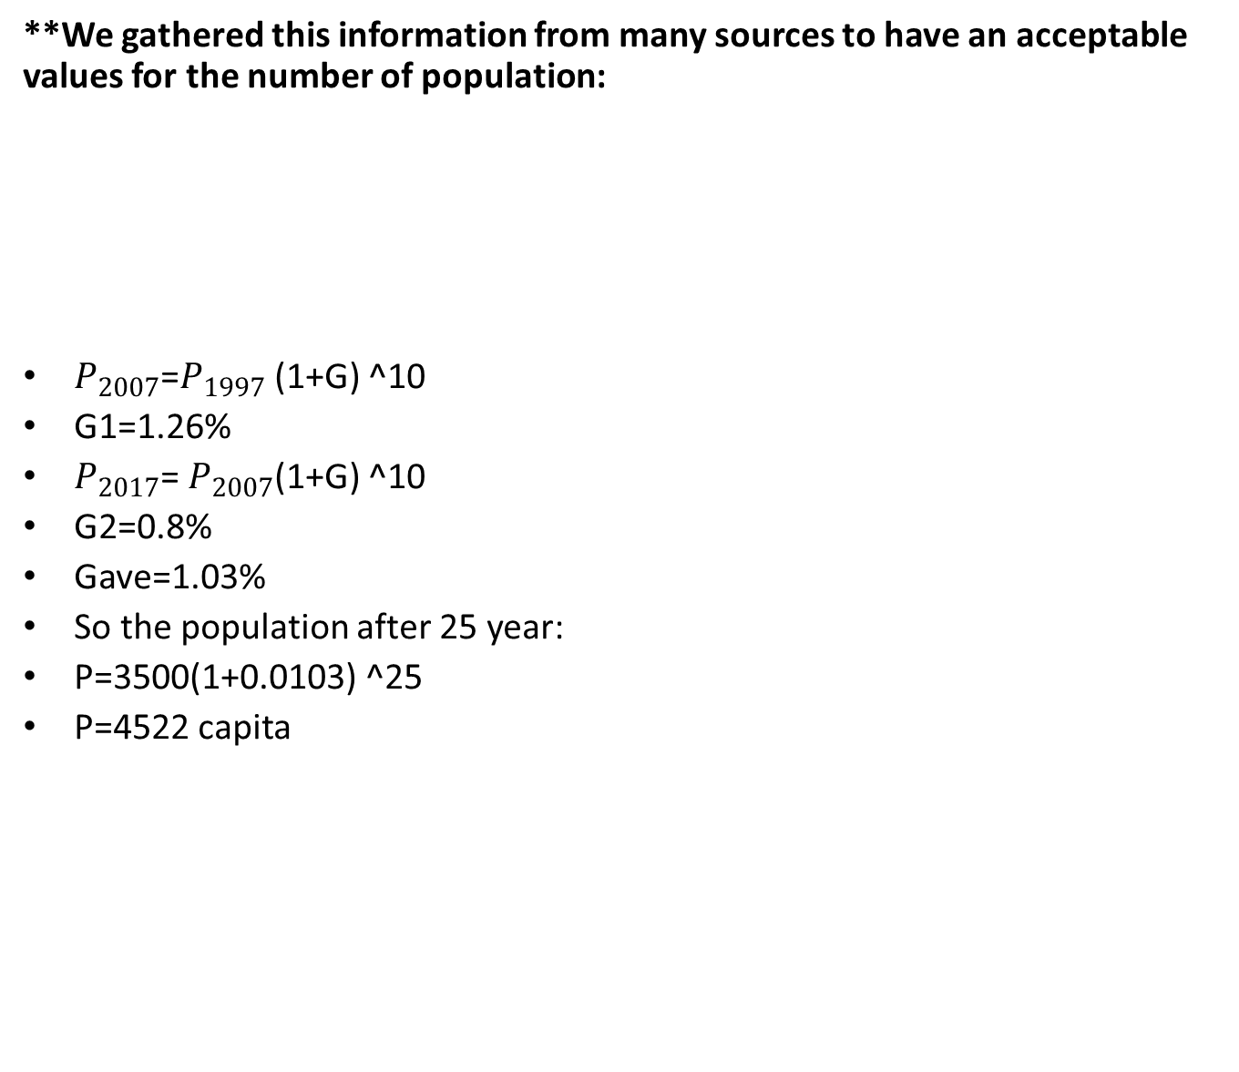
POPULATION
**We gathered this information from many sources to have an acceptable values for the number of population:
$P_{2007}$=$P_{1997}$ (1+G) ^10
G1=1.26%
$P_{2017}$= $P_{2007}$(1+G) ^10
G2=0.8%
Gave=1.03%
So the population after 25 year:
P=3500(1+0.0103) ^25
P=4522 capita
Year | population
1997 | 2852
2007 | 3231
2017 | 3500

Slide 13
PRIMARY EVALUATIONS OF WATER SOURCES
Wells:
Well ID | 15-19/010
Well Name | Bear Za’zoq
Ownerships | Owner by municipality
Managed by | The municipality
Location/ Community | X=155133.75327 Y=199129.31744
Wall depth | 260m
Pumping Capacity | 280 m3/hr.
Connect reservoirs | One reservoirs (500 m3)
Average Static water level below ground level [m] | 82 m
Average Operation water level below ground level [m] | 83 m
Average daily operation hours | 17hr

Slide 14
PRIMARY EVALUATIONS OF WATER SOURCES
*Number of population that get benefit from this well is (20600 capita) with Zeita.
*but Zeita only (3500 capita).
Water pumped for Zeita only(m3/month)
Emergency walls:
-Ba’ar Albhr [80m3/hr.]
-Ba’ar Abo Sabha [70-100m3/hr.]
Year | Jan | Feb | Mar | Apr | May | Jun | Jul | Aug | Sep | Oct | Nov | Dec
2012 |  | 16720 | 18920 | 27000 | 35500 | 39900 | 40860 | 42580 | 38040 | 33401 | 28400 | 24500
2013 | 12820 | 17500 | 17950 | 26500 | 34400 | 40900 | 41900 | 44200 | 36020 | 34400 | 30750 | 28000
2014 | 12800 | 16800 | 18400 | 27800 | 36800 | 41700 | 43800 | 45400 | 35800 | 37600 | 31500 | 30004

Slide 15
PRIMARY EVALUATIONS OF WATER SOURCES

Slide 16
PRIMARY EVALUATIONS OF WATER SOURCES
**Domestic use:
Unite load for the domestic use:
Av consumption for three year in(L/day) =499023L/day
Pop=3500 capita
Unite load=140L/c-day
Year | Jan | Feb | Mar | Apr | May | Jun | Jul | Aug | Sep | Oct | Nov | Dec | Av/month
2012 |  | 7040 | 8000 | 10350 | 20740 | 17000 | 17060 | 19400 | 17040 | 14050 | 14000 | 10403 | 12923.58
2013 | 4900 | 8500 | 8700 | 13000 | 20111 | 21005 | 21950 | 22887 | 18400 | 17200 | 16200 | 14060 | 15576.08
2014 | 4800 | 8004 | 8900 | 13090 | 21450 | 22450 | 23750 | 24444 | 20009 | 19999 | 15456 | 14597 | 16412.42

Slide 17
PRIMARY EVALUATIONS OF WATER SOURCES

Slide 18
PRIMARY EVALUATIONS
**Agricultural use:
Unite load for the :
Av consumption for three year in(m3/day) =424m3/day
Total area for green house in the demand area= 158172.61m2
Unite load=0.0027m3/m2-day➔2.7m3/dunum-day .
Year | Jan | Feb | Mar | Apr | May | Jun | Jul | Aug | Sep | Oct | Nov | Dec | Av/month
2012 |  | 6060 | 7950 | 14500 | 12005 | 18090 | 20400 | 20860 | 19900 | 16040 | 12060 | 12400 | 13355.42
2013 | 6040 | 7400 | 7700 | 14450 | 11890 | 16990 | 17450 | 18940 | 15560 | 15640 | 12233 | 12023 | 12523.00
2014 | 5950 | 7020 | 7650 | 12920 | 12480 | 14897 | 16997 | 18997 | 13010 | 15657 | 13998 | 13670 | 12274.67

Slide 19
PRIMARY EVALUATIONS

Slide 20
PRIMARY EVALUATIONS
Largest consumers
Name | Type of usage | Quantity(m3/month)
Block Al Ghanm | Block factory | 800
Olive press Abo Jzer | Olive press | 150
Zeita food company | Frozen meat | 150
Arboretum | Green house | 350
 |  | 1450

Slide 21
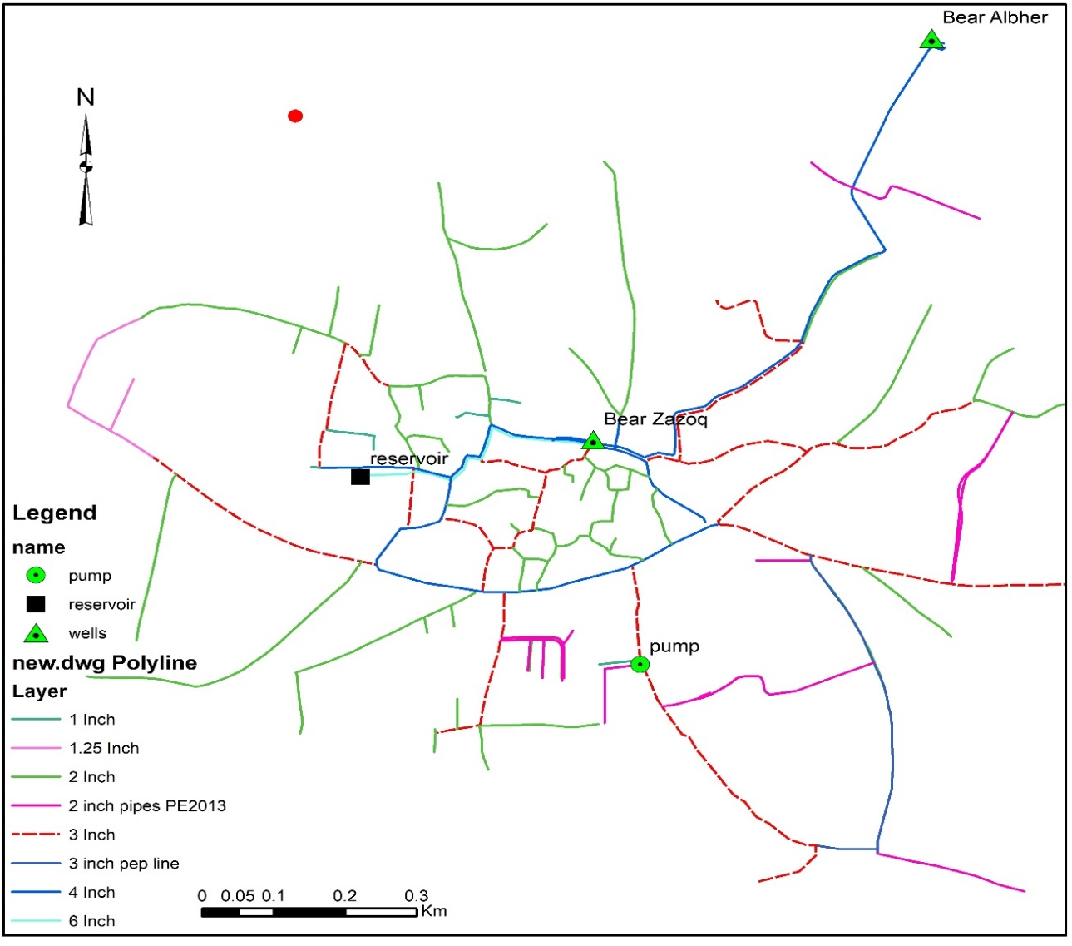
NETWORK DATA
Pipes data:

Slide 22
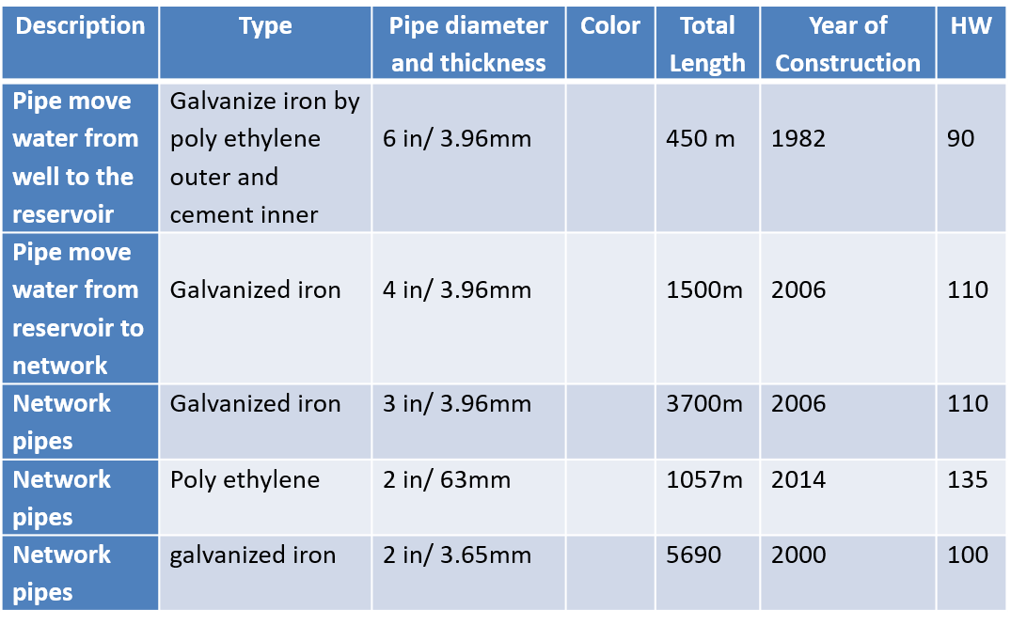
NETWORK DATA
Note: Hazen William coefficient for the material =Original Hazen William – (10) for every 10year.

Slide 23
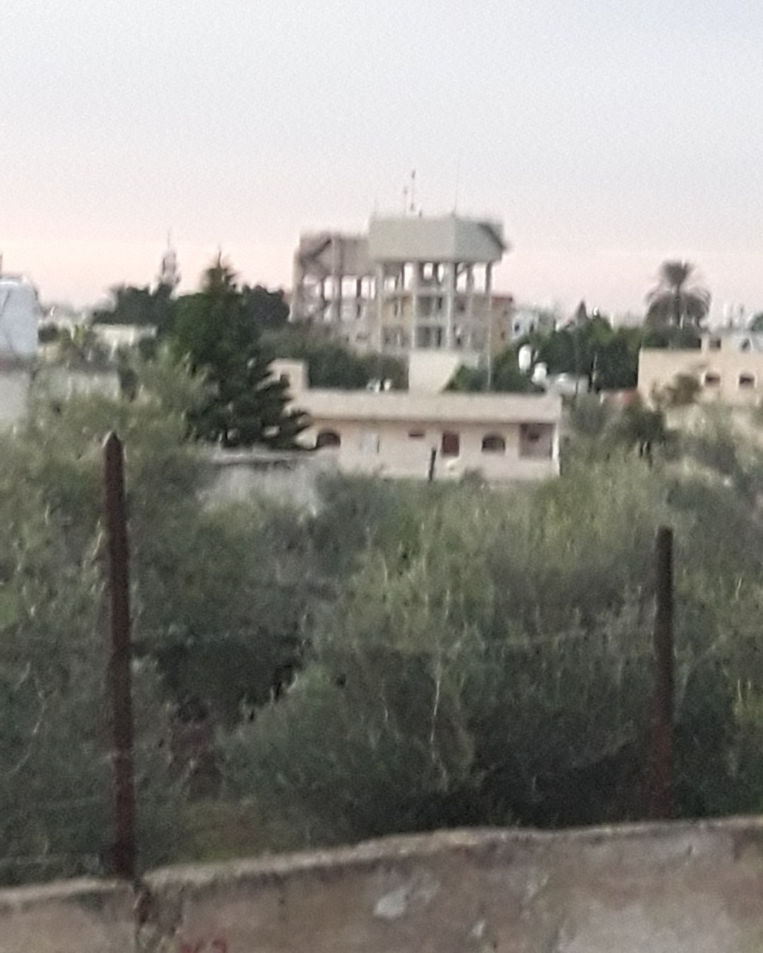
NETWORK DATA
RESERVOIR DATA

Slide 24
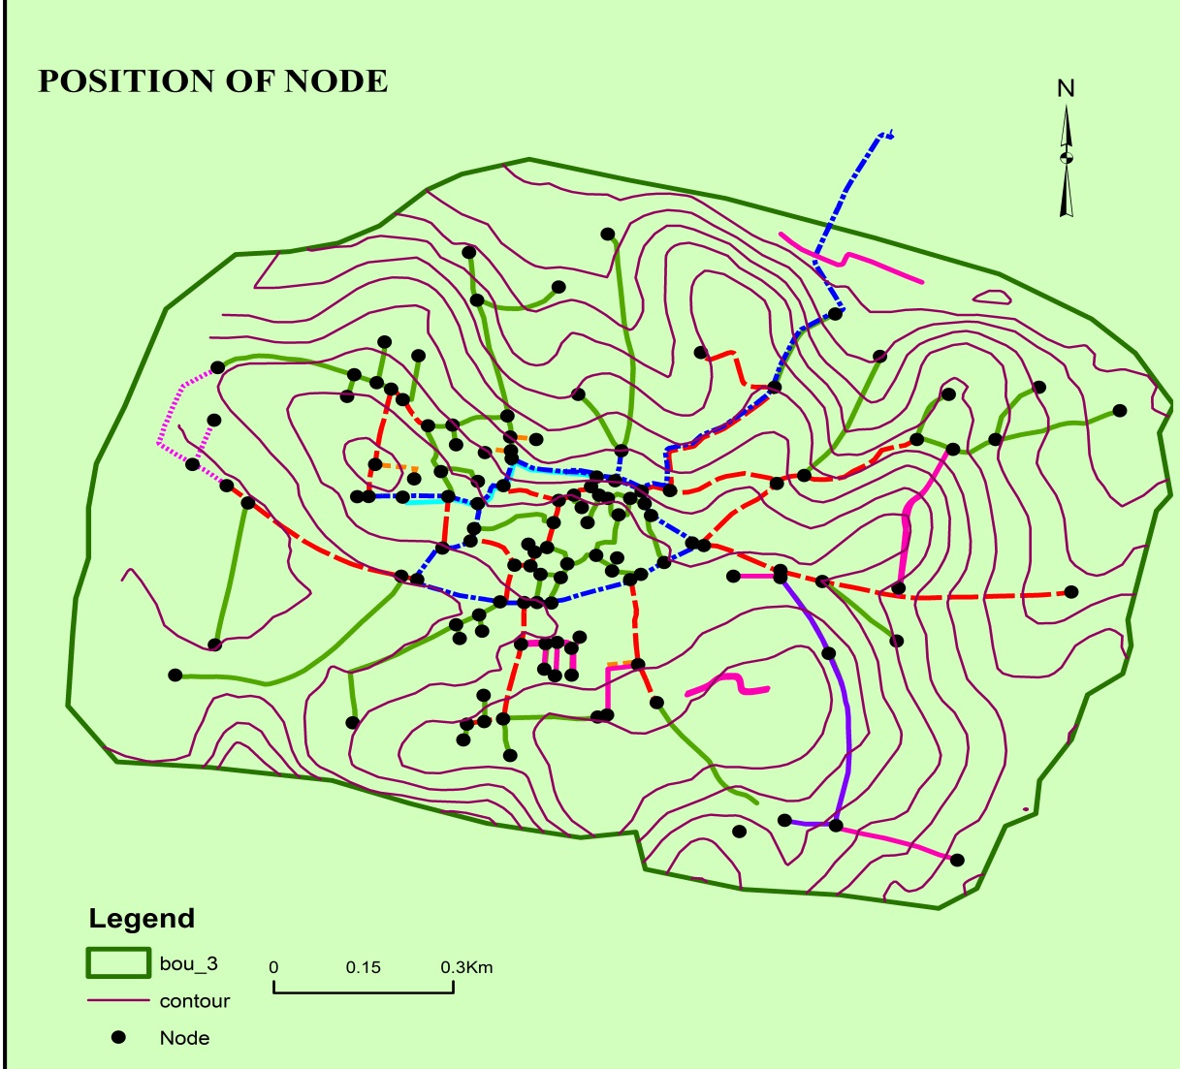
NETWORK DATA
NODE DATA→POSTION OF NODE :

Slide 25
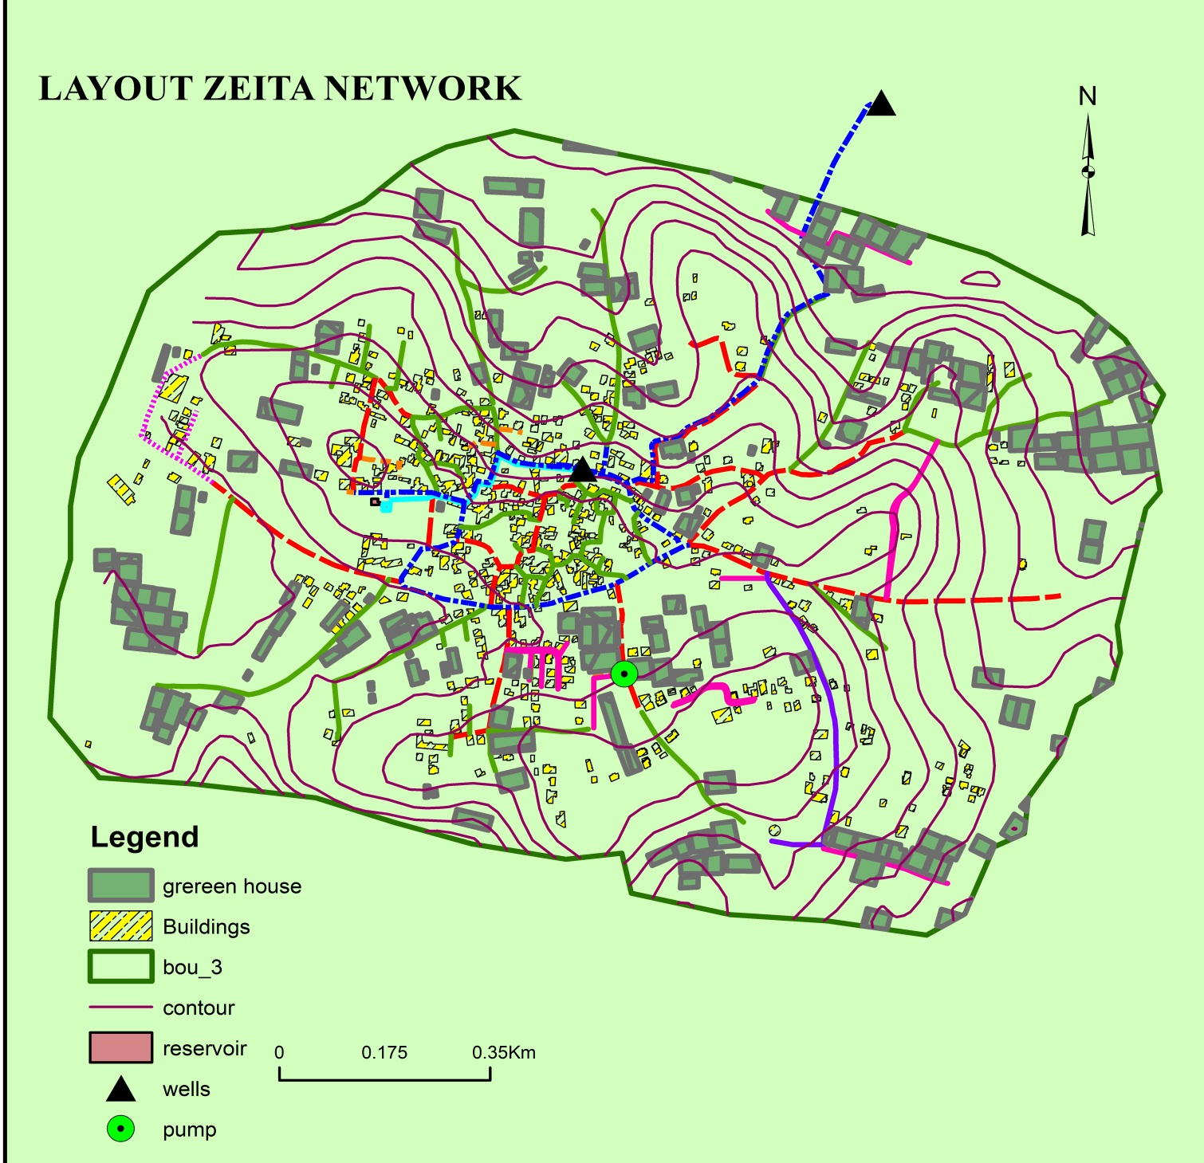
NETWORK DATA
Demand:

Slide 26
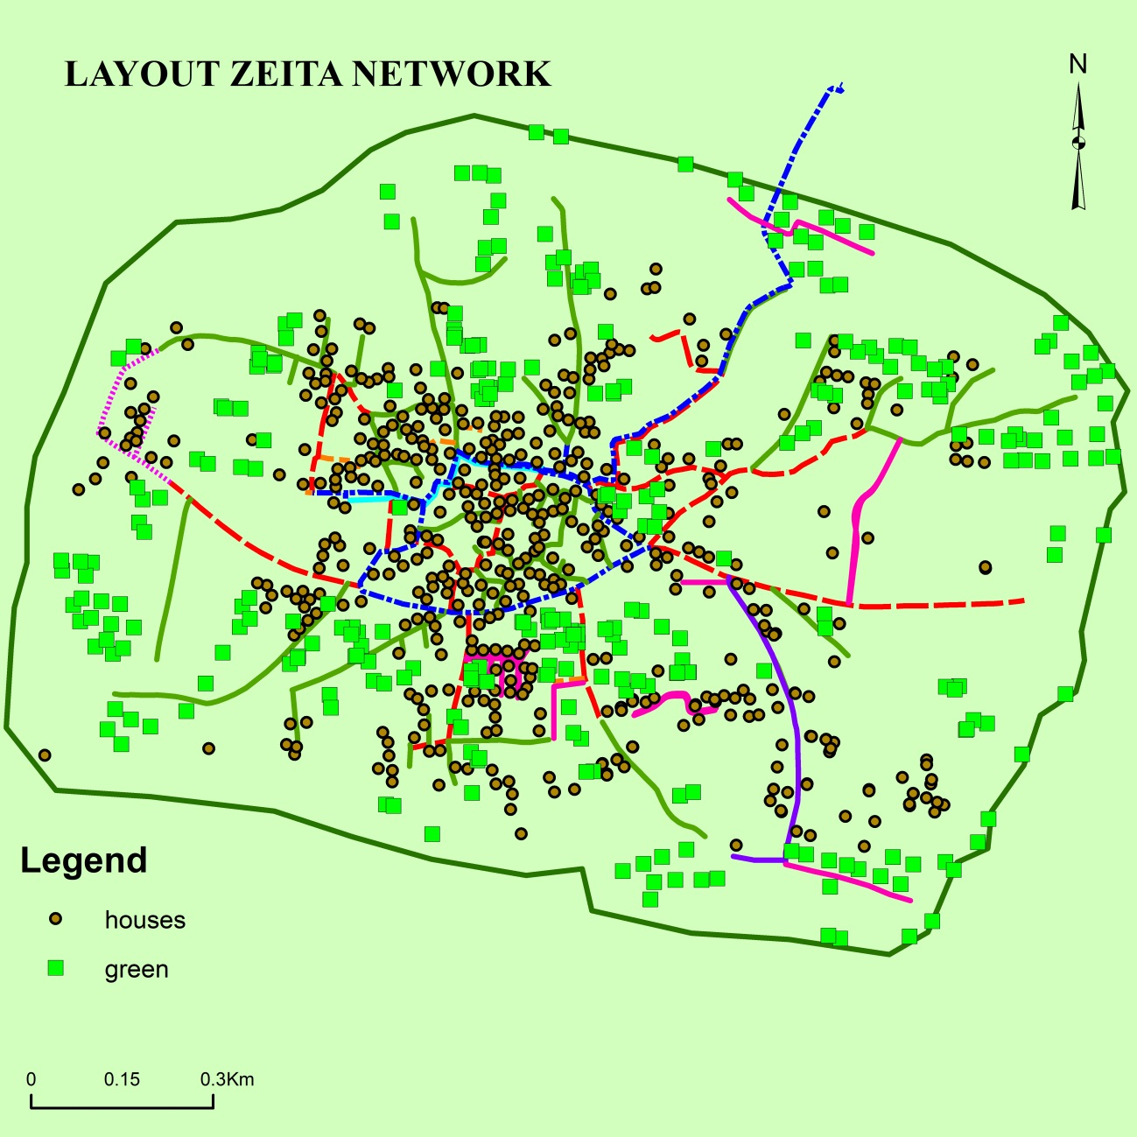
NETWORK DATAu7y
Convert building and green house as a point shape file:

Slide 27
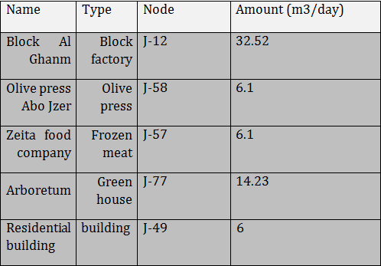
NETWORK DATA
Largest consumers and its nods

Slide 28
MONTHLY FACTORED
 | Jan | Feb | Mar | Apr | May | Jun | Jul | Aug | Sep | Oct | Nov | Dec
M3/HR | 15.06 | 20.38 | 22.64 | 36.25 | 45.68 | 51.13 | 54.45 | 58.11 | 48.11 | 45.64 | 38.86 | 35.72
38.9 | 0.39 | 0.52 | 0.58 | 0.93 | 1.17 | 1.31 | 1.40 | 1.49 | 1.24 | 1.17 | 1.00 | 0.92

Slide 29
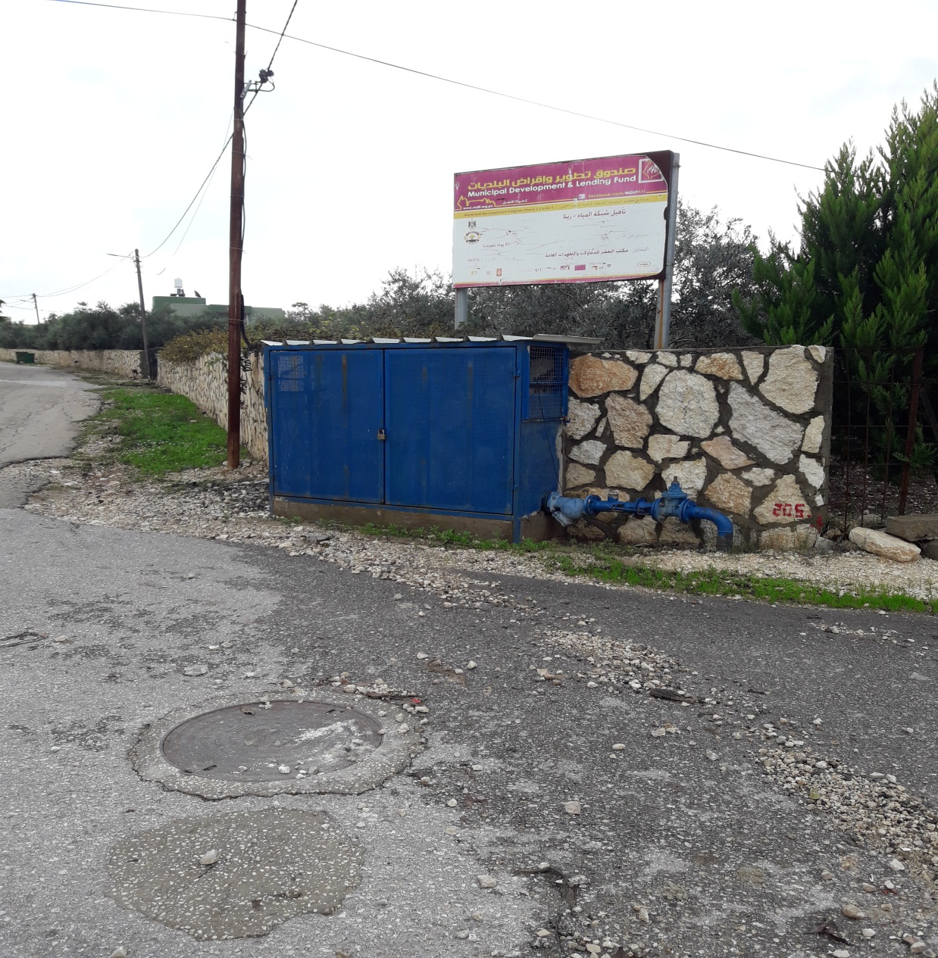
PUMP CHARACTERISTICS
**Pump properties:
Type: Poster
Company: Lenovo
Flow rate design=27
m3/hr. after 25 year
Static head =30m
Characteristic carve:

Slide 30
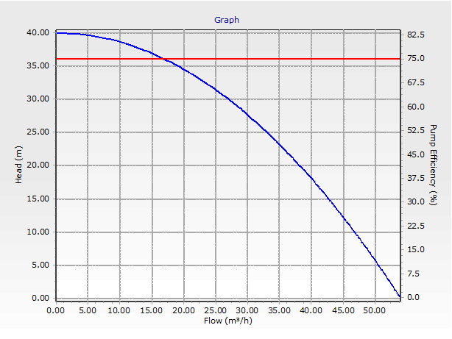
PUMP CHARACTERISTICS

Slide 31
SCENARIO AND RESULTS
1-Analyze the network for the current situation Average condition:
Pressure:

Slide 32
SCENARIO AND RESULTS
Velocities :

Slide 33
SCENARIO AND RESULTS
2-Analyze the network with max monthly factor pulse the demand for the press olive as in table (9): 6.1m3/day at junction 58:
Pressure:

Slide 34
SCENARIO AND RESULTS
Velocities :

Slide 35
SCENARIO AND RESULTS
3-Analyze the network based on the maximum demand on the future after 25 year:
Pressure:

Slide 36
SCENARIO AND RESULTS
Velocities :

Slide 37
DESIGN OF STORM WATER
COLLECTION NETWORK
Rational method
Runoff coefficient ( C)
Area(A)
Intensity(I)
Time of concentration(tc)
Return period(R)
Rational method :

Slide 38
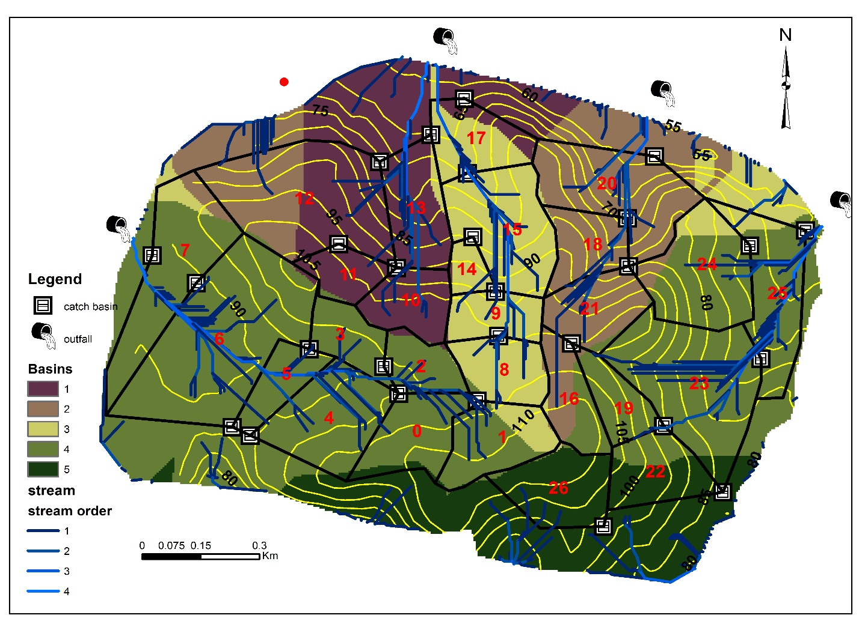
DESIGN OF STORM WATER
COLLECTION NETWORK

Slide 39
DESIGN OF STORM WATER
COLLECTION NETWORK
Runoff coefficient(C):
        C= Cr × Pr + Cg × Pg +Cb × Pb + Cs × Ps
Where:
C: Runoff coefficient
P: Percentage
Cr: runoff coefficient of road=0.85
Cg: runoff coefficient of greenhouse=0.88
Cb: runoff coefficient of building=0.75
Cs: runoff coefficient of soil=0.25

Slide 40
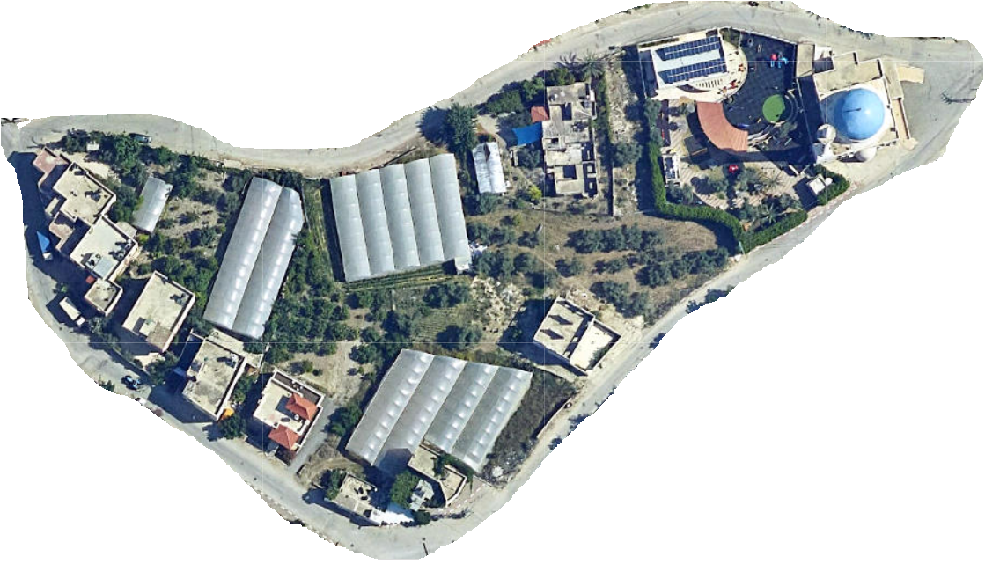
DESIGN OF STORM WATER
COLLECTION NETWORK
Runoff coefficient(C):

Slide 41
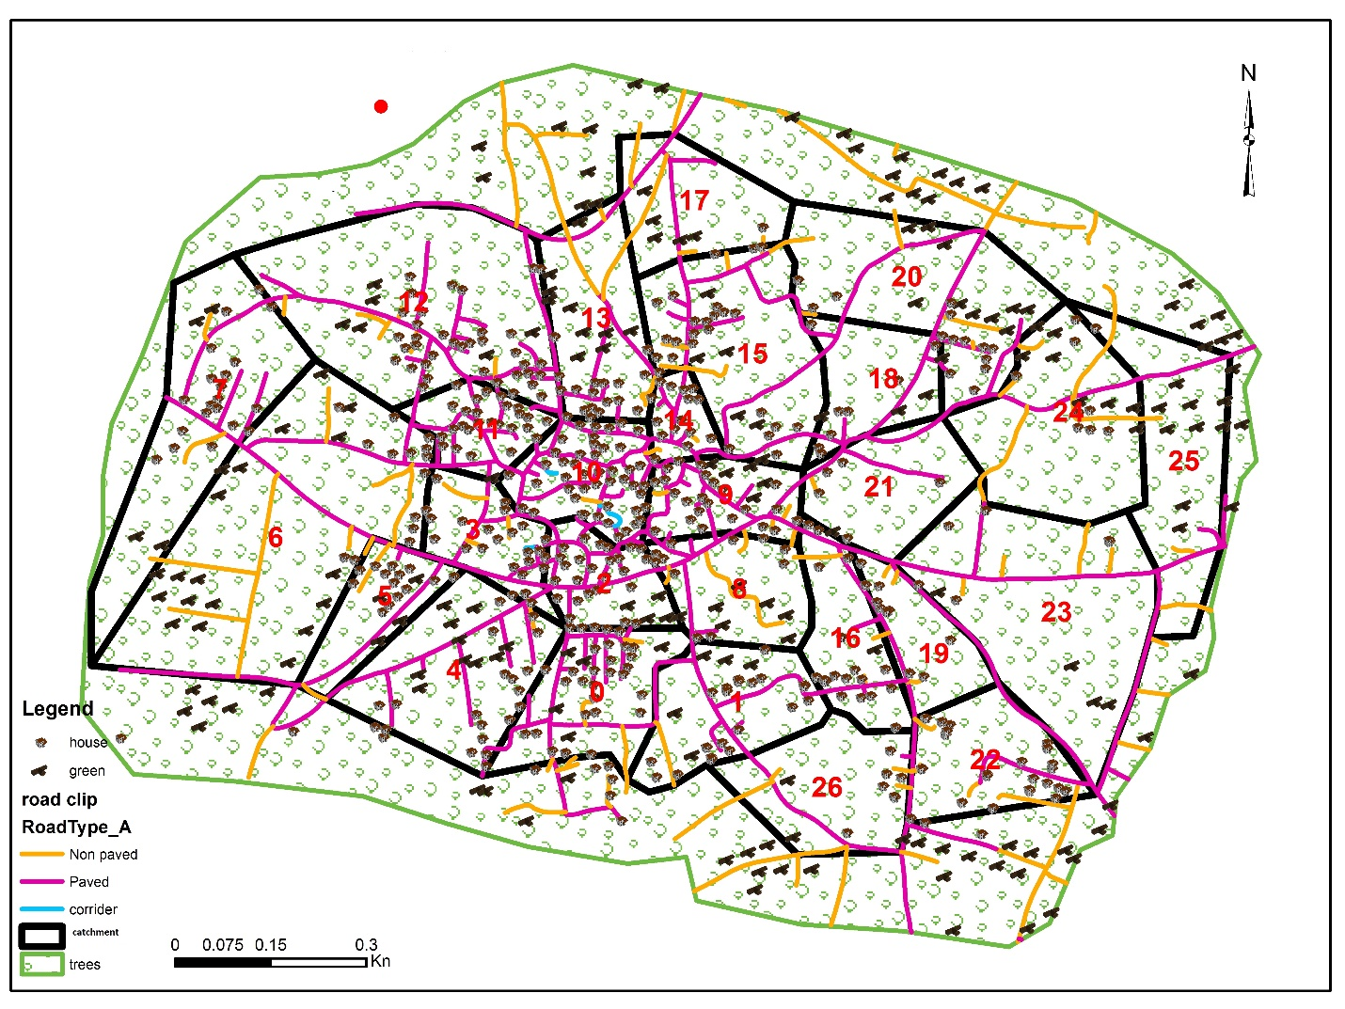
DESIGN OF STORM WATER
COLLECTION NETWORK

Slide 42
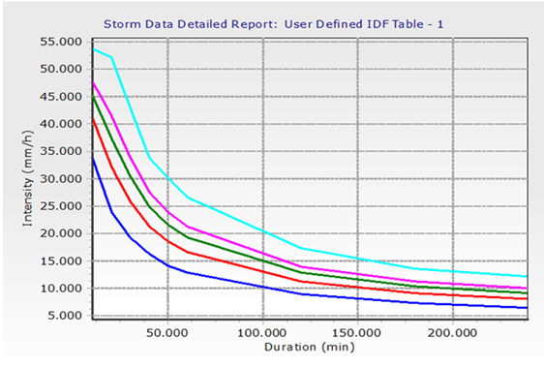

DESIGN OF STORM WATER
COLLECTION NETWORK
Intensity(I):

Slide 43
DESIGN OF STORM WATER
COLLECTION NETWORK
Intensity(I):
Intensity(I):
Time of concentration(C)
slope
Over land flow length
Return period

Slide 44

DESIGN OF STORM WATER
COLLECTION NETWORK
Time of concentration:
Return period= 5 years
$$tc=\frac{1.8\left(1.1−C\right)L^{0.5}}{S^{0.333}}$$

Slide 45
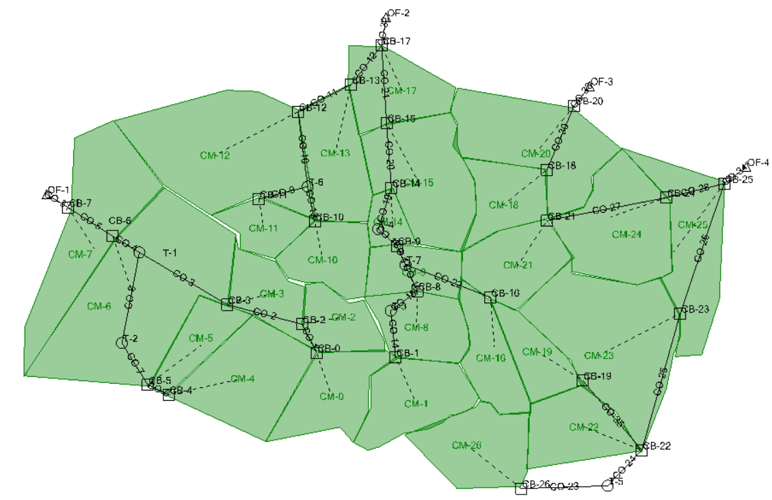
DESIGN OF STORM WATER
COLLECTION NETWORK

Slide 46
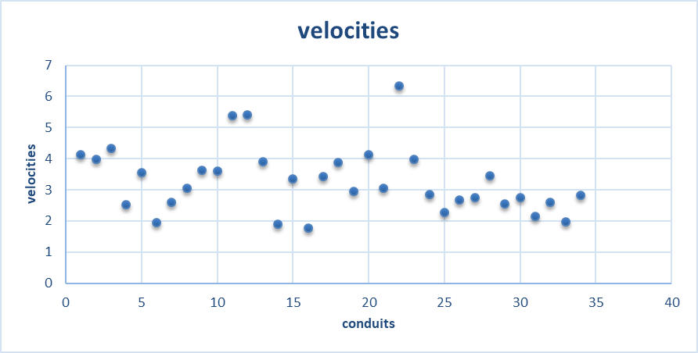
DESIGN OF STORM WATER
COLLECTION NETWORK
Result :

Slide 47
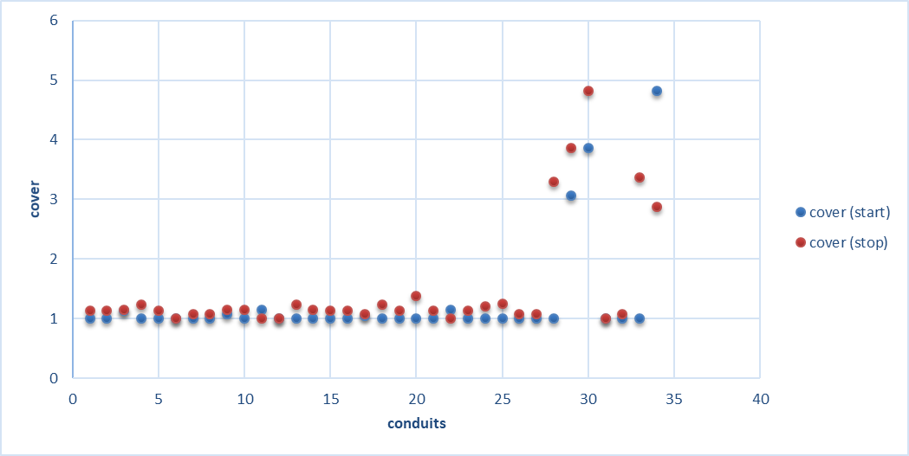
DESIGN OF STORM WATER
COLLECTION NETWORK
Result :

Slide 48
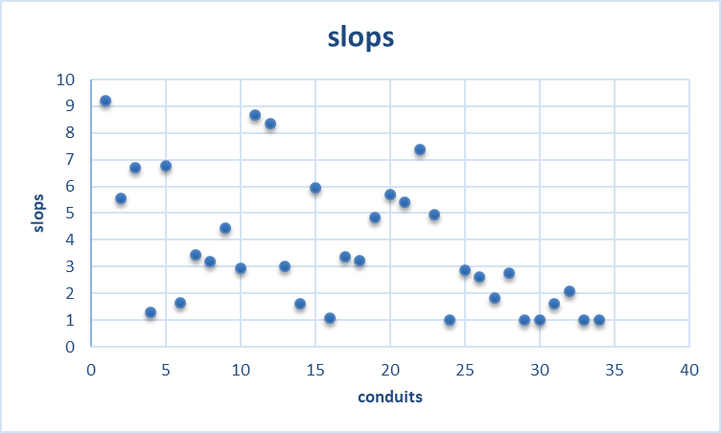
DESIGN OF STORM WATER
COLLECTION NETWORK
Result :

Slide 49
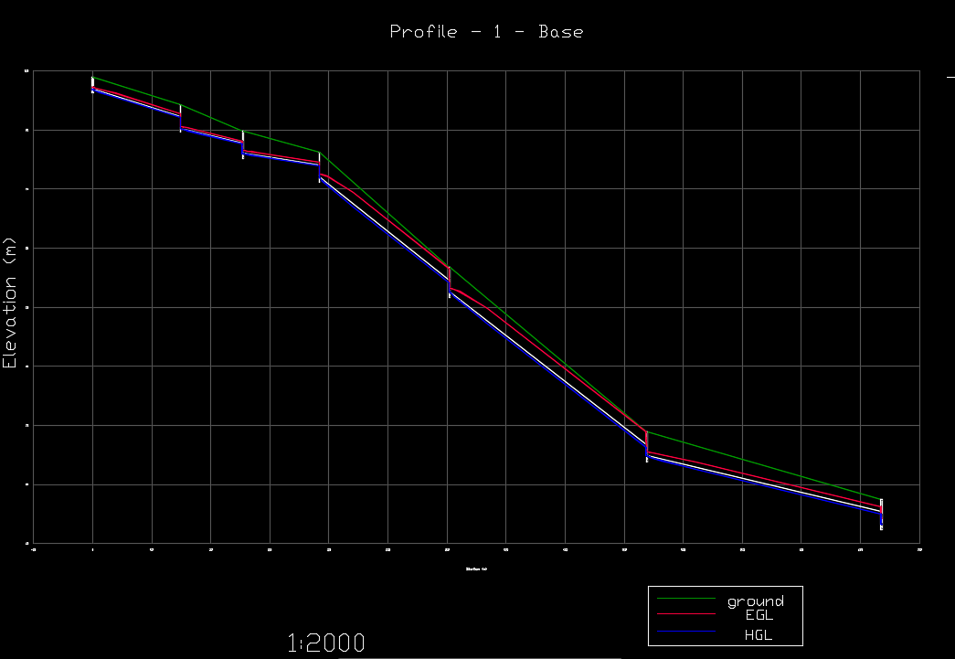
DESIGN OF STORM WATER
COLLECTION NETWORK
Result :

Slide 50
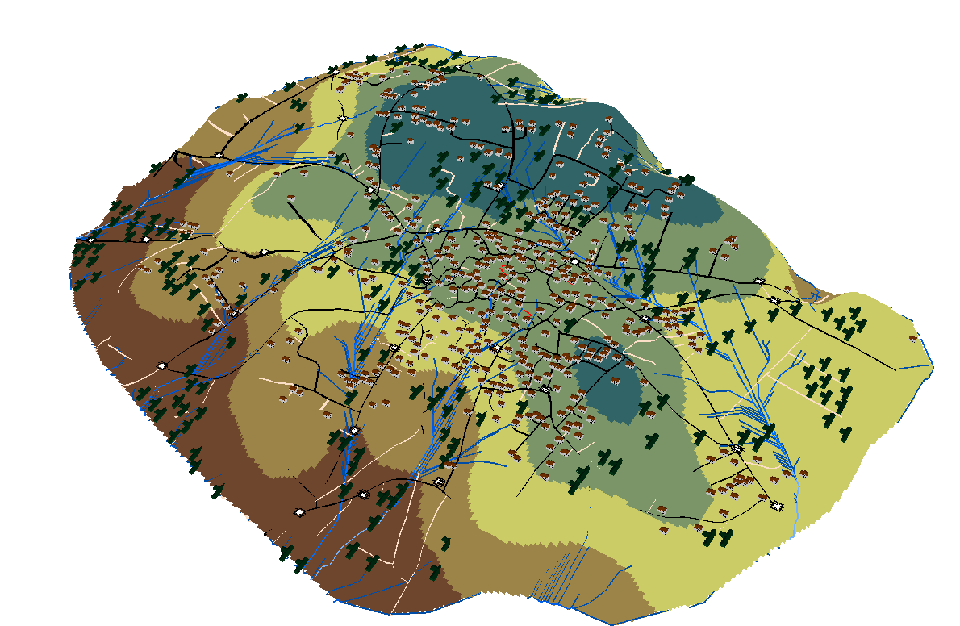
DESIGN OF STORM WATER
COLLECTION NETWORK

