Slide 1
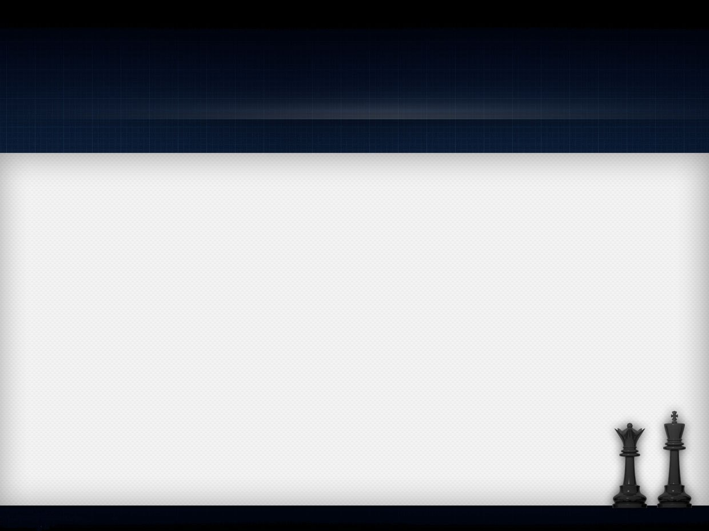
CHESS GAME
Prepared by :
Walaa Maqdasawi
Razan Jararah
Supervised by:
Dr. Aladdin Masri

Slide 2

OUTLINE:
General overview.
Pieces and valid moves.
Interface Design.
Human VS. human.
Human VS. android.

Slide 3
GENERAL OVERVIEW:
Chess is an ancient game.
Mental sport, challenge and entertainment.
Still suited for people of today.

Slide 4
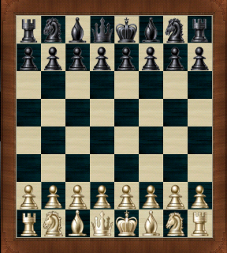
GENERAL OVERVIEW:
Two-player game.
Square board with 8 rows and 8 columns hence, 64 squares.
16 pieces for each player.

Slide 5
GENERAL OVERVIEW:
White player goes first then players alternate turns.
The goal is to capture your opponent’s king, in the game this is known as checkmate.
Checkmate means the end of the game.

Slide 6
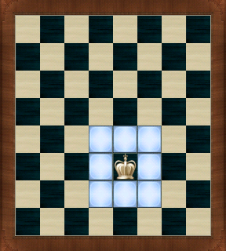
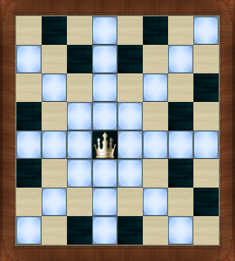
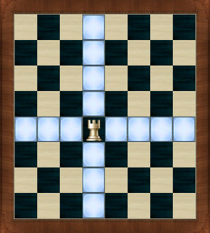
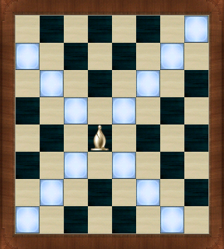
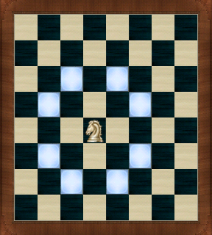
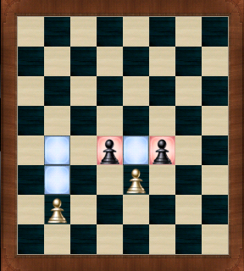
PIECES AND VALID MOVES:
King
Queen
Rook
Bishop
Knight
pawns

Slide 7
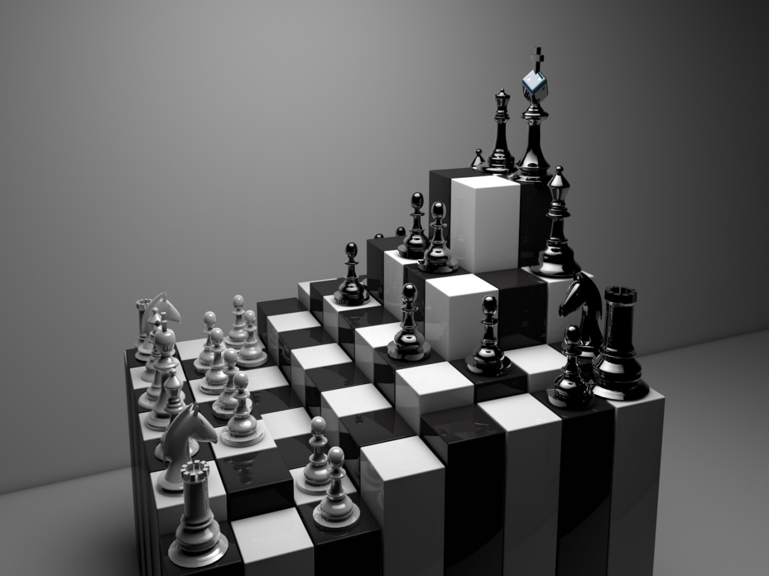
OUR PROJECT

Slide 8
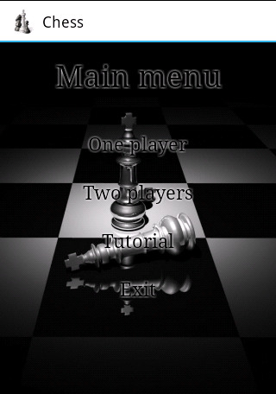
DESIGN:
Three parts:
  Tutorial.
  Human VS. human.
  Human VS. machine.
Game with or without hints.

Slide 9
Tutorial:
Designed to get you started.
explains roles and basics of chess game:
  How to play.
  Board and initial position.
  Pieces and valid moves.

Slide 10
INTERFACE:
We built the board using an array of 64 buttons .
Buttons change their background according to the occupying piece.
We tried to get the interface as attractive as possible.

Slide 11
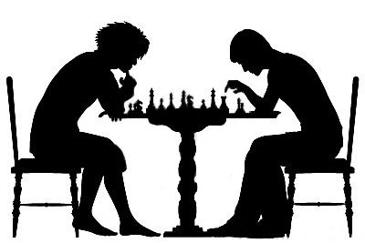
HUMAN VS. HUMAN

Slide 12
HOW TO PLAY:
White player goes first.
Click the piece you want to move.
You can change the selected piece as many times as you want.
Click the square you want to move the piece to.

Slide 13
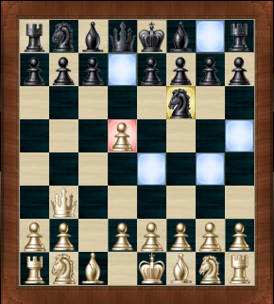
HOW TO PLAY:
If you had chosen to show hints, our game will show you all valid moves.

Slide 14
MOVE RESTRICTIONS:
Make moves according to piece’s valid moves.
It is illegal to move into a square occupied by one of your pieces.
It is illegal to make a move that causes check for your king.

Slide 15
MOVE RESTRICTIONS:
If you enter a square held by your opponent the occupying piece is removed from the board.
A checkmate occurs when the king is trapped by an enemy piece with no available escape route.

Slide 16
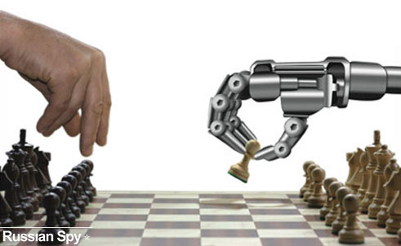
HUMAN VS. MACHINE

Slide 17
OVERVIEW:
Artificial intelligence(AI) techniques.
Mini-max and alpha-beta algorithms.
Evaluation function.
Chess search tree.

Slide 18
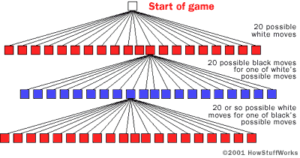
CHESS SEARCH TREE:

Slide 19
CHESS SEARCH TREE:
Unfortunately ☹ the whole game tree size is tremendously huge, for chess 10^40
Solution:
tree with some depth.

Slide 20
MINIMAX ALGORITHM
A player want to make predictions about which future states will be reached.
maximize our score and minimize opponent’s score in order to increase my chance of winning.

Slide 21
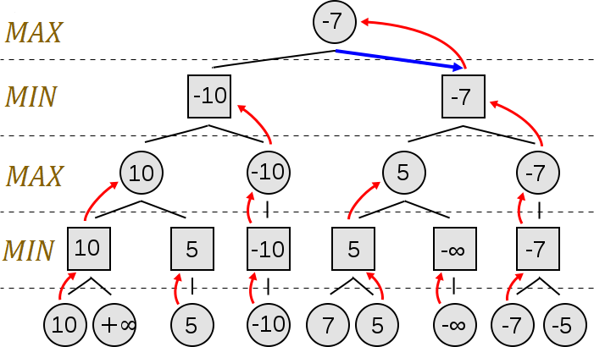
MINIMAX ALGORITHM

Slide 22
MINIMAX ALGORITHM
Using minimax we have to search the whole tree.
This may take too long time to find the best move.
So, we used alpha-beta.

Slide 23
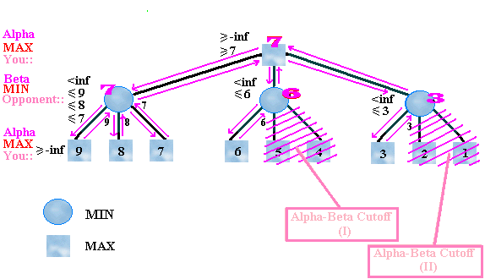
ALPHA-BETA:
Alpha-beta reduces the visited node so decrease the search time.

Slide 24
EVALUATION FUNCTION:
Used to determine the goodness of the board .
many features :
  Material
  Mobility
  Piece square tables
  Threat
  Attack

Slide 25
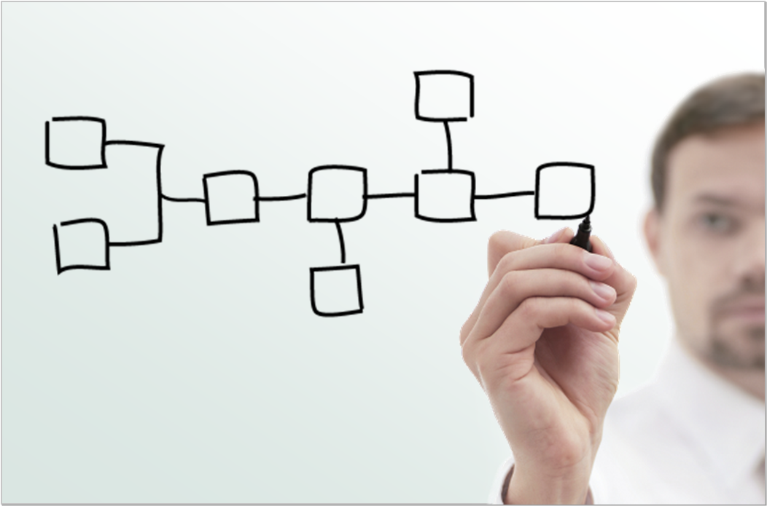
SOME SCENARIOS:

Slide 26
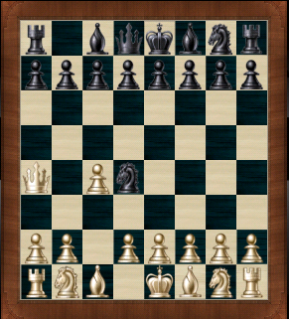
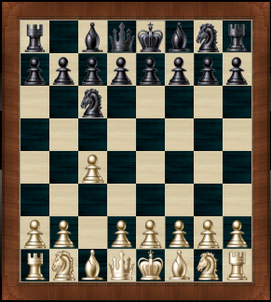
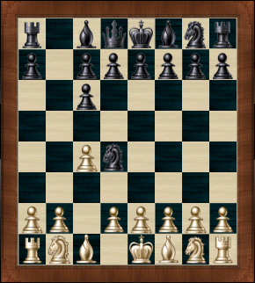
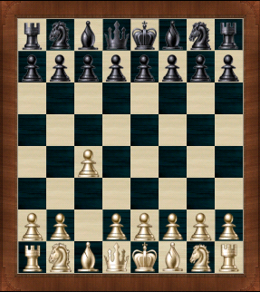
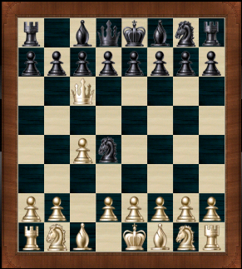
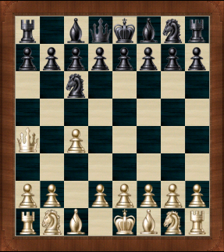
SCENARIO 1 :

Slide 27
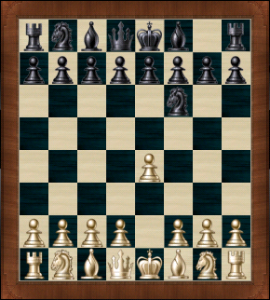
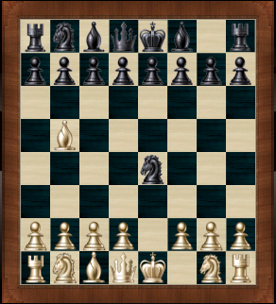
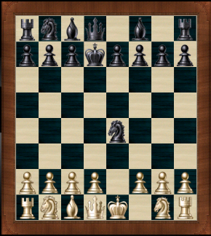
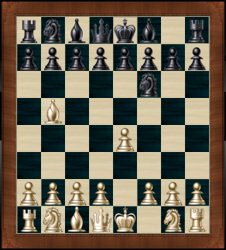
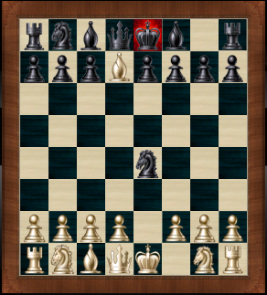
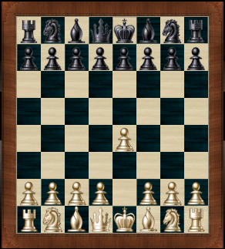
SCENARIO 2 :

Slide 28
