Slide 1




JAWLA
Team : Lama Qawareeq
& Wafaa Hamed
Supervised by : Dr.Abdallah Rashed

Slide 2



CONTENT
01
INTRODUCTION
02
OBJECTIVES
03
FEATURES
04
TOOLS USED
05
FUTURE WORK

Slide 3


WHAT IS THE PROBLEM ?
Tourists face many challenges during their travel, such as finding suitable accommodation, moving around easily, and exploring important tourist places. Therefore, the “jawla” application came to provide a comprehensive solution, as it helps tourists explore tourist attractions, book hotels, and organize transportation in a smart way via GPS, providing a smooth and safe tourist experience.

Slide 4





GOALS AND OBJECTIVES
Facilitating accommodation reservations
Organizing transportation
Providing an integrated platform
enabling tourists to explore the most important tourist attractions and provide information about them.
Requesting a taxi based on the user’s location, using a smart system.
displaying nearby hotels with the ability to book directly and communicate with the hotel.

Slide 5

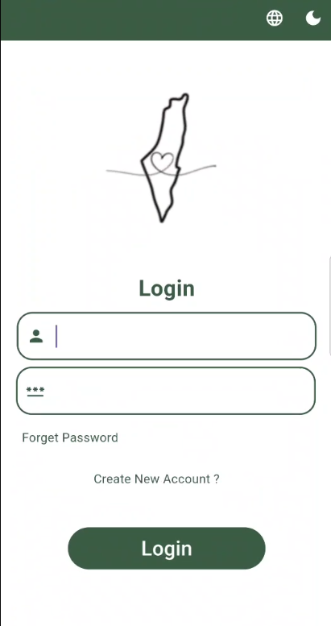
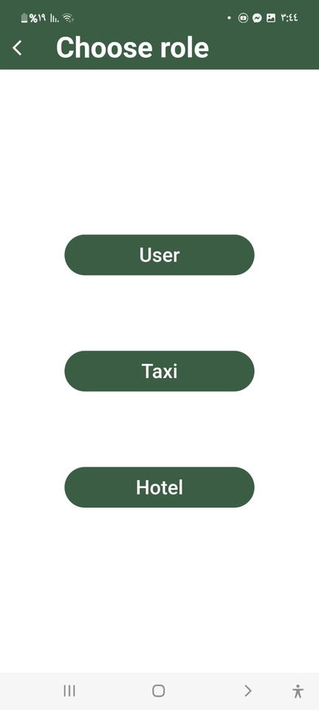
LOGIN PAGE

Slide 6
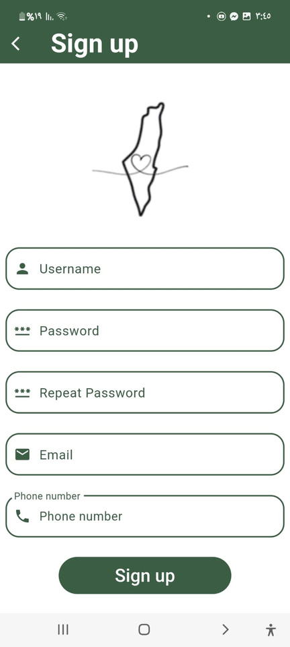
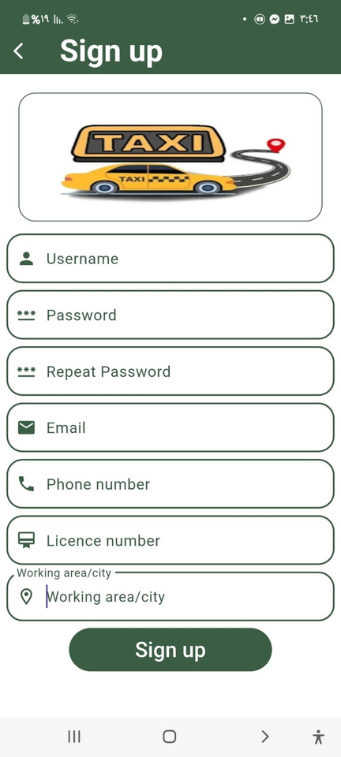
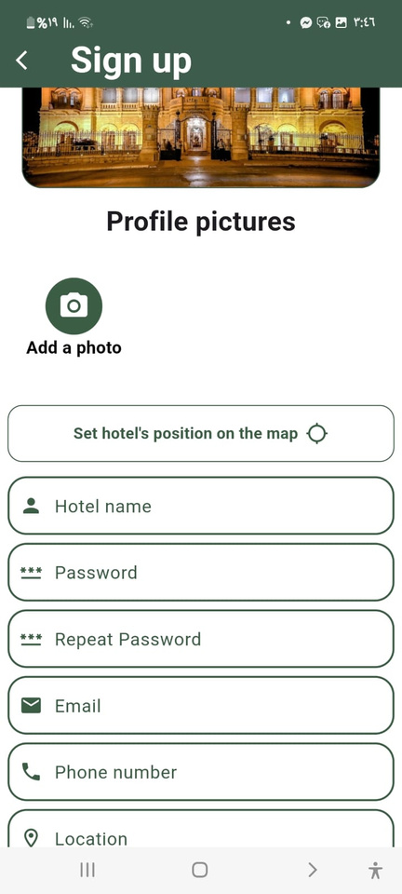
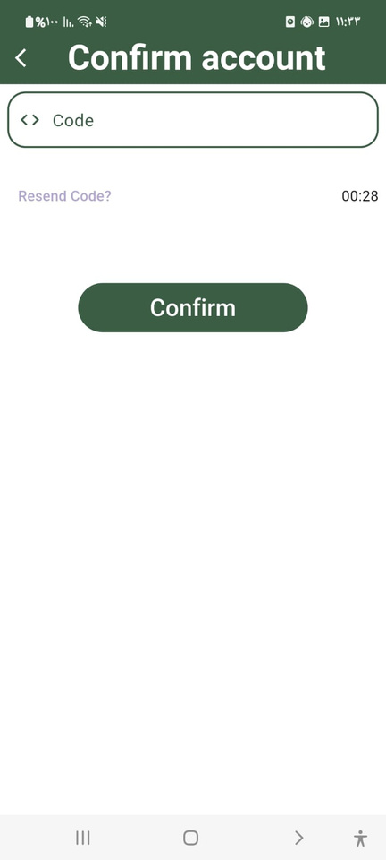
SIGN UP

Slide 7
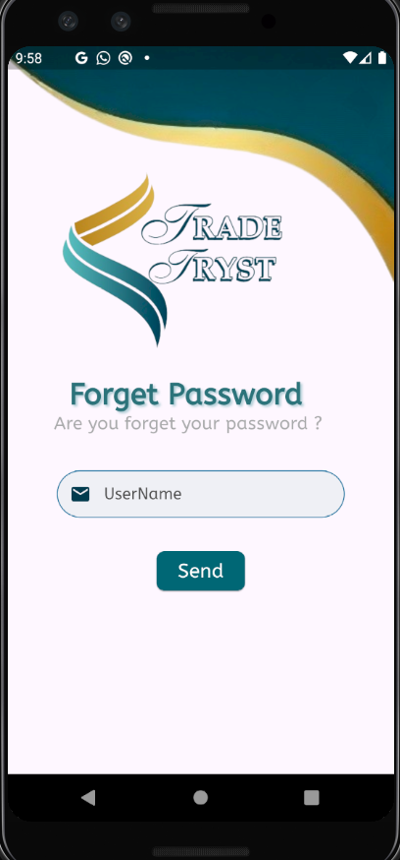
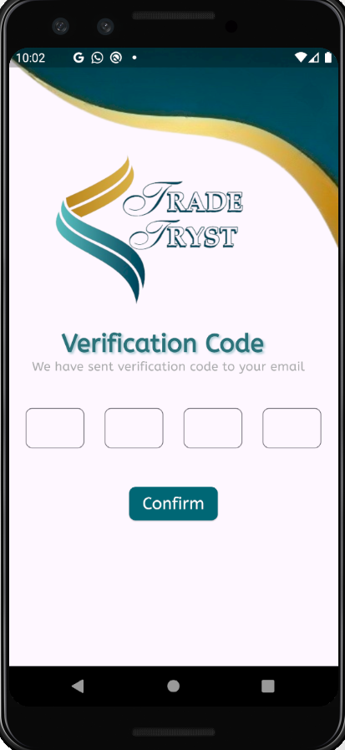
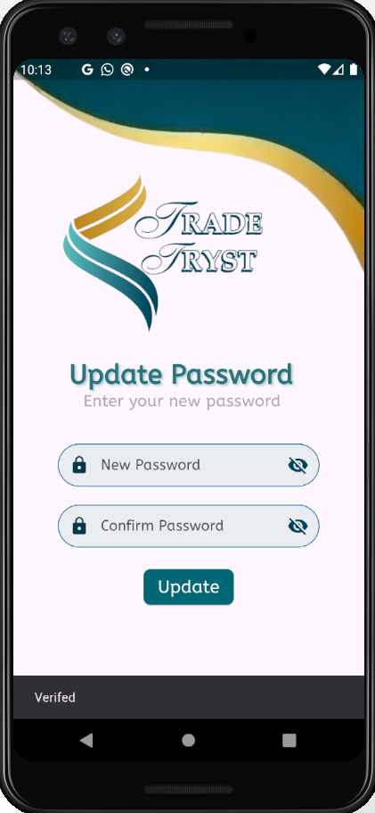
FORGET PASSWORD

Slide 8
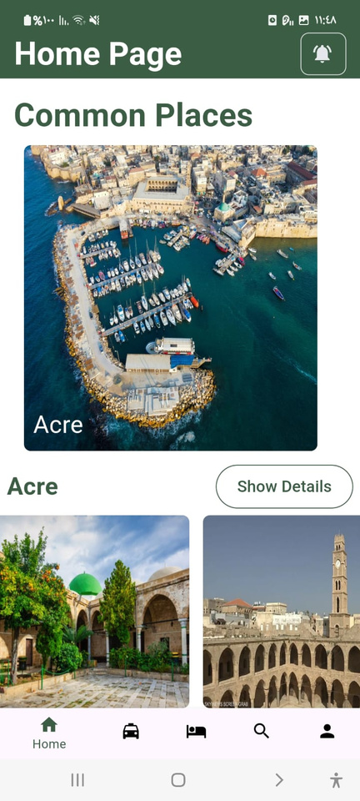
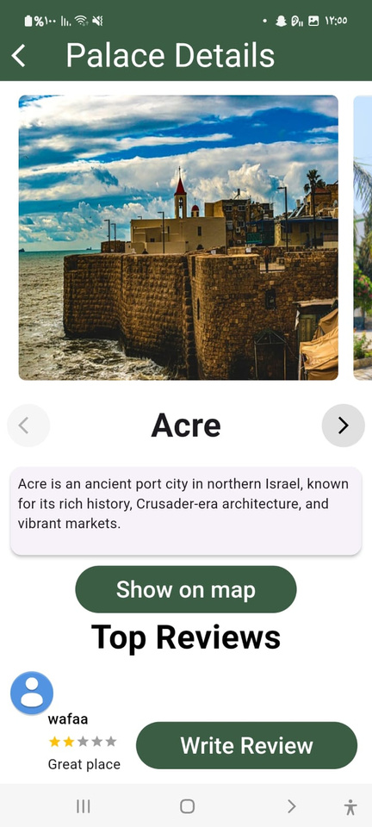
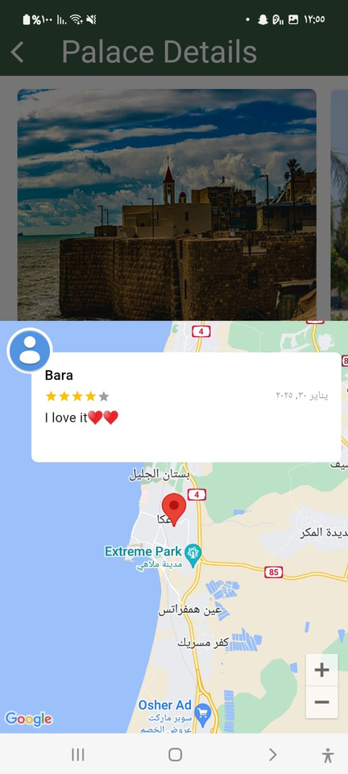

HOME PAGE AT USER

Slide 9
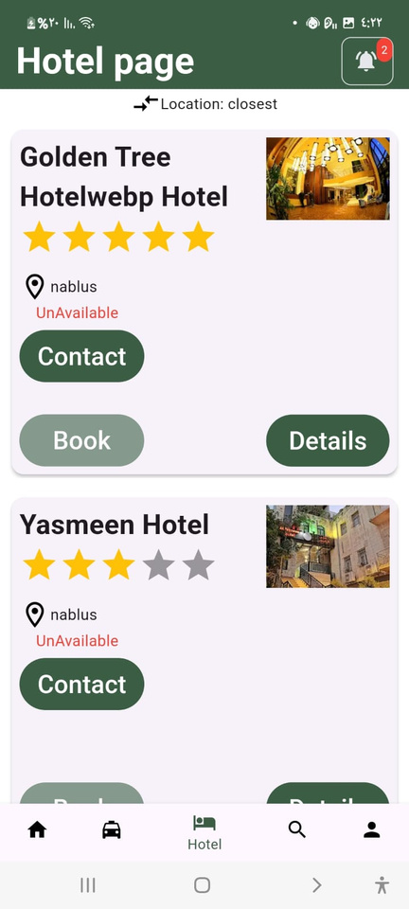
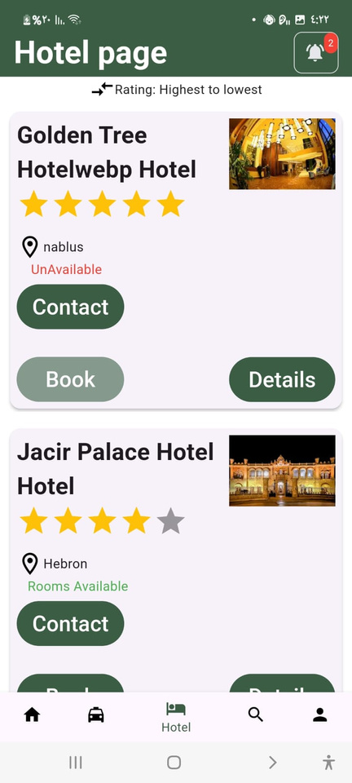
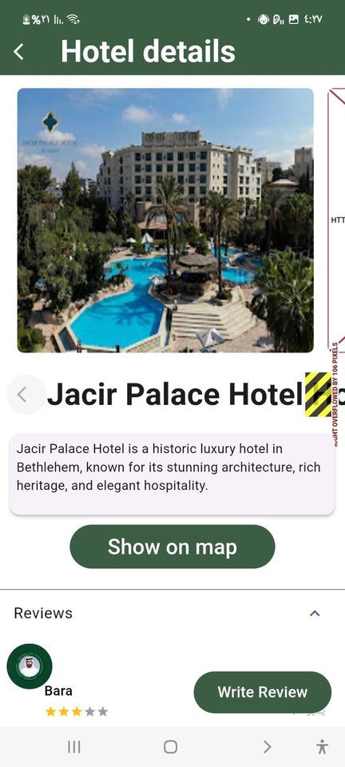
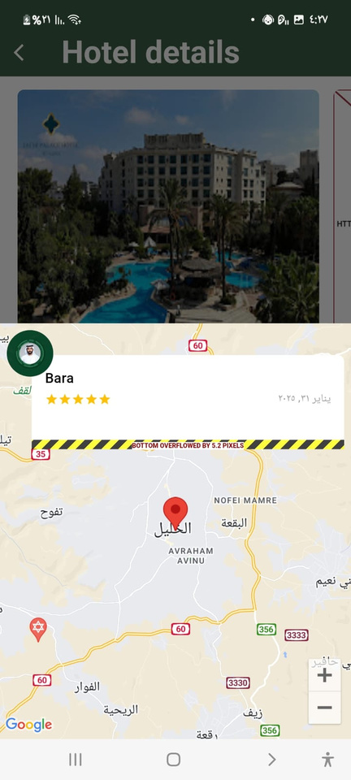
HOTEL PAGE

Slide 10
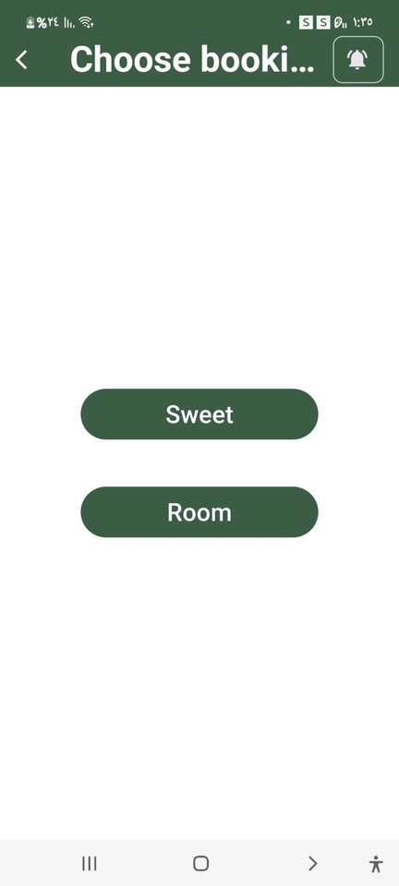
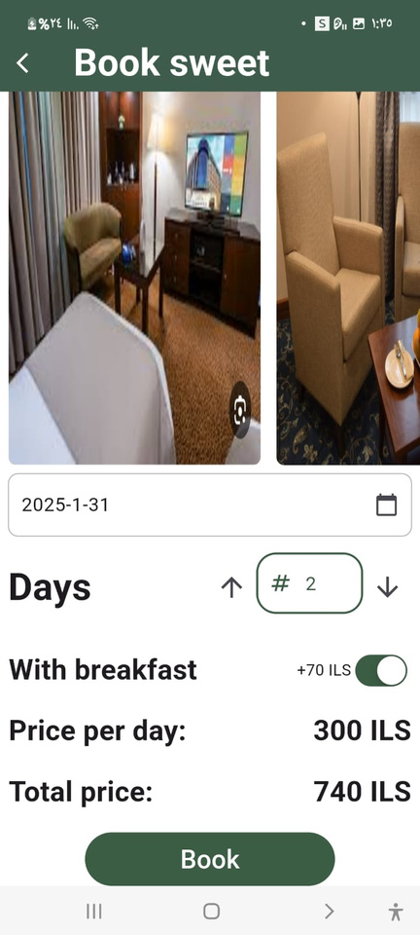
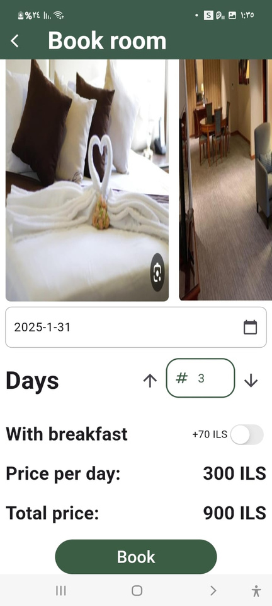
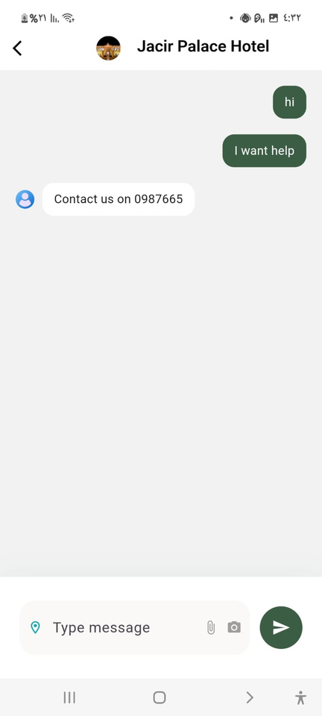

Slide 11
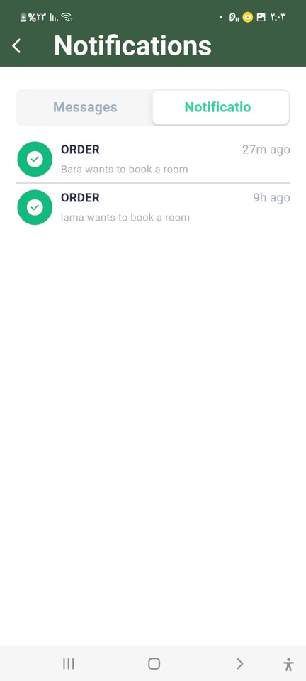
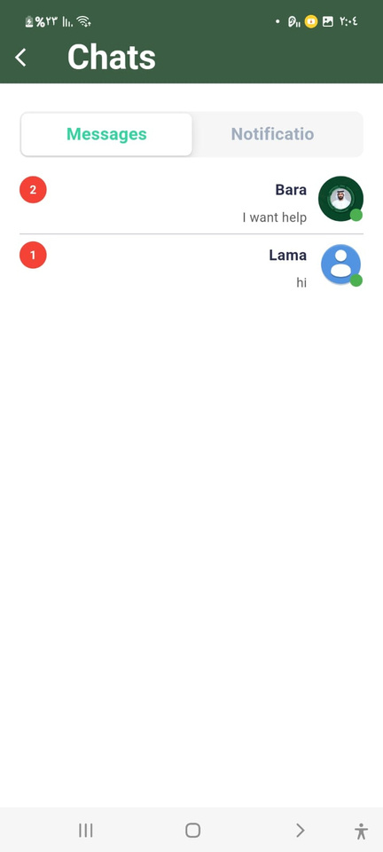
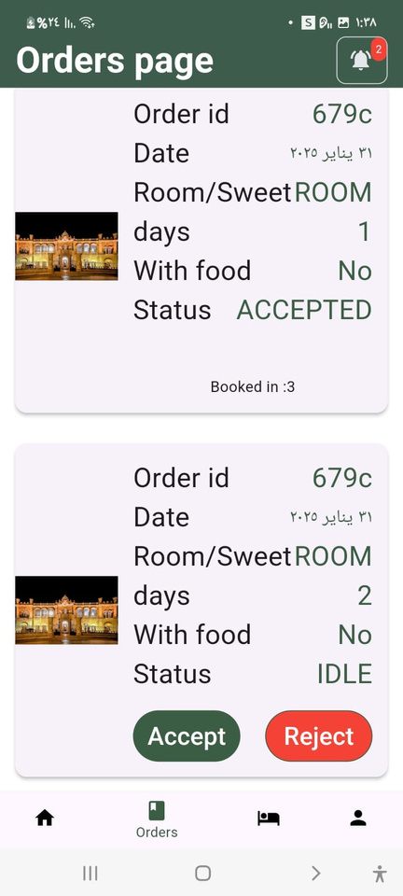
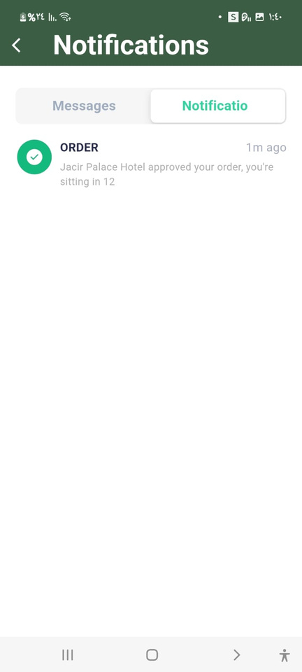
ACCOUNT
AT HOTEL

Slide 12
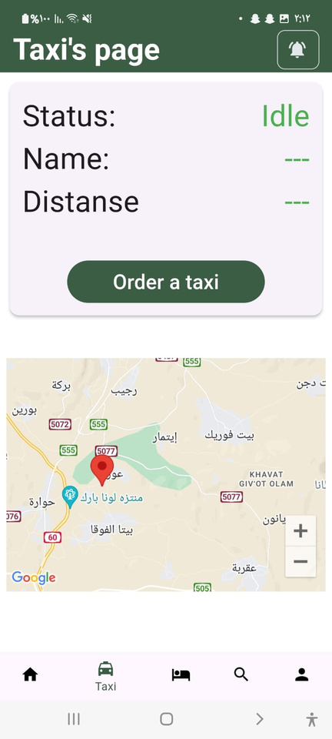
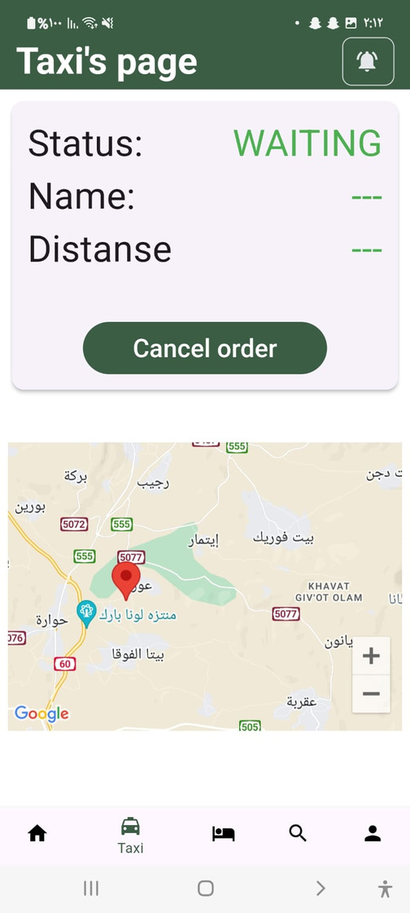
THE USER WILL ASK FOR A TAXI

Slide 13
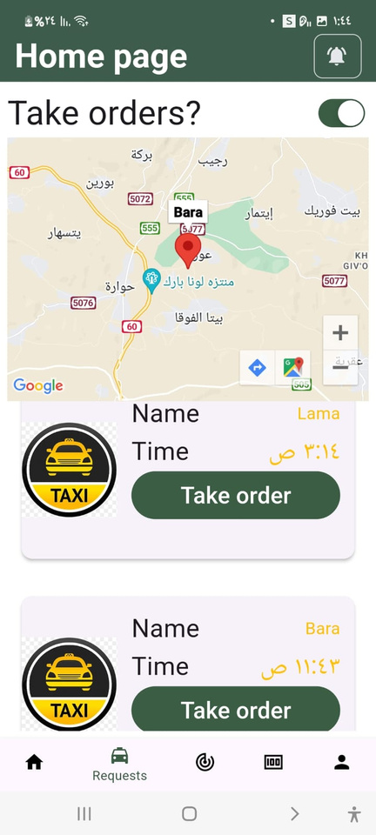
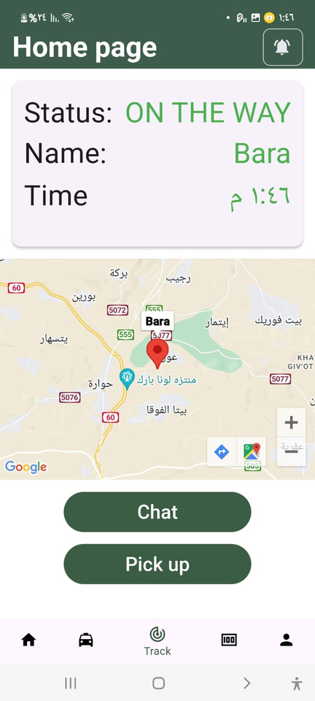
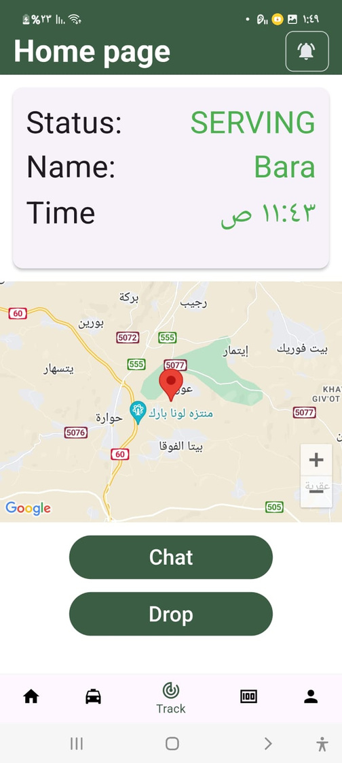
AT TAXI ACCOUNT
THE REQUEST IS DELIVERED TO THE TAXI TO BE PROCESSED.

Slide 14
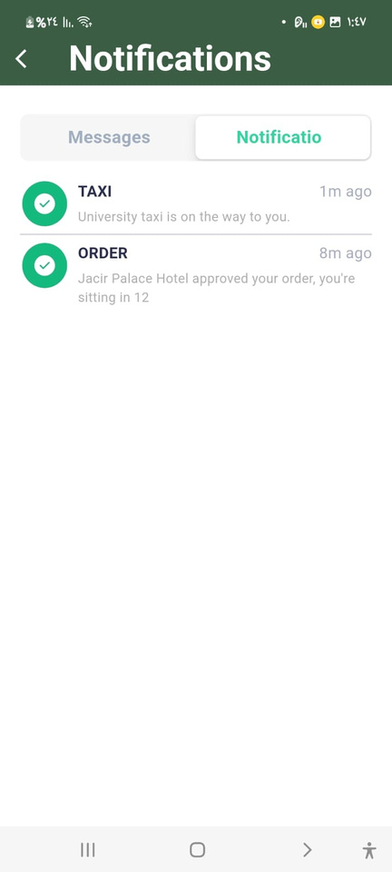
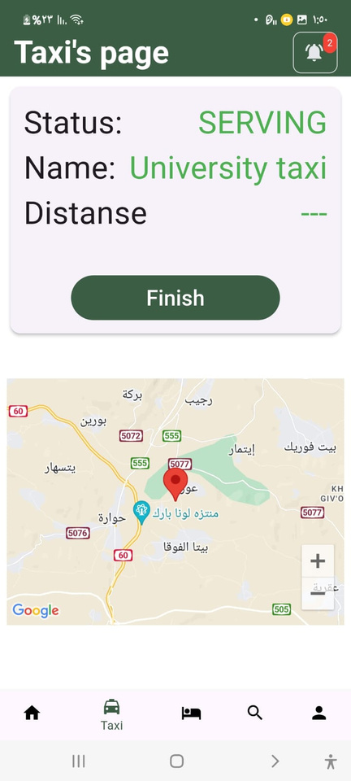
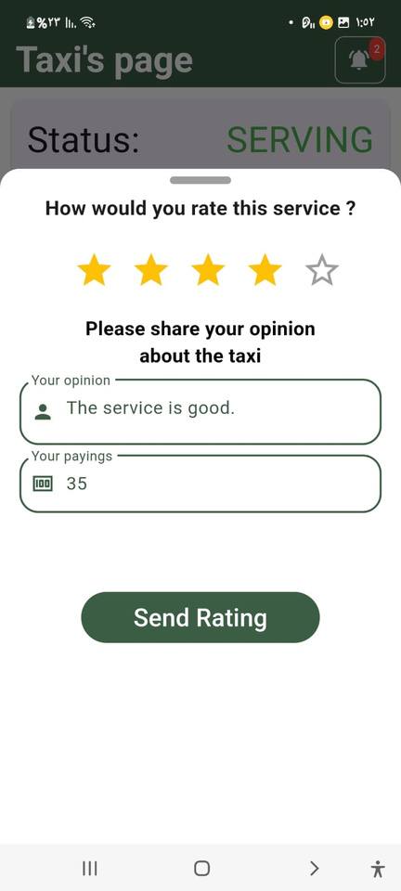

Slide 15

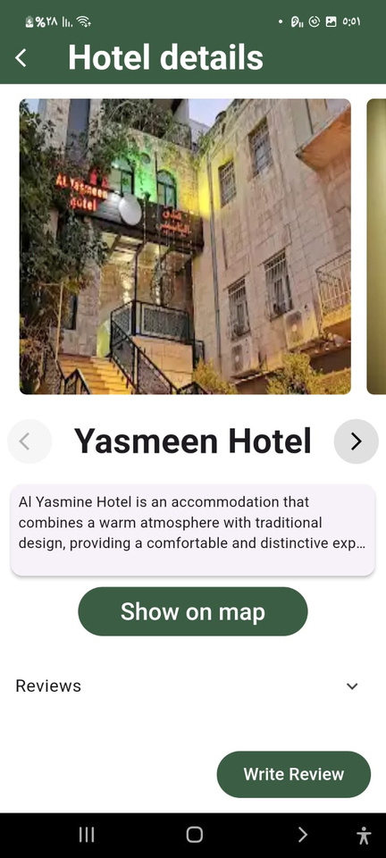

SEARCH FOR THE HOTELS

Slide 16
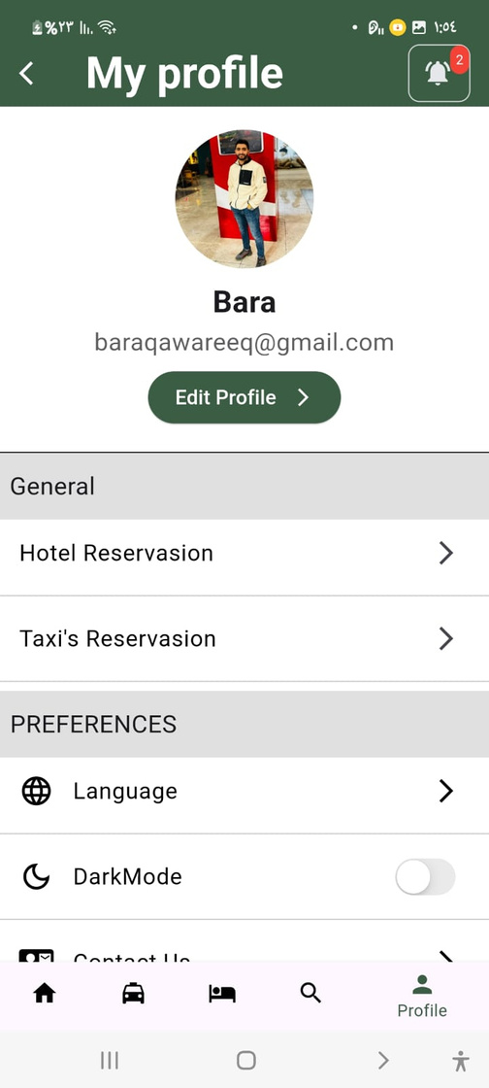
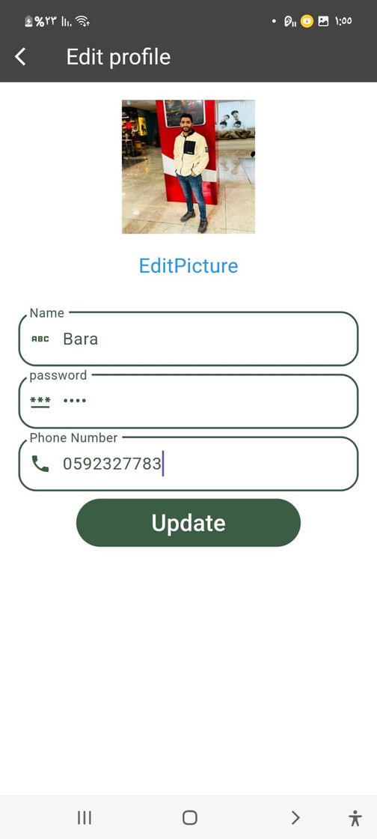
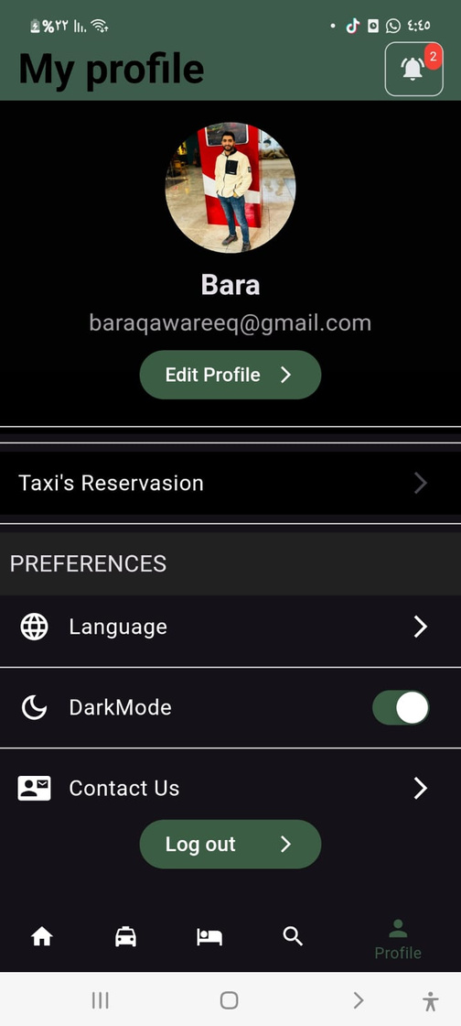
PROFILE PAGE

Slide 17
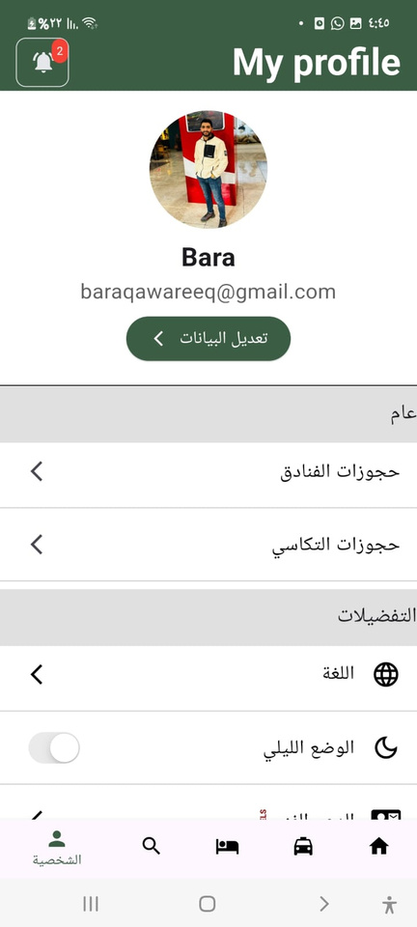
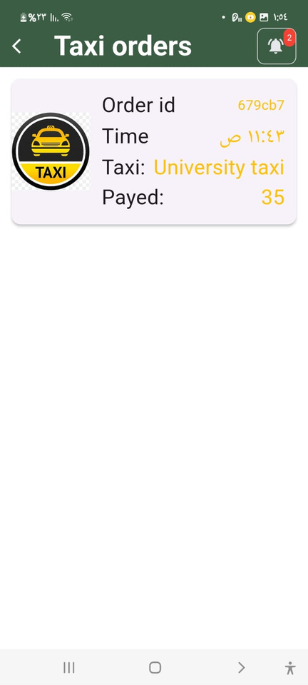
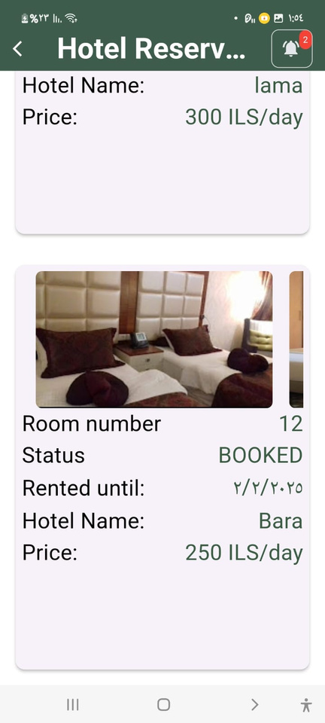
PROFILE PAGE

Slide 18
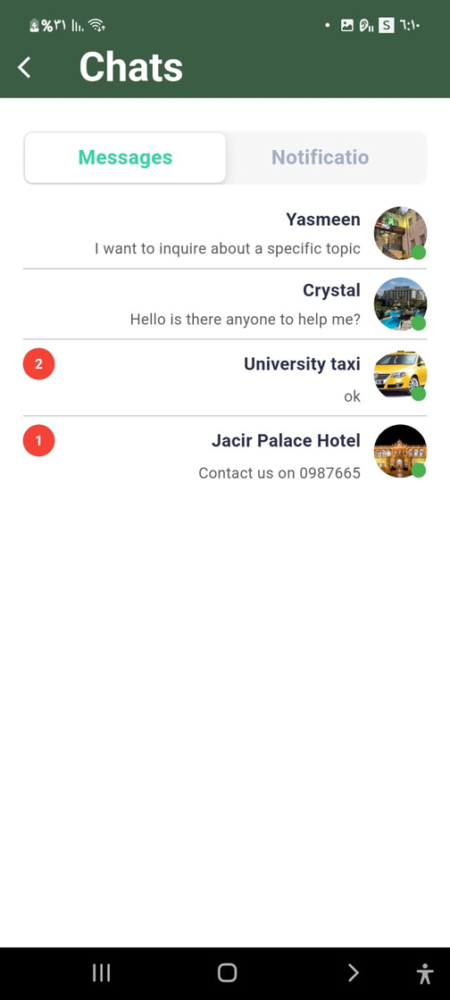
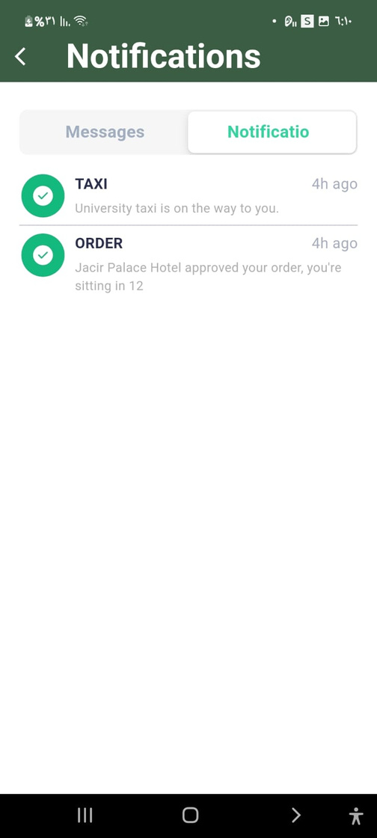
CHATS & NOTIFICATION

Slide 19
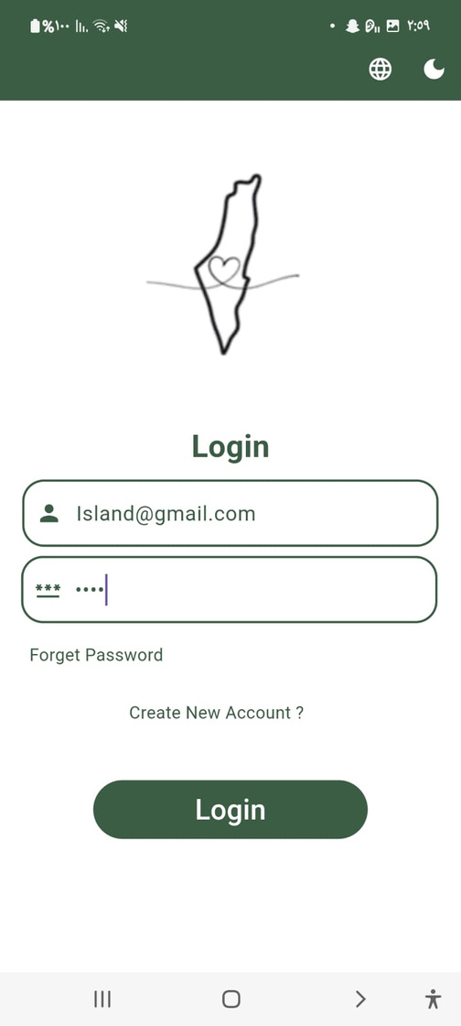
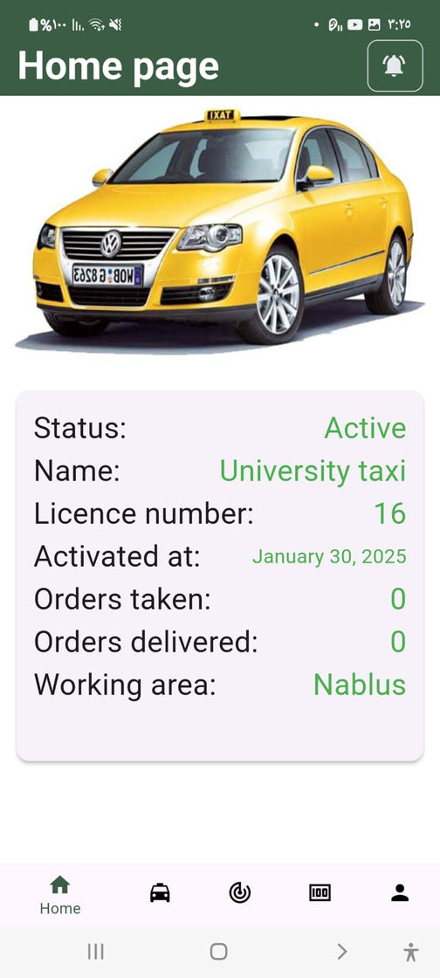
LOGIN AS A TAXI

Slide 20
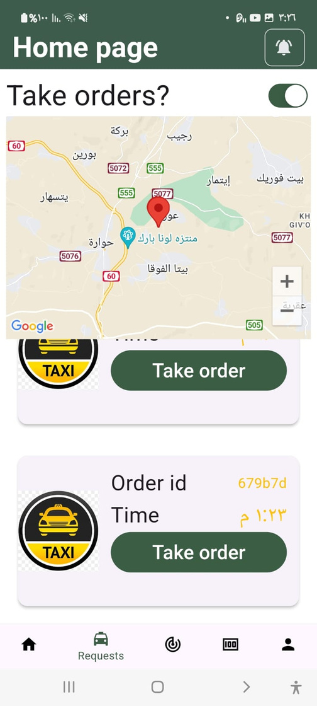
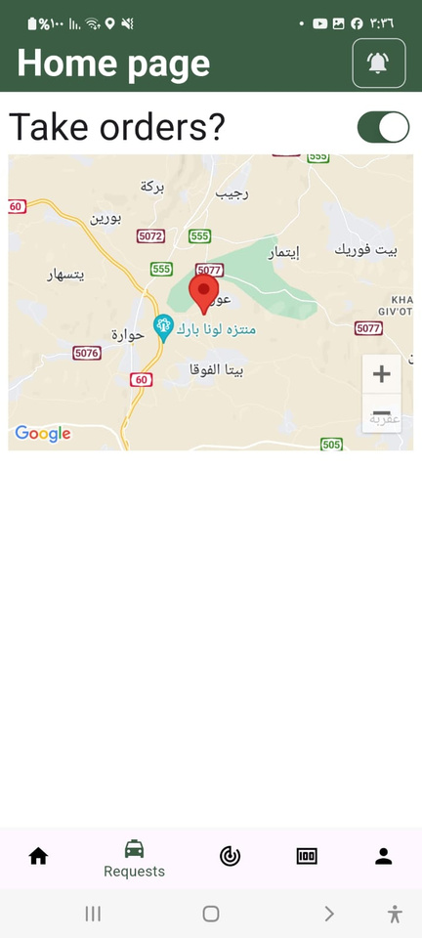
TAXI REQUEST

Slide 21
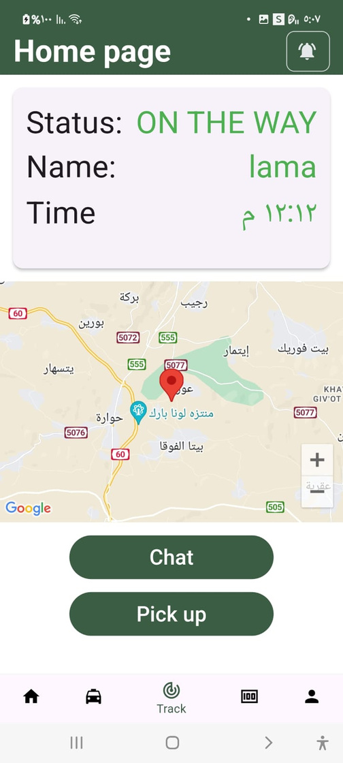
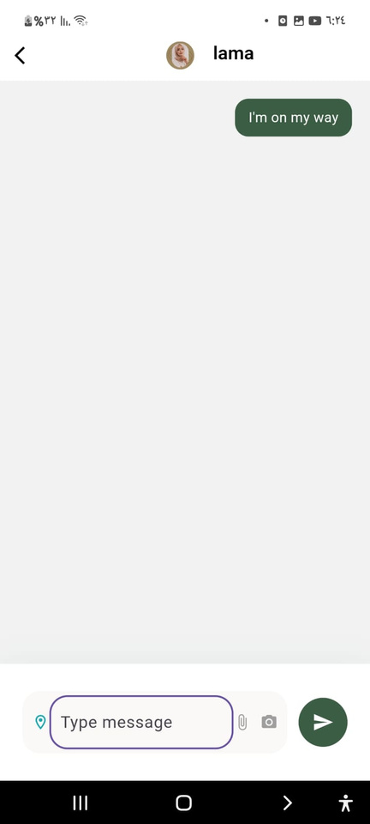
TRACK ORDER

Slide 22
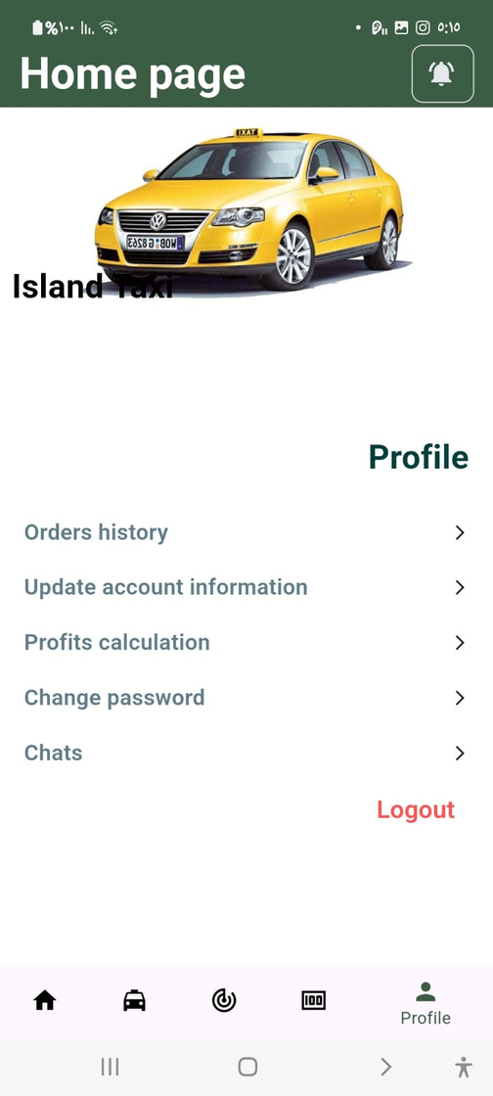
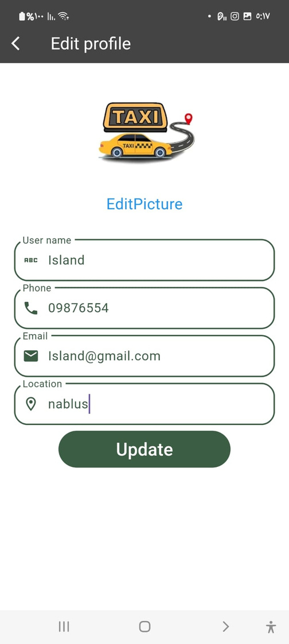
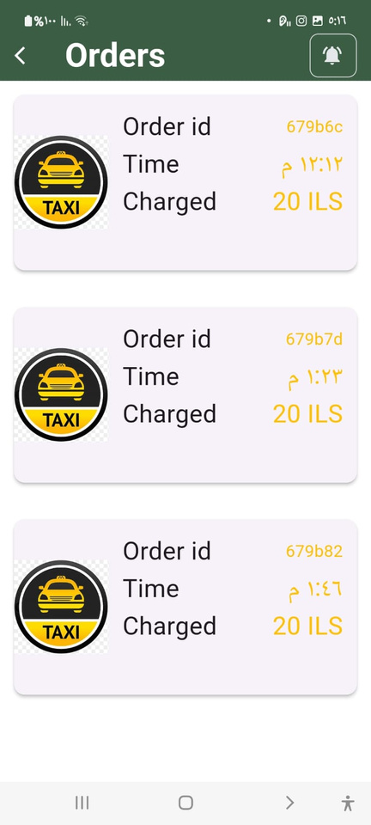

TAXI PROFILE

Slide 23



LOGIN AS A HOTEL

Slide 24

  HOME PAGE
Here we show the number of rooms and sweets available and booked.

Slide 25



ROOMS / SWEETS PAGE

Slide 26



ADD ROOMS / SWEETS

Slide 27

ORDERS PAGE
Here we display the requests to be accepted or rejected.

Slide 28


CHAT & NOTIFICATIONS

Slide 29



HOTELS PROFILE

Slide 30


PROFILE PAGE

Slide 31


future work
SUPPORT BROWSING AND NAVIGATION WITHOUT AN INTERNET CONNECTION
ADD A CURRENCY CONVERTER.
PROVIDE ADDITIONAL SERVICES SUCH AS: BOOKING TOURIST ACTIVITIES.
SO THAT THE TOURIST CAN ACCESS MAPS AND INFORMATION WITHOUT THE INTERNET.

Slide 32


Techniques
  Android Studio
  Visual studio code
  Postman
  GitHub
  MongoDB

Slide 33







Thank You

