Slide 1

An-Najah National University
Information Technology Faculty
Management Information Systems (MIS)

Slide 2
Al-Qadi Motors Car Rental System Using Odoo Tool
Supervised by:
Dr. Najwan Jamil Deleq
Prepared By:
Ahed Yameen
Mais Aldeek
Manal Khelfeh

Slide 3
Abstract
Manual systems are one of the most important reasons for the lack of development of business processes and reaching a highly competitive stage and position in the market, as they are one of the most important obstacles facing Al-Qadi Car Rental Company and stand in the way of its development, which has caused the main problems that the company suffers from, the most important of which is the lack of data interconnection and Absence of reports, so it was necessary to employ an integrated system such as Odoo and its modules in order to making a real step toward solve issues. Examples of the main modules that were employed (inventory, fleet, leasing, maintenance, repair, reports), The workflow through those modules lead to new successful business processes.

Slide 4
Introduction
This project talks about Qadi Car Rental Company and the development of the internal system in relation to car rental and related internal operations as the old system was based on paper invoices and manual procedures.

Slide 5
Vision for the Project:
nvision a future where mobility is not just a necessity but a delightful experience
Mission for the Project:
To become a sovereign company in its field in conjunction with the provision of fast and accurate car rental services and fully dependent on technological development.

Slide 6

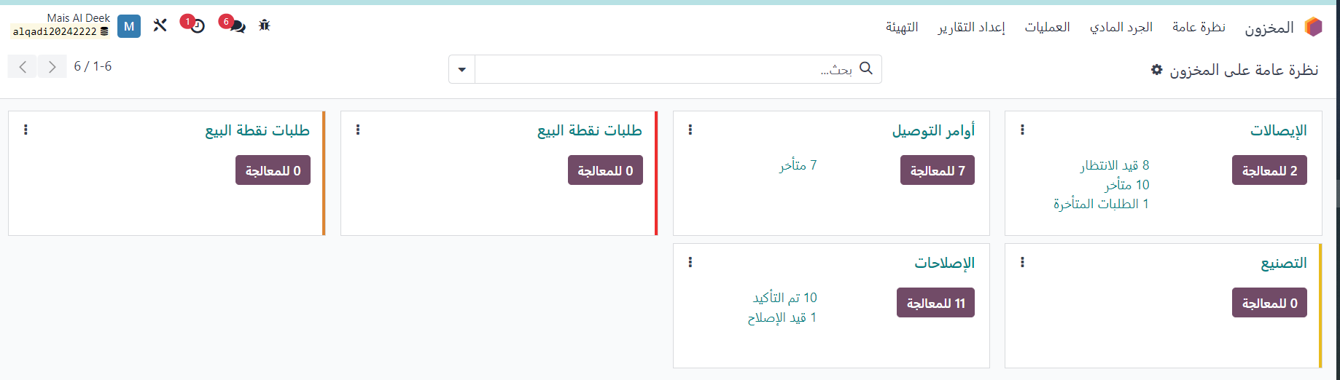
Inventory

Slide 7
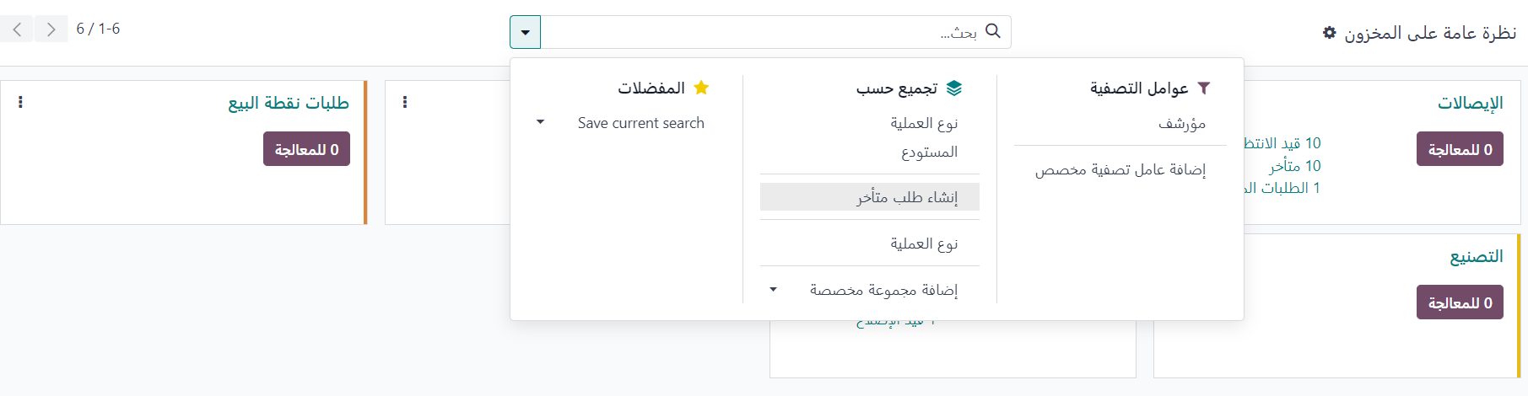
Customization Filter & Group by

Slide 8
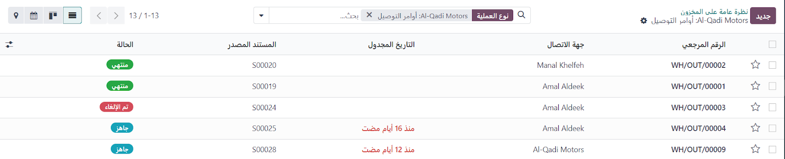
Picking type(reordering rules)

Slide 9
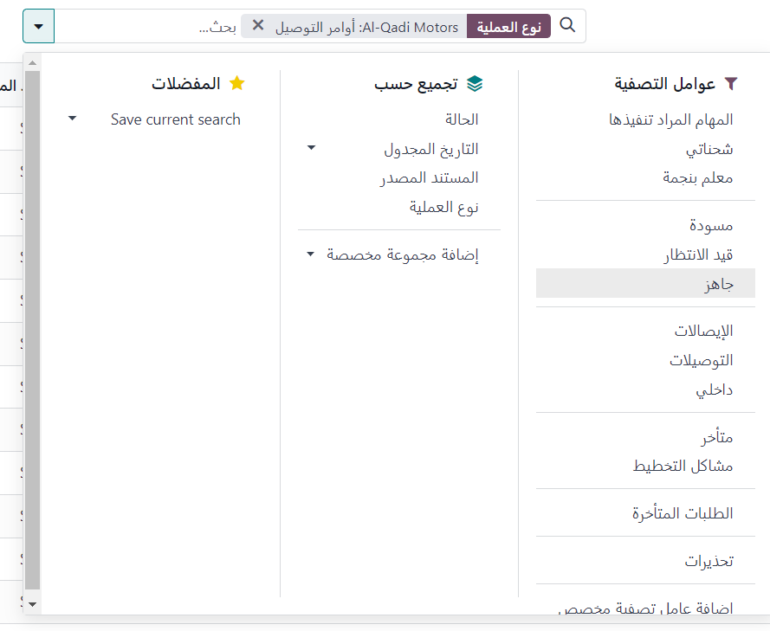
Group by

Slide 10
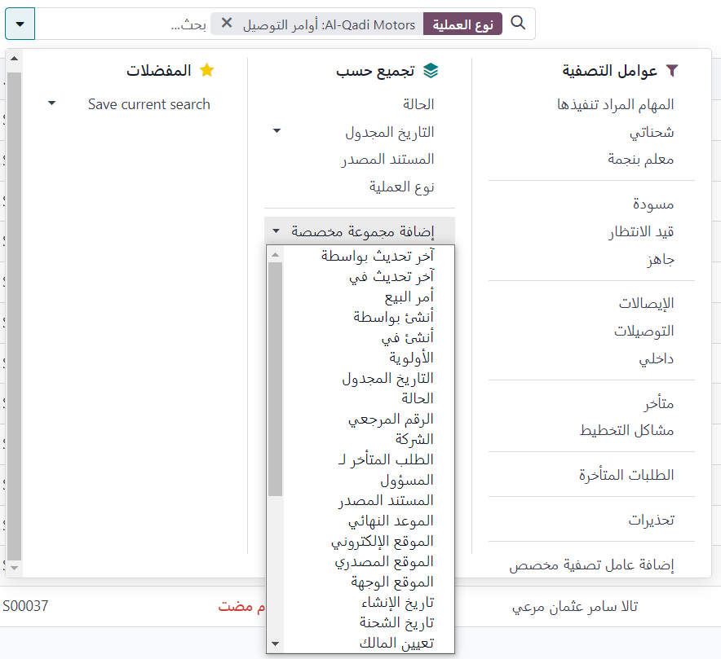
Filtering

Slide 11
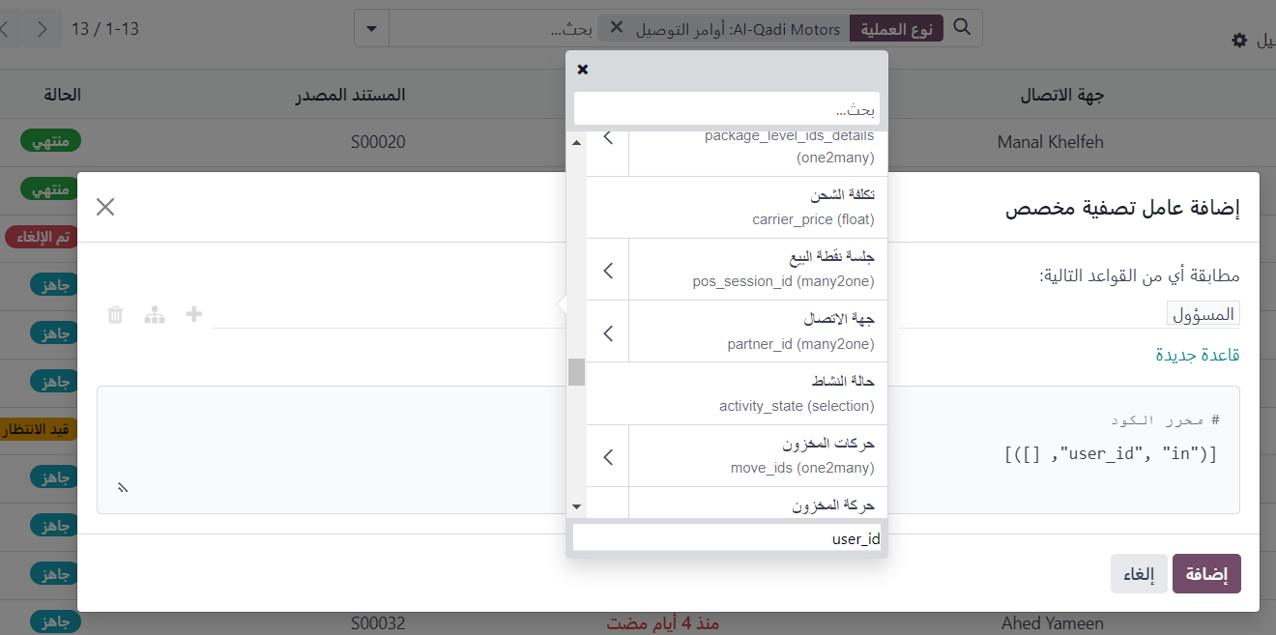
Filtering

Slide 12
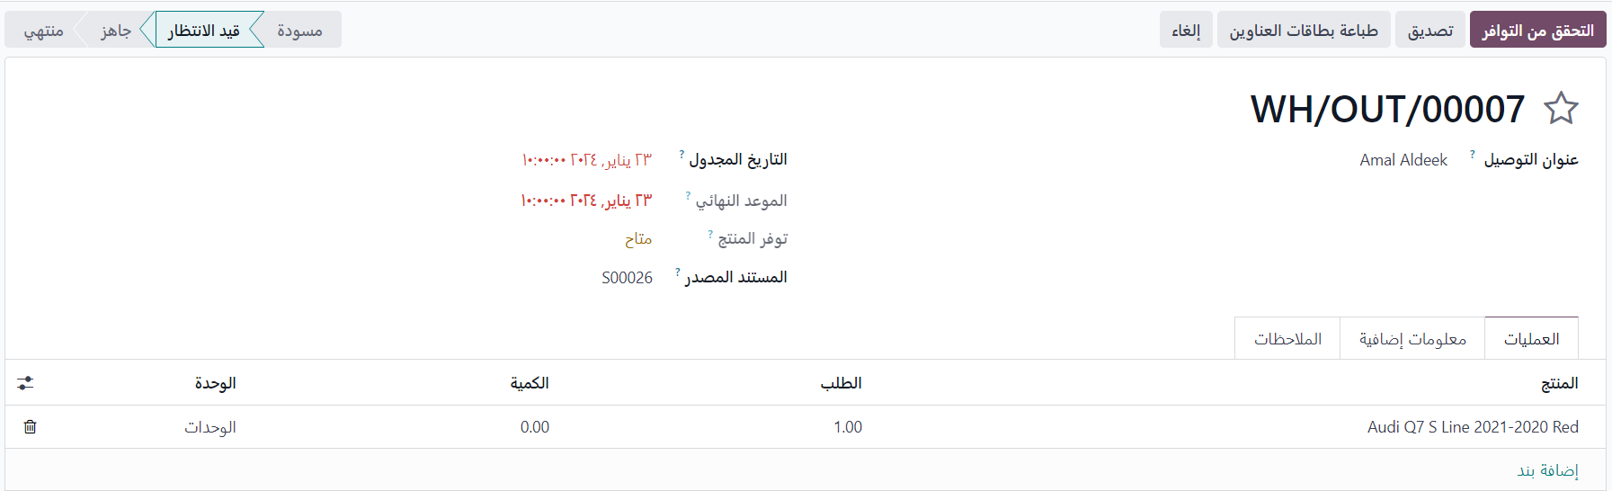
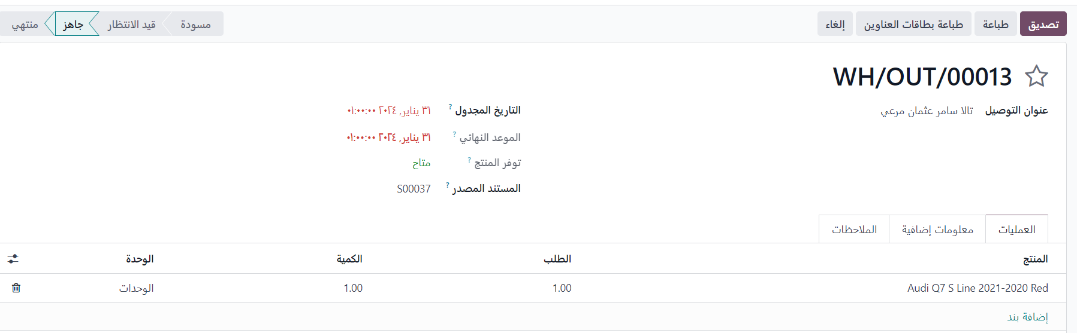
Receipt for Specific order

Slide 13
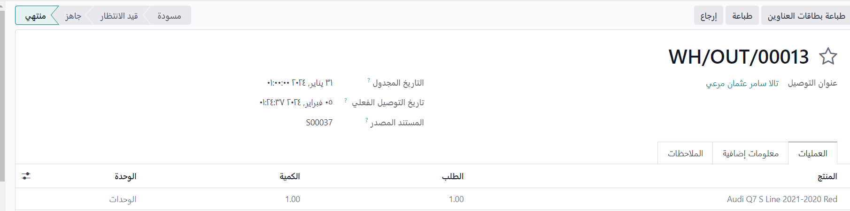
Receipt for Specific order

Slide 14
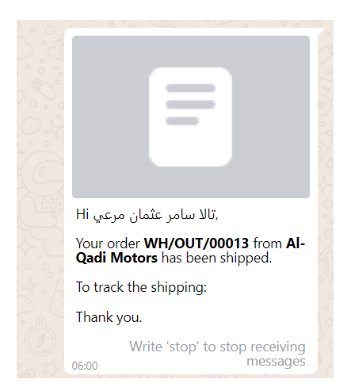
send notification to the customer

Slide 15
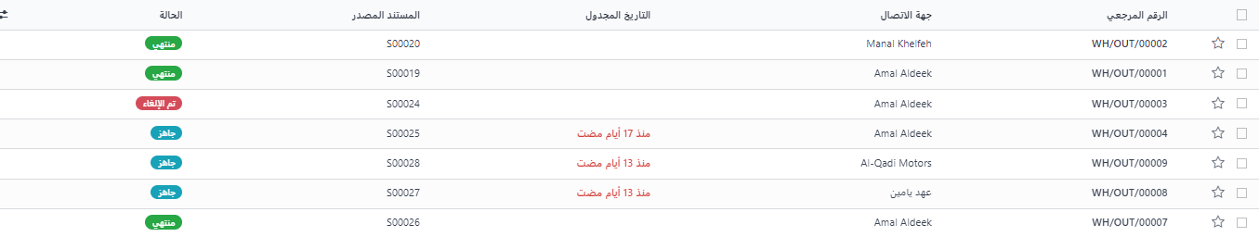
picking type

Slide 16
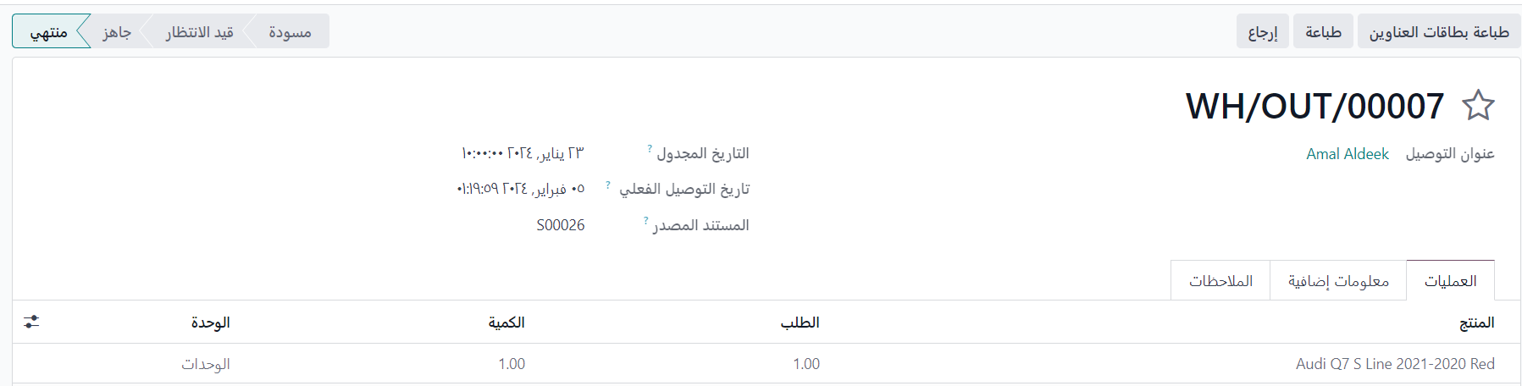
picking type

Slide 17
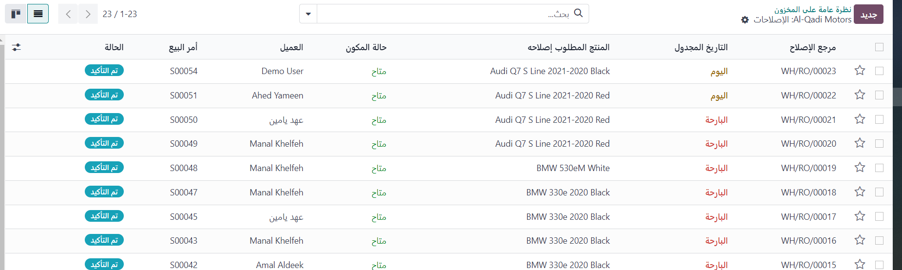
Repairing Orders

Slide 18
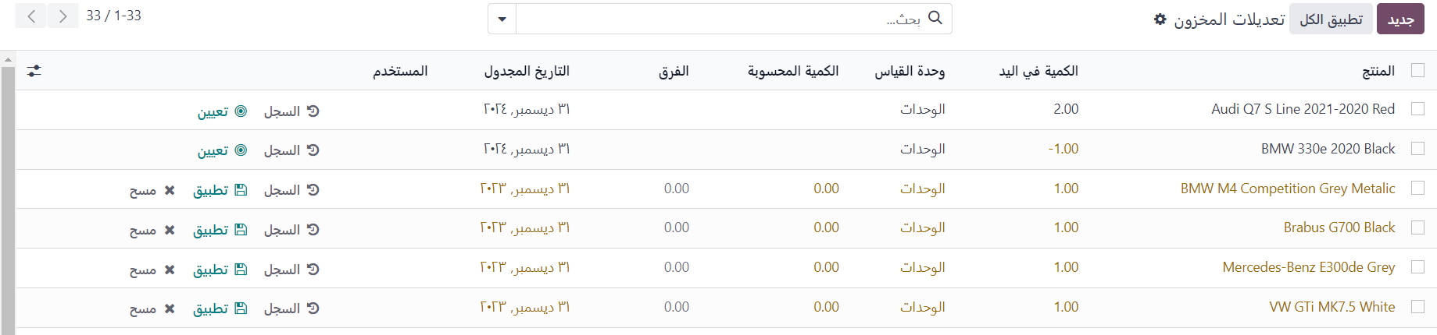
Product inventory

Slide 19
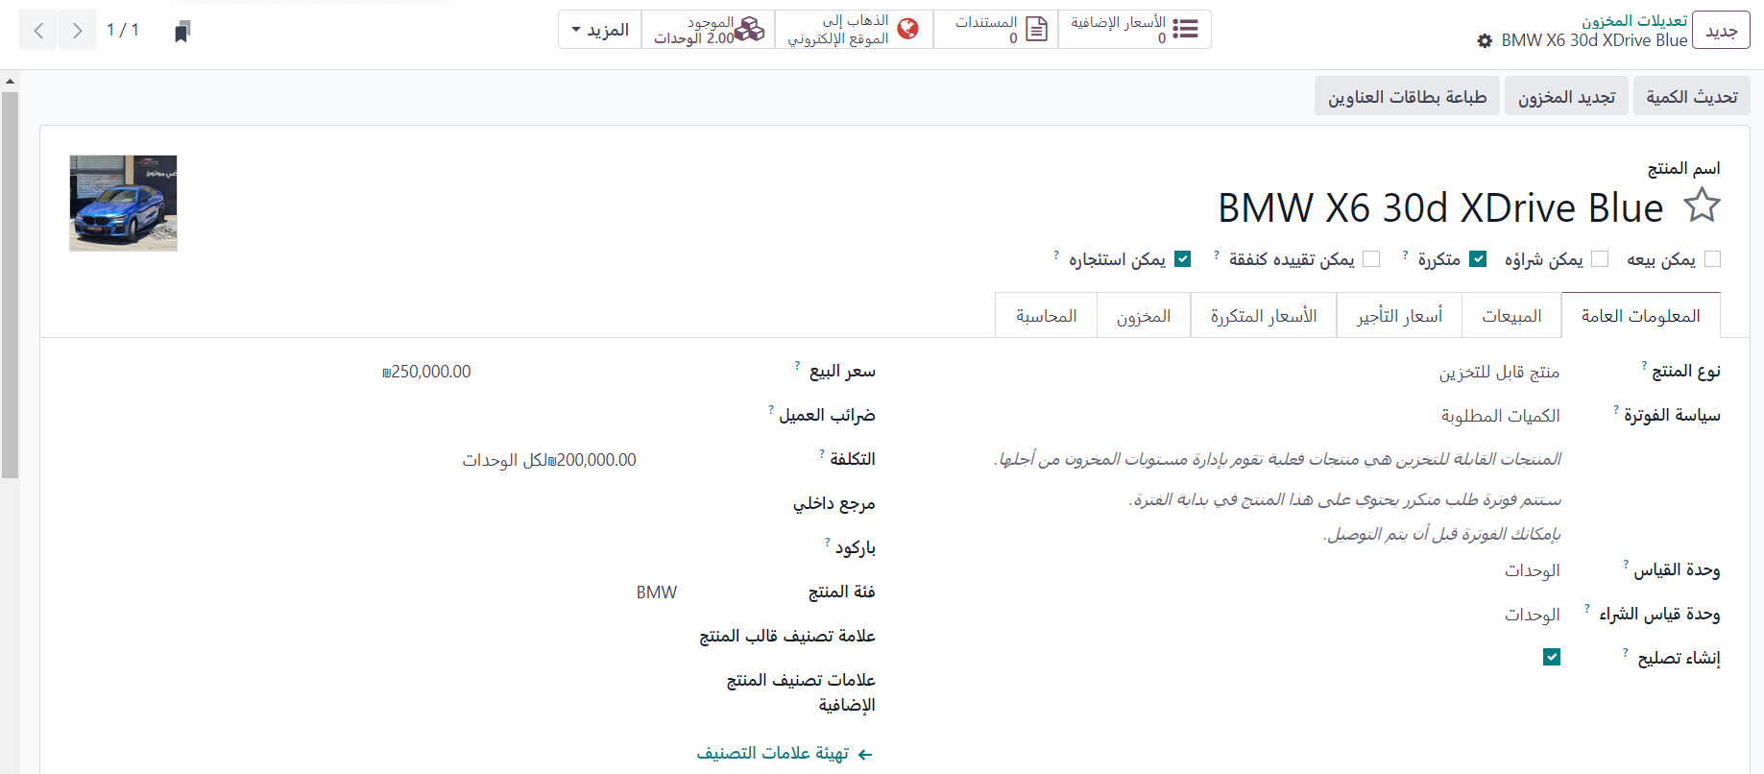
Vehicle information

Slide 20
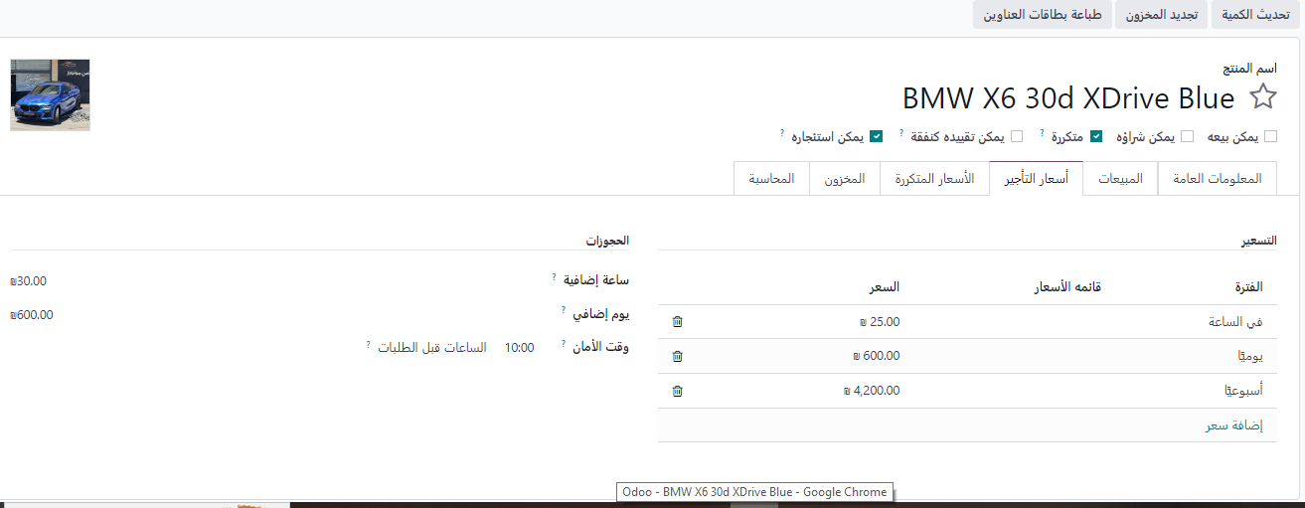
Vehicle information

Slide 21
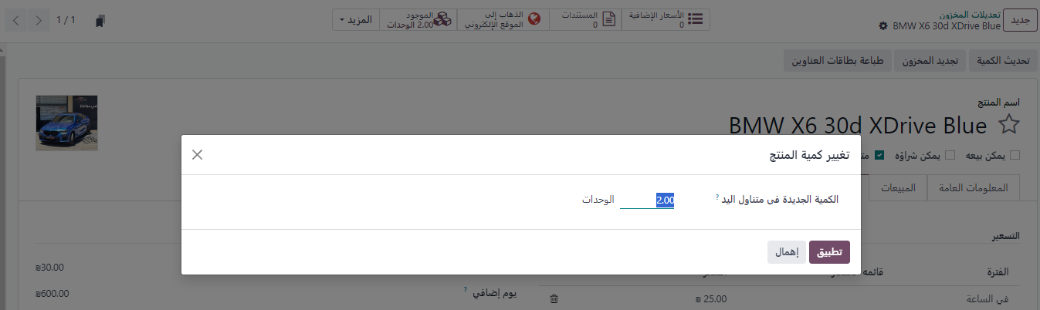
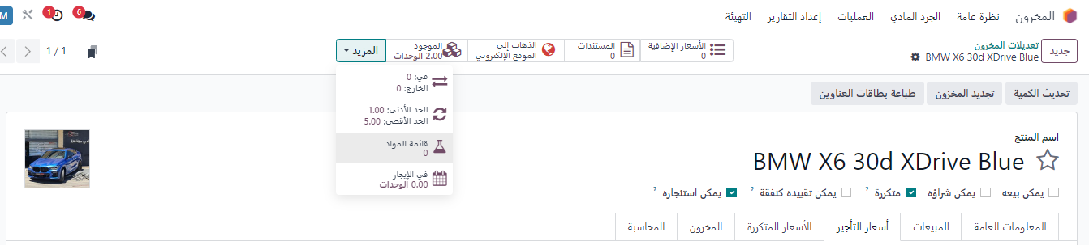
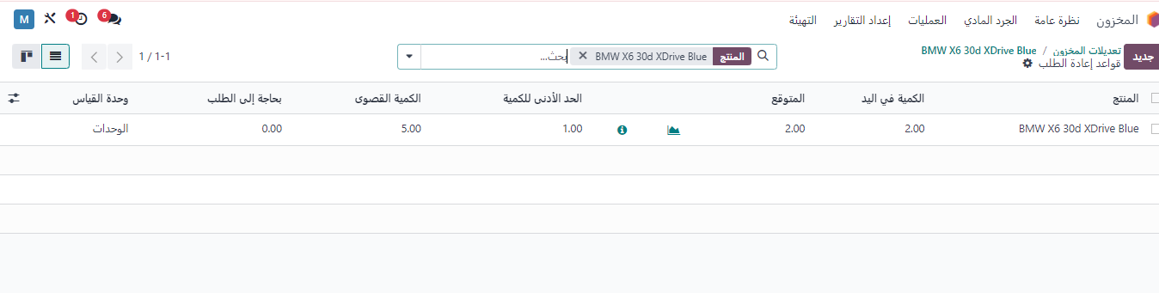
Vehicle information

Slide 22
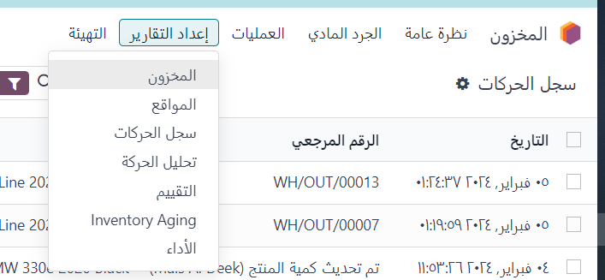
Reporting

Slide 23
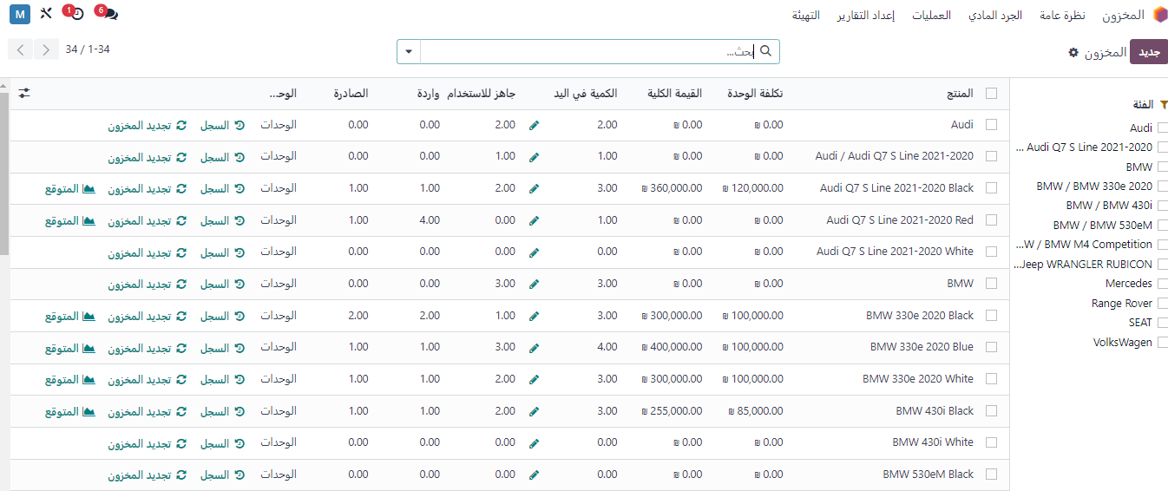
Reporting

Slide 24
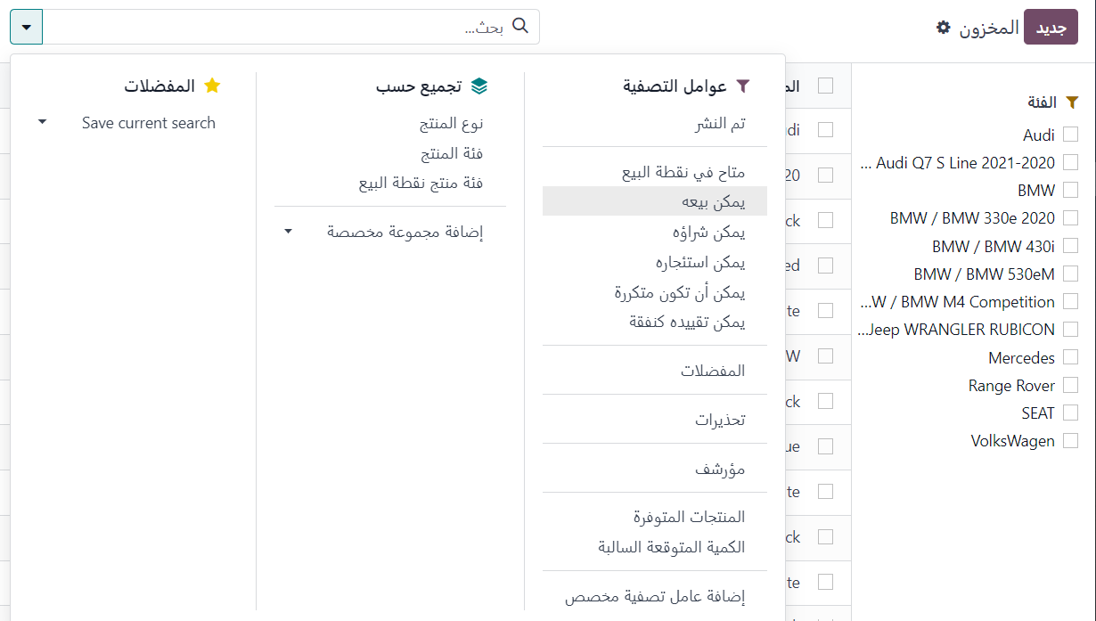
Customization Reporting

Slide 25
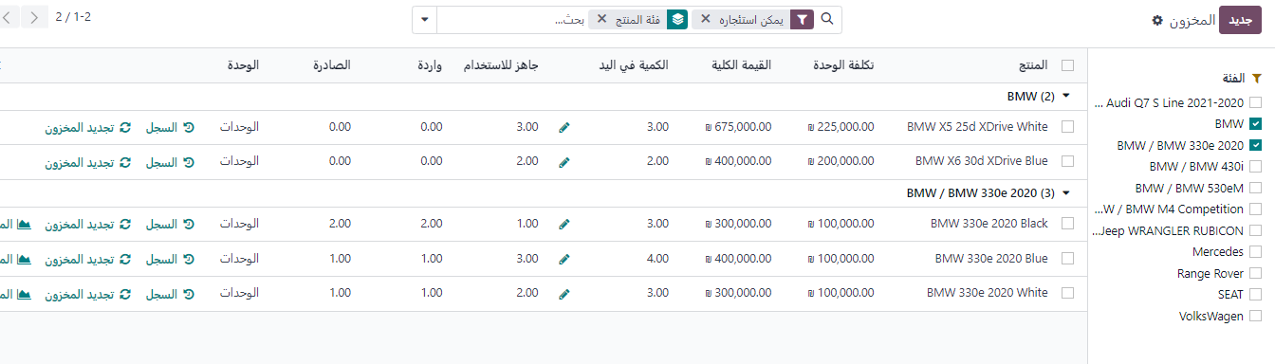
Result

Slide 26
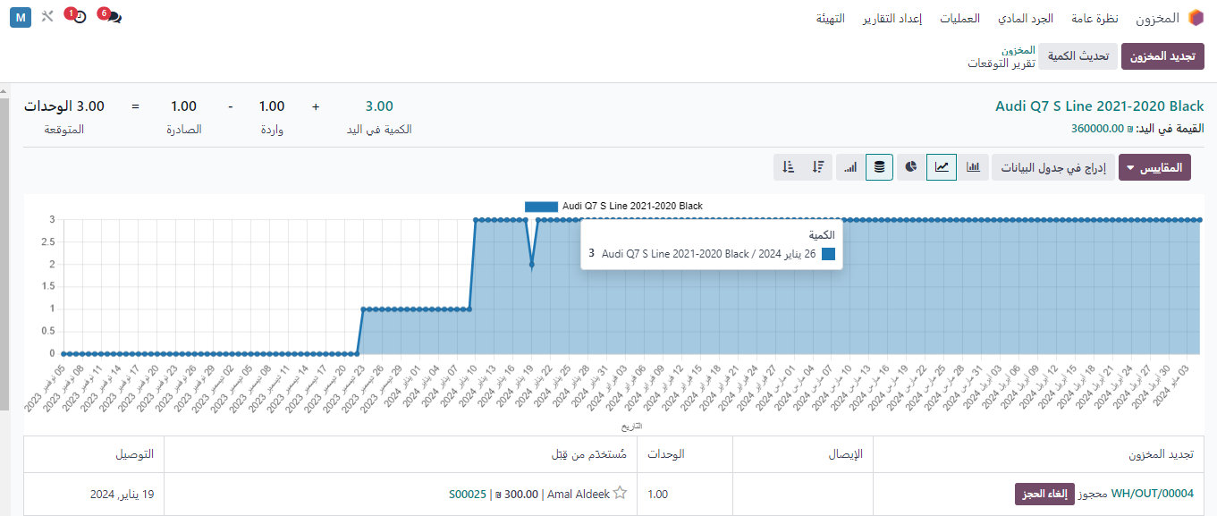
Expectations

Slide 27
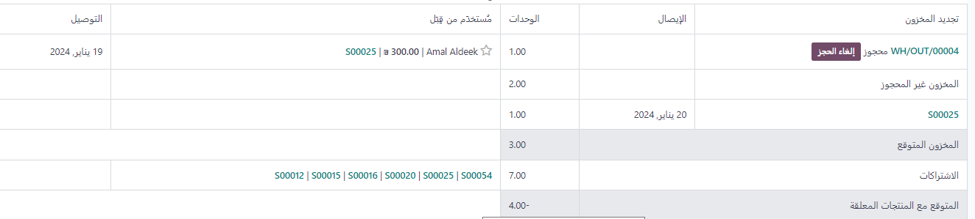
Expectations

Slide 28
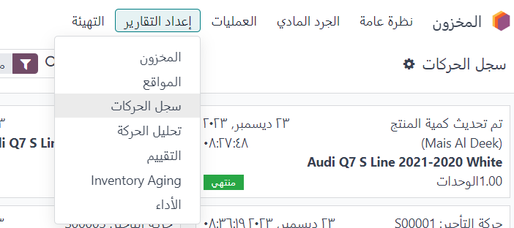
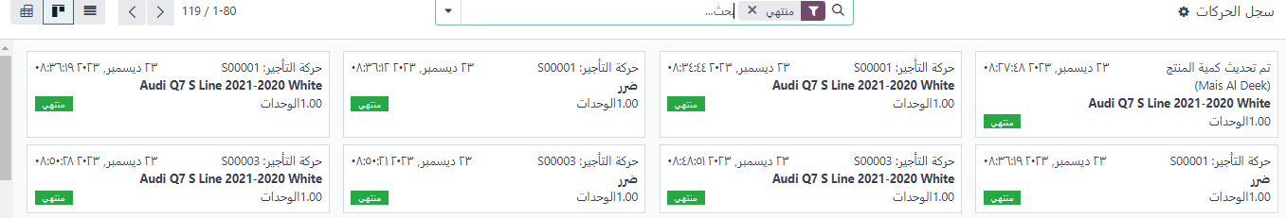

Slide 29
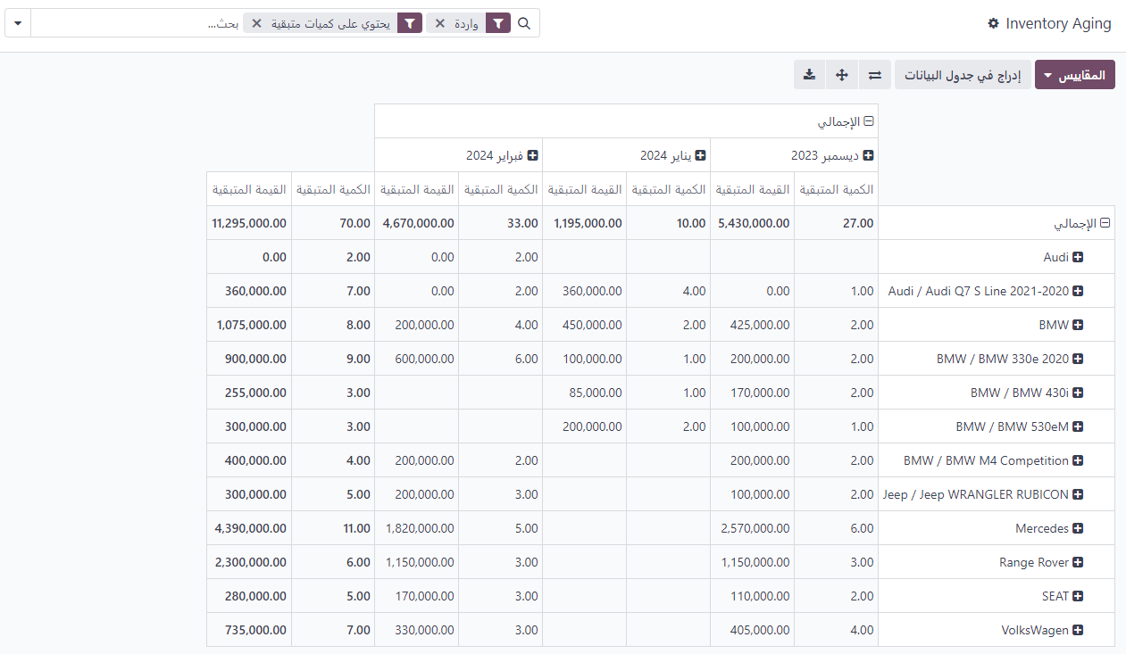
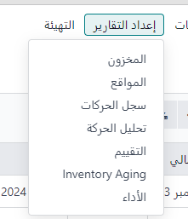
General Report

Slide 30

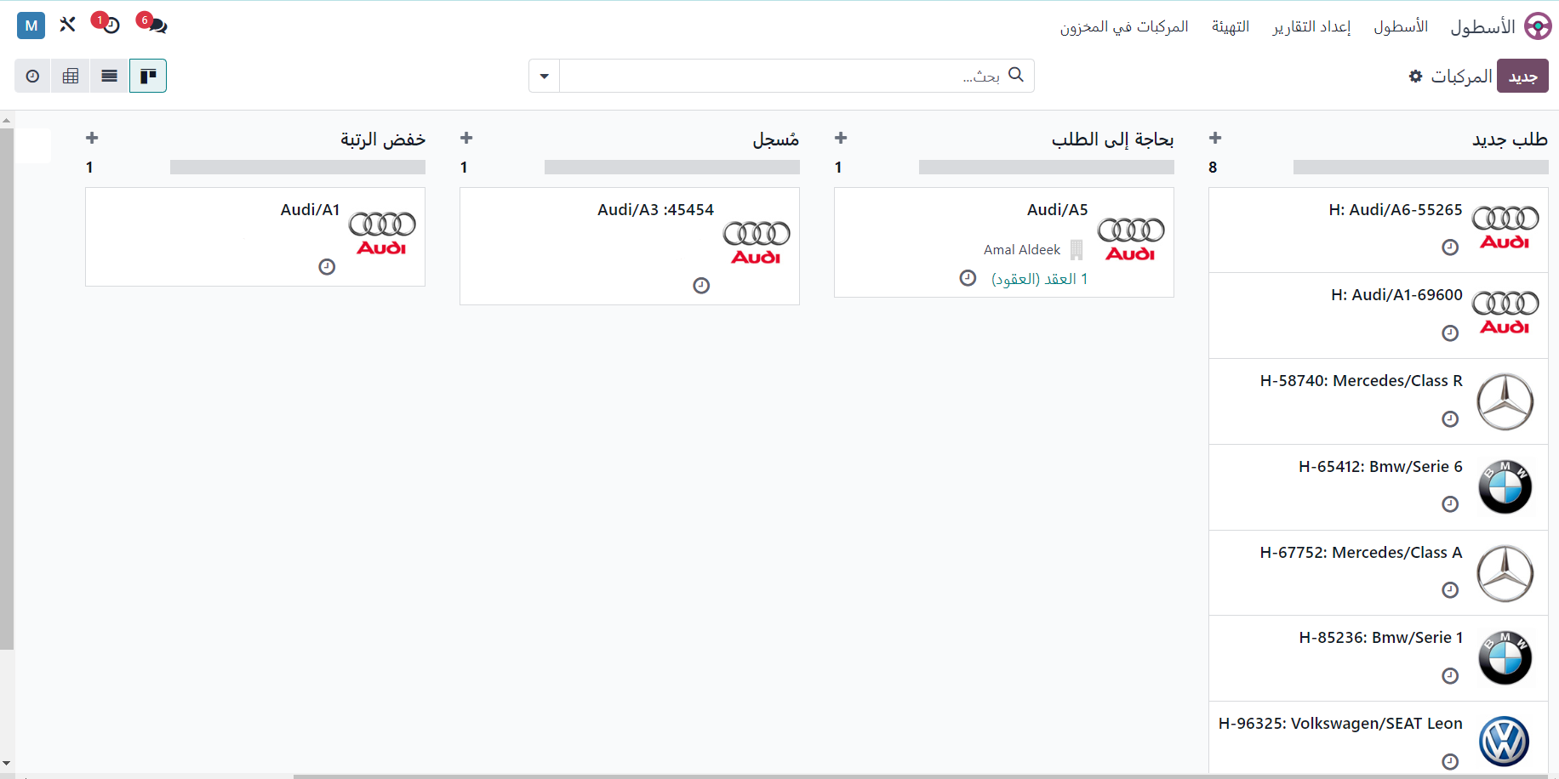
Fleet

Slide 31
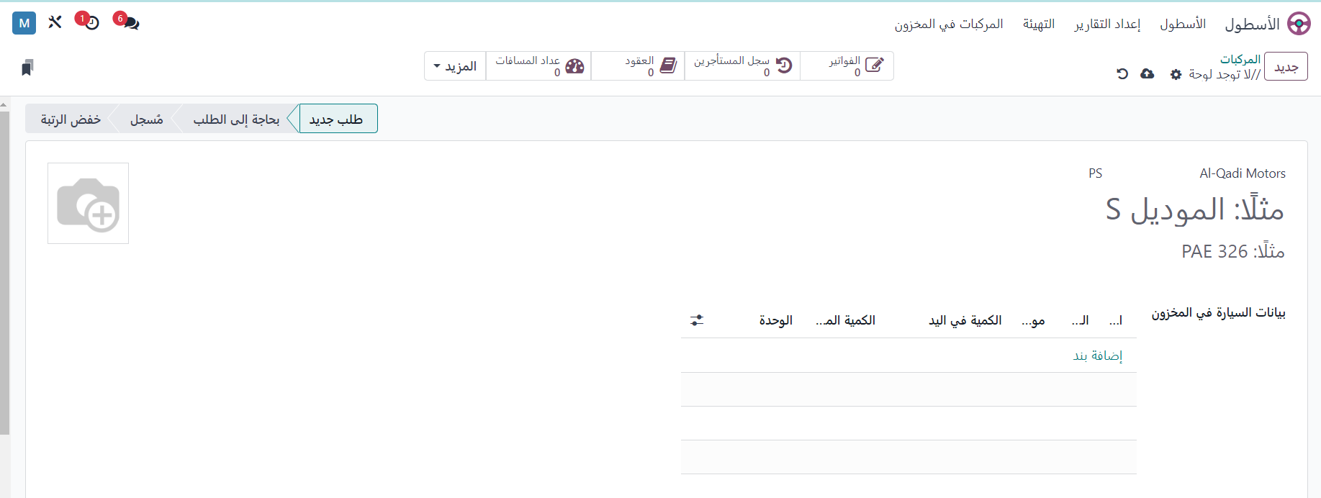
Fleet

Slide 32
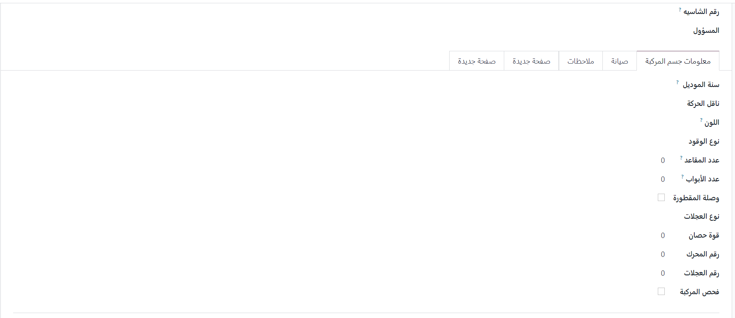
Fleet

Slide 33
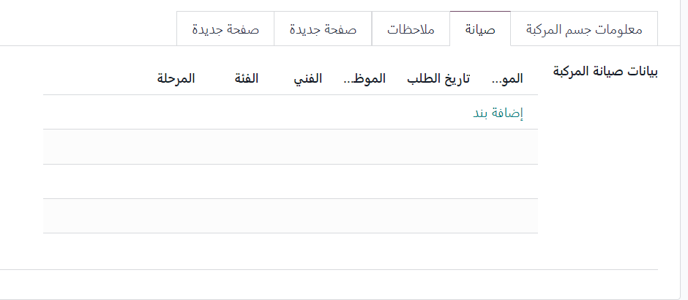
Fleet

Slide 34
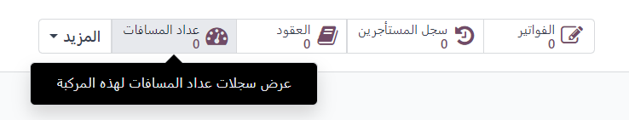

Fleet

Slide 35

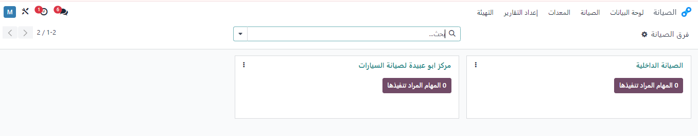
Maintenance

Slide 36
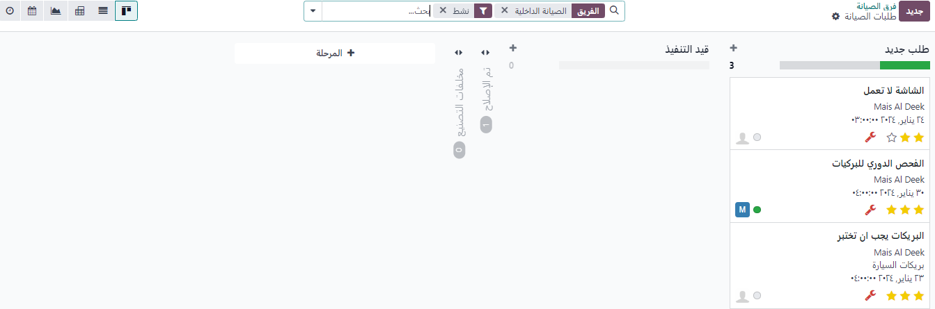
Maintenance

Slide 37
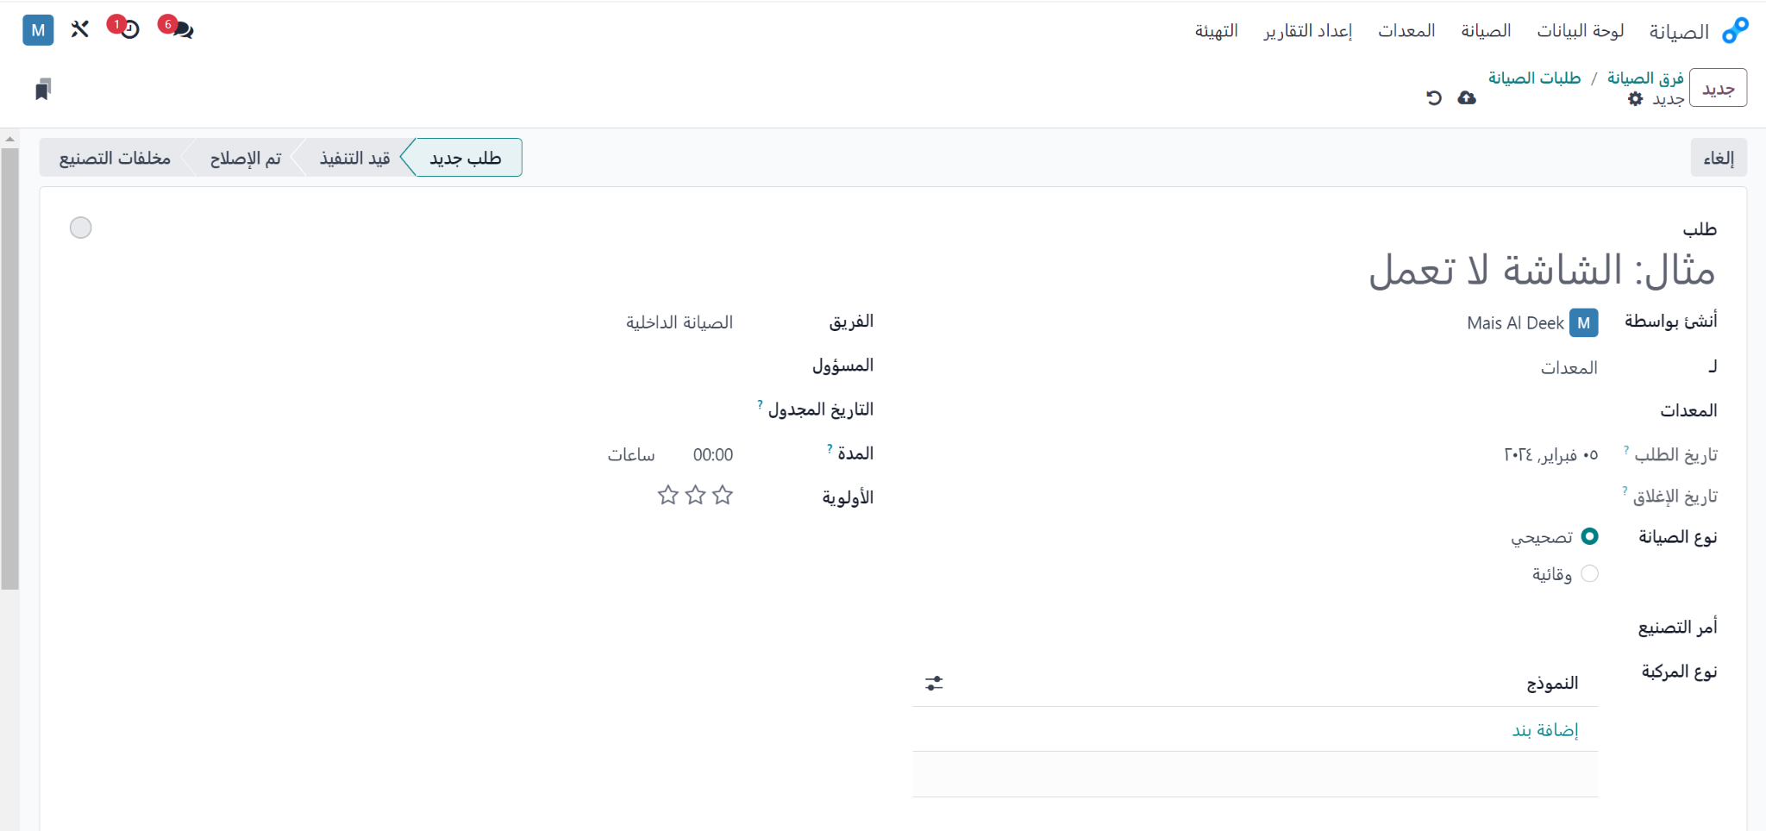
Maintenance

Slide 38
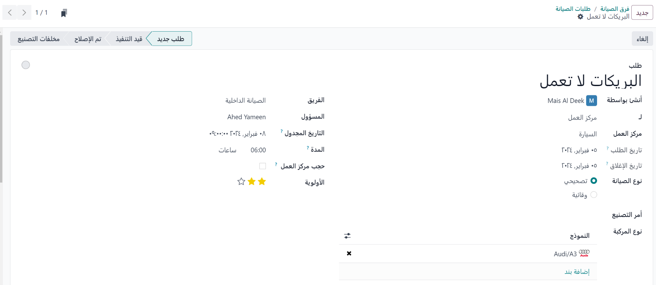
Maintenance

Slide 39
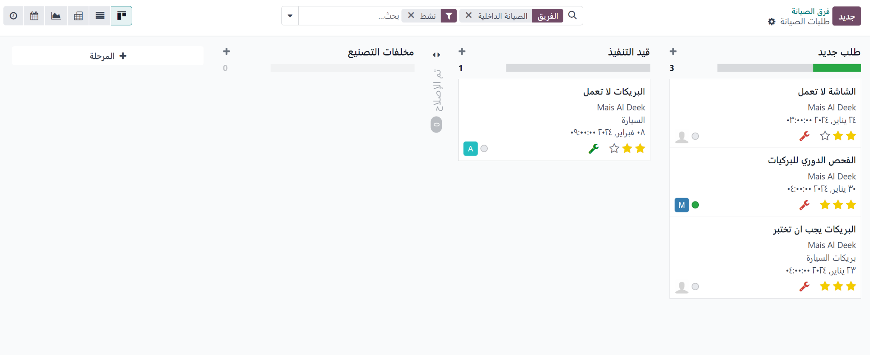
Maintenance

Slide 40
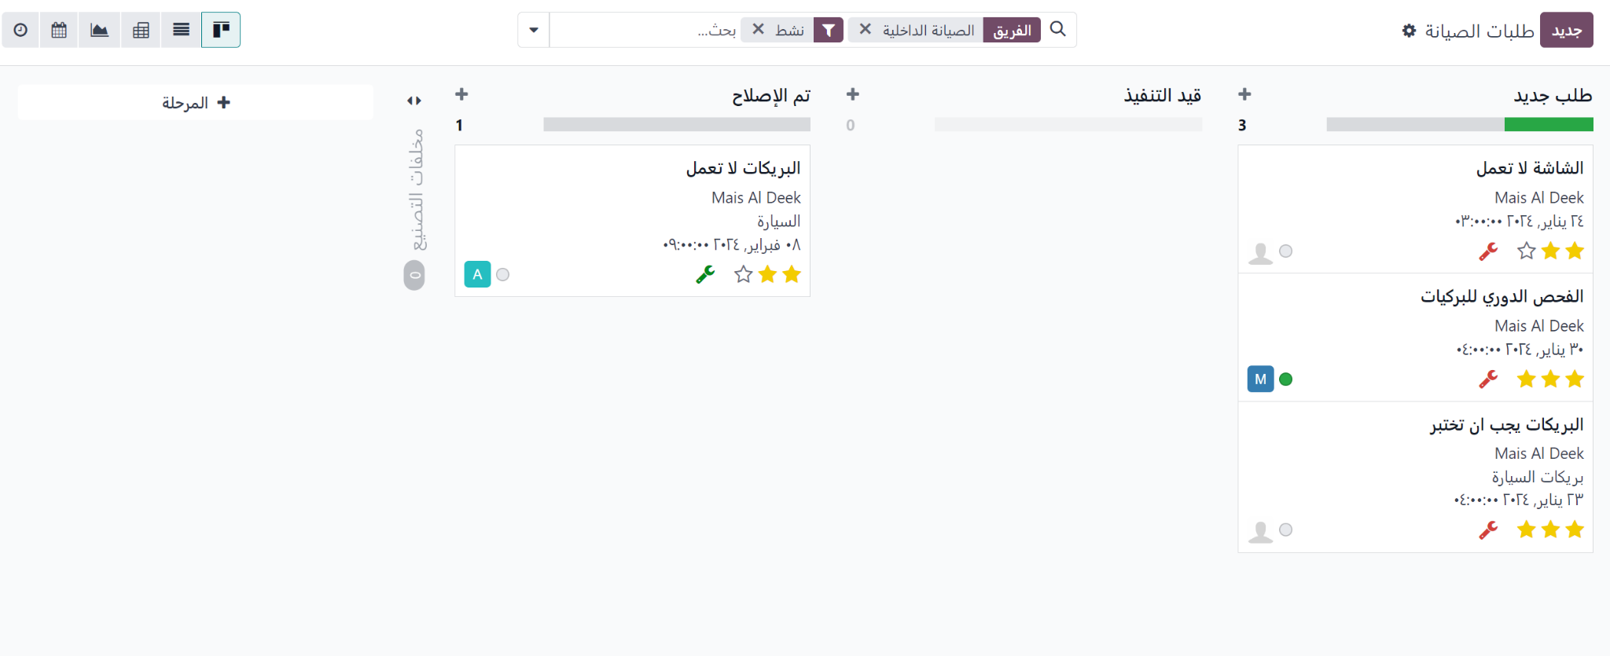
Maintenance

Slide 41
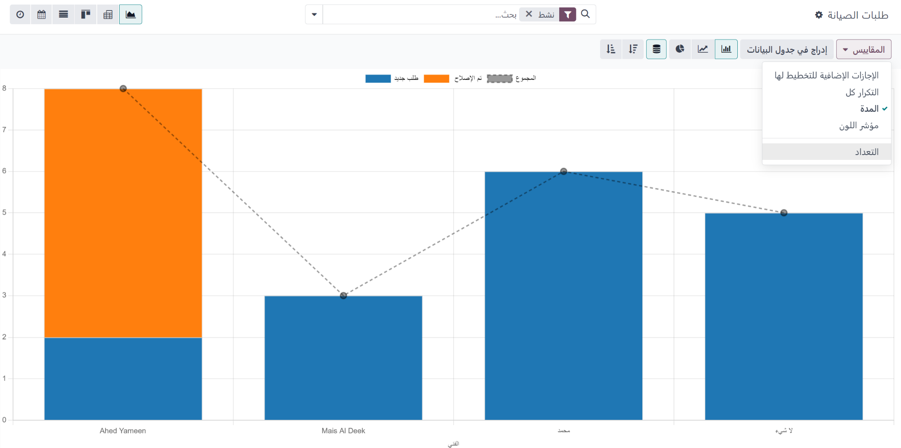
Maintenance

Slide 42

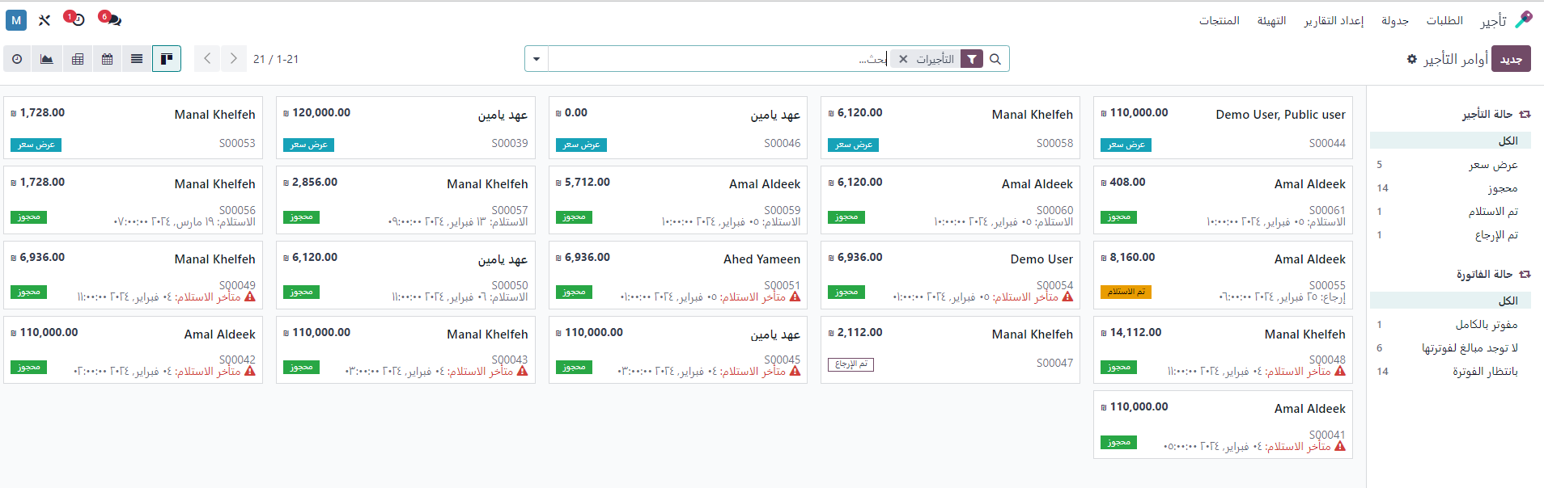
Renting

Slide 43
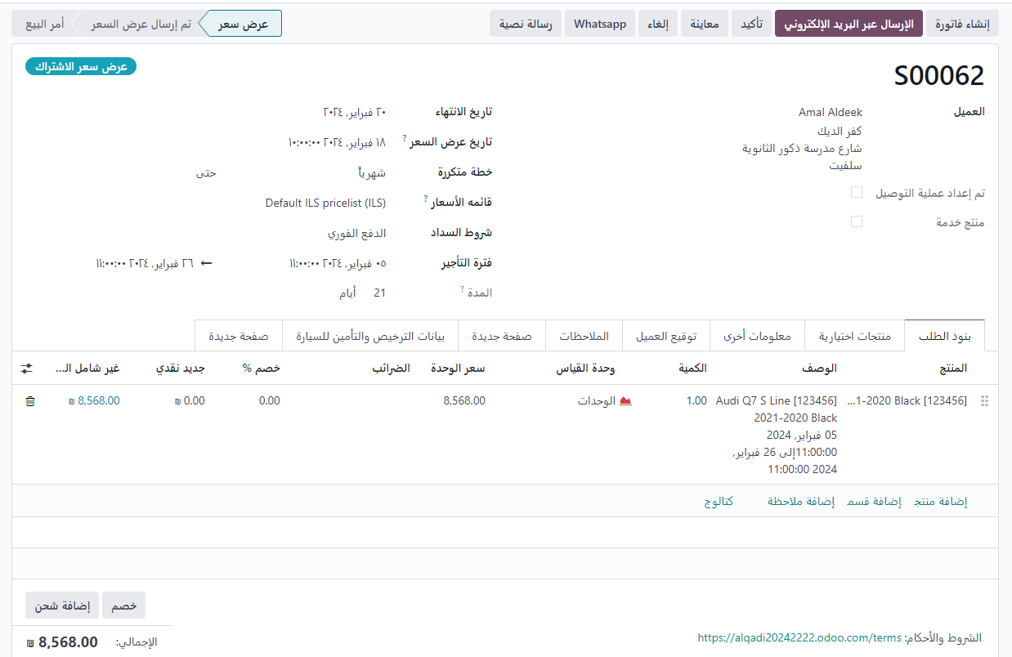
Renting

Slide 44
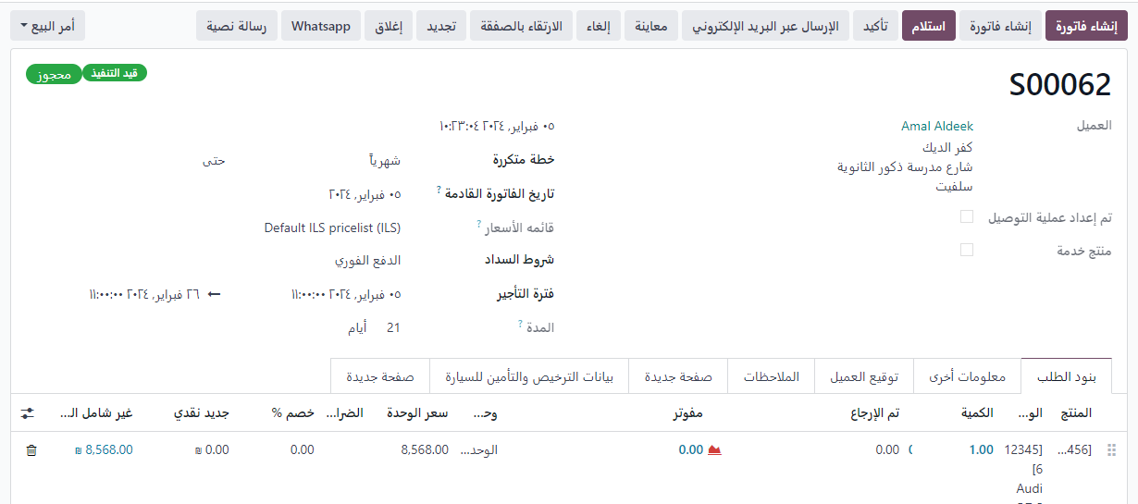
Renting

Slide 45
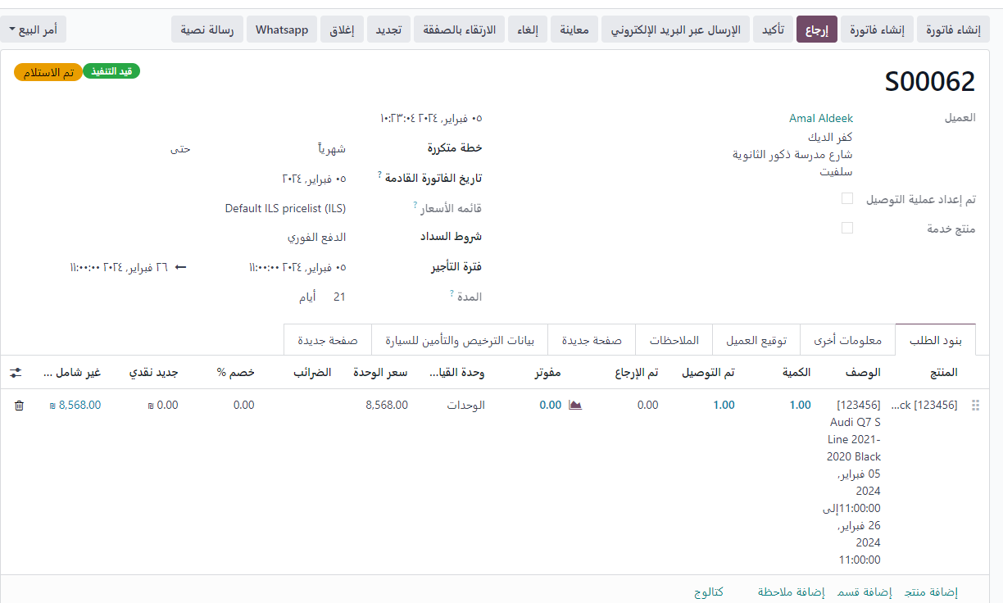
Renting

Slide 46
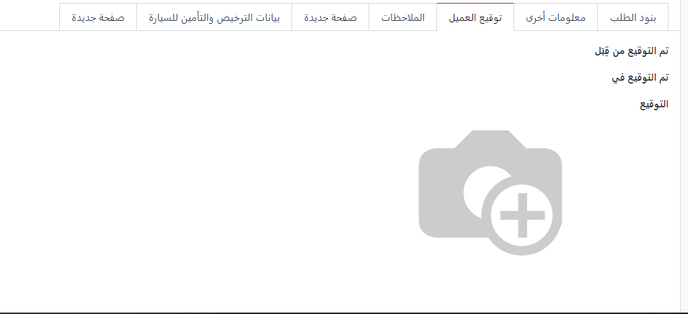
Renting

Slide 47
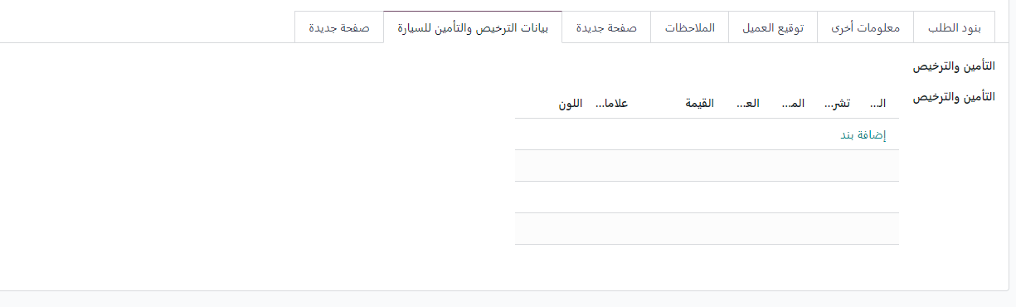
Renting

Slide 48
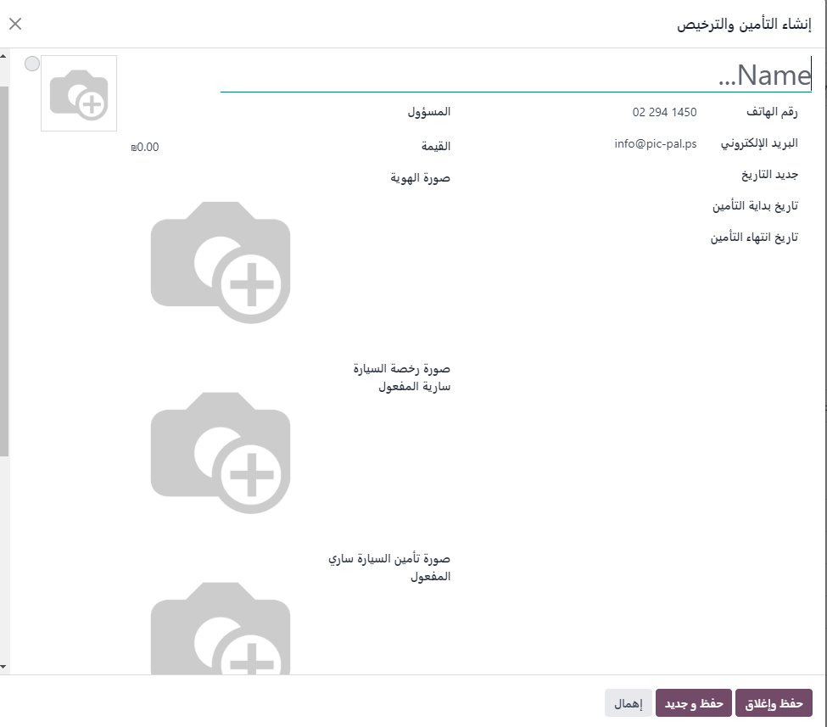
Renting

Slide 49
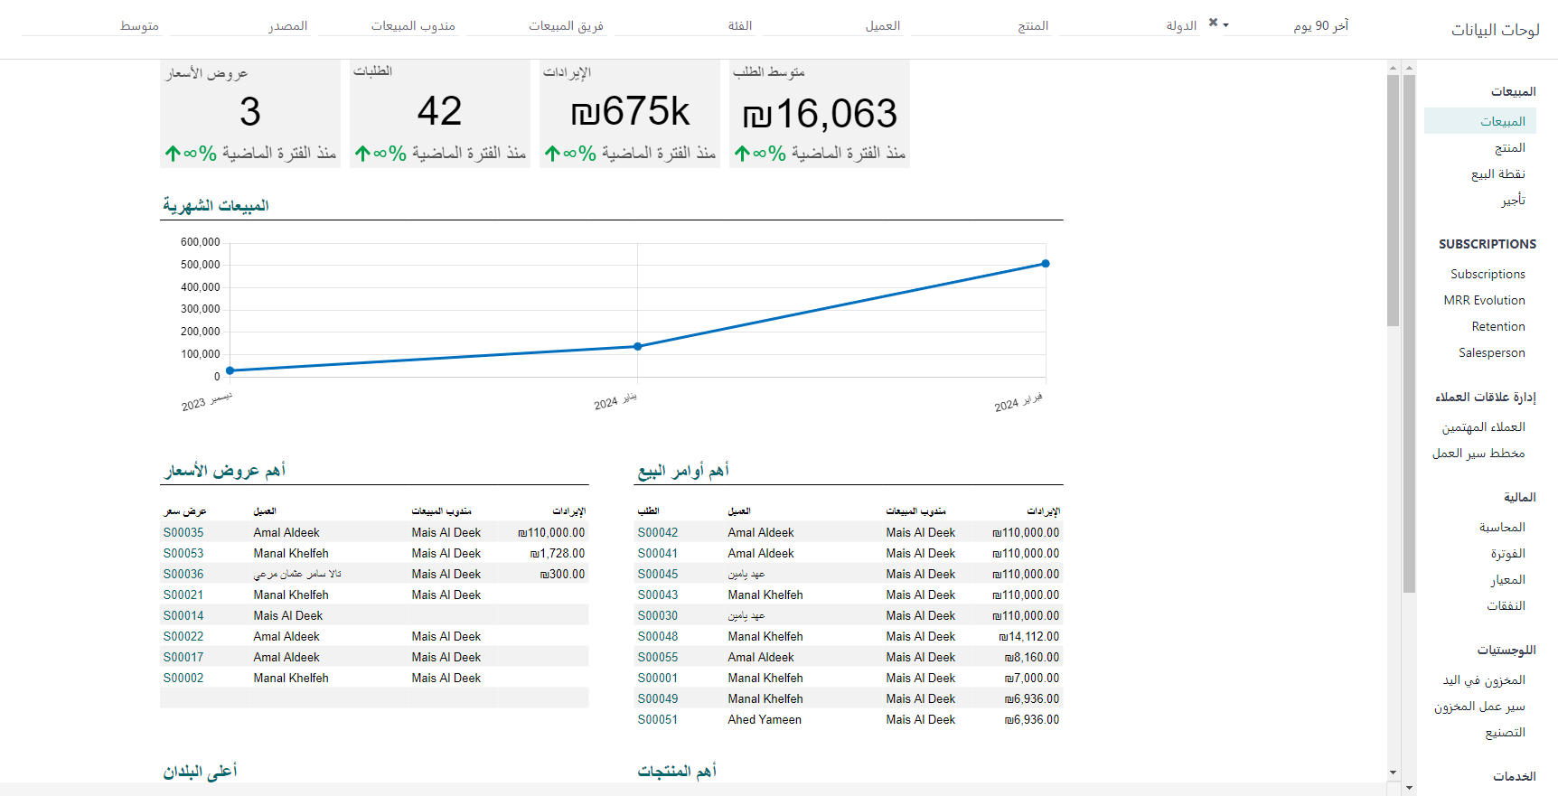
Dashboards reports

