Slide 1
Metal Detector Robotic Vehicle
  By: Rimaa Azzam Duha Rasheed Alaa Mehyar
The Supervisor :D. Omer Tamimi

Slide 2
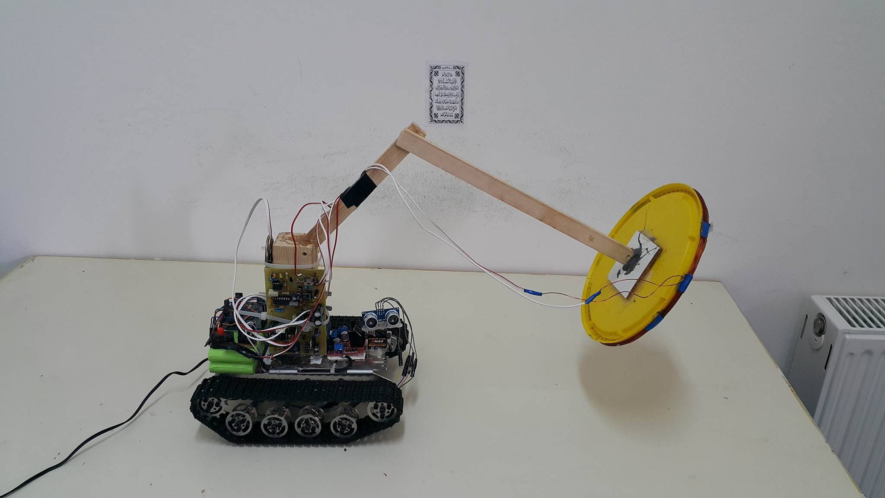
Project objectives & achievements
To build autonomous robot with obstacle sensor for detecting metals.
Page-1

Slide 3
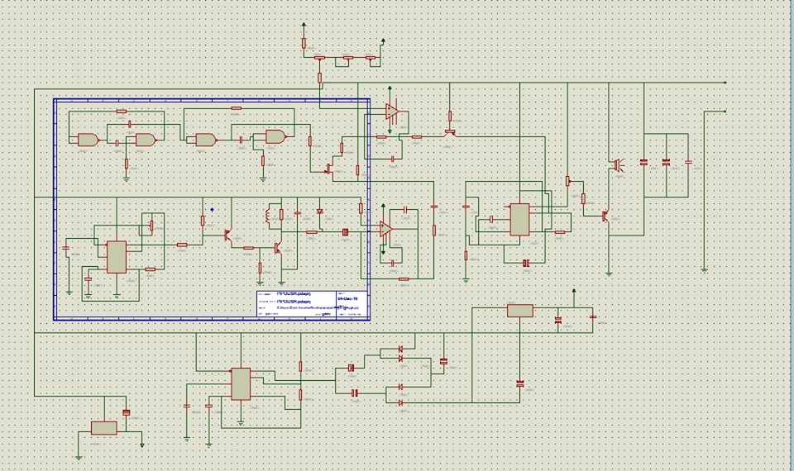
Project objectives & achievements
Metal detector has been built using strong PI Detector (without metal Discrimination).
Page-2

Slide 4
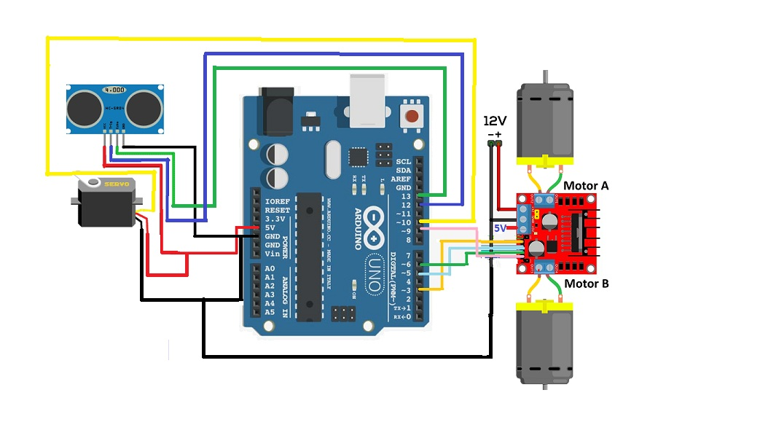
Project objectives & achievements
Obstacle avoidance algorithmes have been implemented using Arduino UNO Model .
Page-3

Slide 5
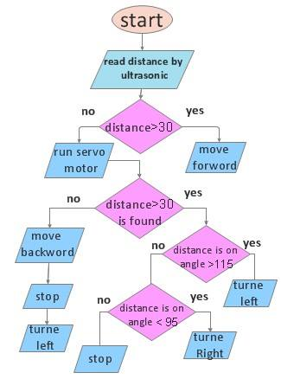
Project objectives & achievements
The models takes distance from ultrasonic sensor and send the motion commend to
H-Bridge .
Page-4

Slide 6
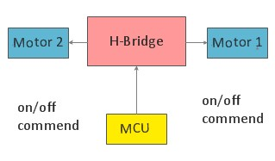
Project objectives & achievements
H-Bridge drives two PM DC Motors .
Page-5

Slide 7
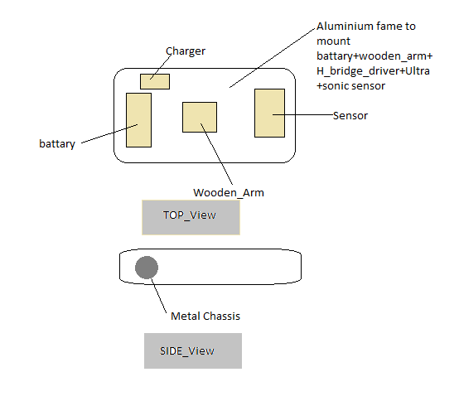
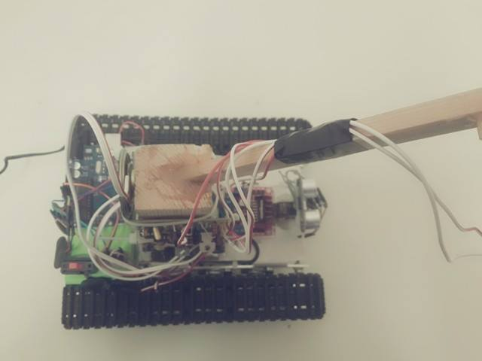
Autonomous Robot
The body of Robot .
Page-6

Slide 8
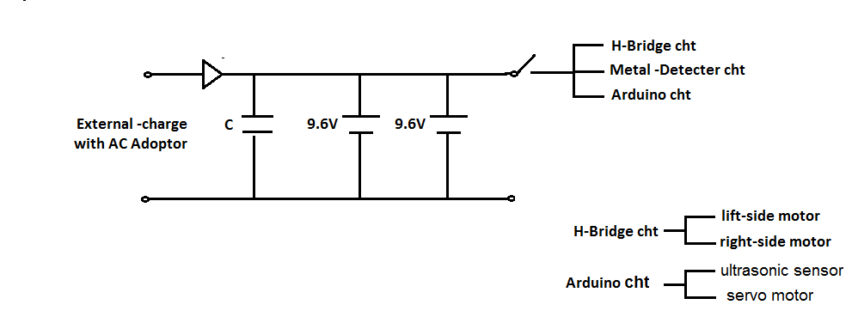
Autonomous Robot
The body of Robot .
- Charging circuit
Page-7

Slide 9
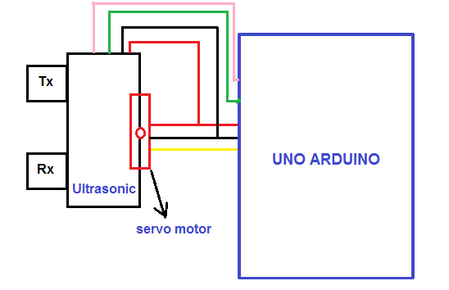
Autonomous Robot
Basic operation of Servo-Motor , Arduino , Ultrasonic sensor .
The servo motor rotation is half cycle (from 30 ˚to 140 ˚).
During this period the Robot is able to scan the area ahead against any obstacle by ultrasonic sensor .
Page-8

Slide 10
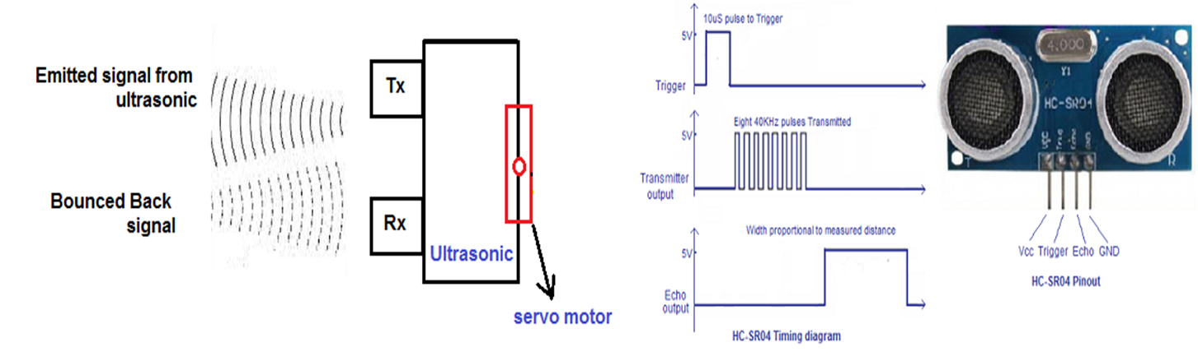
Autonomous Robot
Basic operation of Servo-Motor , Arduino , Ultrasonic sensor .
The ultrasonic scenic is able to detect obstacle at 40 cm range .
There is some disadvantages for ultrasonic as picture below show.
Once the obstacle has been detevted the two motors will immedietly stop and the Robot
will navigate a new root that doesn’t have an abostcal .
Page-9

Slide 11
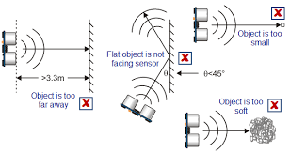
Autonomous Robot
Basic operation of Servo-Motor , Arduino , Ultrasonic sensor .
There is some disadvantages for ultrasonic as picture below show.
Page-10

Slide 12
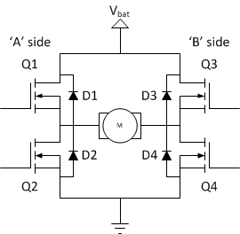
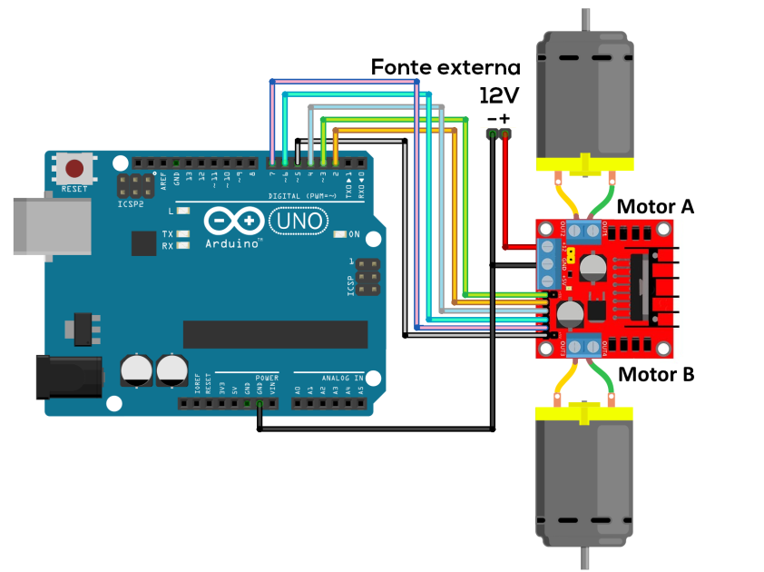
Autonomous Robot
Arduino and H-Bridge .
H-Bridge circuit –Diagram H-Bridge circuit –Diagram
Page-11

Slide 13
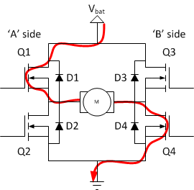
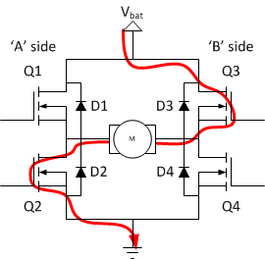
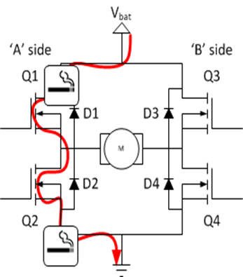
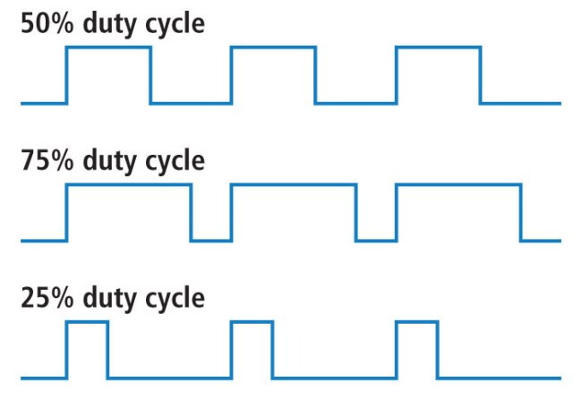
Autonomous Robot
Arduino and H-Bridge .
How does H-Bridge operate.
Page-12

Slide 14
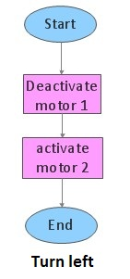
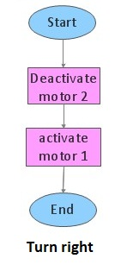
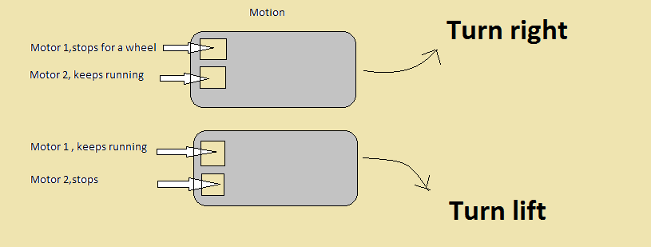
Autonomous Robot
The Motion of robot.
Page-13

Slide 15
Metal detector
Beat Frequency Oscillation (Bf)
This is among the most basic of metal detectors. This metal detector is considered weak and is the option most commonly used in most electronics shops. It has the ability to find objects located about two feet below ground.
Page-14

Slide 16
Metal detector
Very Low-Frequency Detectors(VLF)
This is one of the most popular metal detectors currently in use. This is especially so among experienced treasure seekers. The detector can be highly accurate and sensitive.
Page-15

Slide 17
Metal detector
Pulse Induction(PI)
This is one of the latest innovations in detecting metallic objects. Guards commonly use this type of detectors for detecting concealed weapons at security checkpoints. However, the technology is not very efficient in differentiating the different types of metals.
Page-16

Slide 18
Metal detector
 | BF | VLF | PI
Detection Range | few | medium | wide
cost | More cheap | Expensive | cheap
Metal Discrimination | yes | yes | no
complexity | no | yes | no
Page-17

Slide 19
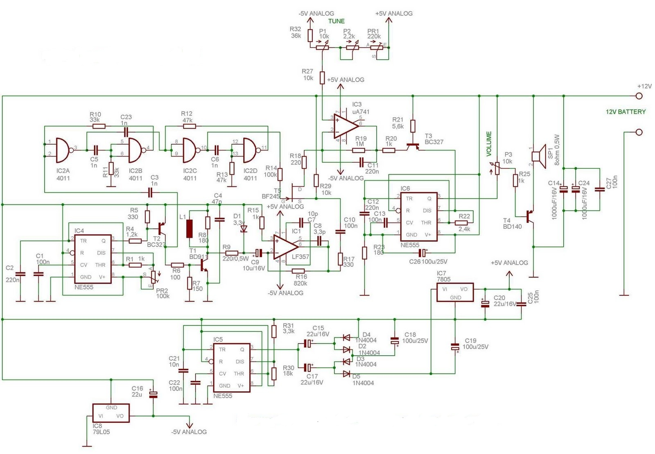
Metal detector
Pi polish metal detector circuit.
Page-18

Slide 20
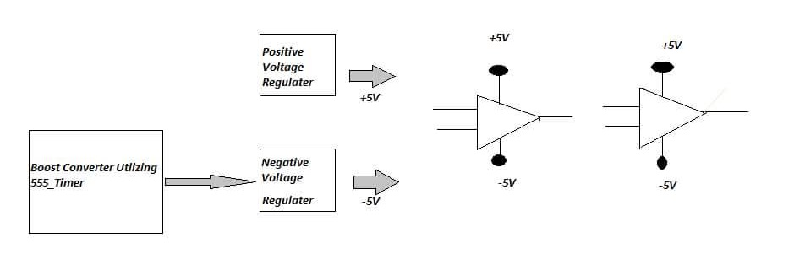
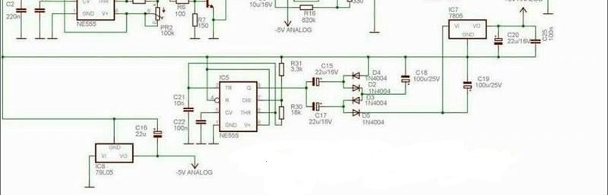
Metal detector
Circuit.1
feeding cct.
Page-19

Slide 21
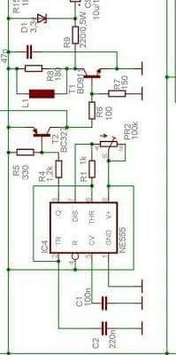
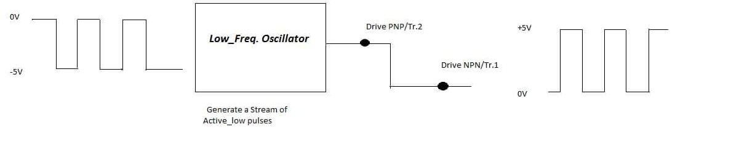
Metal detector
Circuit.2
Generate stream cct.
Page-20

Slide 22
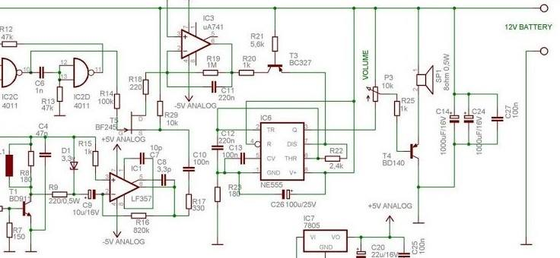
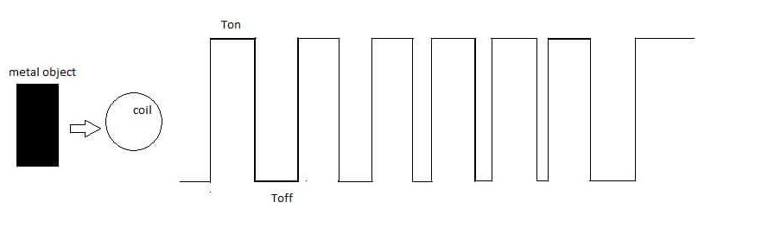
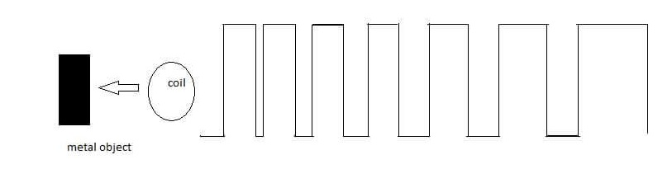
Metal detector
Signal amplifier
Page-21

Slide 23
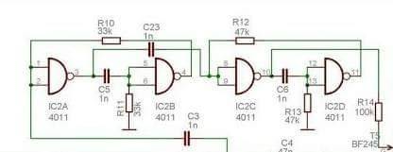
Metal detector
Circuit.3
Shmitt triger cct.
Page-22

Slide 24
FINAL ASSEMBLING AND TROUBLE SHOOTING :
We faced difficulties when we collected all circuits in robot :
1) Wheels were fixed on the robot using a special robot screws.
2) ultrasonic circuit was fixed in front of the robot to detect barriers and avoidance.
3) the batteries , batteries changer , Arduino circuit and H-bridge circuit were fixed on the surface of robot.
4)Wooden arm was fixed on the surface of robot and the metal detector circuit was fixed on this wooden arm To facilitate the tuning circuit
The coil was putted on the end of wooden arm to make it far from the metallic robot
(the coil of metal detector circuit was detected the metal of robot , so we Connected the coil with the wooden arm )
5) we made two circuit but the first circuit didn’t work Efficiently so we built another circuit as we illustrated above
Page-23

Slide 25
Advantages & Application :
:
Advantages :
Saving time and effort.
2) Robots may be used because they are FASTER than people at carrying out tasks.
3) Robots may be used because they can work in places where a human would be in danger.
Application :
Security of buildings such as airport, office, school, prison, etc…
Food processing.
Search for Lost.
To explore for treasures.
Page-24

Slide 26
Future work & Conclusion :
Future work
the wireless visual system will be used to human monitor the robot vision via mobile. To build the wireless visual system, the wireless camera will be applied on the robot and the wireless camera will transmit the visual around the robot to the receiver on the LCD .
the obstacle sensor will be build that the robot capable to stop moving when there are obstacles detected. To build a robot with ability to detect obstacle, the obstacle sensor will be needed.
Conclusion
Finally after all the difficulties that we have encountered the project has worked well and achieved the goals we set and detect metal .
Page-25

Slide 27


